Slide 1
FY 2023-24 HUD Consolidated Plan Budget Development
Grant Administration Division
Budget and Management Services
City of Dallas
Notes:
Welcome all to the meeting.
Remind everyone to stay on mute if they are not speaking.
Let them know that they can ask questions or make comments at any time in the chat or Q&A section
Introductions
Introduce any CDC members or Council members that are present
Introduce Community Development staff
Have department staff introduce themselves
Ask the residents to identify themselves if they want to

Slide 2
Presentation Overview
Purpose
Background
Consolidated Plan Grants
CDBG
HOME
ESG
HOPWA
Consolidated Plan Timeline
Resident Participation/Input Opportunities
Questions

Slide 3
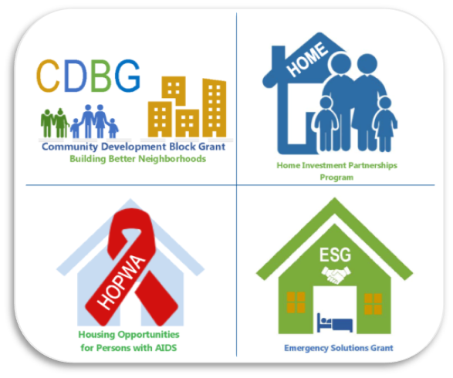
Purpose
Review Consolidated Plan and requirements
Discuss grant funds received from the U.S. Department of Housing and Urban Development (HUD)
Inform attendees of current and potential uses of funds
Provide attendees an opportunity to provide input for the FY 2023-24 Annual Budget (October 1, 2023, through September 30, 2024)

Slide 4
What is the Consolidated Plan?
Consolidated Plan – combines four HUD grants
Community Development Block Grant (CDBG)
HOME Investment Partnerships Program (HOME)
Emergency Solutions Grant (ESG)
Housing Opportunities for Persons with AIDS (HOPWA)
City of Dallas – receives these grants and:
Engages with community
Develops annual budget and programs
Identifies and prioritizes community needs and details how they will be addressed through comprehensive analysis and strategic plan
Monitors compliance
Reports performance back to HUD
Notes:
HUD offers numerous federal programs for community development and affordable housing
City of Dallas annually receives four grants from HUD as part of Consolidated Plan
Must have population of 50,000 or more
Based on census data
10-year census data
5-year American Community Survey data

Slide 5
Current Community Needs
Affordable Housing
Homelessness Support/Prevention
Human/Social Needs to Address Poverty
Economic Development
Public Improvements/
Infrastructure

Slide 6
5-Year Consolidated Plan
5-Year Consolidated Plan
(Submitted to HUD August 2019)
Annual Action Plans
(Application/budget submitted to HUD to receive annual grant funds)
Year 1
FY 2019-20
(Submitted August 2019)
Year 2
FY 2020-21
(Submitted August 2020)
Year 5
FY 2023-24
(Will submit August 2023)
Year 3
FY 2021-22
(Submitted August 2021)
Year 4
FY 2022-23
(Submitted August 2022)
Notes:
Covers a planning period of five years
Current 5-year Plan expires September 30, 2024
FY 2023-24 is the fifth year of the current 5-year Plan
To receive the grant funds, the City must complete a Consolidated Plan and submit the Plan to HUD
Provides a baseline of how the City proposes to use grant funds to address identified community needs
FY 2023-24 Action Plan (annual budget) will be due to HUD by August 15, 2023

Slide 7
Funding History

Slide 8
FY 2022-23 Consolidated Plan Funds
FY 2022-23
Adopted Consolidated Plan Budget
$30 million
CDBG:
$14,120,128
HOME:
$6,440,498
ESG:
$1,268,197
HOPWA:
$8,469,139
Grant amounts for FY 2023-24 are not yet available
“Level Funding” will be assumed to begin the FY 2023-24 budget development process while awaiting HUD notification of grant amounts
Notes:
In the current year, City received $30.2 million from HUD for the Consolidated Plan budget

Slide 9
CDBG
Consolidated Plan Grant: | CDBG
Services: | Services must meet a CDBG National Objective: Principally benefit low- and moderate-income persons Aid in prevention or elimination of slum and blight Meet needs having a particular urgency
Recipient Types: | Program recipients may include: Low/moderate income persons who may apply directly for services Low/moderate income areas Non-profit 501(c) organizations For profit businesses
Program Eligibility: | Program eligibility is based on specific program requirements
Program Examples: | Eligible programs and services can include: Housing Rehabilitation Public Infrastructure Job Training Childcare
Notes:
Largest and most flexible of the Consolidated Plan grants
70% of CDBG must benefit low/mod (meet the low/mod national objective).
In a specific project, 51% of those benefiting must be low or moderate income.
L/M income status is defined as a household income at or below 80% of the City’s median income (depends on family size).

Slide 10
CDBG – FY 2021-22 Highlights
99 new affordable units were created
377 people were served at Community Courts
1,654 children and youth were served in Early Childhood and Out-of-School Time Programs
Over 32,270 residents’ neighborhoods were improved through public improvement projects
36 houses were rehabilitated

Slide 11
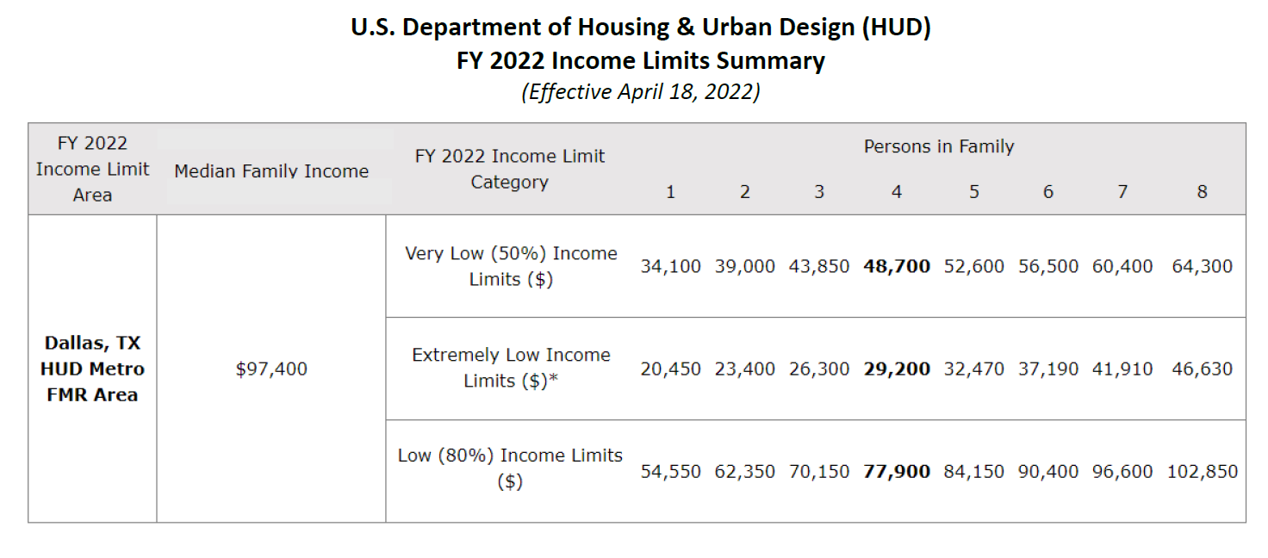
HUD Income Limits

Slide 12
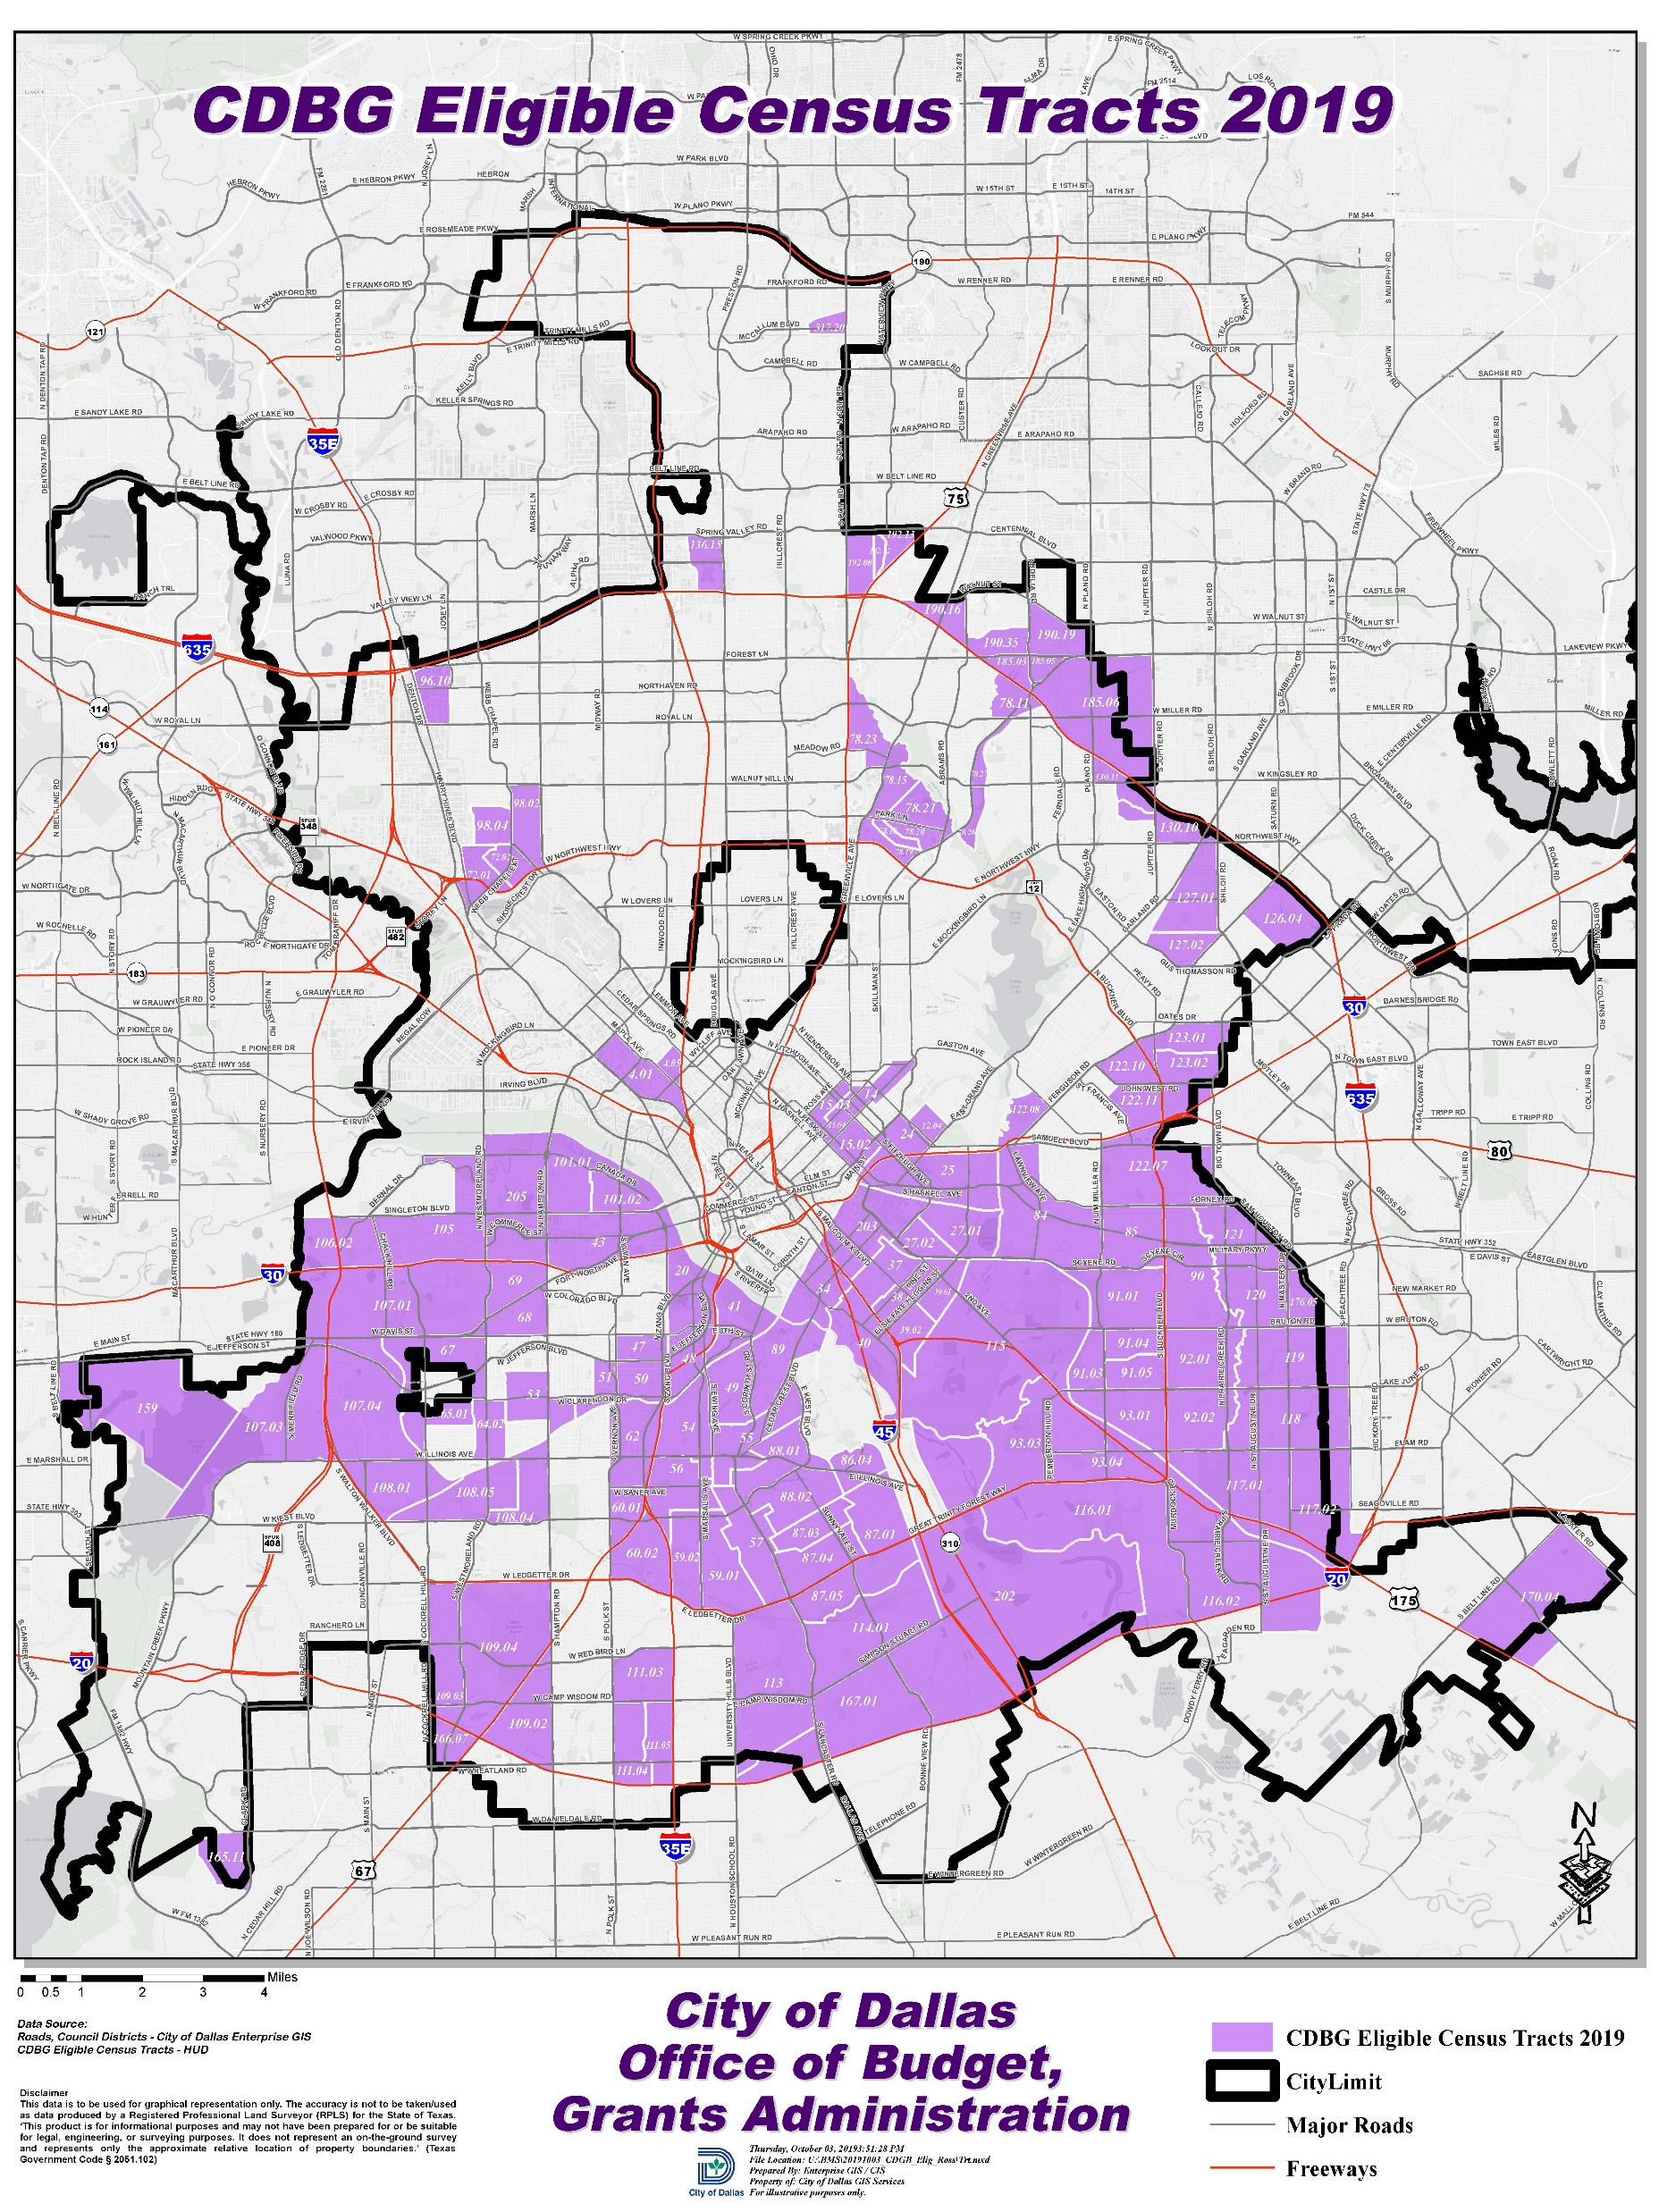
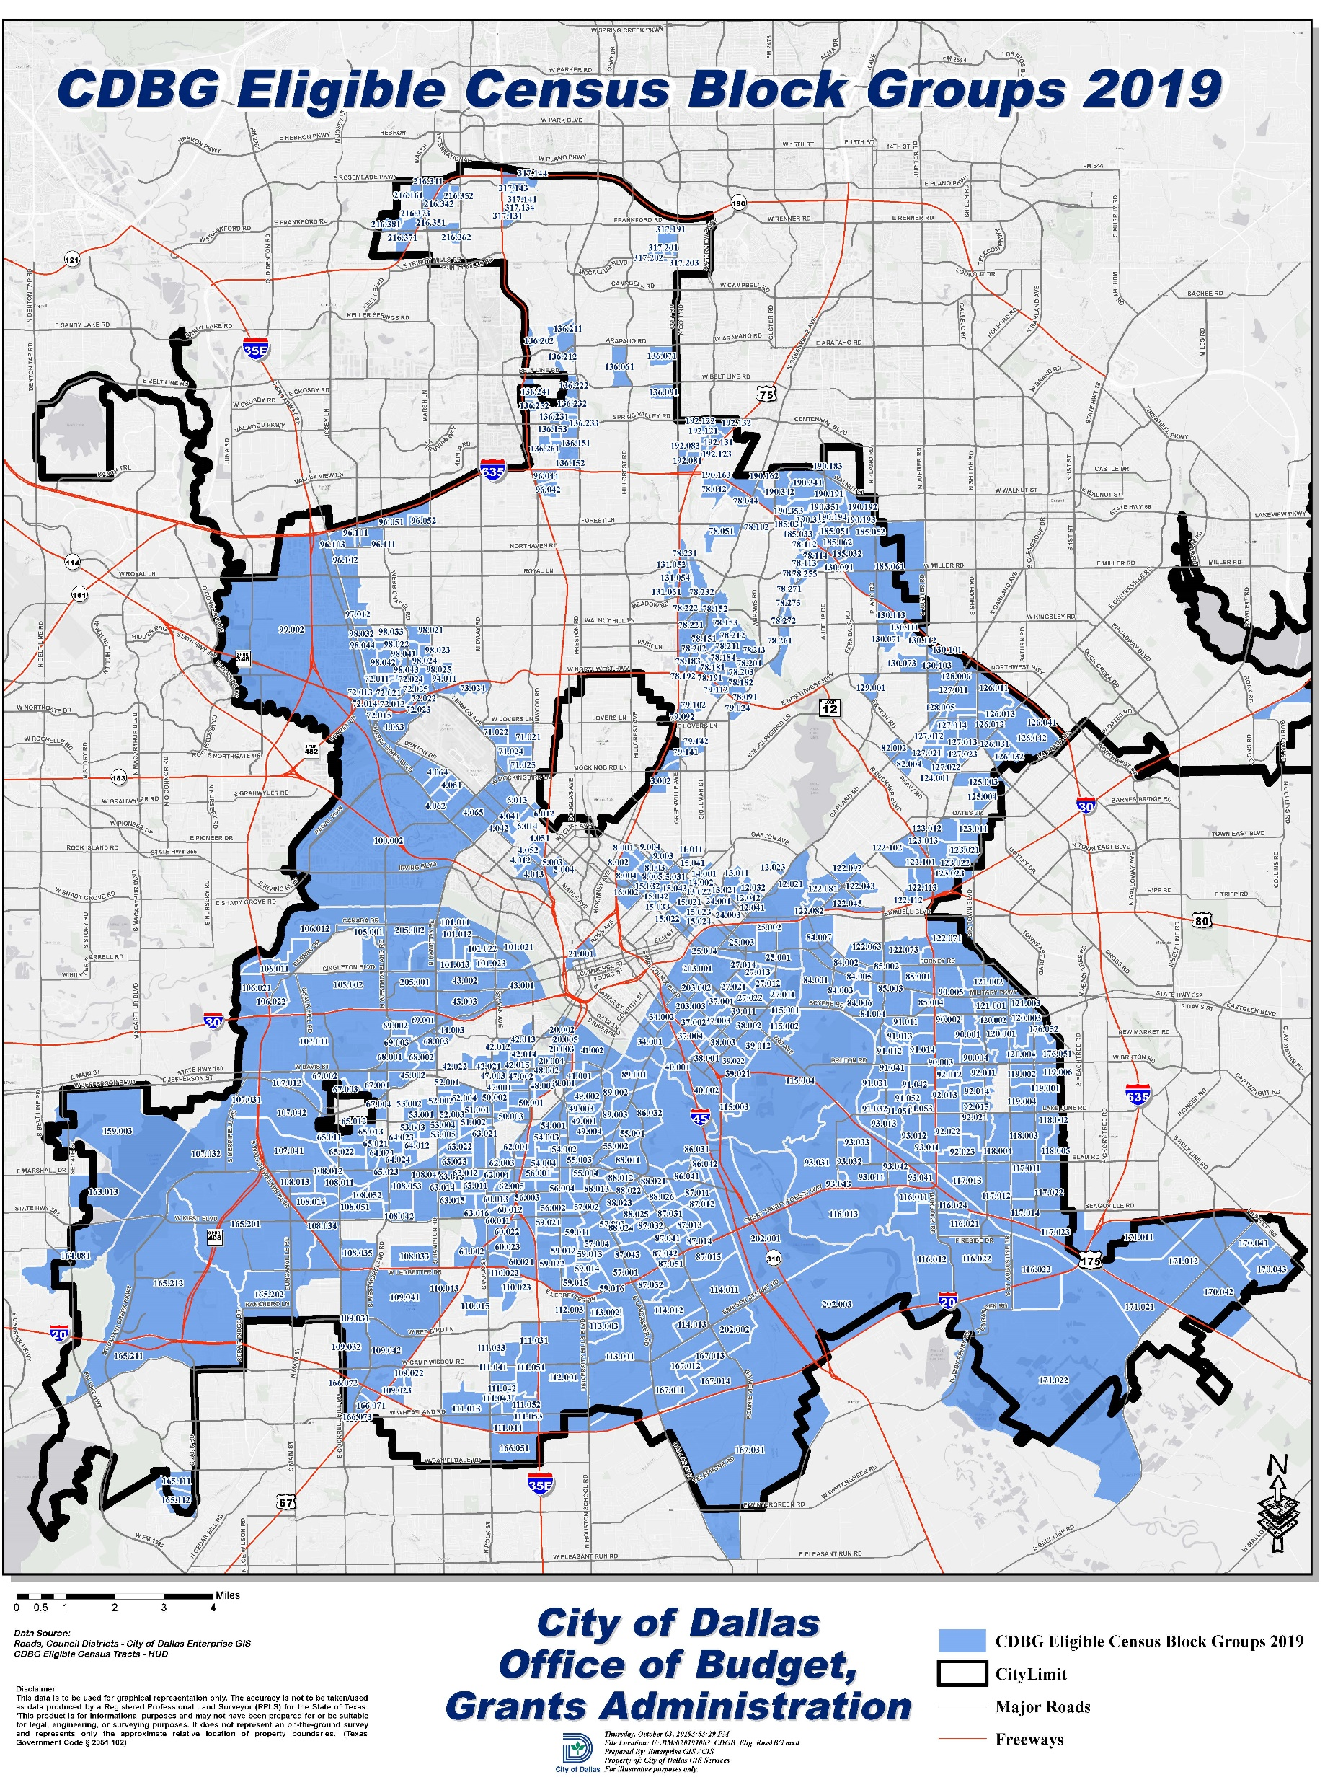
CDBG Census Tract/Block Group Maps

Slide 13
Poll Question #1
How important do you feel it is for the City to continue funding social services, including affordable childcare, after school care, and community courts?
Extremely Important
Somewhat Important
Neutral
Not a Priority

Slide 14
Poll Question #2
Should the City of Dallas continue to use the Community Development Grant for public improvement projects? (Examples: Fix sidewalks/ streets, improve access to people with disabilities, and fund rehabilitation of non-profit facilities.)
Yes
No
Maybe

Slide 15
HOME
Consolidated Plan Grant: | HOME
Services: | 100% of funds must be used for housing activities Minimum of 15% of funds must be set-aside for Community Housing Development Organizations (CHDOs)
Recipient Types: | Program recipients may include: Non-profit 501(c) organizations Developers Low-income individuals seeking financial assistance to purchase a home
Program Eligibility: | Program eligibility is based on specific program requirements

Slide 16
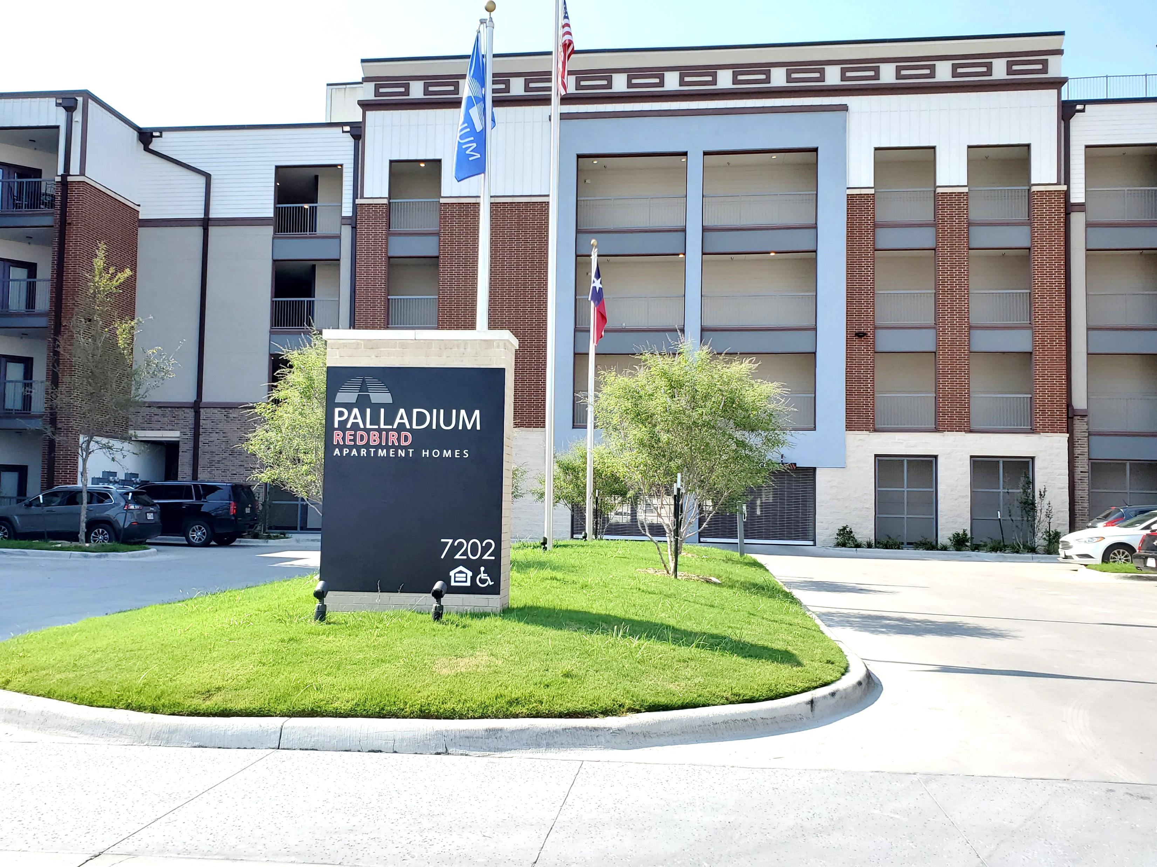
HOME – FY 2021-22 Highlights
75 new affordable units were created
15 homeowners were provided with assistance to purchase their home

Slide 17
Poll Question #3
Which housing service do you feel the City should support the most?
Home Buyer Assistance
Rehabilitation/Reconstruction of existing housing
Development of New Affordable Housing
All the above

Slide 18
ESG
Consolidated Plan Grant: | ESG
Services: | 100% of funds must be used to prevent homelessness and to assist persons experiencing homelessness
Recipient Types: | Individuals cannot receive funds directly, must apply through a contracted organization Nonprofit agencies, 501(c) required
Eligible Activities: | Street Outreach Emergency Shelter Homelessness Prevention Rapid Re-Housing Homeless Management Information System (HMIS) Administration
Notes:
* Note: Combined total of Street Outreach and Emergency Shelter can not exceed 60% of total grant allocation.

Slide 19
ESG – FY 2021-22 Highlights
11,016 people experiencing homelessness were provided overnight shelter
451 households received homeless prevention services (emergency assistance, moving costs, utility assistance)
531 households received Tenant Based Rental Assistance/Rapid-Rehousing services
346 unsheltered people experiencing homelessness were provided street outreach, which connected them to emergency shelter, housing, and critical services

Slide 20
Poll Question #4
One of the HUD grants, the Emergency Solution Grant (ESG) is used to address homelessness. For the City of Dallas, which service do you feel is most important?
Shelter Operations Support
Street Outreach
Homelessness Prevention Programs
Housing Placement Programs

Slide 21
HOPWA
Consolidated Plan Grant: | HOPWA
Services: | 100% of funds must be used to provide housing and/or supportive services to low-income individuals (and/or family members) who have a qualifying medical diagnosis and live within the eligible area
Recipient Types: | Individuals cannot receive funds directly, must apply through a contracted organization Nonprofit agencies, 501(c) required
Program Examples: | Eligible programs and services can include: Tenant Based Rental Assistance Facility Based Housing Housing Services and Information
Notes:
Dallas Eligible Metropolitan Statistical Area (EMSA), which covers seven counties: Collin, Dallas, Denton, Ellis, Hunt, Kaufman, and Rockwall. Services are available to eligible persons with HIV/AIDS and family members from providers located anywhere within the Dallas EMSA.

Slide 22
HOPWA – FY 2021-22 Highlights
190 persons with HIV/AIDS and their families received short-term rent, mortgage, and utility assistance
291 persons with HIV/AIDS and their families received Tenant Based Rental Assistance
847 persons with HIV/AIDS and their families received supportive services such as housing services, information, outreach, and support to enhance their quality of life
232 persons with HIV/AIDS and their families were provided permanent facility-based housing and short-term/transitional housing
182 persons with HIV/AIDS and their families received housing information services

Slide 23
Poll Question #5
Another HUD grant, Housing Opportunities for Persons with AIDS (HOPWA), is used to provide housing for persons with HIV/AIDS and their families. Should the City continue to use HOPWA funds to address the priorities and needs identified by Dallas County and the Ryan White Planning Council of the Dallas Area?
Yes
No
Maybe

Slide 24
Consolidated Plan Timeline
January/February | Public Input Meetings Virtual Neighborhood Meetings – January 5 to 19 Community Partner Meetings (Continuum of Care, Ryan White Planning Council of Dallas) – January and February Deadline for Comment Forms – February 25
March | Community Development Commission (CDC) reviews City Manager’s recommended budget
April/May | CDC recommends budget and amendments to City Council City Council reviews budget City Council preliminarily adopts budget
June | Public review 30-day comment period Public hearing before City Council Final Adoption by City Council
August | Submit plan to HUD
October | Implement plan
Notes:
CDC is appointed by City Council as an advisory body to make recommendations on the potential uses and allocation of funds based on citizen comment during the public hearing process.

Slide 25
Resident Participation
Mail
Mail comments to:
Online
Take Community Survey Online at: https://linktr.ee/dallascommdevelopment
Verbal
Comment during Virtual Public Meetings
Email comments to: ofscommunitydevelopment@dallascityhall.com
Speak at Community Development Commission monthly meetings or City Council public hearings
Call 214-670-4557 to make a comment to Budget & Management Services
City of Dallas
Budget & Management Services/Grant Administration
1500 Marilla Street, 4FS
Dallas, TX 75201
Notes:
Comments received by February 25 will be considered for the FY 2023-24 Annual Action Plan Budget
Submission of a comment does not guarantee funding
The Community Development Commission is a 15-member board made up of representatives from each of the 14 City Council Districts and the Mayor at Large. The Commission meets the 1st Thursday of each month (except the month of July) at Dallas City Hall in Room 6ES or virtually online at 6:00 p.m.

Slide 26
Doing Business with the City
Register as a vendor on-line at:
https://dallascityhall.bonfirehub.com
Contact the Office of Procurement Services at:
214-670-3326
askprocurement@dallascityhall.com
Notification of all procurement opportunities are published quarterly on the Office of Procurement Services website at: https://dallascityhall.bonfirehub.com
Notes:
State law requires that most projects be competitively bid or proposed.
At the buyers request, advertisements' can be placed in neighborhood newspapers.

Slide 27
Contact Information
Justus Bolo, Community Development Manager
214-670-5484
justus.bolo@dallas.gov
Yaiza Wade, Grant Strategic Program Analyst
214-671-9401
yaiza.wade@dallas.gov
Maritza Gutierrez Ramos, Community Development Coordinator
214-670-4600
maritza.gramos@dallas.gov
Ausencio (AV) Vicente, Budget Manager
214-670-5672
ausencio.vicente@dallas.gov
Chan Williams, Assistant Director
214-670-5544
chan.williams@dallas.gov
Let's Connect
@dallascommdev

Slide 28
Poll Question #6
Do you agree or disagree with the following statement:
This presentation has been helpful and informative.
Strongly Agree
Agree
Disagree
Strongly Disagree

Slide 29
Poll Question #7
How did you learn about the Neighborhood Public Meetings?
Newspaper
Social Media
City website
Friend/Family/Work
Email
Other

Slide 30
Questions/Comments

Slide 31
FY 2022-23 HUD Consolidated Plan Budget Development
Grant Administration Division
Budget and Management Services
City of Dallas

