Slide 1
Active Shooter Exercise
City of Dallas OEM
Aug. 11, 2015

Slide 2
Introduction
I am…
Who is participating, what are your roles?
This is an open, low-stress, no-fault environment. Varying viewpoints, even disagreements, are expected.

Slide 3
Active Shooters
An active shooter is an individual actively engaged in killing or attempting to kill people in a confined and other populated area. In most cases, active shooters use firearms and there is no pattern or method to their selection of victims. Active shooter situations are unpredictable and evolve quickly.

Slide 4
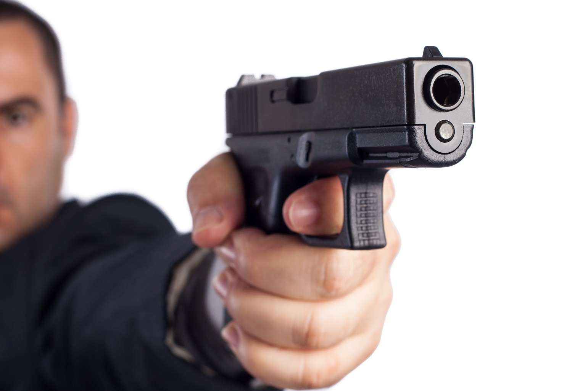
Exercise Overview
-The purpose of this exercise is to provide you with an opportunity to practice and evaluate, response concepts, plans, and procedures for a strategic-level response to an active shooter event at your company.

Slide 5
Objectives and Core Capabilities
Exercise current security measures as they pertain to your company
On-scene Security and Protection.
Evaluate management in a no notice activation.
Notes:
Core capabilities are the distinct critical elements necessary to achieve the National Preparedness Goal. During the exercise design process, the Elected Officials and the Exercise Planning Team selected exercise objectives, and aligned each objective to core capabilities, as shown here. Evaluators will observe and document how exercise objectives and capabilities are met through capability targets and critical tasks based on the participating organizations plans, procedures, and corrective actions from past exercises and real-world events.

Slide 6
Scenario
Your morning starts off like any other normal day at the office, you’re at your desk working, when all of a sudden you hear screaming and what sounds like gun shots. The fire alarm has been pulled, one of your coworkers comes running into the office and says there is a man with a gun in the building.

Slide 7
Your Response
What are your immediate actions?
Who’s in charge?
Do you have a sheltering plan?
How do you notify law enforcement?

Slide 8
Scenario update
Law enforcement has been notified, but the shooter is still active in the building. The gun shots seem to be getter closer every minute, you must make a decision.

Slide 9
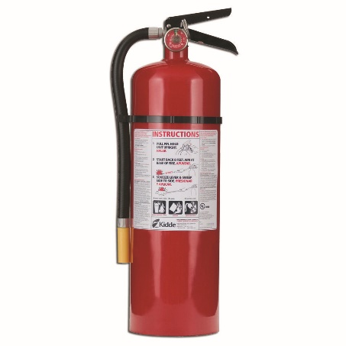
Run, Hide, or Fight
Are you able to get out of the building?
Do you have a safe place to hide?
Is there anything in the room you can use as a weapon?

Slide 10
Run
If you see an opportunity to escape the building, this should be your first option.
When would it be ideal to run and exit the building?
What types of things would you look for when exiting the building?

Slide 11
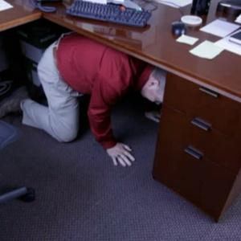
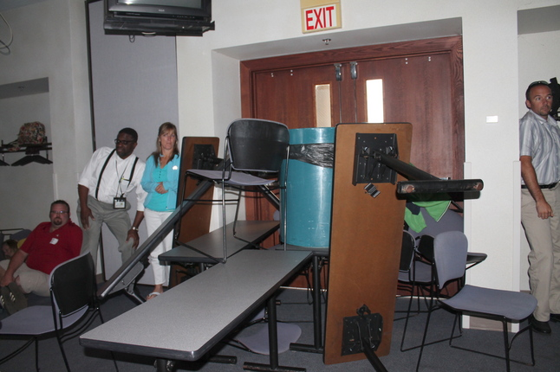
Hide
When would it be appropriate to hide instead of run?
Think of where you would you hide.
Hide under a desk or in a closet.
Turn cellphones on silent.
Lock yourself in a room or use heavy objects to block the door.

Slide 12
Fight
If you can’t escape or find a good hiding spot, your last resort should be to fight the shooter.
Take the shooter by surprise.
Fight back until the shooter is unarmed.

Slide 13
Scenario Update
Law Enforcement have apprehended the shooter, and the incident is now under control.
There have been 5 causalities in your building.

Slide 14
Recovery
What is your first step towards recovery?
How will the victims families be notified?
Where will you continue to work in the mean time?

Slide 15
Questions?

