Slide 1
NAVIGATION
Navigating in unmarked or poorly marked terrain
Advancement Module 04
Dallas CERT

Slide 2
Navigation Objectives
This unit provides:
  Methods for navigating without a map
  Using a map to navigate
  Preparation for navigating in an unmarked disaster scene
  Mental preparation for being lost

Slide 3
Navigation Prepare
CERT team members should consider carrying a compass in their kit
Other basic equipment should include a knife and matches
Complete this unit to be prepared to navigate on your own or with a team

Slide 4
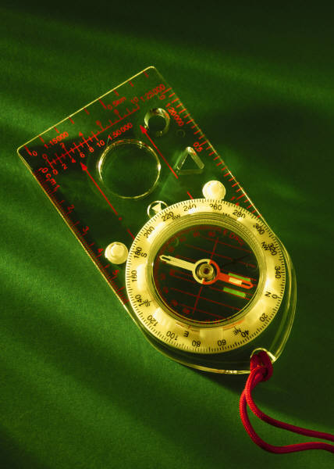
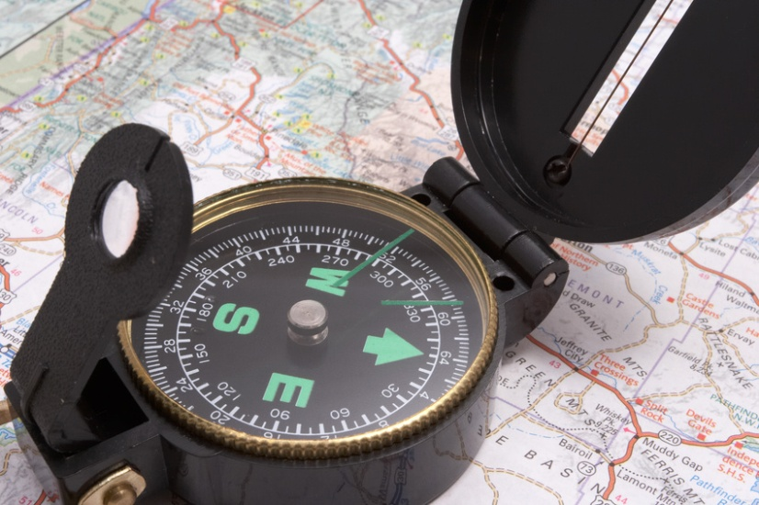
Compass Types
Lensatic
Base Plate
Notes:
These are the two best compasses to pack – they both allow sighting to take a bearing. Other compasses will do in a pinch, but only just.

Slide 5
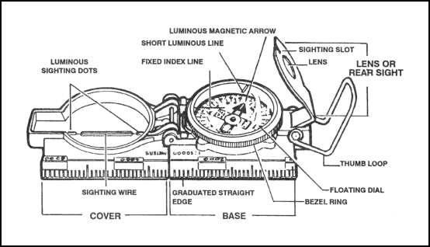
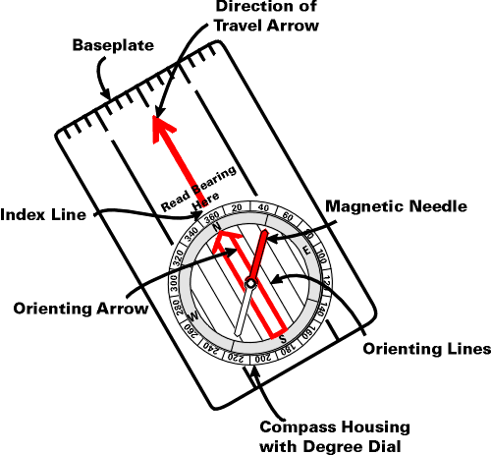
Compass Parts
“Good” compasses are
typically liquid filled
Notes:
INSTRUCTOR:
Note that the instructions in this lesson do not address declination (the correction needed to compensate for true North being different from magnetic North).
Maps are made to include declination, so there is likely to be some difference in compass readings, not large but enough to make it important to really “read” the terrain and match it to the map.
In the illustrations on this slide there is no mention of a ring for adjusting declination

Slide 6
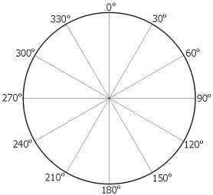
Compass layout
A compass is based on a circle divided into 360 degrees.
These degree divisions are used as a notation to describe directions in relation to North.
On a compass, North is at zero degrees, East is at 90 degrees, South is at 180 degrees, and West is at 270 degrees.

Slide 7
Compass Taking a bearing-baseplate
  Hold the compass level and point the direction of travel arrow at a landmark that is in the direction you need to go
  Rotate the compass until the orienting arrow lines up with the needle, pointing to the North
  Sight along the direction of travel arrow in the direction of the landmark and note the degree mark on the compass that corresponds to that direction – that is your “bearing”

Slide 8
Taking a bearing baseplate
This diagram illustrates a bearing of 330 degrees
N
baseplate
Direction of travel arrow
Compass needle
Orienting arrow (which is part of the dial on the compass)

Slide 9
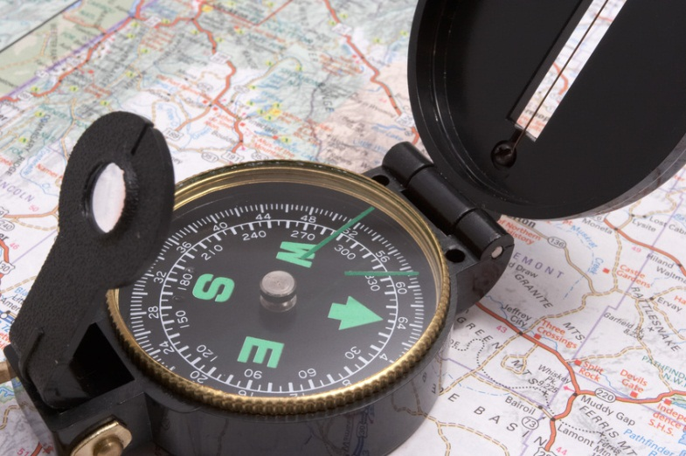
Taking a bearing lensatic
With the Lensatic – set the arm with the small lens so it leans at about a 45% angle with respect to the base of the compass.
Line up the small slot in the arm with a) the hairline in the compass top and b) the object in the distance you want to navigate to;
peek through the lens at the dial and note the degree reading – that is your bearing.

Slide 10
Compass Activity
Take your compass and go outside, away from cars and metal objects
Taking a bearing with a Lensatic compass
or
Taking a bearing with a base plate compass

Slide 11
Compass Using the bearing
  As you progress on your travels, check every so often to stay on the same degree bearing from North that you started with
  Use time or paces to measure the distance traveled

Slide 12
Uses for compass readings
In a disaster site a compass reading would be useful for:
  Understanding street patterns
  How the path of a tornado is oriented
  Orienting a map to the area
  Describing locations to other responding agencies and operators

Slide 13
Maps Parts
Typical map symbols:
    Buildings – solid black with square corners
    Roads – regular solid or hollow smooth lines for main roads
    Streams – meandering lines;
    Water – irregular closed figure, usually blue
    Green overlay – wooded areas
    Bridge – double-ended funnel
    Contour Lines – show elevation; how close together they are indicates the acuteness of the slope
  The top of the map is usually the North end
Notes:
INSTRUCTOR: Use a quad map, either on paper or downloaded from the USGS to your computer to demonstrate the typical map symbols

Slide 14
Maps Scales
Maps are produced in a variety of scales: a scale is the ratio of the map size to the real space depicted.
Commonly maps useful for navigating are produced in 1:24,000, 1:25,000 and 1:10,000 scales – the smaller the number the closer the view of the area

Slide 15
Field Maps Sources
USGS - http://store.usgs.gov
https://www.kappamapgroup.com
www.rei.com
Most outdoor gear stores
May be issued by emergency management agencies for deployments

Slide 16
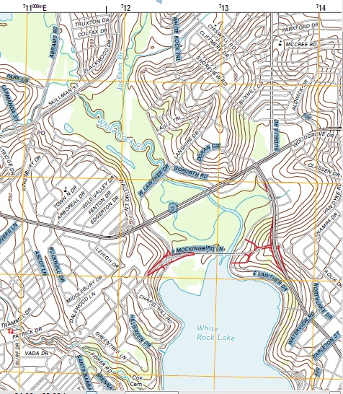
Maps -- Sample
This sample shows the area in Dallas at the North end of Whiterock Lake. The area just above the “T” intersection is known as Flagpole Hill and you can tell it is a hill by the closely spaced contour lines.
Other depictions to note include the waterways in blue and the wooded areas in green. The small square with a flag near McCree Rd at the upper right shows the location of a school.
This map is scaled at 1:24,000 or 7.5 minutes.

Slide 17
Maps Navigating
The first step in using a map is to orient it with a compass so that North on the map is the same as North on the compass
Second, look around and match landmarks or land forms with their depiction on the map
Choose a location to head toward and take a compass bearing for that point

Slide 18
  Measuring distances
Know your stride
  Measure a space on flat ground (a sidewalk) of 50 or 100 feet
  Walk that distance in your normal stride, noting the number of times one foot touches the ground (the strides)
  Divide the length of the course by the number of strides to get an average stride length

Slide 19
Measuring distance
Everyone’s stride or step length varies due to our different leg lengths and heights. The average is taken as 2.2 feet for a woman and 2.5 feet for a man. Work out yours to see how close you are to the average.
Another way you can estimate your step length
Women = height x .413 equals your step length.
Men = height x .415 equals your step length.

Slide 20
Measuring distance
Average number of steps (that is the distance that is travelled forward by just one of your legs.)
  500 steps = ¼ mile,
  1000 steps = ½ mile.
  2000 steps = 1 mile
  10,000 steps = 5 miles
Add knots to a string or rope to keep track of the miles you have gone; get fancier and use ranger beads or a tally counter
Notes:
Ranger beads are a set of beads strung on paracord. A knot divides the cord into two segments, 5 on the “top” and 9 on the “lower”. The bottom beads are used to count off 100 meter units; at the tenth unit one of the top beads is moved to indicate a kilometer.

Slide 21
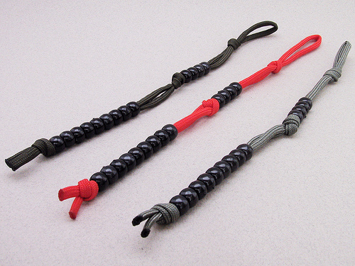
Measuring distance Ranger Beads
Beads are arranged in two section on paracord – a lower section with 9 beads and an upper section with 5 or more beads.
Sliding the beads up can be used to either count strides or the number of yards traveled.

Slide 22

Measuring distance Hand counter
A hand tally counter will count up to 1000 and can be reset by turning the knob on the side. Most counters weight only a few ounces and take up little pack space.

Slide 23
Measuring distance Ranger Beads
Distance walked method (you must know the number of strides you make in 100 feet):
  Every 100 feet pull up one of the beads on the lower section. After the 10th time, pull all the lower beads down and pull up one of the beads on the top section.
Example – I make 45 strides in 100 feet; every 45 strides, one bead gets pulled up
Notes:
INSTRUCTOR Suggestion: Work through with students how they might use a hand tally counter instead of ranger beads

Slide 24
Measuring distance Ranger Beads
Counting paces method: Slide one bead up on the lower section for every 10 strides, on the 10th increment the lower beads are all slid down and one upper bead is pulled up.
Example: After 2 upper beads, the person has gone 200 strides. If their stride length is 2.3 feet, then they’ve gone:
200 x 2.3 = 460 feet
Hint: a mile = 5280 feet
(or 23 upper beads for this particular person)
Notes:
INSTRUCTOR: Suggest ranger beads may work well if you can note distances on some other medium, but they may work particularly well for CERT members to measure short distances such as distances within a neighborhood.

Slide 25
Measuring distance Activity
Find a place where you can measure a distance of 100 feet
Walk the distance, noting the number of steps (if you note the steps on both feet, divide by 2)
Divide 100 by the number of steps
Example: 100/48 steps = 2.08 feet per stride

Slide 26
If Lost Assessing
What to do if lost
  Assess your resources and environment
    Availability of water and means for shelter
    Threats – fire, animals, insects, weather
  Decide whether it is better to stay put or move
  Find a safe location
  Avoiding panic in unfamiliar situations
  Make a SAFE fire and put out signals
Notes:
INSTRUCTOR:
Suggest various techniques for making signals – items of clothing, stones or sticks arranged to spell words, signal mirrors, etc.
Review methods of making a fire safe and for dousing the fire

Slide 27
If Lost Seasoning
Season yourself ahead of time
  What panics you?
    Being alone
    The unknown
    Darkness
    Lost equipment
    Tight spaces
    Heights
  Silently think about taking a few calming breaths when faced by one of these
Notes:
Thinking about the challenges you might face ahead of time prepares you to deal with them more readily when you actually have to face them

Slide 28
If Lost
Understand that it will take real effort on your part to be rescued or find a way out
If you are in a position that others probably know where you are or if you are near a vehicle or building, consider staying there
If you must move, follow a watercourse or a road. Leave a note saying where you’re going and blaze a trail.
Notes:
INSTRUCTOR –
cover basic outdoor weather safety; also cover basic shelter construction for your climate
Point out that following a watercourse might not be good in a marshy area, that a ridgeline might be an alternative path
If lost and a building or road is nearby, staying there may increase the chance of being found.

Slide 29
Blazing a trail
Mark tree branches with some cloth, tape, or string
Make a cairn (pile) of rocks, then leave a single rock on the side of the pile in the direction you are going
Stand a stick in the ground then attach other sticks to point in the direction you are going

Slide 30
If Lost Navigating
Finding compass points (northern hemisphere)
  A crude way to find “North” is to plant a fair sized stick in a vertical position
    At fifteen minutes before noon, note the position of the tip of the stick’s shadow (maybe put a rock or peg there)
    At fifteen minutes after noon, note the position of the tip of the stick’s shadow
    North will be half way between the two points
Notes:
INSTRUCTOR: the North/South line will be the line connecting the base of the stick to the mid-point between the two shadow points. You might make a diagram on the marker board to make this more understandable for students.

Slide 31
In a disaster scene
  Before you enter the scene, pick out the best available landmarks as reference points. Since vertical landmarks may be erased, look for landforms and use your compass. Make a diagram, even if you have to use a shirt or the back of your glove.
  When you enter the scene, look back occasionally to see what the path will look like coming back
  Blaze a path, using triage/marking tape, chalk marks, or a lumber crayon
Notes:
INSTRUCTOR
Suggest ways to make a diagram without good equipment
draw it on your arm
use a knife point on bark or wood
Ask participants to brainstorm alternate means for blazing a path – stone, sticks, others?

Slide 32
In a disaster scene
  Be careful about crossing elements in the landscape such as waterways or major roads that may cause confusion if you cross them again further on; add them to your diagram
  Use distance measuring tools – auto odometer, personal paces, time
Notes:
INSTRUCTOR: Sometimes you have to cross a waterway or major highway, so be sure you’re keeping some kind of diagram because those features snake around and you may cross them again further on and begin to question your direction . . .

Slide 33
Equipment basic
  Compass
  Map of the area
  Notebook and writing instruments
  Radio or cell phone
  Spare batteries or solar charger
  Knife
  Matches
  Whistle
Notes:
Note that this equipment is in addition to basic CERT gear appropriate for the situation; don’t forget water, sunscreen, bug repellant, etc.

Slide 34
Equipment advanced
  Pedometer
  Binoculars or telescope
  Ruler
  Handheld GPS
  Clipboard
  Automobile GPS
Notes:
Disaster scenes obviously differ tremendously.
Many more of us have automobile GPS units and they may serve if we can enter the scene in a car.
An auto GPS may at least give you a North/South orientation and an initial starting point should you not be driving in the disaster area.
Note that pedometers can be inaccurate in hilly or rough terrain because stride length changes frequently

Slide 35
Places for more info
http://www.rei.com/learn/expert-advice/navigation-basics.html
Or – www.rei.com
Youtube
http://www.backpacker.com/backpacking_101_understanding_your_compass/skills/12159
Notes:
There are many websites and outdoors books with info about using a compass, navigating, and survival

Slide 36

Navigation
Be prepared and good luck!

Slide 37
Navigation
Almost done,
Now, Please take the quiz by clicking on this link:
NavQuiz

