Slide 1

Doing Business with the City of Dallas
Office of Business Diversity
City of Dallas

Slide 2
Presentation Overview
Procurement Process
Meet the City of Dallas Buyers
How to Find Bid Opportunities
Minority & Women-Owned Participation/BID Plan
Next Steps

Slide 3
Background/History
The City of Dallas developed a group of business development and procurement specialists titled “ Business Industry Analysts” to connect your business with the resources needed to do business with the City of Dallas.

Slide 4
What do Business Industry Analysts do?
Explain the City of Dallas Procurement process
Connect vendors with City of Dallas buyers
Help vendors find potential bid opportunities
Coordinate Vendor/Department meetings
Assist with City of Dallas Vendor Registration
Assist Vendors in finding their role within City of Dallas solicitations

Slide 5
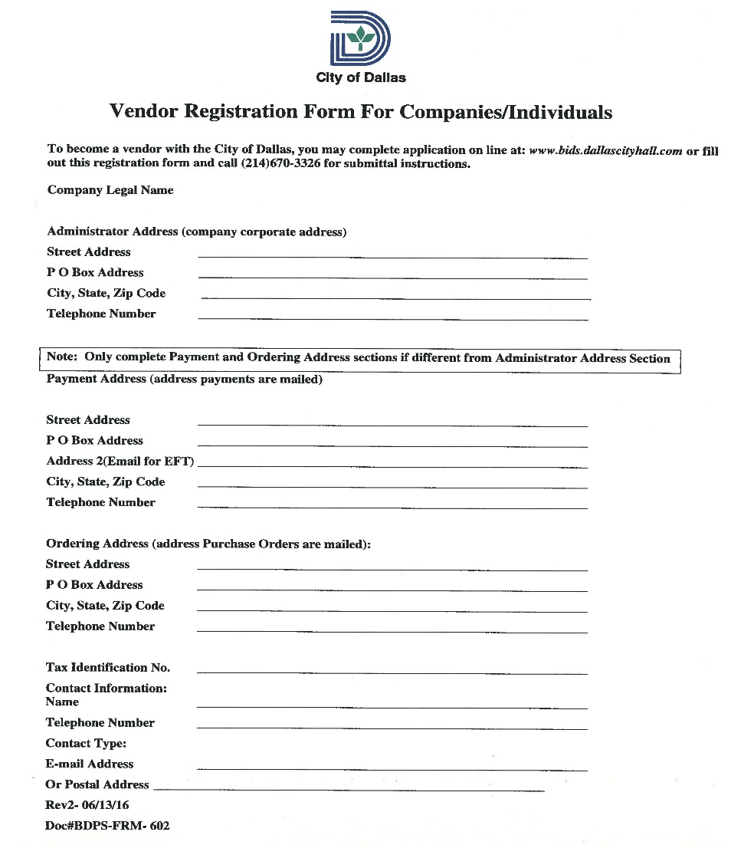
City of Dallas Vendor Registration Application

Slide 6
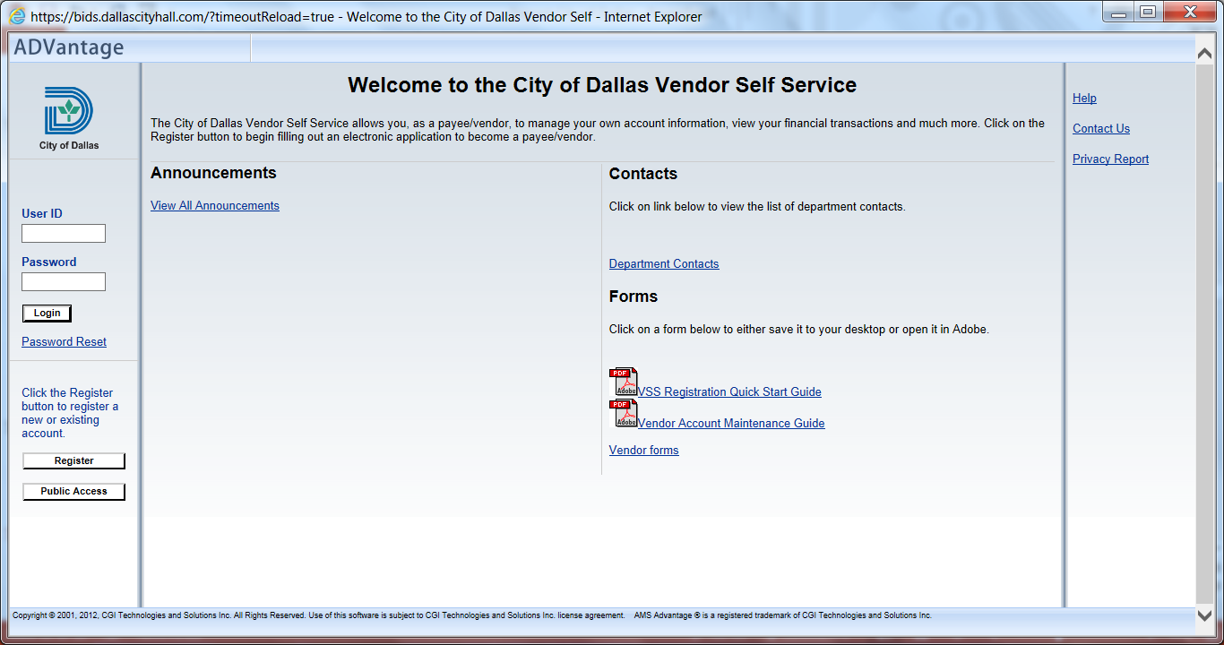
Where to Find City of Dallas BID Opportunities
www.bids.dallascityhall.com

Slide 7
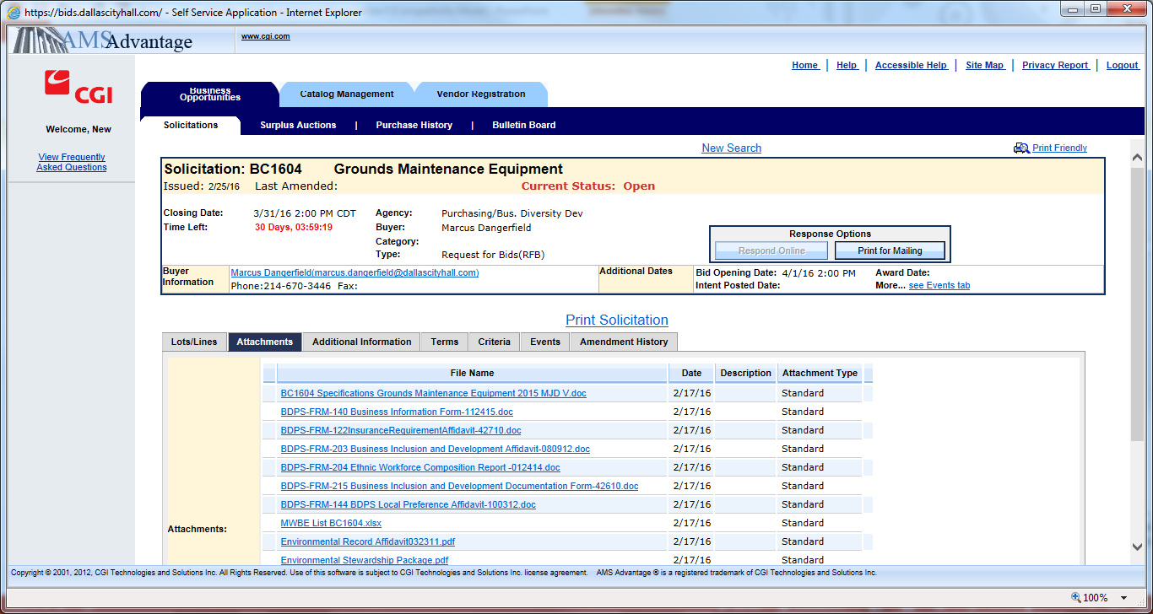
Where to Find City of Dallas BID Opportunities
www.bids.dallascityhall.com

Slide 8
What does the City
of Dallas buy?
Architectural Services | Police cars | Concrete | Ice
Flags | Books | Marketing Consultants | Janitorial Supplies
Shoes | Rodents | Oil & Gas | Catering
Paper | Sports Bras | Tires | Traffic & Street supplies
Drafting Services | Gifts & Novelties | Consulting Services | Plumbing fixtures
Ammunition | Clothing | Police & Fire specialties | Industrial Supplies

Slide 9
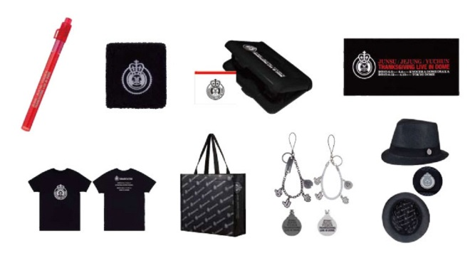


Procurement Process
The City must use the appropriate method of procurement to acquire its goods and services.
The procurement process is typically accomplished through a competitive bidding process which is mandated by state law

Slide 10
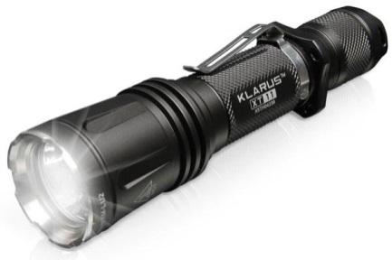
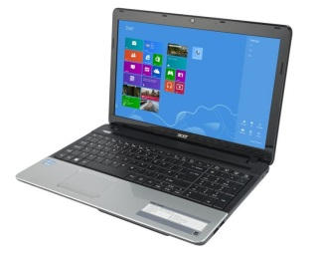

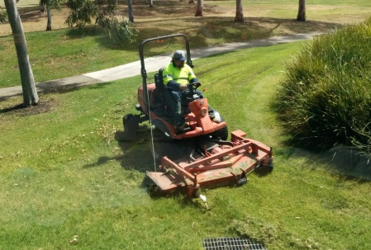
Bid Opportunities
Informal Bids (IFS)
50K and Under- Lowest Bid
Formal Bids (RFB)
50K and Over- Low Bid and experience
Request for Proposals (RFP)
50K and Over- Cost and experience
Request for Qualifications (RFQ) experience

Slide 11
Pre-Bid Meeting
A pre-bid meeting consists of the department who is requesting the solicitation along with the assigned buyer and a RLT representative, and vending community.
The department will be discussing the scopes, submittal process and specifications of the solicitation and any questions the vending community may have regarding the solicitation.

Slide 12
Minority & Women-Owned Participation (M/WBE) BID Plan
The BID Plan is used to encourage & increase participation of M/WBE’s in city contracts and encourage bidders/proposers to create joint ventures when feasible to increase capacity and build stronger M/WBE firms in the market
Only the first tier, local certified M/WBE’s (within Dallas County) can be counted toward the BID goals
M/WBE firms that are certified with one of the City of Dallas recognized certification agencies will count towards the BID goal.

Slide 13
BID Goal
Construction = 25%
Architectural & Engineering = 25.66%
Other Professionals = 36.30%
Other Services = 23.80%
Goods = 18%

Slide 14
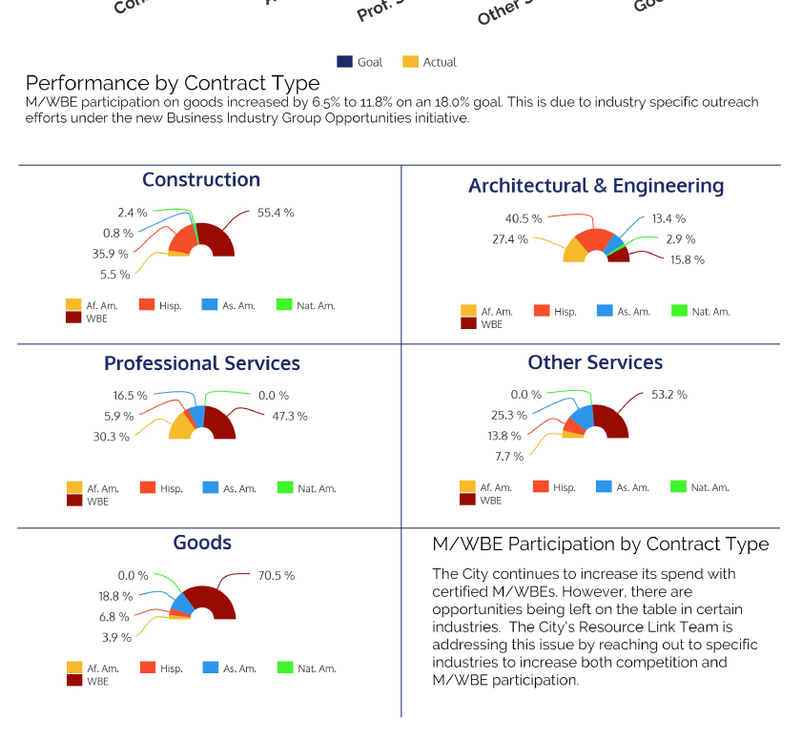

Slide 15
Recognized Certification Agencies
North Central Texas Regional Certification Agency (No cost for this certification)
    http://www.nctrca.org/
    (817) 640-0606
Dallas/Fort Worth Minority Business Council ($270.00 fee for this certification)
    http://www.dfwmbdc.com/
    (214) 630-0747
The Women's Business Council –Southwest ($250.00 fee for this certification)
    http://www.wbcsouthwest.org/
    (817) 299-0566

Slide 16
City of Dallas Buyers

Slide 17
Cherie Moose
(214) 670-3446
Cherie.moose@dallascityhall.com
Commodities
  Grounds Maintenance
  Electrical Supplies & Maintenance
  HVAC
  Alarm Services
  Parking

Slide 18
Kent Brown
(214) 670-3391
Kent.brown@dallascityhall.com
Commodities
  High Technology Procurements for:
    EBS, PWT, SAN, SCS, AVI DWU, DPD, DFR
    Server Support
    Network Security

Slide 19
Eva Badali
(214) 670-3332
Eva.badali@dallascityhall.com
Commodities
  EHS-Social Services
  Awards/Promotional Items
  Advertising
  Library Materials
  Courier
  Food, Water and Ice

Slide 20
Elizabeth Maldonado
(214) 671-9412
Elizabeth.maldonado@dallascityhall.com
Commodities
  Temporary Labor
  Tools & Accessories
  Batteries & Flashlights
  Building Materials
  Locksmith Services

Slide 21
Richard (Rick) Matthews
(214) 670-0604
Richard.matthews@dallascityhall.com
Commodities
  Machinery & Heavy Equipment & Repair Parts & Services
  Purchase & Rental of Mobile-Equipment & Parts
  Purchase of Non-mobile Industrial

Slide 22
Judy Levin-Simmons
(214) 671-8149
Judith.levinsimmons@dallascityhall.com
Commodities
  High Technology Procurements for:
    CDS, CCS, OFS, BDPS, PER
    Radio Network
    Mobile Tech
    Cable & TV
    We, City App
    Data Center
    Data Base

Slide 23
Herschel (Jerry) Perry
(214) 671-9422
Herschel.perry@dallascityhall.com
Commodities
  Chemicals
  Elevators
  Environmental Services
  Waste Management
  Demolition

Slide 24
Rebecca Parrish
(214) 670-3413
Rebecca.parrish@dallascityhall.com
Commodities
  Aggregates
  Concrete, Cement, & Road Related Products
  Road & Traffic Supplies
  Janitorial
  Fuel
  Electricity

Slide 25
Ron Blackmon
(214) 671-9298
Ronnie.blackmon@dallascityhall.com
Commodities
  Medical, Lab Testing & Supplies
  DPD & DFD Specialty
  Uniforms-DFR, DPD & Civilian
  Security Services

Slide 26
Theresa Mackey
(214) 670-5648
Theresa.mackey@dallascityhall.com
Commodities
  Translations & Court Reporting
  Office Supplies
  Furniture
  Reprographic Services
  Mailing/Postage
  Printing

Slide 27
Douglas Shelton
(214) 671-9820
douglas.shelton@dallascityhall.com
Commodities
  Insurance and Development
  Financial Products
  Collections

Slide 28
Vacant
(214) 243-2128
Commodities:
  Animal Related Items
  Exterminating Service
  Pesticides & Herbicides
  Sports Equipment & Supplies

Slide 29
Sheila Smallwood
(214) 670-3396
Sheila.smallwood@dallascityhall.com
Commodities
  DWU Specialty Equipment
  Motor & Motor Repair
  Pump & Pump Parts
  Plumbing

Slide 30
City of Dallas Informal Solicitation Buyers
Richard Fields
(214) 243-2129
richard.fields@dallascityhall.com
Mario Torres
(214) 671-9829
Mario.torres@dallascityhall.com

Slide 31
Master Service Agreement
Master and Service Agreements
Contracts entered into by the City and vendor to provide goods or services over a defined period of time at a predetermined price schedule

Slide 32
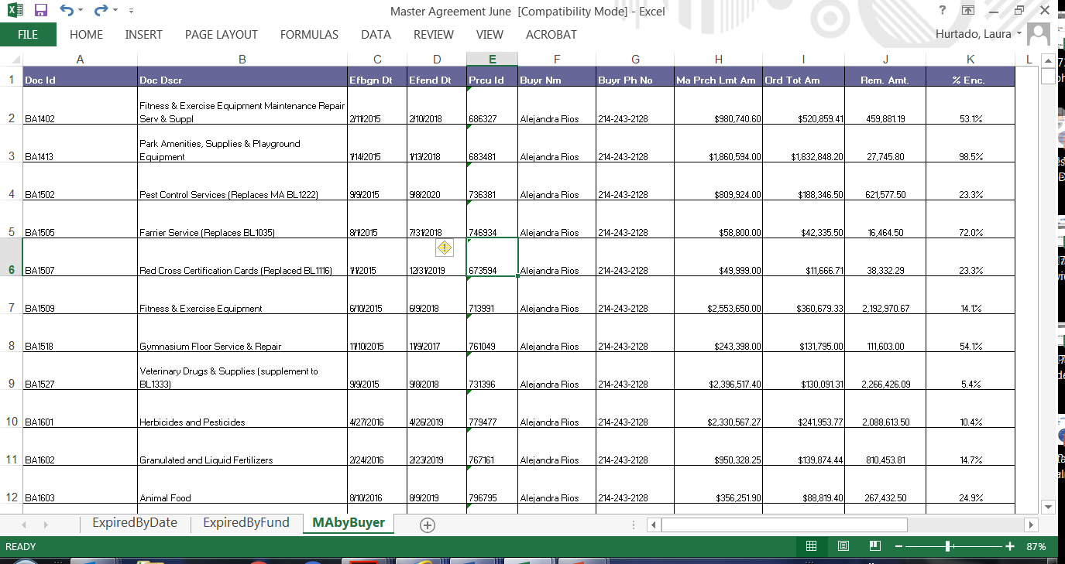
Master Service Agreement
Master and Service Agreements
contracts entered into by the City and ve provide goods or services over a defined period of time at a predetermined price schedule

Slide 33
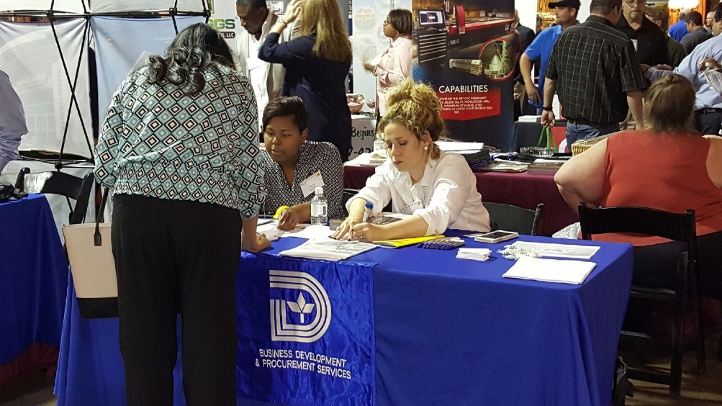
Next Steps
Register online: https://bids.dallascityhall.com
Add commodity codes
Schedule a follow-up meeting with a Business Industry Analyst

