Slide 1
PD_366
Buckner Boulevard Special Purpose District
PD 366
Community Meeting
May 18, 2016
6:00 P.M.
Prairie Creek Library
Presented by:
Sustainable Development and Construction

Slide 2
PD_366
Buckner Boulevard Special Purpose District
PD 366
Background:
PD 366 was established by the Dallas City Council on February 26, 1992
The properties are generally located along both sides of Buckner Boulevard from Heinan Drive and Hoyle Avenue on the north to the T.&N.O. Railroad on the south, and along Lake June Rd between Carbona Drive on the west and Pleasant Drive on the east
Approximately 407.945 acres
on January 7, 2016, City Plan Commission authorized a public hearing to determine the proper zoning for Planned Development District 366.

Slide 3
PD_366
Buckner Boulevard Special Purpose District
PD 366
Background:
The PD is divided into 7 subareas
Subarea 1A and 5 must comply to development and use of a Development Plan

Slide 4
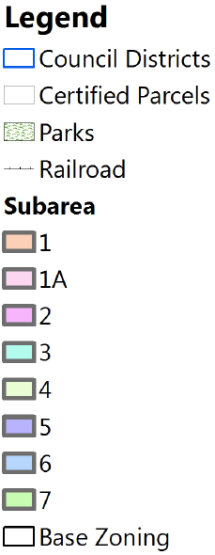
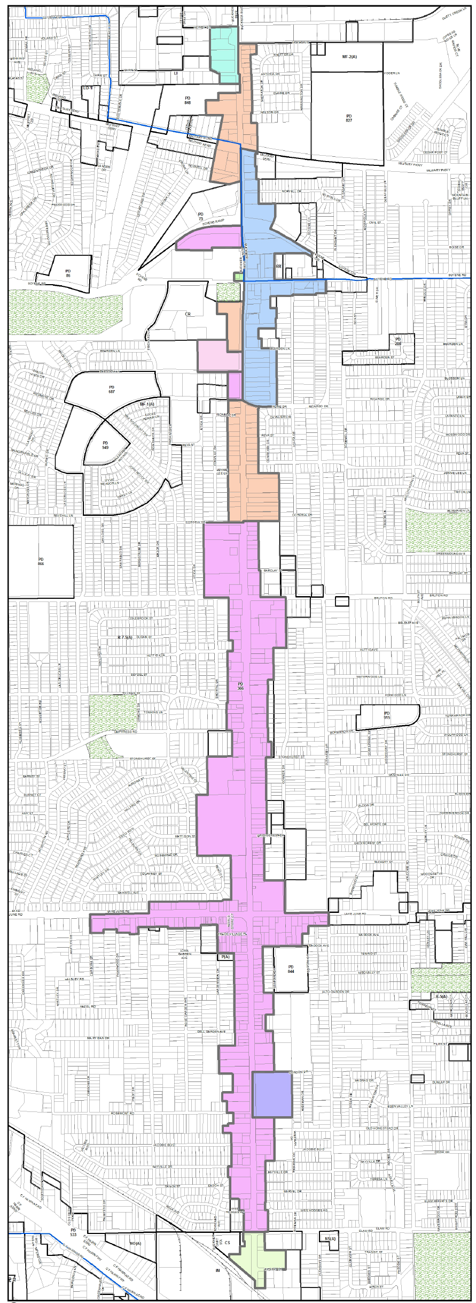
PD_366
Subareas and Permitted Uses
Subarea 1
Agriculture
crop production
Commercial and Business Service
vehicle engine repair
electronics service center
tool or equipment rental
Institutional and Community Service
adult day care
child care facility
library
community service center
Office
office
financial institutions
medical clinic
Retail and Personal Service
auto service center
general merchandise
personal service uses
restaurant

Slide 5
PD_366
Subareas and Permitted Uses
Subarea 1A
Agriculture
crop production
Commercial and Business Service
catering service
electronics service center
Institutional and Community Service
adult day care
child care facility
library
community service center
Office
office
financial institutions
medical clinic
Retail and Personal Service
business school
general merchandise
personal service uses
restaurant

Slide 6
PD_366
Subareas and Permitted Uses
Subarea 2
Agriculture
crop production
Commercial and Business Service
catering service
tool or equipment rental
Institutional and Community Service
adult day care
child care facility
community service center
Office
office
financial institutions
medical clinic
Retail and Personal Service
auto service center
general merchandise
personal service uses
restaurant
Wholesale Distribution and Storage
auto auction
Mini-warehouse

Slide 7
PD_366
Subareas and Permitted Uses
Subarea 3
Uses allowed in LI (Light Industrial)
Agriculture
crop production
Commercial and Business Service
catering service
technical school
tool or equipment rental
Industrial Uses
industrial (inside)for Mfr.
Institutional and Community Service
adult day care
child care facility
Office
office
financial institutions
medical clinic
Retail and Personal Service
furniture store
general merchandise
nursery or plant sales
restaurant

Slide 8
PD_366
Subareas and Permitted Uses
Subarea 4
Uses allowed in IM (Industrial Mfr.)
Agriculture
crop production
Commercial and Business Service
catering service
tool or equipment rental
Industrial Uses
industrial (inside)for Mfr.
outside salvage/ reclamation
Institutional and Community Service
adult day care
child care facility
Office
office
financial institutions
medical clinic
Retail and Personal Service
furniture store
general merchandise
restaurant

Slide 9
PD_366
Subareas and Permitted Uses
Subarea 5
Agriculture
crop production
Commercial and Business Service
catering service
electronics service center
technical school
Institutional and Community Service
adult day care
child care facility
library
community service center
Office
office
financial institutions
medical clinic
Retail and Personal Service
furniture store
dry cleaning store
personal service uses
restaurant

Slide 10
PD_366
Subareas and Permitted Uses
Subarea 6
Agriculture
crop production
Commercial and Business Service
custom business center
feed store
tool or equipment rental
Institutional and Community Service
adult day care
child care facility
library
community service center
Office
office
financial institutions
medical clinic
Retail and Personal Service
auto service center
general merchandise
personal service uses
restaurant

Slide 11
PD_366
Subareas and Permitted Uses
Subarea 7
Agriculture
crop production
Commercial and Business Service
vehicle engine repair
electronics service center
tool or equipment rental
Institutional and Community Service
adult day care
child care facility
library
community service center
Office
office
financial institutions
medical clinic
Retail and Personal Service
auto service center
general merchandise
personal service uses
restaurant

Slide 12
PD_366
Buckner Boulevard Special Purpose District
PD 366
Authorized Hearing Process:
Neighborhood Meeting presentation of current zoning
Steering Committee
Meetings with Steering Committee to develop proposed zoning amendments
Neighborhood meeting to finalize proposed zoning amendments
City Plan Commission public hearing
City Council public hearing

Slide 13
Questions?

