Slide 1
DCA 156-004 Tobacco & Paraphernalia Shops
Public Safety Committee
February 13, 2017
Department of Sustainable Development & Construction

Slide 2
Previous Briefings
On February 8, 2016, the Dallas Police Department briefed the Public Safety Committee on the drug K2, paraphernalia shops, and related public safety issues.
On April 11, 2016, the Public Safety Committee was briefed by the Sustainable Development & Construction Department, the Dallas Police Department, and the City Attorney’s Office on ways to address these public safety issues – a two prong approach was introduced.
City Council Public Safety Committee – February 13, 2017

Slide 3
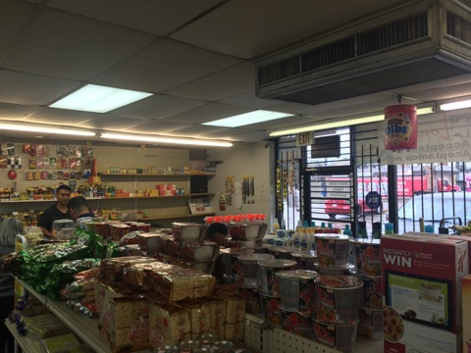
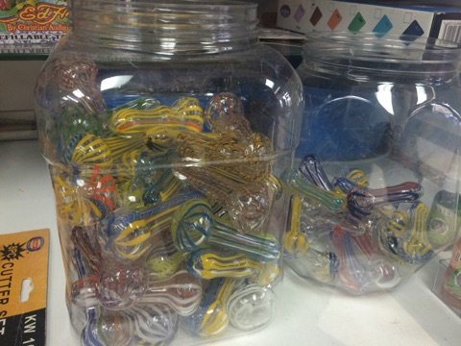
2-Prong Approach
Update Definitions in Chapter 12B Convenience Store Regulations
Create a Paraphernalia Shop Use in Chapter 51A, the Dallas Development Code
City Council Public Safety Committee – February 13, 2017

Slide 4
Background
On August 18 and September 1, 2016, the Zoning Ordinance Advisory Committee was briefed on the proposed amendment to Chapter 51A and on September 1, voted to forward the recommendation the City Plan Commission
On October 6, 2016, the City Plan Commission recommended approval of ZOAC’s recommendation
Concurrently, the City Attorney’s Office worked with DPD on proposed revisions to Chapter 12B – Convenience Stores
City Council Public Safety Committee – February 13, 2017

Slide 5
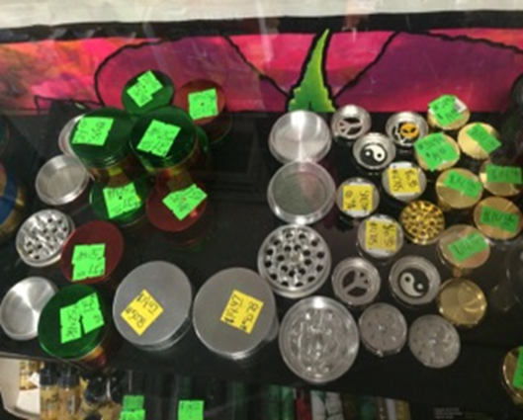
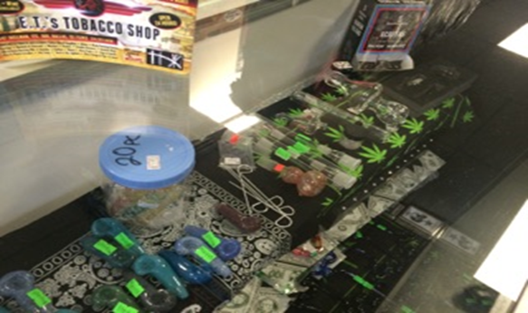
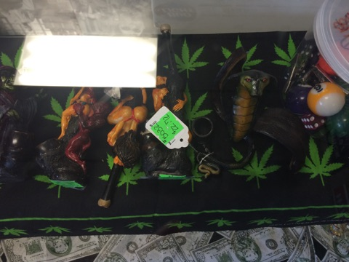
Background
Per Dallas City Code Chapter 31, “Offenses – Miscellaneous”, Illegal Smoking Paraphernalia means any equipment, device, or utensil that is used or intended to be used in ingesting, inhaling, or otherwise introducing into the human body an illegal smoking product.
For zoning purposes, stores that sell paraphernalia (pipes and other accessories) typically operate with a certificate of occupancy for general merchandise or food store use.
City Council Public Safety Committee – February 13, 2017

Slide 6
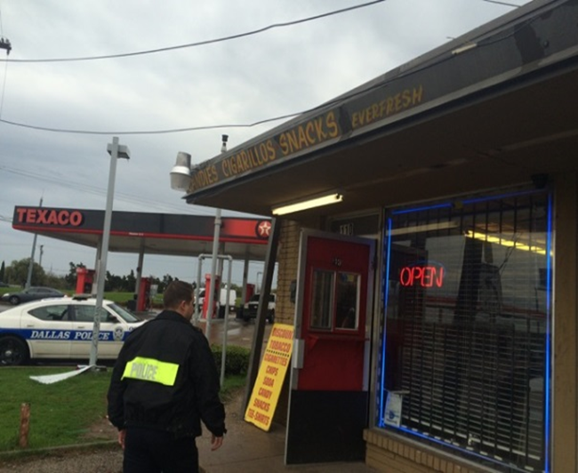
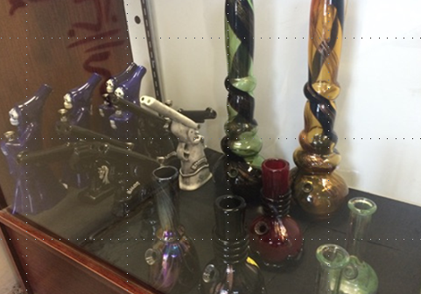
Issues
Problems identified with general merchandise or food store uses that sell paraphernalia products include:
Illegal activities such as gambling (8-liners), K2 and other drug sales, trespassing, and prostitution
Lack of required registration (e.g., Chapter 12B requirements for convenience stores) makes it difficult for DPD to track stores selling paraphernalia
City Council Public Safety Committee – February 13, 2017

Slide 7
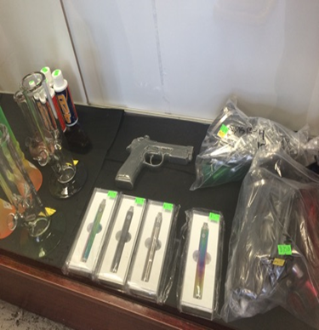
Proposal – Chapter 51A
Create a Paraphernalia Shop Use:
Definition: A Paraphernalia Shop is an establishment that displays or offers for sale paraphernalia, items, equipment, or products commonly used, or commonly known to be used, for the ingestion, inhalation, preparation, or injection of tobacco or illegal substances. For the purposes of this paragraph, rolling papers are not considered paraphernalia.
City Council Public Safety Committee – February 13, 2017

Slide 8
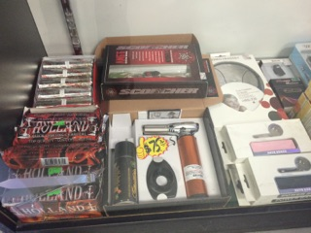
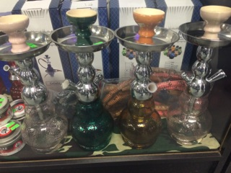
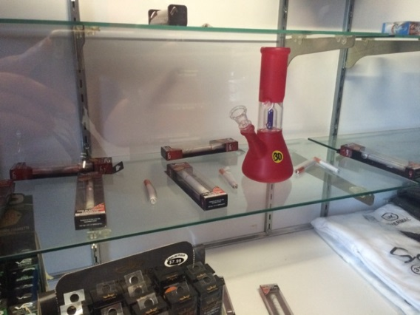
Proposal – Chapter 51A
Where Permitted:
Buy SUP only in the CR Community Retail, RR Regional Retail, CS Commercial Service, Industrial districts (LI, IR, and IM), and in the Mixed Use districts (MU-1, MU-2, and MU-3)
City Council Public Safety Committee – February 13, 2017

Slide 9
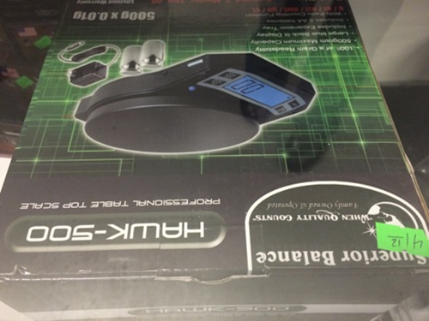
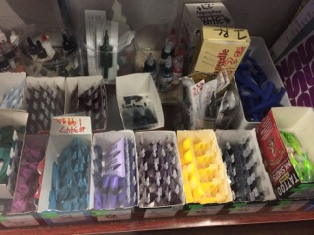
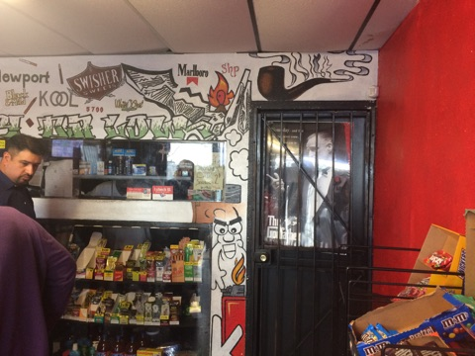
Proposal – Chapter 51A
Additional Provisions:
A paraphernalia shop may only be a main use that requires a certificate of occupancy. A paraphernalia shop may not be an accessory use within the meaning of Section 51A-4.217.
The outside sale, display, or storage of products is prohibited.
A paraphernalia shop may not have a drive-in, drive-through, or walk-up window.
City Council Public Safety Committee – February 13, 2017

Slide 10
Proposal – Chapter 51A
Additional Provisions:
A paraphernalia shop may not be located within 1,500 feet, measured from property line to property line, of any other paraphernalia shop.
A paraphernalia shop may not be located within 1,000 feet, measured from property line to property line, of a lot in a residential district.
A paraphernalia shop may not be located within 1,000 feet, measured from property line to property line, of a lot with a school.
City Council Public Safety Committee – February 13, 2017

Slide 11
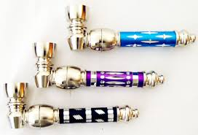
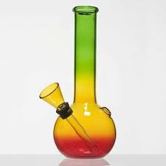
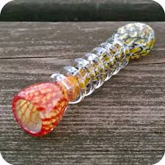
Affect on Existing Stores
Existing stores with valid COs would fall under the regulations governing nonconforming uses [Dallas Development Code Sec. 51A-4.704]
Existing stores with valid COs that are a problem: an application could be made to the Board of Adjustment to consider establishing a compliance date for an existing nonconforming store - Dallas Development Code Sec. 51A-4.704(a)(1)
City Council Public Safety Committee – February 13, 2017

Slide 12
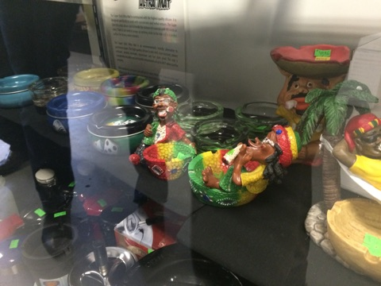
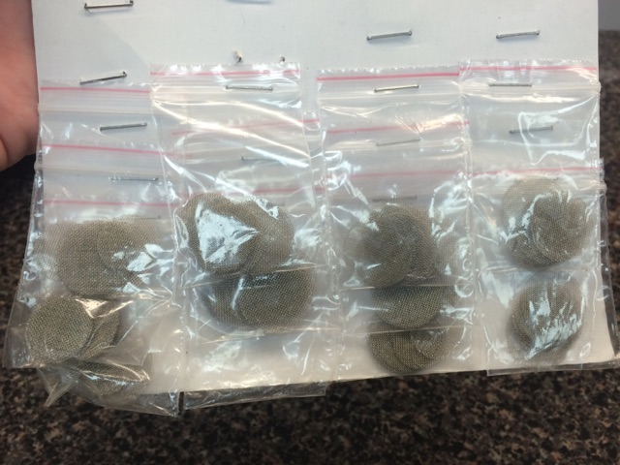
Affect on New Stores
New stores that open after the effective date of the ordinance would require an SUP if any paraphernalia items, equipment, or products are sold and would have to meet distance and the other additional provisions
City Council Public Safety Committee – February 13, 2017

Slide 13
Proposal – Chapter 12B
The amendments to Chapter 12B (Convenience Stores) will:
Require Paraphernalia Shops, as defined by Chapter 51A, to register with the DPD annually
Allow DPD to conduct property inspections
Require Paraphernalia Shops to comply with other miscellaneous convenience store regulations:
Criminal trespass affidavits
Surveillance cameras
Alarm system
Drop safe
Security signs
Height markers
No trespassing signs
Visibility through all windows and public entrances, and
Employee safety training.
City Council Public Safety Committee – February 13, 2017

Slide 14
Proposal – Chapter 12B
The amendments to Chapter 12B (Convenience Stores) will:
Amend the definition of Convenience Store to exclude, Cigar Bars and Tobacco Shops
Amend the definition of Convenience Goods to include tobacco products and paraphernalia
Note: Cigar Bar and Tobacco Shop are not defined uses in Chapter 51A. The definitions are taken from Dallas City Code Chapter 41
Cigar Bars and Tobacco Shops may be general merchandise or food stores
City Council Public Safety Committee – February 13, 2017

Slide 15
Proposal – Chapter 12B
The amendments to Chapter 12B (Convenience Stores) will
add the following definitions:
Cigar Bar – a bar that derives 15 percent or more of its gross revenue on a quarterly basis from the sale or rental of tobacco, tobacco products, or smoking accessories for on-premise consumption (same as Dallas City Code – Ch. 41)
Paraphernalia – any device, equipment, or utensil that is commonly used, or commonly know to be used, for the ingestion, inhalation, preparation, or injection of tobacco products or illegal substances. For purposes of this chapter, rolling papers, are not considered paraphernalia.
Tobacco Shop – a retail or service establishment that derives 90 percent or more of its gross revenue on a quarterly basis from the sale of tobacco, or tobacco products.
City Council Public Safety Committee – February 13, 2017

Slide 16
Recommendation
Staff is seeking the support and recommendation from the Public Safety Committee to move the two code amendment proposals forward to full Council for approval on the March 22, 2017 Council Agenda.
City Council Public Safety Committee – February 13, 2017

Slide 17
Questions?
City Council Public Safety Committee – February 13, 2017

