Slide 1
Article XIII – Form Districts Community Meeting
North Dallas Chamber of Commerce
March 25, 2019
Nathan Warren
Senior Planner
Sustainable Development & Construction Department

Slide 2
Introduction
This is not a zoning change.
This is a code amendment:
  It is an amendment to the Dallas Development Code base zoning district – Article XIII – Form Districts.

Slide 3
Code Amendment Process
What is the process to make a change to the Dallas Development Code?
  An issue is assigned to city staff.
  Staff researches the issue, discusses the issue with other departments, and formulates a proposed code amendment to address the issue.
  Staff presents the code amendment to the Zoning Ordinance Advisory Committee (ZOAC).
  ZOAC makes a recommendation to the City Plan Commission (CPC).
  City Plan Commission considers the code amendment and makes a recommendation to City Council.
  City Council ultimately votes to approve a code amendment.

Slide 4
Article XIII – Form Districts
What is Article XIII?
  Article XIII is the portion of the Dallas Development Code that regulates Form Districts.
  The goal of Article XIII is to create walkable urban neighborhoods where higher density mixed uses and mixed housing-types promote less dependence on the automobile.
It is the base for:
  Planned Development District No. 468
  Planned Development District No. 887
  A subdistrict in Planned Development District No. 595

Slide 5
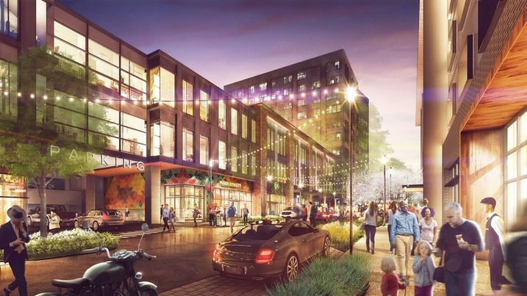
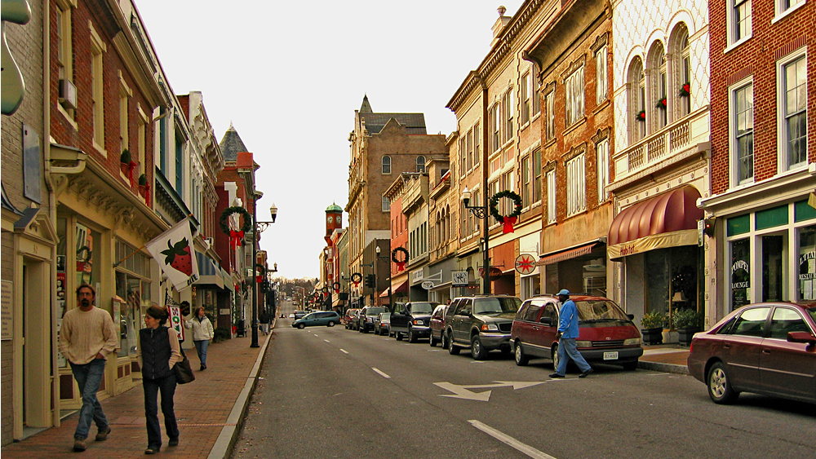
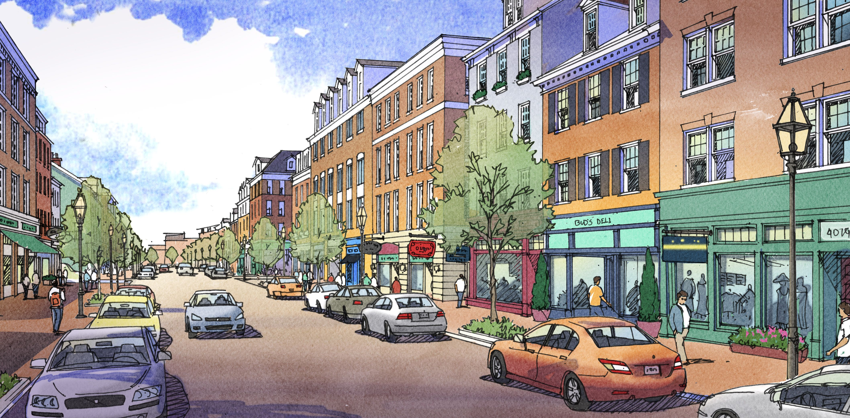
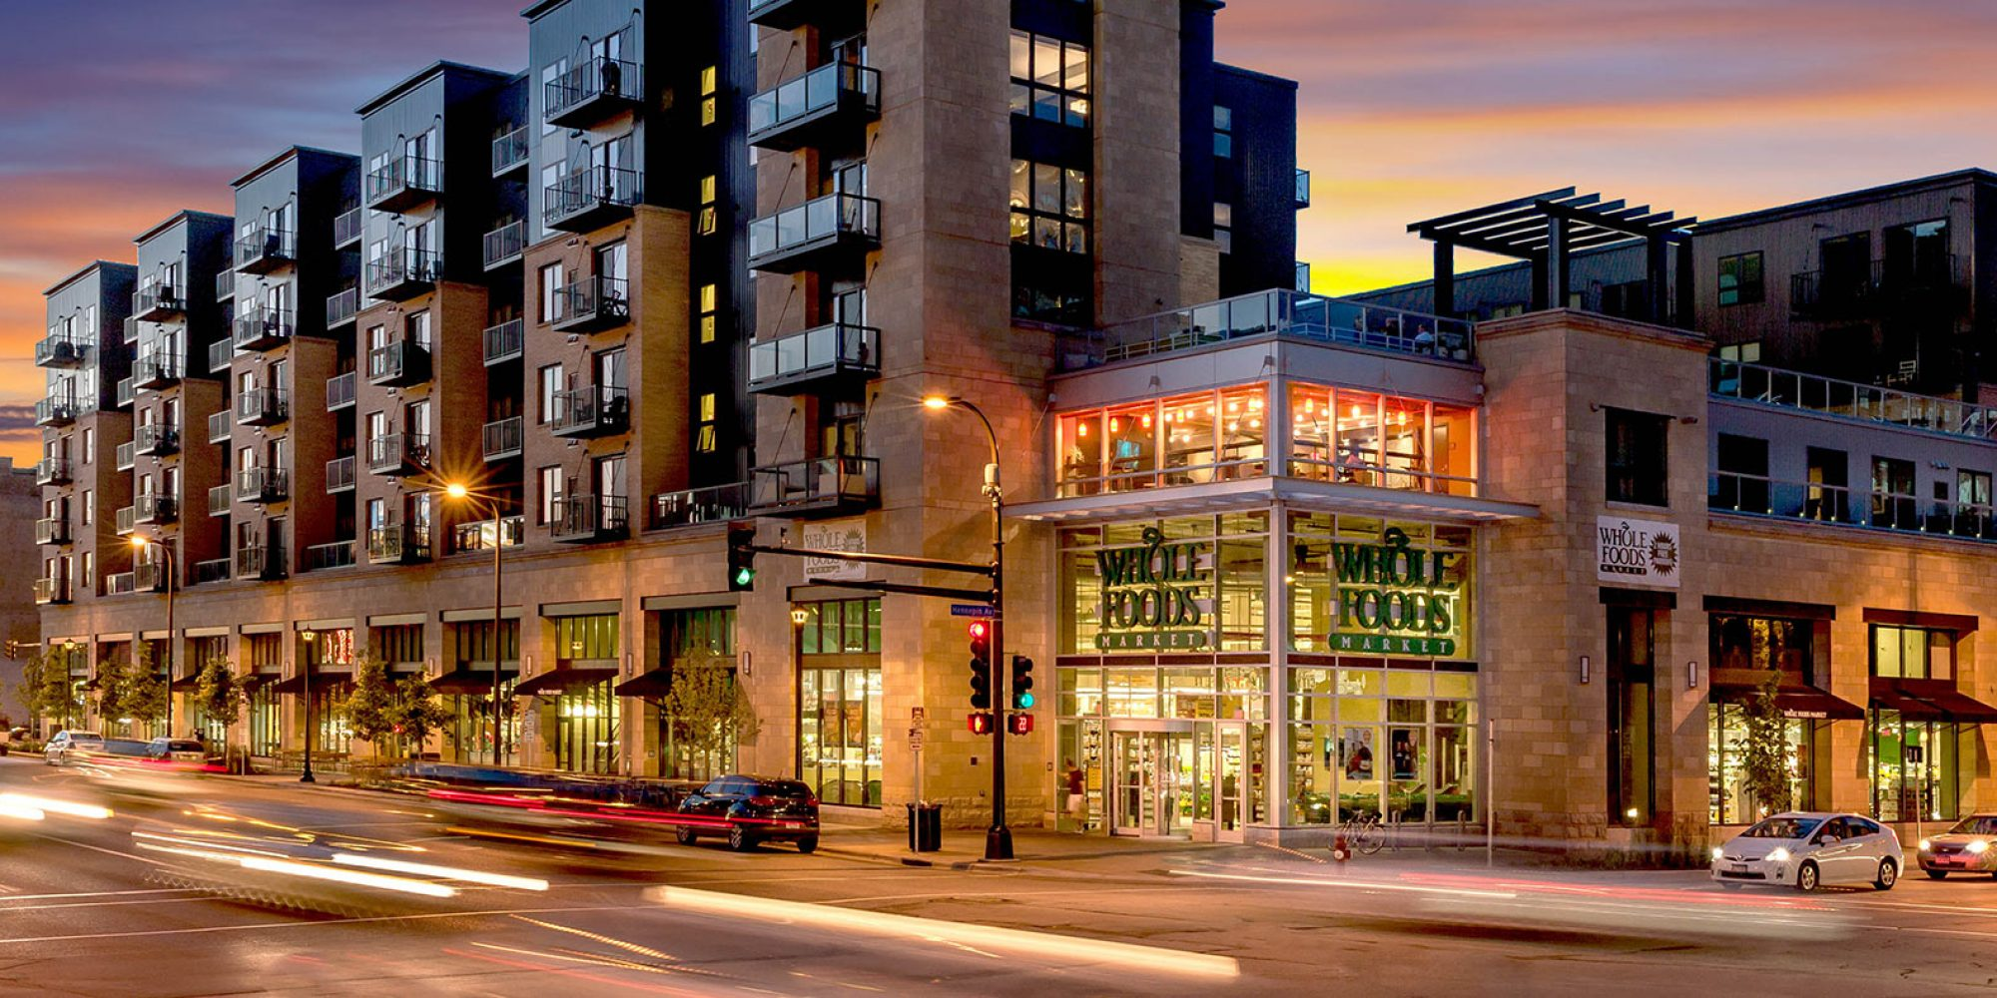
Article XIII
Notes:
First images when you google “mixed use walkable”

Slide 6
History
City Council adopted Article XIII on February 25, 2009.
First round of amendments: Approved by Council on August 12, 2015
  Expanded non-conforming structures definition to allow for expansion up to 35%
  Allowed artificial lots
  Cleaned up language about the planting zone in reference to utility regulations
  Adjusted block definition requirements to allow for infill development
  Increased the average width of pedestrian passages.

Slide 7
History
Second round of amendments: Approved by Council on June 13, 2018
  Ensured consistency between text and pictures by addressing the graphic for stoops and front porches
  Provided an administrative waiver to deviate from the front setback requirement
  Story height definition adjusted to allow for uses that do not follow standard floor spacing
  Created an avenue to deviate from the required street frontage through approval at a public hearing with public notice
  Clarified that a stop on a fixed rail system is considered a rail transit station when addressing parking reductions for access to transit
  Added language that structured parking transparency is not required to be filled with glass
  Clarified that a single family district means a residential district other than multifamily
  Location of replacement trees moved to be no closer than five feet from the building façade (previously 10 feet)
  Added language to require off-street loading to be located behind the parking setback
  Permitted self-service storage use by SUP

Slide 8
Article XIII – Form Districts
Why are a third round of amendments needed?
  Alleviate common issues that Building Inspection runs into with respect to Street Designation.
  Opportunity to clean up cumbersome and confusing language.
  The changes aim to provide clarity and consistency for the neighborhoods, developers, and redevelopment in communities affected by Article XIII.

Slide 9
Article XIII – Form Districts
What are the proposed changes to Article XIII?
  Street Designation
  Minimum Lot Size for Duplexes
  Required Parking Language
  Introducing a Land Use
  Broadening the Development Types Allowed in one District
  Adding a Graphic that better represents all development choices in a Development Type

Slide 10
Street Designation
There are three types of streets in Article XIII:
  Primary Streets
    PRIMARY STREET means the principal frontage for a building site, as defined during site plan review. Any street designated with a -SH overlay is a primary street.
  Side Streets
    SIDE STREET means a frontage that is not a primary street, as defined during site plan review.
  Service Streets
    SERVICE STREET means a service street designated on a regulating plan or site plan.

Slide 11
Street Designation - Issues
Currently: Street designation is determined on a lot by lot basis.
  Triangular blocks in which the designation of primary streets on multiple sides of the block limits the possibility of development.
  Multiple street designations in the same blockface because some lots only have one frontage.
Proposed: Street designation should be determined on a block by block basis

Slide 12
Street Designation
Primary Street
Side Street

Slide 13
Street Designation - Current
Primary Street
Side Street

Slide 14
Street Designation - Proposed
Primary Street
Side Street

Slide 15
Street Designation
What implications does street designation have on development standards?
  Front Setback Area
  Required Street Frontage
  Parking Setback
  Ground Story Transparency
  Entrance
  Blank Wall Area

Slide 16
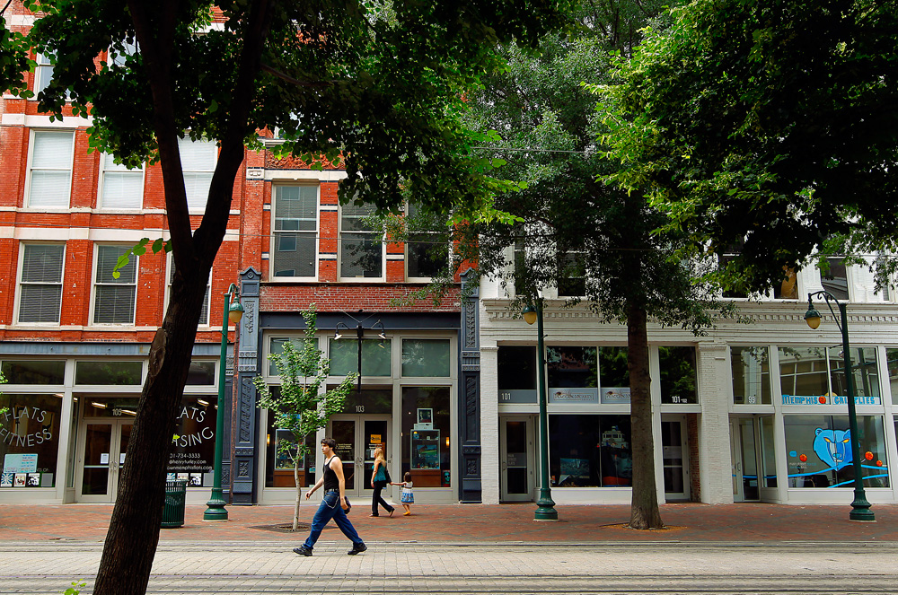
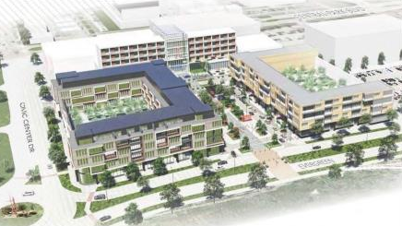
Street Designation
Front Setback Area
Required Street Frontage
Parking Setback
Ground Story Transparency
Entrance
Blank Wall Area

Slide 17
Minimum Lot Size for Duplexes
Currently: The minimum lot size for a property with two units in Manor House (Mh) is 7,000 square feet.
Proposed: A minimum of 6,000 square feet for a property with two units in Manor House (Mh).
Rationale: 6,000 square feet is the minimum area in other city regulations.

Slide 18
Required Parking Language
There are no amendments to the amount of required parking.
The proposed changes are to clean up confusing language that refers to parking requirements for similar uses in the Dallas Development Code.

Slide 19
Land Use
Currently: Medical Use is not allowed in the Ground Story of the Townhouse Stacked (Ts) Development Type
Proposed: Allow Medical Use in the Ground Story of the Townhouse Stacked (Ts) Development Type
Rationale: In all other instances, Medical use and Office use are both allowed in the same development type. Townhouse Stacked (Ts) is the only instance where Office is allowed, but not Medical.

Slide 20
New Development Type in a District
Current: Single-Story Shopfront (Ss) is not allowed in Walkable Urban Residential (Low WR-3, WR-5)
Proposed: Allow Single-Story Shopfront (Ss) Development Type in the Walkable Urban Residential District, Low (WR-3, WR-5) restricted to only Office and Medical uses along thoroughfares.
Rationale: The allowance of Single-Story Shopfront (Ss) development type, with these uses currently exist along thoroughfares.

Slide 21
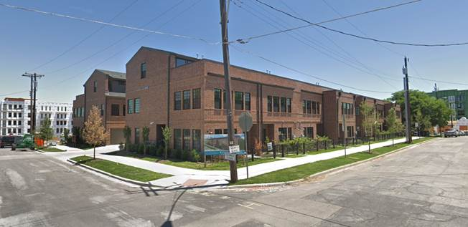
Replacing an Image
Replacing an Image from Townhouse (Th) to show a Shared Access Development
  The new graphic will enhance the representation of all development choices available in the Development Type Townhouse (Th).

Slide 22
Next Steps
First Community Meeting
  Hitt Auditorium
  March 20, 2019
Second Community Meeting
  North Dallas Chamber of Commerce
  March 25, 2019
Third Community Meeting
  April 1, 2019
Zoning Ordinance Advisory Committee (ZOAC)
  Tentatively Scheduled for April 4, 2019
City Plan Commission (CPC)
City Council

Slide 23
Questions

Slide 24
Contact Information
Nathan Warren
Senior Planner
nathan.warren@dallascityhall.com
214-670-4195
City of Dallas Code Amendments website:
https://dallascityhall.com/departments/sustainabledevelopment/planning/Pages/Code-Amendments.aspx

Slide 25
Article XIII – Form Districts Community Meeting
North Dallas Chamber of Commerce
March 25, 2019
Nathan Warren
Senior Planner
Sustainable Development & Construction Department

