Slide 1
Harvest Hill Road Speeding Concerns
Department of Transportation – City of Dallas
May 16, 2023

Slide 2
Agenda
Area of Focus
Improvements and Speed Mitigation Efforts
Current Options
Next Steps
Q&A and Conclusion
2

Slide 3
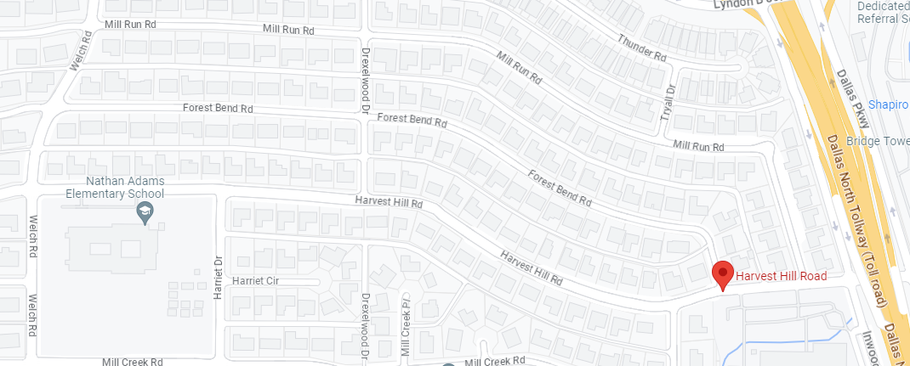
Area of Focus
Harvest Hill Road from Dallas North Tollway to Welch Road
3

Slide 4
Improvements & Speed Mitigation Efforts
Harvest Hill Road repaved and restriped in 2022.
Collection of vehicle speed and volume data in Fall 2022; engineering assessments conducted.
Replacement and enhancement of outdated school signs and curve warning signs.
Lane reductions and pavement striping to denote parking areas.
Consideration of speed cushions and rumble strips.

Slide 5
Current Options
Speed Cushions:
Petition submitted by abutting property owners in 2022.
Intended to slow traffic; typically installed on residential streets.
Designed to allow Fire Engine clearance.
Rubberized material, rather than asphalt.
May have a noise impact for abutting homeowners.

Slide 6
Speed Cushion Proposed Schematic Section 1 of 4
6

Slide 7
Speed Cushion Proposed Schematic Section 2 of 4
7

Slide 8
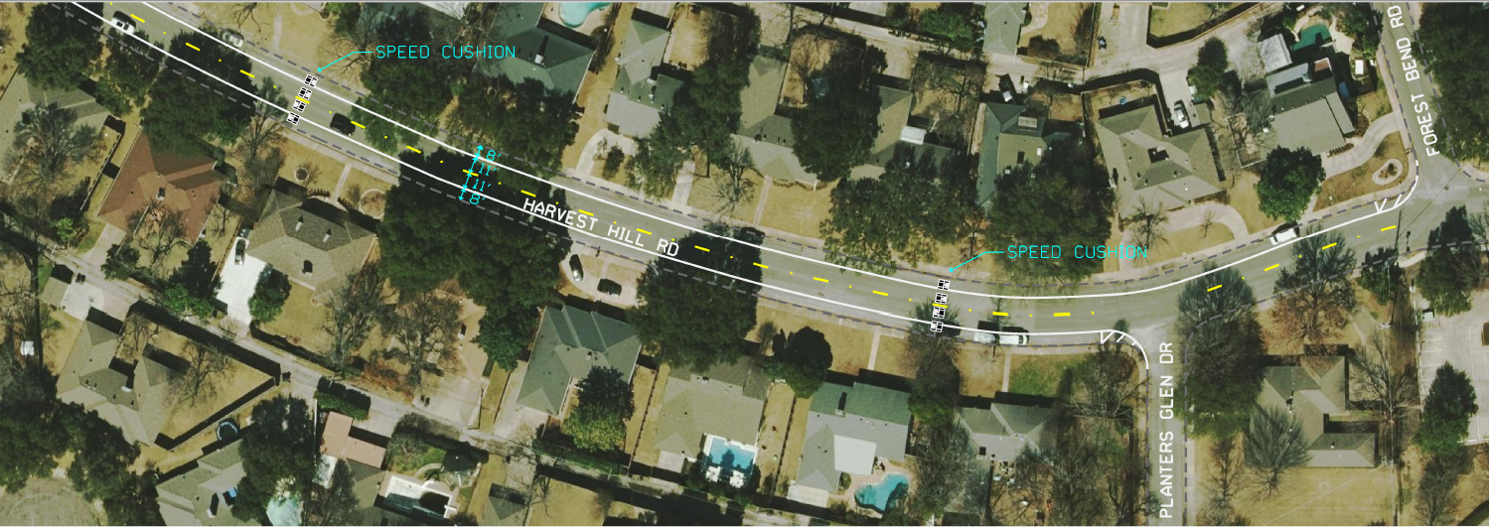
Speed Cushion Proposed Schematic Section 3 of 4
8

Slide 9
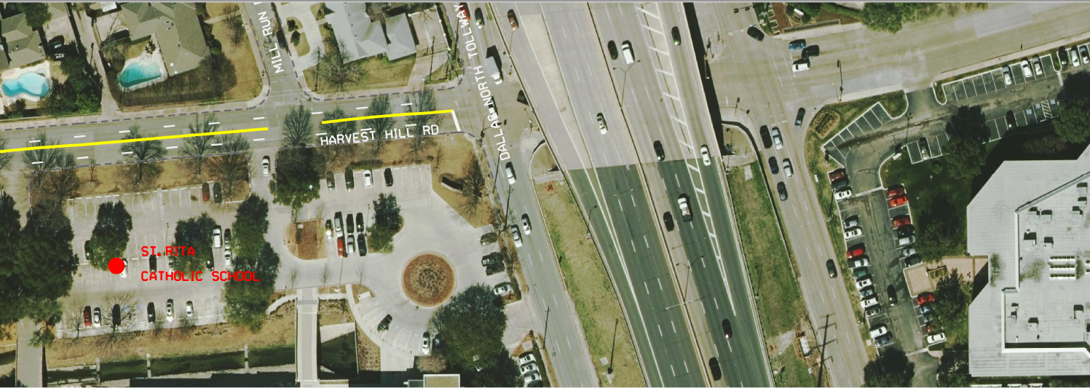
Speed Cushion Proposed Schematic Section 4 of 4
9

Slide 10
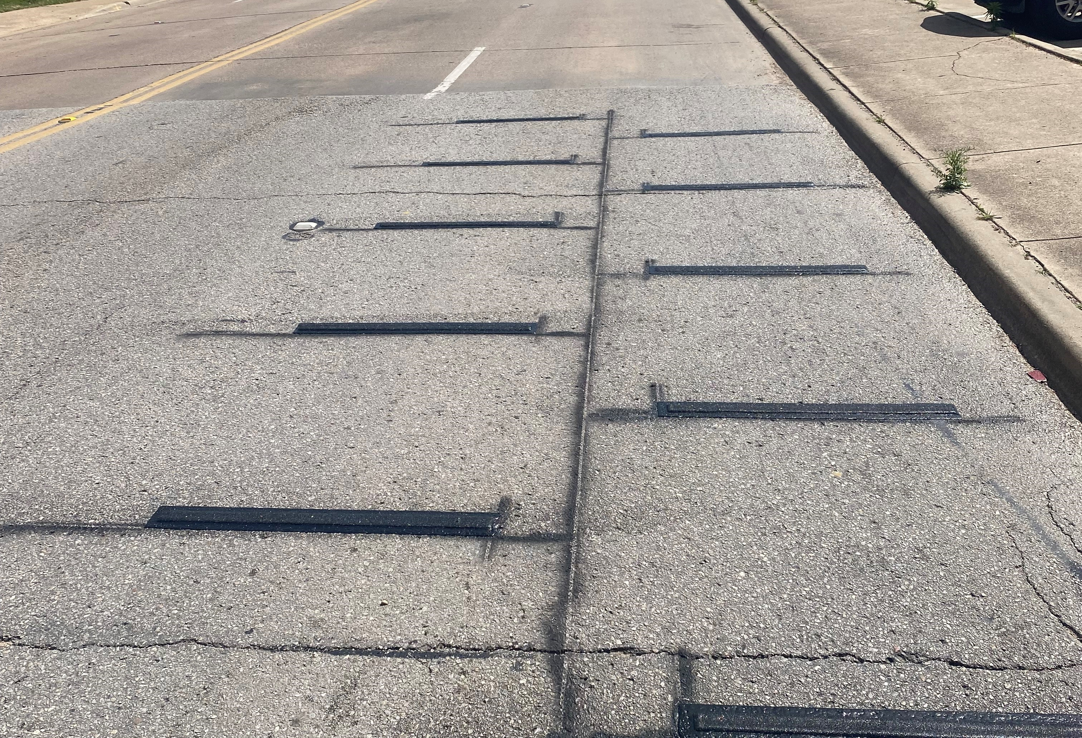
Current Options
Rumble Strips:
Pilot testing installation of rumble strips across lanes, in order to slow traffic.
Experimental use on Canton Street in Dallas.
Primary concern is noise.
Proposed layout is similar to speed cushions – available as a reference.
Similar intent and effect as another pilot project for “raised pavement markers”, as seen on Cesar Chavez Blvd.

Slide 11
Next Steps
Community Meeting on 5/16/23 to receive feedback and answer questions.
Final confirmation from Dallas Fire-Rescue on proposed plan.
30-day comment period. Feedback can be sent to ddot@dallas.gov.
If two-thirds support is received and support from DFR is verified, implementation will proceed in late Summer 2023. Minor location adjustments may be needed based on field conditions.
Continued evaluation of speed & vehicle volumes on Harvest Hill to evaluate effectiveness of recently implemented and proposed measures.

Slide 12
Conclusion
Q&A

