Slide 1
Brownfields 101
Notes:
Welcome everyone! I'm joined by my colleagues SeLena Cosma and Andrew Portalatin to present a quick introductory presentation on what is Brownfields and the benefits of the program for your community.

Slide 2
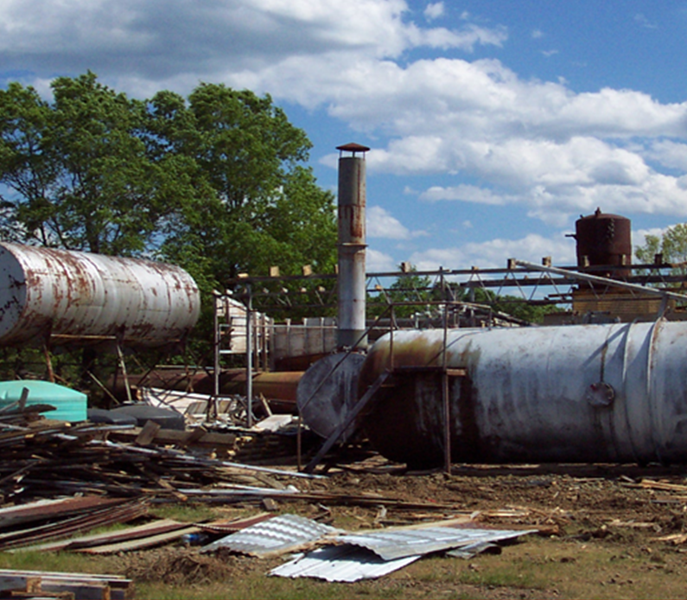
Brownfields - Definition
Real property, the expansion, redevelopment or reuse of a site may be complicated by the presence or potential presence of hazardous substance, pollutant, or contaminant.
Notes:
This is the official definition of a Brownfields. But what is likely more important for the people in this meeting are the benefits of utilizing your brownfields. Those benefits include:
Cleaning up and reinvesting in these properties increases local tax bases, facilitates job growth, utilizes existing infrastructure, takes development pressures off of undeveloped, open land, and both improves and protects the environment.

Slide 3
Benefits of the Brownfields Program
Revitalize communities
Create jobs and increase local revenue
Revitalize urban areas
Protect the environment using greenspaces
Community Health- by improving Walkability and neighborliness while at the same time decreases crime
Projects leveraged $20 per EPA dollar expended
Leveraged 170,000 jobs nationwide
Residential property values increase by 5% to 15% when brownfield sites are cleaned up.

Slide 4
The Process
Notes:
Let's talk briefly about the process that will hopefully lead you to some of those benefits I just mentioned

Slide 5
Elements of Brownfields Revitalization
Determine reuse and vision goals
Identify Brownfield sites
Conduct Environmental Assessments
Prioritize Brownfields
Leverage Funding Resources
Clean Up and Revitalize
RLF and/or Clean up Grants
Assessment grants
Notes:
Local stakeholders are involved throughout all the elements of brownfields revitalization.
The Process-To accomplish these steps your goal should be identifying and assessing the needs of your community and doing so you will be identifying potential Brownfields Sites and prioritizing the projects that will provide environmental relief and benefits of your community. The process includes envisioning the goals that fit the community needs; Inventory potential brownfield sites (remember the examples; abandoned gas stations, movie theaters, dilapidated buildings, etc.)
Prioritize the sites from the brownfields inventory by feasibility and importance.
All steps are needed for successful revitalization—not a step-by-step recipe, this work is continuous, but the result improves the community and local environment in many ways.

Slide 6
Brownfields Project Process
1. Identify site
2. Assess
3. Clean up
4. Redevelop
Notes:
Initially you might have a goal or vision for your town or community. That vision might lead you to look at properties already around your community where potential Brownfields sites are present. You narrow down and prioritize your list and you identify one site that will provide environmental relief and benefits of your community. Next you go on to assess that site through a Phase 1/Phase II. If warranted, you move on to clean up and redevelop your site as shown in the pictures above of the former smelter power plant that was redeveloped into the American Airlines Center here in Dallas.

Slide 7
Brownfields Assistance Opportunities – Eligible Applicants
Regional Councils of Government
Cities
Redevelopment Agencies
States
Non-profit organizations
Local Governments
Tribes
Notes:
The brownfields assistance and funding opportunities that we'll discuss are only available for eligible applicants. Applicants include those listed on your screen.

Slide 8
Not Eligible for Brownfields Assistance
Notes:
This is a list of ineligible entities for Brownfields funding
Cannot give grants to Potentially Liable Parties or Private owners—not in the business of giving tax-payer money to the ones potentially responsible for the contamination (can do assessments by proxy with the knowledge these parties are potentially liable for the cleanup)

Slide 9
Brownfields Assistance and Funding Opportunities
State/Tribal Response Programs
Assessment Grants
Technical Assistance
Revolving Loan Funds
Job Training Grants
Targeted Brownfields Assessments
Cleanup Grants
Multipurpose Grants
Notes:
Briefly name the various funding opportunities provided. Note the variety and number of opportunities.

Slide 10
How does it work?
Grants
State and Tribal Grants
Competitive
Targeted Brownfields Assessments (TBA)
Direct assistance to communities to assess brownfields sites
Technical Assistance to Brownfields (TAB)
Variety of programs to assist tribes/communities
Notes:
Grants are provided competitively to communities and eligible organizations along with state and tribal funding.
There are also technical assistance programs to help fill the gaps for those who were not fortunate to receive a grant.
Targeted Brownfields Assessments
Technical Assistance to Brownfields
(More information about Technical Assistance programs in later slides)

Slide 11
When to Conduct an All-Appropriate Inquiry/Phase I ESA
BEFORE acquiring the property
Conducted or updated within 1 Year PRIOR to the acquisition of the property
Update within 180 days prior to the acquisition
Notes:
Phase I Environmental Site Assessment is a record review of the site (current and past owners, current and past uses) and a site visit. This helps to determine the potential contamination/s.
When to conduct an All-Appropriate Inquiry/ Phase I Environmental Site Assessment:
1 year prior to the acquisition of the property
If needed, an updated Phase I Environmental Site Assessment 180 days prior to the acquisition.

Slide 12
Targeted Brownfields Assessments & Technical Assistance

Slide 13
Targeted Brownfields Assessments and State and Tribal Response Program
Targeted Brownfields Assessments (TBA)
Provided by EPA or State, at no cost to the applicant
Area-wide inventories
Phase I – Research
Phase II – Sampling
Phase III – Cleanup Planning
Available year-round, case-by-case basis, performed by service contractors and managed by EPA or State
State and Tribal Response Program Grants
Funding is non-competitive
Awarded on an annual basis
Can also be used for limited site assessments or cleanups at brownfield sites
Purchase environmental insurance
Develop other insurance mechanisms for cleanup activities
Want additional information?
Please contact: Roxanne Welch
Welch.Roxanne@epa.gov
Want additional information?
Please contact: Elizabeth Reyes
Reyes.Elizabeth@epa.gov
Notes:
Read from slide: Highlight the TBA and how this TA can help fill the gaps of not having access to an assessment grant.
Briefly discuss the State and Tribal Response Program.

Slide 14
Technical Assistance to Brownfields (TAB)
Provides expert technical assistance and guidance to help communities understand
acquiring, assessing, cleaning up and redeveloping brownfield properties;
the health impacts of brownfield sites;
how science and technology are used for site assessment, remediation, redevelopment and reuse; and
how to comply with voluntary cleanup requirements.
https://www.ksutab.org/
Want additional information?
Please contact: Scott Nightingale
scottnight@ksu.edu

Slide 15
Land Revitalization Technical Assistance
Market analysis—labor market and economic research
Site reuse assessment—identify site assets and barriers
Financial feasibility and/or implementation plan for site reuse
Conceptual site design
Climate resiliency and sustainable reuse (renewable energy)
Rapid Health Impact Assessment
Transportation and site access improvements
Want additional information?
Please contact: Emily Jimenez
Jimenez.Emily@epa.gov
Notes:
LR TA is contract assistance, and regional staff recommend projects. EPA pays and directs contractors to provide specific types of site assessment, cleanup and reuse expertise to BF communities.

Slide 16
Smart Growth – Technical Assistance
Smart Growth covers a range of development and conservation strategies that help protect our health and natural environment
To help make our communities more attractive, economically stronger, and more socially diverse.
By offering in-kind assistance, Smart growth helps provide an action plan to reach the next steps.
Smart Growth partners with other agencies & programs such as:
USDA
Rural Development
Want additional information?
Please contact: Michael Kennedy
Kennedy.Michael@epa.gov
Notes:
CAN READ THESE NOTES
Smart Growth :
Technical assistance through Smart Growth is in-kind, no direct funding to the community … so not a grant.
Communities are assisted by EPA/Contractor-led facilitation
for the pre-workshop planning, three-day workshop, and post-workshop follow up. At the end of the workshop and follow up, the Action Plan is produced for community.
Reports and other publications can be found on the EPA smart growth webpage.
Tool kits that have been proven successful are available
Past successful projects are highlighted—the issue faced, the ideas/solutions, and how the action plan moved forward.
Partnerships with FEMA and Smart Growth Network—more than 40 organizations

Slide 17
Grants
Notes:
Next, we will talk about the different grant types

Slide 18
Multipurpose (MP) Grants
Up to $800,000
demonstrate how grant funds will result in at least:
One Phase II environmental site assessment;
One brownfield site cleanup; and
an overall plan for revitalization that includes a feasible reuse strategy for one or more brownfield sites, if there is not already a plan in place.
Want additional information?
Please contact: Paul Johnson
Johnson.Paul@epa.gov

Slide 19
Assessment Grants
Up to $500,000 (Community – wide assessment)
4-year project period
States and Tribes can apply for an Assessment Grant up to $2 million (limited awards will be made)
5-year project period
At least 30% of funds can be used for planning (State/Tribe/Community)
Site specific solicitations not available in FY-23
Want additional information?
Please contact: Michael Kennedy
Kennedy.Michael@epa.gov
Notes:
FY22 Change
Currently, 4-to-5-year performance period
Developing an inventory of Brownfield sites, conducting community involvement activities, Phase 1 & 2 Environmental Site Assessments, Clean up reuse planning and developing area wide revitalization plans

Slide 20
Revolving Loan Fund Grants
Can loan to public or private developers
Grantee determines loan terms
Five-year performance period
Provides up to $1,000,000
Want additional information?
Please contact: Camisha Scott
Scott.Camisha@epa.gov
Notes:
Revolving Loan Fund is one of the more complex grants.
Can apply as an eligible individual entity or as an RLF Coalition comprised of two or more entities.
Nonprofits, LLCs and Non profit community development entities are eligible.
Eligible activities include cleanup, loan program implementation and confirmatory sampling only
Can provided funds up to a million dollars
can be loan to public or private developers
Grantee determines loan terms
5-year performance

Slide 21
Cleanup Grants
One or more sites
4-year project period
Option 1
Up to $500,000
Option 2
$500,001 - $1,000,00
Option 3
$1,000,001 - $2,000,00
Want additional information?
Please contact: Paul Johnson
Johnson.Paul@epa.gov
Notes:
Clean up grants provide funding to eligible entities to carry out clean up activities
Applicant must be the sole owner of the sites prior to application. Applicant must have Phase 2 ESA completed
Conducting community involvement activities
Have one or more applicant owned sites with clean-up potential.
Submit one Cleanup Grant proposal each competition cycle, along side with Analysis of Brownfields Cleanup Alternatives (ABCA) for each site.
Applicant have Phase 2 ESA complete

Slide 22
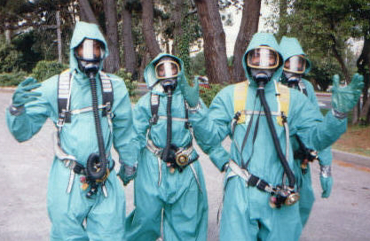
Job Training Grant
Conducts environmental training, allowing applicants to tailor the curriculum of their programs
OSHA 29 CFR 1910.120 40-hour HAZWOPER is the only required training.
Provides up to $500,000
Five-year Performance period
Currently closed
Want additional information?
Please contact: Emily Jimenez
Jimenez.Emily@epa.gov
Notes:
Allow nonprofits, local gov, and other organization to recruit and train residents affected by the presence of a near BF.
40 Hour HAZWOPER is the only required training
Grant helps to conduct environmental training and tailoring through a curriculum program-
Funding can be up to $500,000
with a 5-year performance period and up to 5% used on admin cost
Currently Closed

Slide 23
Brownfields Grant Schedule
Applications are due November 22, 2022
FY23 Multipurpose (MP) Grants
FY23 Assessment Grants
FY23 Revolving Loan Fund Grants
FY23 Cleanup Grants
Announced usually May/June
Awarded by October (next FY)
Notes:
Read Slide
Guidelines are currently out.
Deadlines to submit proposals in November 22, 2022.

