Slide 1
Transportation-for-Hire
Driver Training
Provided by the City of Dallas, Department of Code Compliance, Transportation Regulation Division
April 2015

Slide 2
Disclaimer
This is a summary of the information in Chapter 47A of the Dallas City Code. A complete review of Chapter 47A is strongly recommended to anyone who plans to provide transportation-for-hire services in Dallas.

Slide 3
What is Transportation-For-Hire (TFH)?
TRANSPORTATION-FOR-HIRE SERVICE means the business of offering or providing transportation of persons for compensation.
From Dallas City Code Section 47A-1.5(25)

Slide 4
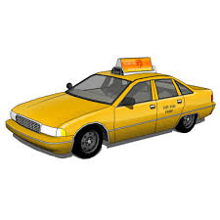
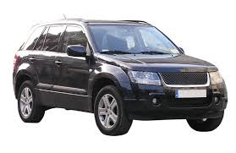
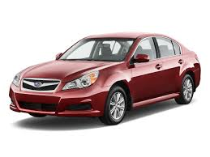
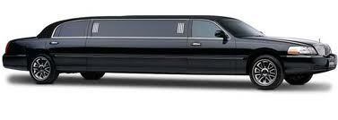
What is TFH?
The bottom line: Unless the ride you provide is courtesy transportation (free to the customer), it is transportation-for-hire, and must comply with the regulations in Dallas City Code chapter 47A.

Slide 5
Overview of Requirements
To provide TFH services in Dallas you must:
  Have a valid Driver Permit
  Use a vehicle with a valid Vehicle Permit
  Work for or contract with a TFH company that has a valid Operating Authority in Dallas any time and every time you provide a ride

Slide 6
Roadmap
Your Driver Permit
Your Vehicle Permit
Operating Authority
Your Passengers
Rates
Insurance
Dallas Airports
Consequences of Violating the City’s TFH Regulations

Slide 7
Roadmap
Your Driver Permit
Your Vehicle Permit
Operating Authority
Your Passengers
Rates
Insurance
Dallas Airports
Consequences of violating the City’s TFH Regulations

Slide 8
How to Get Your Driver Permit
You can’t be a TFH driver without a driver permit.
To get a driver permit, you must:
  Have a valid driver’s license
  Complete an online application, pass a background check of your criminal history* and driving record**, and pay the permit fee
    *Not have been convicted of a disqualifying crime within the relevant time period (see Section 47A-2.2.2 of the Dallas City Code)
    **Not have been convicted of more than three moving violations, or involved in more than one automobile accident that was your fault, within any 12-month period in the last two years

Slide 9
Responsibilities Regarding Your Driver Permit
You must have your driver permit on your person when you are providing TFH services, and you must show it to an enforcement officer if asked.
If any information you provided in your driver permit application changes (for example, your address, email or phone number), you must immediately report that new information to the City of Dallas Transportation Regulation.
Your driver permit will expire one year from the date it was issued, and you must renew it before it expires to continue driving for-hire – there is no renewal grace period.

Slide 10
Driver Permit: Review
Question: When does your TFH driver permit expire?
  Six months from when it was issued.
  Two years from when it was issued.
  One year from when it was issued.
  Five years from when it was issued.

Slide 11
Driver Permit: Review
Question: When does your driver permit expire?
  Six months from when it was issued.
  Two years from when it was issued.
  One year from when it was issued.
  Five years from when it was issued.

Slide 12
Driver Permit: Review
Question: How soon must you update the information on your driver permit application if the information changes?
  Immediately upon the change.
  Within 5 business days of the change.
  Within 2 weeks of the change.
  Within a year of the change.

Slide 13
Driver Permit: Review
Question: How soon must you update the information on your driver permit application if the information changes?
  Immediately upon the change.
  Within 5 business days of the change.
  Within 2 weeks of the change.
  Within a year of the change.

Slide 14
Roadmap
Your Driver Permit
Your Vehicle Permit
Operating Authority Permit
Your Passengers
Rates
Insurance
Dallas Airports
Consequences for Violating the City’s TFH Regulations

Slide 15
Your Vehicle Permit
Any vehicle you use to provide TFH must have a valid TFH vehicle permit.
To get a vehicle permit, the vehicle must:
  The vehicle must be registered in the AVI-Transportation Regulation TFH system
  A current state inspection
  Proof of valid operating authority insurance
    Vehicle must be insured and registered with a valid TFH operating authority
    Individual or driver insurance is unacceptable
The vehicle permit expires one year from when it was issued
The vehicle permit may NOT be transferred to another vehicle

Slide 16
Vehicle Permit: Quality Standards
A vehicle must meet the following quality standards while it is being used to provide TFH services:
  body panels, trim, and moldings are free of dents (other than minor door dings that do not involve paint damage), scratches, or other obvious unrepaired damage
  paint in good condition, free of scratches or other obvious unrepaired damage, visible fading, runs, peeling, overspray, mismatched colors, or excessive “orange peel”
  all recall work recommended by the vehicle’s manufacturer has been performed
  all exterior lights function and are aimed as designed by the manufacturer

Slide 17
Your Vehicle: Quality Standards
Standards, continued
  all doors open and close smoothly using interior and exterior door handles
  windshield and windows are in good condition, free of cracks or any condition that obscures visibility
  front and rear seats, armrests, interior door panels, headliners, carpet, mats, and front and rear dashboards are in good condition, free of cracks, rips, tears or excessive wear
  all seat belts function smoothly, lock securely, and are free of twists, cuts or visible signs of wear
  power windows and locks function properly

Slide 18
Your Vehicle: Quality Standards
Standards, continued
  windshield wipers function as designed and wiper blades clean properly
  all dashboard lights illuminate as designed
  air conditioner, heater, and defoggers function properly
  all interior lights function properly
  all power controlled rearview mirrors function properly
  trunk lid functions properly
  trunk compartment contains a proper spare tire in good condition with proper tread depth and air pressure, and all tools required to change a tire
  engine hood release operates properly

Slide 19
Your Vehicle: Quality Standards
Standards, continued
  all engine compartment fluid levels are at manufacturer recommended levels
  no leaks or excessive noise emitting from the fuel pump, cooling system, water pump, engine, or transmission
  all engine belts are in good condition with no visible signs of damage or excessive wear
  air filter is clean
  engine oil is clean and free of contaminants
  battery is at full charge, tests to proper standards and shows no visible signs of damage or leakage

Slide 20
Your Vehicle: Quality Standards
Standards, continued
  front and rear tires, wheels and wheel covers match and are the proper size and type for the vehicle
  front and rear tires contain the proper air pressure, sidewalls are in good condition, and tread depth is a minimum of 5/3 2”
  all lug nuts are properly torqued
  brake rotors show no signs of warpage, heat damage, or excessive wear
  brakes, including parking brakes, and brake assemblies, calipers, lines, hoses and cables show no signs of leakage, damage, or excessive wear

Slide 21
Your Vehicle: Quality Standards
Standards, continued
  vehicle chassis, including frame rails, subframe, transmission case or pan, drive shaft, fuel tank and components, steering system, differential assembly, exhaust system, transmission mounts, and struts/shocks show no sign of damage, leakage, or excessive wear
  on startup, engine idles normally
  while driving, engine performs normally, transmission shifts normally, brakes function normally, no warning lights illuminate, and steering functions normally, with no abnormal vibration
Note that these standards only apply to motorized TFH vehicles.

Slide 22
Your Vehicle – Interior display of Information
While you’re providing TFH services, you must display in your vehicle, in a way that a passenger can easily see it, the following information:
  Your first name
  Your picture
  Your driver permit number,
  The vehicle permit number
  Information on how to contact the city to make a complaint (“Call 311”).

Slide 23
Your Vehicle Permit: Review
Question: If my permitted car is in the shop for repairs, can I temporarily use a car that doesn’t have a vehicle permit to provide rides for-hire?
  Yes
  No

Slide 24
Your Vehicle Permit: Review
Question: If my permitted car is in the shop for repairs, can I temporarily use a car that doesn’t have a vehicle permit to provide rides for-hire?
  Yes
  No

Slide 25
Your Vehicle Permit: Review
Question: You see this on your dashboard. Does your vehicle meet the City’s vehicle quality standards right now?
  Yes
  No

Slide 26
Your Vehicle Permit: Review
Question: You see this on your dashboard. Does your vehicle meet the City’s vehicle quality standards right now?
  Yes
  No
To meet the City’s quality standards, no warning lights must be illuminated. If a warning light comes on, complete the ride, then get your vehicle repaired before you resume providing TFH services.

Slide 27
Roadmap
Your Driver Permit
Your Vehicle Permit
Operating Authority
Your Passengers
Rates
Insurance
Dallas Airports
Consequences of Violating

Slide 28
Operating Authority
To provide TFH driver services, you must work for or contract with a TFH company that has a valid operating authority permit.
You are not prohibited from working for/contracting with more than one TFH company.
Every for-hire ride you provide must be attributable to a TFH company that you work for/contract with.
You may NOT accept a ride request that is outside of the TFH company(ies) that you work for/contract with.
Similarly, if your permitted vehicle is not equipped as a hailable vehicle (see chapter 47A-2.4.8 and 2.4.9) you may NOT accept a street/curbside hail.

Slide 29
Operating Authority: Review
Question: A driver permit and a permitted vehicle is all you need in order to offer rides for-hire.
  True.
  False.

Slide 30
Operating Authority: Review
Question: A driver permit and a permitted vehicle is all you need in order to offer rides for-hire.
  True.
  False.
You may NOT provide for-hire rides unless/until you work for/contract with a TFH company that has a valid operating authority permit.

Slide 31
Operating Authority: Review
Question: You drive an unmarked (non-hailable) vehicle, and you work for/contract with one TFH company. That TFH company only sends ride requests via a smartphone application. You just dropped off your passenger and you are approached by someone who offers you cash to give them a ride. Can you accept this ride request?
  Yes
  No

Slide 32
Operating Authority: Review
Question: You drive an unmarked (non-hailable) vehicle, and you work for/contract with one TFH company. That TFH company only sends ride requests via a smartphone application. You just dropped off a passenger and you are approached by someone who offers you cash to give them a ride. Can you accept this ride request?
  Yes.
  No.
The correct answer is “no” for two reasons: (1) If the TFH company you work for only sends ride requests via a smartphone application, then you may only accept ride requests via that TFH company’s application; and (2) a non-hailable vehicle may not accept street/curbside hails.

Slide 33
Roadmap
Your Driver Permit
Your Vehicle Permit
Operating Authority
Your Passengers
Rates
Insurance
Dallas Airports
Consequences of Violating the City’s TFH Regulations

Slide 34
Your Passengers
You can’t refuse service to someone because of their race, color, age, religion, sex, marital status, sexual orientation, gender identity, national origin, disability, political opinions, or affiliations.
You can refuse service to someone if you’re providing TFH services to another passenger.
You can also refuse service to someone if they’re acting disorderly, if you think they’re committing a crime, or if they’re behaving in a way that makes you fear for your safety.

Slide 35
Your Passengers
You can’t pay anyone (such as a hotel employee) to direct passengers to you.
You must accept credit card payments from your passengers. When you accept credit cards, you must use a “secure credit card processing method that encrypts information transmitted to authenticate credit card payment transaction for approval.”
You must take the most direct and expeditious route, unless your passenger tells you otherwise. (This does not apply to non-motorized TFH services.)

Slide 36
Roadmap
Your Driver Permit
Your Vehicle Permit
Operating Authority
Your Passengers
Rates
Insurance
Dallas Airports
Consequences of Violating the City’s TFH Regulations

Slide 37
Rates
Rates for TFH services must be published by the operating authority, and must be disclosed to the person paying for the service before the TFH service is provided.
Maximum rates for hailable vehicles (vehicles someone can wave down; not dispatched vehicles) are set by the city.
You may not charge more than the rates published by your operating authority.
You may not charge higher rates for wheelchair accessible vehicles.

Slide 38
Rates
At the time of payment, you or your operating authority must provide the person paying for the TFH services with a receipt containing:
  the fare rate,
  the total fare,
  how the fare was calculated,
  the trip distance (if the fare was based on distance),
  the length of the trip (if the fare was based on length),
  the name of the operating authority,
  your first name and permit number, and
  the vehicle permit number.

Slide 39
Roadmap
Your Driver Permit
Your Vehicle Permit
Operating Authority
Your Passengers
Rates
Insurance
Dallas Airports
Consequences of Violating the City’s TFH Regulations

Slide 40
Insurance
The TFH company(ies) you work for/contract with must maintain insurance that meets the city’s requirements.
In order for TFH companies to meet the city’s requirements, a TFH company may require that you signal to them (for example, through an app) when you:
  Are available to accept ride requests,
  Have accepted a ride request, and
  Have completed a requested ride.
While you’re providing TFH services, you must keep proof of all liability insurance policies that apply to your vehicle in the vehicle.

Slide 41
Roadmap
Your Driver Permit
Your Vehicle Permit
Operating Authority
Your Passengers
Rates
Insurance
Dallas Airports
Consequences of Violating the City’s TFH Regulations

Slide 42
Dallas Airports
If you provide TFH services at Dallas Love Field Airport or Dallas-Fort Worth International Airport, you must comply with all of the rules and regulations of those airports.
2011 year model SmartWay certified vehicles (and passenger vehicles with a seating capacity of 7 or more certified by the EPA as an ultra low emission vehicle or an equivalent or better emission rating)* that are eligible for head-of-the-line privileges at Love Field.
  CNG vehicles that were in service as of April 30, 2015, will continue to be eligible for head-of-the-line privileges until the end of 7 calendar years from the vehicle’s model year.

Slide 43
Roadmap
Your Driver Permit
Your Vehicle Permit
Operating Authority
Your Passengers
Rates
Insurance
Dallas Airports
Consequences of Violating the City’s TFH Regulations

Slide 44
Consequences of Violating the
City’s TFH Regulations
The Dallas Police Department now has direct access to the City’s Transportation Regulation database of permitted drivers, vehicles and TFH companies
Class “C” misdemeanor citations can be issued by DPD officers and Code Compliance officers for minor violations
  A citation for a vehicle quality standards violation will be dismissed on proof that the vehicle was repaired within 21 days of receiving the citation
In addition to receiving a citation, your driver permit could be suspended or revoked for a more serious violation, particularly those relating to passengers, rates, and discrimination
Your vehicle will be towed and impounded if you are found to be driving for-hire: (i) on a ride not authorized by a TFH company; (ii) without a valid driver permit, (iii) without a valid vehicle permit; or (iv) without proof of the liability insurance provided by your TFH company

Slide 45

Driver Familiarity with Key Locations and Landmarks

Slide 46
Know Where These Areas are Located in Dallas
Downtown
West End Historic District
Victory Park
Oak Lawn
Uptown
Arts District
Deep Ellum
Fair Park
South Side

Slide 47
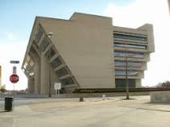
Important Buildings
City Hall – 1500 Marilla Street
Dallas County Records – 509 Main Street
Dallas Convention Center – 650 S. Griffin St.
Dallas Police Department – 1400 S. Lamar
Dallas Municipal Courts – 2014 Main Street
Frank Crowley Courts – 133 N. Riverfront Blvd
George Allen Courts – 600 Commerce Street
Lew Sterrett Jail – 111 West Commerce Street

Slide 48
Map of Downtown Dallas

Slide 49
Arts District Map

Slide 50
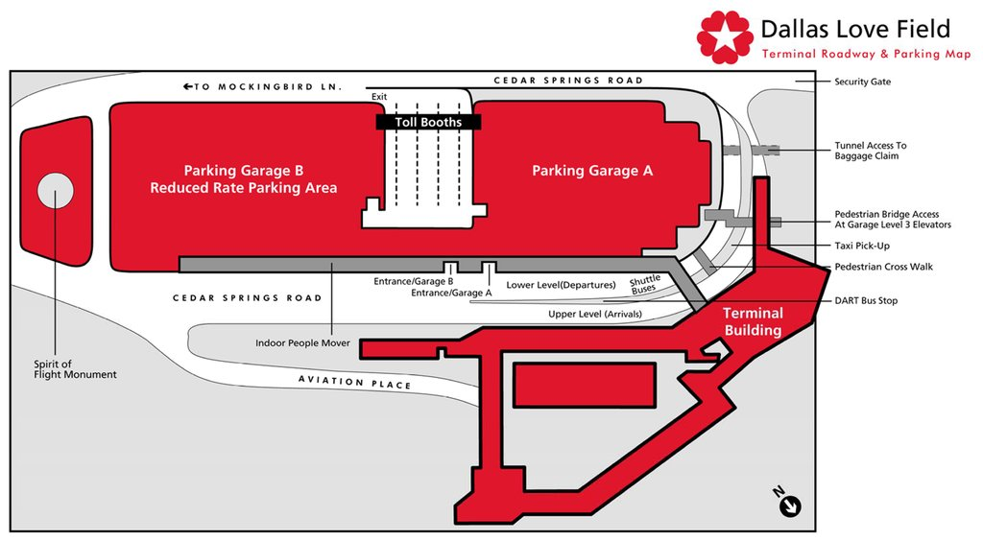
Dallas Love Field
8008 Cedar Springs Road, Dallas

Slide 51
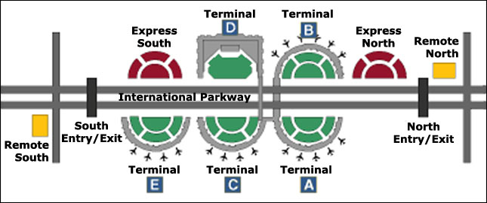
DFW Airport
3200 E. Airfield Drive, DFW Airport

Slide 52
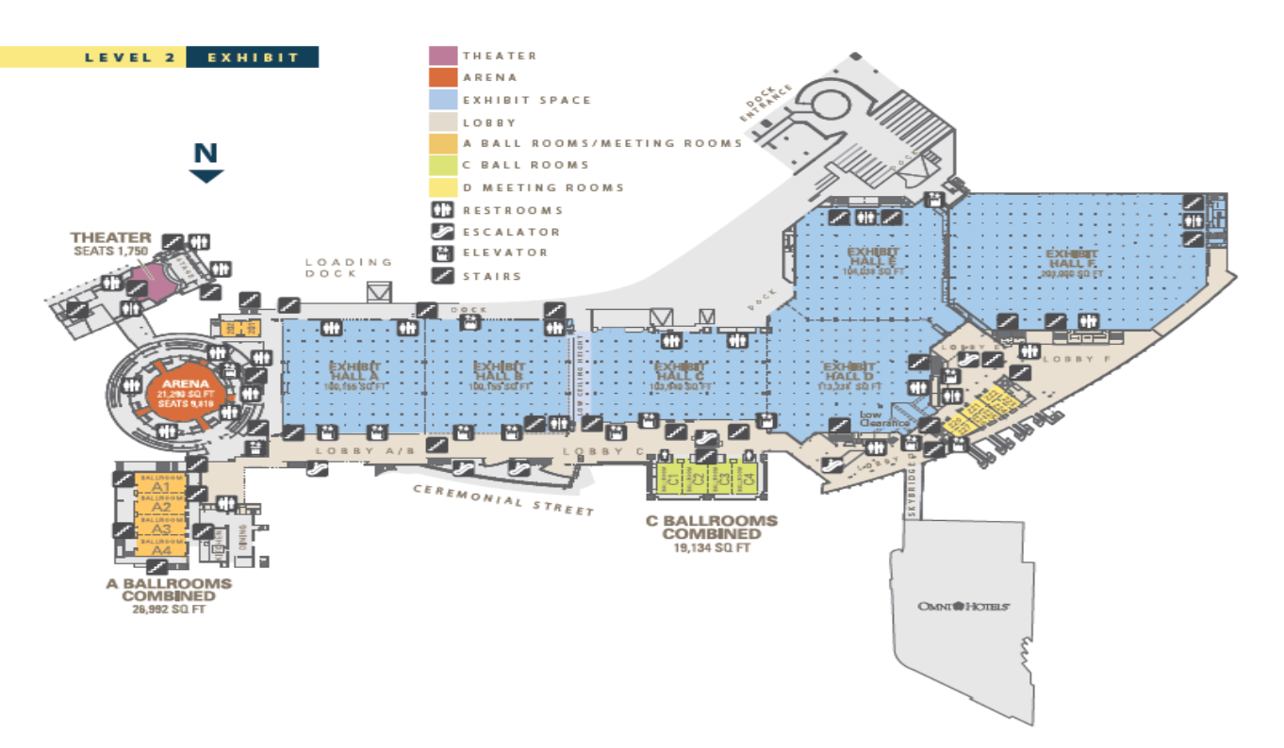
Convention Center – 650 S. Griffin

Slide 53

Major Dallas Hotels
Downtown/Uptown
  Adolphus Hotel – 1321 Commerce Street
  Aloft Dallas Downtown – 1033 Young Street
  Belmont Hotel – 901 Ft. Worth Avenue
  Crowne Plaza Dallas Downtown – 1015 Elm Street
  Dallas Convention Center Hotel – 1011 S. Akard Street
  Dallas Marriott City Center – 650 N. Pearl Street
  Fairmont Hotel Dallas – 1717 N. Akard Street
  Homewood Suites – 1025 Elm Street
  Hotel Indigo – 1933 Main Street
  Hotel Lawrence – 302 S. Houston Street

Slide 54
Major Dallas Hotels
Downtown/Uptown
  Hotel Zaza Dallas – 2332 Leonard Street
  Hyatt House Uptown – 2914 Harry Hines Blvd
  Hyatt Regency at Reunion – 30 Reunion Boulevard
  Joule Dallas – 1530 Main Street
  La Quinta Inn Uptown – 4440 N. Central Expressway
  Nylo Dallas South Side – 1325 S. Lamar Street
  Omni Dallas Hotel – 555 S. Lamar Street
  Sheraton Dallas – 400 N. Olive Street
  Springhill Suites West End – 1907 N. Lamar Street
  W Dallas Victory – 2440 Victory Park Lane

Slide 55
Major Dallas Hotels
Market Center/Love Field
  Candlewood Suites -7930 N. Stemmons Freeway
  Country Inn Love Field – 2383 Stemmons Trail
  Courtyard Marriott – 2150 Market Center Boulevard
  Crowne Plaza – 7050 Stemmons Freeway
  Doubletree Hotel – 2201 Market Center Boulevard
  Embassy Suites Love Field – 3880 W. Northwest Hwy
  Embassy Suites – 2727 N. Stemmons Freeway
  Fairfield Inn & Suites – 2110 Market Center Boulevard
  Hilton Anatole Hotel – 2201 Stemmons Freeway
  Hilton Garden Inn – 4500 Harry Hines Boulevard

Slide 56
Major Dallas Hotels
Market Center/Love Field
  Holiday Inn – 4500 Harry Hines Boulevard
  Holiday Inn Express – 1521 Inwood Road
  La Quinta Inn – 8300 W. Carpenter Frwy
  Marriott Suites – 2493 N. Stemmons Frwy
  Park Inn Radisson – 1241 W. Mockingbird Ln
  Ramada Dallas Love Field – 1575 Regal Row
  Renaissance Dallas Hotel – 2222 N. Stemmons Frwy
  Residence Inn – 6950 N. Stemmons Frwy
  Sheraton Suites Market Center – 2101 Stemmons Frwy

Slide 57

Performing Arts &
Entertainment
Anita N. Martinez Ballet – 4422 Live Oak Street
AT&T Performing Arts Center – 2403 Flora
Dallas Black Dance Theatre – 2700 Flora Street
Hard Rock Café – 2211 N. Houston Street
House of Blues – 200 N. Lamar Street
Medieval Times – 2021 Stemmons Freeway
Verizon Theatre – 1001 Performance Place, Grand Prairie

Slide 58

Dallas Parks & Activities
Dallas Arboretum – 8525 Garland Road
Dallas Farmers Market – 1010 S. Pearl Street
Dallas World Aquarium – 1801 N. Griffin
Dallas Zoo – 650 S. RL Thornton Frwy
Fair Park Dallas – 1300 Robert B. Cullum Blvd.
Klyde Warren Park – 2012 Woodall Rodgers Frwy
Reunion Tower – 300 Reunion Blvd East
Texas Discovery Gardens – 3601 MLK Jr. Blvd
Thanksgiving Square – 1627 Pacific Ave
Trinity Audubon Center – S. Great Trinity Forest Way

Slide 59

Shopping in Dallas
Galleria Dallas – 13350 Dallas Parkway
Neiman Marcus – 1618 Main Street
Northpark Center – 8687 N. Central Expressway
The Shops at Park Lane – 8080 Park Lane
Underground Tunnel & Skybridge - Downtown
West Village – 3699 McKinney Avenue

Slide 60

Hospitals in Dallas
Baylor Medical Center – 3501 Junius Street
Medical City – 7777 Forest Lane
Medical City Children’s – 7777 Forest Lane
Methodist Medical Center – 1441 N. Beckley Ave
Parkland Memorial – 5201 Harry Hines Blvd
St. Paul Hospital – 5909 Harry Hines Blvd
Texas Health Presbyterian – 8200 Walnut Hill Ln
UT Southwestern Medical – 5323 Harry Hines Blvd

Slide 61
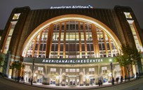
Sporting Venues
American Airlines Center – 2500 Victory Avenue
AT&T Stadium – 1 AT&T Way, Arlington
Globe Life Park – 100 Ballpark Way, Arlington
Lone Star Park – 1000 Lone Star, Grand Prairie
Mesquite Rodeo – 1818 Rodeo Drive, Mesquite

Slide 62

Dallas Museums
Museums
  African American Museum – 3836 Grand Ave
  Crow Collection of Asian Art – 2010 Flora
  Dallas Museum of Art -1717 N. Harwood Street
  George W. Bush Library – 2943 SMU Boulevard
  Perot Museum – 2201 N. Field Street
  Sixth Floor Museum - 411 Elm Street
  Texas Theatre – 231 Jefferson Boulevard

Slide 63

Essentials for
Successful Customer Service Delivery

Slide 64

Essentials for Successful
Customer Service Delivery
Dress for success – be clean and neat in appearance and well groomed
Make sure your vehicle is free of litter, odor and equipped with sightseeing guides or magazines, Kleenex and a waste disposal bag
Greet your customer with “good morning,” “good afternoon” or “good evening”
Repeat back to the customer what you heard their destination to be
If you don’t understand what the customer said, ask if they will repeat it

Slide 65
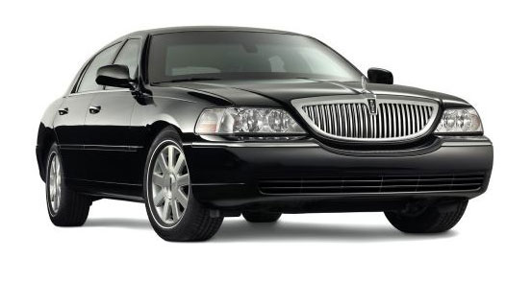
Essentials for Successful
Customer Service Delivery Continued
Ask the customer if they need to arrive by a certain time and tell them if you will be able to meet their deadline
If the customer asks questions try to answer, if you are unable to answer attempt to contact dispatch for the answer
Be courteous, considerate and conscientious at all times
Keep a sense of humor, it will take you a long way
Use common sense
If a customer is rude to you, ignore their rudeness and avoid arguing with them

Slide 66
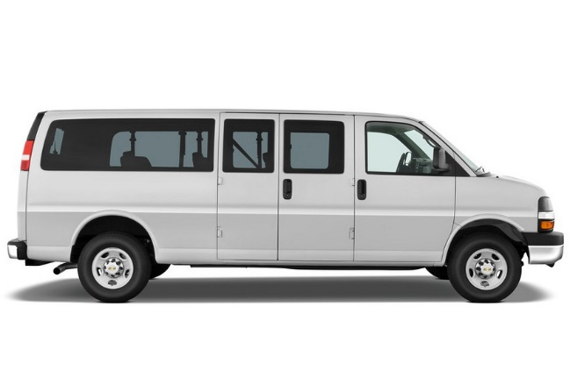
Essentials for Successful
Customer Service Delivery Continued
Maintain adequate amounts of change to minimize frustrations
Treat your customer the way you would like to be treated
Thank the customer at the end of the trip for allowing you to serve them
Professional behavior and friendliness bring about compliments not complaints
Smile you are successful! ☺

Slide 67
Summary
Know the rules – there aren’t that many of them
Follow the rules – it’s easy to do
Be safe, friendly, courteous drivers – and be proud to know that you are part of what makes Dallas such a great city to live, work, and visit!

