Slide 1
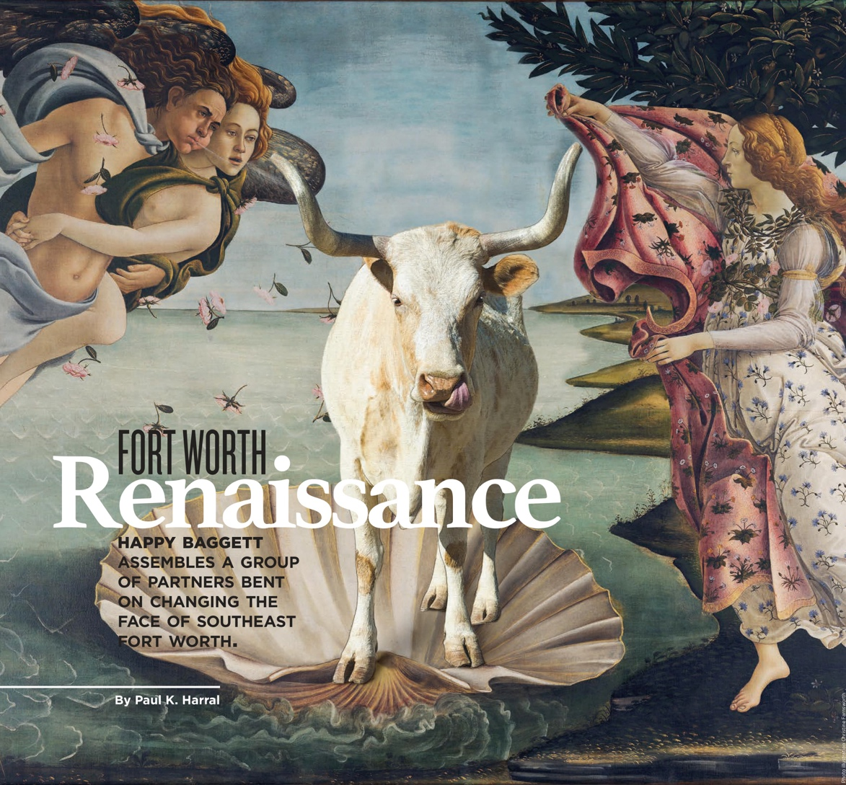

Slide 2
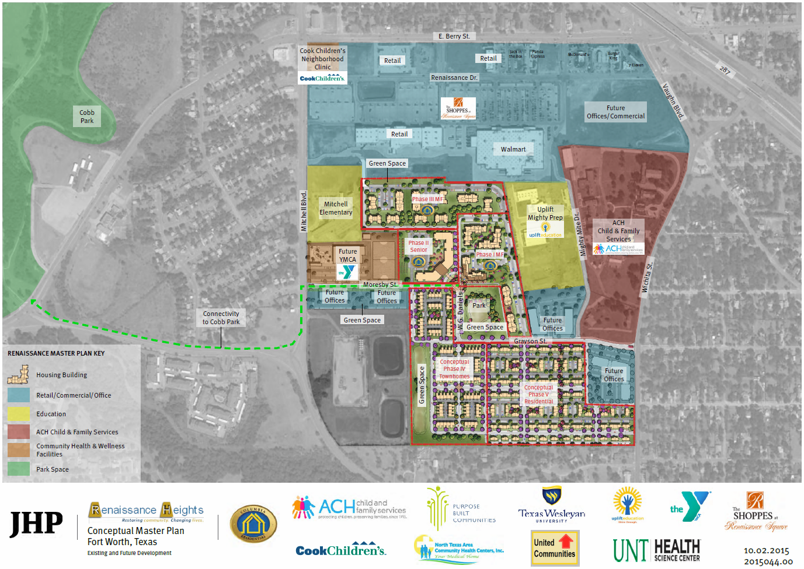
Renaissance Heights Master Plan
(with Phase 1 Site Plan)

Slide 3
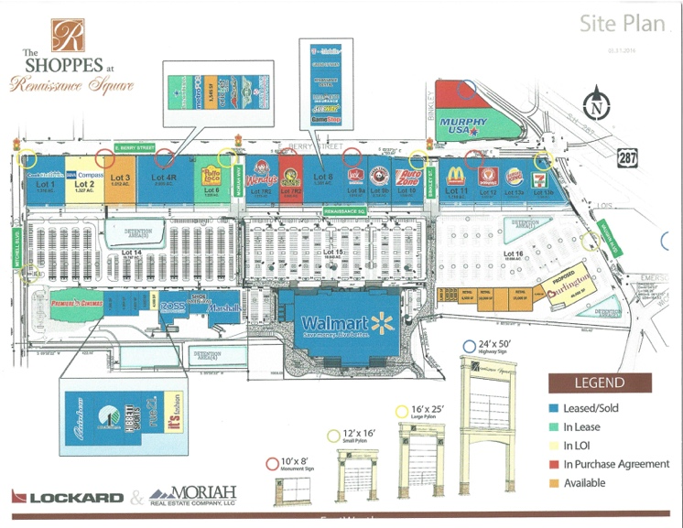
The Shoppes at
Renaissance Square

Slide 4
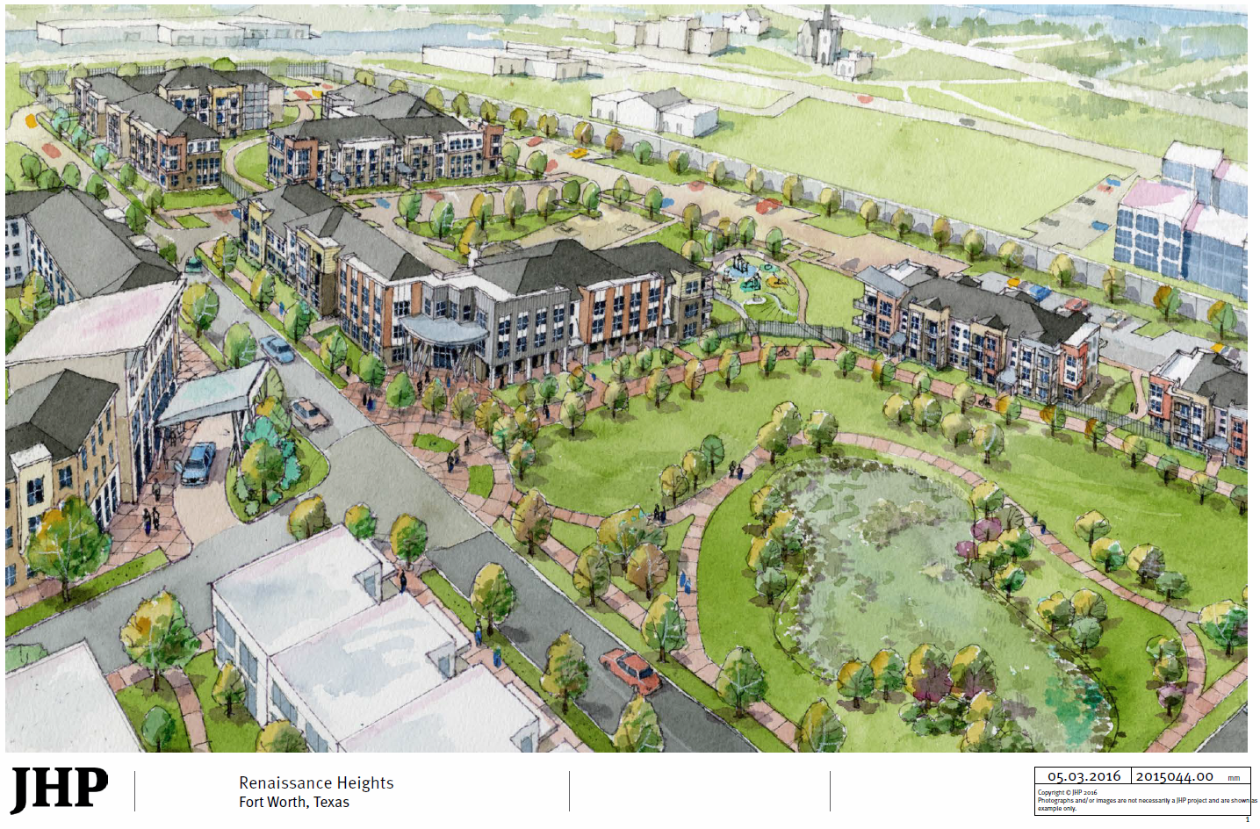
Renaissance Square
(with Phase 1 in red outline)

Slide 5
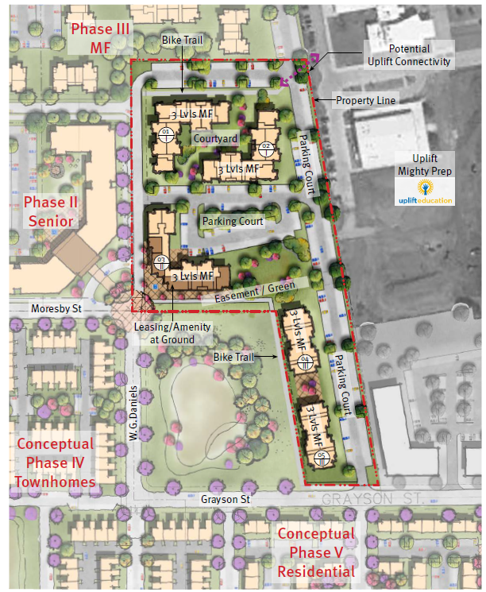
Phase 1 Site Plan (in context)

Slide 6
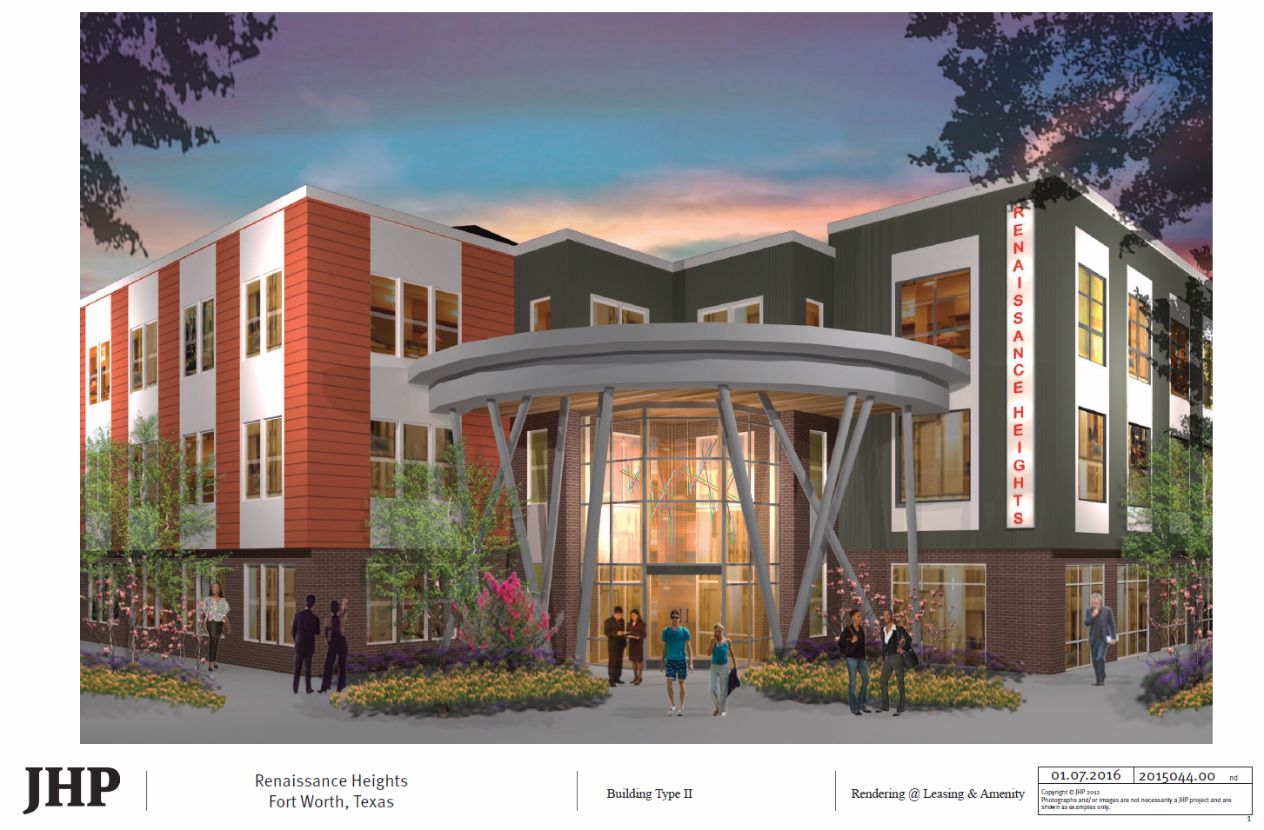
Renaissance Square Phase 1
Leasing Center and Apartments

Slide 7
