Slide 1
2021 Employee Benefits

Slide 2
Open Enrollment Overview
Open Enrollment for employees is October 19 – November 1, 2020.
Active Enrollment
You must ACTIVELY enroll in benefits in order to have coverage for the 2021 plan year!
If you do not enroll, your current benefit elections will end on December 31, 2020.
REMINDER: If you choose to waive coverage, do so through EBC. If you do not enroll or waive coverage through EBC, the City will assume you do not want coverage for 2021.
This is the only time during the year you can make changes to your coverage unless you experience a qualifying life event
Example: birth or adoption, marriage, divorce, etc.
Any changes to your benefit elections must be made within 31 days of the qualifying event.

Slide 3
How do I enroll?
Must enter exact address to access site.
Online: https://standard.benselect.com/cityofdallas
Log in with your user name: first name.last name and your 4 digit birth year.
(For example, if your name is John Smith and you were born in 1966, your USER NAME would be john.smith1966)
Your PIN is 6 digits, composed of the last 4 digits of your Social Security Number and the last two digits of your birth year.
(For example, If the last 4 digits of your SSN are 1234 and you were born in 1966, your PIN would be 123466). You will be asked to change your PIN, after you log in for the first time. Be sure to make note of your new password for future use
If you have logged in previously, you will use the credentials you created.
Having trouble accessing the system, contact EBC at 855-855-2871.
By Phone with a Benefit Specialist
Call (855) 855-2871 Monday-Friday, 8:15 a.m. – 5:15 p.m.
Benefit Specialists will be available starting October 19th

Slide 4
What do I need to enroll?
Supporting documentation required
If you add an eligible dependent who is not currently enrolled, you must provide supporting documentation (marriage license, birth certificate, etc.)
Upload it from your computer during the online enrollment process (follow the on-screen instructions)
Send it from your Smartphone with the My Selerix app
Email it to: yourenrollment@ebcoh.com
Fax it to: (513) 371-5559
Questions about or assistance with enrollment?
Call (855) 855-2871 Monday-Friday, 8:15 a.m. – 5:15 p.m.
Benefit Specialists will be available starting October 19th

Slide 5
Medical Benefits – Blue Cross Blue Shield of Texas (BCBSTX)

Slide 6
Why Blue Cross Blue Shield of Texas?
BCBS of Texas Offers the City of Dallas
Greater network options
- Blue Essentials Network – “New PCP Plan”
- Blue Choice Network – Copay Plan and HSA Plan
Increased provider access
Enhanced wellness & clinical resources

Slide 7
Blue Essentials PCP Plan – Narrow Network
Plan Highlights: Texas only residents
Copays for multiple services
PCP must be selected to access benefits
Referral needed for specialty care
* For these services to be covered under your office visit copay, the lab or X-ray must be performed in and billed by your physician’s office.

Slide 8
Blue Choice Copay Plan – Broad Network
Plan Highlights:
Copays for multiple services
Enhanced network option
* For these services to be covered under your office visit copay, the lab or X-ray must be performed in and billed by your physician’s office.

Slide 9
Blue Choice HSA Plan – Broad Network
Plan Highlights:
You can open a health savings account (HSA).
2021 City of Dallas HSA contribution!
Individual: $700
Family: $1,700
You pay all costs for care until your deductible is met.

Slide 10
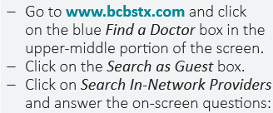
NETWORK OPTIONS
Network | Blue Choice | Blue Essentials
Medical Plan | Copay & HSA Plan | PCP Plan
Network Description | Blue Choice provides a broad network of providers and covers 80% of your eligible expenses after you have met the deductible. Out-of-network services are not covered. | Blue Essentials is a targeted, narrow network, with an emphasis on the most high-quality and cost-effective physicians. Out-of-network services are not covered.
Blue Choice Copay and HSA plans include the enhanced benefit tier option
Enhanced benefit tier - plan pays 90% of your facility charges at Baylor or Methodist Health Systems (after deductible)
BE SURE TO CONFIRM IF YOUR DOCTOR IS IN-NETWORK.

Slide 11
Pre-65 Retiree Contributions
Monthly Rates
Blue Essentials PCP
Tier | Retiree | Retiree Hired after 1/1/2010
Employee Only | $636.18 | $1,156.69
Employee + Spouse | $1,672.68 | $2,538.69
Employee + Children | $1,110.77 | $1,789.48
Employee + Family | $2,070.73 | $3,094.94
Spouse Only | $412.87 | $1,382.00
Spouse + Children | $1,938.24 | $1,938.24
Blue Choice Copay Plan
Tier | Retiree | Retiree Hired after 1/1/2010
Employee Only | $613.25 | $1,115.00
Employee + Spouse | $1,553.75 | $2,369.00
Employee + Children | $1,070.00 | $1,724.00
Employee + Family | $1,888.50 | $2,856.00
Spouse Only | $383.50 | $1,254.00
Spouse + Children | $1,741.00 | $1,741.00

Slide 12
Pre-65 Retiree Contributions
Monthly Rates
Blue Choice HSA Plan
Tier | Retiree | Retiree Hired after 1/1/2010
Employee Only | $601.15 | $1,093.00
Employee + Spouse | $1,524.40 | $2,324.00
Employee + Children | $1,048.90 | $1,690.00
Employee + Family | $1,852.15 | $2,801.00
Spouse Only | $377.00 | $1,231.00
Spouse + Children | $1,708.00 | $1,708.00

Slide 13
Pharmacy – Prime Therapeutics
30 Day Retail | Blue Essentials PCP Plan | Blue Choice Copay Plan | Blue Choice HSA Plan
Generic Medications | $15 copay | $15 copay | You pay 20% after medical deductible is met
Preferred Brand-Name Medications | $40 copay | $40 copay | You pay 20% after medical deductible is met
Non-Preferred Brand-Name Medications (Includes Specialty Drug Formulary) | $75 copay | $75 copay | You pay 20% after medical deductible is met
Additional Pharmacy Benefits
Free diabetes and hypertension medications for certain drug classes
Available to Blue Essentials PCP and Blue Choice Copay plan members
Preventive Therapy Drug List (PTDL) offers reduced cost for certain generic preventive medications
Available to Blue Choice HSA plan members
Mail order also available!

Slide 14
Pre-Tax Savings Account

Slide 15
Health Savings Account – HSA Bank HDHP Participants Only
To be Eligible for a City of Dallas Health Savings Account:
You must participate in the Blue Choice HSA plan which is an IRS-qualifying high deductible health plan (“HDHP”).
You cannot be entitled to benefits under Medicare or “double-covered” under any other medical plan.
You or your spouse cannot be enrolled in a Medical Spending FSA.
You cannot be claimed as a dependent on another person's tax return.
*FUNDS ARE FULLY VESTED. PENALTIES APPLY IF USED FOR NON-QUALIFIED EXPENSES

Slide 16
Dental Benefits – Delta Dental Vision Benefits – Davis Vision

Slide 17
Dental – Delta Dental
Plan Highlights:
DPPO
If you use an out-of-network dentist, you are responsible for 100% of the amount the dentist charges that exceeds Delta Dental’s network-negotiated fee.
DHMO
You MUST select a primary dental office to begin using your benefits.
LOCATE A PROVIDER AT:
https://www1.deltadentalins.com/individuals/find-a-dentist.html

Slide 18
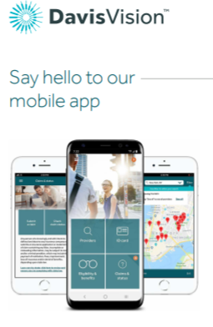
Vision – Davis Vision
Plan Feature | High Plan 2-Pair Benefit | Low Plan iDEALChoice
Benefits | 2 pairs mix or match | Glasses or Contacts
Eye Exam | Retinal Imaging | $10 copay | $39 copay | $10 copay | $39 copay
Frame Allowance OR Davis Vision Collection Frames | $150 allowance plus 20% off balance OR covered-in-full frames at Visionworks locations | $140 allowance plus 20% off balance OR covered-in-full frames at Visionworks locations
Lens Benefit
Single Vision | Covered in full after $10 copay | Covered in full after $20 copay
Bifocal | Covered in full after $10 copay | Covered in full after $20 copay
Trifocal | Lenticular | Covered in full after $10 copay | Covered in full after $20 copay
Contact Allowance
Davis Vision Collection | $10 copay, then covered in full up to 8 boxes | $20 copay, then covered in full up to 4 boxes
Retail | $130 allowance plus 15% off balance | $130 allowance plus 15% off balance
Frequency Guidelines
Exams | Once every January 1 | Once every January 1
Frames | Once every January 1 | Once every other January 1
Contacts or Lenses | Once every January 1 | Once every January 1
Plan Highlights:
FREE frames at all Visionworks stores (excludes Maui Jim)
Enhanced High Plan benefits
In-Network Benefits online at Glasses.com, 1-800-Contacts, and Befitting
Go to www.davisvision.com to find providers in your network (use client code 7955 for the High Plan or 9573 for the Low Plan).

Slide 19
Dental and Vision Rates
Monthly Rates

Slide 20
Value Added Benefits at No Cost to You!

Slide 21
BCBS Discount Programs
Blue365 offers premier health and wellness discounts and is free to join for medical plan members. Members have access to discount programs in:
Apparel & Footwear
Fitness
Hearing & Vision
Home & Family
Nutrition
Personal Care
How to access? Visit:
https://www.blue365deals.com/BCBSTX/

Slide 22
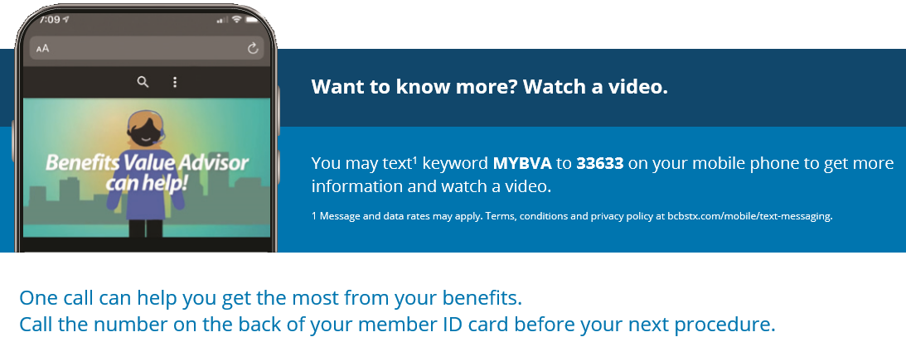
Benefit Value Advisor
BVAs can help you save money on health procedures and tests. They can also help you understand and use your benefits more wisely.
BVAs can help you:
Navigate and maximize your benefits
Get cost estimates for various providers and procedures • Schedule appointments
Find a doctor or facility
Set up preauthorization

Slide 23
BCBS Member Rewards Program
Administered by Sapphire Digital - offers cash rewards when a lower-cost, quality provider is selected from several options.
How does it work?
When a doctor recommends treatment, call your Benefit Value Advisor (BVA) at the number on the back of your member ID card, or log into Blue Access for MembersSM at bcbstx.com and click the Doctors and Hospitals tab – then on Find a Doctor or Hospital
Choose a Member Rewards eligible location, and you may earn a cash reward
Complete your procedure and, once verified, you will receive a check within 4 to 6 weeks Questions? Call the number on the back of your member ID card.
Additional program details coming in 2021!

Slide 24
CareATC Clinics – Closed until City Hall Re-opens
City Hall Onsite Clinic
Blue Essentials PCP and Blue Choice Copay plan members
Free office visits (sick and preventive), onsite-dispensed medications, and onsite lab work
Blue Choice HSA plan members
Free preventive office visits
$25 fee for sick visits, onsite-dispensed medications, and onsite lab work
Fee reduced to $5 – once deductible satisfied
Fee reduced to $0 – once the out-of-pocket maximum satisfied
SERVICE | EXAMPLE
Acute Care (Treatment of common illnesses and minor injuries) | Flu Sinus infections, Sprains
Chronic Disease Evaluation, Monitoring and Care Management | Hypertension Diabetes Asthma
Minor Procedures and Wound Care | Simple biopsies Skin tag/mole removal
Preventive Care and Comprehensive Physical Exams | Age appropriate physicals Routine gynecological exams prostate exams kids sports/camp physicals,
Diagnostic Testing and Screenings | On-site lab work EKGs
To make an appointment, call 1-800-993-8244, visit www.careatc.com, or use the CareATC mobile app.

Slide 25
Kannact Diabetes & Cardiovascular Management
You receive:
Free glucometer and testing supplies delivered to your doorstep
Option for a traditional glucometer or a smartphone-based glucometer
Free blood pressure cuff monitor
Both Programs Include
Dedicated, certified diabetes and/or cardiovascular coach to help you self-manage your condition
Customizable mobile app
Personalized action plan and personalized support based on your lifestyle
Talk to a Kannact representative today or sign up at:
www.Kannact.com/cityofdallas

Slide 26
Questions?
Enrollment Reminders:
Online: https://standard.benselect.com/cityofdallas
By Phone with a Benefit Specialist: (855) 855-2871
Benefit Specialists will be available starting October 19th
General benefits questions
Call the City Hall Benefits Service Center at (214) 671-4181 or (214) 671-9875, e-mail hrbenefits@dallascityhall.com
Monday-Friday, 8:15 a.m.- 5:15 p.m.
Must enter exact address to access site.
Open Enrollment Dates:
October 19th – November 1st

