Slide 2
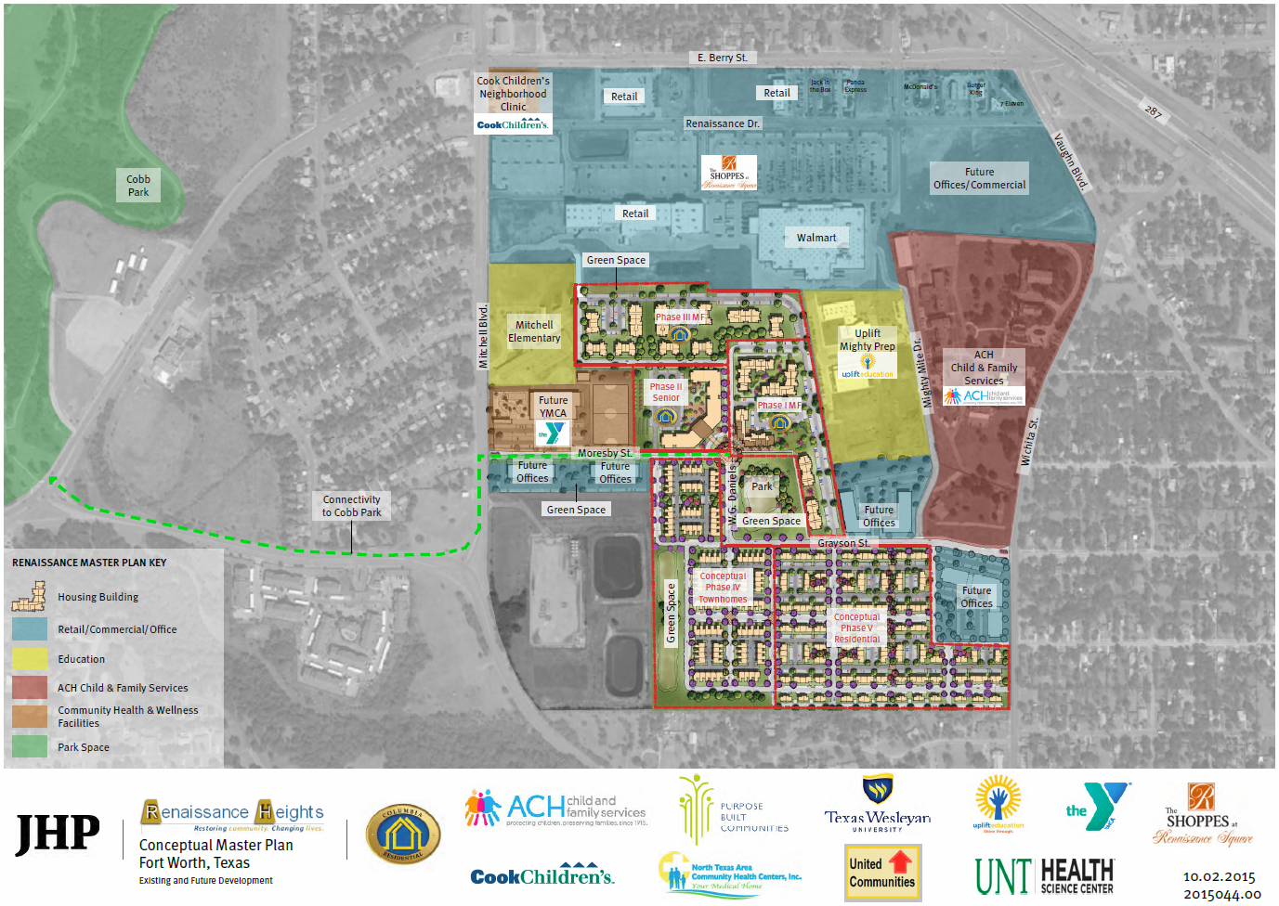
Renaissance Heights Master Plan (with Phase 1 Site Plan)

Slide 3
The Shoppes at
Renaissance Square

Slide 4
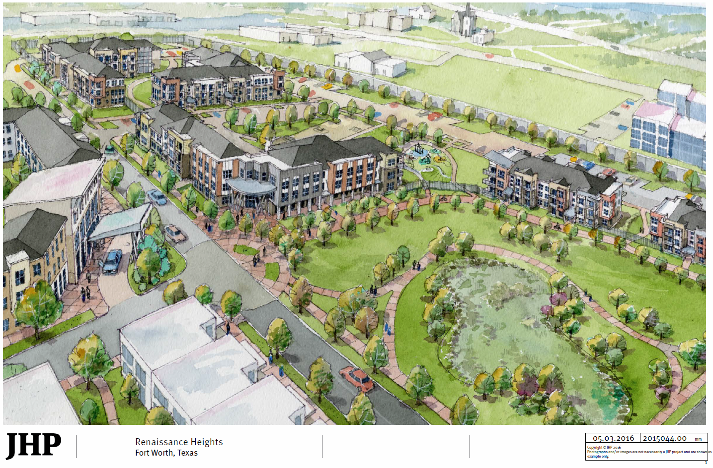
Renaissance Square (with Phase 1 in red outline)

Slide 5
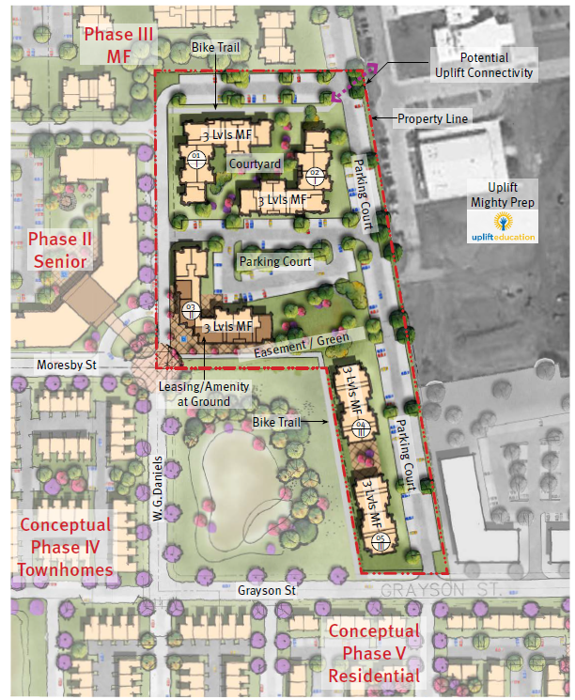
Phase 1 Site Plan (in context)

Slide 6
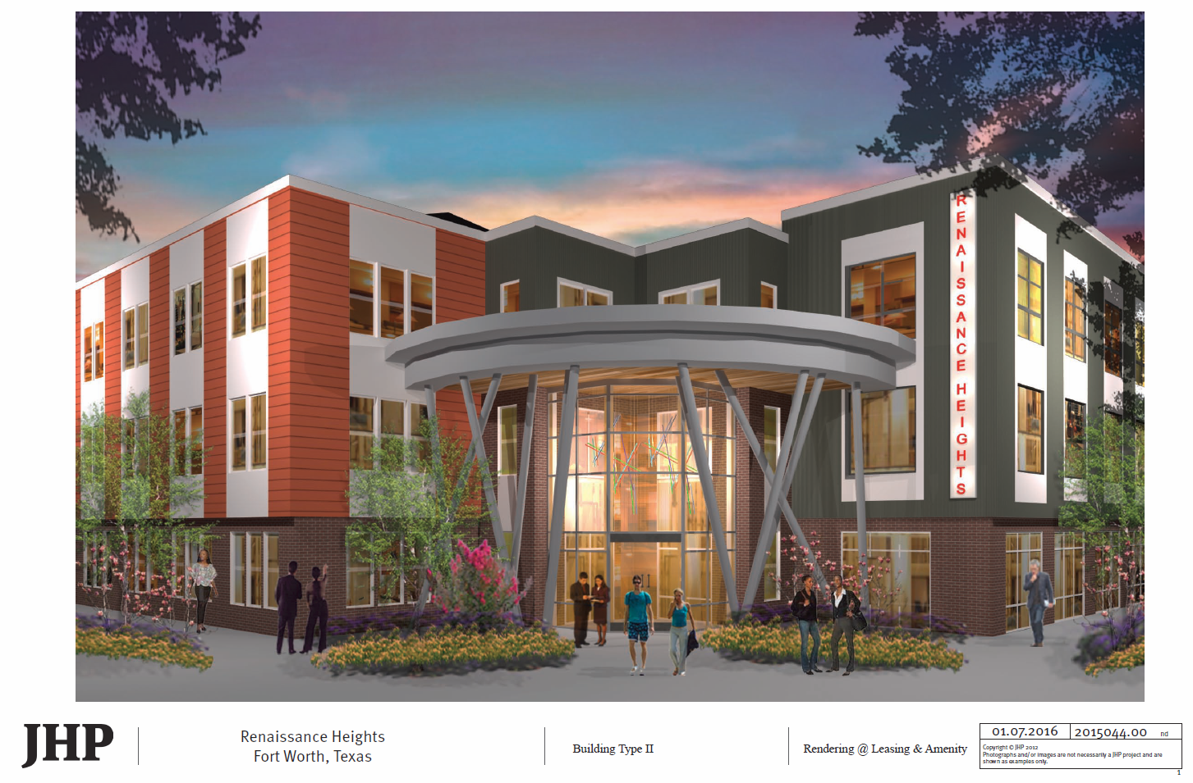
Renaissance Square Phase 1 Leasing Center and Apartments

Slide 7
