Slide 1
Summit Parque Apartments Dallas, TX http://www.summitparque.com Opened in Fall 2015
Photo Presentation for
North Texas Regional Fair Housing Symposium
May 12, 2016, Arlington Convention Center
Megan Lasch, Project Manager, Saigebrook /Pinroc

Slide 2
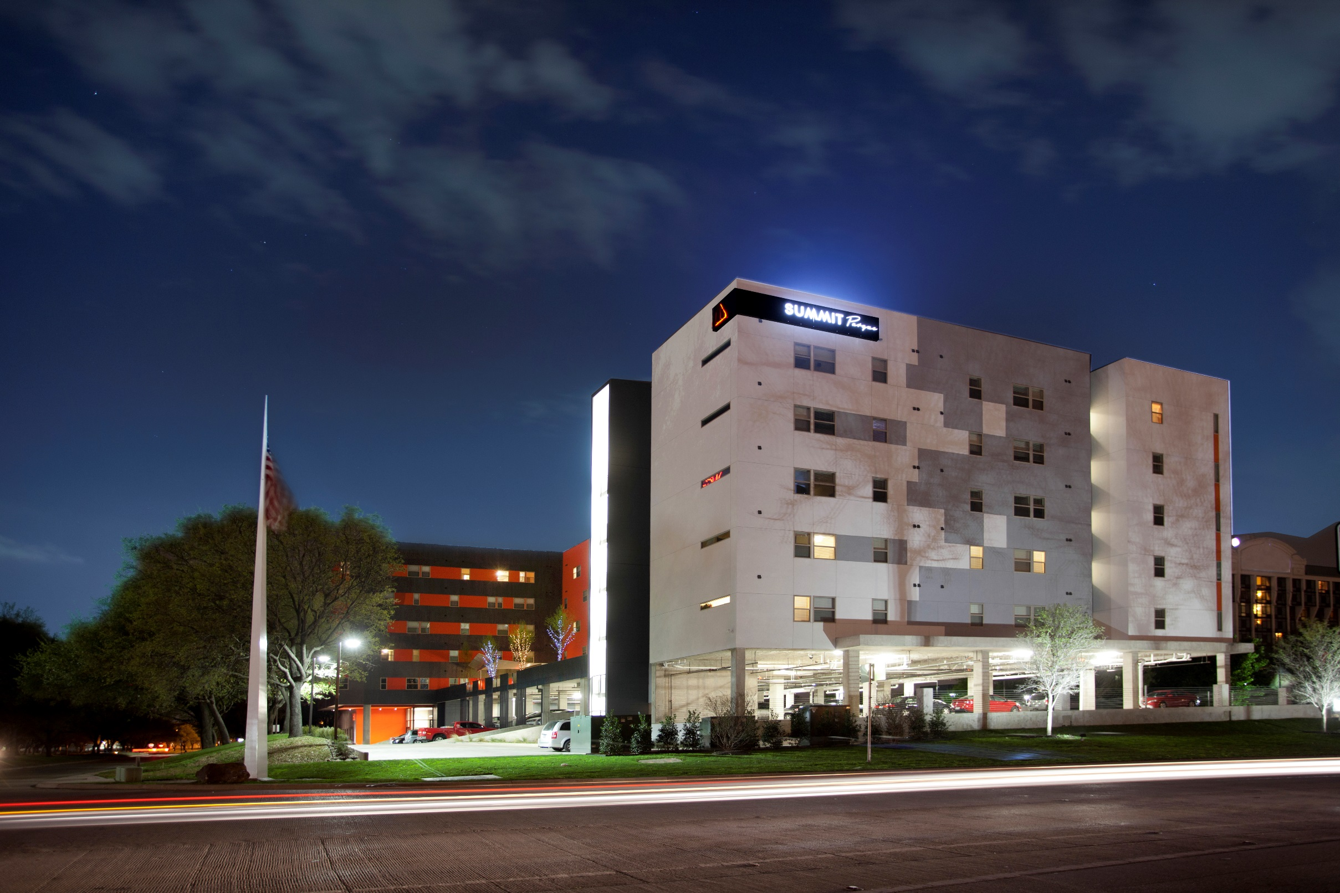

Slide 5
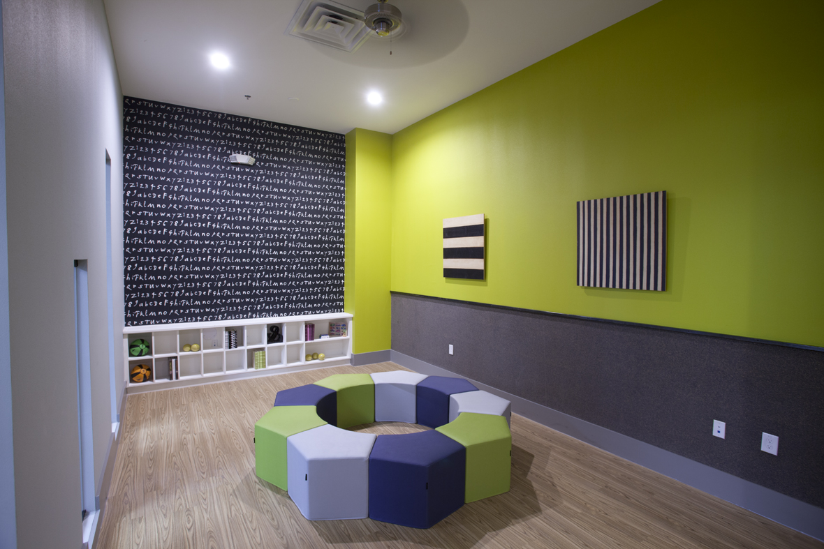

Slide 6
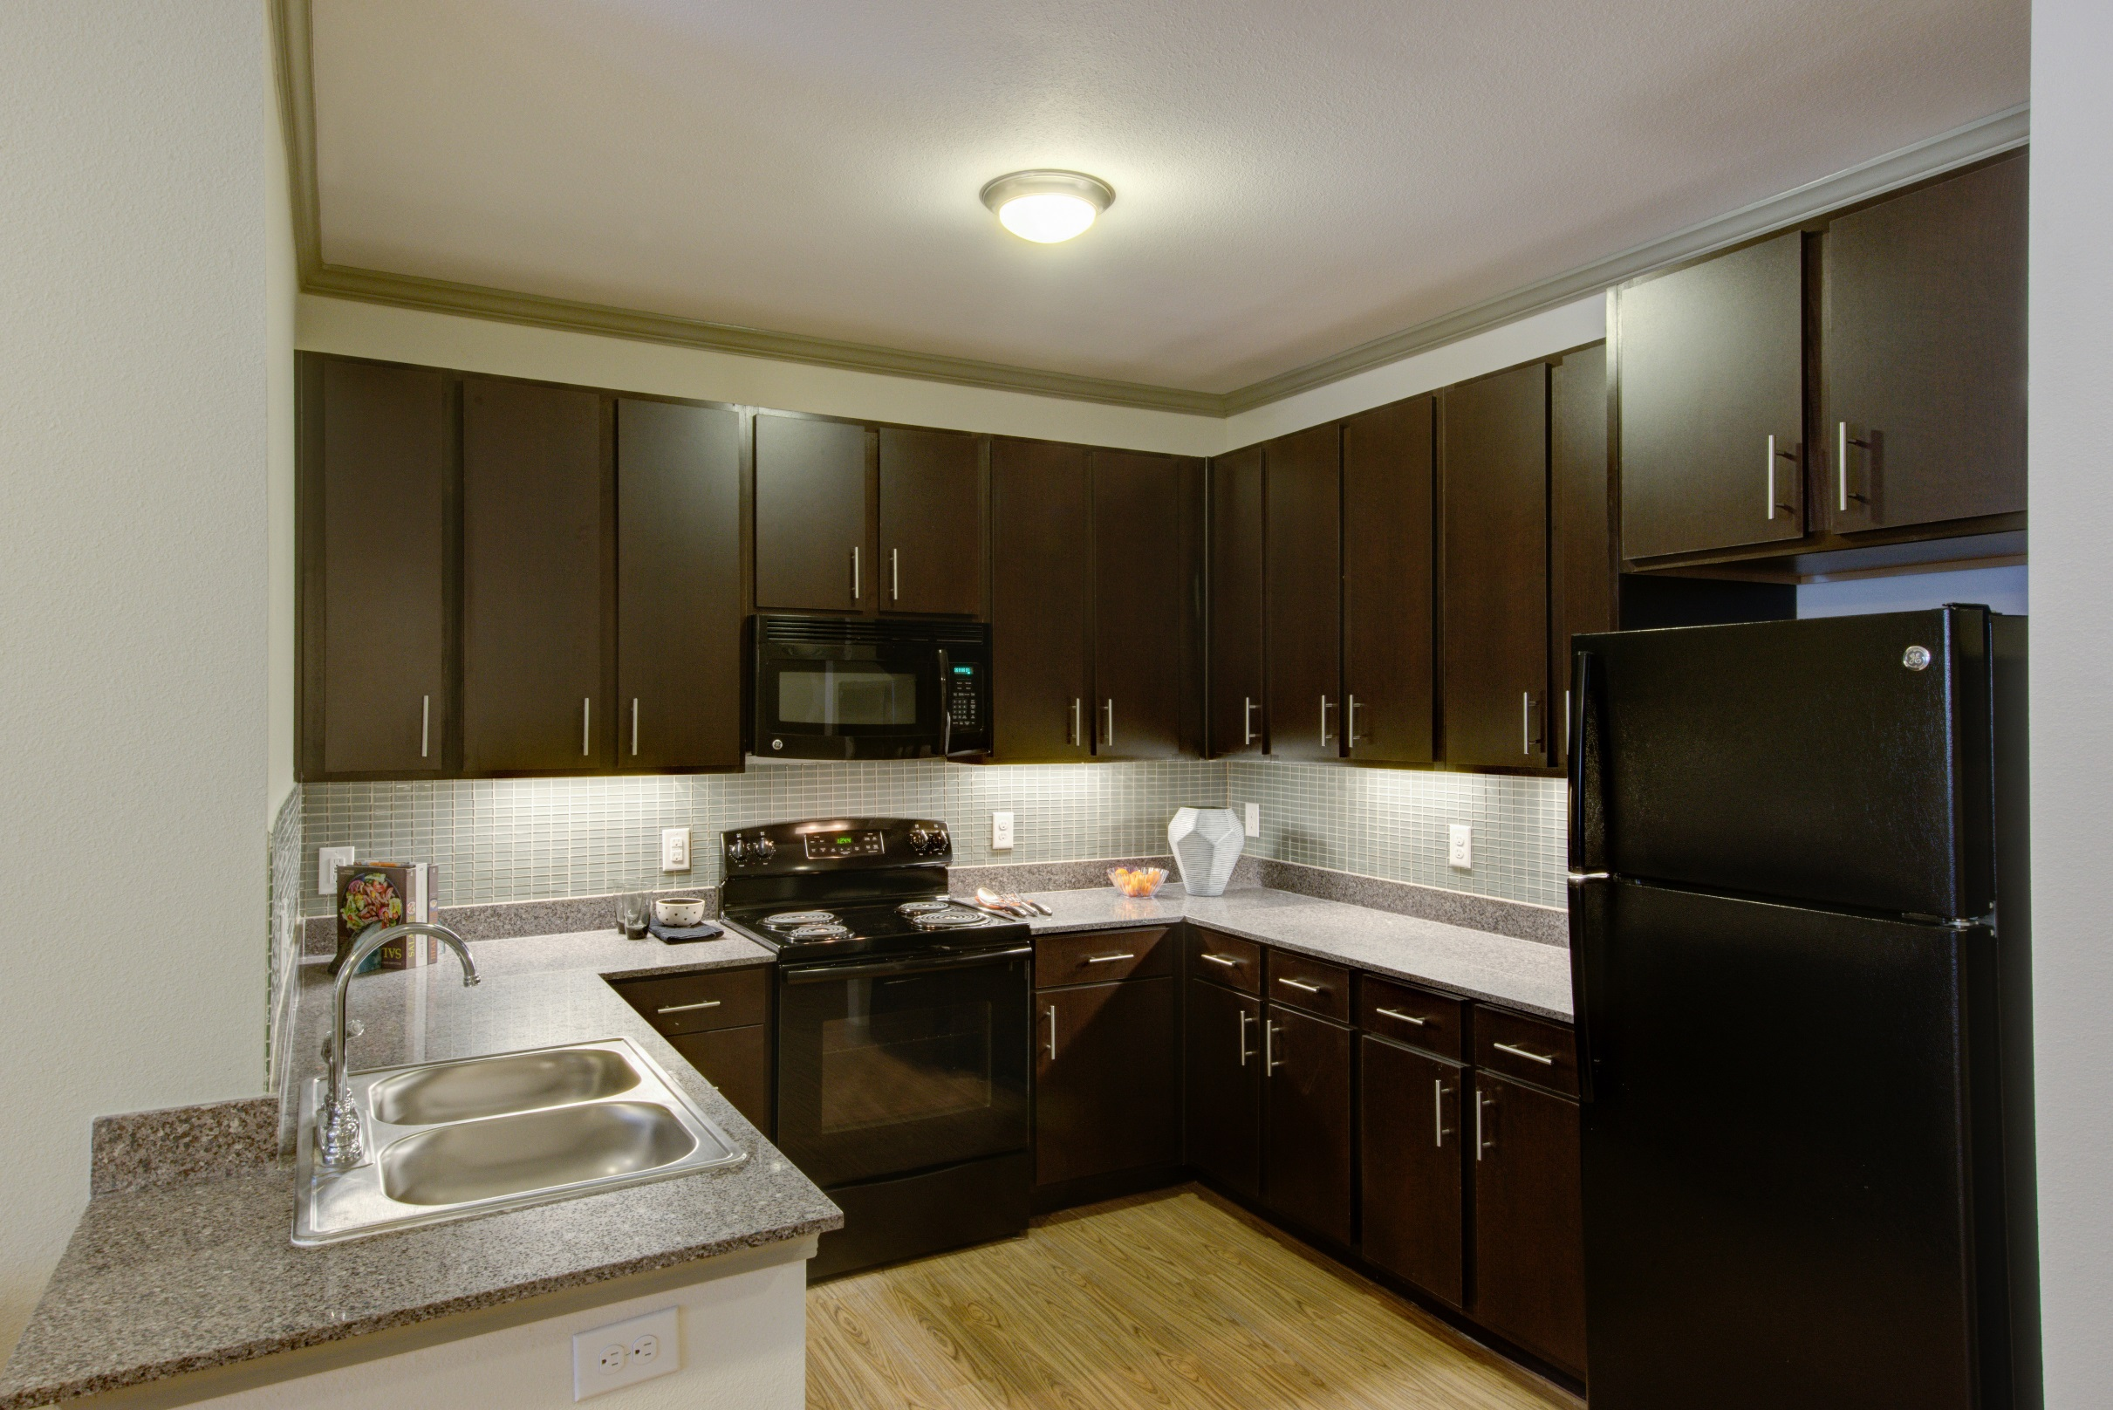

Slide 7
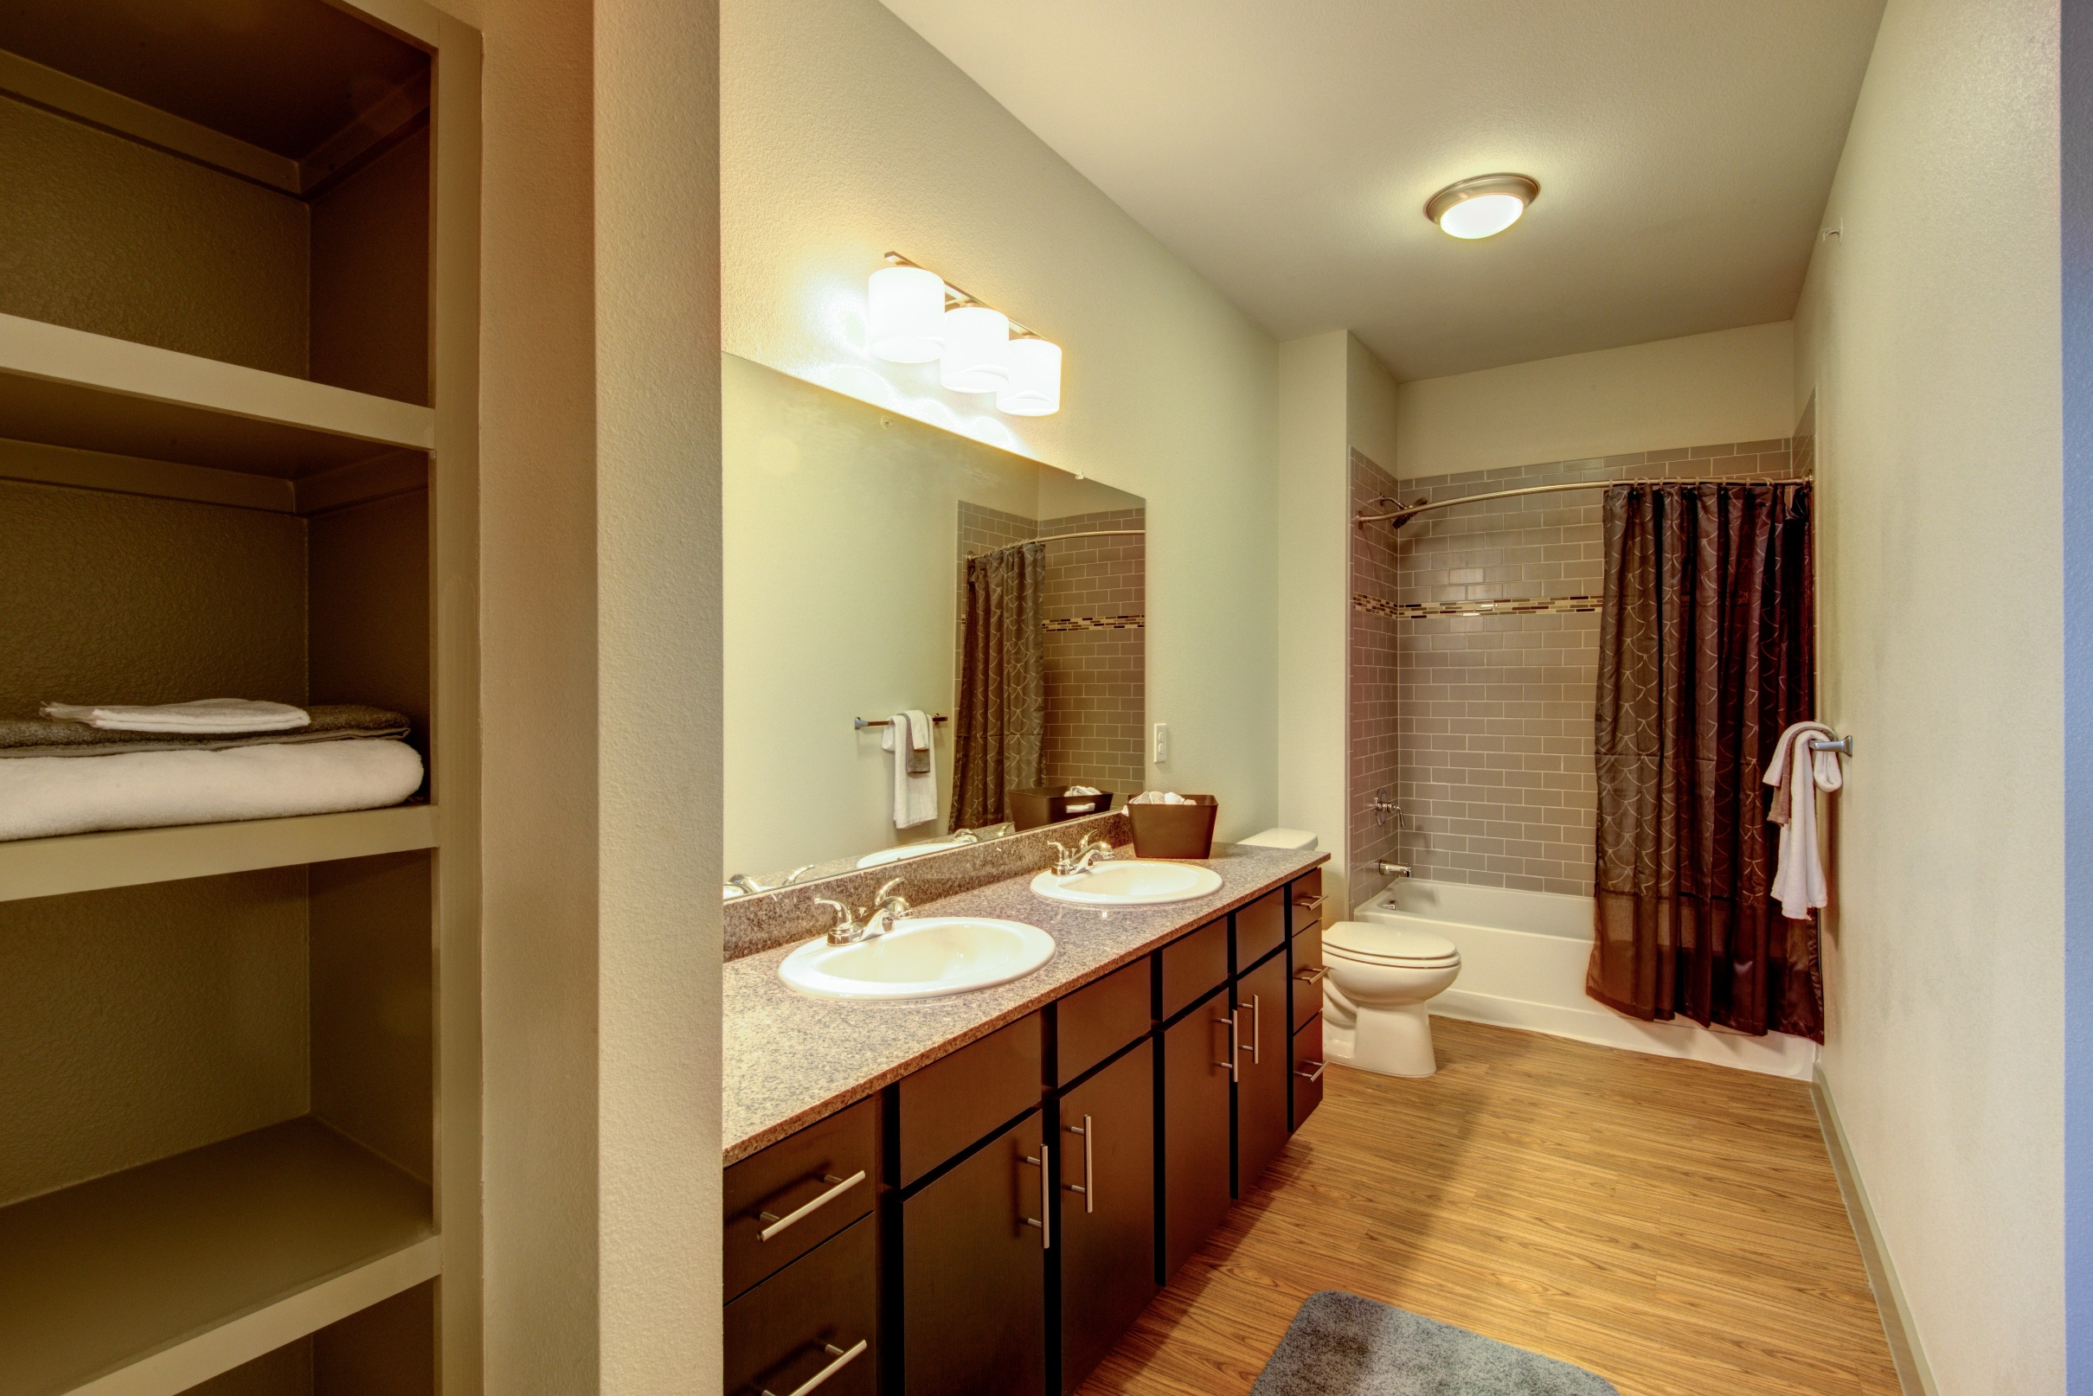

Slide 8
