Slide 1
HAZMAT
Advancement Module 03
Dallas CERT

Slide 2
Materials for this unit:
You should have a copy of the Emergency Response Guidebook, either in print or online, plus - paper and a pen or pencil
The current electronic copy is available at:
https://www.phmsa.dot.gov/hazmat/library/erg

Slide 3
HAZMAT Overview
CERT safety protocol for hazmat
Reading Placards
Using the Emergency Response Guide (ERG)
Response within CERT abilities

Slide 4
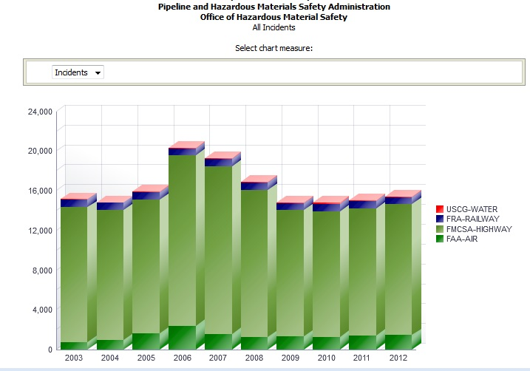
HAZMAT Stats
Notes:
Note that airlines have more incidents than railways, but also think which type of carrier is transporting larger cargo units

Slide 5
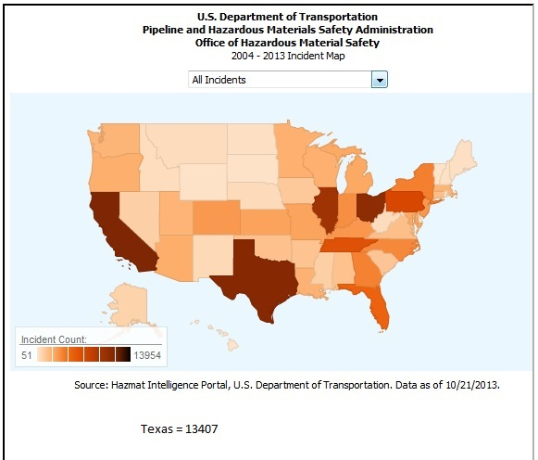
HAZMAT Texas

Slide 6
HAZMAT CERT Protocol
CERT team members must protect themselves and others, doing the greatest good for the greatest number
CERT training is not sufficient to:
  deal directly with a hazardous substance, or
  rescue people affected by the substance
MOVE AWAY and keep others safe
Notes:
First question – is this a Hazmat situation or a terrorism incident?
Next question – is the situation the result of a crime?

Slide 7
HAZMAT CERT Tasks
OBSERVE – size up the incident
  Location, wind direction, people affected
  Substance involved
REPORT
EVACUATE & SET UP A PERIMETER
DECONTAMINATION – consult ERG, use tepid/cold water, blot dry
TRIAGE – any injuries
Notes:
From the “Homeland Security Field Guide” showing potential actions (some are optional):
FIRST-IN UNIT CHECKLIST
Recognize event as potential terrorism incident
Estimate hazard zone and evaluate personal safety
Notify dispatch of potential terrorist incident
Establish Incident Command System (as appropriate)
Establish/activate personnel accountability system
Request additional assistance and resources
Isolate the scene and deny entry
Perform rescue and triage as safety permits
Scan for secondary devices
Protect crime scene and evidence
Videotape scene and operations
Further, the Checklist expands:
Make a safe approach
Approach from upwind, uphill, and upstream
Do not drive through spills or clouds
Maintain a safe distance
Position vehicles headed away from the incident for a quick departure
Maintain situational awareness
Give an On-Scene report
Look for physical indicators:
Debris field
Casualties
Dead animals and vegetation
Unusual odors, color of smoke, vapor clouds
Interview victims
Identify type of event
Check weather conditions and forecast

Slide 8
HAZMAT CERT Tasks
While CERT members should not get close to a hazmat incident, that does not mean they should abandon victims.
  Verbal support may be possible until professional responders arrive
  Victims may be talked into moving to a decontamination area
  The ERG also has suggested first aid cautions for each substance

Slide 9
TERRORISM?
If you recognize event as potential terrorism incident
  Notify OEM or 911 of potential terrorist incident
  Isolate the scene and deny entry
  Scan for secondary devices
  Do not drive through spills or clouds
  Position vehicles headed away from the incident for a quick departure
  Look for physical indicators:
    Debris field
    Casualties
    Dead animals and vegetation
    Unusual odors, color of smoke, vapor clouds
  Protect crime scene and evidence

Slide 10
HAZMAT Gear Up
CERT Team should wear full Personal Protective Equipment (PPE) to protect against accidental minor exposure, provide very limited protection, and keep out particulates & smoke
  Nitrile & work gloves
  Helmet
  Goggles
  Work boots or Galoshes (if available)
Notes:
PPE will at least mitigate harmful effects

Slide 11
HAZMAT CERT Tasks
CAUTION
  In any HAZMAT situation involving explosives or terrorist potential DO NOT use radios or cell phones within the evacuation zone and preferrably within at least a half mile
  These electronic devices may :
    Cause an static charge to build
    Activate a radio frequency trigger device

Slide 12
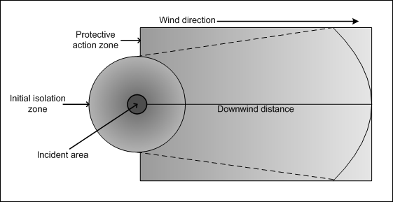
HAZMAT Time, Distance, Shielding
Observe ERG evacuation distances

Slide 13
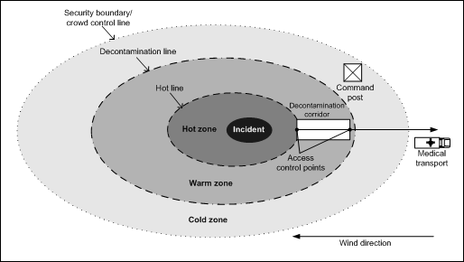
HAZMAT Time, Distance, Shielding
Evacuate upwind, uphill, upstream
Contamination
Reduction
zone
Support
zone
Public exclusion zone
Perimeter
Notes:
The “hot zone” is the area where there is heavy contamination or danger
The “warm zone” is the area where decontamination takes place – victims and rescuers shed any clothing or equipment before moving to the cold zone
The “cold zone” is free of contamination and the risk of contamination; it is inside the perimeter where responders can work without interference
The “public zone” is outside the controlled perimeter and where vehicles are parked

Slide 14
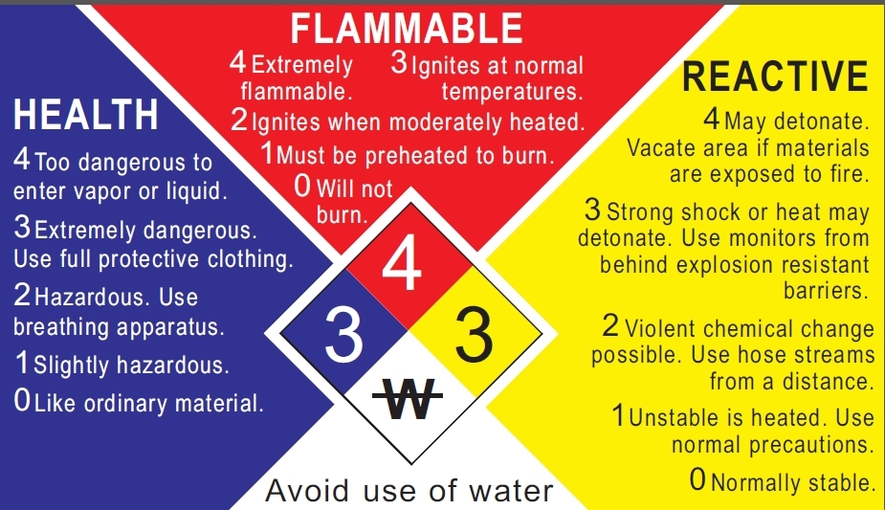
NFPA 704* Response Guide Numbers
* NFPA = National Fire Protection Association
Notes:
An NFPA diamond provides a quick notion of how to respond to a given material and provides a starting point before more detailed information is known

Slide 15
HAZMAT Time, Distance, Shielding
Note that in the ERG, some of the explosive substance Guides say:
“Move people out of the line of sight of the scene and away from windows”
Does that translate into “TAKE COVER” for you?

Slide 16
ERG 2012 Size Up
Table of Placards
  Find the early pages of the ERG that depict the different placards used in the transport of dangerous goods. Should the placard on a vehicle be damaged, the general appearance gives a clue about the goods.
  Each group of placards is associated to a 3-digit guide number (ORANGE Section).
  Caution: The recommended guides should be considered as a last resort if the material cannot be identified by any other means.

Slide 17
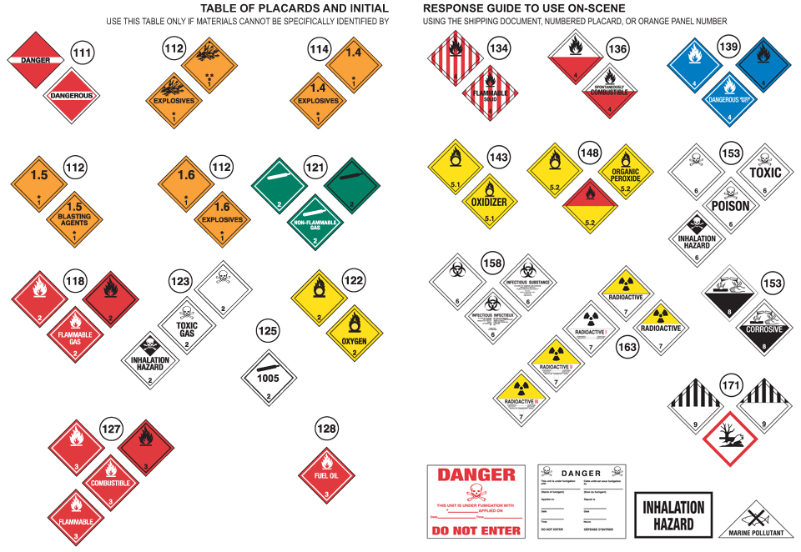
Notes:
Pictograms on the placards provide immediate clues about the substance in the container

Slide 18
ERG 2012 Size Up
Rail Car and Road Trailer ID Charts
  Find the pages that depict the general shapes of railcars and road trailers used in the transportation of dangerous goods. Their shape is another clue.
  Each shape is associated to a 3-digit guide number in the ORANGE Section (Table 1 is the GREEN section)
  Caution: The recommended guides should be considered as a last resort if the material cannot be identified by any other means.

Slide 19
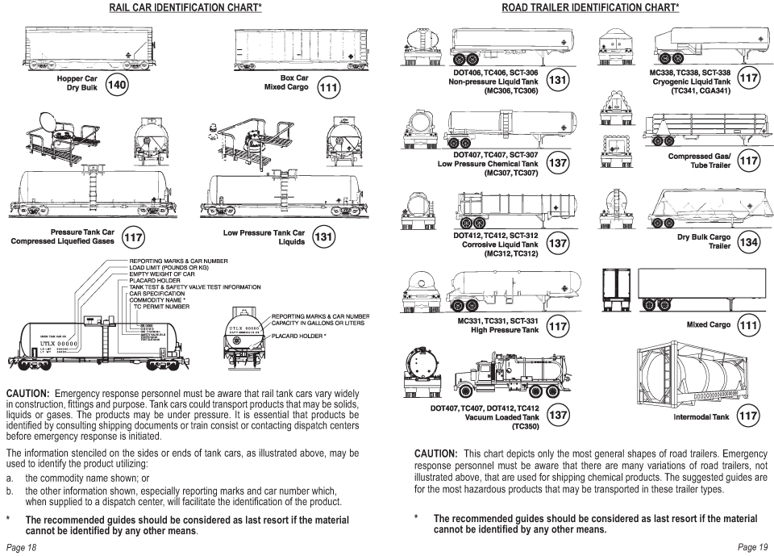

Slide 20
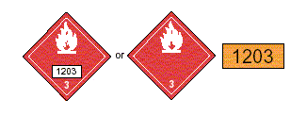
ERG2016
A) The 4-digit ID Number on a placard or orange panel;
.

Slide 21
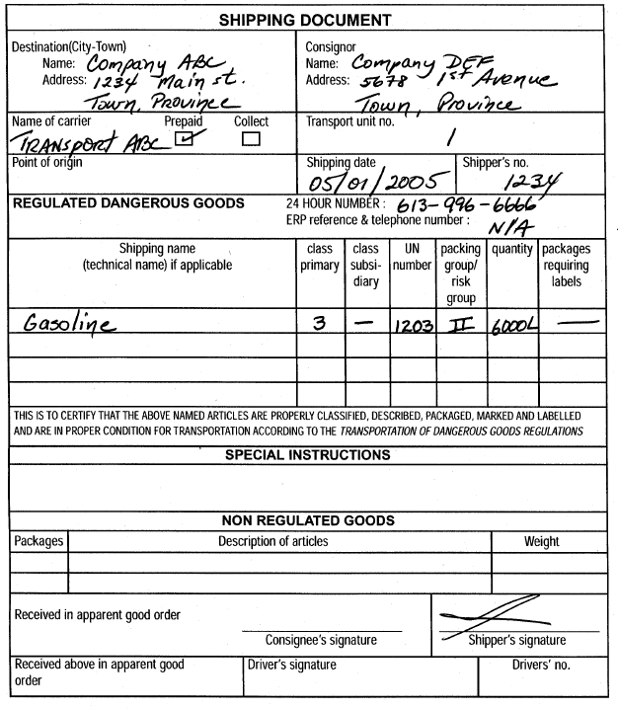
ERG2012
B) The 4-digit ID Number (following UN or NA) on a shipping document or package;
.
Example of a shipping document

Slide 22
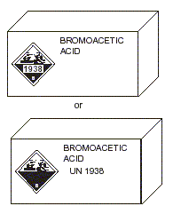
ERG2016
C) The name of the material on a shipping document or package.
.
Example of a package
Example of a shipping document

Slide 23
ERG 2016
1) Look up the material’s 3-digit Guide number in either:
The ID Number index (YELLOW-bordered pages);
The name of material index (BLUE-bordered pages);
Note if the substance is highlighted in GREEN.
As a last resort, if the ID number or the name of material are not available, use the Table of Placards and/or the Rail Car & Road Trailer Identification Charts

Slide 24
ERG 2016
2) Turn to the numbered guide (ORANGE-bordered pages):
Read carefully all the information provided in the ORANGE Guide;
use jointly the GREEN Section if the substance is highlighted green in the yellow or blue section

Slide 25

ERG 2016
CAUTION: If a reference to a guide cannot be found and the incident is believed to involve dangerous goods:
Turn to GUIDE 111
and use it until additional information becomes available.
If the incident involves explosives:
Use GUIDE 112 for all explosives, except:
For Class 1.4 Explosives, use GUIDE 114.
(Class 1.4 has no significant blast hazard)

Slide 26
Now for some Examples!
For each of the following examples:
Find the ORANGE-bordered Guide-pages using the information provided;
Identify the suggested distances / zones in the ORANGE and/or GREEN Sections;
Describe the main characteristics and hazards of the substance.

Slide 27
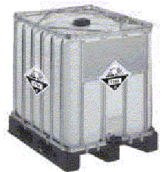
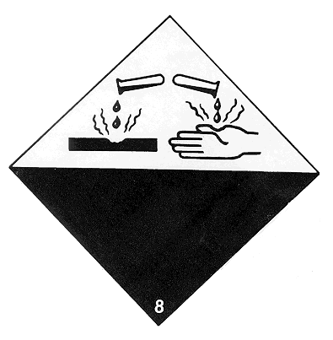
Example 1
A 1000-litre tote container is leaking.
1824

Slide 28
Solution for Example 1
ID No. is 1824
1824
The YELLOW-bordered pages indicate that the name of the material is Sodium hydroxide, solution or Caustic soda, solution and refers to Guide 154;
Substance not highlighted; no need for the GREEN Section;
The Guide 154 corresponds to Substances - Toxic and/or Corrosive (Non-Combustible);
As an immediate measure, the Guide suggests to isolate the leak area in all directions for at least 50 metres for liquids

Slide 29
Solution for Example 1
In Guide 154, under the Potential Hazards Section, the Health hazards precede the Fire or Explosion hazards;
This type of substance is toxic by inhalation / ingestion / skin contact and may cause severe injury or death;
Effect of contact or inhalation may be delayed;
Fire may produce irritating, corrosive and/or toxic gases;
This type of substance is non-combustible.
1824

Slide 30
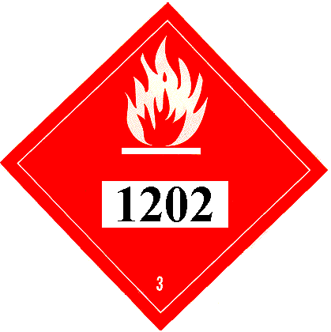
Example 2
A tanker truck carrying the following product rolled over and is leaking from the top hatch.

Slide 31
Solution for Example 2
ID No. is 1202
The YELLOW-bordered pages indicate that the substance is Diesel fuel or Fuel oil, and refers to Guide 128;
Substance not highlighted; no need for the GREEN Section
The Guide 128 corresponds to Flammable Liquids (Non-Polar / Water-Immiscible);
As an immediate precautionary measure, the Guide suggests to isolate spill or leak area for at least 50 metres in all directions. If the spill is large, the Guide suggests to consider an initial downwind evacuation of at least 300 metres;

Slide 32
Solution for Example 2
At Guide 128, under the Potential Hazards Section, the Fire or Explosion hazards precede the Health hazards;
This type of substance is flammable and vapours may form explosive mixture with air;
Most vapours are heavier than air, they will spread along the ground and collect in low or confined areas;
Containers may explode when heated;
Inhalation or contact with material may irritate or burn skin and eyes.

Slide 33
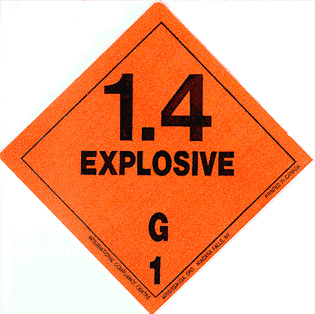
Example 3
A truck displaying this placard is on fire on the side of the road.

Slide 34
Solution for Example 3
The placard indicates the material is an explosive of class 1.4G;
According to the Table of placards, Guide 114 must be used when explosives in class 1.4 are involved;
Explosives are not highlighted; there is no need to refer to the GREEN Section
(see Explosives in the BLUE Section);
In case the truck is involved in a fire, the Guide suggests to isolate for 500 metres in all directions and to initiate an evacuation, including emergency responders, for 500 metres in all directions;

Slide 35
Solution for Example 3
At Guide 114, under the Potential Hazards Section, the Fire or Explosion hazards precede the Health hazards;
This type of substance may explode and throw fragments at a distance of 500 metres or more if fire reaches cargo;
Fire may produce irritating, corrosive and/or toxic gases.

Slide 36
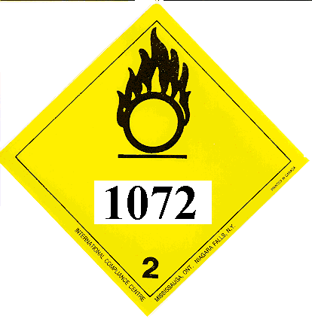
Example 4
A tanker truck is involved in a road accident.

Slide 37
Solution for Example 4
The ID No. is 1072;
The YELLOW-bordered pages indicate that the product is Oxygen, compressed and refers to Guide 122;
Substance not highlighted; no need for the GREEN Section
The Guide 122 corresponds to Gases - Oxidizing (Including Refrigerated Liquids);
As an immediate precautionary measure, the Guide suggests to isolate spill or leak area for at least 100 metres in all directions;
In case of a large spill, the Guide suggests to consider an initial downwind evacuation of at least 500 metres;

Slide 38
Solution for Example 4
At Guide 122, under the Potential Hazards Section, the Fire or Explosion hazards precede the Health hazards;
This type of substance does not burn, but will support combustion;
Some may react explosively with fuels;
Containers may explode when heated;
Vapours may cause dizziness or asphyxiation without warning.

Slide 39
Example 5

Slide 40
Solution for Example 5
There is no ID No. and the DANGER placard indicates a mixed load of dangerous goods;
In this case, refer to Guide 111, Mixed Load / Unidentified Cargo;
As an immediate precautionary measure, the Guide suggests to isolate the area for at least 100 metres in all directions, until the contents of the vehicle is known;
In case of fire, the Guide suggests to isolate for 800 metres in all directions and to consider an initial evacuation of 800 metres in all directions;

Slide 41
Solution for Example 5
At Guide 111, under the Potential Hazards Section, the Fire or Explosion hazards precede the Health hazards;
Until the vehicle content is known, all hazards must be considered: flammability, corrosivity, toxicity…

Slide 42
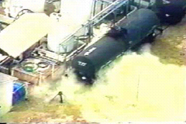
Example 6
A rail car is leaking at a well-known facility in your area, where chlorine cars are handled.
KTVI-TV St.Louis, Missouri, USA

Slide 43
Solution for Example 6
KTVI-TV St.Louis, Missouri, USA
The product involved is Chlorine;
The BLUE-bordered pages indicate that the ID number is 1017, refers to Guide 124 and the substance is highlighted;
The Guide 124 corresponds to Gases – Toxic and/or Corrosive – Oxidizing;
Because the substance is highlighted and there is a spill situation, the Initial Isolation and Protective Action Distances must be taken from the GREEN Section;
For ID 1017, the GREEN Section suggests refers to Table 3 which says for large spills use 500 metres as an Initial Isolation Distance;

Slide 44
Solution for Example 6
KTVI-TV St.Louis, Missouri, USA
For ID 1017, the GREEN Section suggests, for large spills during the day, 2.1 miles as a Protective Action Distance in moderate wind; The Emergency Responders will have to decide which Protective Action will be pursued: evacuation, shelter in place, or a combination of both;
At Guide 124, under Potential Hazards, the Health hazards precede the Fire or Explosion hazards;
The Guide 124 indicates that this product is toxic and may be fatal if inhaled or absorbed through the skin.

Slide 45
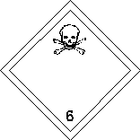

Example 7
A drum is leaking in a puddle of water.
1689

Slide 46
Solution for Example 7
The ID Number is 1689;
The YELLOW-bordered pages indicate that this substance is Sodium cyanide;
It refers to Guide 157 and the substance is highlighted;
The Guide 157 corresponds to Substances – Toxic and/or Corrosive (Non-Combustible / Water-Sensitive);
The substance is highlighted and there is a spill situation: Table 1 / the GREEN Section must be used to determine the Initial Isolation and Protective Action Distances;
1689

Slide 47
Solution for Example 7
Under ID No.1689, the GREEN Section suggests distances specifically when the product is spilled in water. If this is not the case, the initial isolation and evacuation distances must be taken from Guide 157, under Public Safety;
Since the product is leaking in water, the GREEN Section suggests an Initial Isolation Distance of 30 metres in all directions for a small spill and 100 metres in all directions for a large spill;
Additionally, the Protective Action Distances for day and night will have to be taken from the GREEN Section;
1689

Slide 48
Solution for Example 7
The Guide 157 indicates that this type of substance is toxic and non-combustible, but fire will produce irritating, corrosive and/or toxic gases;
For a water-reactive substance (mention when spilled in water in Table 1) , refer to the last pages of the GREEN Section (Table 2), where the TIH gases produced are listed, for each water-reactive substance; in this case the gas produced is HCN or Hydrogen cyanide;
Searching for Hydrogen cyanide in the BLUE Section, there is a reference to Guide 117, which correspond to Gases – Toxic – Flammable (Extreme Hazard).
1689

Slide 49
Solution for Example 7
NOTE: In the GREEN section (Table 1), you must use the Initial Isolation and Protective Action Distances (IIPAD) for the water reactive material itself (when spilled in water) (in this case UN1689) and not the IIPAD for the generated TIH gas (Hydrogen cyanide).
Be prepared to move back though!
1689

Slide 50
Example 8
A drum containing this substance is punctured and is leaking on the ground.
2692

Slide 51
Solution for Example 8
2692
ID No. is 2692;
The YELLOW-bordered pages indicate that this substance is called Boron tribromide;
It refers to Guide 157 and is highlighted;
The Guide 157 correspond to Substances – Toxic and/or Corrosive (Non-Combustible / Water-Sensitive);
Since the substance is highlighted and there is a spill situation, the GREEN Section must be used to determine the Initial Isolation and Protective Action Distances;
For this product, the GREEN Section presents 2 separate entries for ID No. 2692: the 1st one applies when the product is spilled on the ground and the 2nd one, when it is spilled in water;

Slide 52
Solution for Example 8
In this case, the product is spilled on the ground and the Initial Isolation Distance suggested in the GREEN Section is 30 metres in all directions for a small spill and 60 metres in all directions for a large spill;
Additionally, the Protective Action Distances for day and night will have to be taken from the GREEN Section;
The Guide 157 indicates that this type of substance is toxic and non-combustible, but a fire will produce irritating, corrosive and/or toxic gases.
2692

Slide 53

Example 9
An alert for Sarin gas was activated in a building.

Slide 54
Solution for Example 9
The product involved is Sarin;
The BLUE-bordered pages indicate that the ID No. is 2810;
It refers to Guide 153 and the substance is highlighted;
The Guide 153 corresponds to Substances – Toxic and/or Corrosive (Combustible);
Since the substance is highlighted and there is a spill situation (type of dispersion is unknown), the GREEN Section must be used to determine the Initial Isolation and Protective Action Distances;
In the GREEN Section, there are multiple entries for ID No. 2810; select Sarin (when used as a weapon);

Slide 55
Solution for Example 9
The GREEN Section suggests an Initial Isolation Distance of 60 metres in all directions for a small spill and 400 metres in all directions for a large spill; these distances will have to be adapted considering that the incident takes place inside a building;
Additionally, the Protective Action Distances for day and night will have to be taken from the GREEN Section, and adapted;
The Guide 153 indicates that this type of substance is toxic and the effects of contact or inhalation may be delayed;
The Guide 153 also indicates that the substance is combustible, may burn, but does not ignite readily; a fire may produce irritating, corrosive and/or toxic gases.

Slide 56
HAZMAT Summary
OBSERVE
REPORT
EVACUATE
SET A PERIMETER
DECONTAMINATE
TRIAGE

Slide 57
HAZMAT
Almost done,
Now, Please take the quiz by clicking this link:
HAZMATQuiz

