Slide 1
Proposed Conservation District
Pre-Application Meeting No. 2
October 1, 2025
Melissa Parent
Chief Planner, Conservation Team
Planning & Development Department
City of Dallas
Notes:
Good evening. I am Melissa Parent, Senior Planner with the City of Dallas Conservation Team –
Lindsay – intro members, concerns, outreach, and PD works/not works

Slide 2
Agenda
Introduction
Background of Request
Process for Establishing a Conservation District
Next steps
Community Discussion
Notes:
A neighborhood committee, made up of 10 property owners, submitted a request for pre-application meetings. This request kicks off the process of potentially adding the conservation district.
So, this meeting is the first of two pre-application meetings to talk about this potential amendment to City Code. I’ll walk you through the process and take your questions along the way.
Today, the purpose of the meeting is to tell you about this request, let you know a little about conservation districts, and talk about the process for amending the district. We’ll talk about the categories where regulations may be amended or added.
By the way, this process itself was amended in 2015 to ensure more property owner participation.

Slide 3
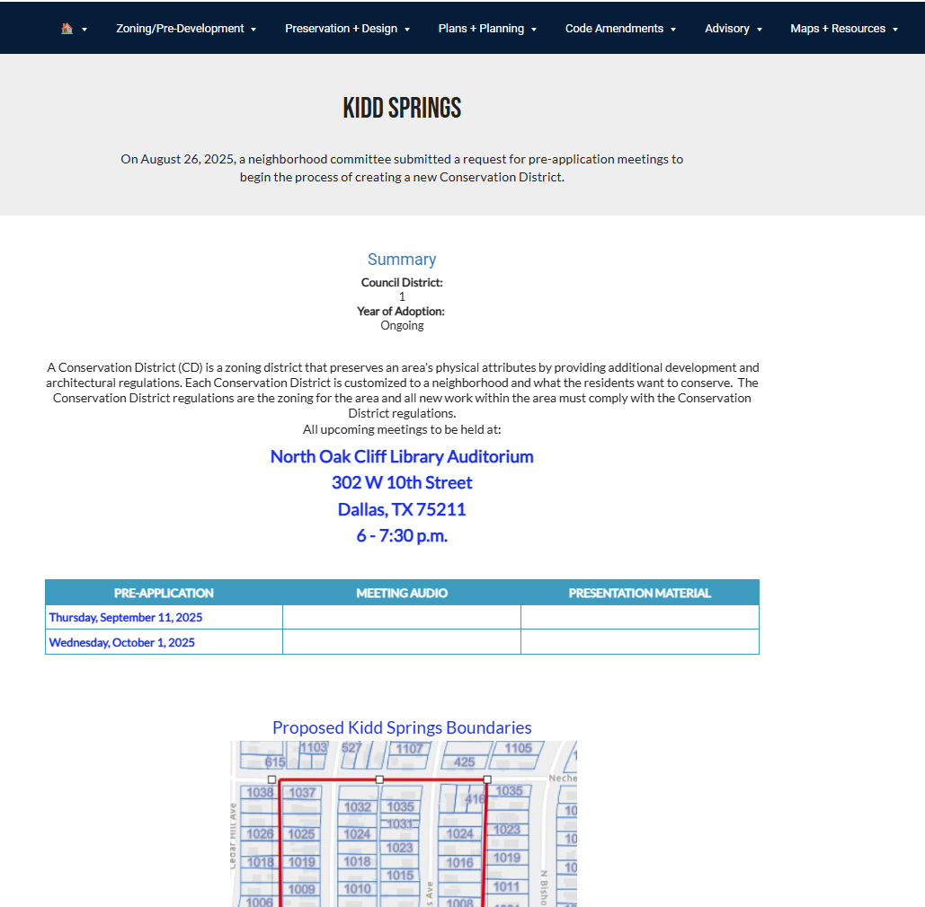
Kidd Springs Page
https://bit.ly/cdkiddsprings
Main CD page:
https://bit.ly/dallascd

Slide 4
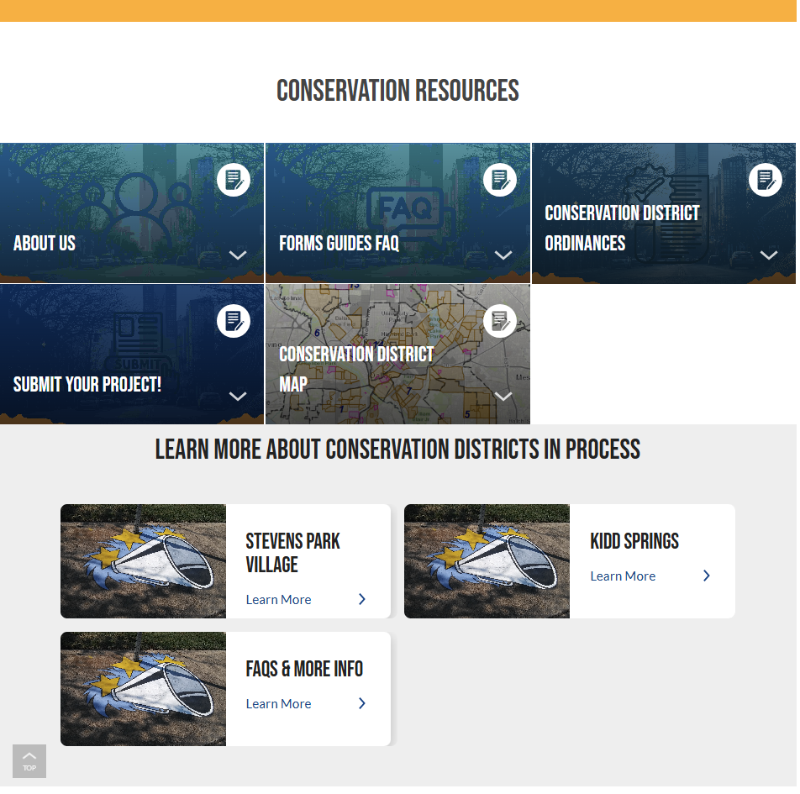
Kidd Springs Page
https://bit.ly/cdkiddsprings
Main CD page:
https://bit.ly/dallascd

Slide 5
Purpose of This Meeting
On August 26, 2025, a neighborhood committee (12 property owners) submitted a request for pre-application meetings to begin the process of potentially establishing a conservation district in your neighborhood.
This meeting is the second of two pre-application meetings to talk about this potential conservation district.
The purpose of this meeting is to:
  Inform property owners about the request, conservation districts, and the steps in the process.
  Discuss and establish a general list of development and architectural standards the neighborhood would like to protect and regulate.
  Note: The process for creating and amending conservation districts was amended in 2015 to encourage more property owner participation.
Notes:
A neighborhood committee, made up of 10 property owners, submitted a request for pre-application meetings. This request kicks off the process of potentially adding the conservation district.
The neighborhood committee begins the process by requesting these meetings, serves as a point of contact for the city to the neighborhood, collects petitions, and submits required documents.

Slide 6
Purpose of a Conservation District
Intended to provide a means of conserving an area’s distinctive character by protecting or enhancing its physical attributes.
Promote development or redevelopment that is compatible. with an existing area or neighborhood.
Promote economic revitalization.
Enhance the livability of the city.
Ensure harmonious, orderly, and efficient growth.
Notes:
So what is the purpose of a conservation district?

Slide 7
Background
Initial request - A neighborhood committee initiated the process to establish a CD.
  June 2022 – first inquiry into a CD
  August 2023 – engagement with City about process and submitting Determination of Eligibility
  August 22, 2025 – Determination of Eligibility for pre-application approved
  August 26, 2025 – first request for pre-application meeting
  September 11, 2025 – first pre-application meeting
  October 1, 2025 – second pre-application meeting
Notes:
Staff began to talk with the neighborhood committee members in mid 2022.
(Read slide.)

Slide 8
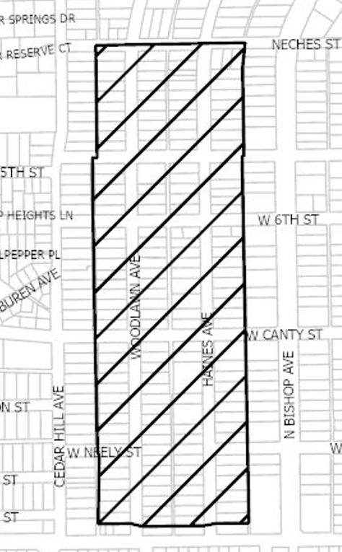
Proposed CD Boundary
Neighborhood Committee Members
Susan Evans-Wickberg
Peter Abrahamsen
Carl Busbey
Greg Feiser
Lindsay Haroon
James Harrington
Mari Hidalgo
Shamus McInerney
Kim Morgan
John Norris
Chip Norton
Dan Wickberg
April Coover
Notes:
Next Slide: Before we get into the CD process, I’d like to go over the differences between what the PD covers and the differences between CD and HD,
Alleviate any confusion or misinformation that might be out there

Slide 9
PD Conservation Historic
PD160, Tract 1b
Front Yard setback
Side yard setback
Minimum lot size
Minimum lot width
Density
All other codes defer to R7.5A
No architectural component
Front Yard setback
Side yard setback
Rear yard setback
Structure height/stories
Lot Coverage
Fencing
Minimum lot size
Parking
Permitted uses
Density
Landscaping
Architectural component – specifics are negotiable, but typically include regulations for roof form/pitch, porches, chimneys,
and windows
Front Yard setback
Side yard setback
Rear yard setback
Structure height/stories
Lot Coverage
Parking & Driveways
Screening/Fencing
Minimum lot size
Minimum lot width
Density
Landscaping
Preservation Criteria (includes REQUIRED architectural standards – chimneys, awnings, columns, glass, materials, outdoor lighting, etc)
All other codes defer to R7.5A
Notes:
Historic list – not comprehensive Big-ticket items, most representative in all styles
18 CD + 1 in progress HEIGHT
CD – projects handled in-house Standards are less restrictive, materials
HD Landmark (45-60 day min) WHOLE HOUSE

Slide 10
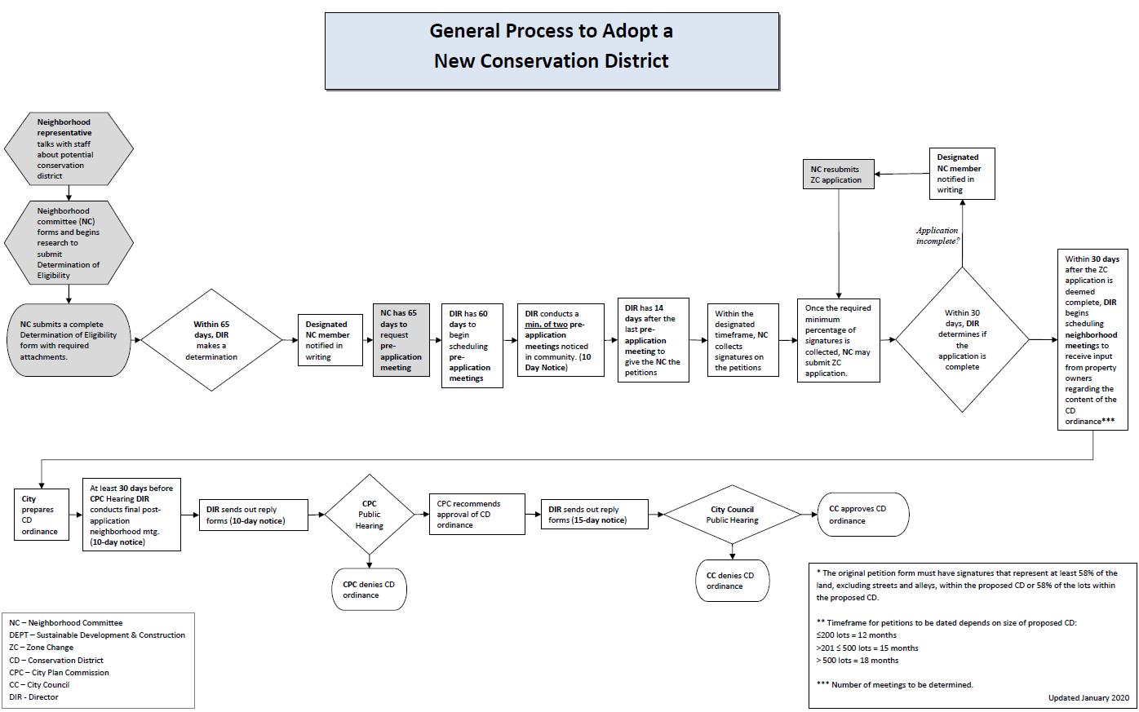
Notes:
Once the petitions are verified, the neighborhood committee submits the zoning change application and fee.
If you get 75% or more verified signatures on your petition, the fee will be waived.
This, then is the beginning of the zoning change process.
TIMELINE

Slide 11
Process for establishing a CD
Neighborhood committee submitted a Determination of Eligibility and pre-application form (complete).
City holds pre-application meetings with property owners to discuss and establish a list of categories of development and architectural standards the property owners are interested establishing for a new conservation district.
The neighborhood committee meets with property owners to ensure awareness of the process and active participation throughout the neighborhood.
  Emphasis on consensus among all property owners in neighborhood.
Neighborhood committee and property owners convey additional comments on categories and elements.
Notes:
So what is the process for turning your neighborhood into a conservation district?
We’ll go through the standards in more detail in just a few slides
We’ll go through the process tonight, but I can’t emphasize enough that it is incumbent upon the neighborhood committee and property owners to get the involvement of the entire neighborhood. The more you talk and reach consensus about what you want, before we actually start the official zoning change process, the better this process will go.
My e-mail address will be at the end of this presentation… feel free to send comments by e-mail, also.

Slide 12
Process for establishing a CD
After the final pre-application meeting, the neighborhood committee will finalize the petition items and request petitions.
The city provides neighborhood committee with petitions.
  Neighborhood committee will have 12 months to obtain the necessary percentage of signatures and submit them to the City. 58% of the land area or 58% of the lots is required.
Staff verifies the signatures and petitions.
Notes:
After the neighborhood has reached some consensus on what types of changes it wants to make and conveys those changes to staff, then the City holds an additional pre-application meeting to develop and finalize the categories of standards to amend or add.
Using those categories and elements, the city drafts petition language and gives the petitions to the neighborhood committee.
The NC will have 12 months to gather signatures and return them to the city.
City staff then verifies the signatures and petitions.

Slide 13
Process for establishing a CD
Once petitions are verified, neighborhood committee submits zoning change application with appropriate fees, if necessary.
  Fee waived if petitions are signed by a minimum of 75% of property owners
This application is the beginning of the zoning change process.
The city begins scheduling neighborhood meetings as needed to work out proposed detailed regulations in each of the categories
  Multiple meetings held
  Neighborhood committee works to ensure all voices are heard and everyone is aware of process
At the conclusion of the series of meetings, City prepares ordinance.
City holds neighborhood meeting to review draft language.
City Plan Commission public hearing and recommendation.
City Council public hearing and decision.
Notes:
Once the petitions are verified, the neighborhood committee submits the zoning change application and fee.
If you get 75% or more verified signatures on your petition, the fee will be waived.
This, then is the beginning of the zoning change process.

Slide 14
Conservation Districts Must Regulate:
Development Standards:
  Accessory structures
  Building & structure height
  Density
  Fences & walls
  Floor area ratio
  Lot coverage
  Lot size
  Off-street parking
  Permitted uses
  Setbacks
  Stories
Architectural standards:
  Architectural styles
  Building elevations
  Building materials
  Chimneys
  Porch styles
  Roof form or pitch
  Roofing materials
  Windows
Notes:
Our development code regulates what can be regulated by conservation districts, and here is the list.
These are the things that are generally regulated in each district. On the next page are additional items that may be regulated if you would like.

Slide 15
Conservation Districts May Also Regulate:
Building relocation
Building width
Demolition
Driveways, curbs, and sidewalks
Foundations
Garage location and entrance
Impervious surfaces
Landscaping or other natural features
Massing
Paint colors
Solar energy systems and the components
Steps
Window and dormer size and location
Additional development and architectural standards, as desired
Notes:
At the end of this presentation, I am going to open up the call for comments and questions. Be thinking about what items your neighborhood wants to regulate from these last two slides
List not comprehensive

Slide 16
Considerations Specific for this area
The neighborhood committee is concerned that without a Conservation District the neighborhood may face substantial inappropriate redevelopment and encroachment.
In the discussion with the neighborhood committee about wanting Conservation District status the main goals were to:
  Protect architectural styles
  Ensure compatibility of materials used in remodeling and new construction
  Expanding upon development criteria included in the existing PD, missing pieces affecting height & massing
All of these things could be regulated to maintain the appearance and characteristics of the neighborhood.

Slide 17
Considerations Specific for this area (cont.)
Architectural styles:
  A variety of styles in the homes exist in this district.
  What styles of architecture would be allowed for new construction?
  Would existing structures be required to be remodeled or added on to in their existing styles?
Architectural characteristics:
  There are several architectural styles found within the proposed boundaries including Craftsman, Victorian, Neoclassical, Colonial Revival, and Prairie.
  What are the characteristics of the styles that should be maintained?
  Characteristics could include the building materials, roof form and pitch for all styles, window types, etc.
Notes:
Pattern recognition

Slide 18
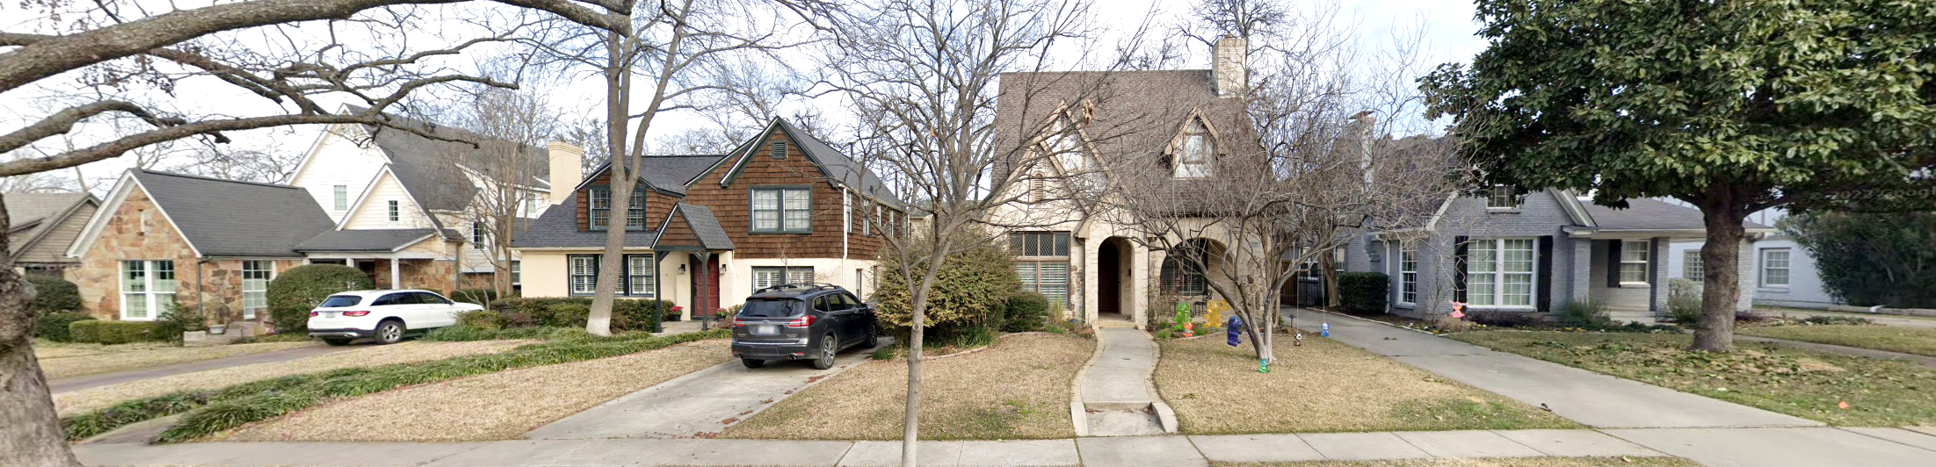
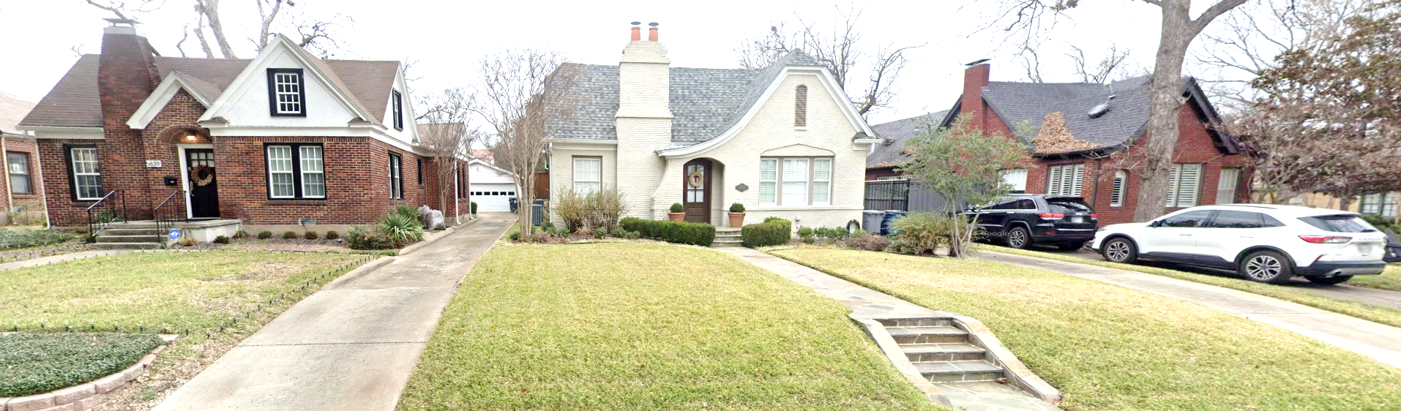
M Streets(CDs 9 & 11)
McCommas & Morningside
Notes:
Chimneys, Dormers, Arches HARMONY, Balance, cohesion,
Pair of ganged windows
Front entry driveway same side
Front porch/entrance feature
Window Grid patterns

Slide 19
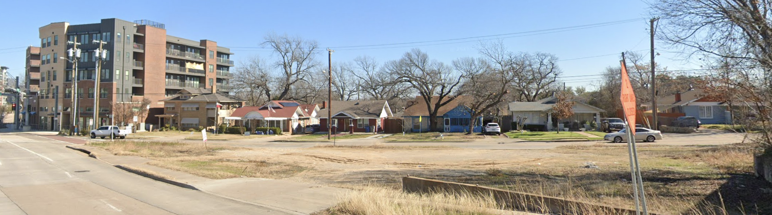
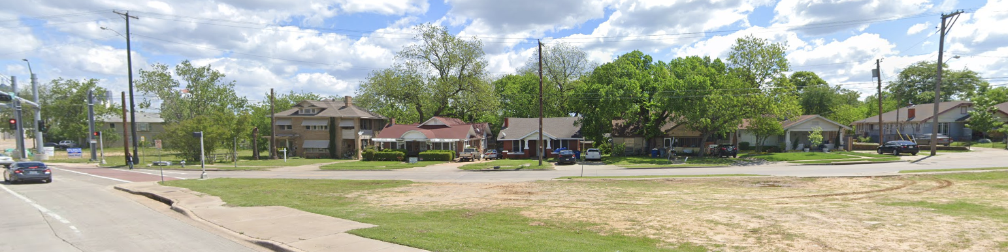
A Tale of 2 Cities (2019 vs Now)
Regulated by PD-468
Protected by Lake Cliff Historic District Ordinance

Slide 20
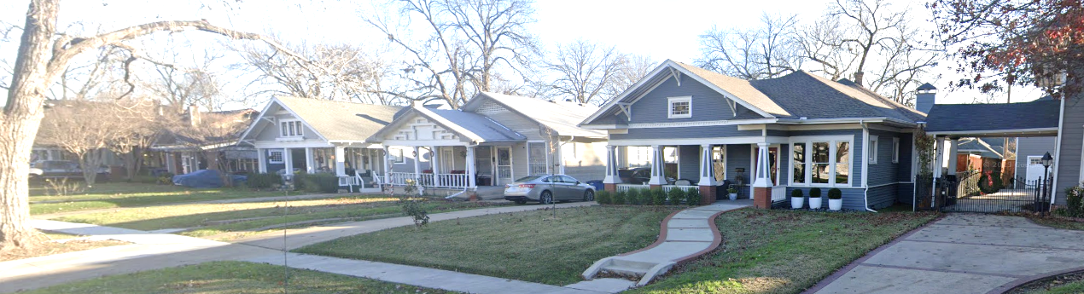
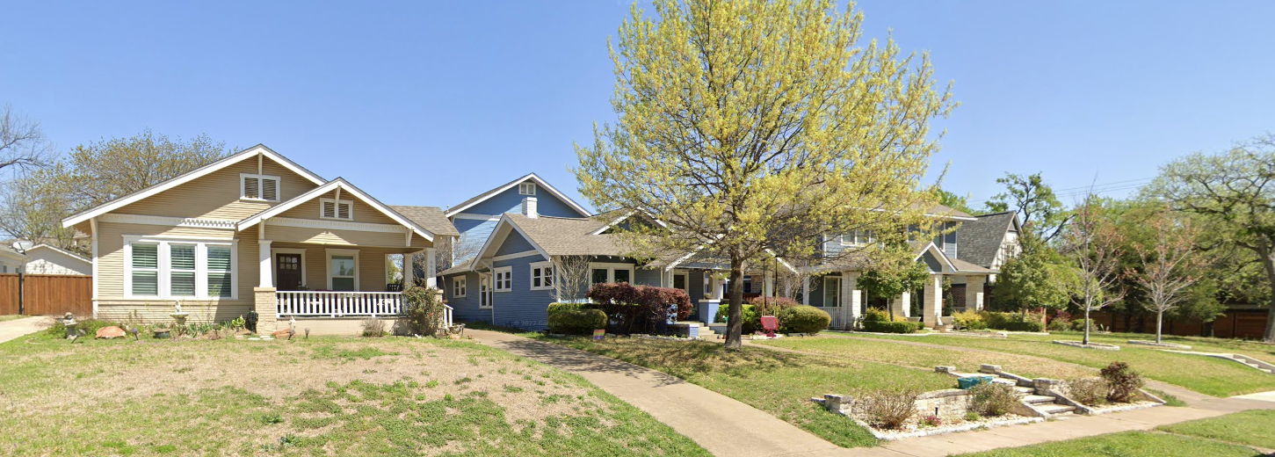
Belmont (CD-12)
Goliad & Velasco
Notes:
Wide front porches HARMONY, Balance, cohesion,
Columns & railings
Deep eaves with Braces
Ganged windows

Slide 21
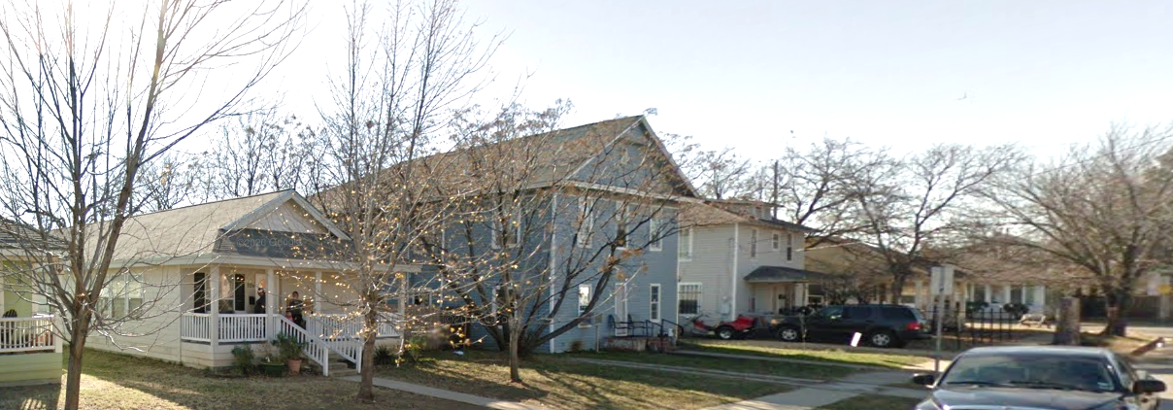
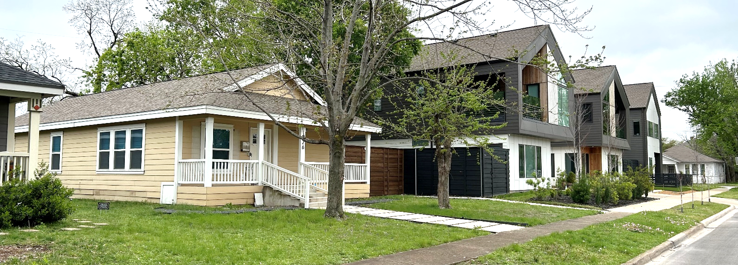
Polk & Sunset 2012 vs NOW

Slide 22
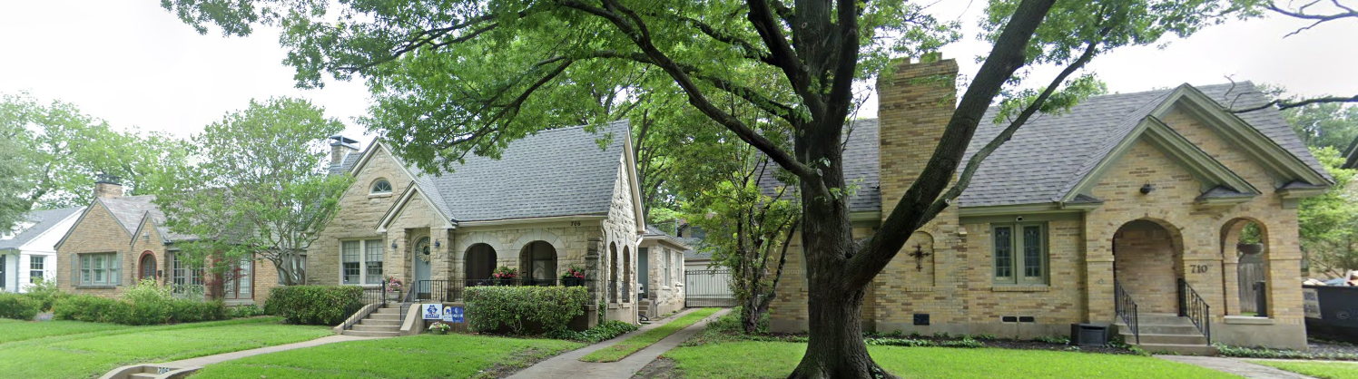
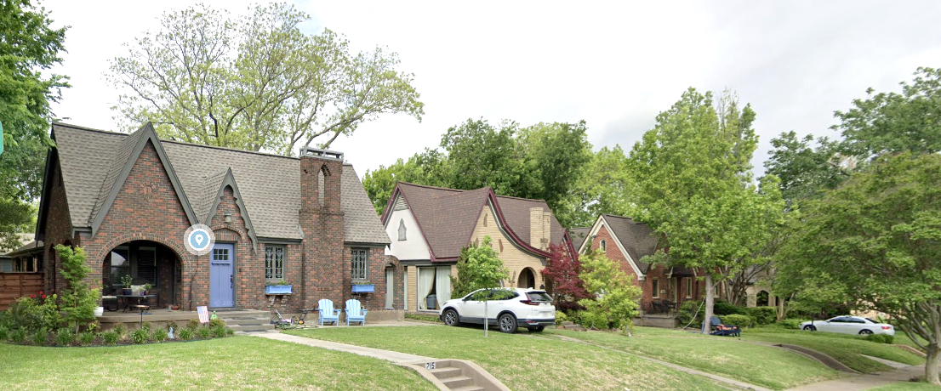
Hollywood/Santa Monica (CD-6)
Valencia & Monte Vista
Notes:
Chimneys HARMONY, Balance, cohesion, rhythym
Porch/entry/Arches
Front gables

Slide 23
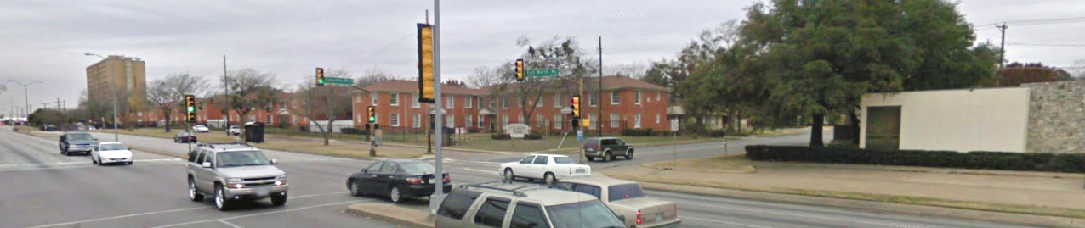
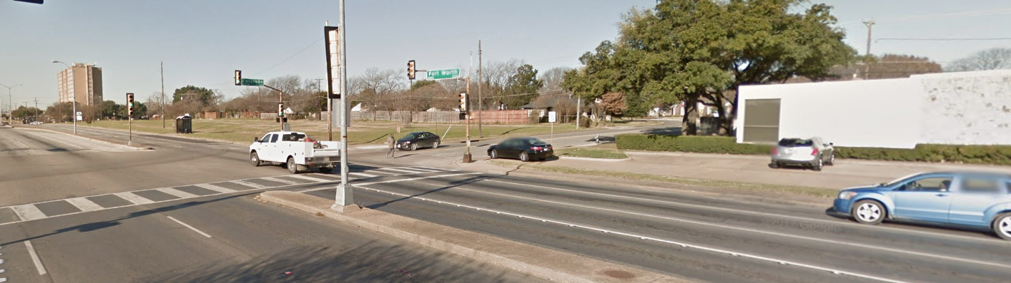
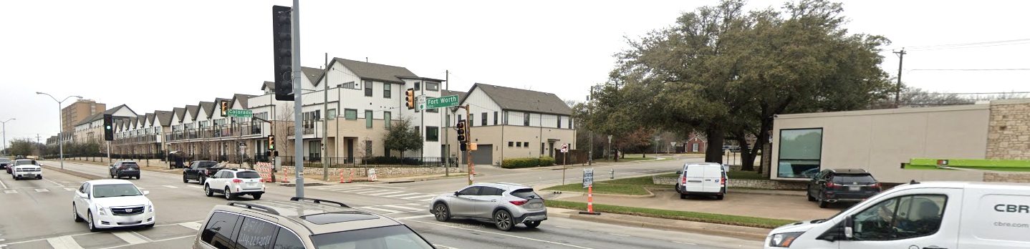
Development at Ft. Worth Ave & Colorado, 2008 vs 2016 vs NOW
Notes:
SPV

Slide 24
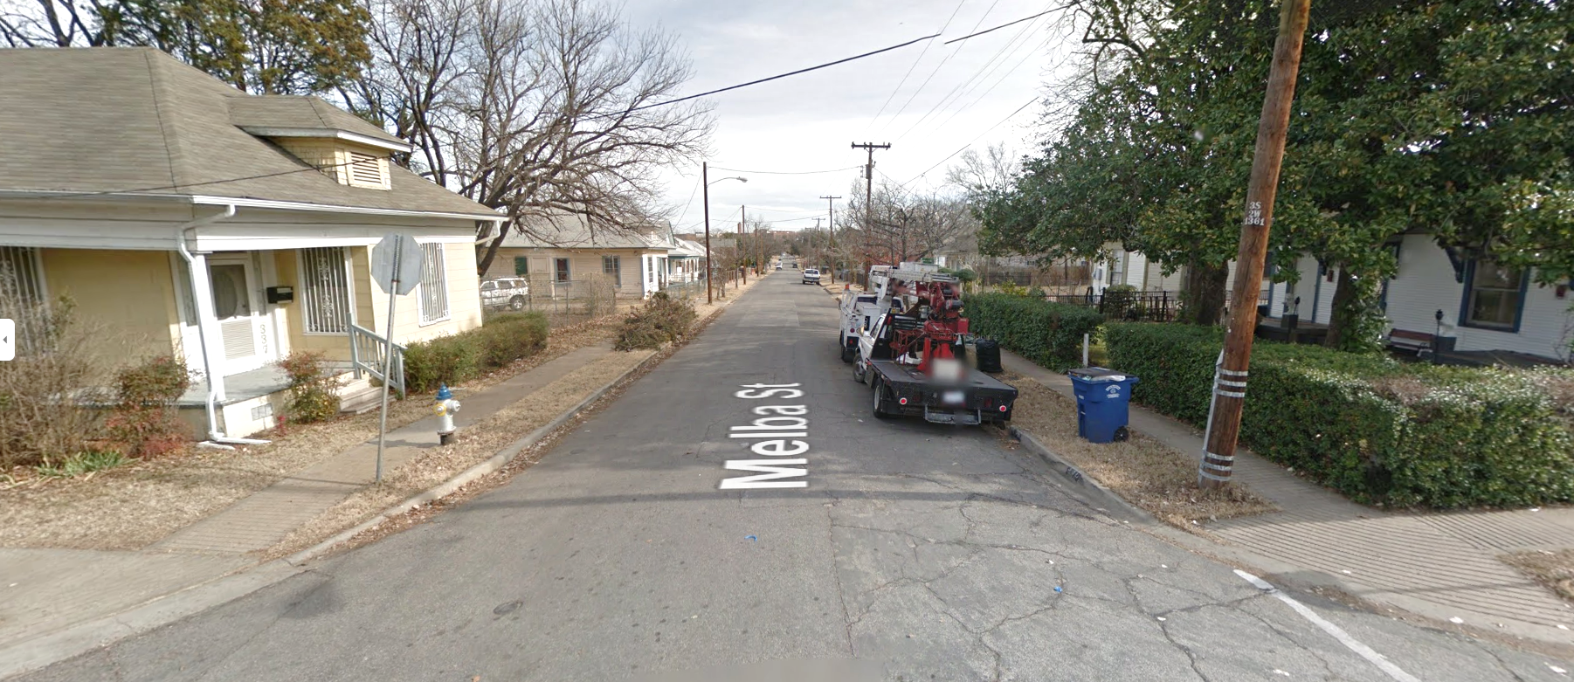
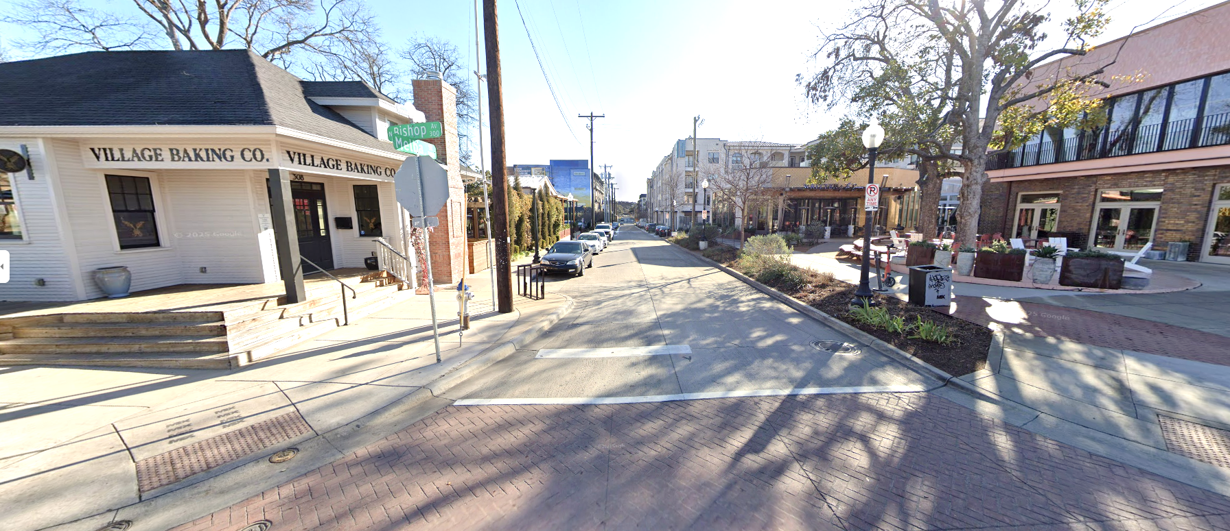
Just outside of Bishop Arts CD
2012
2025

Slide 25
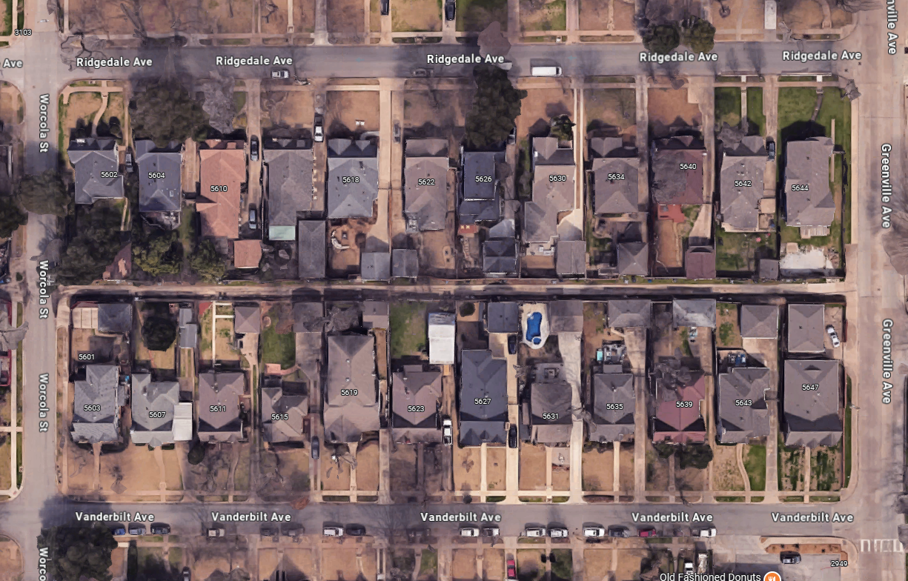
Vickery Place (CD-15)
Notes:
5622 Ridgedale
Driveways
Rhythm

Slide 26
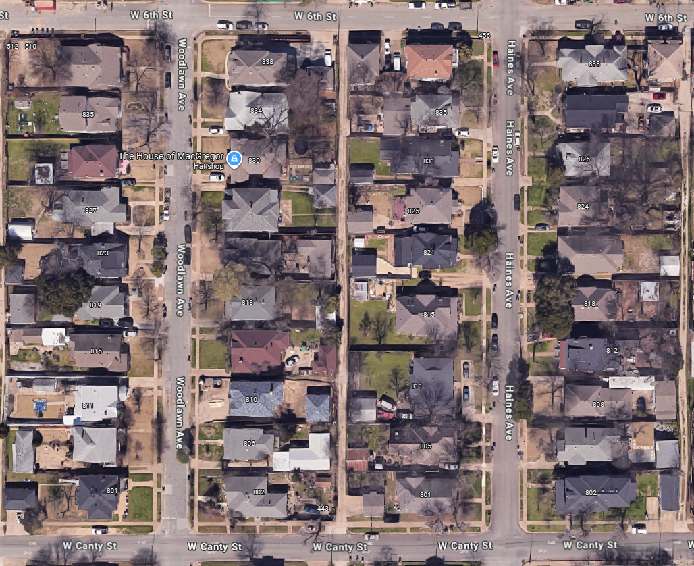
Kidd Springs
Notes:
Rhythm, Patterns

Slide 27
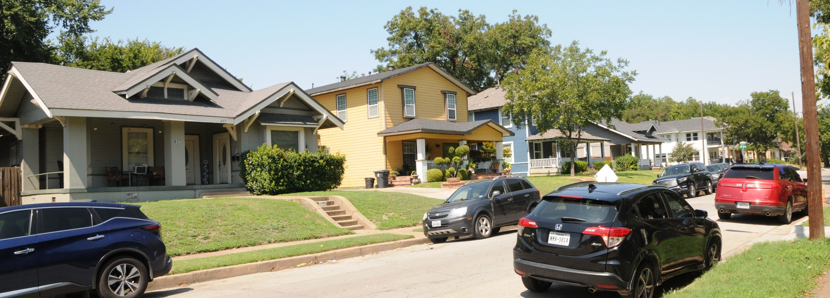
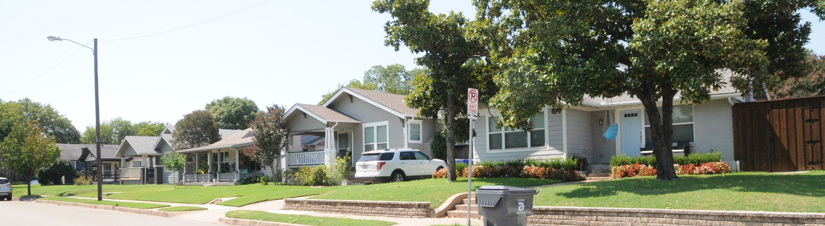
Kidd Springs
Notes:
Tree-lined streets
Mix of 1 to 2- story
Things to be thinking about

Slide 28
Petition Language
Purpose of petition
  Determine what the neighborhood wants to regulate and preserve.
  Capture the elements under discussion in preparation for longer and more detailed discussions as part of the zoning change process.
If the petition is successful, then the city and the neighborhood begin to talk through the details of what the neighborhood would like to regulate and preserve.
Meetings held as often as needed to gather input.
Notes:
The purpose is to determine what the neighborhood wants and to capture the elements under discussion. It’s a macro to micro approach, if you will.
This is the step that is easily overlooked. The petition is not the redline of the district regulations. The petition is just supposed to be a list of the categories that might be amended regulated and what elements of those categories might change.
For those that draft agreements as part of your business, the petition is a letter of intent, of sorts, or an outline of basic terms. It allows the discussion of the details to start. Consensus building is important at this step, or you are going to struggle to get the required signatures.

Slide 29
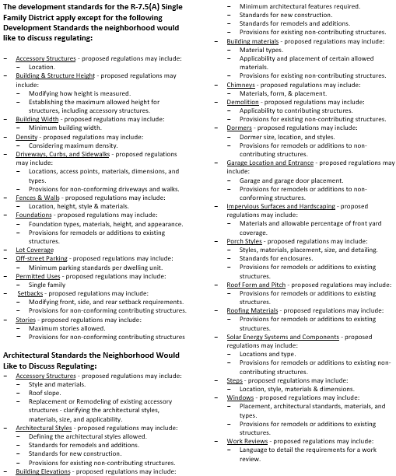
Petition Language
Petition wording must be broad enough to allow for discussion of details, yet narrow enough to allow owners to understand what is under discussion.
Example - fences
  Too broad: Fences – (no detail about what is under discussion)
  Too narrow: Fences - proposed regulations may include adjustments to the allowed height of fences in corner-side yards abutting Inwood Road and fence openness for side yard fences located within parkway setbacks.
  Just right: Fences - proposed regulations may include allowed height, percent of open surface area, location.
Notes:
So, the perfect a good petition wouldn’t just say “fences” but it also wouldn’t does not prescribe what, exactly is up for amendment. That’s part of the conversation after the petitions are signed.
I’ve heard that the fence regulations are likely to need to be amended. At this point, though, it’s too early in the process to start digging into how tall fences can be, or what materials. At this point, the idea is to collect that the neighborhood may want to amend the regulations for fences. The details will be worked out later in the process.

Slide 30
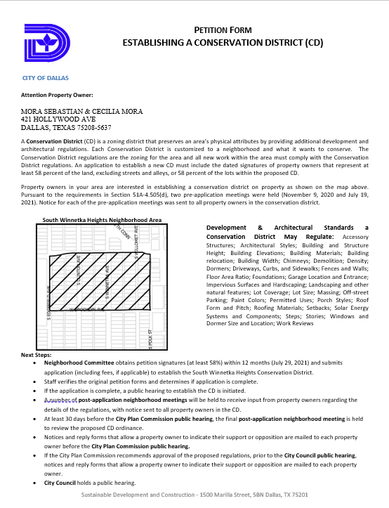
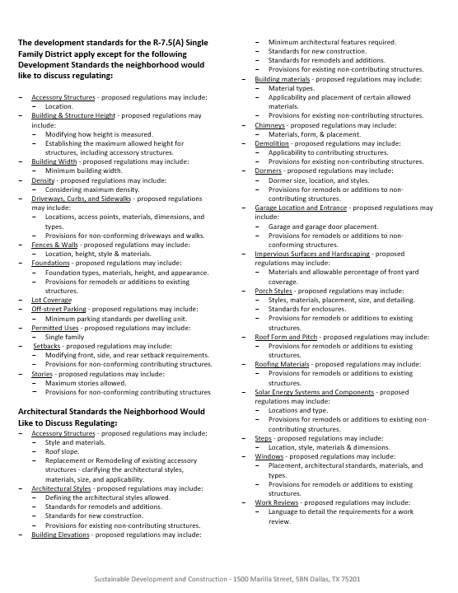
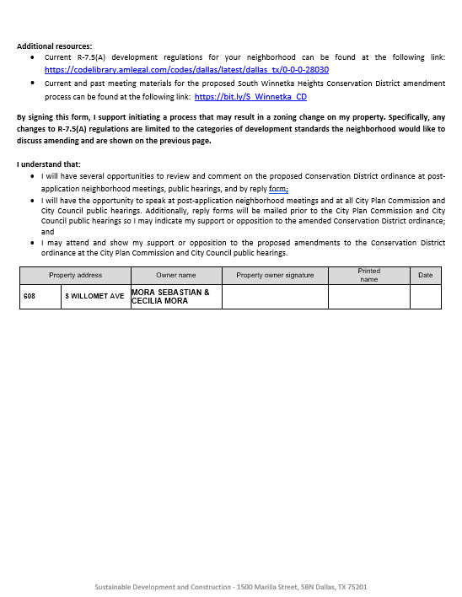
Petition Example
Neighborhood Committee will have to return the original petition form with wet signature of property owner
Notes:
To be on the lookout for
MUST BE OWNER OF RECORD

Slide 31
Next Steps
Neighborhood committee and property owners should meet to discuss proposed categories to create regulations.
Additional feedback should be conveyed to city staff.
The neighborhood committee will provide the categories to be added to the petition.
After the last pre-application meeting, the city will provide the designated neighborhood committee member with the petition forms.
The neighborhood committee will have 12 months to obtain signatures from property owners that represent at least 58% of the lots or 58% of the land mass (excluding streets) within the CD.
If petition is successful, zoning change can be initiated.

Slide 32
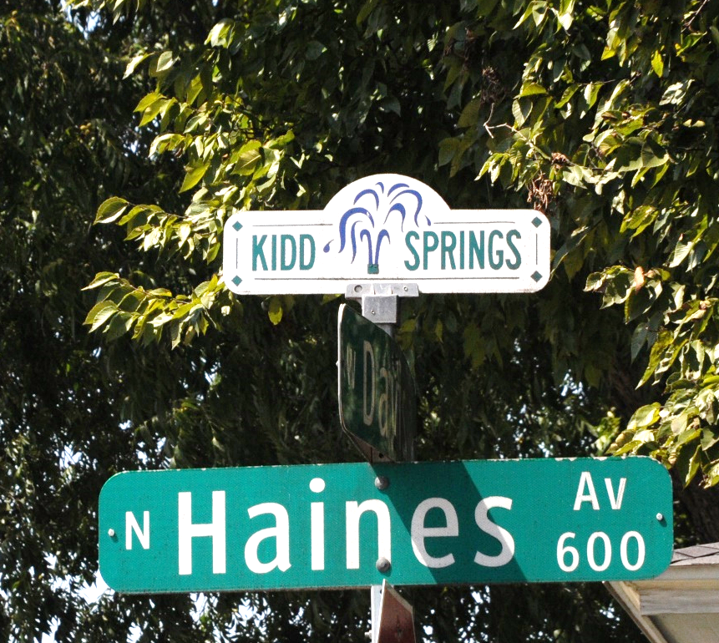
Questions?
https://bit.ly/cdkiddsprings

Slide 33
Proposed Conservation District
Pre-Application Meeting No. 2
Mike Flowers
michael.flowers@dallas.gov
214-671-6725
Marisol Martinez
Marisol.martinez@dallas.gov
214-671-8058
October 1, 2025
Staff Contacts:
Melissa Parent
melissa.parent@dallas.gov
214-671-5070
Meeting materials can be found at https://bit.ly/cdkiddsprings
Notes:
In closing, please reach out to your neighbors, discuss your ideas, and build consensus. If you have questions, call or email me.
Thank you for taking part in this effort in improving your neighborhood, your city, and your property. Civic involvement makes a good city a great city, and we really do appreciate you.
[Question and Answer]

