Slide 1
Proposed Conservation District Pre-Application Meeting No. 2
April 24, 2024
Melissa Parent
Senior Planner, Conservation Districts
Planning & Urban Design
City of Dallas

Slide 2
Agenda
Introduction
Background of Request
Process for Establishing a Conservation District
Next steps
Community Discussion
Notes:
A neighborhood committee, made up of 10 property owners, submitted a request for pre-application meetings. This request kicks off the process of potentially adding the conservation district.
So, this meeting is the second of three pre-application meetings to talk about this potential amendment to City Code. I’ll walk you through the process and take your questions along the way.
Today, the purpose of the meeting is to tell you about this request, let you know a little about conservation districts, and talk about the process for amending the district. We’ll talk about the categories where regulations may be amended or added.
By the way, this process itself was amended in 2015 to ensure more property owner participation.
The neighborhood committee begins the process by requesting these meetings, serves as a point of contact for the city to the neighborhood, collects petitions, and submits required documents.

Slide 3
Purpose of This Meeting
On March 8, 2024, a neighborhood committee (10 property owners) submitted a request for pre-application meetings to begin the process of potentially establishing a conservation district in your neighborhood.
This meeting is the second of at least three pre-application meetings to talk about this potential conservation district.
The purpose of this meeting is to:
Inform property owners about the request, conservation districts, and the steps in the process
Discuss and establish a general list of development and architectural standards the neighborhood would like to protect and regulate
Note: The process for creating and amending conservation districts was amended in 2015 to encourage more property owner participation.
Notes:
A neighborhood committee, made up of 10 property owners, submitted a request for pre-application meetings. This request kicks off the process of potentially adding the conservation district.
So, this meeting is the second of two pre-application meetings to talk about this potential amendment to City Code. I’ll walk you through the process and take your questions along the way.
Today, the purpose of the meeting is to tell you about this request, let you know a little about conservation districts, and talk about the process for amending the district. We’ll talk about the categories where regulations may be amended or added.
By the way, this process itself was amended in 2015 to ensure more property owner participation.
The neighborhood committee begins the process by requesting these meetings, serves as a point of contact for the city to the neighborhood, collects petitions, and submits required documents.

Slide 4
Background
Initial request - A neighborhood committee initiated the process to establish a CD.
August 2015 – first inquiry into a CD
May 2022 – engagement with City about process and submitting Determination of Eligibility
February 2024 – Determination of Eligibility for pre-application
March 2024 – first request for pre-application meeting
April 9, 2024 – first pre-application meeting
April 24, 2024 – second pre-application meeting
June 6, 2024 – third pre-application meeting
Notes:
Staff began to talk with the neighborhood committee members in mid 2022.
(Read slide.)

Slide 5
Purpose of a Conservation District
Intended to provide a means of conserving an area’s distinctive character by protecting or enhancing its physical attributes
Protect the physical attributes of an area or neighborhood
Promote development or redevelopment that is compatible with an existing area or neighborhood
Promote economic revitalization
Enhance the livability of the city
Ensure harmonious, orderly, and efficient growth
Notes:
So what is the purpose of a conservation district?

Slide 6
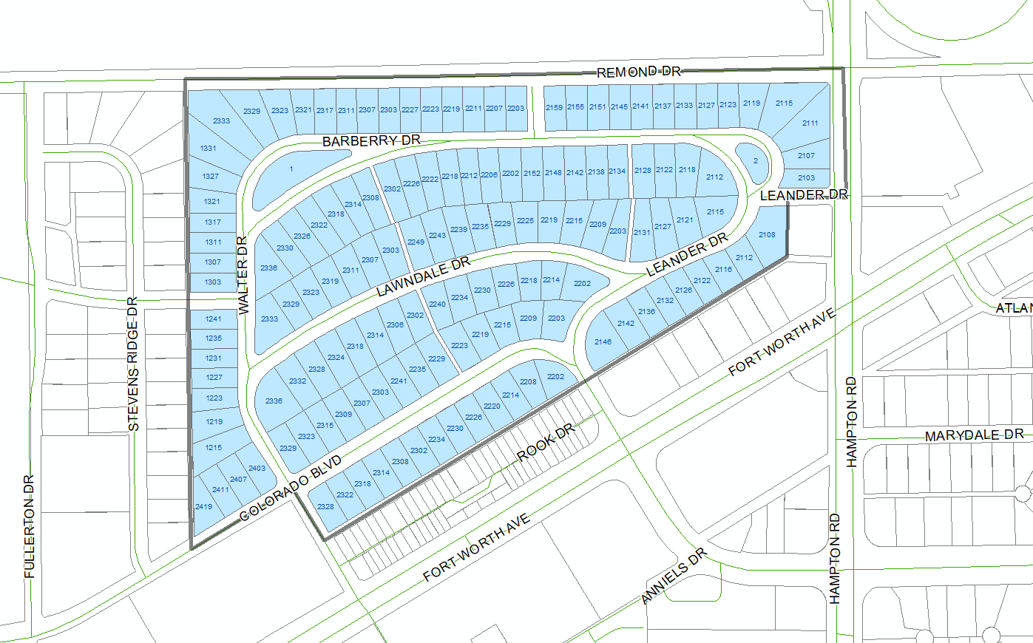
Proposed CD Boundary
Notes:
These are the boundaries submitted by neighborhood committee and reflect the original SPV plat.
Boundaries – alley behind Walter Dr to the west, alley behind W Colorado Blvd to the south, Remond Dr to the north, and the N Hampton on the east.

Slide 7
Process for establishing a CD
Neighborhood committee submitted a Determination of Eligibility and pre-application form (complete).
City holds pre-application meetings with property owners to discuss and establish a list of categories of development and architectural standards the property owners are interested establishing for a new conservation district
The neighborhood committee meets with property owners to ensure awareness of the process and active participation throughout the neighborhood.
Emphasis on consensus among all property owners in neighborhood.
Neighborhood committee and property owners convey additional comments on categories and elements.
Notes:
So what is the process for turning your neighborhood into a conservation district?
We’ll go through the process tonight, but I can’t emphasize enough that it is incumbent upon the neighborhood committee and property owners to get the involvement of the entire neighborhood. The more you talk and reach consensus about what you want, before we actually start the official zoning change process, the better this process will go.
My e-mail address will be at the end of this presentation… feel free to send comments by e-mail, also.

Slide 8
Process for establishing a CD
City holds additional pre-application meetings with property owners to develop and finalize categories of standards for the proposed CD
These categories form the basis of CD establishment petition.
The city drafts petition language with input received from the neighborhood committee and property owners at these pre-application meetings.
The city provides neighborhood committee with petitions
Neighborhood committee will have 12 months to obtain the necessary percentage of signatures and submit them to the City. 58% of the land or 58% of the lots is required
Staff verifies the signatures and petitions.
Notes:
After the neighborhood has reached some consensus on what types of changes it wants to make and conveys those changes to staff, then the City holds an additional pre-application meeting to develop and finalize the categories of standards to amend or add.
Using those categories and elements, the city drafts petition language and gives the petitions to the neighborhood committee.
The NC will have 12 months to gather signatures and return them to the city.
City staff then verifies the signatures and petitions.

Slide 9
Process for establishing a CD
Once petitions are verified, neighborhood committee submits zoning change application with appropriate fees, if necessary.
Fee waived if petitions are signed by a minimum of 75% of property owners
This application is the beginning of the zoning change process.
The city begins scheduling neighborhood meetings as needed to work out proposed detailed regulations in each of the categories
Multiple meetings held
Neighborhood committee works to ensure all voices are heard and everyone is aware of process
At the conclusion of the series of meetings, City prepares ordinance
City holds neighborhood meeting to review draft language
City Plan Commission public hearing and recommendation
City Council public hearing and decision
Notes:
Once the petitions are verified, the neighborhood committee submits the zoning change application and fee.
If you get 75% or more verified signatures on your petition, the fee will be waived.
This, then is the beginning of the zoning change process.

Slide 10
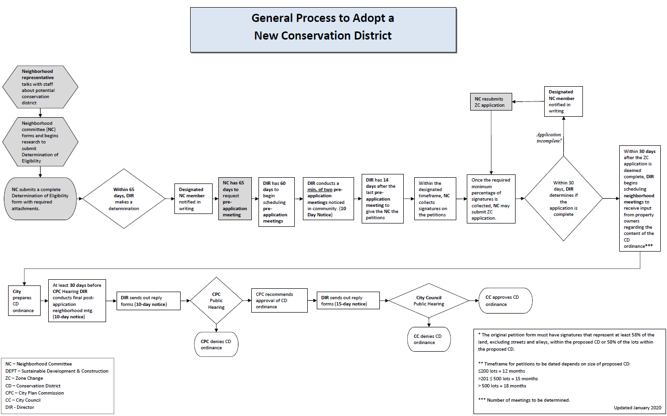
Notes:
Once the petitions are verified, the neighborhood committee submits the zoning change application and fee.
If you get 75% or more verified signatures on your petition, the fee will be waived.
This, then is the beginning of the zoning change process.

Slide 11
DOE SUBMITTED BY INTERESTED PARTIES
Neighborhood committee picks up petitions
Not signing means you are opposed to a district forming
Informational meetings to gauge interest
*YOU ARE HERE
Signing means you are in favor of a district being formed.
If 58%+ of the neighborhood signs the petitions, the process for creating an ordinance will begin
Ordinance discussions
-What should be included in ordinance?
- Draft Review Meeting
CPC Meeting
-Submit comments on Favor/Opposition
City Council Meeting
-Submit comments on Favor/Opposition
Notes:
Once the petitions are verified, the neighborhood committee submits the zoning change application and fee.
If you get 75% or more verified signatures on your petition, the fee will be waived.
This, then is the beginning of the zoning change process.

Slide 12
Conservation Districts Must Regulate:
Development Standards:
Accessory structures
Building & structure height
Density
Fences & walls
Floor area ratio
Lot coverage
Lot size
Off-street parking
Permitted uses
Setbacks
Stories
Architectural standards:
Architectural styles
Building elevations
Building materials
Chimneys
Porch styles
Roof form or pitch
Roofing materials
Windows
Notes:
Our development code regulates what can be regulated by conservation districts, and here is the list.
These are the things that are generally regulated in each district. On the next page are additional items that may be regulated if you would like.
Just because it’s regulated, doesn’t mean it has to CHANGE

Slide 13
Conservation Districts May Also Regulate:
Building relocation
Building width
Demolition
Driveways, curbs, and sidewalks
Foundations
Garage location and entrance
Impervious surfaces
Landscaping or other natural features
Massing
Paint colors
Solar energy systems and the components
Steps
Window and dormer size and location
Additional development and architectural standards, as desired
Notes:
At the end of this presentation, I am going to open up the call for comments and questions. Be thinking about what items your neighborhood wants to regulate from these last two slides

Slide 14
Considerations Specific for this area
The neighborhood committee is concerned that without a Conservation District the neighborhood may face substantial inappropriate redevelopment and encroachment.
In the discussion with the neighborhood committee about wanting Conservation District status the main goals were to:
protect architectural styles
ensure compatibility of materials used in remodeling and new construction
protect lot coverage
protect consistent setbacks
single-family land uses
regulate height of structures
regulate number of stories
All of these things could be regulated to maintain the appearance and characteristics of the neighborhood.

Slide 15
Considerations Specific for this area (cont.)
Architectural styles:
Predominately Minimal Traditional style homes exist in this district.
What styles of architecture would be allowed for new construction?
Would existing structures be required to be remodeled or added on to in their existing styles?
Architectural characteristics:
The majority of the homes are Minimal Traditional style, although seven Ranch style homes exist.
What are the characteristics of the styles that should be maintained?
Characteristics could include the building materials, roof form and pitch for all styles, window types, etc.

Slide 16
Considerations Specific for this area (cont.)
Setbacks:
Regulate the distance separation from a structure to a property line.
Building Height:
Could cap the allowable building height at a certain height. The vast majority of structures are one-story, although approximately three structures are two-story.
Accessory structure/garage:
Regulate the location of accessory structures or garages on a lot, such as behind the house, front entry garages. May also regulate the design and materials for new accessory structures or accessory structure remodels.

Slide 17
Considerations Specific for this area (cont.)
Fences:
Proposed regulations may include allowable fence heights, locations, and materials.
Driveways/walkways:
Proposed regulations may include the location and materials allowed for driveways/walkways.

Slide 18
Petition Language
Purpose of petition
Determine what the neighborhood wants to regulate and preserve
Capture the elements under discussion in preparation for longer and more detailed discussions as part of the zoning change process.
If the petition is successful, then the city and the neighborhood begin to talk through the details of what the neighborhood would like to regulate and preserve.
Meetings held as often as needed to gather input.
Notes:
The purpose is to determine what the neighborhood wants and to capture the elements under discussion. It’s a macro to micro approach, if you will.
This is the step that is easily overlooked. The petition is not the redline of the district regulations. The petition is just supposed to be a list of the categories that might be amended regulated and what elements of those categories might change.
For those that draft agreements as part of your business, the petition is a letter of intent, of sorts, or an outline of basic terms. It allows the discussion of the details to start. Consensus building is important at this step, or you are going to struggle to get the required signatures.

Slide 19
Petition Language
Petition wording must be broad enough to allow for discussion of details, yet narrow enough to allow owners to understand what is under discussion.
Example - fences
Too broad: Fences – (no detail about what is under discussion)
Too narrow: Fences - proposed regulations may include adjustments to the allowed height of fences in corner-side yards abutting Inwood Road and fence openness for side yard fences located within parkway setbacks.
Just right: Fences - proposed regulations may include allowed height, percent of open surface area, location.
Notes:
So, the perfect a good petition wouldn’t just say “fences” but it also wouldn’t does not prescribe what, exactly is up for amendment. That’s part of the conversation after the petitions are signed.
Winnnetka Heights, north of this neighborhood, is a conservation district on the national register, which requires that the viewshed to the parkways and walkways be protected. I’ve heard that the fence regulations are likely to need to be amended. At this point, though, it’s too early in the process to start digging into how tall fences can be, or what materials. At this point, the idea is to collect that the neighborhood may want to amend the regulations for fences. The details will be worked out later in the process.

Slide 20
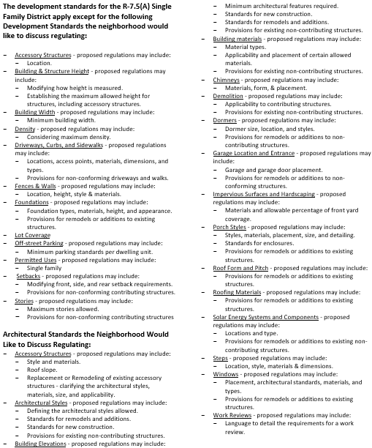
Petition Language
Petition wording must be broad enough to allow for discussion of details, yet narrow enough to allow owners to understand what is under discussion.
Example - fences
Too broad: Fences – (no detail about what is under discussion)
Too narrow: Fences - proposed regulations may include adjustments to the allowed height of fences in corner-side yards abutting Inwood Road and fence openness for side yard fences located within parkway setbacks.
Just right: Fences - proposed regulations may include allowed height, percent of open surface area, location.
Notes:
So, the perfect a good petition wouldn’t just say “fences” but it also wouldn’t does not prescribe what, exactly is up for amendment. That’s part of the conversation after the petitions are signed.
I’ve heard that the fence regulations are likely to need to be amended. At this point, though, it’s too early in the process to start digging into how tall fences can be, or what materials. At this point, the idea is to collect that the neighborhood may want to amend the regulations for fences. The details will be worked out later in the process.

Slide 21
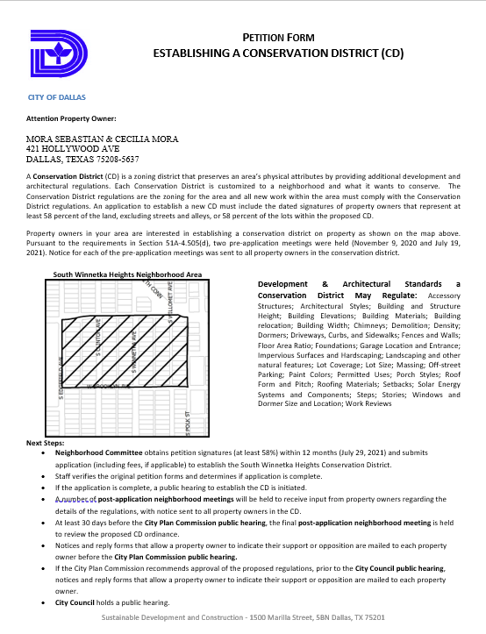
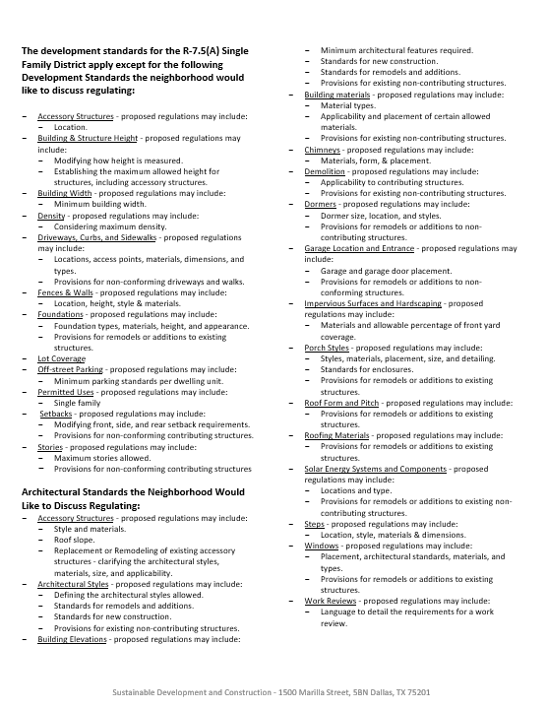
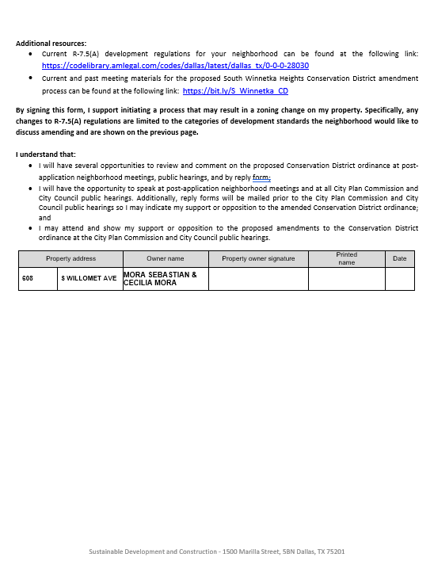
Petition Example
Neighborhood Committee will have to return the original petition form with wet signature of property owner
Notes:
So, the perfect a good petition wouldn’t just say “fences” but it also wouldn’t does not prescribe what, exactly is up for amendment. That’s part of the conversation after the petitions are signed.
Winnnetka Heights, north of this neighborhood, is a conservation district on the national register, which requires that the viewshed to the parkways and walkways be protected. I’ve heard that the fence regulations are likely to need to be amended. At this point, though, it’s too early in the process to start digging into how tall fences can be, or what materials. At this point, the idea is to collect that the neighborhood may want to amend the regulations for fences. The details will be worked out later in the process.

Slide 22
Next Steps
Neighborhood committee and property owners should meet to discuss proposed categories to create regulations.
Additional feedback should be conveyed to city staff
The city will schedule at least one more pre-application meeting (more if necessary) to confirm categories in which standards will be created.
After the last pre-application meeting, the city will provide the designated neighborhood committee member with the petition forms.
The neighborhood committee will have 12 months to obtain signatures from property owners that represent at least 58% of the lots or 58% of the land mass (excluding streets) within the CD.
If petition is successful, zoning change can be initiated.

Slide 23
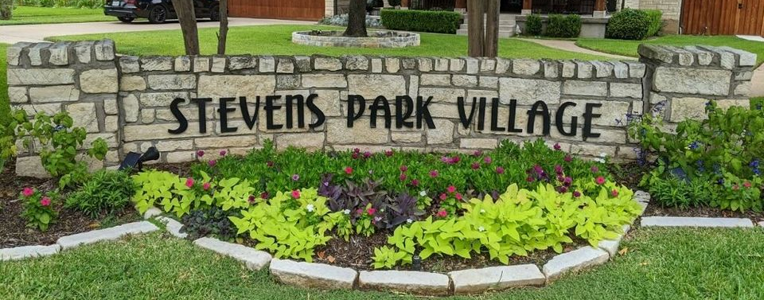
Questions?
https://bit.ly/spvconservation
Next pre-application meeting June 6

Slide 24
Proposed Conservation District Pre-Application Meeting No. 2
April 24, 2024
Staff Contacts:
Trevor Brown Melissa Parent
trevor.brown@dallas.gov melissa.parent@dallas.gov
214-670-4193 214-671-5070
Meeting materials can be found at https://bit.ly/spvconservation
Notes:
In closing, please reach out to your neighbors, discuss your ideas, and build consensus. If you have questions, call or email me.
Thank you for taking part in this effort in improving your neighborhood, your city, and your property. Civic involvement makes a good city a great city, and we really do appreciate you.
[Question and Answer]

