Slide 1
City of Dallas Urban Design Committee July 21, 2016

Slide 2
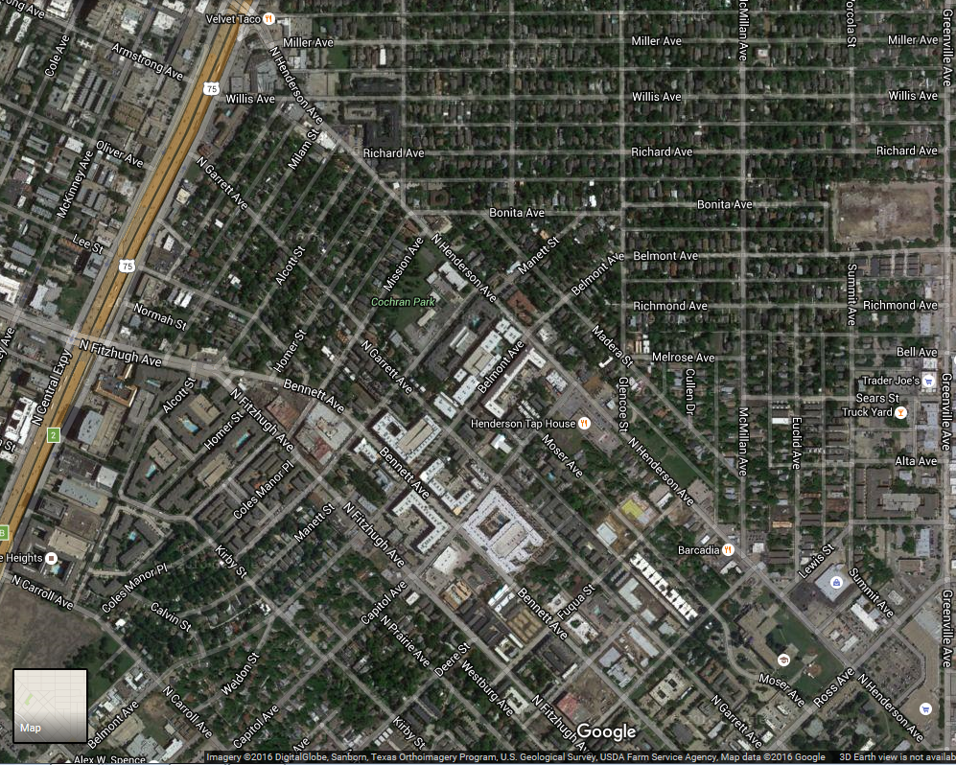
The Henderson Corridor
U.S. 75
Henderson Ave.
Ross Ave.

Slide 3
Overview of Planning Initiatives for Henderson Avenue
Authorized hearing for all of PD 462
2) Complete Streets
3) Pending zoning request from Glencoe to McMillan (z145-300)
4) Public Improvement District

Slide 4
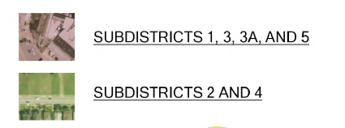
Authorized Hearing – PD 462

Slide 5
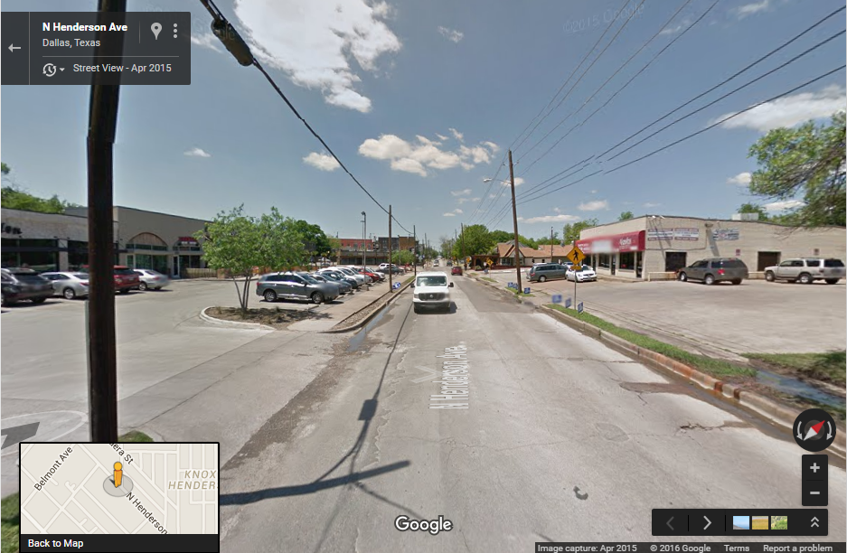
Complete Streets
VS.

Slide 6
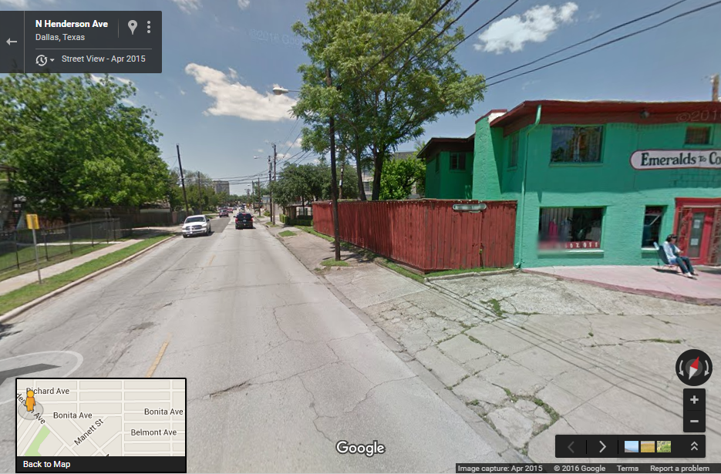
Possible PID

Slide 7
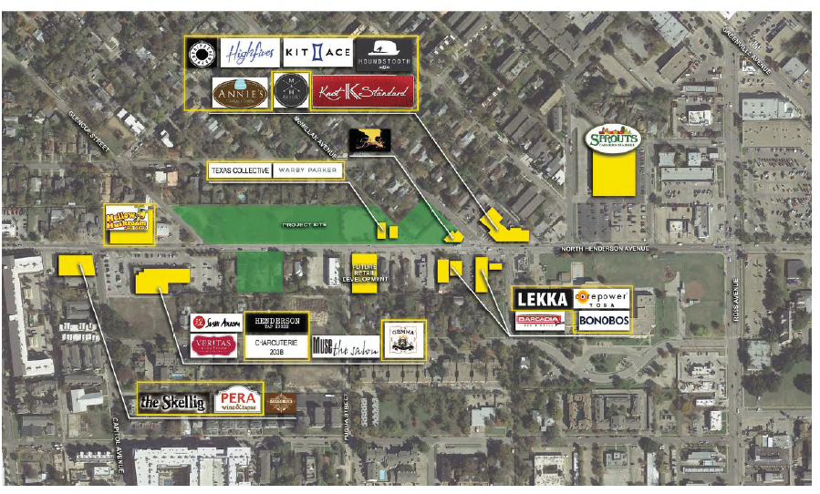
Pending Zoning Request

Slide 8
Potential Improvements to PD 462
Existing
Potential
Focus on architectural guidelines (e.g., façade materials, seasonal color, decorative pavement).
Article X landscaping
Focus on urban design (e.g. pedestrian amenities, sidewalk width, concealing parking structures, buildings closer to the street).
Parkway landscaping

Slide 9
Objectives of Existing PD
Accommodate the existing mix of uses in the area.
Protect the integral and adjacent stable residential neighborhoods.
Preserve and enhance the architectural and cultural significance of the area.
Strengthen neighborhood identity.
Create a more desirable pedestrian environment.

Slide 10
Questions?

Slide 11
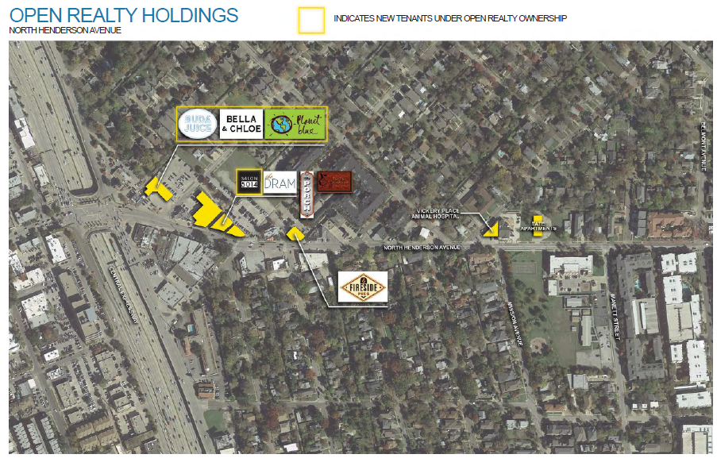

Slide 13
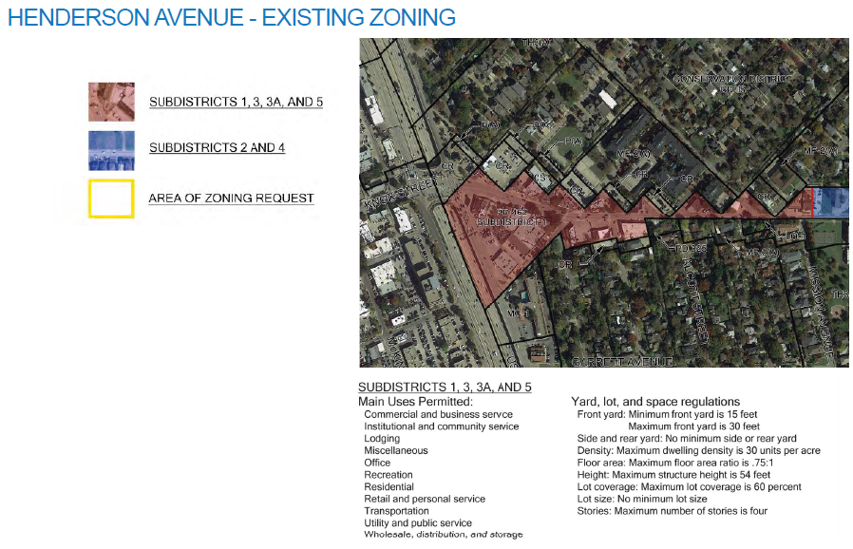

Slide 14
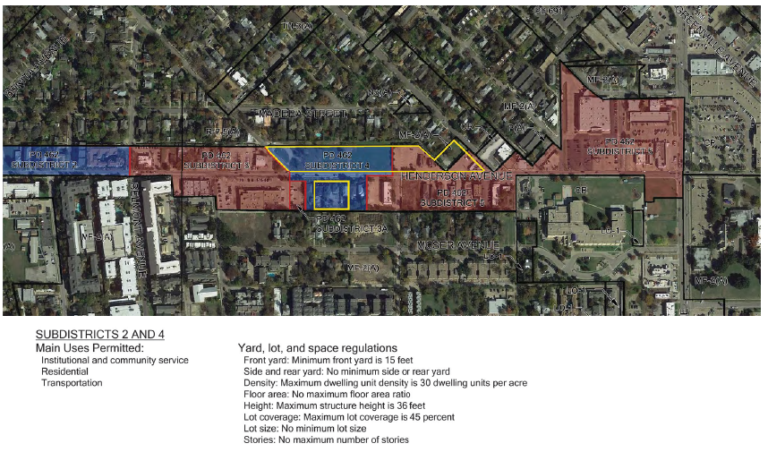

Slide 15
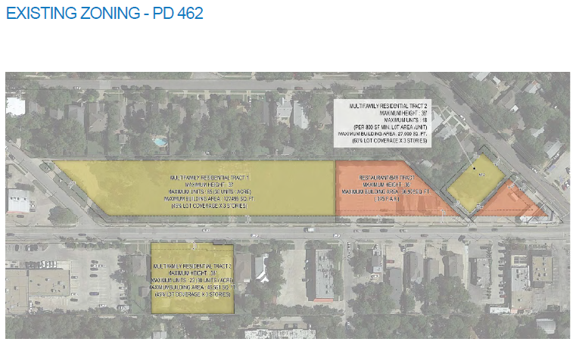

Slide 16
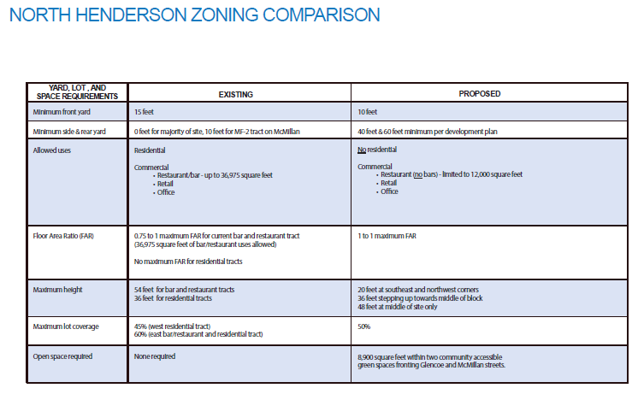

Slide 17
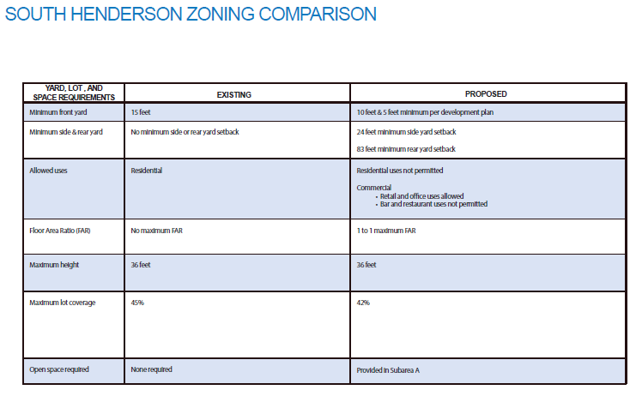

Slide 18
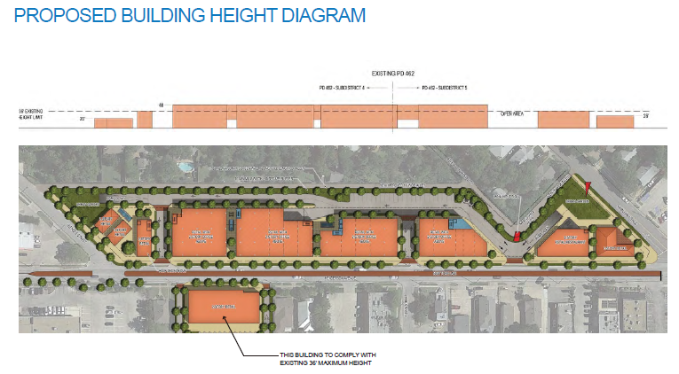

Slide 19
