Slide 1
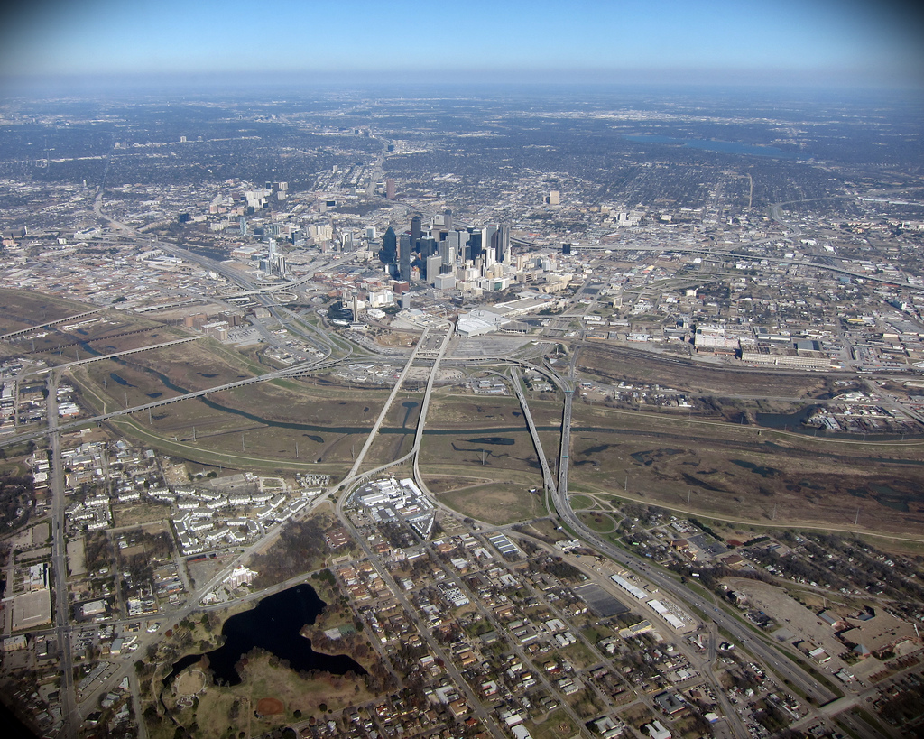
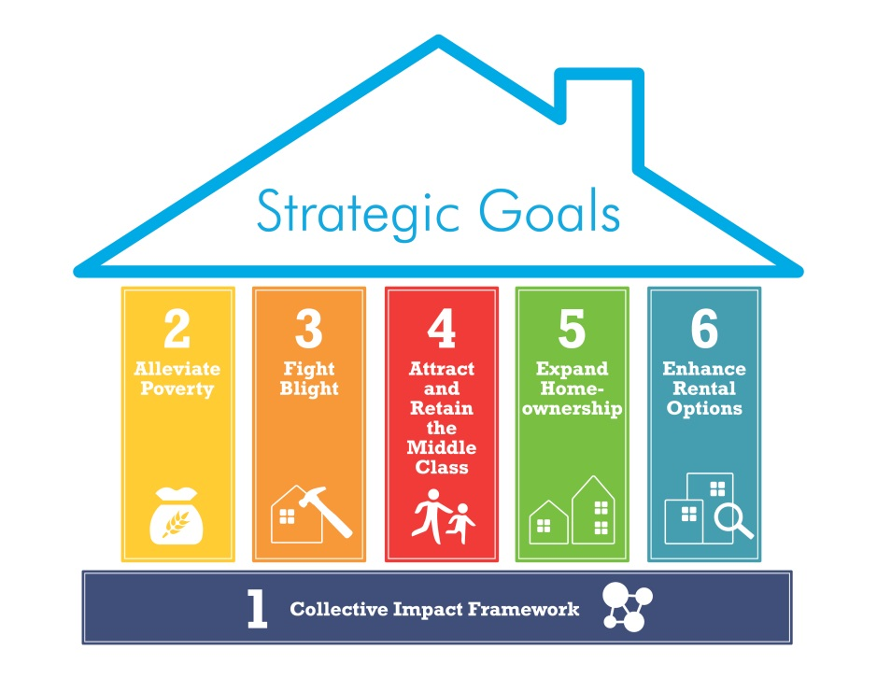
Vickery Meadow Target Area
District 13
Councilmember Gates
Team Leader Monique Ward
June 2016

Slide 2
Target Area Highlights
Ethnically diverse with about 50 different ethnicities, many immigrants and refugees
Low income levels; over 34% of households below poverty level (citywide-24%)
High proportion of households with children (35.4%); mostly concentrated at the center and upper parts; Area attracts young couples with children
Rental housing dominate (94%) and almost entirely multifamily
Majority of housing consist of older multi-family apartments and condos built in the 1970’s
Commercial land use along Greenville includes a Walmart, ethnic grocery stores and health clinics affiliated with adjacent Texas Health Presbyterian Hospital medical district
Property values around Greenville Avenue have increased more than twice the city mean, but decreased everywhere else within target area
High number of condo improvements along Fair Oaks, north of Park Lane
Proximity to major parks, but lacking community facilities like recreation centers
Poor sidewalks, street conditions and roadway configuration
2 TIFs (Vickery Meadow, Skillman Corridor), 2 PIDS.
Potential to partner with Vickery Meadow Management Corporation/ Vickery Meadow Improvement District
Area has an adopted TOD Plan developed in 2013 under the HUD Community Challenge Planning Grant

Slide 3
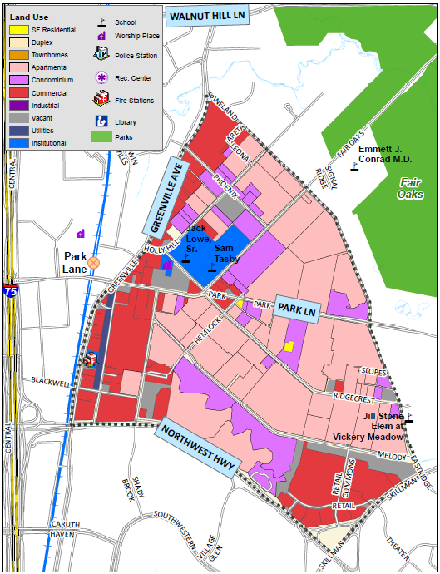
Vickery Meadow Target Area Land Use Map
* Source: DCAD 2015

Slide 4
Vickery Meadow Demographics
Total Population: 20,067
Households: 7,513
Age
Younger population, 68% below 35 years old
Households with children 35%
High concentration of senior-led households at the center
Very large household size,6 people per household- average
Race/Ethnicity
Ethnically diverse, over 50 different languages spoken in the area
Majority Hispanic (51%)
Has many African immigrants
Educational Attainment
High school 64.8% (citywide74%)
Bachelors degree or higher 20.1%
(citywide 32%)
* Source: 2010-2014 5 year ACS Estimates

Slide 5
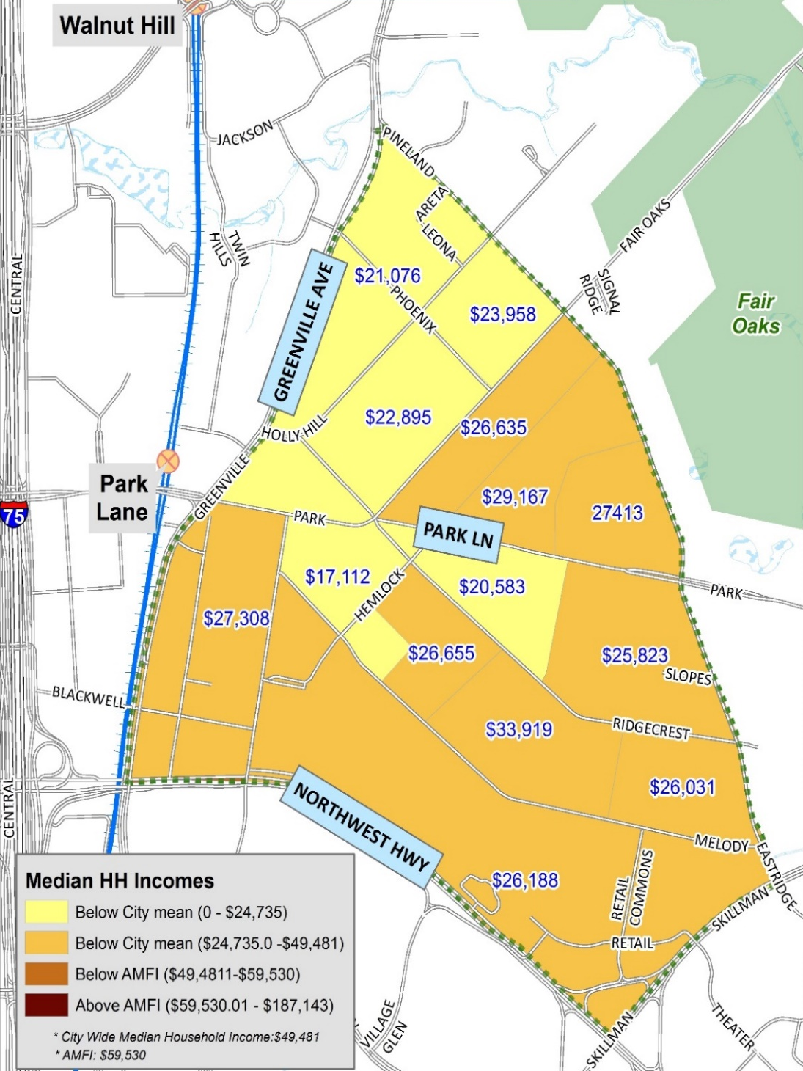
Income
2010-2014 Median Household Income
Citywide median Household Income: $49,481
Low income levels throughout
Area’s median household income of $26,411 is 51% of the city’s median household income ($49,481)
About 58% of households earn less than $30,000 a year
Poverty level 34% (citywide 24%)
Low income households concentrated in the northern part
* Source: 2010-2014 5 year ACS Estimates

Slide 6
Housing Overview
Housing Type:
Predominantly multi-family housing consisting of older (low-quality) mid-density apartment complexes built in the 1970’s and 1980’s
Housing Tenure/Vacancy
Rental housing (94%) dominate; homeownership is only 6% (citywide rate - 43%)
Housing vacancy 21% (citywide - 11.2%)
Very few single-family(SF) homes, only one single-family rental home
Housing Conditions
86% of SF housing above average condition, significantly better than city average
Housing conditions generally good throughout target area
Property Value
Property values increased more than twice the city average along lower portion of Greenville Avenue, but decreased mostly everywhere else within target area
Increase primarily as a result of the development of the Shops at Park Lane
New Construction/Improvement Activity
9 new single-family homes, several home improvement activities throughout target area, particularly in the apartment complexes east of the “Five Points”.
Notes:
Increase in property values resulting from the development The Shops at Park Lane, a 2.4-million sq. ft mixed-use development containing more than 700,000 square feet retail, restaurants and entertainment space is anchored by Whole Foods grocery stores

Slide 7
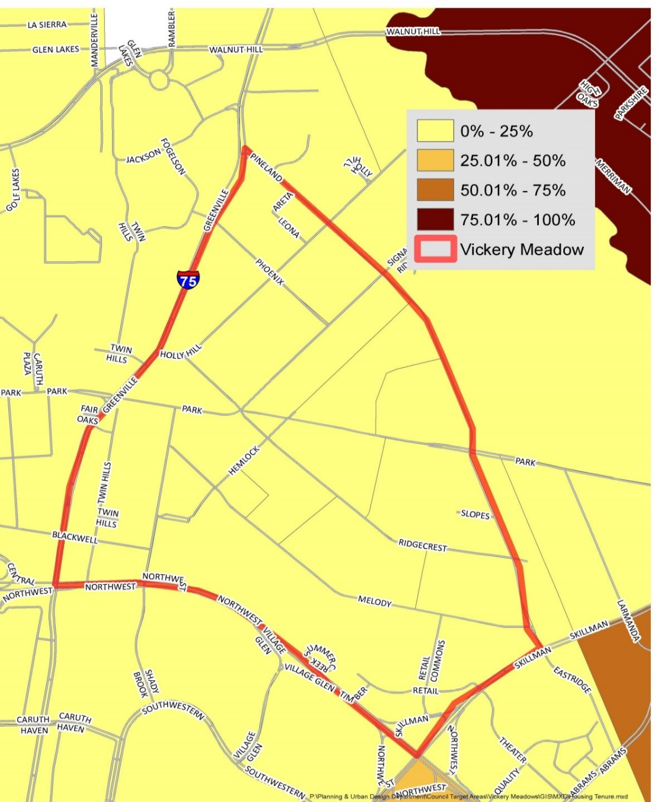
Housing Tenure/Vacancy
2010-2014 Percentage of Senior Led Housing
Housing Tenure Breakdown
Renter | 7,057 | 93.9%
Owner | 456 | 6.1%
Housing Vacancy
Vacant units | 1,972 | 20.8%
Occupied units | 7,513 | 79.2%
Citywide Homeownership Rate: 43%
* Source: 2010-2014 5-Year ACS Estimates

Slide 8
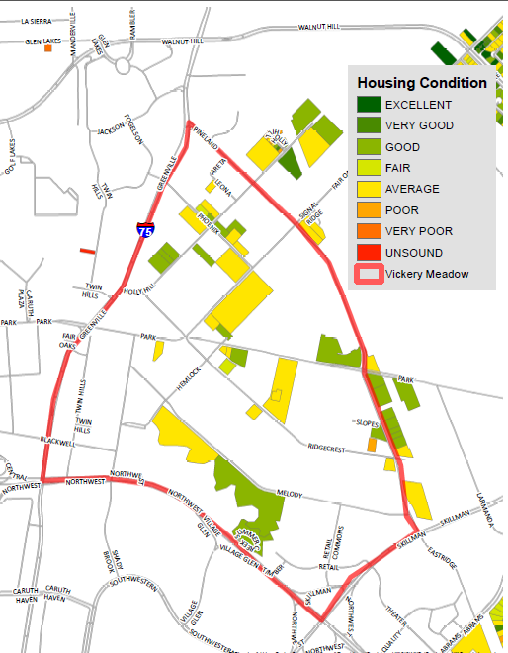
Single-Family Housing
Conditions: 2015
Very few single-family homes in the target area
* Source: DCAD 2015
8

Slide 9
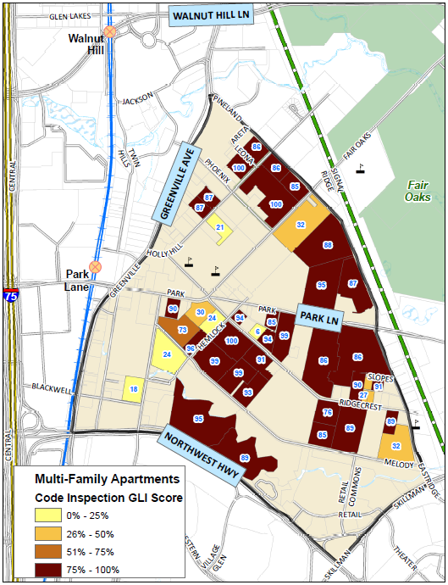
Multi-Family Apartments
Code Inspection Ratings
2015 Street Conditions
The Code Compliance department inspects multifamily properties on a 0 to 100 score, 85 and above is a passing score. Interior and exterior factors are considered
* Source: City of Dallas Code Compliance Department

Slide 10
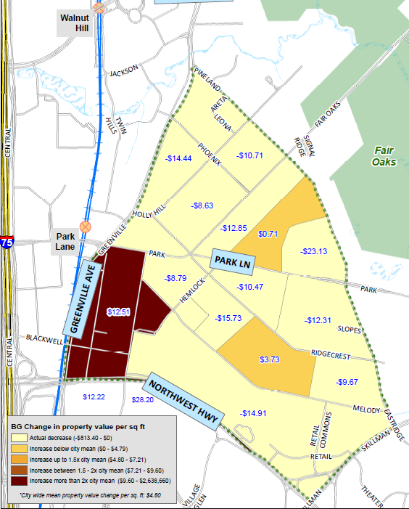
Change in Property
Value per Square Foot:
2010-2015
Citywide mean Change in Value: $4.8 per SF.
Most block groups decreased in property values, with only three block groups experiencing an overall increase
The block group at the northeast corner of Greenville and Northwest Highway experienced significant increase in property value ($12.51) due to its proximity to the “Shops at Park Lane”, a major mixed-use development along I-75
* Source: DCAD 2010 & 2015 Property Appraisal
* Source: DCAD 2010 & 2015 Property Appraisal
10

Slide 11
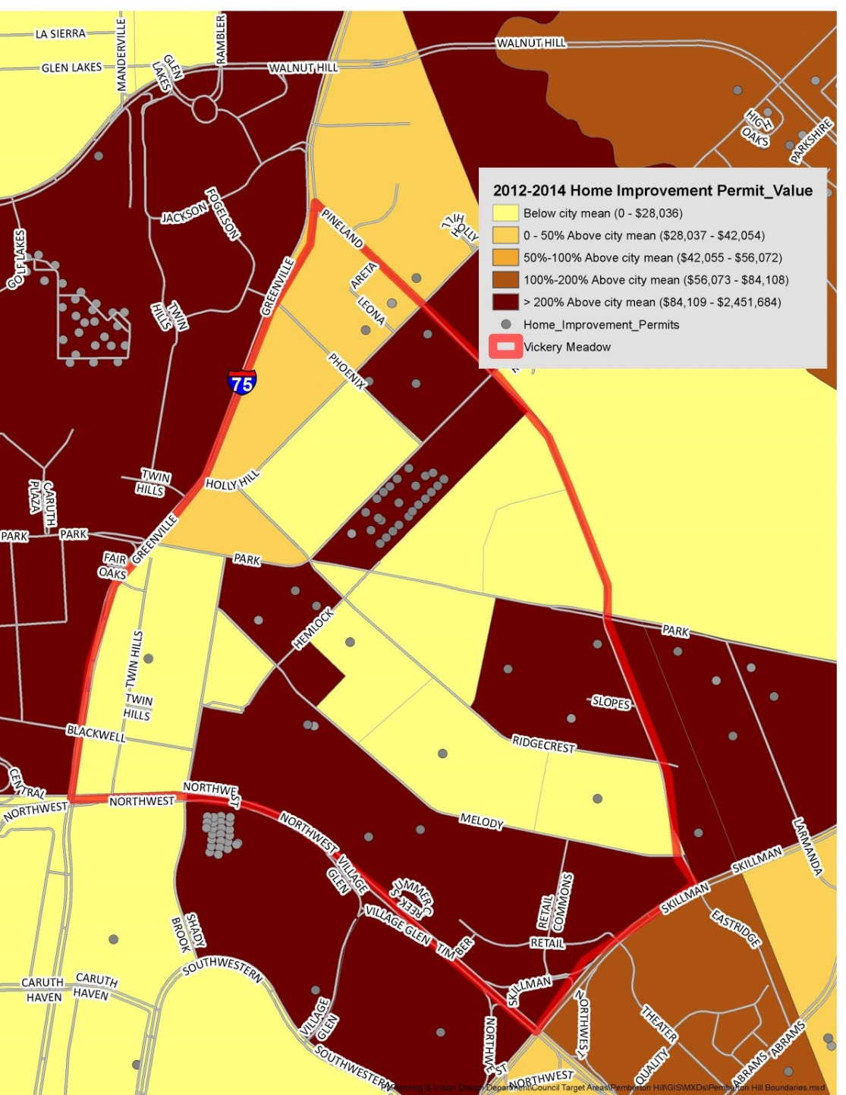
Home Improvement
Permits:2012-2014
2012-2014 Home Improvement Permits
Home improvement permits concentrated near the Five Point, adjacent to Hemlock and Park Lane
Pockets of home improvement activities throughout the target area
Citywide BG Mean Permit Value: $ 28,038
* Source: City of Dallas 2012- 2014 Permit data

Slide 12
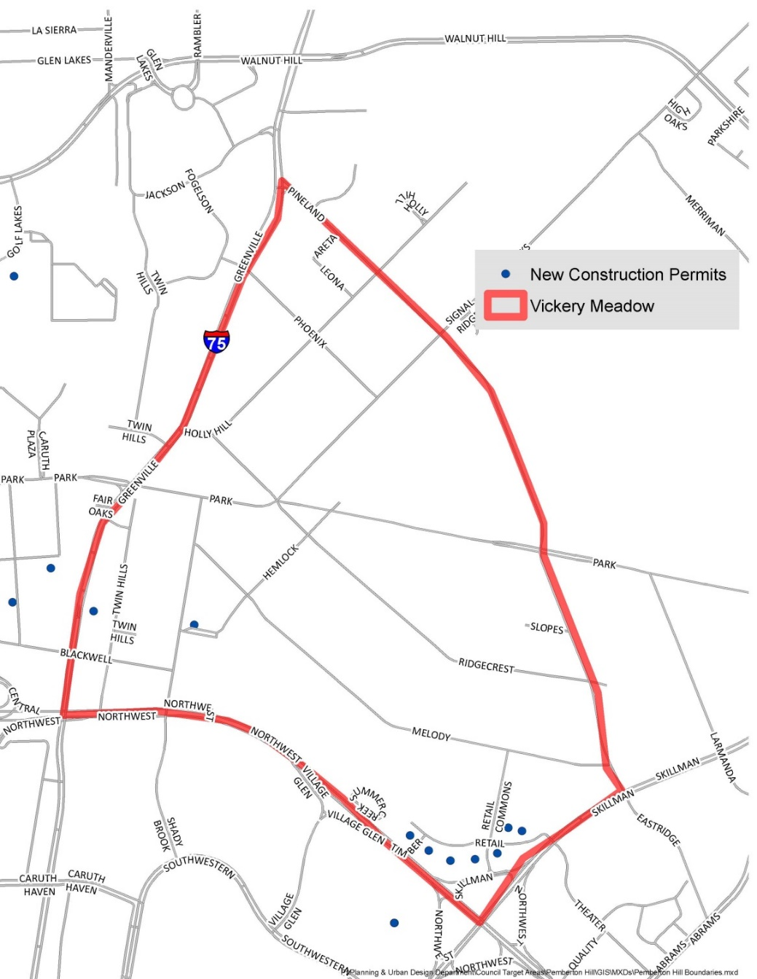
2012-2014 New Single-Family Homes
2012-2014 New Single Family Homes
Few single-family homes (9); most of them concentrated in the southern edge, along Skillman and Northwest Highway
* Source: City of Dallas 2012- 2014 Permit data

Slide 13
City of Dallas Initiatives
Department | Initiatives
Economic Development | Vickery Meadows TIF; Dallas B.R.A.I.N. at Skillman library; potential multifamily project involving the construction of a new Vickery Meadows library branch---will also involve 9% LIHTC
Library | Skillman Southwestern – income tax assistance; Skillman Players (theater group for seniors); 1 on 1 computer classes; English Conversation for Adults Forest Green – income tax assistance; GED classes; 1 on 1 computers classes Audelia Road – ESL classes in partnership with Richardson Adult Learning Center; 1-on-1 Job Application Assistance; computer classes; income tax assistance; afterschool programming (note: all schools in this area are Richardson ISD); Dallas B.R.A.I.N. office hours and programming
Parks and Recreation | This area has been identified as a high need area for parkland by the Trust for Public Land in 2015.
Other: Water Utilities, Public Works/Street Services, | Information in Appendix (See Bond Projects & Water Utilities maps)

Slide 14
Target Area Matrix
Category |  | Notes
In CDBG Eligible Area? | Yes
In a DPD TAAG Area? | Yes
DART Station Within ½ Mile? | Yes | Park Lane Station
Community Prosecution Area? | Yes
Parks Within ¼ Mile? | Yes | Fair Oaks (233 Acres), Harry S. Moss Park
TIF/PID? | Yes | Skillman Corridor TIF, Vickery Meadow TIF, Vickery Meadow Premium PID, Vickery Meadow Improvement District
Library? | No
Dallas ISD? | Yes | Jack Lowe Sr. Elementary School, Sam Tasby Middle School, Jill Stone Elementary School at Vickery Meadow
Charter School? | No
Recreation Center? | No
Major Issues: |  | Substandard Structures including plumbing issues and inoperable apartments Confined animals Fire Inspection Street Repair (Routine) Additionally: Animal cruelty, abandoned Shopping Carts

Slide 15
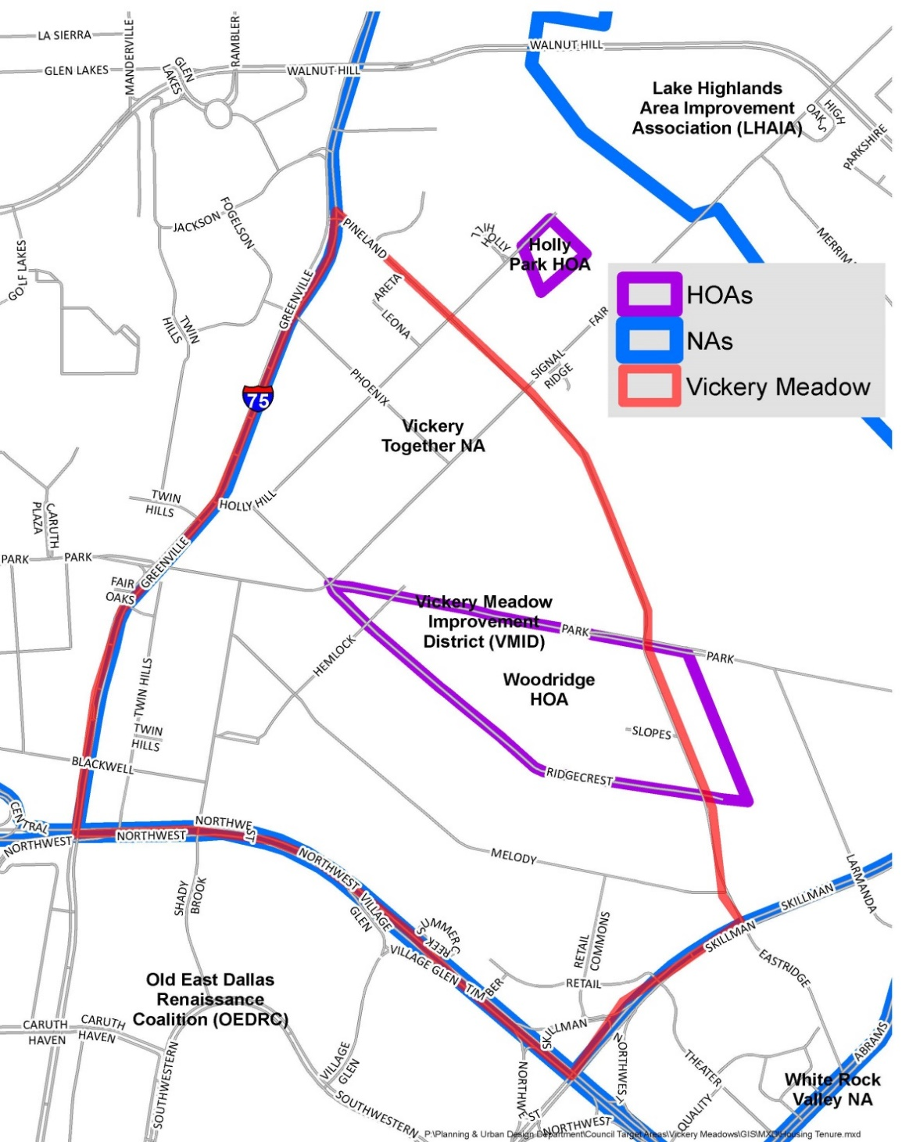
Homeowner and Neighborhood Association Groups
Homeowner Association & Neighborhood Association
Neighborhood Associations
Vickery Together NA
White Rock Manager's Meeting*
Preston Royal NW NA
Homeowner Associations
Woodbridge HOA
Royal Highlands HOA
Crime Watch Groups
Vickery Together
Preston Royal NW NA*
Royal Highlands HOA*
* Source: City of Dallas Planning & Urban Design Department

Slide 16
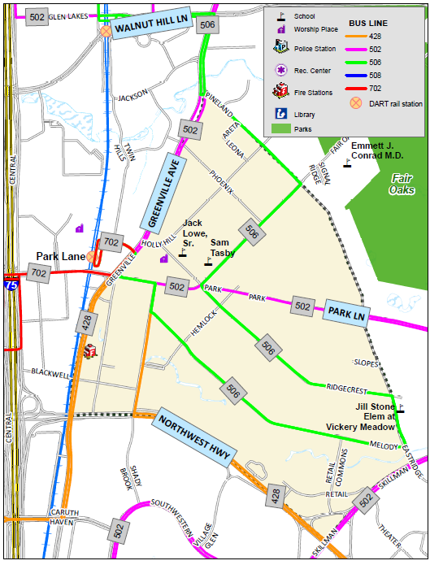
2015 Street Conditions
Transportation
Good public transportation; served by 5 bus lines
Proximity to 2 DART rail stations
Modes of travel to work:
Public transit 11.1% (Citywide - 4.1%)
Automobile 78.6% (citywide – 88%)
* Source: DART

Slide 17
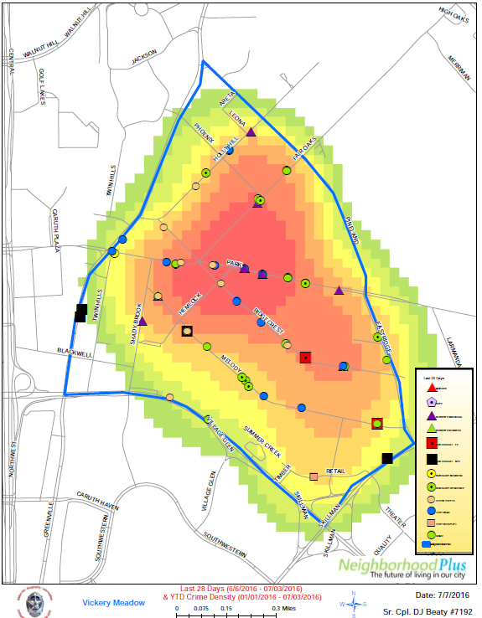
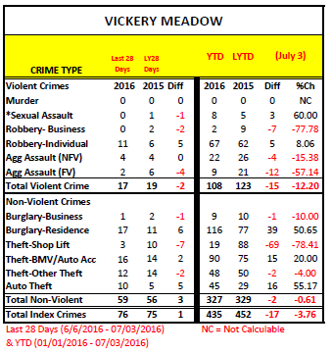
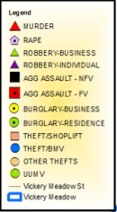
Crime Statistics
* Source: Dallas Police Department

Slide 18
Appendix
18

Slide 19
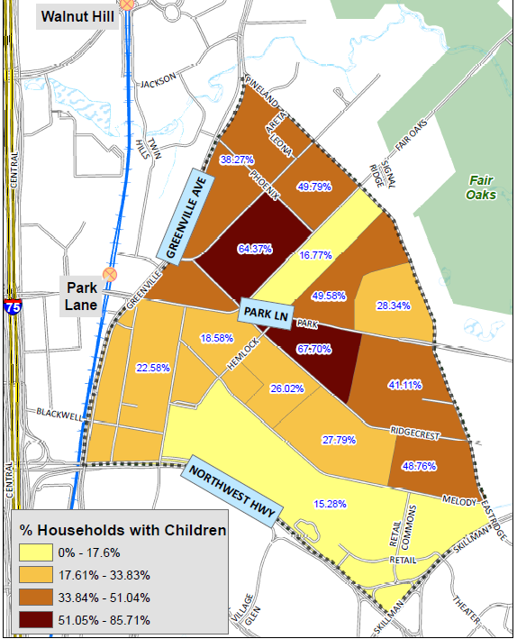
Households with Children: 2010-2014
2010-2014 Percentage of Households with Children
More children (17 years old and under) in the northern segment with highest concentration around the “Five Points” intersection
Citywide Rate: 33%
* Source: 2010-2014 5-Year ACS Estimates

Slide 20
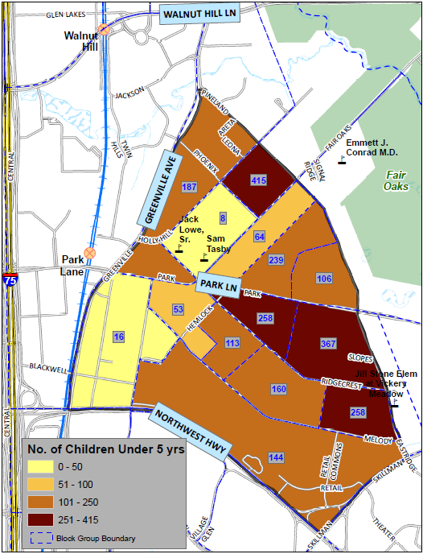
No. of Children under 5 years: 2016
2015 Street Conditions
High concentration of children under 5 years old in the eastern segment
* Source: 2010-2014 5-Year ACS Estimates

Slide 21
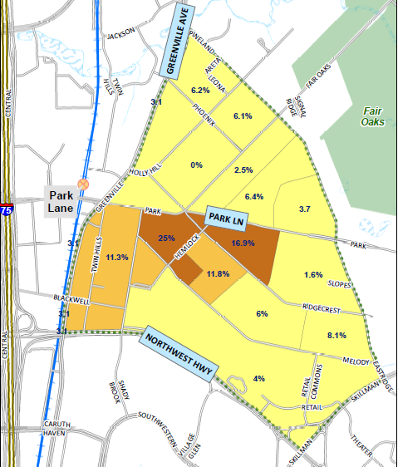
Households headed by Seniors (65yrs.& above)
High concentration of senior-led households at the center; south of the “Five Points” intersection
* Source: 2010-2014 5 year ACS Estimates
21

Slide 22
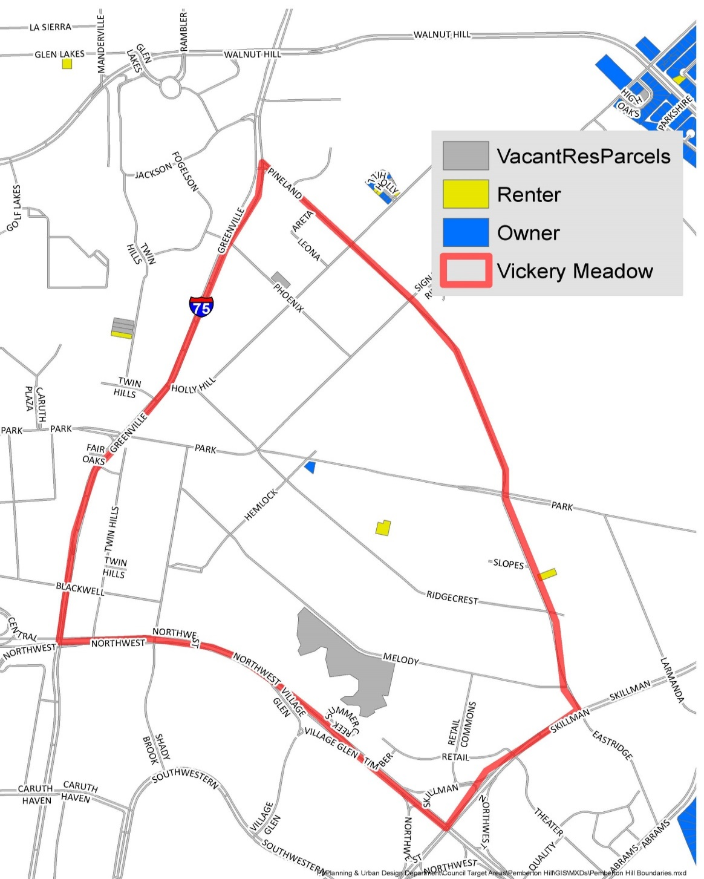
Single Family Rental/Ownership (2010-2014)
Single Family
Rental/ Ownership:
2010-2014
Single-family homes almost non existent in the target area; only one rented and one owner-occupied
* Source: 2010-2014 5-Year ACS Estimates

Slide 23
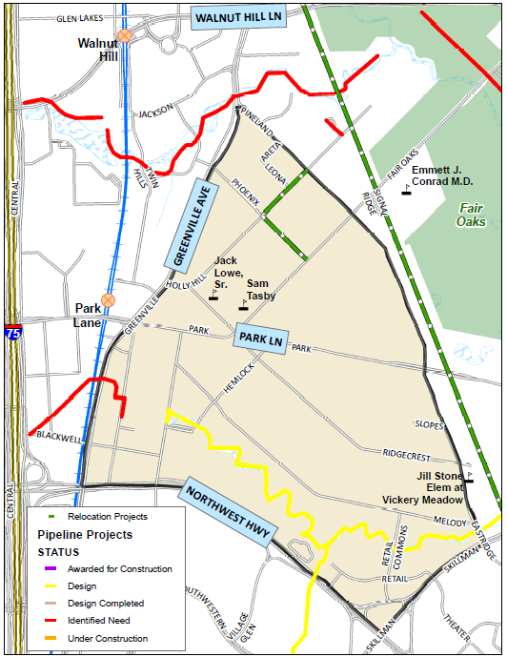
Water Utilities Projects
2015 Street Conditions
* Source: City of Dallas Water Utilities Department

Slide 24
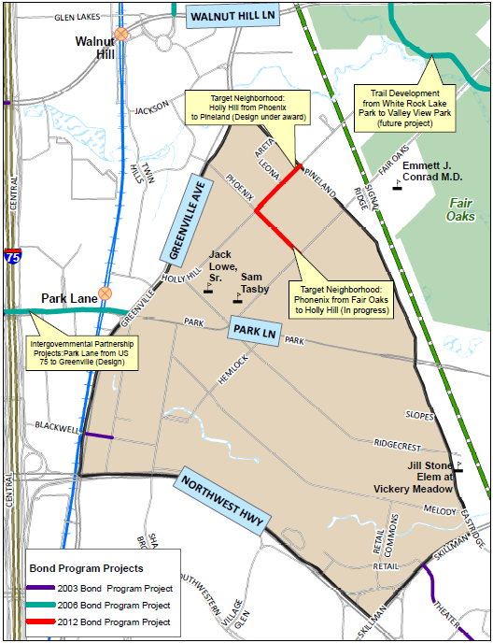
2003-2012 Bond
Projects
2015 Street Conditions
* Source: City of Dallas Public Works Department

Slide 25
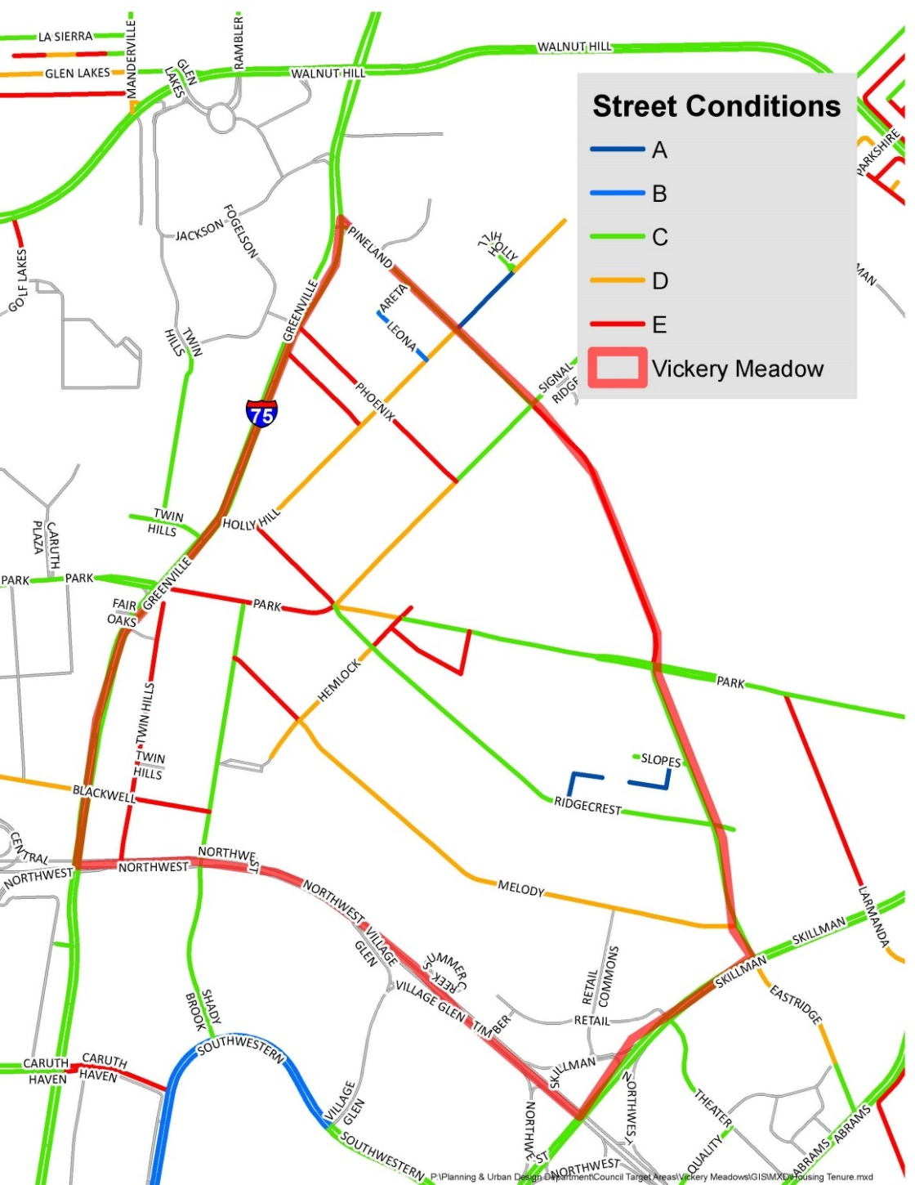
Street Conditions
Neighborhood Classification Exercise
* Source: City of Dallas, Public Works Department

Slide 26
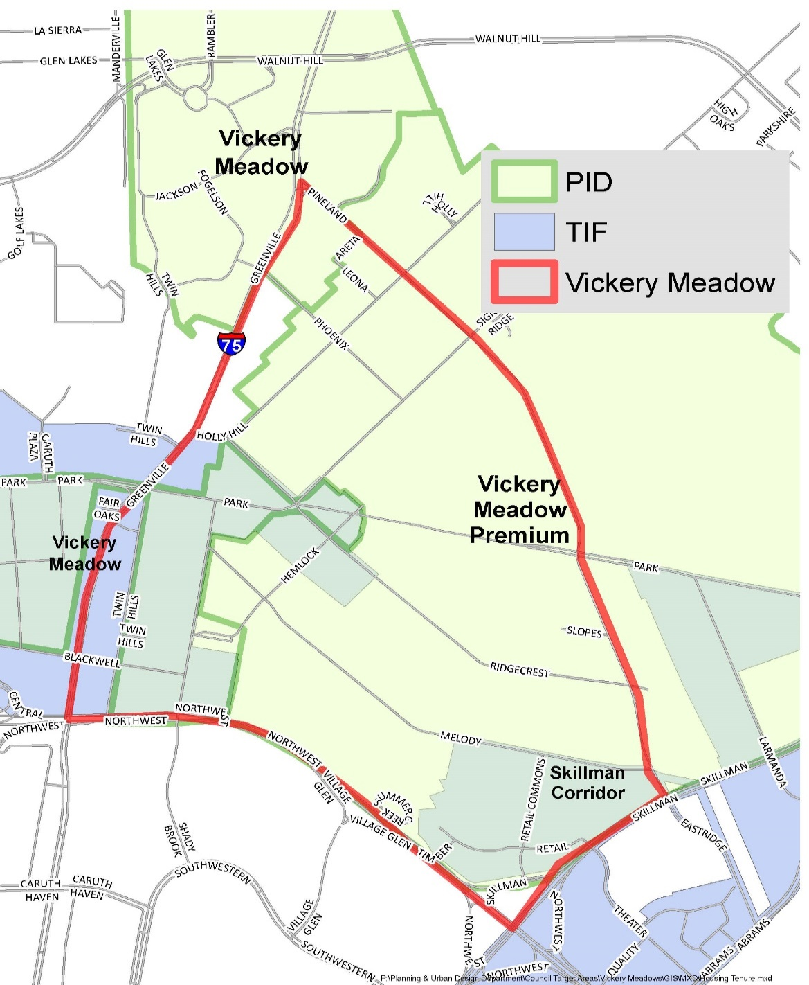
TIFs & PIDs
2015 Street Conditions
TIFs
Vickery Meadow
Skillman Corridor
PIDs
Vickery Meadow
Vickery Meadow Premium
* Source: City of Dallas Economic Development Department

Slide 27
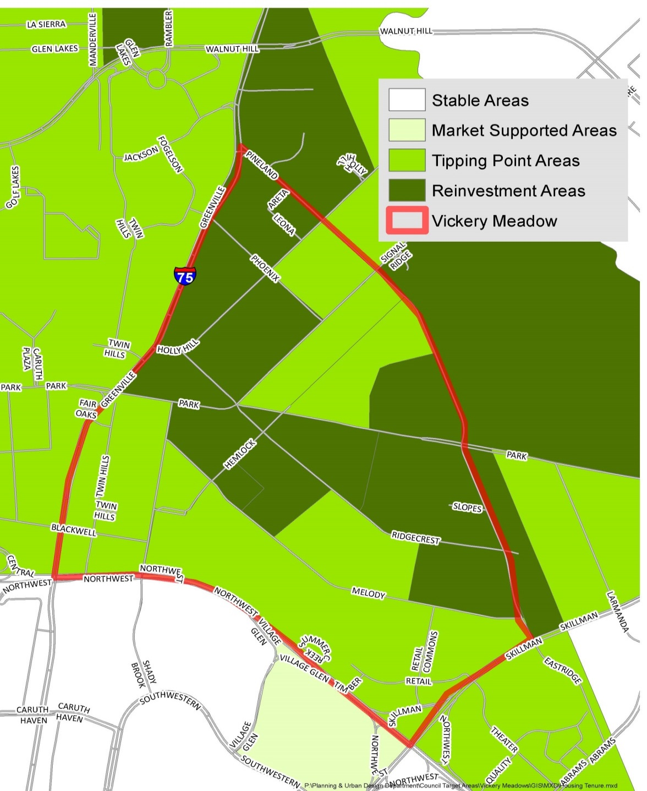
Neighborhood Classification Exercise
Neighborhood Classification Exercise
* Source: City of Dallas, Planning & Urban Design Department

