Slide 1
CD-2 - Lakewood Conservation District Expansion Post-Application Neighborhood Meeting No. 17
February 13, 2024
Trevor Brown, Chief Planner
Melissa Parent, Senior Planner
Scott Bellen, Senior Planner
Planning & Urban Design
City of Dallas

Slide 2
CD-2 - Lakewood Conservation District Expansion Post-Application Neighborhood Meeting No. 16
Staff Contact
Trevor Brown
Trevor.Brown@dallas.gov
214-670-4193
Melissa Parent
Melissa.Parent@dallas.gov
214-671-5070
Project Webpage
https://bit.ly/LakewoodExpansion
Agenda
Presentation of DRAFT ordinance
Discussion
Next Steps
Online Survey
City Plan Commission – May 2 or 16*
City Council – TBD

Slide 3
Purpose of This Meeting
This meeting is the 17th Post-Application Neighborhood Meeting to discuss the DRAFT of the proposed Conservation District Ordinance to expand the Lakewood Conservation District 2.
The proposed ordinance would modify the base zoning of the area from R-7.5(A) and R-10(A) to Tract IV of CD 2.

Slide 4
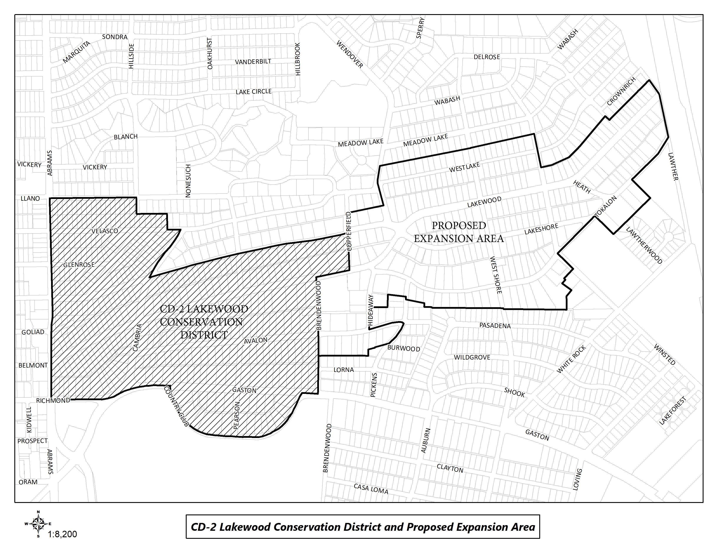
CD-2 Boundaries & Proposed Expansion Area

Slide 5
Sec. 51A-4.505 Conservation Districts
(b) Findings and purpose.
(1) State law authorizes the city of Dallas to regulate the construction, alteration, reconstruction, or razing of buildings and other structures in "designated places and areas of historic, cultural, or architectural importance and significance."
(2) Conservation districts are intended to provide a means of conserving an area's distinctive character by protecting or enhancing its physical attributes.
(3) Conservation districts are distinguished from historic overlay districts, which preserve historic residential or commercial places; neighborhood stabilization overlay districts, which preserve single family neighborhoods by imposing neighborhood- specific yard, lot, and space regulations that reflect the existing character of the neighborhood; and planned development districts, which provide flexibility in planning and construction while protecting contiguous land uses and significant features.

Slide 6
Sec. 51A-4.505 Conservation Districts
(4) The purpose of a CD is to:
(A) protect the physical attributes of an area or neighborhood;
(B) promote development or redevelopment that is compatible with an existing area or neighborhood;
(C) promote economic revitalization;
(D) enhance the livability of the city; and
(E) ensure harmonious, orderly, and efficient growth.

Slide 7
Sec. 51A-4.505 Conservation Districts
Determination of Eligibility:
The area contains at least one blockface.
The area is either "stable" or "stabilizing" as defined in this section.
The area is compact and contiguous with boundary lines drawn to the logical edges of the area or subdivision, as indicated by a creek, street, subdivision line, utility easement, zoning boundary line, or other boundary.
At least 75 percent of the lots are developed with main buildings that are at least 25 years old.
The area has physical attributes that include recognizable architectural style(s).

Slide 8
Conservation Districts Must Regulate:
Development Standards:
Accessory structures
Building & structure height
Density
Fences & walls
Floor area ratio
Lot coverage
Lot size
Off-street parking
Permitted uses
Setbacks
Stories
Architectural standards:
Architectural styles
Building elevations
Building materials
Chimneys
Porch styles
Roof form or pitch
Roofing materials
Windows
Notes:
Our development code regulates what can be regulated by conservation districts, and here is the list. This is the first proposed CD expansion since new City Code language was adopted by City Council in 2015.
At the time the original CD 2 was created, these topics were not listed in the City Code.
These are the things that are generally regulated in each district. On the next page are additional items that may be regulated if you would like.

Slide 9
Additional Standards that the Expansion May Regulate
These additional standards are optional and are not required for the petition, but once the petition is provided by the City, no additional standards may be added except as authorized by CPC.
Additional Optional Standards (not limited to)
Developmental
Building relocation
Building width
Driveways/curbs/sidewalks
Steps
Garage location and entrance
Landscaping
Impervious Surfaces
Massing
Additional development standards as desired
Architectural
Foundations
Demolition
Paint colors
Solar Energy Systems
Window and dormer size and location
Additional architectural standards as desired
Notes:
Items included on the petition to be discussed at these meetings are specifically listed in the ordinance.

Slide 10
Process for expanding a CD
On April 12, 2022 the City approves the Determination of Eligibility for the proposed expansion area which initiated the process to potentially expand regulations in CD-2.
On April 28, 2022 the City mails the notification for a Pre-Application Meeting and provided petitions to the Neighborhood Committee.
The Neighborhood Committee has 60 days to get support from at least 58% of all property owners in the proposed expansion area by signing of the official petition by the owner on the last certified municipal tax roll.
Notes:
Important dates in our specific process.

Slide 11
Process for expanding a CD
On May 23, 2022 the City holds the Pre-Application Meeting at The Filter Building on White Rock Lake with property owners to discuss the process and list of categories of development and architectural standards the property owners are interested in adopting or adding to the proposed expansion area. Focus is on broad categories.
Neighborhood Committee submits signed original petitions to the City for verification on June 27, 2022.
68% of petitions returned to City and verified on July 26, 2022.

Slide 12
Process for expanding a CD
City staff holds Post-Application Neighborhood Meetings to discuss and develop detailed regulations in each of the categories listed in the petition.
At the conclusion of these meetings, City staff prepares ordinance
City holds additional Neighborhood Meeting to review draft ordinance language. (Meeting notices mailed 2 weeks prior to meeting)
City Plan Commission public hearing and recommendation
City Council public hearing and decision
YOU
ARE
HERE
Notes:
Notification will be mailed of CPC and CC hearings – area + 500’ buffer; anyone can speak to the item at these hearings.

Slide 13
Meeting Schedule
Post-Application Neighborhood Meeting #1 – August 31
Process, schedule, driveways and curbing
Post-Application Neighborhood Meeting #2 – September 14
Driveways and curbing, sidewalks, front yard coverage, uses and parking, density, lot coverage
Post-Application Neighborhood Meeting #3 – September 26
Lot size, slope/drainage
Post-Application Neighborhood Meeting #4 – October 12
Building height & stories, Floor Area Ratio
Post-Application Neighborhood Meeting #5 – October 26
Floor Area Ratio, setbacks-main
Post-Application Neighborhood Meeting #6 – November 9
Setbacks-main, setbacks-accessory

Slide 14
Meeting Schedule
Post-Application Neighborhood Meeting #7 – November 16
Setbacks-accessory, accessory structures, solar, waterfall steps
Post-Application Neighborhood Meeting #8 – November 30
Solar, waterfall steps, fences and walls
Post-Application Neighborhood Meeting #9 – December 7
Contributing architectural styles (new construction standards, remodel/addition standards, areas of regulation)
Post-Application Neighborhood Meeting #10 – December 14
Contributing architectural styles (new construction standards, remodel/addition standards, areas of regulation), demolition
Post-Application Neighborhood Meeting #11 – January 4
Demolition, paint
Post-Application Neighborhood Meeting #12 – January 18
Landscape (tree preservation), demolition

Slide 15
Meeting Schedule (cont.)
Post-Application Neighborhood Meeting #13 – February 13
Roofing materials, windows
Post-Application Neighborhood Meeting #14 – March 1**
Porches, chimneys, work reviews
Post-Application Neighborhood Meeting #15 – March 8
Porches, chimneys, work reviews, recaps
Final Post-Application Neighborhood Meetings
Ordinance Review Feb 6 & 13, 2024
City Plan Commission – May 2024
City Council – TBD
**Rescheduled meeting due to January 31 meeting cancelled due to winter storm.

Slide 16
Procedure
To speak during the discussion portions of tonight’s meeting:
Please raise your hand and wait to be recognized before you begin speaking
Before your comments, state your name and address for the record
All comments must be related to the topic being discussed at that time
Provide input to inform City Staff to work toward an approach to accomplish your desired objective of maintaining the character of the neighborhood.
Write name and address on comment sheets.

Slide 17
DRAFT Ordinance Organization Overview
Ordinance (Exhibit A):
Developmental Regulations
Architectural Regulations
Exhibit B:
Illustrations
Architectural Regulations – Point System
List of Property Addresses and Architectural Styles
Map of Conservation District
17

Slide 18
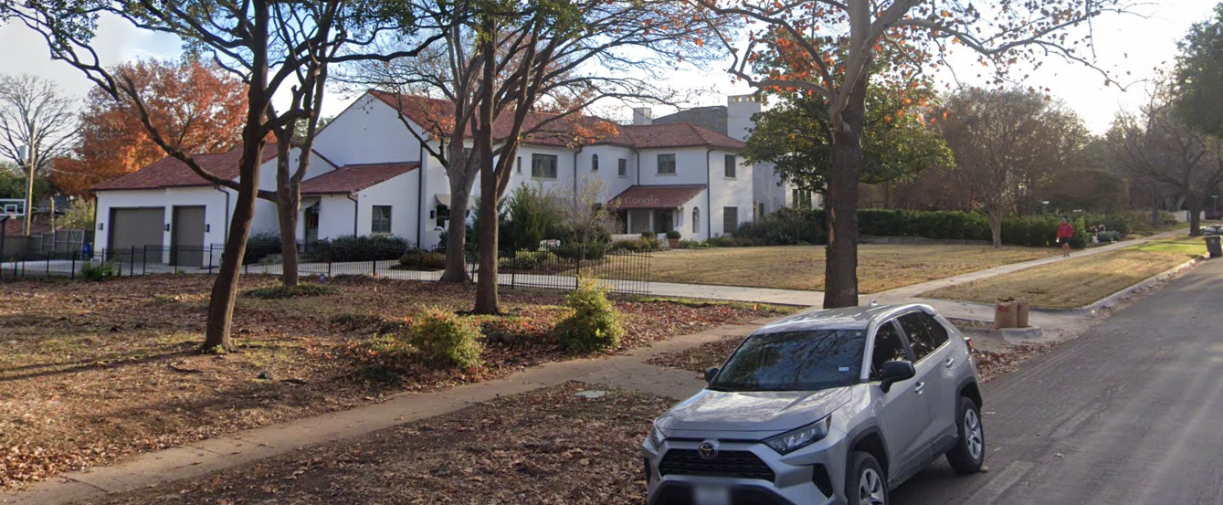
Garages, Carports, and Accessory Structures
Location
Must be located behind the rearmost facade of the main building.
For corner lots the accessory structure may not be closer to the cornerside lot line than the main building.
Attached garages are prohibited within the wrap-around.
Garage doors may not face the front street.
18

Slide 19
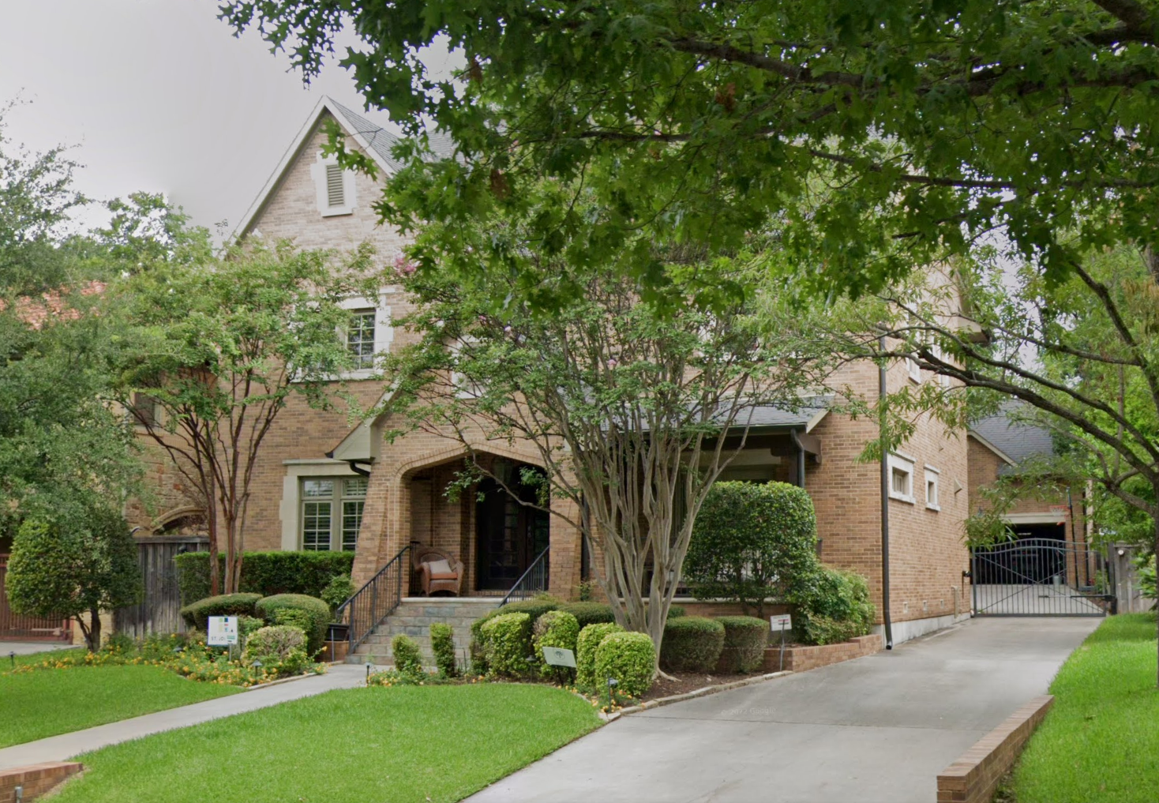
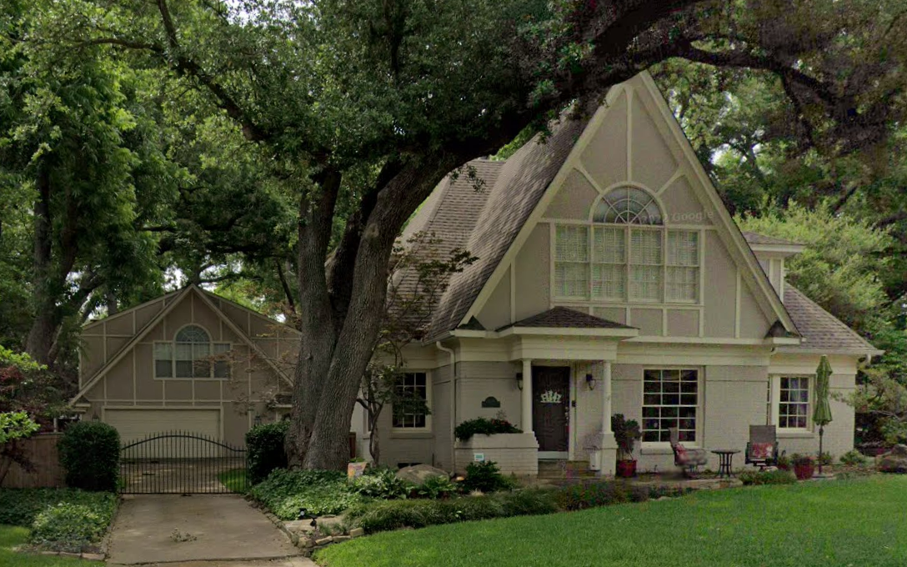
Garages, Carports, and Accessory Structures
Setbacks
Structures 24’ in height and under will require a one-foot side yard setback, and no minimum rear yard setback as long as all eaves and overhangs are within the property boundary.
Structures over 24’ in height require a minimum five-foot side and five-foot rear setback.
19

Slide 20
Garages, Carports, and Accessory Structures
Style and Materials
The color, style, design, and materials of structures that are visible from a street must be compatible with the color, architectural style, design, materials, of the main building.
If a structure is visible from the street, the slope of the roof must either match the roof slope of the main building, be compatible with the architectural style of the main building, or compatible with the roof slope of original garages.
20

Slide 21
Solar Panels
Style and Materials
Solar panels may only be located on the rear 50% or the roof of a main building.
Solar panels are allowed on 100% of an accessory structure’s roof.
Solar panels that are compatible in appearance to a traditional shingle or tile within the District may be approved for use on 100 percent of a main building. The intent of this paragraph is to allow for advancements in technology that mimic the appearance of typical roofing material (i.e. must not be glossy, shiny, shimmering) in appearance.
21

Slide 22
Paint/Color
1) A building facade may not be painted with more than one body color and can only have a maximum of three trim colors.
2) Brick and stone surfaces not painted on (day approved by City Council) may not be painted unless the applicant establishes that:
A) The color and texture of replacement brick cannot be matched with that of the existing brick surface;
B) The brick is not original or compatible with the style and period of the main building and the district; and
C) Painting is the only method by which the brick may be restored or preserved.
3) Certain colors prohibited. Fluorescent and metallic colors, and the use of black as a main body color are not permitted on the exterior of any structure in this district.
22

Slide 23
Yard, Lot, Space
Front Yard Setback
The minimum front yard setback will be equal to the average of the adjacent lots. All original or contributing homes are deemed conforming to the front yard setback requirement.
Side Yard Setback
Lots smaller than 10,000 square feet – Five feet on one side and 10 feet on the other
Lots 10,000 square feet and larger – Six feet on one side and 11 feet on the other
A 15-foot cornerside setback is required on corner lots.
Rear Yard Setback
The minimum rear yard setback is 20 feet.
The minimum rear yard setback is 10 feet for 6844 Avalon, 6850 Avalon, and 6858 Avalon.
Lot Coverage
Lot coverage for lots with original structures is 45 percent.
Lot coverage for new construction is 40 percent.
23

Slide 24
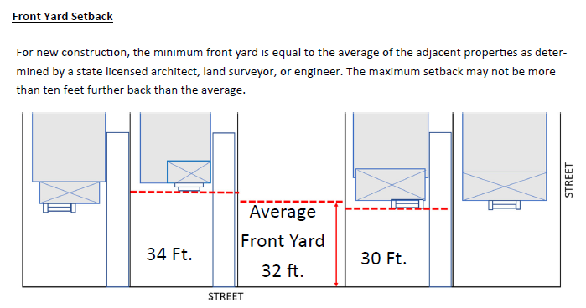
24
Notes:
FYSB deviates greatly between different streets 60’ lakewood, 40’ lakeshore, much less on Westlake. Because the neighbors at meetings wanted this area to be treated the same this was the best approach.

Slide 25
Documented Assurance
DOCUMENTED ASSURANCE means an architectural drawing, survey, or photograph delineating the original or existing appearance, height, or footprint of the structure. [This includes driveways]
In cases where an existing structure is nonconforming to the yard, lot, and space regulations, documented assurance may be used to allow for remodeling or reconstruction of the nonconforming portion of the building:
1) If the property owner provides the director with documented assurance, the portion of the structure may be renovated, remodeled, repaired, or rebuilt within the original or previously nonconforming building footprint and height:
A) with materials and features shown in the documented assurance;
B) in compliance with the development standards and architectural
standards in this district; or
C) any combination of (a) or (b); and
D) must not increase the degree of nonconformity of the structure.
2) For portions of the structure without documented assurance regarding materials
and features, the architectural standards apply.
25
Notes:
Expanded on from CD2 to allow for repair/reconstruction of areas of structures that are legally nonconforming.

Slide 26
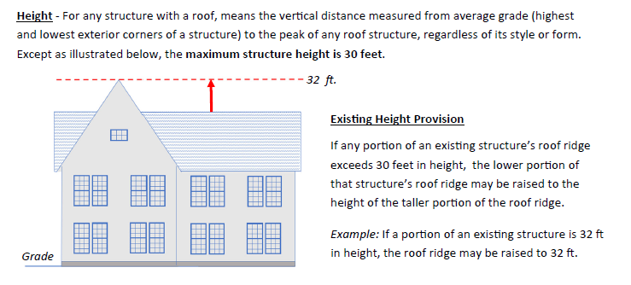
26

Slide 27
Height Adjacency
New structures may be built to within minus five percent of the maximum height of an existing adjacent Contributing or Significant House with the same number of stories as the adjacent structure, even if that height exceeds the maximum height of 30 feet. This is to allow for compatible height in areas of Tract IV.
27

Slide 28
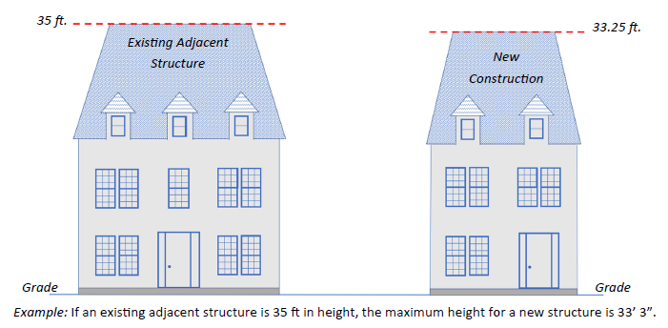
28

Slide 29
Height Looming Explanation
Height Looming is not to be interpreted as an overall setback for the structure. The highest point of a building element (wall, parapet, dormer, etc.) shall not be taller than three times its distance from a side property line.
No portion of a building or structure greater than 24 feet in height may be located above the height looming slope (as illustrated) which extends vertically and is calculated by multiplying the distance from a side property line by three. This creates a diagonal line that slopes back proportionately from the side yard property line by one foot in horizontal distance for every three feet in vertical distance.
29

Slide 30
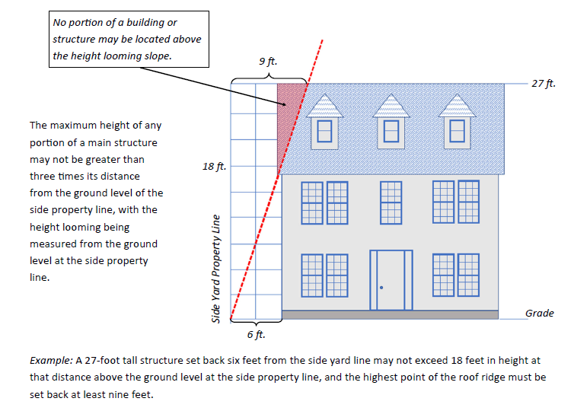
30

Slide 31
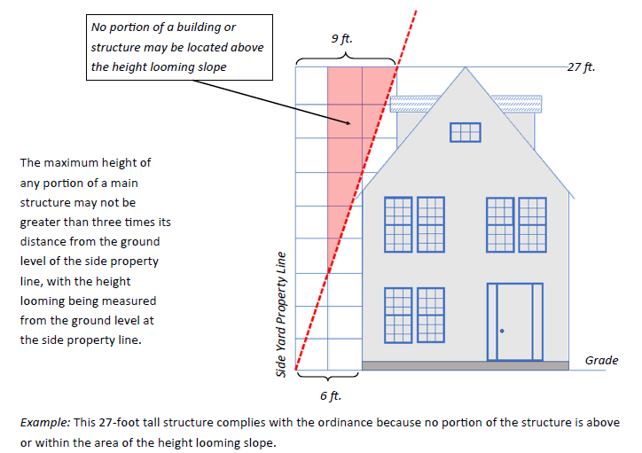
31

Slide 32
Height Looming only applies to main buildings and does not apply to a structure that is 24-feet in height or lower.
32

Slide 33
Stories
The maximum number of stories above grade is two. Attic stories (illustrated) are allowed for Tudor, French Eclectic, Colonial Revival, Neoclassical style structures.
Attic Story means the space between the existing ceiling framing of the topmost story and the underside of the roof framing.
One-and-One-Half Story means a building where any habitable space immediately above the first story is entirely contained within the main sloping roof structure, with the exception of dormers utilized for natural light.
33

Slide 34
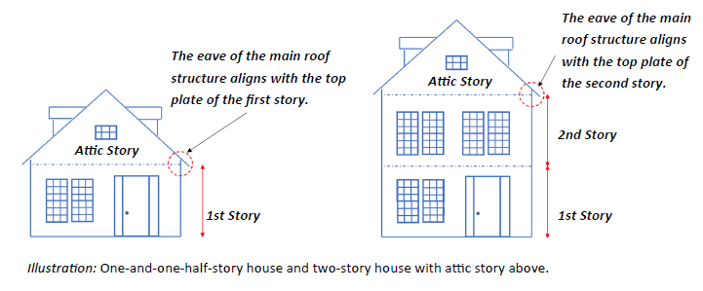
34

Slide 35
Paving and Landscape in the Front Yard
Driveways
A front entry driveway is required on new construction.
Circular driveways are prohibited, except that any existing circular drive may be repaired or replaced within its existing footprint.
Impervious Surface
Artificial of synthetic grass is prohibited in a front yard or parkway.
No more than 35 percent of the front yard may be paved or hardscaped.
Tree Mitigation
Mature trees, those over 15 caliper inches, located in the front yard are protected under Article X of the Dallas Development Code.
Trees may be removed if a tree removal application is approved by City Arborist.
There are defenses to prosecution (reasons allowed) including sick or dying tree, or causing damage to an existing structure.
Mitigation can include planting of new trees or payment into the reforestation fund.
35
Notes:
Original ord only allows for 30% impervious in front yard

Slide 36
Fences
Location
Fences and walls, excluding retaining walls, are not allowed in a front yard. For purposes of this section, “front yard” means that area between the front façade and street, excluding porches, as illustrated below.
Courtyard walls must not project into the required front yard.
Solid fences must be set back a minimum of five feet from the corner of the front facade of a main building nearest the side property line, excluding porches.
Fences that are at least 70% open may be located flush to the corner of the front facade, excluding porches.
36

Slide 37
Fences
Height
Fences in the side yard must not exceed six feet.
Fences in a corner side yard must not exceed eight feet.
Fences in the rear yard must not exceed eight feet.
Materials
Fences may be made of brick that matches the main structure, stone, wood, wrought iron or materials that look like wrought iron, or a combination of these materials.
Chain link is prohibited.
37

Slide 38
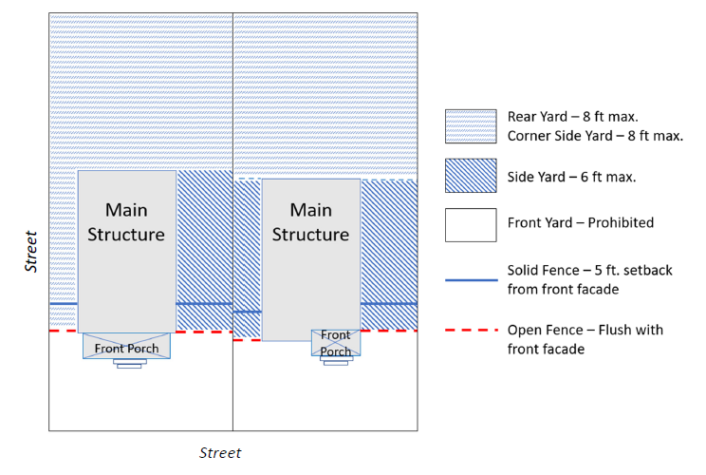
Fences
38

Slide 39
Building Materials
1st Story of Main Building - brick or stone, or a combination of the two.
No vinyl or aluminum siding
Wood, materials that look like wood, cast stone, wrought iron, or stucco with half-timbering may be applied in a manner and location typical of original houses in the district.
On a front facade and within the wrap-around, all materials and their application must be typical of the period and architectural style, or be compatible with original main buildings designated the same architectural style in the district. This applies to all main buildings in the proposed Tract IV.

Slide 40
Demolitions
1) Original Houses [pre Jan. 1,1961] identified as Tudor, Spanish Revival, French Eclectic, Colonial Revival, and Neoclassical, or identified as Significant in Exhibit B may be demolished only if the cost of bringing the house into compliance with Section 27-11, “Minimum Property Standards; Responsibility of Owner,” of the Dallas City Code using materials similar to the original materials is greater than 80 percent of the value of Improvements according to the Dallas Central Appraisal District(DCAD).
A) Applicant shall demonstrate the need for demolition by providing:
i) Building Inspection report
ii) Engineer’s report
iii) Itemized list of required repairs, broken down into labor and material costs
2) All structures not covered under paragraph 1 of this section may be demolished. New construction on those lots must be in either the style of the main building to be demolished or one of the five contributing styles.
40
Notes:
May be built back in style of houses demolished OR 5 styles

Slide 41
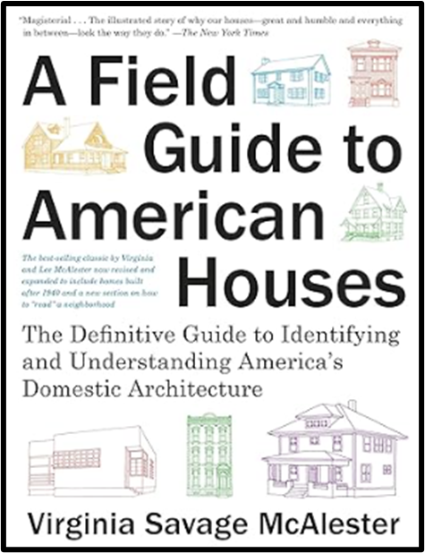
Architectural Standards
a) Statement of intent. The purpose of the architectural standards is to allow the application of architectural elements and materials in such a way that allows the continuation of flexibility of design by referencing those elements as outlined in this section through documentation. Any use of a referenced architectural element must be in a manner similar to the example provided for consideration. This is in recognition of the unique/varied design of a many of the original homes within Tract IV.
b) Accepted Sources for Regulation of Architectural Standards. Except as provided in this subsection, architectural standards are established utilizing original, contributing architectural styles and housing stock within this district, in conjunction with images and descriptions derived from “A Field Guide to American Houses” by Virginia Savage McAlester, (et. al.), or in another publication approved by the director.
c) Purpose statement: Inclusion of “A Field Guide to American Houses” is to provide descriptions and pictorial examples of architectural forms, styles, and features that may be utilized during construction and remodeling.
41

Slide 42
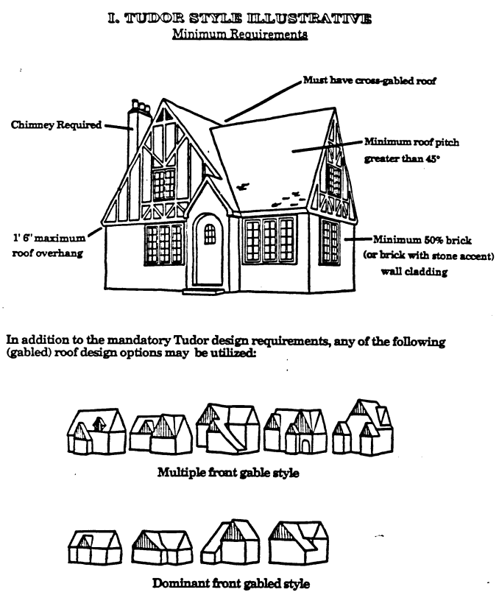
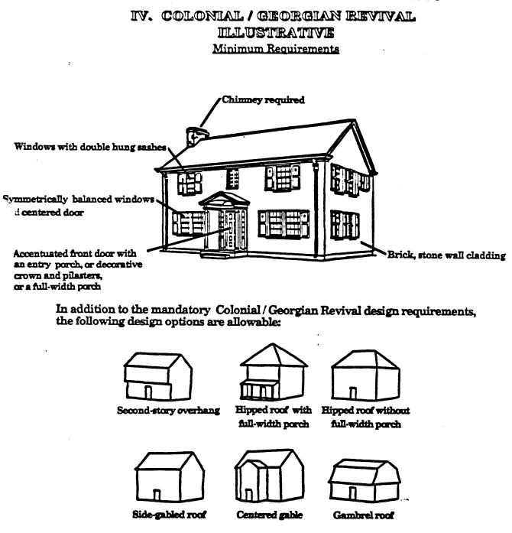
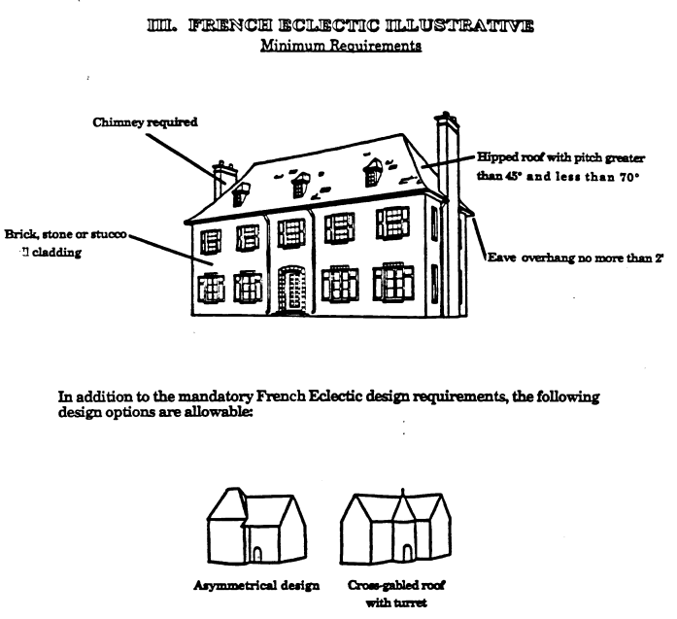
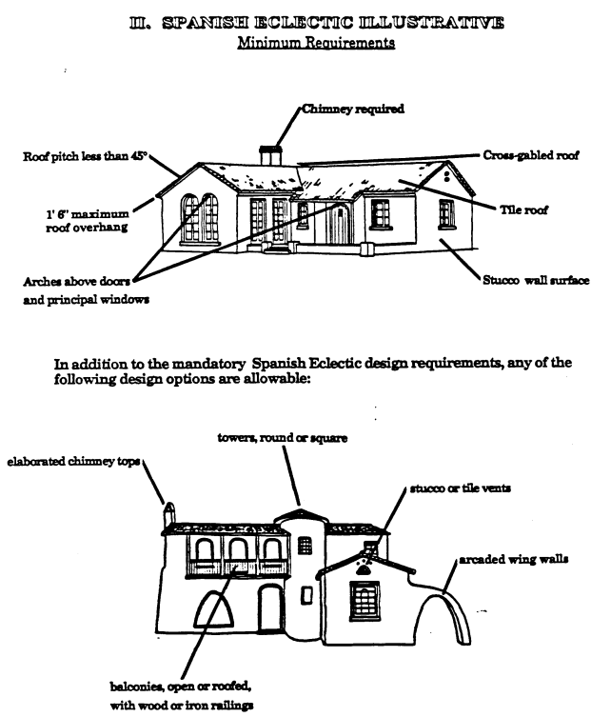
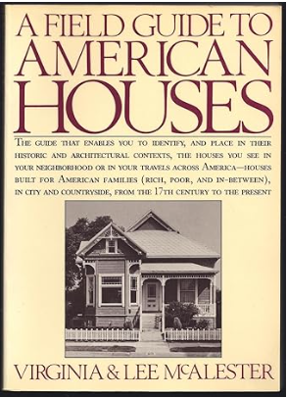
Architectural Standards for CD-2
42
Notes:
The drawings from the Illustrations from Exhibit A of CD2 ordinance are from the original Field guide.

Slide 43
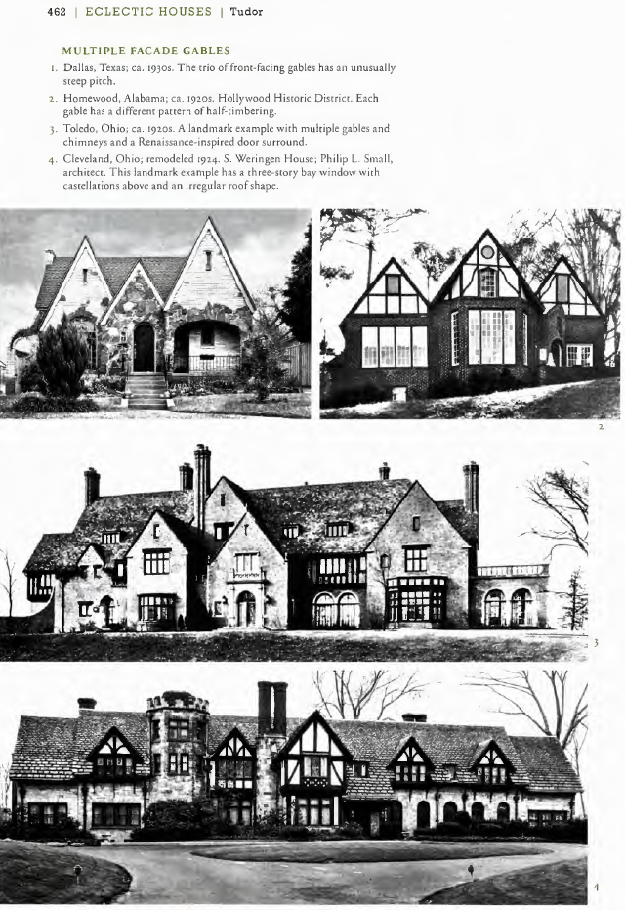
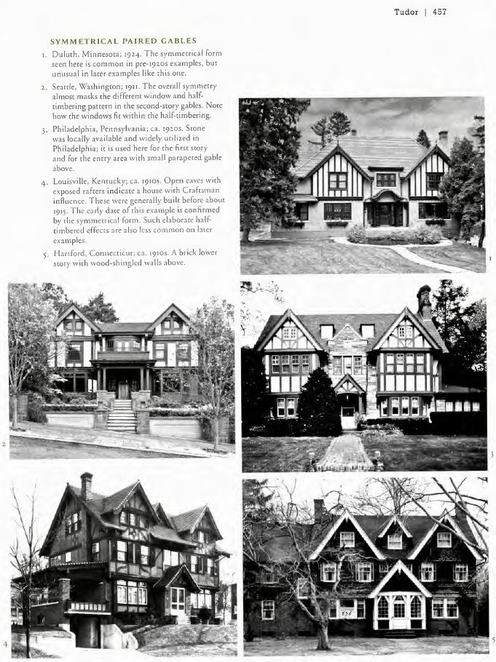
A Field Guide to American Houses
43
Notes:
The drawings from the Illustrations from Exhibit A of CD2 ordinance are from the original Field guide.

Slide 44
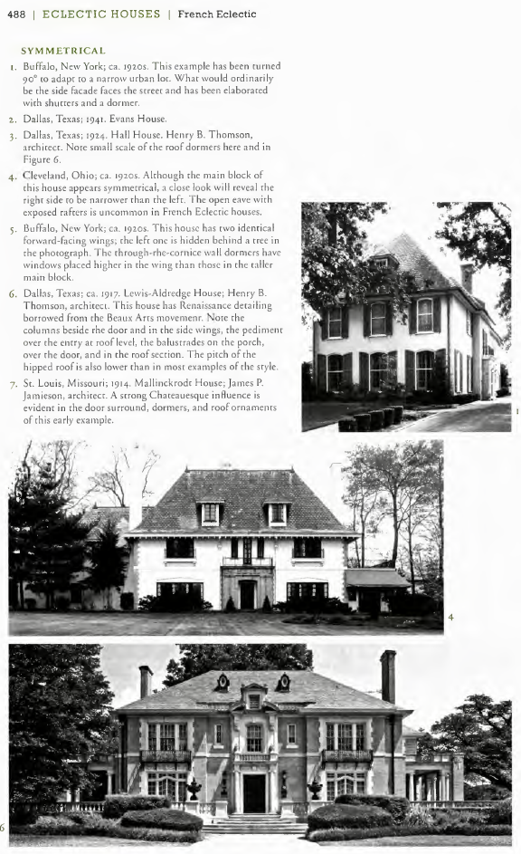
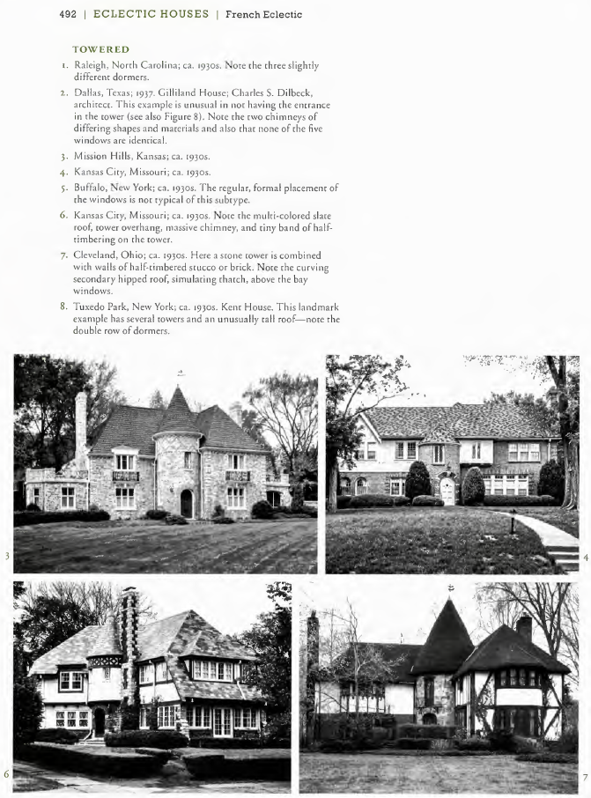
A Field Guide to American Houses
44
Notes:
The drawings from the Illustrations from Exhibit A of CD2 ordinance are from the original Field guide.

Slide 45
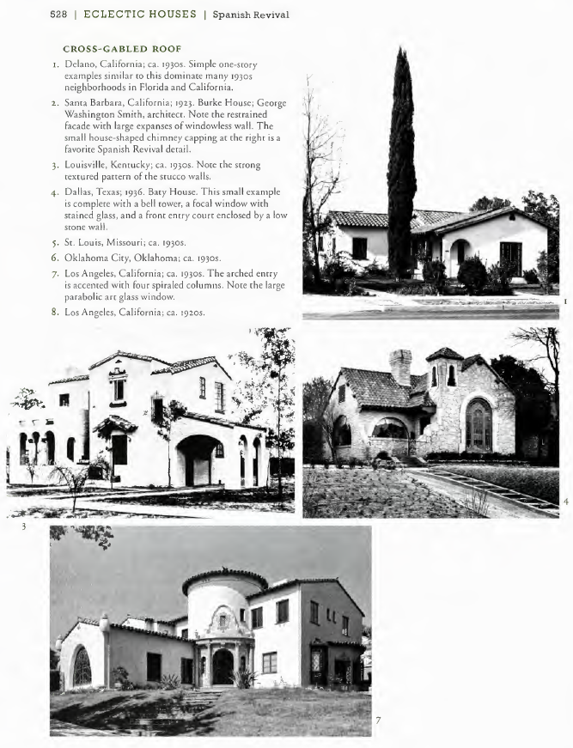
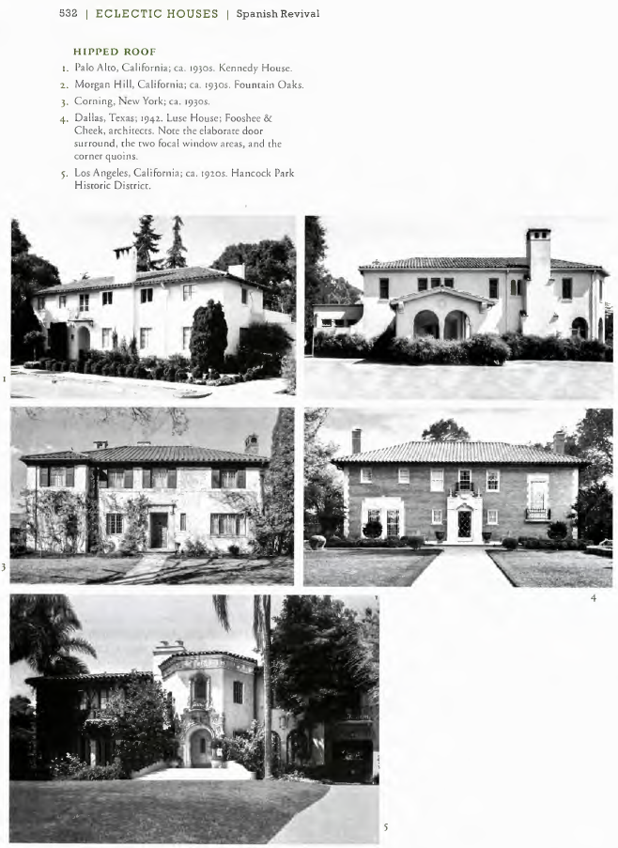
A Field Guide to American Houses
45
Notes:
The drawings from the Illustrations from Exhibit A of CD2 ordinance are from the original Field guide.

Slide 46
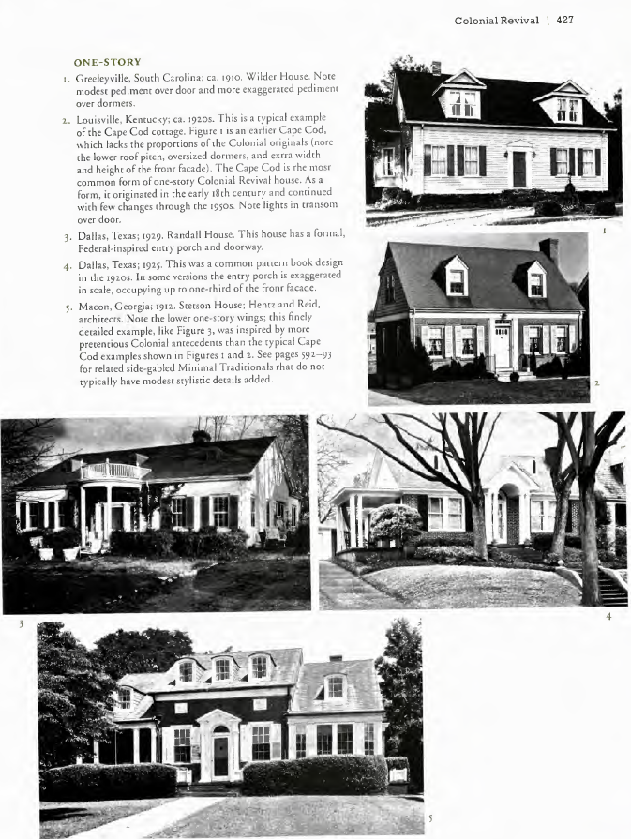
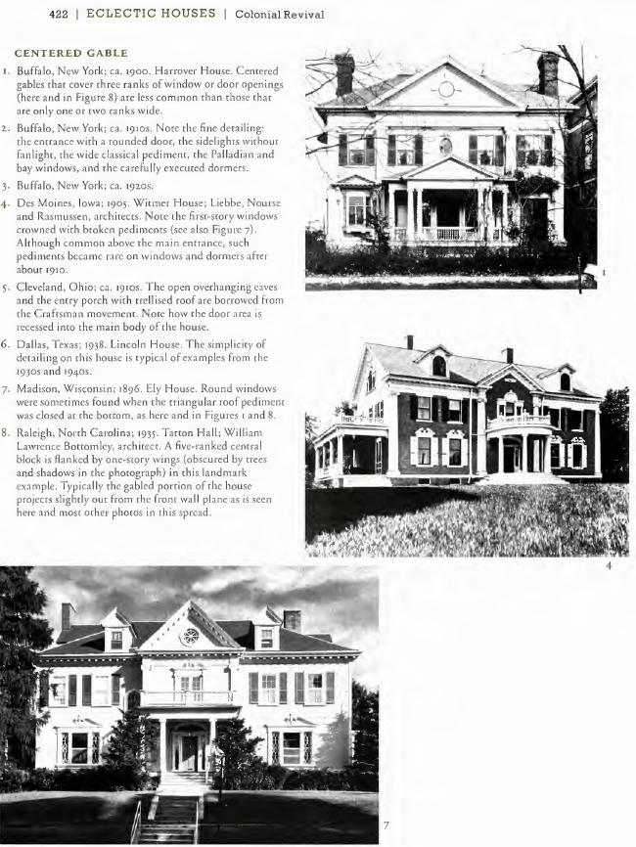
A Field Guide to American Houses
46
Notes:
The drawings from the Illustrations from Exhibit A of CD2 ordinance are from the original Field guide.

Slide 47
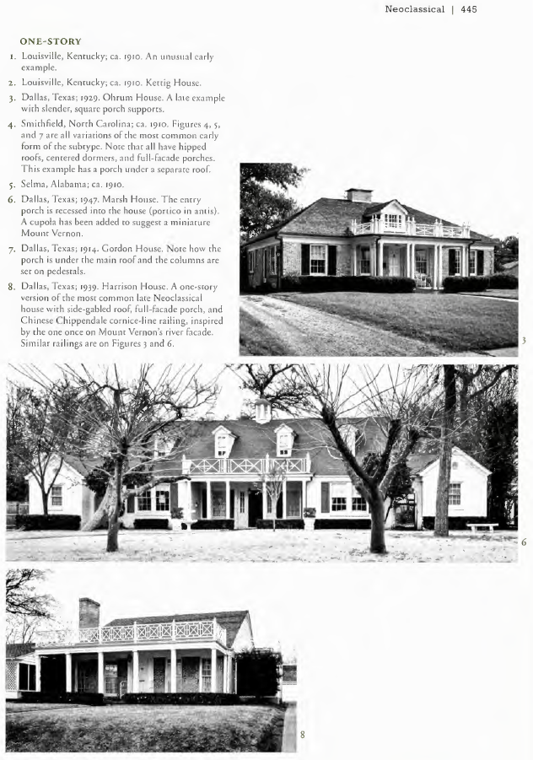
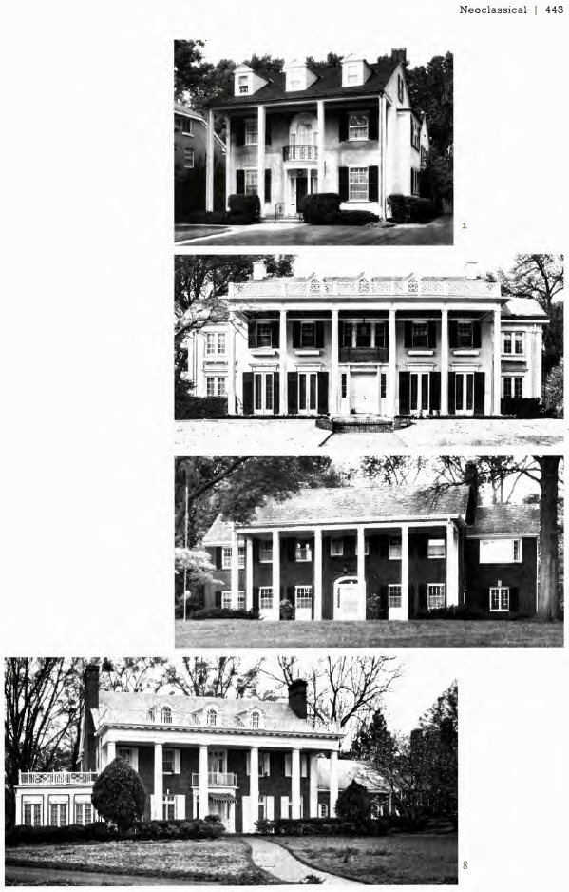
A Field Guide to American Houses
47
Notes:
The drawings from the Illustrations from Exhibit A of CD2 ordinance are from the original Field guide.

Slide 48
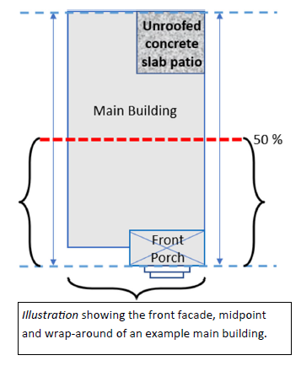
Architectural Standards
The architectural standards for new construction and remodeling will apply to the front facade and wrap-around.
WRAP-AROUND means the area to the midpoint of the structure measured from the furthest front wall or omitted wall line (porch) of the structure to the furthest rear wall or omitted wall line of the structure. The result shall be a straight line through the structure.
48

Slide 49
Architectural Standards
NEW CONSTRUCTION – All new construction must be built in compliance with architectural standards of one of the five contributing styles: Tudor, Spanish Revival/Eclectic, French Eclectic, Colonial Revival, Neoclassical.
REMODELING – CONTRIBUTING – If a structure of a contributing style is remodeled, the remodeling must be compatible with the standards for its architectural style for that element of the structure being remodeled. In addition, certain elements that are characteristic of the style must be maintained or relocated with the wrap-around.
REMODELING – NONCONTRIBUTING – If a noncontributing structure is remodeled, the remodeling must be compatible with the standards for its existing architectural style or one of the 5 contributing styles (Tudor, Spanish Revival/Eclectic, French Eclectic, Colonial Revival, Neoclassical) for that element of the structure being remodeled. All subsequent remodeling must be in the same architectural style as the first remodeling in the contributing style.
49

Slide 50
Architectural Standards - Noncontributing
Architectural Styles – Monterey, Minimal Traditional, Ranch, Mid-Century Modern, Contemporary, American Vernacular, New Traditional
If a noncontributing structure is remodeled, the remodeling must be compatible with the standards for its existing architectural style or one of the 5 contributing styles (Tudor, Spanish Revival/Eclectic, French Eclectic, Colonial Revival, Neoclassical) for that element of the structure being remodeled. All subsequent remodeling must be in the same architectural style as the first remodeling in the contributing style.
Each style has general requirements including roof type, pitch, eaves, and material, as well as window type and appearance. All materials and their application must be typical and appropriate for the style and period of the structure. Porches may be included if characteristic of that style, like Monterey and Minimal Traditional.
The architectural standards apply to the front facade and wrap-around.
50

Slide 51
Architectural Standards – Noncontributing
Architectural styles that are most commonly one story, both traditionally and in the proposed expansion area like Ranch and Minimal Traditional, will push the addition of a second story back to the rear half of the structure. This maintains the one-story appearance from the street while allowing the development and expansion of the existing structure in a way that maintains the character and architectural style that exists today by following historic development patterns.
51

Slide 52
Architectural Standards – New Traditional
1) Structures identified as New Traditional may remodel in the existing style of architecture to include windows, materials, roof material and roof pitch to be compatible to the main building.
2) Structures identified as New Traditional Tudor/Spanish Revival/French Eclectic/Colonial Revival/Neoclassical may remodel using the standards for the Contributing architectural style it models after.
3) Any remodeling of architectural features listed under the designated Contributing classification must be retained, but additional features from that style can be added without having to meet the required point total. For example, a New Traditional Tudor with half-timbering in the gables, the remodel cannot remove that feature from the front facade or wrap around, but elements like brick pattern or iron details may be added.
52

Slide 53
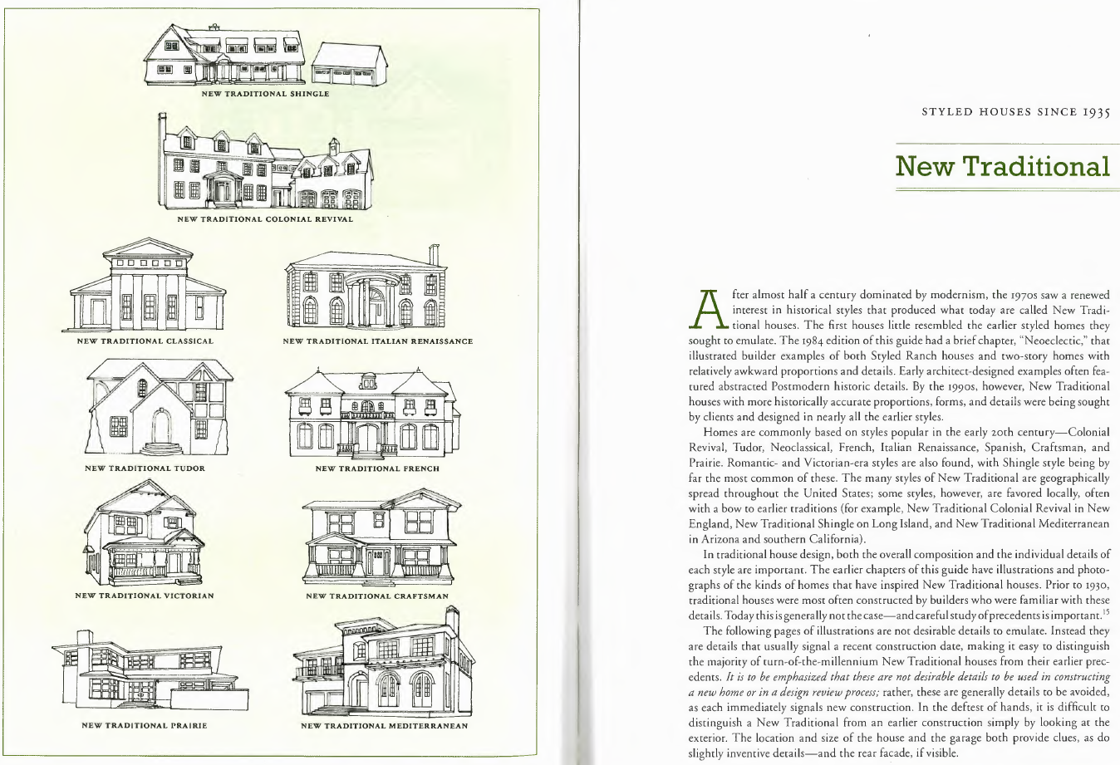
Architectural Standards – New Traditional
53
Notes:
34 New Traditional

Slide 54
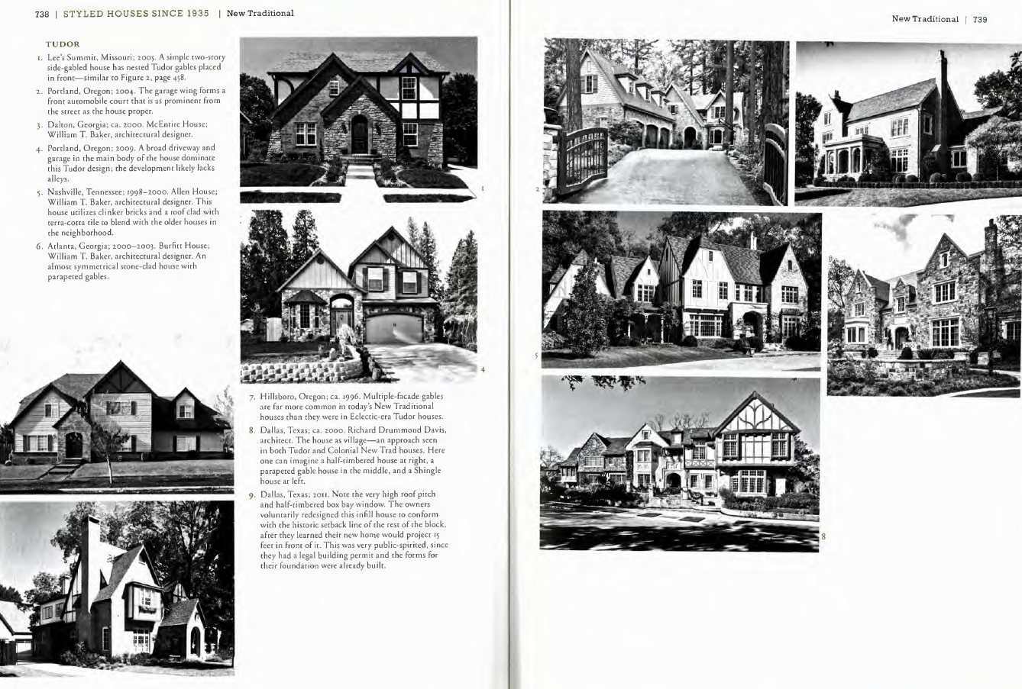
Architectural Standards – New Traditional
54

Slide 55
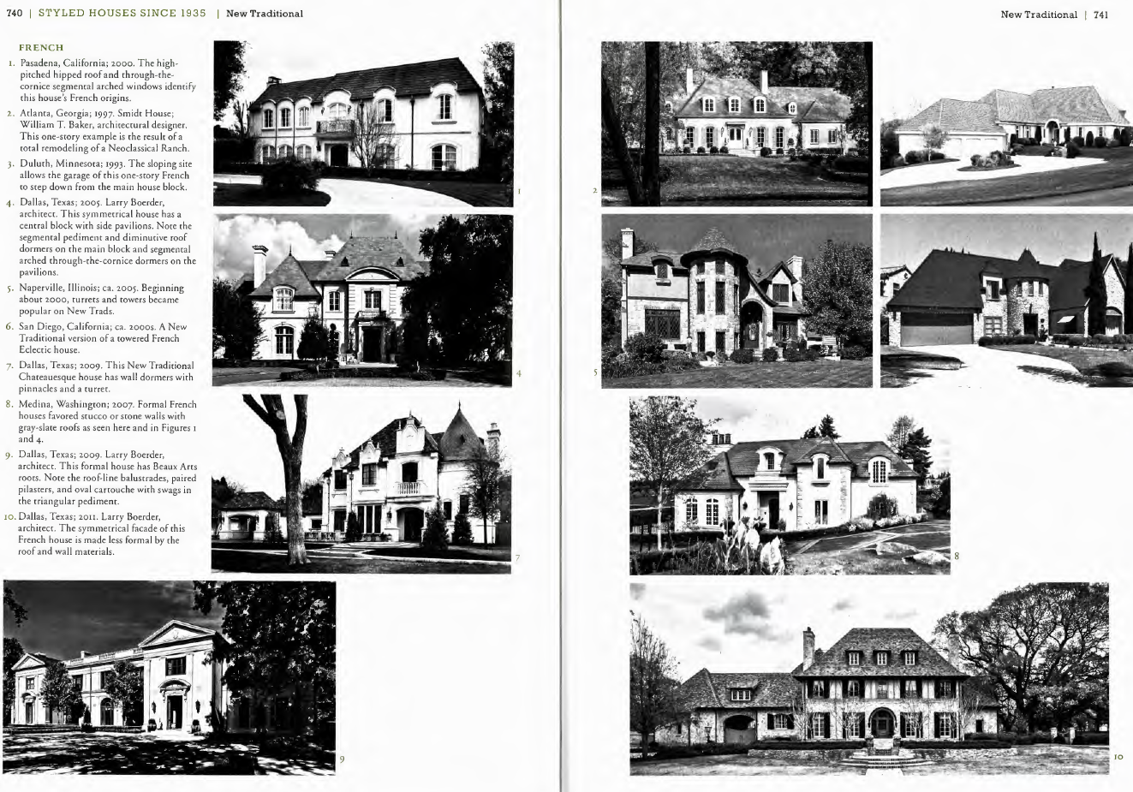
Architectural Standards – New Traditional
55

Slide 56
Architectural Standards - Contributing
The following architectural design features must be maintained or replicated. These architectural design features may be relocated within the front facade or wrap-around.
A) Balustrades B) Chimneys C) Dormers
D) Exterior stained and leaded glass E) Front porches or porticos with columns
F) Porte cocheres G) Roof eaves H) Turrets and towers
I) Window and door openings
Plans for new construction or a major modification or remodel of a structure must earn at least 70 points for a two-story structure, and 50 points for a one-story or one-and one-half story and comply with all mandatory requirements for that style of architecture.
MAJOR MODIFICATION means any remodeling that impacts 25 percent of the surface area (using wall and window/door area affected) of front facade by altering or obscuring existing materials.
56

Slide 57
57

Slide 58
58

Slide 59
59

Slide 60
60

Slide 61
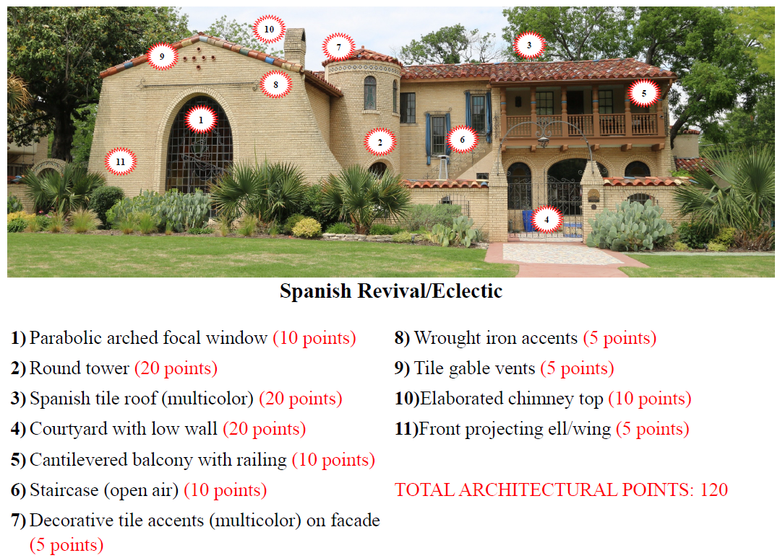
61

Slide 62
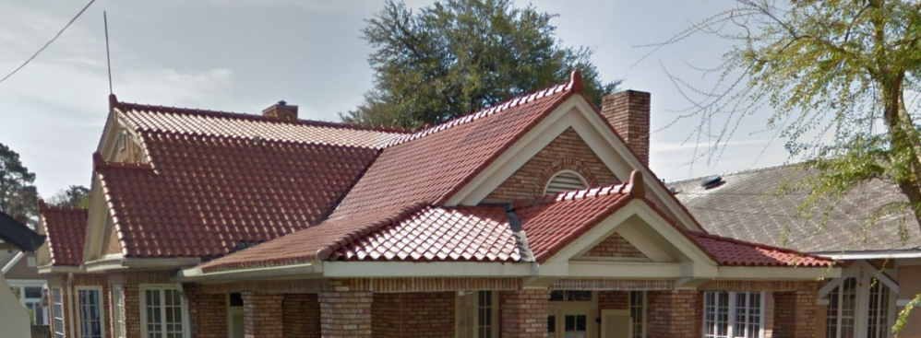
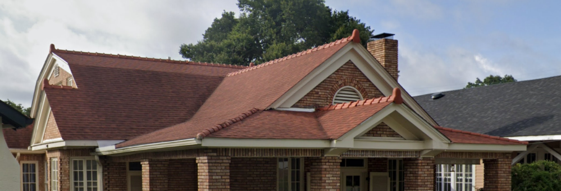
Roof Materials for Spanish Revival / Eclectic
Only the following roofing materials are allowed on structures in the Spanish Revival/Eclectic architectural style within the wrap-around.
i. Terra cotta tile in Spanish, mission, or barrel style; or
ii. Materials that look like Spanish, mission, or barrel style tile in:
a. Metal
b. Concrete
c. Plastic composite
d. Composition shingles in a color palette of original Spanish tile roofs with terra cotta hips, ridge caps, and rake tiles applied to mimic original tile roofs.
Example: Roof materials that look like Spanish, mission, or barrel style tile in metal, concrete, or plastic composite.
Example: Composition shingles in a color palette of original Spanish tile roofs with terra cotta hips, ridge caps, and rake tiles applied to mimic original tile roofs.
62

Slide 63
Next Steps
Online Survey to be posted on the Lakewood Expansion page on the Conservation District website
City Plan Commission Public Hearing: Date TBD (notified 10 days before)
Residents respond to written notice using reply form
Residents may register to speak at public hearing
City Council Public Hearing: Date TBD (notified 10 days before)
Residents respond to written notice using reply form
Residents may register to speak at public hearing
63

Slide 64
CD-2 - Lakewood Conservation District Expansion Post-Application Neighborhood Meeting No. 16
Staff Contact
Trevor Brown
Trevor.Brown@dallas.gov
214-670-4193
Melissa Parent
Melissa.Parent@dallas.gov
214-671-5070
Project Webpage
https://bit.ly/LakewoodExpansion
Next Opportunity for Input –
Online Survey
Following Steps: (Dates TBD)
City Plan Commission Meeting
City Council Meeting

Slide 65
Thank You!

Slide 66
66

