Slide 1
CD-2 - Lakewood
Conservation District Expansion
Post-Application Neighborhood Meeting No. 5
October 26, 2022
Trevor Brown, Chief Planner
Melissa Parent, Senior Planner
Scott Bellen, Senior Planner
Planning & Urban Design
City of Dallas

Slide 2
CD-2 - Lakewood
Conservation District Expansion
Post-Application Neighborhood Meeting No. 5
Agenda
Introduction & Recap
Overview of process
Discussion
  Recap – Building height & stories
  Floor Area Ratio
  Setbacks – Main
  Setbacks - Accessory
Next Steps
Staff Contact
Trevor Brown
Trevor.brown@dallas.gov
214-670-4193
Project Webpage
https://bit.ly/LakewoodExpansion

Slide 3
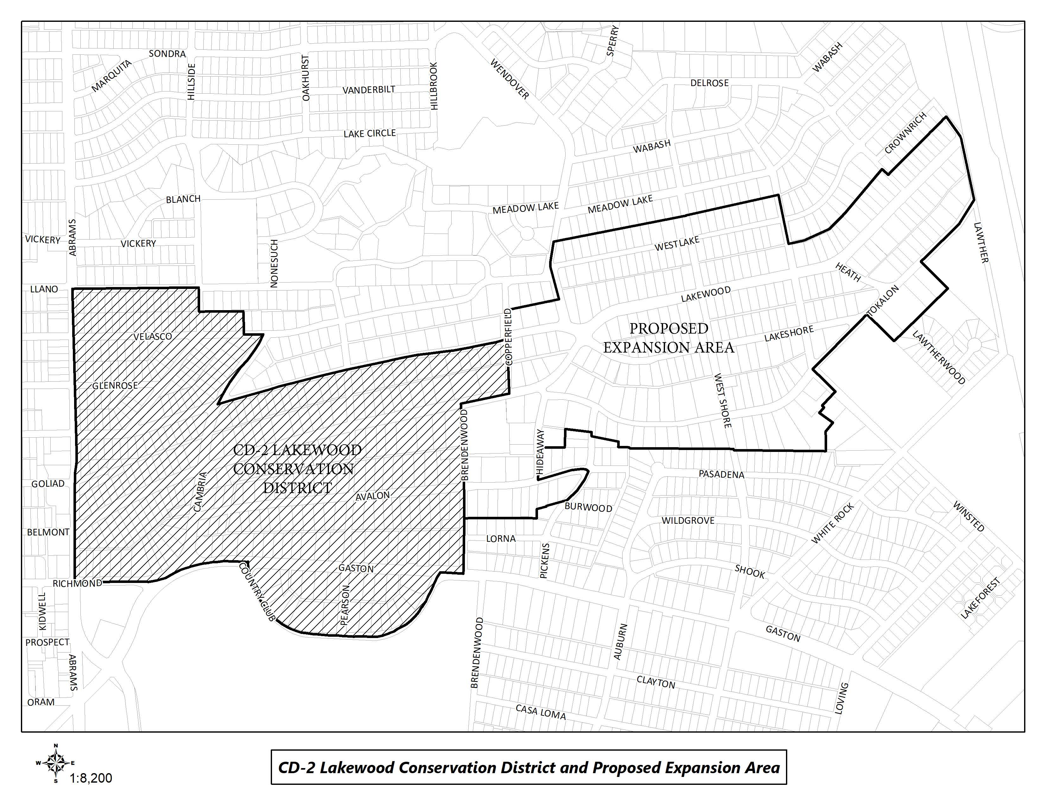
CD-2 Boundaries & Expansion Area

Slide 4
Purpose of This Meeting
This meeting is the 5th Post-Application Neighborhood Meeting to discuss the CD expansion process and the development and architectural standards the neighborhood may want to amend, based on the petition.
Discussion
  Recap – Building height & stories
  Floor Area Ratio
  Setbacks – Main
  Setbacks – Accessory

Slide 5

Meeting Schedule
Post-Application Neighborhood Meeting #1 – August 31
  Process, schedule, driveways and curbing
Post-Application Neighborhood Meeting #2 – September 14
  Driveways and curbing, sidewalks, front yard coverage, uses and parking, density, lot coverage
Post-Application Neighborhood Meeting #3 – September 26
  Lot size, slope/drainage
Post-Application Neighborhood Meeting #4 – October 12
  Building height & stories, Floor Area Ratio
Post-Application Neighborhood Meeting #5 – October 26
  Floor Area Ratio, setbacks-main, setbacks-accessory, accessory structures
Post-Application Neighborhood Meeting #6 – November 9
  fences, retaining walls, waterfall steps, landscape, paint, solar

Slide 6
Meeting Schedule
Post-Application Neighborhood Meeting #7 – November 16
  Demolition, documented assurance, roofing materials, windows, porches
Post-Application Neighborhood Meeting #8 – November 30
  Contributing architectural styles, new construction standards, remodel/addition standards, areas of regulation, work reviews
Post-Application Neighborhood Meeting #9 – December 7
  Architectural styles – Minimal Traditional, Colonial Revival
Post-Application Neighborhood Meeting #10 – December 14
  Architectural styles – Spanish Eclectic, French Eclectic
Post-Application Neighborhood Meeting #11 – January 4
  Architectural styles – Tudor, Neoclassical, Non-Contributing
Post-Application Neighborhood Meeting #12 – January 18
  If needed

Slide 7
Meeting Schedule (cont.)
Final Post-Application Neighborhood Meeting – TBD
  Ordinance Review (30-60 days after last meeting)
City Plan Commission – TBD
City Council – TBD

Slide 8
CD-2 Regulations:
Development Standards:
  Use
  Lot size
  Accessory uses
  Setbacks
  Lot coverage
  Height
Landscaping Provisions:
  Fences and walls
  Driveways and curbing
  Sidewalks
  Front yard coverage
  Berms
Architectural Provisions:
  Regulation of Architectural Styles
  Garages and accessory structures
  Street facade width
  Roofs
  Glass
  Enclosures
  Screen and storm doors and windows
  Color
8
Notes:
These are all the development standards regulated by CD 2. Every property in the city is governed by a set of these rules, but each CD has a ‘custom’ set of rules.

Slide 9
CD-2 Regulations (cont.):
Review Procedures:
  Building permit review
  Work not requiring a building permit
9

Slide 10
Topics for Discussion:
Accessory Structures:
  Location and materials
  Provisions for remodels or additions to non-conforming structures
Building Height:
  Modifying how height is measured
  Establishing a maximum allowed height for structures, including accessory structures and additions
Demolition:
  Applicability to structures
  Provisions for existing non-contributing structures
Density:
  Consideration of maximum number of dwelling units
10
Notes:
These are the specific items that were on the petition – what we’ll be discussing at these meetings

Slide 11
Topics for Discussion (cont.):
Drainage:
  Establishing restrictions on lot-to-lot drainage
Driveways, Curbs, Sidewalks, and Steps
  Materials, width, and lot coverage
  Provisions for removal of existing rolling or waterfall steps
  Provisions for existing non-conforming structures
Fences and Walls
  Location, height, and materials
Floor Area Ratio
11

Slide 12
Topics for Discussion (cont.):
Landscaping or Other Natural Features:
  Materials and allowable percentage of front yard coverage for impervious surfaces and hardscaping
  Provisions for tree preservation
Lot Coverage
  Maximum lot coverage
Lot size
  Minimum width
Paint
  Provisions for painting stone and brick
  Consideration of restriction of certain colors
  Number of colors allowed
12

Slide 13
Topics for Discussion (cont.):
Off-Street Parking and Loading Requirements:
  Minimum parking standards per dwelling unit
Permitted Uses
  Single family
  Provisions for existing non-conforming uses
Setbacks
  Modifying front, side, and rear setback requirements, including accessory structures
  Provisions for existing non-conforming structures
Slope
  Provisions for modifications to the existing slope of a lot
13

Slide 14
Topics for Discussion (cont.):
Solar Energy Systems:
  Location and type
Stories
  Maximum stories
  Provisions for non-conforming structures
14

Slide 15
Topics for Discussion (cont.):
Accessory Structures:
  Style and materials
  Roof slope
  Replacement or remodeling of existing accessory structures
  Clarifying the architectural styles, materials, size, and applicability
Architectural Styles:
  Defining the architectural styles allowed
  Standards for remodels and additions
  Standards for new construction
  Provisions for existing non-contributing structures
Building Elevations:
  Minimum number of architectural features required
  Standards for remodels and additions
  Standards for new construction
  Provisions for existing non-contributing structures
15

Slide 16
Topics for Discussion (cont.):
Building Materials:
  Material types
  Applicability and placement of certain allowed materials
  Provisions for existing non-contributing structures
Chimneys:
  Materials, form, and placement based on architectural style
Porch Styles:
  Materials, architectural style, and placement
  Standards for enclosures
  Provisions for remodels or additions to existing structures
Roof Form and Pitch:
  Provisions for remodels or additions to existing structures
16

Slide 17
Topics for Discussion (cont.):
Roofing Materials:
  Provisions for remodels or additions to existing structures
Windows:
  Placement, architectural standards, and materials
  Provisions for remodels or additions to existing structures
Work Reviews:
  Language to detail the requirements for a work review by the City
17

Slide 18
Sec. 51A-4.505 Conservation Districts
(b) Findings and purpose.
(1) State law authorizes the city of Dallas to regulate the construction, alteration, reconstruction, or razing of buildings and other structures in "designated places and areas of historic, cultural, or architectural importance and significance."
(2) Conservation districts are intended to provide a means of conserving an area's distinctive character by protecting or enhancing its physical attributes.
(3) Conservation districts are distinguished from historic overlay districts, which preserve historic residential or commercial places; neighborhood stabilization overlay districts, which preserve single family neighborhoods by imposing neighborhood- specific yard, lot, and space regulations that reflect the existing character of the neighborhood; and planned development districts, which provide flexibility in planning and construction while protecting contiguous land uses and significant features.
(4) The purpose of a CD is to:
(A) protect the physical attributes of an area or neighborhood;
(B) promote development or redevelopment that is compatible with an existing area or neighborhood;
(C) promote economic revitalization;
(D) enhance the livability of the city; and
(E) ensure harmonious, orderly, and efficient growth.

Slide 19
Procedure
To speak during the discussion portions of tonight’s meeting:
  Please raise your hand and wait to be recognized before you begin speaking
  Before your comments, state your name and address for the record
  All comments must be related to the topic being discussed at that time
  Provide input to inform City Staff to work toward an approach to accomplish your desired objective of maintaining the character of the neighborhood.

Slide 20


Making an Ordinance for Lakewood Expansion
Lot Coverage
Setbacks
Height
Floor Area Ratio
Slope of Lot
Architectural Style
Notes:
Important dates in our specific process.

Slide 21
Petition Topic – Building Height & Stories
Modifying how height is measured
Establishing a maximum allowed height for structures, including accessory structures and additions
Establishing a maximum number of stories allowed
Provisions for non-conforming structures
Existing Regulations CD-2
BUILDING HEIGHT means the vertical distance measured from grade to the highest ridge of the roof structure.
ROOF RIDGE means the apex of any roof structure regardless of its style or form.
Maximum building height
  (1) Except as provided in Paragraph (2), the maximum permitted height for all structures in Tracts I, II, and III is 30 feet.
  (2) If any portion of an existing structure’s roof ridge exceeds the applicable maximum height in paragraphs (1)(A) or (1)(B), the lower portion of that structure’s roof ridge may be raised to the height of the taller portion of the roof ridge.

Slide 22
Discussion – Building Height & Stories
CD-2 BUILDING HEIGHT means the vertical distance measured from grade to the highest ridge of the roof structure.
Dallas Development Code has maximum height of 30 feet.
HEIGHT means the vertical distance measured from grade to:
(A) for a structure with a gable, hip, or gambrel roof, the midpoint of the vertical dimension between the lowest eaves and the highest ridge of the structure;
(B) for a structure with a dome roof, the midpoint of the vertical dimension of the dome; and
(C) for any other structure, the highest point of the structure.
Nonconforming height allow additions to maintain existing height as allowed by CD-2 ordinance.
22

Slide 23
Discussion – Building Height & Stories
How tall are most houses on your street? How many stories?
What are your concerns about height of structures?
Any thoughts on additions that are taller than the original structure?
Maximum number of stories
  Consider when talking about different styles - Minimal Traditional, Tudor, Spanish Eclectic, French Eclectic, Noncontributing
23

Slide 24
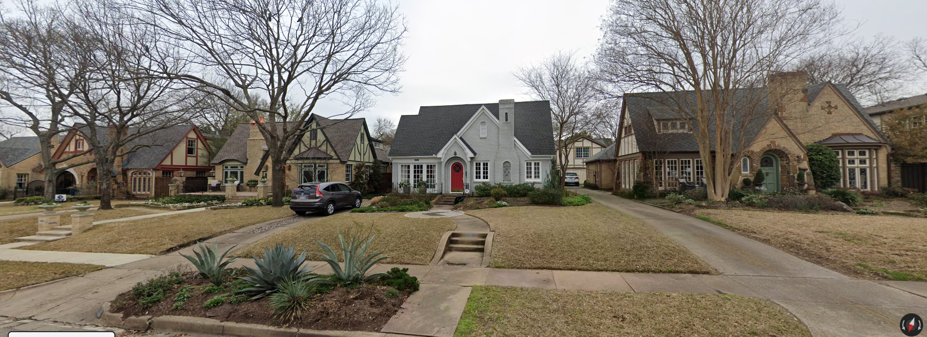
Discussion – Building Height & Stories
6900 block Lakewood
24

Slide 25
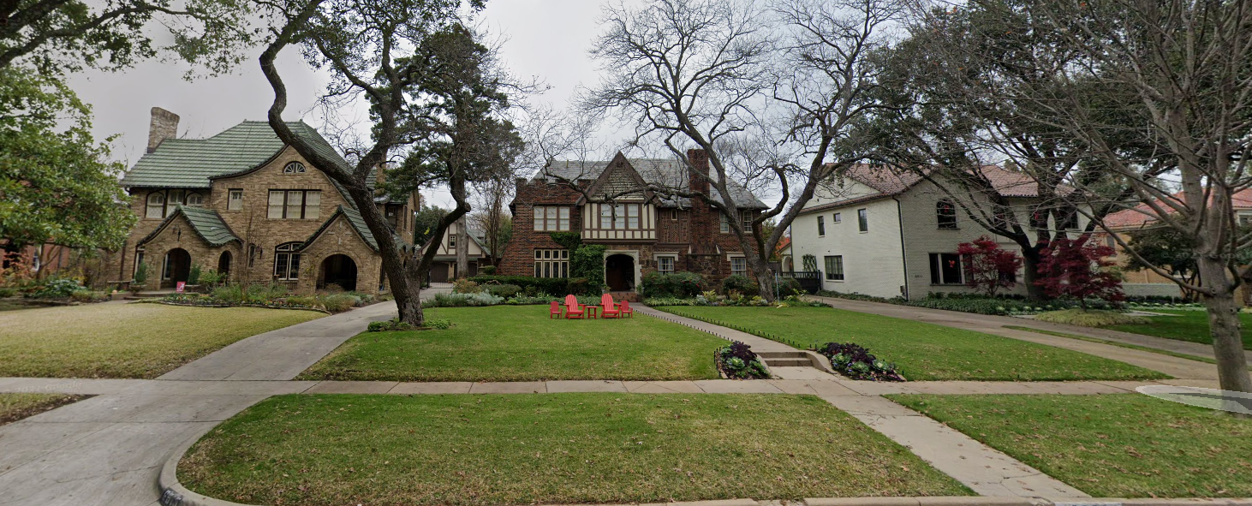
Discussion – Building Height & Stories
6900 block Lakewood
25

Slide 26
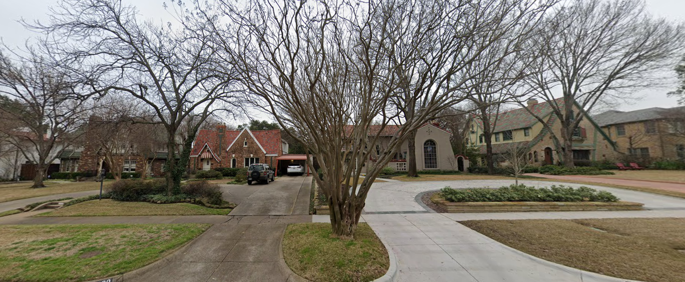
Discussion – Building Height & Stories
7000 block Lakewood
26

Slide 27
Recap – Building Height & Stories
Overall building height is a concern, but new construction looming over original houses seemed to be a focus.
Measure height from average grade to highest peak
Sizable segment in favor of adopting CD-2 height regulations and utilizing other tools (setbacks, lot coverage, height looming, Floor Area Ratio) to limit overall mass
Consideration of average height of blockface to determine allowed height for new construction.
  Needs to be certified by building professional, either architect or engineer.
Need for different Tracts is a possibility
Number of stories to be tied to Tract and architectural style
27

Slide 28
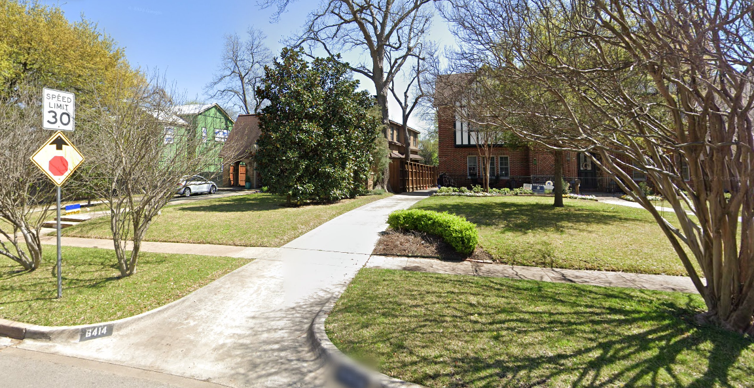
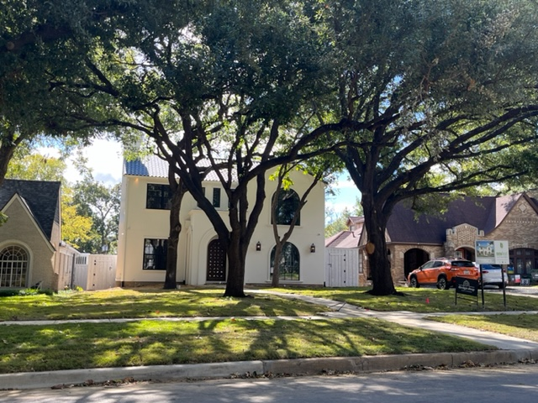
Discussion – Building Height & Stories
6400 block Lakewood
Existing CD-2
2021, 1990, 2008
28

Slide 29
Recap – Building Height & Stories
Language for consideration:
Maximum building height
  (1) Except as provided in Paragraph (4), the maximum permitted height for all structures in Tract A is 30 feet.
  (2) Except as provided in Paragraph (4), the maximum permitted height for all structures in Tract B is 25 feet.
  (3) If any portion of an existing structure’s roof ridge exceeds the applicable maximum height in paragraphs (1) and (2), the lower portion of that structure’s roof ridge may be raised to the height of the taller portion of the roof ridge.
  (4) New structures may be built to within minus five percent of the maximum height of an existing adjacent contributing or significant house with the same number of stories as the new build, even if that height exceeds the maximum height for that Tract.
29
Notes:
If the height of the house next door is 33’, you could build your house to max height of 31’4” (33’ x 5% = 1’8”). This allows houses in the area where we have significant houses taller than 30’ to be consistent with adjacent structures…or at least in the ballpark.
If tract with all 1.5 story Tudor and allow Spanish Eclectic in area, a two story could fall under 25’.

Slide 30
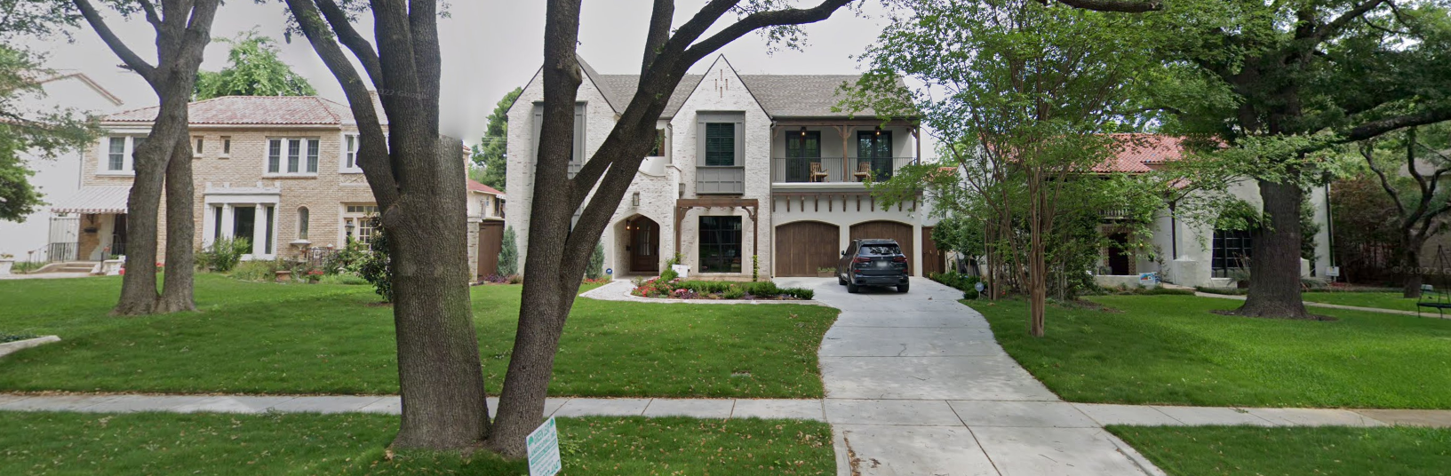
Recap – Building Height & Stories
Example for discussion
6900 block Lakewood
30
Notes:
If the height of the house next door is 33’, you could build your house to max height of 31’4” (33’ x 5% = 1’8”). This allows houses in the area where we have significant houses taller than 30’ to be consistent with adjacent structures…or at least in the ballpark.
If tract with all 1.5 story Tudor and allow Spanish Eclectic in area, a two story could fall under 25’.

Slide 31
Petition Topic – Floor Area Ratio
  Consideration of maximum Floor Area Ratio
Existing Regulations CD-2
None
Dallas Development Code
None for single family residential use
Notes:
Current regs for driveway access; Point is that access is allowed from EITHER street or alley, but not both

Slide 32
Discussion – Floor Area Ratio
Strategy to address massing of buildings on a lot
Floor Area Ratio (FAR) is the measurement of a building’s floor area in relation to the size of the lot that the building is located on.
FLOOR AREA means the total square footage of floor space in a building measured to the outside faces of the exterior walls or to the omitted wall lines, whichever produces the larger area, but excluding the following: (i) Area used solely for off street parking. (ii) Area between an omitted wall line and the structural wall when the area is used solely for foot traffic or landscaping. (iii) Area of a private balcony that is not accessible to the public and does not provide a means of ingress or egress. (iv) Area of a breezeway or an unenclosed stairway located within the first three stories, excluding any basement, of a residential use.
Greenway Parks CD language
  Floor area ratio. The intent of this subsection is to encourage the retention of original single family buildings. The maximum floor area ratio for lots containing original single family buildings is 0.55. The maximum floor area ratio for all other lots, including lots with new construction, is 0.50. The term “original single family building” means any single family main building that existed on May 28, 2003. An original single family building shall be considered “new construction” if an expansion results in more than 30 percent of the total exterior surface of the building being removed or obscured. The term “total exterior surface” includes all exterior walls but excludes the roof. (**Greenway Parks counts areas used for parking in FAR calculation which the Dallas Development Code does not.)
May be used to mitigate the building structures out of scale and compatibility with existing houses.
Can be another way of promoting retention of existing structures.
32

Slide 33
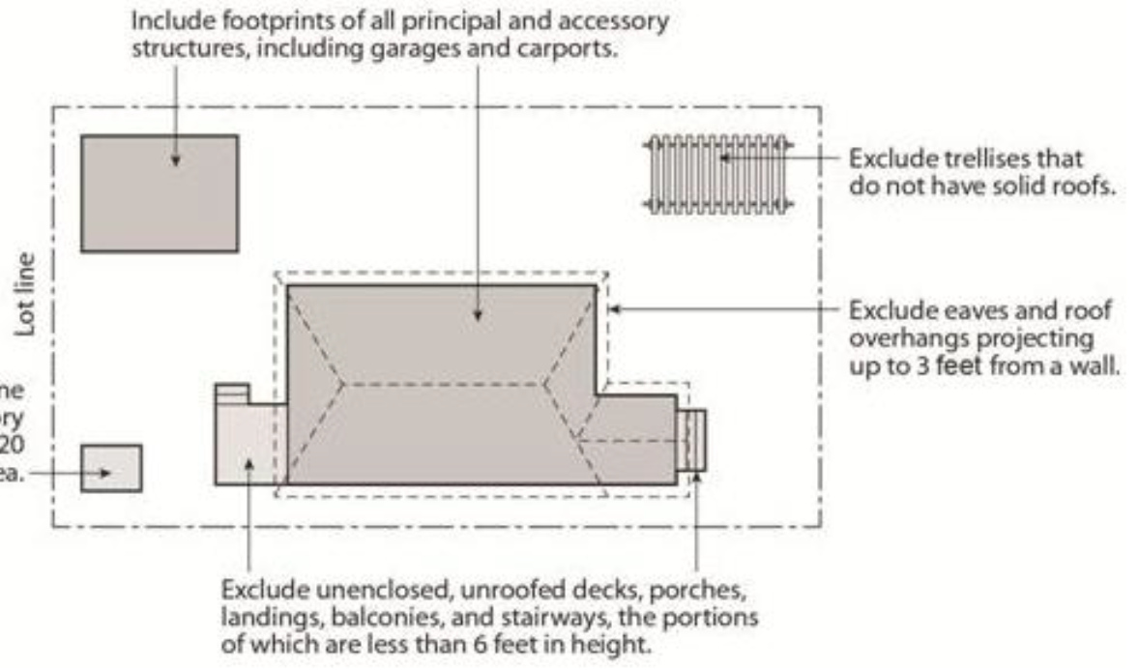
Discussion – Floor Area Ratio
Lot Coverage Examples
50’x150’= 7,500 Sq. Ft.
45%= 3,375 Sq. Ft.
40%= 3,000 Sq. Ft.
FAR .55= 4,125 Sq. Ft.
FAR .5= 3,750 Sq. Ft.
70’x150’= 10,500 Sq. Ft.
45%= 4,725 Sq. Ft
40%= 4,200 Sq. Ft.
FAR .55= 5,775 Sq. Ft.
FAR .5= 5,250 Sq. Ft.
33

Slide 34
Discussion – Floor Area Ratio
Westlake Lot example (1.5 story house)
DCAD – 3,234 sq. ft. with 480 sq. ft detached garage (total including parking 3,714 sq. ft.)
Lot size = 9,274 sq. ft.
45% lot coverage = 4,173 (possible 8k sq. ft house + accessory)
0.5 FAR = 4,637 sq. ft house + accessory
0.4 FAR = 3,890 sq. ft. house + accessory
40% lot coverage = 3,710 sq. ft. (possible 7,400 sq. ft house + accessory)
35% lot coverage = 3,246 sq. ft. (possible 6,400 sq. ft house + accessory)
34

Slide 35
Discussion – Floor Area Ratio
Lakewood Lot example (2 story house)
DCAD – 3,384 sq. ft. with 530 sq. ft detached garage and 760 sq. ft. detached quarters (total including parking 4,674 sq. ft.)
Lot size = 10,200 sq. ft.
45% lot coverage = 4,590 (possible 9k sq. ft house + accessory)
0.5 FAR = 5,100 sq. ft house + accessory
0.4 FAR = 4,080 sq. ft. house + accessory
40% lot coverage = 4,080 sq. ft. (possible 8,100 sq. ft house + accessory)
35% lot coverage = 3,570 sq. ft. (possible 7,100 sq. ft house + accessory)
35

Slide 36
Discussion – Floor Area Ratio
Tokalon Lot example #1 (1 story house)
DCAD – 4,633 sq. ft. with 315 sq. ft detached garage and 480 sq. ft. detached carport (total including parking 5,428 sq. ft.)
Lot size = 18,610 sq. ft.
45% lot coverage = 8,375 (possible 16,750 sq. ft house + accessory)
0.5 FAR = 9,305 sq. ft house + accessory
0.4 FAR = 7,444 sq. ft. house + accessory
40% lot coverage = 7,444 sq. ft. (possible 14,900 sq. ft house + accessory)
35% lot coverage = 6,513 sq. ft. (possible 13k sq. ft house + accessory)
36

Slide 37
Discussion – Floor Area Ratio
Tokalon Lot example #2 (2 story house)
DCAD – 5,029 sq. ft. with 420 sq. ft detached garage and 265 sq. ft. detached quarters (total including parking 4,674 sq. ft.)
Lot size = 43,560 sq. ft.
45% lot coverage = 19,602 (possible 39k sq. ft house + accessory)
0.5 FAR = 21,780 sq. ft house + accessory
0.4 FAR = 17,424 sq. ft. house + accessory
40% lot coverage = 17,424 sq. ft. (possible 35k sq. ft house + accessory)
35% lot coverage = 15,246 sq. ft. (possible 30k sq. ft house + accessory)
37

Slide 38
Discussion – Floor Area Ratio
New Construction example (2 story house)
DCAD – 5,056 sq. ft. with 506 sq. ft attached garage and 402 sq. ft. outdoor living (total including parking 5,964 sq. ft.)
Lot size = 11,462 sq. ft.
45% lot coverage = 5,157 (possible 10k sq. ft house + accessory)
0.5 FAR = 5,731 sq. ft house + accessory
0.4 FAR = 4,585 sq. ft. house + accessory
40% lot coverage = 4,585 sq. ft. (possible 9k sq. ft house + accessory)
35% lot coverage = 4,011 sq. ft. (possible 8k sq. ft house + accessory)
38

Slide 39
Recap – Floor Area Ratio
39

Slide 40
Petition Topic – Setbacks (Main)
Modifying front, side, and rear setback requirements
Provisions for existing non-conforming structures
Existing Regulations CD-2 – Front Yard Setback
A minimum 40-foot front yard setback must be provided on all building sites in Tract I.
A minimum 50-foot front yard setback must be provided on all building sites in Tract II.
A minimum 60-foot front yard setback must be provided on all building sites in Tract III, except for lots located in City Block Q/2983, for which a minimum 40-foot front yard setback must be provided.
Existing Regulations R-7.5(A) – Front Yard 25-foot setback
Existing Regulations R-10(A) – Front Yard 30-foot setback

Slide 41
Petition Topic – Setbacks (Main)
Existing Regulations CD-2 – Side Yard
A minimum side yard setback of five feet and a minimum cornerside yard setback of 15 feet must be provided on all building sites in Tract I and II.
A minimum side yard setback of six feet and a minimum cornerside yard setback of 15 feet must be provided on all building sites in Tract III.
Existing Regulations R-7.5(A) – Side Yard
Five-foot setback
Existing Regulations R-10(A) – Side Yard
Six-foot setback

Slide 42
Petition Topic – Setbacks (Main)
Existing Regulations CD-2 – Rear Yard
A minimum rear yard setback of five feet must be provided on all building sites in Tract I and II.
A minimum rear yard setback of six feet must be provided on all building sites in Tract III.
Existing Regulations R-7.5(A) – Rear Yard
Five-foot setback
Existing Regulations R-10(A) – Rear Yard
Six-foot setback

Slide 43
Discussion – Setbacks (Main)
Do you know your setback?
Is there variation along the street, or do all houses appear to be situated similarly on the lot?
Allowance for nonconforming structures
  Any additions must meet applicable setbacks without clarifying language
  Continuation of nonconforming setbacks
  Documented Assurance for repairs to existing nonconforming structures
43

Slide 44
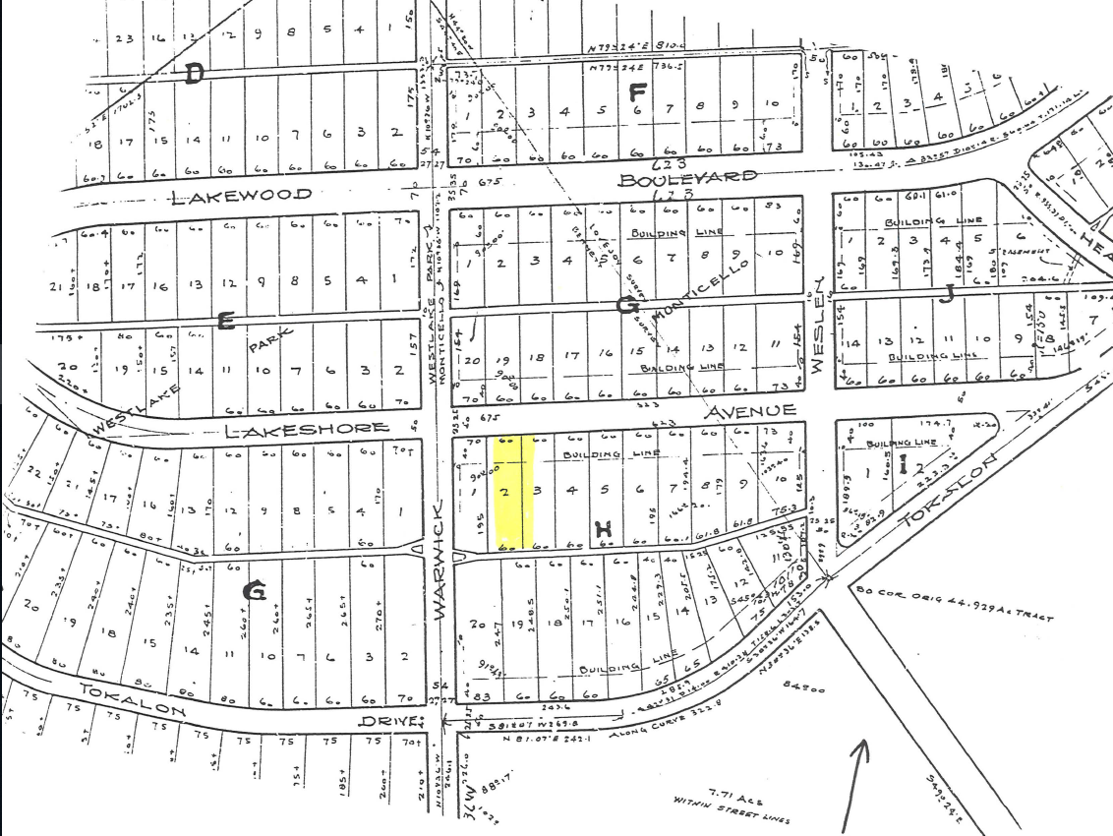
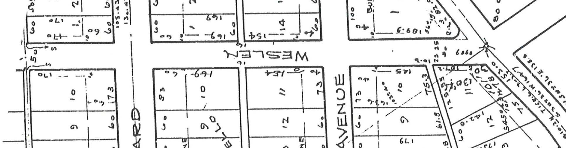
Discussion – Setbacks (Main)
44

Slide 45
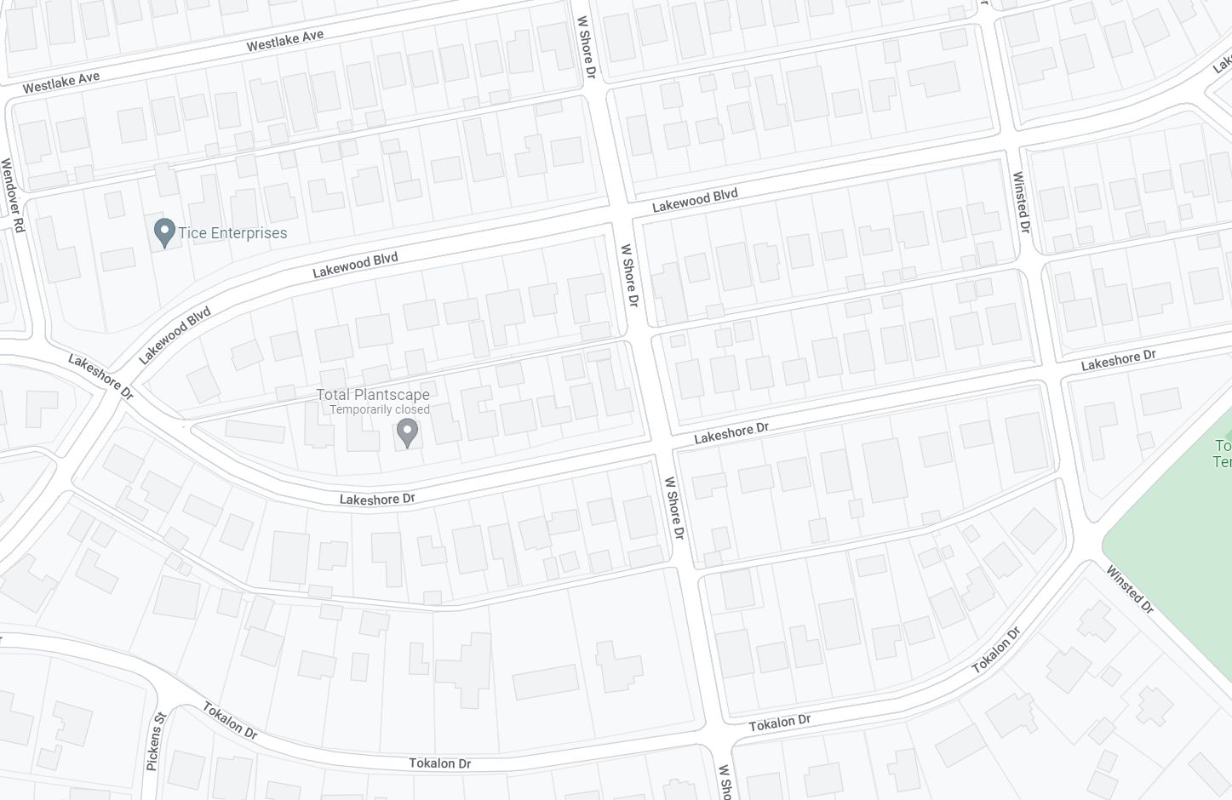
Discussion – Setbacks (Main)
45

Slide 46
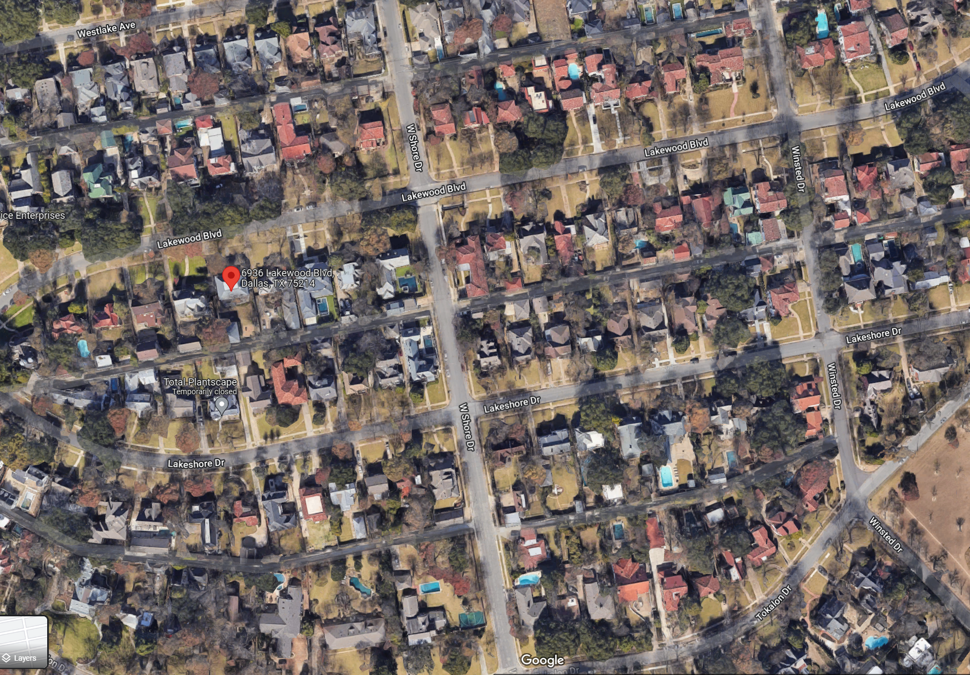
Discussion – Setbacks (Main)
46

Slide 47
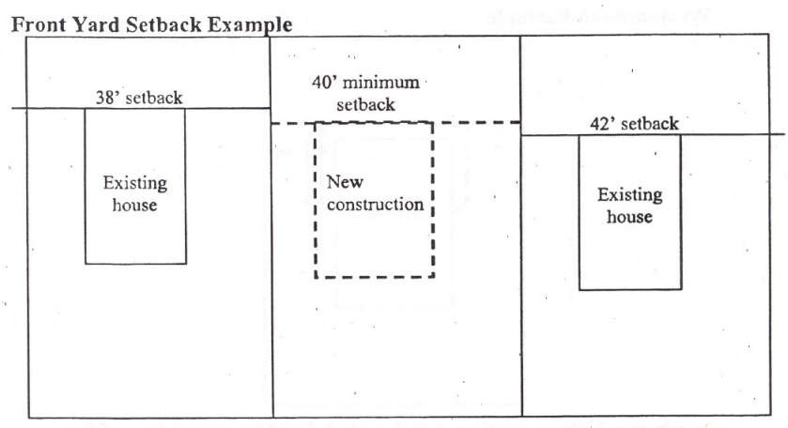
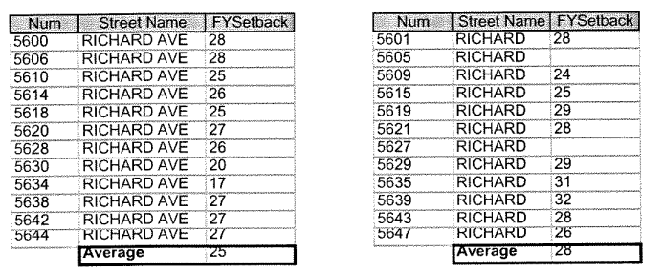
Discussion – Setbacks (Main)
Average Adjacent Lots
Average Blockface
47

Slide 48
Recap – Setbacks (Main)
48

Slide 49
Petition Topic – Setbacks (Accessory)
Modifying side and rear setback requirements for accessory structures
Provisions for existing non-conforming structures
Existing Regulations CD-2
(A) All garage and accessory structures are exempt from side and rear yard setback requirements and may extend along the entire distance of the rear lot line provided that:
  (i) no portion of the garage or accessory structure extends into the front half of the area between between the rear lot line and the primary rear facade of the main structure; and
  (ii) the second floor of any such structure does not extend along the width of the lot for a distance greater than:
    (aa) 40 feet; or
    (bb) 60 percent of the length of the rear lot line.
(B) All eaves and overhangs of all accessory structures must be located within the confines of a lot.

Slide 50
Petition Topic – Setbacks (Accessory) (Cont.)
Existing Regulations CD-2 (Cont.)
(C) Any new construction of a wall of a building located less than three feet from an adjacent lot is required to meet a one-hour fire rating as described by the Dallas Building Code, as amended. These walls are not permitted to have window or door openings.
(D) Any construction of a wall of a building located less than three feet from a street or alley must meet the provisions of the Dallas Building Code, as amended.
(E) No side yard setback is required for:
  (i) a new or existing one-story porte-cochere; or
  (ii) an existing porte-cochere with more than one story; provided that the stormwater runoff from the roof of the porte-cochere is not directed onto an adjacent lot. New additions to a porte-cochere above the first story must meet minimum side yard requirements.
(7)(b) Garages and accessory structures must be locate at the rear of the main structure.

Slide 51
Petition Topic – Setbacks (Accessory) (Cont.)
Existing Regulations R-7.5(A) and R-10(A)
Side yard setback for accessory structures
  In a residential district, a person need not provide a side yard setback for a structure accessory to a residential use, including a generator, if the structure:
    (A) does not exceed 15 feet in height; and
    (B) is located in the rear 30 percent of the lot.
Rear yard setback for accessory structures
  In a residential district, a person need not provide a full rear yard setback for a structure accessory to a residential use, including a generator, if the structure does not exceed 15 feet in height. Where the rear yard is adjacent to an alley, a three-foot setback must be provided. Where the rear yard is not adjacent to an alley, no setback is required.

Slide 52
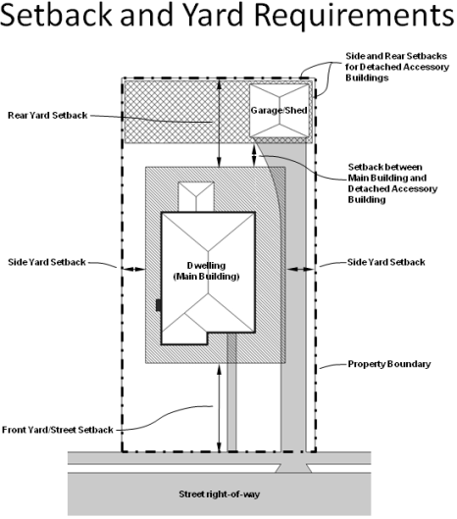
Discussion – Setbacks (Accessory)
Where are original garages and accessory structures located?
Limiting where accessory structures can be located
  To the rear of main
  Rear 30 percent of lot
Allowance for nonconforming structures
  Any additions must meet applicable setbacks without clarifying language
52

Slide 53
Recap – Setbacks (Accessory)
53

Slide 54
Petition Topic – Accessory Structures
Provisions for style, materials, roof slope
Consider remodeling or replacement of existing accessory structures
Existing Regulations CD-2
Garages and accessory structures
  Garages and accessory structures may be constructed of any legal building material and in any architectural style. New construction of a roof on a garage or an accessory structure must consist of a hipped, side gabled, gambrel, mansard, or cross gable roof form.
Existing Dallas Development Code 51A-4.209(6)(E)
(ff) Accessory structures must have exterior siding, roofing, roof pitch, foundation fascia, and fenestration compatible with the main building. "Compatible" as used in this provision means similar in application, color, materials, pattern, quality, shape, size, slope, and other characteristics; but does not necessarily mean identical. The burden is on the property owner or applicant to supply proof of compatibility. This provision does not apply to accessory structures with a floor area of 200 square feet or less.

Slide 55
Discussion – Accessory Structures
Any style or same style of house?
Materials
Roof slope
When to regulate architecture, if at all
  Visible from street?
55

Slide 56
Recap – Accessory Structures
56

Slide 57
Next Steps
Neighborhood Meeting #6: November 9
Neighborhood Meeting #7: November 16
Neighborhood Meeting #8: November 30
Neighborhood Meeting #9: December 7
Neighborhood Meeting #10: December 14
Neighborhood Meeting #11-12: If needed
Final Neighborhood Meeting to review ordinance: Date TBD
City Plan Commission Public Hearing: Date TBD (notified 10 days before)
City Council Public Hearing: Date TBD (notified 14 days before)
57

Slide 58
CD-2 - Lakewood
Conservation District Expansion
Post-Application Neighborhood Meeting No. 5
Staff Contact
Trevor Brown
trevor.brown@dallas.gov
214-670-4193
Project Webpage
https://bit.ly/LakewoodExpansion
Next Meeting November 9, 6:00 pm
Introduction and Recap
Discussion
  fences, retaining walls, waterfall steps, landscape, paint, solar
Next Steps

Slide 59
59

Slide 61
Notes:
Notification will be mailed of CPC and CC hearings – area + 500’ buffer; anyone can speak to the item at these hearings.

Slide 62
62

Slide 63
63

Slide 64
64

Slide 65
65

Slide 67
67

Slide 68
68

Slide 69
69

Slide 70
70

Slide 71
Notes:
Current regs for driveway access; Point is that access is allowed from EITHER street or alley, but not both

Slide 72
72

Slide 73
Notes:
Current regs for driveway access; Point is that access is allowed from EITHER street or alley, but not both

Slide 74
74

Slide 75
Notes:
Current regs for driveway access; Point is that access is allowed from EITHER street or alley, but not both

Slide 76
76

Slide 77
Petition Topic – Drainage & Slope
  Consideration of provisions for modifications to the existing slope of a lot
Existing Regulations CD-2
None
Dallas Development Code
No lot-to-lot drainage is allowed.
Notes:
Current regs for driveway access; Point is that access is allowed from EITHER street or alley, but not both

Slide 78
Recap – Drainage & Slope
Maintaining the existing slope of the lot for lots where new construction is proposed.
Sample language
  The existing slope of a lot must be maintained. This provision does not prevent minor grading as necessary to allow construction, prevent lot-to-lot drainage, or match the slope of contiguous lots.
  For purposes of this subsection, "slope" means any change in elevation from the front lot line to the rear lot line or from a side lot line to the other side lot line.
78

Slide 79
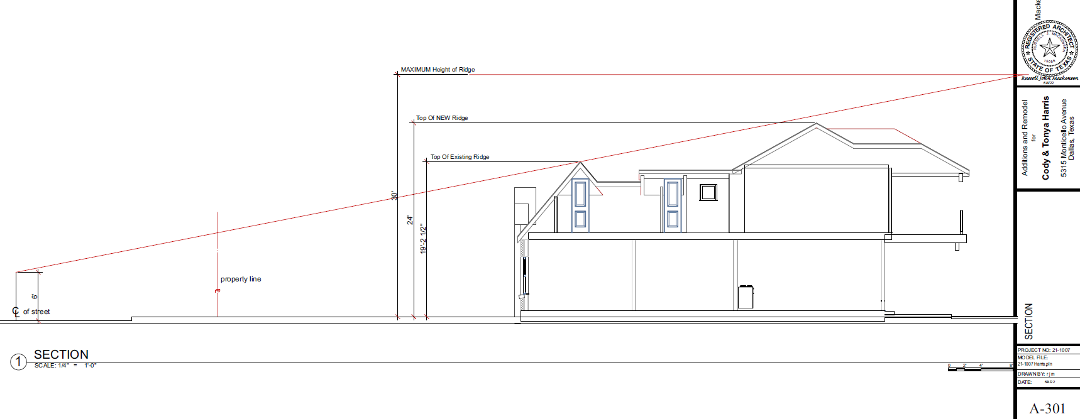
0

Slide 80
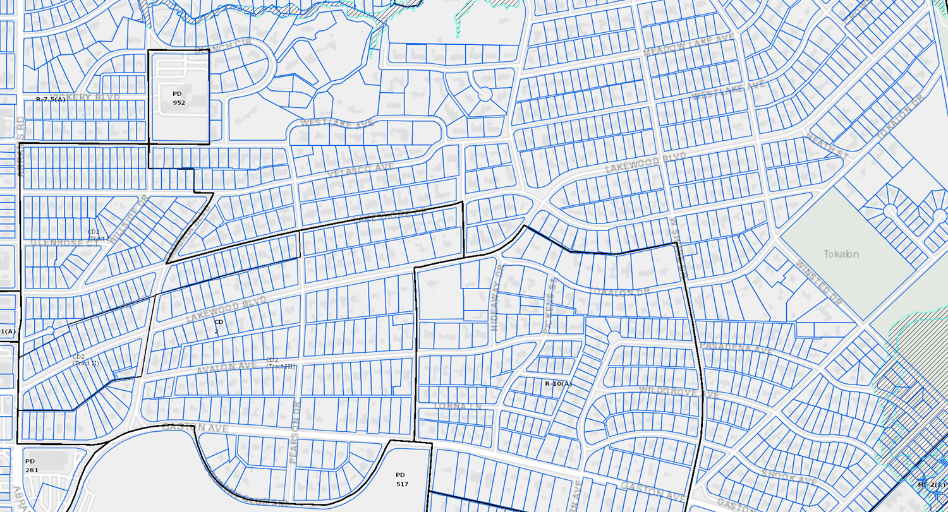
80

