Slide 1
South Winnetka Heights Proposed Conservation District Post-Application Neighborhood Meeting No. 1
September 29, 2022
Trevor Brown, Chief Planner
Melissa Parent, Senior Planner
Scott Bellen, Senior Planner
Planning & Urban Design
City of Dallas

Slide 2
South Winnetka Heights Proposed Conservation District Post-Application Neighborhood Meeting No. 1
Staff Contact
Trevor Brown
trevor.brown@dallas.gov
214-670-4193
Project Webpage
https://bit.ly/S_Winnetka_CD
Agenda
Background
Overview of process
Discussion
Driveways and curbing
Front Pathways
Front yard coverage
Lot size
Next Steps

Slide 3
Purpose of a Conservation District
Intended to provide a means of conserving an area’s distinctive character by protecting or enhancing its physical attributes
Protect the physical attributes of an area or neighborhood
Promote development or redevelopment that is compatible with an existing area or neighborhood
Promote economic revitalization
Enhance the livability of the city
Ensure harmonious, orderly, and efficient growth
Notes:
So what is the purpose of a conservation district?

Slide 4
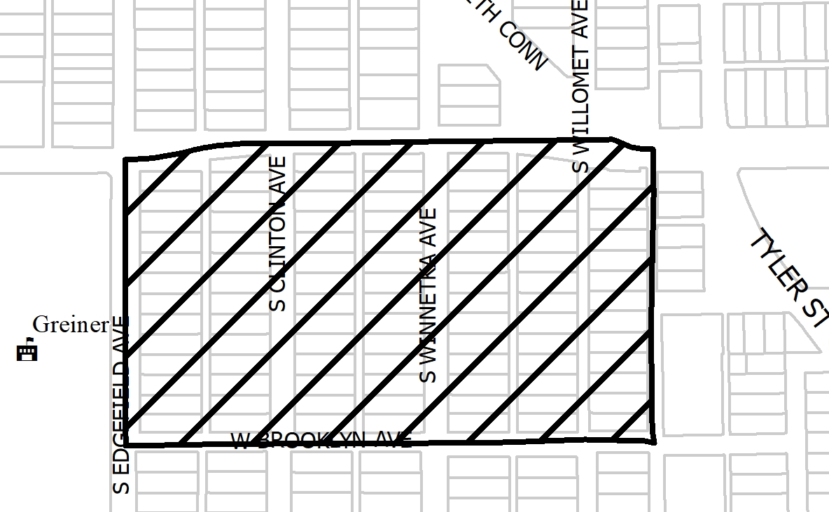
CD Proposed Boundaries

Slide 5
Purpose of This Meeting
This meeting is the 1st Post-Application Neighborhood Meeting to discuss the CD creation process.
Develop the specific details for the development standards and architectural standards your neighborhood chose for consideration.
Discussion
Driveways and curbing
Front walks
Front yard coverage
Lot size

Slide 6
CD Creation Flow Chart
Notes:
This is our process for amending an existing Conservation District – long story short: Pre-applications meetings, petitions, post-application meetings, ordinance revisions, public hearings.
We have verified petitions (75% of owners signed requesting to consider amendments), so we are holding meetings to actually determine what changes are appropriate.

Slide 7
Process for establishing a CD
Neighborhood committee submits a pre-application form (complete).
City holds pre-application meetings with property owners to discuss and establish a list of categories of development and architectural standards the property owners are interested in establishing for a new conservation district.
The neighborhood committee meets with property owners to ensure awareness of the process and active participation throughout the neighborhood.
Emphasis on consensus among all property owners in neighborhood.
Neighborhood committee and property owners convey additional comments on categories and elements.
Notes:
So what is the process for turning your neighborhood into a conservation district?
We’ll go through the process tonight, but I can’t emphasize enough that it is incumbent upon the neighborhood committee and property owners to get the involvement of the entire neighborhood. The more you talk and reach consensus about what you want, before we actually start the official zoning change process, the better this process will go.
My e-mail address will be at the end of this presentation… feel free to send comments by e-mail, also.

Slide 8
Process for establishing a CD
City holds additional pre-application meetings with property owners to develop and finalize categories of standards for the proposed CD
These categories form the basis of CD establishment petition.
The City drafts petition language with input received from the neighborhood committee and property owners at these pre-application meetings.
The city provides neighborhood committee with petitions.
Neighborhood committee will have 12 months to obtain the necessary percentage of signatures and submit them to the City. 58% of the land or 58% of the lots is required
Staff verifies the signatures and petitions.
Notes:
After the neighborhood has reached some consensus on what types of changes it wants to make and conveys those changes to staff, then the City holds an additional pre-application meeting to develop and finalize the categories of standards to amend or add.
Using those categories and elements, the city drafts petition language and gives the petitions to the neighborhood committee.
The NC will have 12 months to gather signatures and return them to the city.
City staff then verifies the signatures and petitions.

Slide 9
Process for establishing a CD
Once petitions are verified, neighborhood committee submits zoning change application with appropriate fees, if necessary.
Fee waived if petitions are signed by a minimum of 75% of property owners
This application is the beginning of the zoning change process.
The City begins scheduling neighborhood meetings as needed to work out proposed detailed regulations in each of the categories
Multiple meetings held
Neighborhood committee works to ensure all voices are heard and everyone is aware of process
At the conclusion of the series of meetings, City prepares ordinance
City holds neighborhood meeting to review draft language
City Plan Commission public hearing and recommendation
City Council public hearing and decision
YOU
ARE
HERE
Notes:
Once the petitions are verified, the neighborhood committee submits the zoning change application and fee.
If you get 75% or more verified signatures on your petition, the fee will be waived.
This, then is the beginning of the zoning change process.

Slide 10
Background
August 2019 – first inquiry into a CD
July 2020 – Determination of Eligibility for pre-application
August 20, 2020 - Neighborhood committee (10 property owners) submitted a request for pre-application meetings to begin the process of potentially creating a new Conservation District.

Slide 11
Background
November 9, 2020 - 1st Pre-application Meeting.
July 19, 2021 - 2nd Pre-application Meeting
July 29, 2021 - Petitions provided to Neighborhood Committee for collection of property owner signatures.
July 29, 2022 – 71 petitions were submitted by the Neighborhood Committee for verification.
August 29, 2022 - ​Planning & Urban Design staff verified 76% of the petitions.

Slide 12
Meeting Schedule
Post-Application Neighborhood Meeting #1 – September 29
Process, schedule, driveways/curbing, front walk, front yard impervious coverage, lot size.
Post-Application Neighborhood Meeting #2 – October 17
Use and parking, density, lot coverage, building height & stories, Floor Area Ratio, drainage, and slope
Post-Application Neighborhood Meeting #3 – November 1 (Tuesday)
Setbacks-main, setbacks-accessory, accessory structures, foundations
Post-Application Neighborhood Meeting #4 – November 14
Demolition, documented assurance, roofing materials, windows, porches
Post-Application Neighborhood Meeting #5 – December 5
Fences, retaining walls, waterfall steps, landscape, paint, solar
Post-Application Neighborhood Meeting #6 – TBD
Contributing architectural styles, new construction standards, remodel/addition standards, areas of regulation, work reviews

Slide 13
Meeting Schedule
Post-Application Neighborhood Meeting #7 – TBD
Architectural styles – Craftsman, Transitional Bungalow
Post-Application Neighborhood Meeting #8 – TBD
Architectural styles – Contributing and Non-Contributing
Post-Application Neighborhood Meeting #9 – TBD
If needed
Post-Application Neighborhood Meeting #10 – TBD
If needed
Post-Application Neighborhood Meeting #11 – TBD
If needed
Post-Application Neighborhood Meeting #12 – TBD
If needed

Slide 14
Meeting Schedule (cont.)
Final Post-Application Neighborhood Meeting – TBD
Ordinance Review (30-60 days after last meeting)
City Plan Commission – TBD
City Council – TBD

Slide 15
Topics for Discussion:
Accessory Structures - proposed regulations may include:
Location.
Building & Structure Height - proposed regulations may include:
Modifying how height is measured.
Establishing the maximum allowed height for structures, including accessory structures.
Building Width - proposed regulations may include:
Minimum building width.
Density - proposed regulations may include:
Considering maximum density.
15
Notes:
These are the specific items that were on the petition – what we’ll be discussing at these meetings

Slide 16
Topics for Discussion (cont.):
Driveways, Curbs, and Sidewalks - proposed regulations may include:
Locations, access points, materials, dimensions, and types.
Provisions for non-conforming driveways and walks.
Fences & Walls - proposed regulations may include:
Location, height, style & materials.
Foundations - proposed regulations may include:
Foundation types, materials, height, and appearance.
Provisions for remodels or additions to existing structures.
Lot Coverage
16

Slide 17
Topics for Discussion (cont.):
Off-street Parking - proposed regulations may include:
Minimum parking standards per dwelling unit.
Permitted Uses - proposed regulations may include:
Single family
Setbacks - proposed regulations may include:
Modifying front, side, and rear setback requirements.
Provisions for non-conforming contributing structures.
Stories - proposed regulations may include:
Maximum stories allowed.
Provisions for non-conforming contributing structures
17

Slide 18
Topics for Discussion (cont.):
Accessory Structures - proposed regulations may include:
Style and materials.
Roof slope.
Replacement or Remodeling of existing accessory structures - clarifying the architectural styles, materials, size, and applicability.
Architectural Styles - proposed regulations may include:
Defining the architectural styles allowed.
Standards for remodels and additions.
Standards for new construction.
Provisions for existing non-contributing structures.
18

Slide 19
Topics for Discussion (cont.):
Building Elevations - proposed regulations may include:
Minimum architectural features required.
Standards for new construction.
Standards for remodels and additions.
Provisions for existing non-contributing structures.
Building materials - proposed regulations may include:
Material types.
Applicability and placement of certain allowed materials.
Provisions for existing non-contributing structures.
19

Slide 20
Topics for Discussion (cont.):
Chimneys - proposed regulations may include:
Materials, form, & placement.
Demolition - proposed regulations may include:
Applicability to contributing structures.
Provisions for existing non-contributing structures.
Dormers - proposed regulations may include:
Dormer size, location, and styles.
Provisions for remodels or additions to non-contributing structures.
20

Slide 21
Topics for Discussion (cont.):
Garage Location and Entrance - proposed regulations may include:
Garage and garage door placement.
Provisions for remodels or additions to non-conforming structures.
Impervious Surfaces and Hardscaping - proposed regulations may include:
Materials and allowable percentage of front yard coverage.
21

Slide 22
Topics for Discussion (cont.):
Porch Styles - proposed regulations may include:
Styles, materials, placement, size, and detailing.
Standards for enclosures.
Provisions for remodels or additions to existing structures.
Roof Form and Pitch - proposed regulations may include:
Provisions for remodels or additions to existing structures.
Roofing Materials - proposed regulations may include:
Provisions for remodels or additions to existing structures.
22

Slide 23
Topics for Discussion (cont.):
Solar Energy Systems and Components - proposed regulations may include:
Locations and type.
Provisions for remodels or additions to existing non-contributing structures.
Steps - proposed regulations may include:
Location, style, materials & dimensions.
Windows - proposed regulations may include:
Placement, architectural standards, materials, and types.
Provisions for remodels or additions to existing structures.
23

Slide 24
Topics for Discussion (cont.):
Work Reviews - proposed regulations may include:
Language to detail the requirements for a work review.
24

Slide 25
Procedure
To speak during the discussion portions of tonight’s meeting:
Please raise your hand and wait to be recognized before you begin speaking
Before your comments, state your name and address for the record
All comments must be related to the topic being discussed at that time

Slide 26
Petition Topic – Driveways and Curbing
Potential requirements for driveway access and location
Existing Regulations
Width - Residential driveway approaches shall not be less than 10 feet nor more than 30 feet in width measured at the property line.
Notes:
Current regs for driveway access; Point is that access is allowed from EITHER street or alley, but not both

Slide 27
Discussion - Driveways
Material
Concrete
Paver
Stone
Gravel
Any materials to prohibit from use?
Location
Front entry/cornerside entry/rear entry
Which side of the lot
Width
Type
Solid
Ribbon
27
Notes:
Front yard, corner side yards, rear yard height – delete unless someone brings it up?

Slide 28
Recap
28

Slide 29
Petition Topic – Front Walk
Potential requirements for sidewalks in front yard leading to main structure
Existing Regulations
None
Petition Topic - Front yard coverage
Potential requirements for impervious paving in the front yard.
Existing Regulations
None

Slide 30
Discussion – Front Walk
Materials
Concrete (brushed, smooth, stamped)
Brick
Stone
Width
Type/Design
Straight
Curved
Coverage by impervious materials
Location
30

Slide 31
Discussion – Front Yard Coverage
Coverage by impervious materials
Concrete
Brick
Stone
Any other materials to include as impervious?
Parking pads
Location
31

Slide 32
Recap
32

Slide 33
Petition Topic – Lot Size
Discuss the requirements of minimum width and depth of lots
Existing Regulations
Dallas Development Code has minimum width of 55 feet and depth of 100 feet for R7.5(A) lots.
Notes:
Current regs for driveway access; Point is that access is allowed from EITHER street or alley, but not both

Slide 34
Discussion – Lot Size
All lots in the district boundaries are zoned R7.5(A)
Lots have 50’ width and a depth of 150’
34
Notes:
Front yard, corner side yards, rear yard height – delete unless someone brings it up?

Slide 35
Recap
35

Slide 36
Next Steps
Neighborhood Meeting #2: October 17 (Monday) **
Neighborhood Meeting #3: November 1 (Tuesday) **
Neighborhood Meeting #4: November 14 (Monday) **
Neighborhood Meeting #5: December 5 (Monday) **
Neighborhood Meeting #6: TBD - January 9 (Tentative)
Neighborhood Meeting #7: TBD - January 23 (Tentative)
Neighborhood Meeting #8: TBD – February 6 (Tentative)
Neighborhood Meeting #9: TBD – February 21(Tentative)
Neighborhood Meeting #10-12: If needed
Final Neighborhood Meeting to review ordinance: Date TBD
City Plan Commission Public Hearing: Date TBD (notified 10 days before)
City Council Public Hearing: Date TBD (notified 14 days before)
** Meeting scheduled to be held at Arts Mission Oak Cliff **
36

Slide 37
South Winnetka Heights Proposed Conservation District Post-Application Neighborhood Meeting No. 1
Staff Contact
Trevor Brown
trevor.brown@dallas.gov
214-670-4193
Project Webpage
https://bit.ly/S_Winnetka_CD
Next Meeting October 17, 6:00 pm
** Arts Mission Oak Cliff **
410 S. Windomere Avenue
Introduction and Recap
Discussion
Use and Parking, density, lot coverage, building height & stories, Floor Area Ratio, drainage, and slope
Next Steps

