Slide 1
Development Services
Development Advisory Committee
August 25, 2023
Andrew Espinoza, CBO, MCP, CFM, CCEA
Director/Chief Building Official
Development Services Department
City of Dallas

Slide 2
Topics
Introductions​
Technology​ - DallasNow Update
Self-Certification Update​
School Team​
Fee Study​
House Bill 14​
Outreach Efforts​
Recruitment and Hiring
Metrics and Report Cards​
FY 2023/2024 Performance Goals​
Open Discussion

Slide 3
Technology – DallasNow Update
The implementation project of the new land management system completed its third month of progress on August 1st.
Record types [permit types] for most complex commercial and residential permits have been fully developed and entering the scripting [automation] phase.
The team has completed the tailoring phase[tailoring out-of-the-box product to COD business needs] for record types [permit types] for less complex commercial and residential permits; and is now moving to validation phase.
Record types for Current Planning [zoning changes]completed prep sessions on August 10 and will be moving to the tailoring stage of the process.

Slide 4
Self-Certification Update
Final Draft was submitted to City Attorney’s Office for final review/approval
Go Live Date Spring 2024
Staff identification, forms, applications, work processes, and Bulletins
Outline in this program may be used to help develop Third-Party Program as outlined in HB14 Legislation

Slide 5
School Team
Since its creation, the team has performed review for 21 DISD projects that had been in the queue but had not started the review process. All but one of those projects are waiting on applicant’s revisions, some of those are awaiting Council approval of their zoning changes.
Team of four team members including Project Coordinators and Plan review staff for zoning and building code. The team is responsible for coordinating and facilitating the communication between applicants and the different divisions/departments involved in the permitting process.
For the month of July, the team received a total of five new applications for school projects. two of those were for DISD, and three were other.
Last month, one DISD project was issued, and four more were approved and are ready to be issued. 11 DISD projects have been issued since the team was established. Additionally, two other projects for other school districts/private school were also approved during this time.

Slide 6
Fee Study
DSD initiated a Fee Study mid-year FY23
Last review of fees in FY2019 but not implemented
Last fee update FY 2015
MGT Consultants/DSD will publish Study
DSD plans to share results with Council Winter 2023
DSD executed several recommendations and needed improvements in FY23:
Increase in service delivery by adding 56 new positions
7800 N Stemmons “One Stop Center”
DallasNow Land Management System

Slide 7
House Bill 14
Third Party Review of Development Documents and Inspection of Improvements:
If the City does not approve, conditionally approve, or disapprove a development document by the 15th day after the date prescribed by a provision of this code, the review may be performed by a 3rd party.
DSD is meeting with CAO to:
Define specific sections of the Bill and determine:
Code interpretations
Code amendments
3rd party registration process
3rd party qualifications, insurance, and expectations

Slide 8
Outreach Efforts
Lunch & Learn Sessions
June 29th – “Survey & Subdivision”
July 13th – “Zoning – Create a Legal Build Site”
July 28th – “Construction Management”
August 11th – “Signs 101”
August Lunch and Learn
August 18th – “GIS Website Overview”
August 21st – “Tree Removal”
August 25th – “Water/Wastewater and Paving/Drainage”
August 30th – “Affordable Housing”
August 31st – “Board of Adjustment”

Slide 9
Outreach Efforts
Chief Electrical Inspector, Trey Kneggs, and Chief Plumbing Inspector, Terry Johnson, presented an overview of DSD processes to Career Institute South CTE instructors during their professional development workshops.
August 7-8, 2023

Slide 10
Recruitment and Hiring
Filled Department Administrators for priority teams:
Policy Administrator
Customer Advocate
Land Management
Created Training & Development Team:
Training Manager
2 Senior Training Specialists
Current Vacancy Status:
Pending Hires | Interview Pipeline | Job Posting | Dept. Restructure | Recently Vacant | Total Vacancies
8 | 13 | 7 | 20 | 1 | 49

Slide 11
Metrics & Report Card
New Single-Family permits increased from 158 to 204 from the previous (22.5% increase). 207 New Single-Family permits issued. Median number of days to issue decreased from 19 days to 8 days. A total of 42 RSVP permits and were issued the same day.

Slide 12
Metrics & Report Card
7 new commercial, 18 commercial additions, 245 commercial remodels, 21 complex commercial Q-Team, and 26 minor commercial Q-Team project permits. All new commercial/remodels initial reviews were performed within 6 days and all Q-Team initial reviews were performed within 4 days.

Slide 13
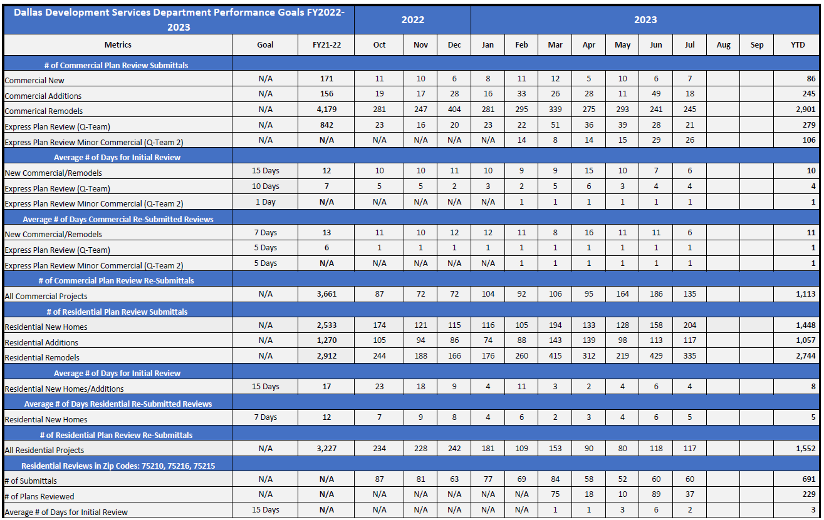
Metrics & Report Card
Dallas Development Services Department Performance Report Card
“Click Here”

Slide 14
FY 2023/2024 Performance Goals
Metric | Initial Review Time Goals for 2023/2024
QTeam | 1 Day (Same Day for In-Person Session)
QTeam | 10 Days
Complex Commercial Plans | 15 Days
Minor QTeam | Same Day
New One-and-Two Family Dwellings | 7 Days
New One-and Two-Family Dwellings (RSVP) | 1 Day (Same Day)
All Plan Review Submittals | Half the initial review times
Fire Alarm/Fire Sprinklers | 15 Days
Water/Wastewater Engineering Review | 15 Days
Paving/Drainage Engineering | 15 Days
% of Plats Reviewed per State Law | 30 Days
All Plan Review Submittals | Half the initial review times

Slide 15
Development Services
Development Advisory Committee
August 25, 2023
Andrew Espinoza, CBO, MCP, CFM, CCEA
Director/Chief Building Official
Development Services Department
City of Dallas

