Slide 1

Development Services
Development Advisory Committee
June 30, 2023
Andrew Espinoza, CBO, MCP, CFM, CCEA
Director/Chief Building Official
Development Services Department
City of Dallas

Slide 2
Topics
Introductions
Technology
New Initiatives
  Self-Certification
  School Team
  Impacts of Ransomware Attack
  Certification and Performance Pay
Outreach Efforts
Recruitment and Hiring
Metrics
Relocation to 7800 N. Stemmons Update
Open Discussion

Slide 3
Introduction / Technology -Accela
Donald Dixson, CBO, Deputy Building Official Intro
Kamil Miskowiec, Senior Architect Intro
DallasNOW Update (Carolina/Ali)
School Team
Impacts of Ransomware Attack
Notes:
To answer the original question though, these sessions are essentially Accela walking us through their out-of-the-box solution, us walking them through our current processes, and then merging these together - translating our processes into their solutions
Orientation today is covering the first 4 tailoring groups and will be an overview of the process, what to expect, what is expected of us, and describing the kind of preparation that needs to occur in advance (any documents that need to be supplied, items to review, etc
This week has been:
Kickoff meeting
Reviewing the SOW with the Core Team
Standing up the development & test environments
Standing up the project tracking system and providing staff an introduction to it (our first time using Jira)
Next week:
Tailoring Group 1 will have two prep sessions
Training relating to the database will occur for applicable individuals
Data Conversion kicks off Thursday and Friday
Reports (traditional and literal documents like an issued CO document) will be discussed Friday with the Core Lead and supporting Core staff
Tailoring Group 1 will start its tailoring sessions on Monday, 3/15

Slide 4
Certification and Performance Pay
Certification Pay Program
  Incentivize professional development
  Continuing education
  ISO Department Accreditation
  Increase wages and retention
Performance Pay Program
  Metrics and measurables
  Attendance and punctuality
  Customer service and responsiveness
  Professional Development and succession planning

Slide 5
Outreach Efforts
Four Lunch & Learn Outreach Trainings
  Water/Wastewater
  Landscape – Mandatory Provisions and Ordinances
  Gas Test Operating Procedures
  Survey/Subdivision
  NFSA Three-day Training – *July 19-21, 2023
RHCA Family Day
RHCA Quarterly Meeting
Dallas ISD B.I.G Construction Mixer
National Society of Black Engineers (NSBE)
June Newsletter – 75% open rate

Slide 6
Recruitment and Hiring
DSD Interns (6)
  Participated in the 2023 Dallas Works Mayor’s Summer Internship Program
  5 College Interns working with our Engineering Division
Current Onboarding Totals

Slide 7
Self Certification
Matrix Consulting to assist to provide research
Undertaking of analysis the project team reviewed other cities programs
Development Services is exploring a program to register for Self-certification

Slide 8
Self Certification
Customer service
Eligible project criteria
Pilot program for select project types
Expand to other project types

Slide 9
Self Certification
Establish qualifications for self certifiers
  Professional engineers
  Licensed architects
  Certified code professional
Participants must meet experience, license, and certification requirements

Slide 10
Self Certification
Development Services soliciting feedback
  Development Advisory Committee
  Dallas Home Builders Association
  Regional Hispanic Contractors Association
  Texas Real Estate Commission
  American Institute of Architects
  Engineering Community

Slide 11
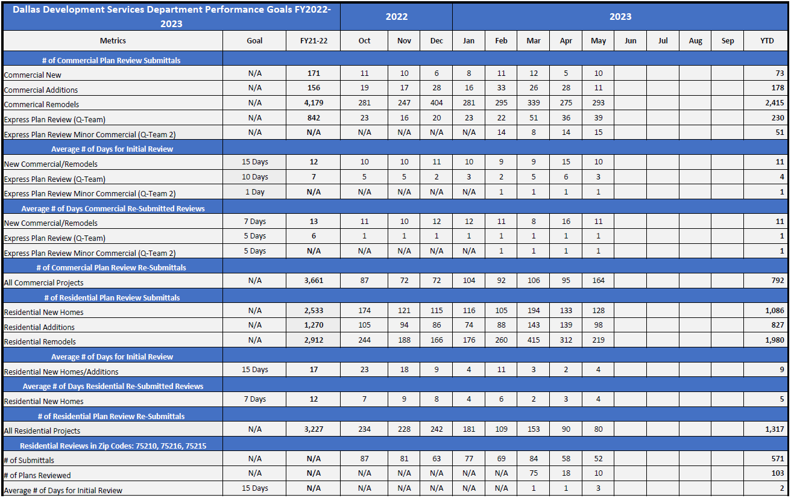
Metrics

Slide 12
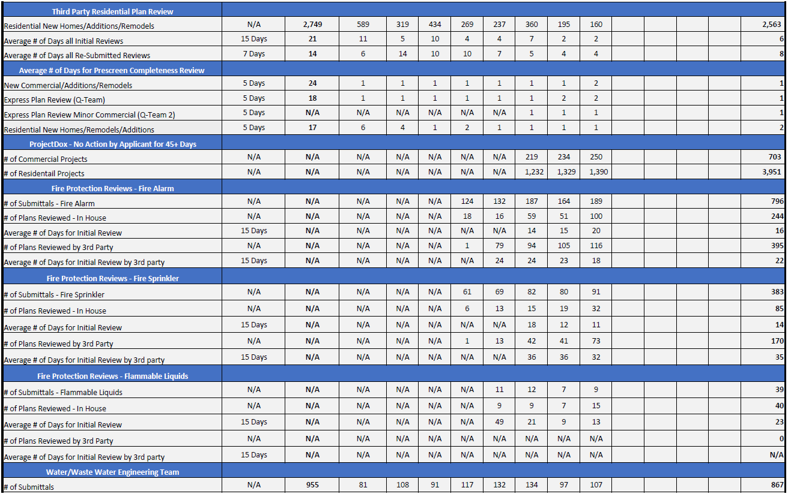
Metrics

Slide 13
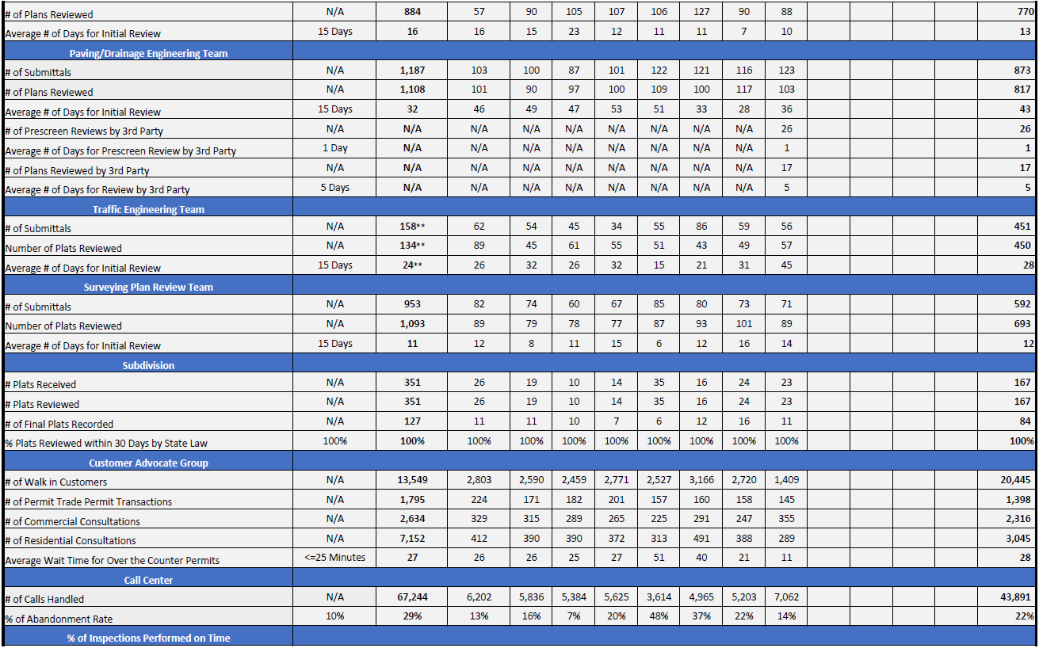
Metrics

Slide 14
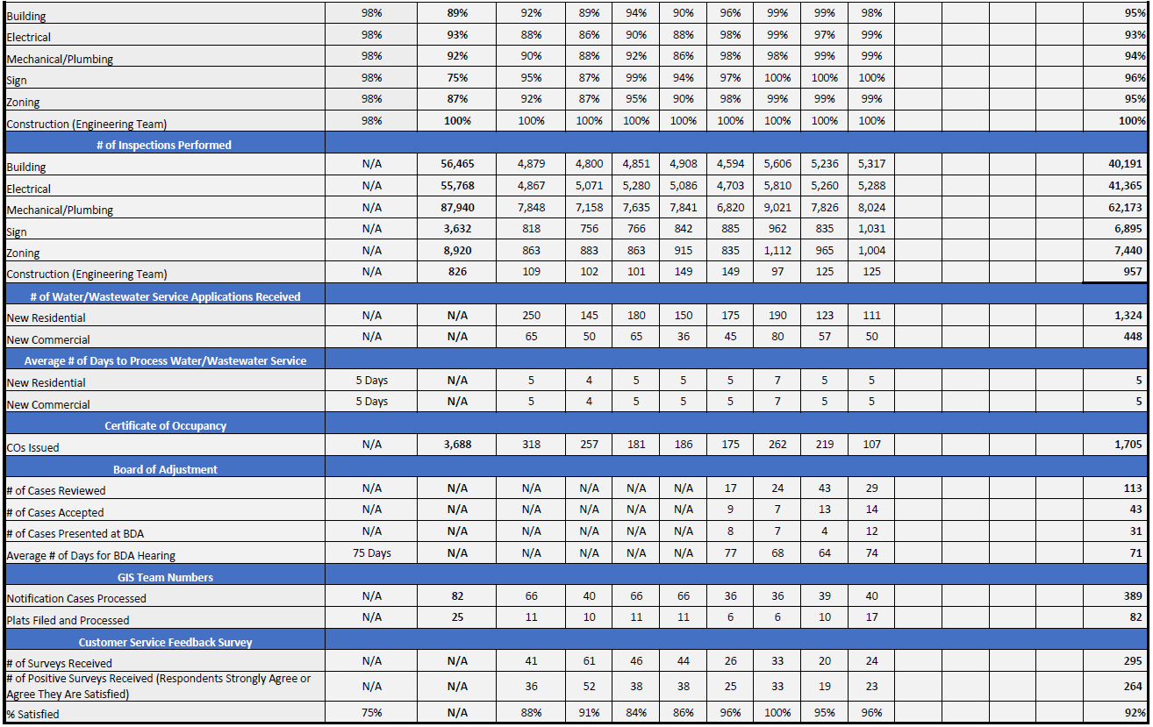
Metrics

Slide 15
Relocation to 7800 N. Stemmons Update
Ransomware Attack Impact
Phase 1 – October 2023 Move In
  Floor 1 Permit Counter/Call Center
  Floor 2 Residential/Minor Commercial Team
  Floor 3 Engineering/Subdivision/GIS
  Floor 4 Admin
  Floor 5 Commercial Plan Review/Q-Team

Slide 16
Open Discussion

Slide 17
Development Services
Development Advisory Committee
June 30, 2023
Andrew Espinoza, CBO, MCP, CFM, CCEA
Director/Chief Building Official
Development Services Department
City of Dallas

