Slide 1
McKinney/Cole Avenue Two-Way Conversion Project
Public Meeting
October 2, 2024
City of Dallas
Department of Transportation & Public Works
Notes:
Introductions:
Council
PBW
TRN

Slide 2
Introductions
Cameron Anderson, P.E., Program Administrator
Changho Yi, P.E., CFM, Project Manager
Kathryn Rush, AICP, Chief Planner
Jessica Scott, AICP, LCI, Bicycle & Micromobility Manager
Kimley-Horn, Design Consultant

Slide 3
Agenda
McKinney/Cole
Purpose
Background
Project Description
Project Goals
Scope of Work
Project Schedule
MATA Extension Study
Existing vs. Proposed Operations
Key Design Elements
Typical Sections & Intersections
Intersection Options
Bike Network Considerations
Purpose
Background
Impacts to McKinney/Cole Project
Your Input
Next Steps
Contact Information

Slide 4
Purpose of This Presentation
Present the revised 30% plan designs to the public
Discuss operational impacts of the project
Share key intersection options
Discuss next steps
Solicit public input on the McKinney/Cole project and key intersections

Slide 5
Background
2015 – Uptown Dallas Inc. (UDI) funded a traffic study to evaluate the impacts of converting McKinney Avenue and Cole Avenue from a one-way couplet to two-way operations
November 18, 2016 – The Dallas City Council approved the two-way conversions via an amendment to the City's Thoroughfare Plan
October 12, 2017 – The Regional Transportation Council awarded federal funding to the McKinney/Cole Two-Way Conversion Project
November 7, 2017 – Funding for the project was allocated as part of the larger City of Dallas 2017 Bond package

Slide 6
Background (Cont.)
September 12, 2018 – An agreement was executed between the City and UDI
June 10, 2020 – An agreement was executed between the City of Dallas and Texas Department of Transportation was executed
November 4, 2022 – 30% conceptual design completed
December 12, 2023 – An engineering firm was awarded the final design of the project

Slide 7
Project Description
Project Length = 4.5 Miles
Estimated Total Project Cost $35 M (as of Sept. 2024)
Partnership* Project
City of Dallas (Lead agency to administer design and construction)
Texas Department of Transportation (TxDOT)
Uptown Dallas, Inc.
*Funding Partners

Slide 8
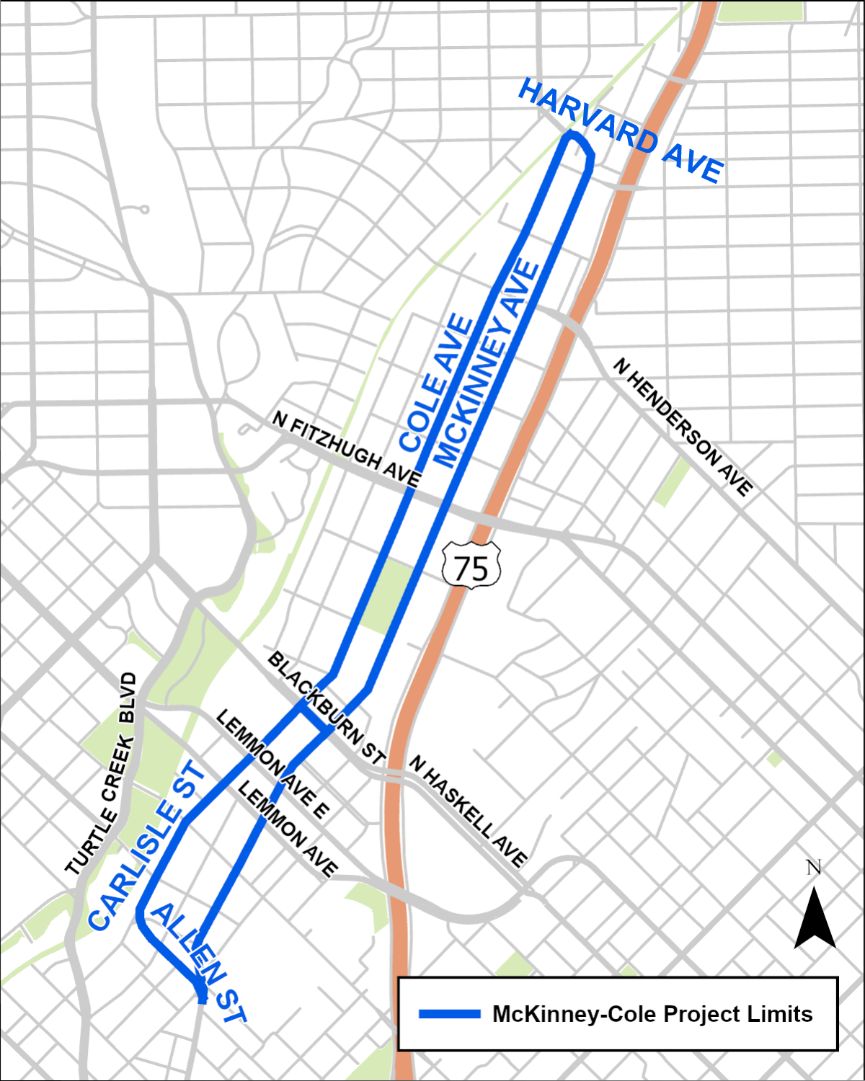
Project Description (Cont.)
McKinney Avenue
Allen Street to Harvard Avenue
Harvard Avenue
McKinney Avenue to Cole Avenue
Cole Avenue
Harvard Avenue to Carlisle Street
Carlisle Street
Cole Avenue to Allen Street
Allen Street
Carlisle Street to McKinney Avenue

Slide 9
Project Goals
Calm traffic
Improve safety
Provide more route choices
Create public gathering spaces (Pocket Parks)
Convert one-way to two-way traffic operations
Maintain Trolley operation during construction
Minimize the disruption to the businesses during construction
Notes:
A goal of this project is to reduce the use of McKinney/Cole as a thoroughfare for through traffic to other destinations and create neighborhood Main Streets.

Slide 10
Scope of Work
Convert the following roads from one-way operation to two-way operation:
McKinney Avenue from Allen Street to Harvard Avenue
Harvard Avenue from McKinney Avenue to Cole Avenue
Cole Avenue from Harvard Avenue to Carlisle Street
Carlisle Street from Cole Avenue to Allen Street
Allen Street from Carlisle Street to McKinney Avenue
Replace existing signs, markings, traffic signals for two-way operation
Pedestrian improvements – sidewalks at strategic locations, curb ramps, lighting, median refuge, crosswalks, and midblock crossing

Slide 11
Scope of Work (Cont.)
Traffic Calming – curb extensions (bulb outs) with parking at select locations
Trolley Relocation and Associated Overhead Catenary System
Cole Avenue from Blackburn Street to Lemmon Avenue
Blackburn Street from Cole Avenue to McKinney Avenue
Allen Street from Cole Avenue to McKinney Avenue
Upgrade existing traffic signals
Street Reconstruction - Cole Avenue
Note: All construction will be within the existing curb lines except the above areas

Slide 12
Project Schedule
Revised 30% Design: 08/30/2024
60% Design: 02/07/2025
Prefinal Design: 04/18/2025
Final Design: 06/19/2025
FHWA Approval: 08/15/2025
Construction: 01/12/2026

Slide 13
Future MATA Extension
NCTCOG is planning to conduct a feasibility study for MATA trolley extension
Proposed concepts do not preclude MATA streetcar extension
Streetcar will use shared travel lane with vehicles to accommodate vehicular traffic flow
Flexible use lanes will be impacted by any future extension
Note: The potential MATA extension is not part of the two-way conversion

Slide 14
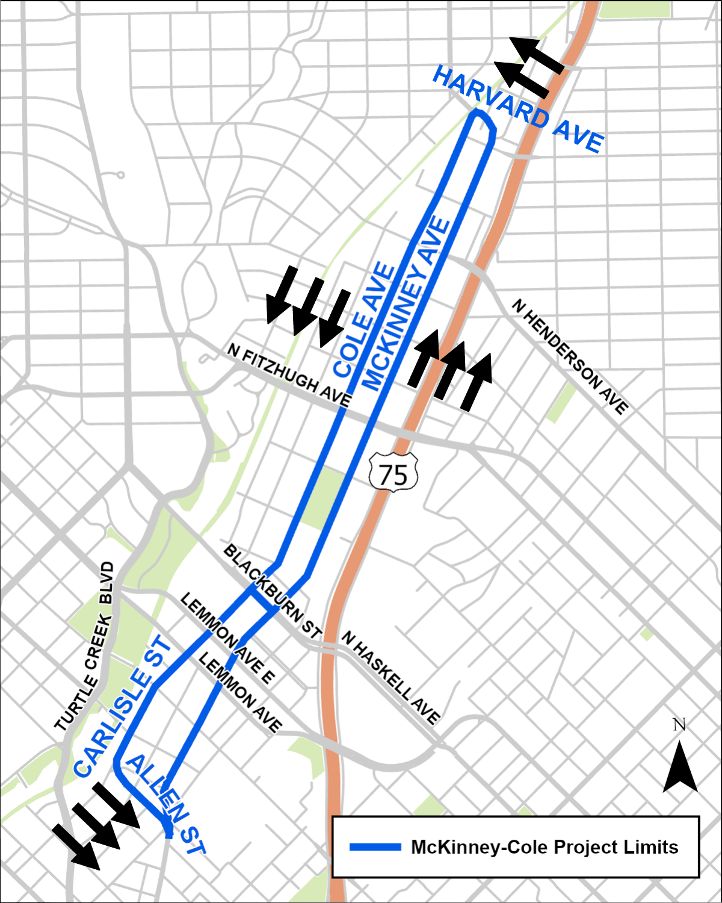
Existing Operations
McKinney Avenue – 3-lanes northbound
Cole Avenue/Carlisle Street – 3-lanes southbound
Allen Street – 3-lanes eastbound
Harvard Avenue – 2-lanes westbound

Slide 15
Proposed Operations
McKinney Avenue
2-lanes northbound
1-lane southbound
Cole Avenue/Carlisle Street
2-lanes southbound
1-lane northbound
Allen Street
2-lanes eastbound
1-lane westbound
Harvard Avenue
1-lane westbound
1-lane eastbound

Slide 16
Key Design Considerations
McKinney-Cole Corridor Two-Way Conversion Feasibility Report (August 21, 2015)
Two through lanes in primary direction for McKinney Avenue and Cole Avenue between Allen Street and Blackburn Street
No left turns in subordinate direction (except at driveways) to improve traffic operation efficiency and safety (i.e., trolley, pedestrian, vehicle)

Slide 17
McKinney Avenue
Existing Typical Section
Proposed Typical Section
Notes:
Striped for two lanes, 44 feet of pavement, parking on both sides of the roadway, although it is not currently striped.

Slide 18
Cole Avenue (Lemmon to Blackburn)
Existing Typical Section
Proposed Typical Section
Notes:
Striped for two lanes, 44 feet of pavement, parking on both sides of the roadway, although it is not currently striped.

Slide 19
Cole Avenue (North of Blackburn)
Existing Typical Section
Proposed Typical Section
Notes:
Striped for two lanes, 44 feet of pavement, parking on both sides of the roadway, although it is not currently striped.

Slide 20
Carlisle Street
Existing Typical Section
Proposed Typical Section

Slide 21
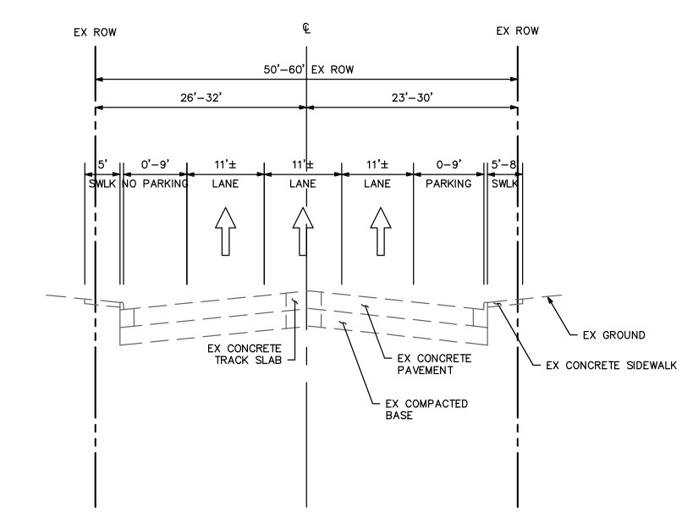
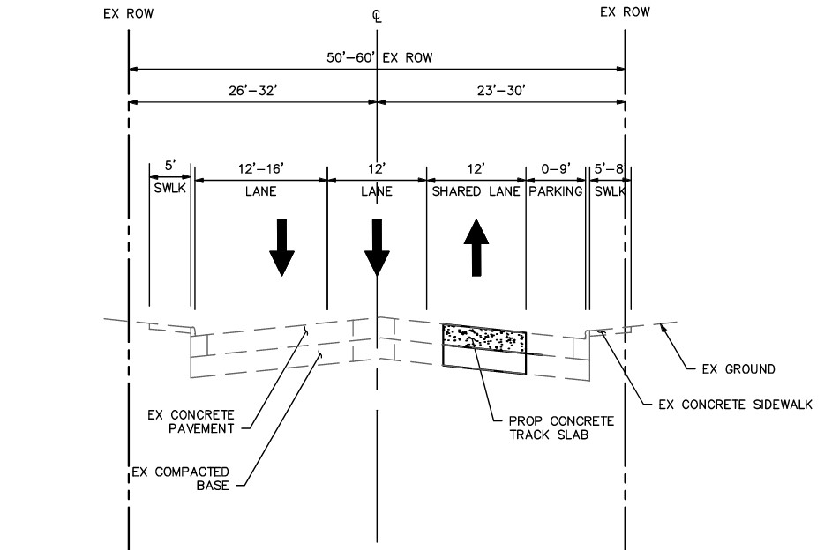
Allen Street
Existing Typical Section
Proposed Typical Section
Notes:
Striped for two lanes, 44 feet of pavement, parking on both sides of the roadway, although it is not currently striped.

Slide 22
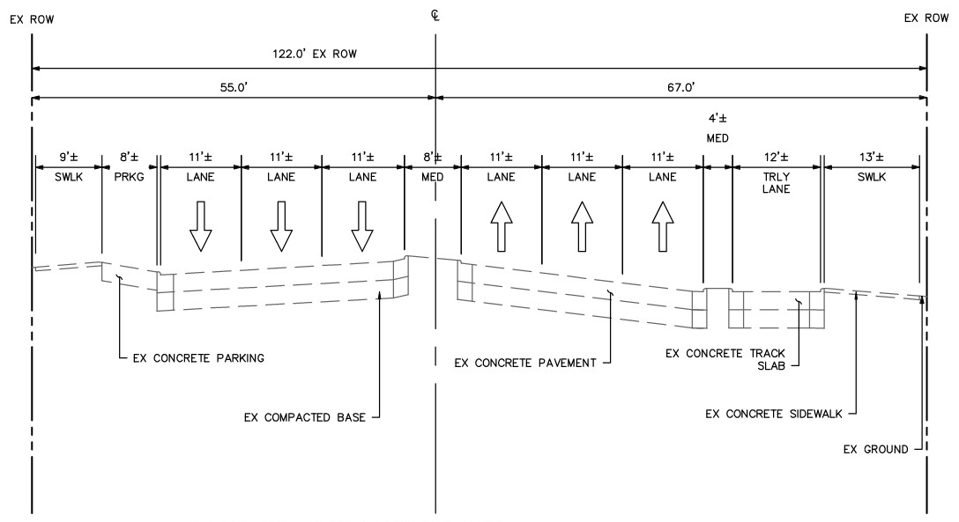
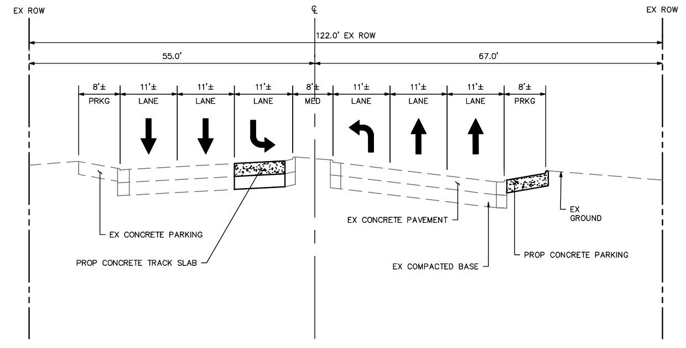
Blackburn Street
Existing Typical Section
Proposed Typical Section
Notes:
Striped for two lanes, 44 feet of pavement, parking on both sides of the roadway, although it is not currently striped.

Slide 23
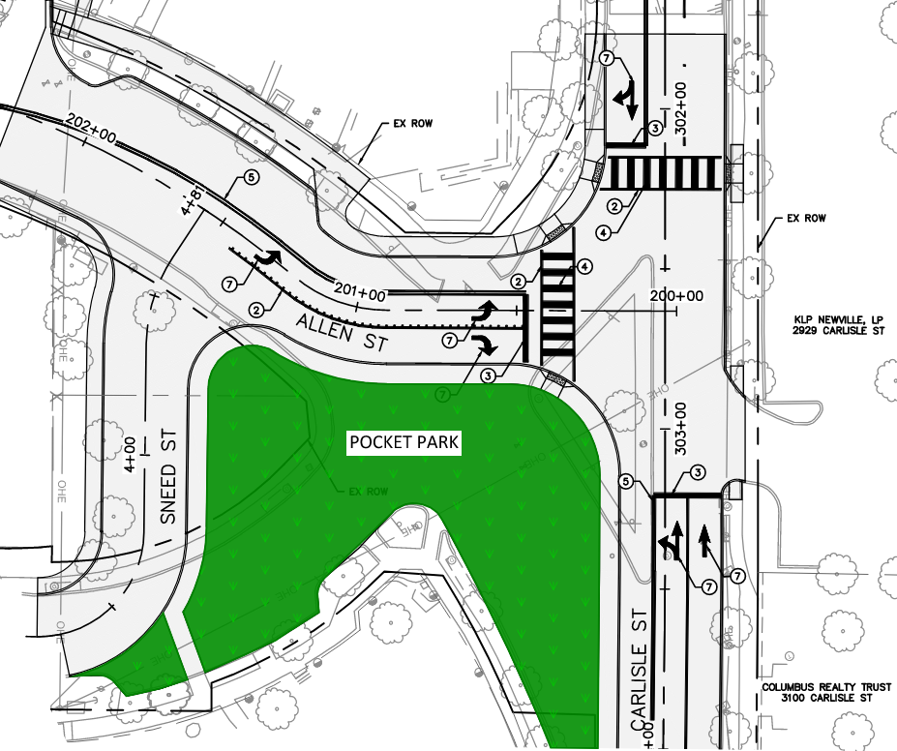
Allen / Carlisle Intersection Modification
Remove existing triangular median island
Allen Street to intersect Carlisle Street perpendicularly
Sneed Street to intersect Allen Street away from the current intersection at Carlisle Street
Creation of a large pocket park (11,750 SF)
Curb extension to create indented parking condition on Allen Street
Notes:
Striped for two lanes, 44 feet of pavement, parking on both sides of the roadway, although it is not currently striped.

Slide 24
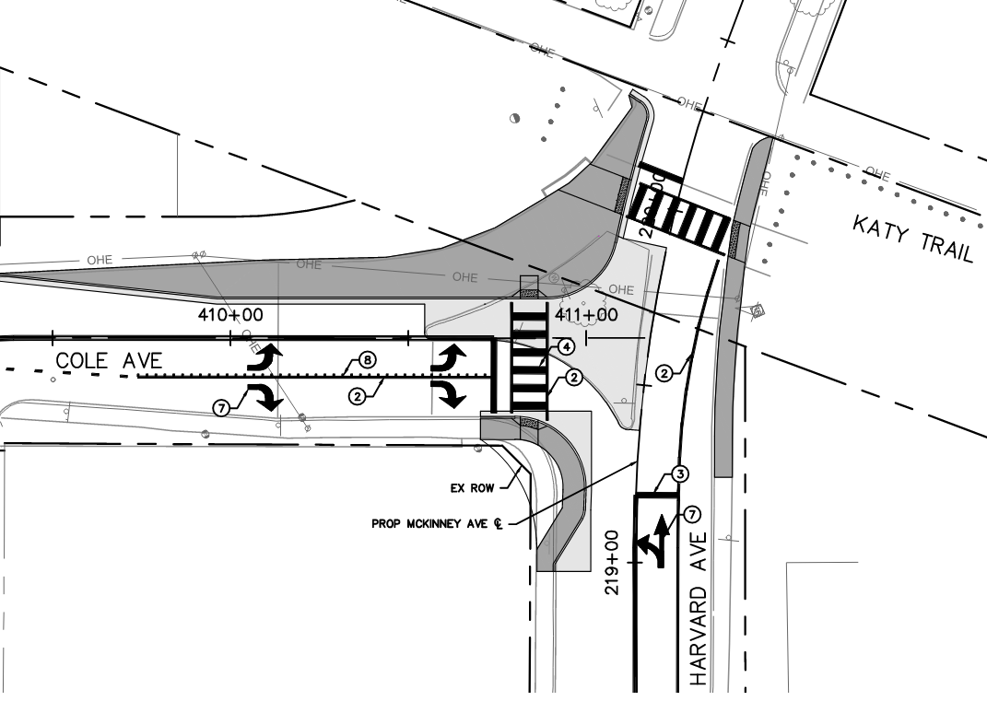
Cole / Harvard Intersection Modification
Remove existing triangular median island
Curb extension on southeast corner to create indented parking condition
Ongoing coordination with Friends of Katy Trail on pedestrian safety improvement at Katy Trail crosswalk
All-way stop signs
Notes:
Striped for two lanes, 44 feet of pavement, parking on both sides of the roadway, although it is not currently striped.

Slide 25
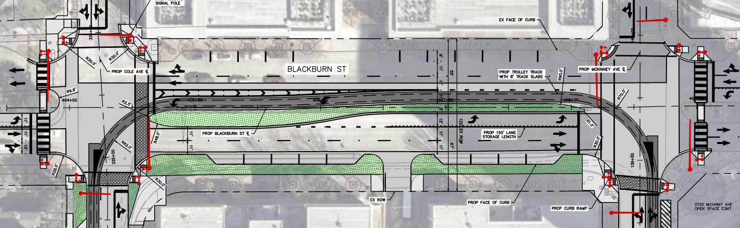
Blackburn St Option 1
COLE AVE
MCKINNEY AVE
9 new parallel parking spaces on south side of Blackburn St
Trolley track realignment to north of median on Blackburn St
Shift westbound left turn lane on Blackburn St farther south for better visibility of oncoming traffic
Maintain left turn lane on Blackburn St at McKinney Ave
Eastbound left turn lane on Blackburn St at Cole Ave

Slide 26
Blackburn St Option 1
COLE AVE
MCKINNEY AVE
Pros
Eastbound left turn to northbound Cole Ave
Eastbound and westbound left turns can run simultaneously
Cons
Eliminates trees in median west of Cole Ave

Slide 27
Blackburn St Option 2
COLE AVE
MCKINNEY AVE
9 new parallel parking spaces on south side of Blackburn St
Trolley track realignment to north of median on Blackburn St
Shift westbound left turn lane on Blackburn St farther south for better visibility of oncoming traffic
Maintain left turn lane on Blackburn St at McKinney Ave
No eastbound left turn lane on Blackburn St at Cole Ave

Slide 28
Blackburn St Option 2
COLE AVE
MCKINNEY AVE
Pros
Trees and median areas remain on Blackburn St west of Cole Ave
Cons
Left turns are prohibited for eastbound Blackburn onto Cole Ave

Slide 29
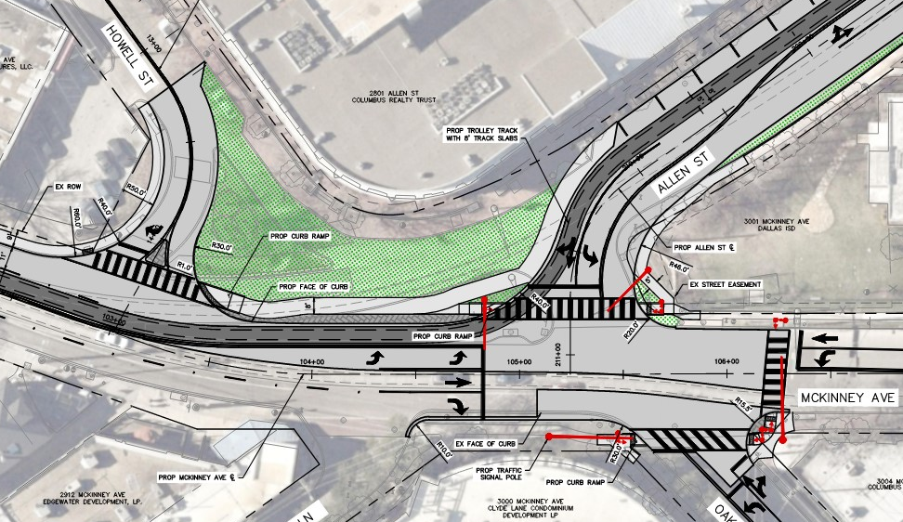
Allen / Oak Grove Option 1
Howell St meets McKinney Ave at more of a "T intersection"
Crosswalks on 3 sides of intersection
Largest pocket park (9,650 SF)
Left turn lanes on all approaches
Allen St: Shared trolley lane and through-right lane
CLYDE LN
OAK GROVE AVE

Slide 30
Allen / Oak Grove Option 1
Pros
Left turns are allowed on all approaches
Traffic on Allen and Oak Grove is allowed to go straight through the intersection
Largest pocket park space
CLYDE LN
OAK GROVE AVE

Slide 31
Allen / Oak Grove Option 1
Cons
Traffic is expected to back up significantly on Allen St due to 8-phase traffic signal cycle and high number of eastbound right turns combined with the trolley. This backup would extend to Cole Avenue (500’) and result in waiting 2-3 cycles to get through intersection.
Allen and Oak Grove left turns overlap, cannot turn simultaneously
Oak Grove and Allen through movements do not line up and will require separate signal phases
CLYDE LN
OAK GROVE AVE

Slide 32
Allen / Oak Grove Option 1
Cons (Continued)
Risk of impatient drivers traveling northbound on McKinney using right turn lane to pass the trolley.
This option has the most conflict points from a safety perspective.
The turning radii for the trolley track turning from Allen to McKinney is below standard design guidelines, which will require more frequent maintenance of trolleys and the tracks. Could hinder City's ability to get necessary trolley safety certification.
Due to the crosswalk skew across the trolley tracks, track filler will be required to prevent wheels from getting stuck (wheelchairs, strollers, bikes, etc.). Adds to future maintenance costs. Funding source would need to be identified.
CLYDE LN
OAK GROVE AVE

Slide 33
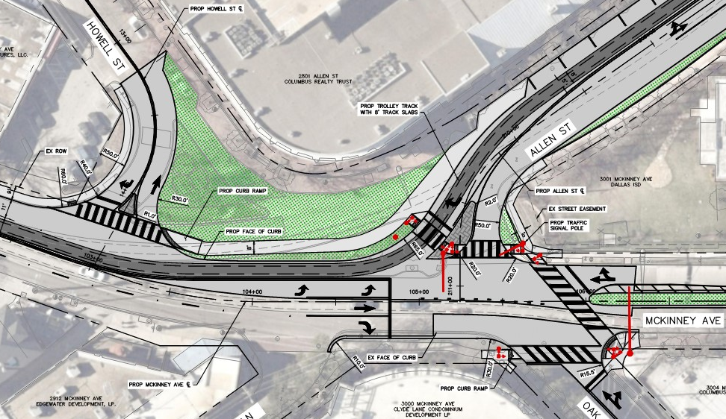
Allen / Oak Grove Option 2
Howell St meets McKinney Ave at more of a "T intersection"
Crosswalks on 3 sides of intersection
Large pocket park (9,165 SF)
Left turns only allowed for northbound McKinney Ave
Allen St: Shared trolley lane and right turn lane
Allen St: no through movement to Oak Grove permitted
CLYDE LN
OAK GROVE AVE

Slide 34
Allen / Oak Grove Option 2
Pros
Traffic on Oak Grove is allowed to go straight through the intersection
Large pocket park space
Intersection operations and queuing are slightly better than Option 1
Eastbound Allen Street backup would extend to Laclede Street (300’), waiting 1-2 cycles to get through intersection
Fewer signal phases
Northbound McKinney left turns can occur at the same time as eastbound Allen right turns
Median on McKinney can provide landscaping elements
Trolley meets standard design guidelines
CLYDE LN
OAK GROVE AVE

Slide 35
Allen / Oak Grove Option 2
Cons
Pedestrians must cross Allen St traffic twice
Prohibits the following movements:
Allen: Eastbound through and left
McKinney: Southbound left
Oak Grove: Westbound left
No right turns on red for eastbound Allen St due to trolley operations and pedestrian safety concerns
Risk of impatient drivers traveling northbound on McKinney using right turn lane to pass trolley
CLYDE LN
OAK GROVE AVE

Slide 36
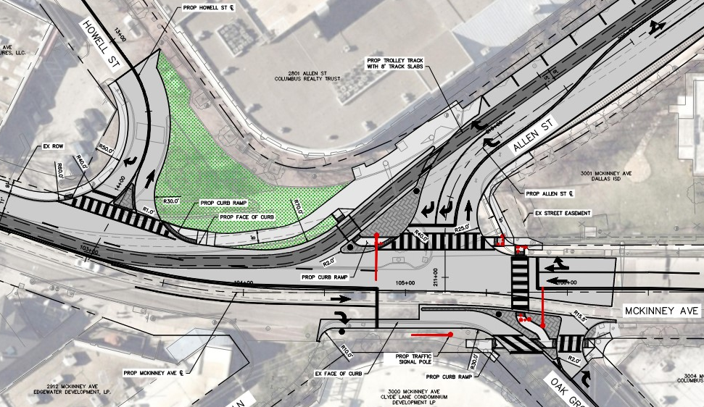
Allen / Oak Grove Option 3
Howell St meets McKinney Ave at more of a T intersection
Crosswalks on 3 sides of intersection
Smallest pocket park (6,710 SF)
No left turns allowed for any direction
Allen St: Trolley-only lane and dual right turn lanes
McKinney Ave: Two southbound lanes
CLYDE LN
OAK GROVE AVE

Slide 37
Allen / Oak Grove Option 3
Pros
Lowest delay (wait time) for vehicles of the three options
Trolley is separated from vehicles to reduce delay for vehicles
Trolley design meets standard design guidelines
Has the fewest conflict points
Addresses the concern about impatient drivers traveling northbound on McKinney using right turn lane to pass the trolley
Accommodates two southbound lanes on McKinney
CLYDE LN
OAK GROVE AVE

Slide 38
Allen / Oak Grove Option 3
Cons
Smallest pocket park area
Trolley will require dedicated signal phase to merge onto southbound McKinney traffic
Prohibits the following:
Allen: Eastbound through and left
McKinney: Northbound left and southbound left
Oak Grove: Westbound through and left
Potential negative impacts to adjacent signalized intersections due to limited turns (e.g., Bowen & Oak Grove, Bowen & Hall)
Need No Right Turns on Red for eastbound Allen St due to pedestrian safety concerns
CLYDE LN
OAK GROVE AVE

Slide 39
Bike Network Considerations

Slide 40
Purpose of This Section
Present the revised bike network that has been recommended for Uptown parallel to the Katy Trail
Present the potential modifications needed to the impacted portions of the McKinney/Cole Project to realize this network
Solicit public input on the recommended network and whether the necessary modifications should be made to the impacted portions McKinney/Cole project

Slide 41
Background
In November 2023, City Council asked staff to conduct additional study engagement for the Bike Plan Update
Stakeholders expressed concern about the lack of alternatives to the Katy Trail for bicyclists through Uptown
From May-July 2024, the public was asked to provide their input on four potential alternatives:
Route 1: Turtle Creek
Route 2: Travis/Carlisle
Route 3: McKinney/Cole
Route 4: Katy Trail Widening

Slide 42
Background (Cont.)
On the survey and in the public meeting presentation, it was made clear that it would not be possible to implement Route 3 - McKinney/Cole with the McKinney/Cole Two-Way Conversion project
The results of the survey question “What is your preferred route?”

Slide 43
Background (Cont.)
Representatives from the City of Dallas, Uptown Dallas, Inc., Friends of the Katy Trail, The Loop, Oak Lawn Committee, Turtle Creek Conservancy, and the City’s Bicycle Advisory Committee met in August 2024 to confirm what the recommendation should be
The consensus from that meeting was that both Route 1 (Turtle Creek) and Route 2 (Travis/Carlisle) should be recommended, with minor modifications
Notes:
The Turtle Creek route would serve long-distance bicyclists, the Travis/Carlisle route would serve Uptown residents and bicyclists looking to visit Uptown businesses.

Slide 44
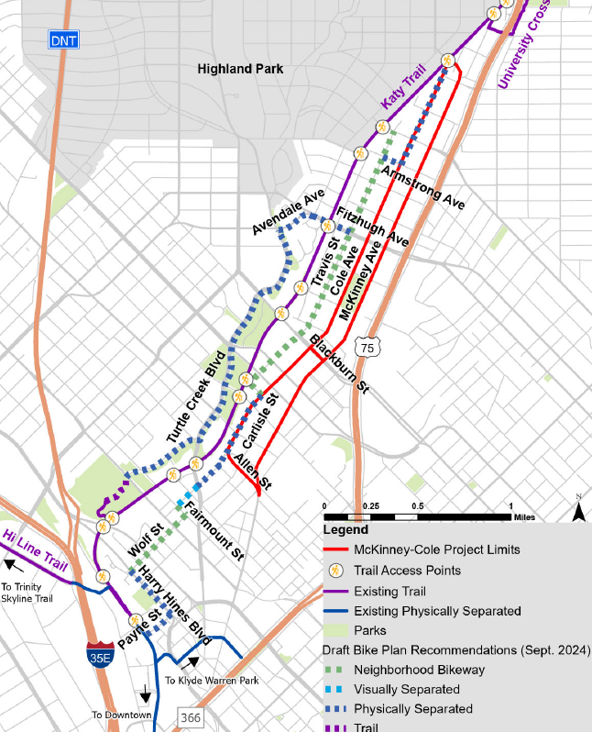
Impacts to McKinney/ Cole Project
Route 1 (Turtle Creek) and Route 2 (Travis/Carlisle) still have locations of overlap with the McKinney/Cole project, and modifications to the impacted sections of the McKinney/Cole project would be needed realize these routes.
Impacted/overlapping sections of McKinney/ Cole project

Slide 45
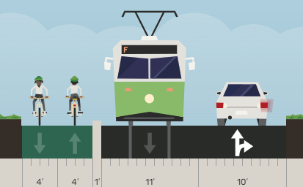
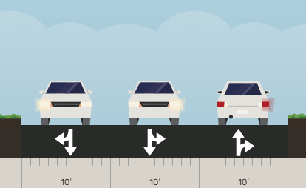
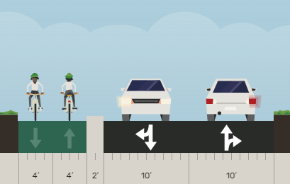
Impacts to McKinney/ Cole Project
Cole Avenue Between Harvard Avenue and Armstrong Avenue
Typical Section if Trolley Was Extended in the Future
Current Plan Set Typical Section
Modifications Needed to Typical Section

Slide 46
Impacts to McKinney/ Cole Project (Cont.)
Carlisle Street Between Carlisle Place and Allen Street
Current Plan Set Typical Section
Modifications Needed to Typical Section

Slide 47
Impacts to McKinney/ Cole Project (Cont.)
Carlisle Avenue Between Carlisle Place and Allen Street (Cont.)
Current Plan Set –
Intersection of Carlisle and Allen
Modifications Needed – Intersection of Carlisle and Allen
CARLISLE ST
CARLISLE ST
LEGEND
Proposed Traffic Flow
Proposed Pavement
Proposed Sidewalk
Proposed Park
ALLEN ST
ALLEN ST
Two-Way Protected Bike Lanes
Conceptual Illustration

Slide 48
We Want Your Input!
Which key design considerations are priority? Please rank the following:
Pedestrian safety
Trolley operation (minimize delay, maximize safety)
Vehicular traffic operation (minimize delay, maximize turning options)
Pocket park space
Feedback on the Blackburn options
Feedback on the Allen/Oak Grove options
Any other feedback

Slide 49
We Want Your Input! (Cont.)
Should Uptown have a high-comfort bicycle network that connects residents to Downtown, Victory Park, West Village, Knox Street, etc.?
Is an alternative to the Katy Trail needed for bicyclists?
What do you think of the proposed bicycle network, specifically the alternative Katy Trail routes? (Travis/Carlisle and Turtle Creek routes)
Do you think modifications should be made to the impacted portions of the McKinney/Cole plans to incorporate the proposed bicycle network?

Slide 50
Next Steps
Gather and review community feedback – October 2024
Identify community preferences – November 2024
Update community at 60% - February 2025 (Tentative)
Complete Environmental Clearance - January 2025
Complete Design – June 2025
Begin Construction – January 2026

Slide 51
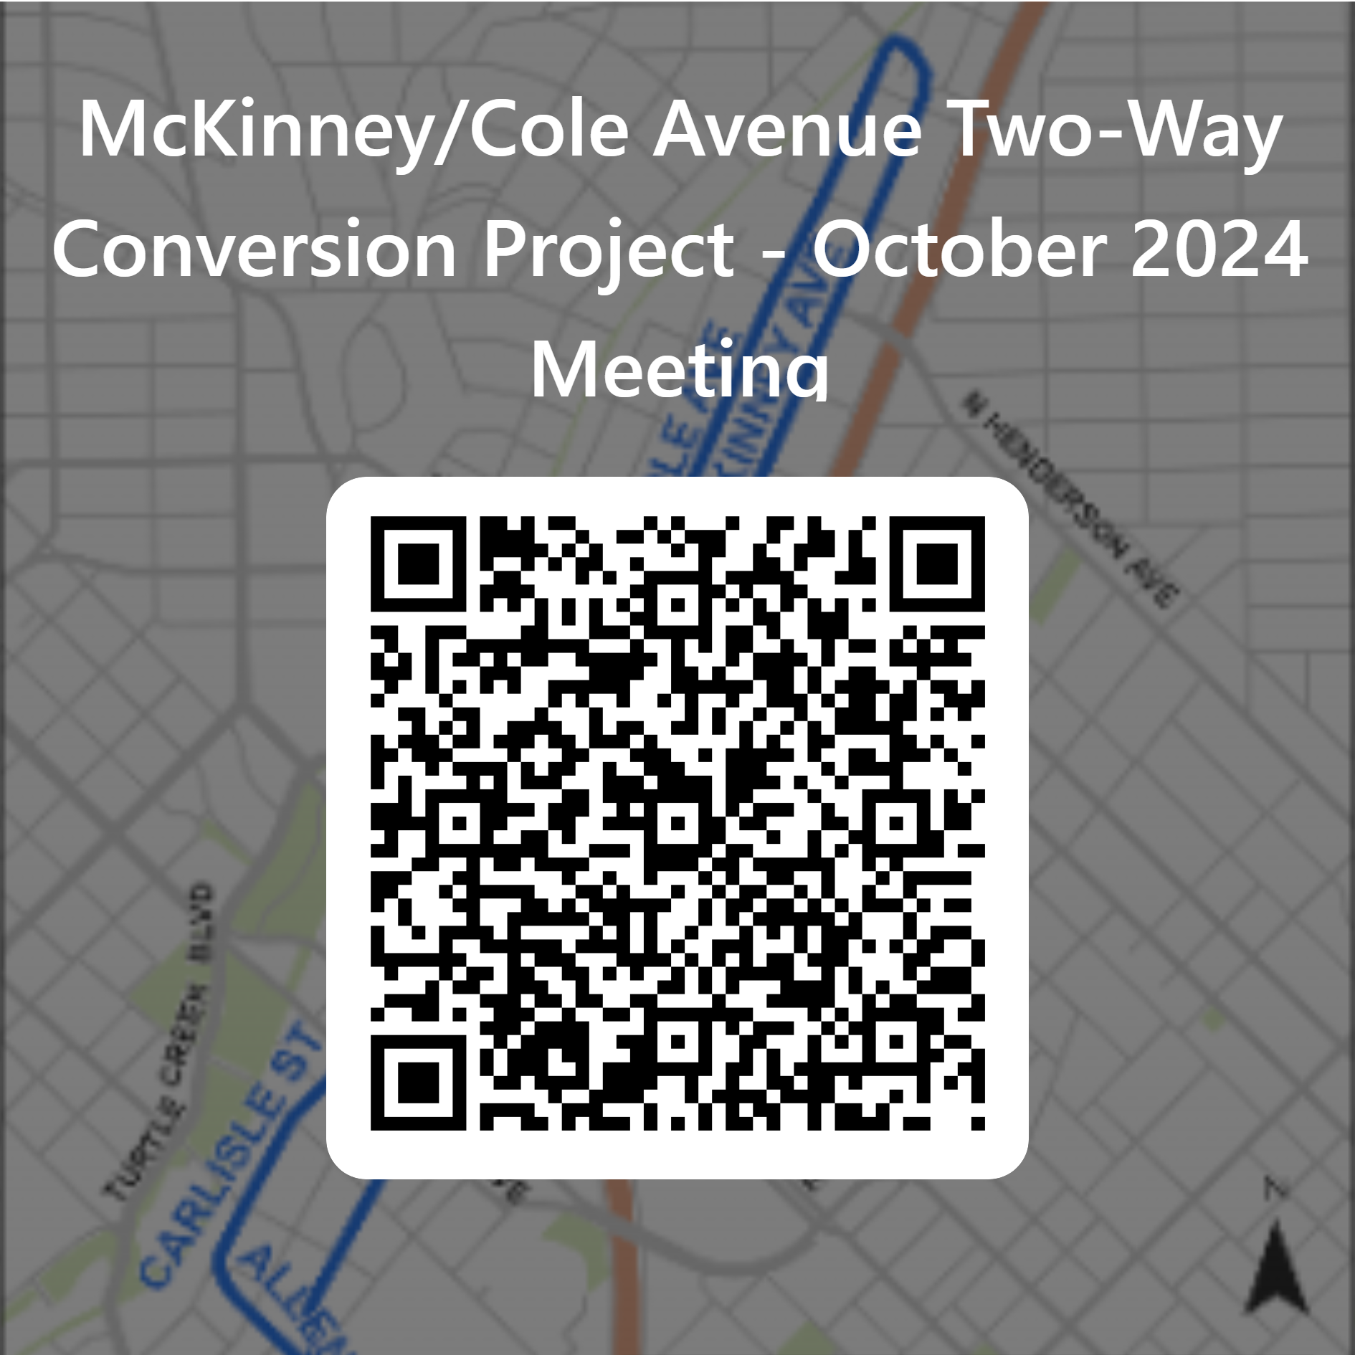
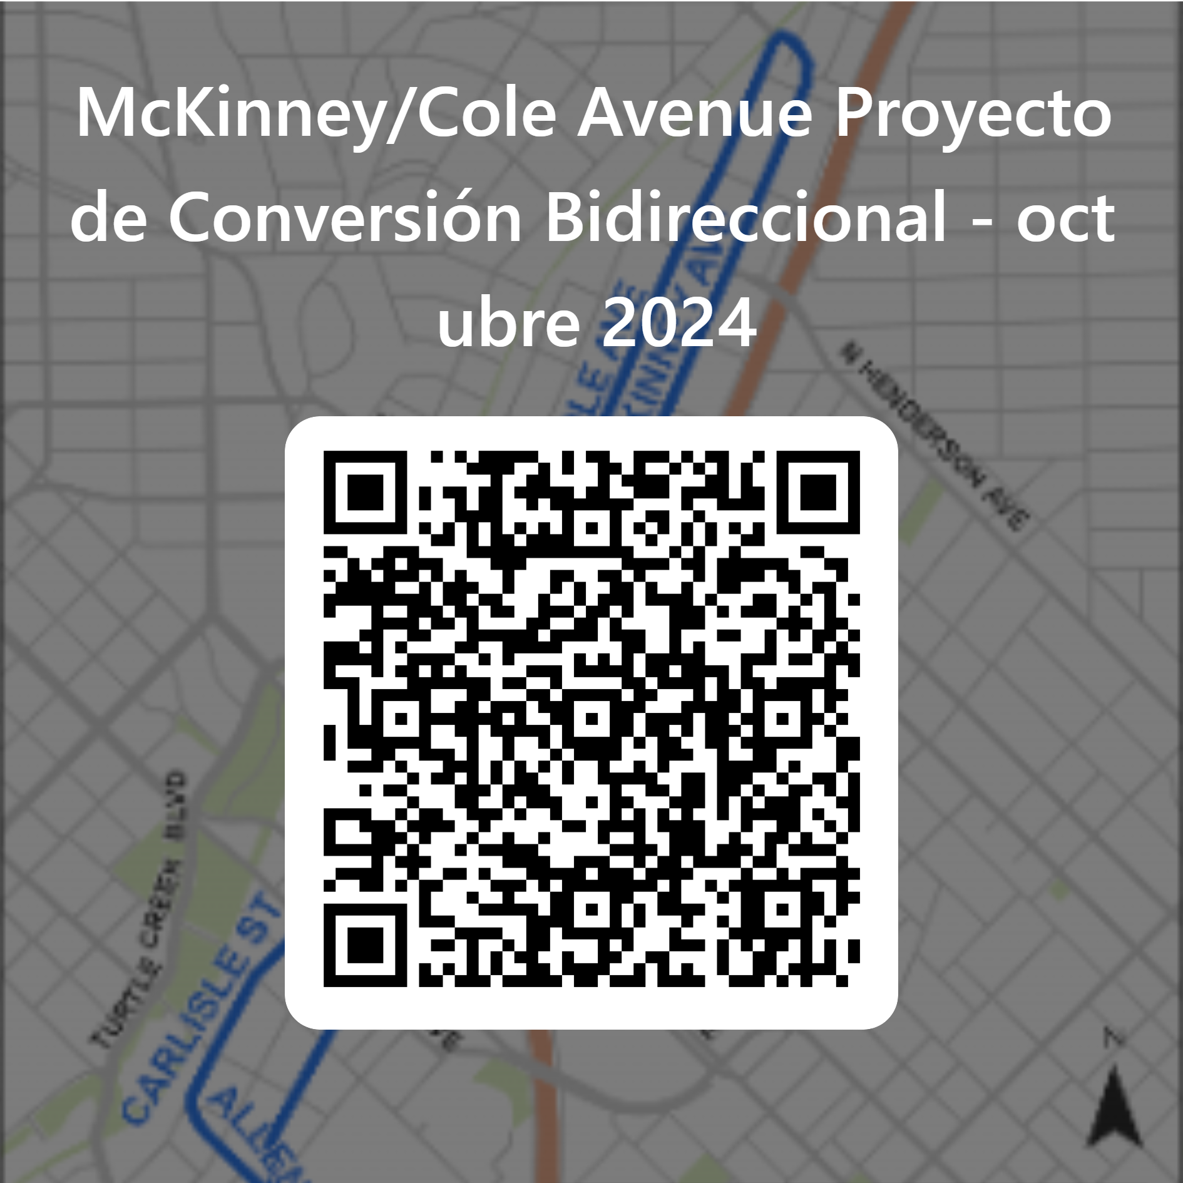
Q&A and Comments
Comments will be accepted through October 16, 2024. Please provide comments using the survey link on the public meeting website or the QR codes below:
Public Meeting Website: bit.ly/McKinneyCole1002

Slide 52
Contact Information
Cameron Anderson, P.E., Program Administrator
Cameron.Anderson@dallas.gov
Ph: 214-948-4601
Changho Yi, P.E., CFM, Project Manager
Changho.yi@dallas.gov
Ph: 469-482-9164
Kathryn Rush, AICP, Chief Planner
Kathryn.rush@dallas.gov
Ph: 469-798-3117
Jessica Scott, AICP, LCI, Bicycle & Micromobility Manager
Jessica.scott@dallas.gov
Ph: 214-671-5207

