Slide 1
Cesar Chavez Boulevard Traffic Corridor Study
US 75 to IH 30
Public Meeting
09/17/2024
Auro Majumdar, P.E., P.T.O.E.
Asst. Director – Engineering & Operations
City of Dallas, Department of Transportation

Slide 2
Purpose of Meeting
The purpose of this meeting is to present the preliminary findings and recommendations for the Cesar Chavez corridor traffic study and solicit stakeholder input

Slide 3
Presentation Outline
Study Location & Objective
Existing Conditions
Preliminary Recommendations
Next Steps
Q&A and Comments

Slide 4
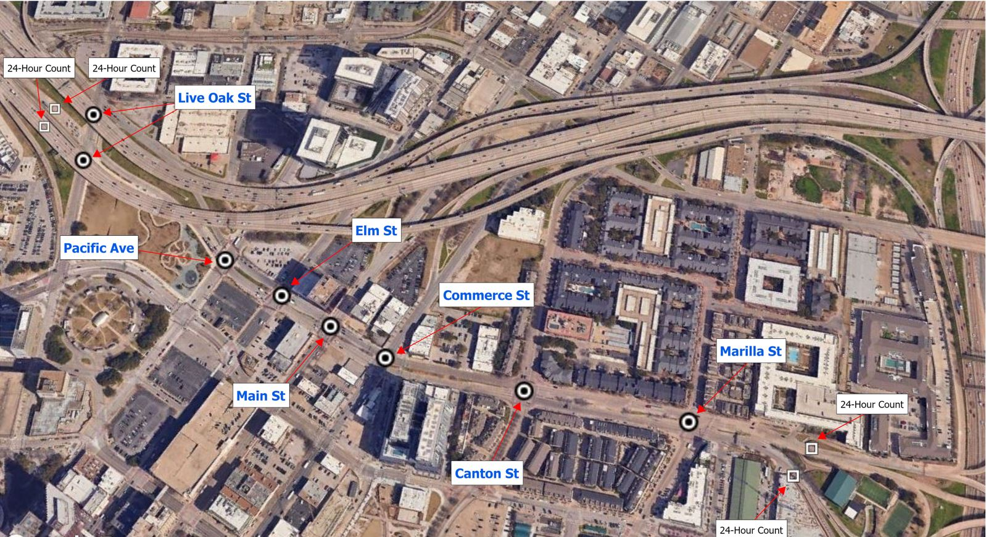
Study Location & Objectives
Project Location
Cesar Chavez Boulevard
US 75 to IH 30
Objective
Identify deficiencies in existing infrastructure
Analyze crash history and identify causal factors
Recommend short and long-term improvements to enhance safety, walkability, and quality of life for all users of corridor

Slide 5
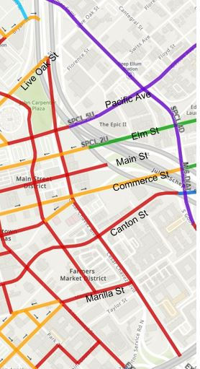

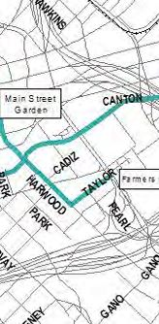

Previous Plans and Studies
City of Dallas Thoroughfare Plan
City of Dallas Bike Plan (2011)
Principal Arterial
Planned On-Street Bike Facility
Minor Arterial
Community Collector
Residential Collector
Note: The ongoing Bike Plan Update (Summer 2023 version) does not recommend any bike facilities on Cesar Chavez Blvd between US 75 and IH 30
Two Way Principal Arterial

Slide 6
Corridor Data
Corridor Parameters
Classified as a 6-Principal Arterial
Classified as 7-Principal (3-NB, 4-SB), r.o.w 120’-131’, Between Marilla Street to Main Street
Classified as 6-Principal (3-NB, 3-SB, r.o.w 110’-120’, Between Main Street and Live Oak
Classified as 8-Principal (4NB, 4-SB), south of Marilla Street, observed r.o.w varies
Active DART Bus Route # 383, #224, #16
Posted speed limit: 30 mph; 85th Percentile Speed: 20-40 mph
Volume– 14k-15k vehicles per day
261 crashes (59 on Canton; 46 on Main, 43 on Elm recorded between Jan 2020-June 2024
    5 crashes involved a pedestrian/bicyclist (4-pedestrian, 1-bicyclist)
  Above crashes resulted in minor or possible injuries (1-Fatality, 8-Serious injuries, and102- total injuries)
  89% of all crashes occurred at intersections

Slide 7
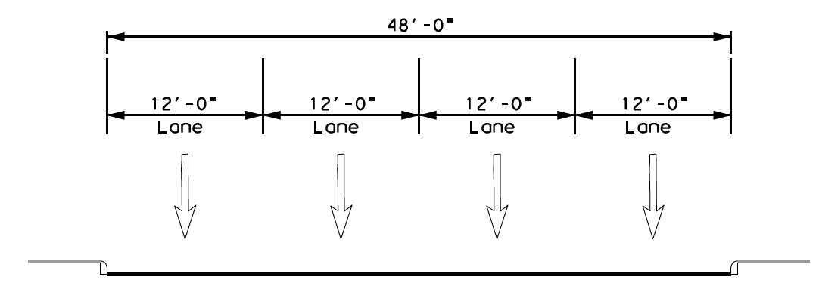
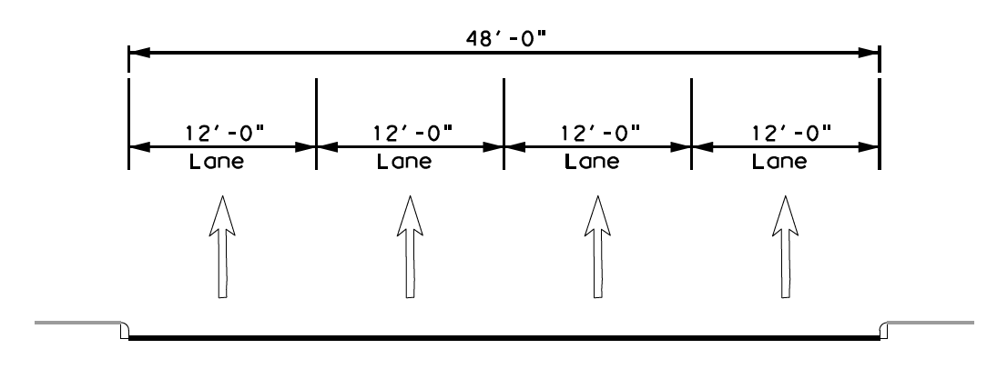
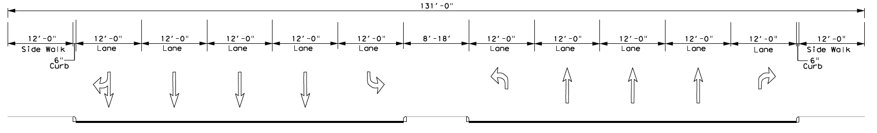
Typical Sections
Cesar Chavez of Marilla St
Cesar Chavez Between Canton Street and Marilla Street

Slide 8
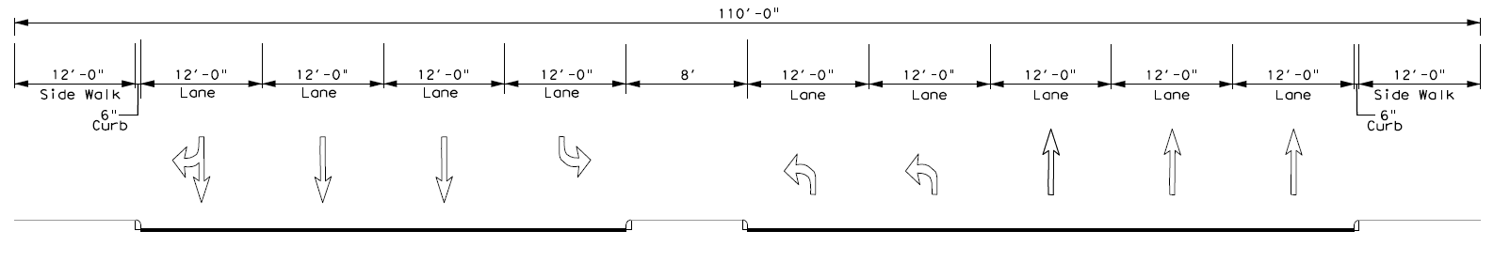
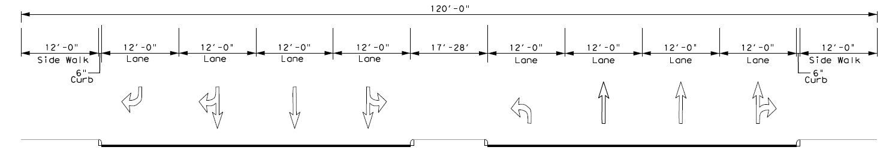
Typical Sections
contd.
Cesar Chavez Blvd between Elm Street and Main Street
Cesar Chavez Blvd between Pacific Avenue and Elm Street

Slide 9
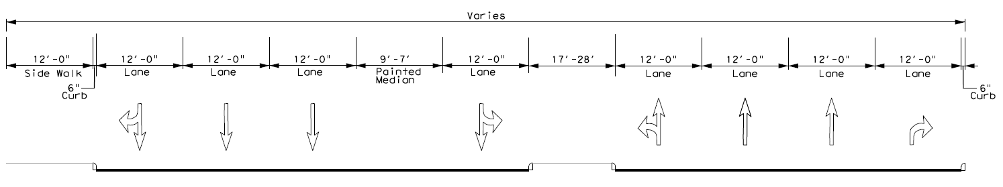
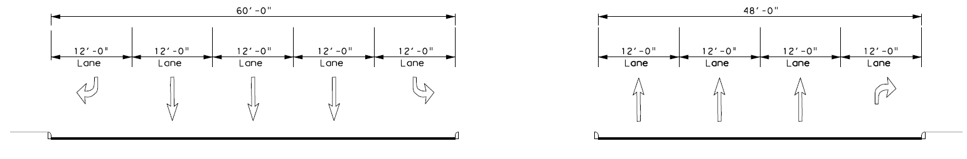
Typical Sections
contd.
Cesar Chavez Blvd between Pacific Avenue and Live Oak Street
Cesar Chavez Blvd at Live Oak Street

Slide 10
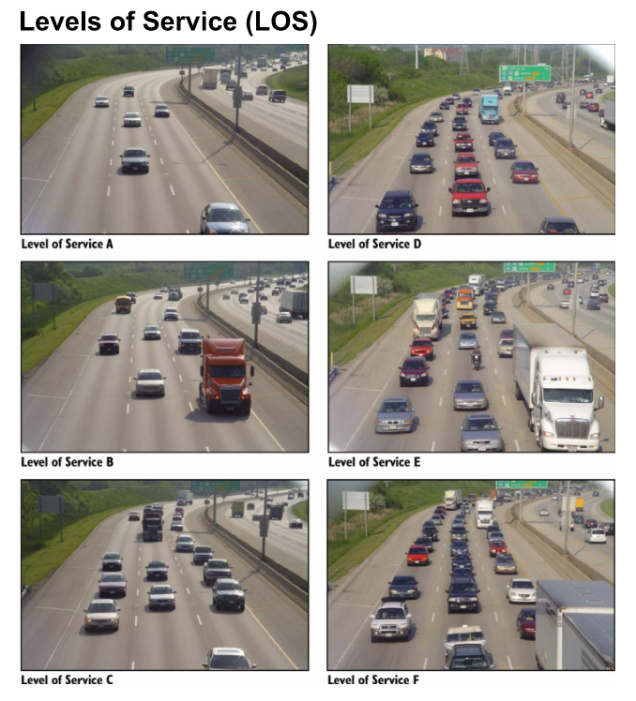
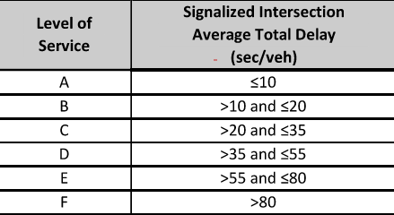

What is Level of Service (LOS)?

Slide 11
Existing Levels of Service (LOS)
Signalized intersections along the corridor operate at acceptable levels of service except for Commerce Street intersection which operate at LOS F during p.m. peak hours;
The level of Service is a measure of the amount of delay of vehicles.

Slide 12
Weekend Speeds on Cesar Chavez Blvd

Slide 13
Existing Speed Data - Weekday
Live Oak Street to Marilla Street
 |  | Posted Speed Limit | Mean Speed (MPH) | 85th %tile Speed (MPH) | Maximum Speed
Northbound |  | 30 | 24 | 31 | 53
Southbound |  | 30 | 26 | 33 | 60

Slide 14
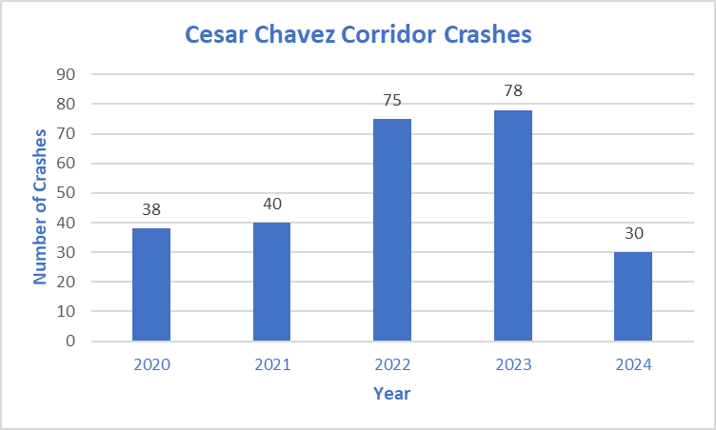
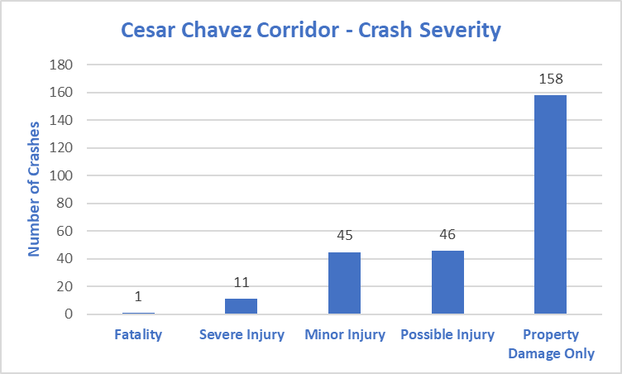
Crash History (Jan 2020- Jun 2024
Data is from State’s CRIS database compiled from Police Reports of Crashes
Total crashes – 261 crashes
  Pedestrian/bicycle related crashes – 5 crashes
  Total fatalities –one fatality in 2024

Slide 15
Crash Data ( Jan 2020- Jun 2024)

Slide 16
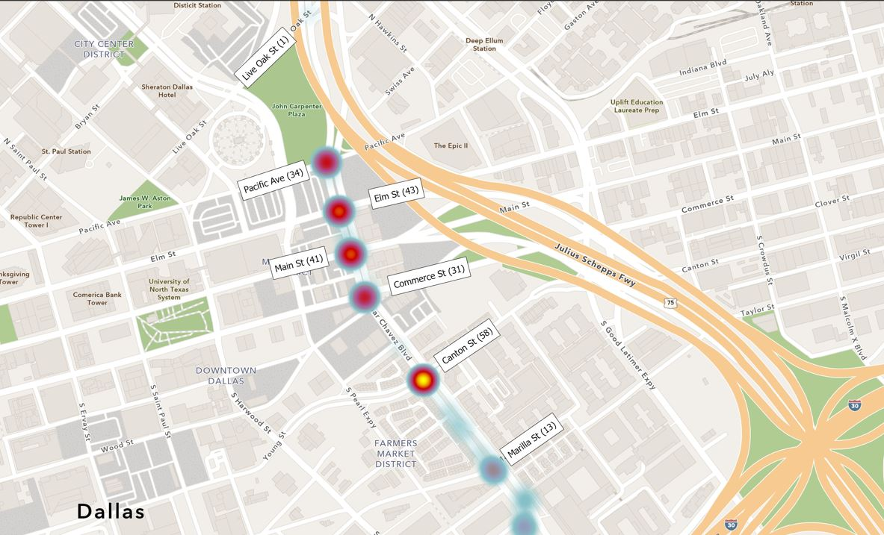
Heat Map – Crashes (Jan 2020-June 2024)
Total Crashes – 261
Fatal Crashes – 1 (2024)
Severe Injury Crashes – 8
Minor/Possible Injury Crashes – 151
Pedestrian & Bicycle Crashes – 5

Slide 17
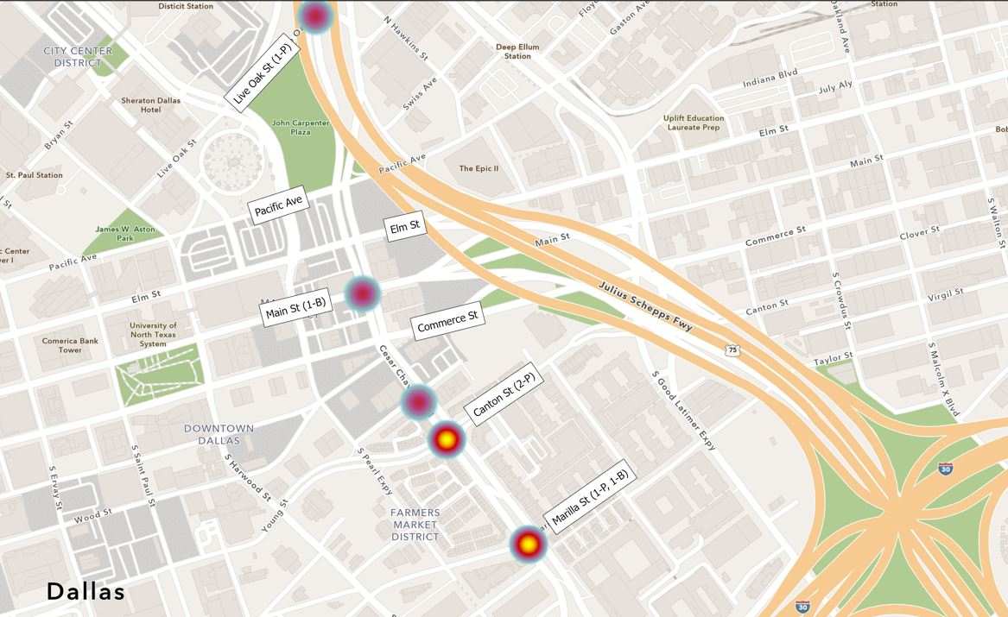
Pedestrian & Bicycle Crashes
Total Pedestrian
& Bicycle crashes – 5
Fatal – 0
Severe Injury – 0
Minor/ Possible Injury – 4
Property Damage -1

Slide 18
Crash History (Jan 2020-June 2024)
All Crashes
Left-turn Crashes (24%), Right Angle Crashes (45%), Rear-end Crashes (6%)
Failed to Yield the Right of Way – Turning Left (21%), Failed to Control Speed (5%), Disregard Signal (34%)

Slide 19
Crash History (Jan 2020- Jun 2024)
Crashes at Signalized Intersections (232)
Canton Street (25%)
Main Street (20%)
Elm Street (18%)
Crashes at Unsignalized Intersections (29)
IH 30 (86%)
Albany (7%)
Helsminster Dr (7%)

Slide 20
Causal Factors for Crashes
Two main causal factors of crashes are failure to yield right-of-way (Left-turns, Right-angle, and Disregard Traffic Signal Together, they account for 94% of all crashes
Existing infrastructure deficiencies could also be indirect contributors
Pedestrian and Bicycle crashes account for 1.9% of total crashes

Slide 21
Existing Conditions Summary
Pedestrian Amenities
  Several obstructions on sidewalks, non-ADA compliant BFRs
Streetlights - older infrastructure with weak illumination for the sidewalks in certain sections
Signal timing lacks coordination between signals and phasing optimization; resulting in excessive queuing and delays for Left turning vehicles
Several segments have faded pavement marking
Sections of pavement need repair

Slide 22
Preliminary Recommendations – Short Term (0-3 Years)
Refresh signing and striping for the entire corridor
Clear sight-distance obstruction at intersections
For large intersections, add puppy tracks to guide turning vehicles
Redesign Canton Street intersection for safer vehicular and pedestrian operations. Remove and Replace existing traffic signal
Optimize traffic flow through the corridor from Canton Street to Live Oak Street by using signal coordination and upgrade of the traffic signal system
Explore signing, striping, and other traffic control features between Live Oak Street and Pacific Avenue to deter speeding and promote safe driving in the vicinity of Carpenter Park

Slide 23
Preliminary Recommendations – Long Term (>3 Years)
Increase pedestrian safety by adding pedestrian refuge to medians where feasible
Explore opportunities to install LED Streetlights throughout the corridor
Consider a roundabout at Marilla Street intersection; or redesign intersection to reduce pedestrian crossing distance and remove and replace existing traffic signal
Reduce vehicular lanes between Canton Street and Marilla Street as also other sections of the corridor where feasible (This will require a Thoroughfare Plan Amendment)
Explore a “Boulevard” concept for the corridor with median landscaping and enhanced pedestrian features

Slide 24
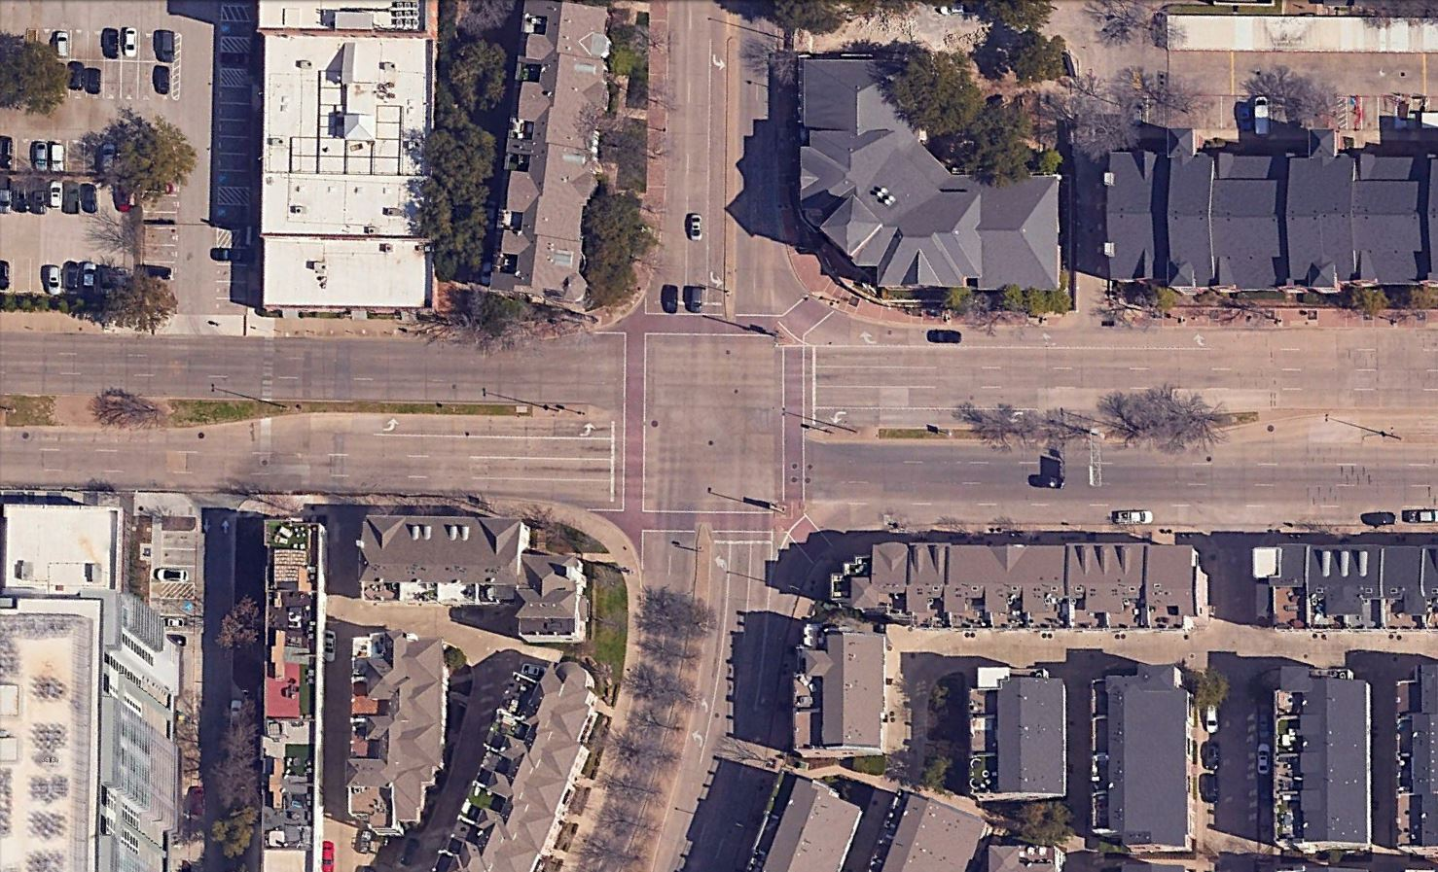
Existing Canton Street Intersection

Slide 25
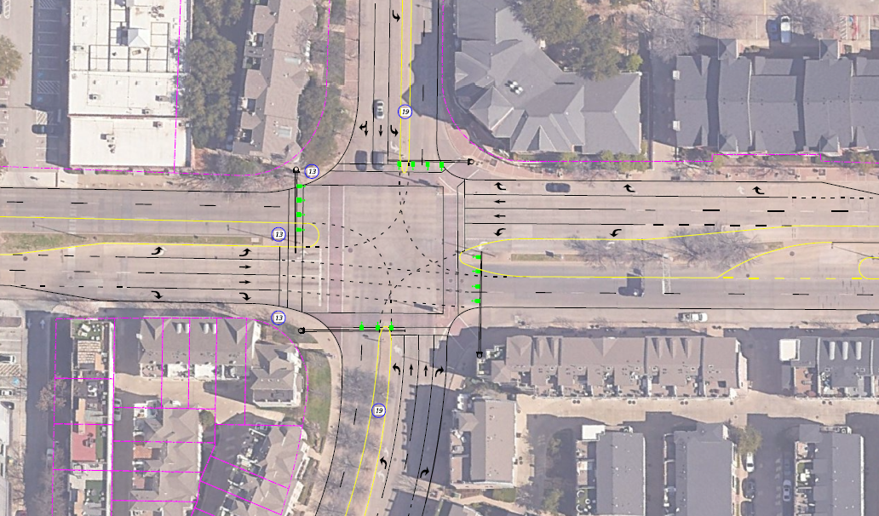
Conceptual Ugrade for Canton Street Intersection

Slide 26
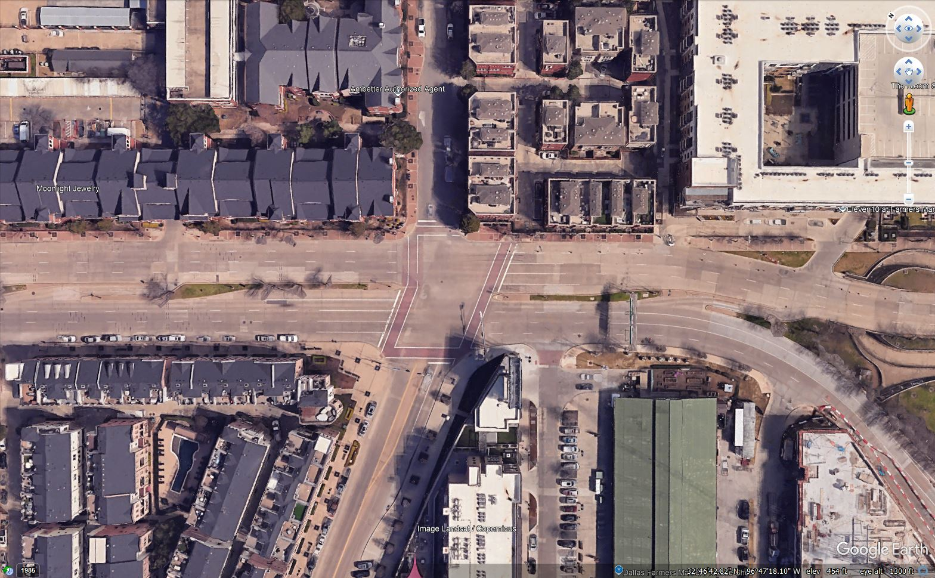
Existing Marilla Street Intersection

Slide 27
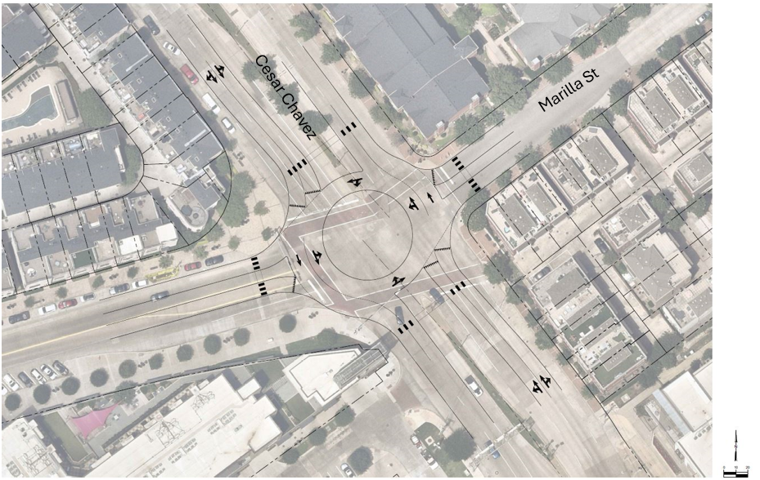
Roundabout Concept at Marilla Street Intersection
ICD of 140 feet- two lane roundabout
1107 vph –east leg, AM Peak
1153 vph -west leg, PM Peak
Adequate capacity for 1300 vph

Slide 28
Next Steps
Engage with Stakeholders to refine improvement concepts for the corridor
Develop a pre-final list of improvements based on stakeholder input and further technical analyses
Have a second Public Meeting in January 2025 to present the list of recommended improvements and finalize Short and Long-Term project lists
Undertake design and construction of select short-term projects, identify funding for long term projects and initiate Thoroughfare Plan Amendment Process as needed

Slide 29
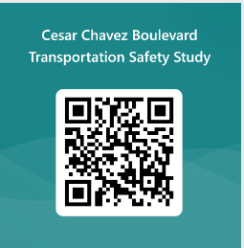

Q&A and Comments
Comments will be accepted through October 1st, 2024. Fill out one of the comment forms.
Project Webpage:
http://bit.ly/ChavezBlvd.

