Slide 1
Skillman Street Corridor Study
Live Oak to Abrams
Public Meeting Presentation
June 17, 2025
City of Dallas
Department of Transportation & Public Works

Slide 2

Presentation Outline
Study Location & Objectives
Existing Conditions
Potential Improvements
Recommendations
Implementation of Improvements
Updates Since the Last Public Meeting
Next Steps

Slide 3
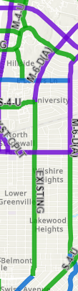



Previous Plans
City of Dallas Thoroughfare Plan
City of Dallas Bike Plan (2011)
Loop 12
Principal Arterial
Planned On-Street Bike Facility
Minor Arterial
Planned Off-Street Bike Facility
Community Collector
Residential Collector
Note: The latest version of the ongoing Bike Plan Update (Summer 2023 version) does not recommend any bike facilities on Skillman or Abrams north of Richmond.
Skillman
Skillman
Mockingbird
Mockingbird
Loop 12
Abrams
Lovers
Lovers

Slide 4
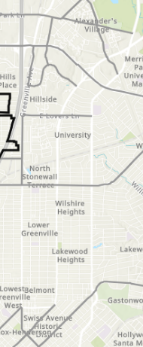
Previous Plans
City of Dallas Vision Zero Action Plan
High Injury Network
The goal of Vision Zero is to eliminate traffic fatalities.
Skillman is not on the High Injury Network (the 7% of Dallas streets that account for 62% of fatal and severe injury crashes).

Slide 5

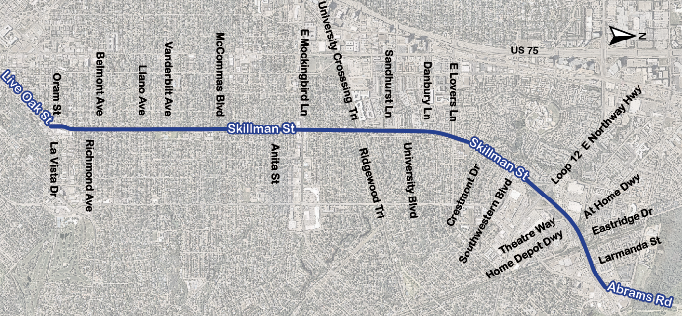
Study Locations & Objectives
Evaluate Existing Conditions and
Speeding Issues
Evaluate Crash Reports
Traffic Operations Analysis
Pedestrian and Bike Accommodations
Develop Mitigations for Safety Challenges
Recommendations for Operational Improvements

Slide 6
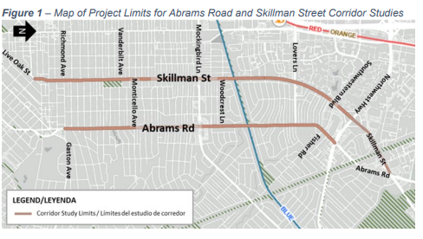
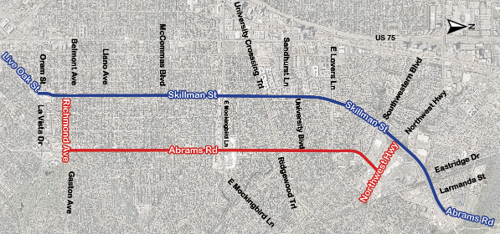

Purpose and Public Engagement in May 2024
Purpose of Skillman St. Study:
  To determine recommended strategies and improvements to enhance safety and mobility for all users of the corridor and address resident concerns.
A Public Engagement Survey was hosted in May 2024 for the following concurrent studies:
  Skillman St (Live Oak St to Abrams Rd)
  Abrams Rd (Richmond Ave to Northwest Hwy)
  Positive feedback on existing number of lanes and connectivity
  Strong desire for sidewalk improvements, bike lanes/shared use paths, crosswalks, and traffic calming
Public Meeting Feedback
Notes:
A unified public engagement meeting was held on May 2024 due to the interrelated impacts of the concurrent corridor studies:
-Abrams Rd (Richmond Ave to Northwest Hwy)
-Skillman St. (Live Oak St to Abrams Rd)
-----------------------------------------------
Discussion about the Abrams Rd. study. Show the limits of that project. That study is happening in tandem to the Skillman St. project
Previous public meeting about Skillman/Abrams corridor – Do a quick summary of the results of this study https://dallascityhall.com/departments/transportation/DCH%20Documents/Transportation_Planning/Corridor%20Studies/Abrams_and_Skillman_Public_Engagement_Summary_Draft.pdf

Slide 7
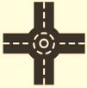
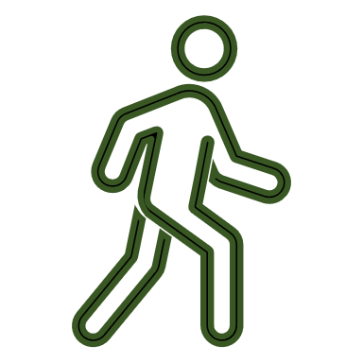

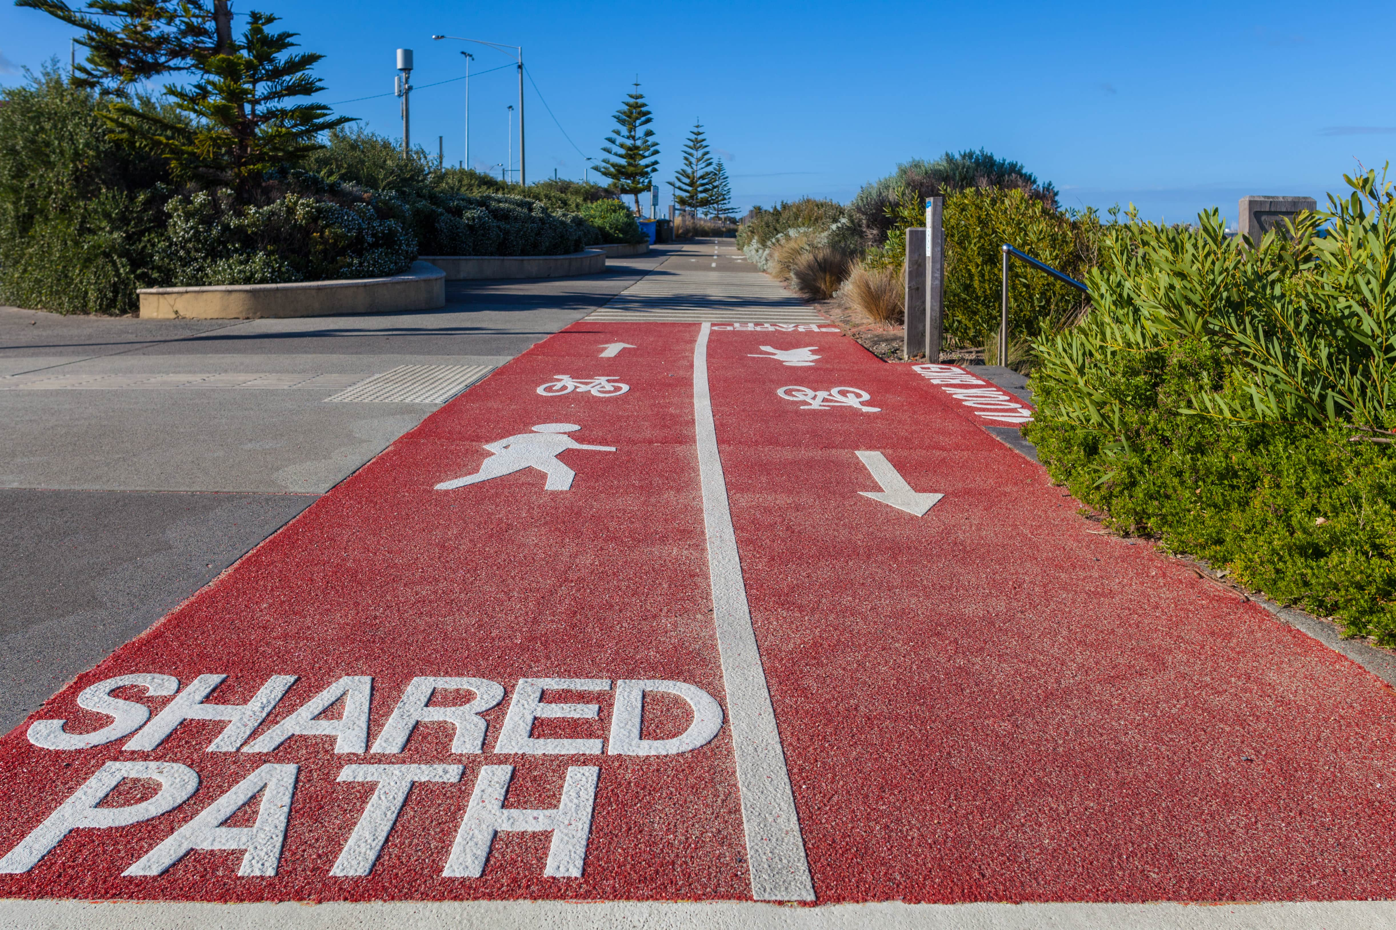
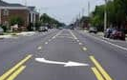


Public Engagement Summary from September 2024
Skillman Public Meeting Feedback
  Interest in a roundabout at Live Oak at Skillman
  Strong desire for sidewalk improvements, bike lanes/shared use paths, crosswalks, and traffic calming
  Desire for a road-diet and speed calming around Tietze Park
  Desire to enhance safety lighting
  Desire for improved infrastructure
Notes:
A unified public engagement meeting was held on May 2024 due to the interrelated impacts of the concurrent corridor studies:
-Abrams Rd (Richmond Ave to Northwest Hwy)
-Skillman St. (Live Oak St to Abrams Rd)
-----------------------------------------------
Discussion about the Abrams Rd. study. Show the limits of that project. That study is happening in tandem to the Skillman St. project
Previous public meeting about Skillman/Abrams corridor – Do a quick summary of the results of this study https://dallascityhall.com/departments/transportation/DCH%20Documents/Transportation_Planning/Corridor%20Studies/Abrams_and_Skillman_Public_Engagement_Summary_Draft.pdf

Slide 8
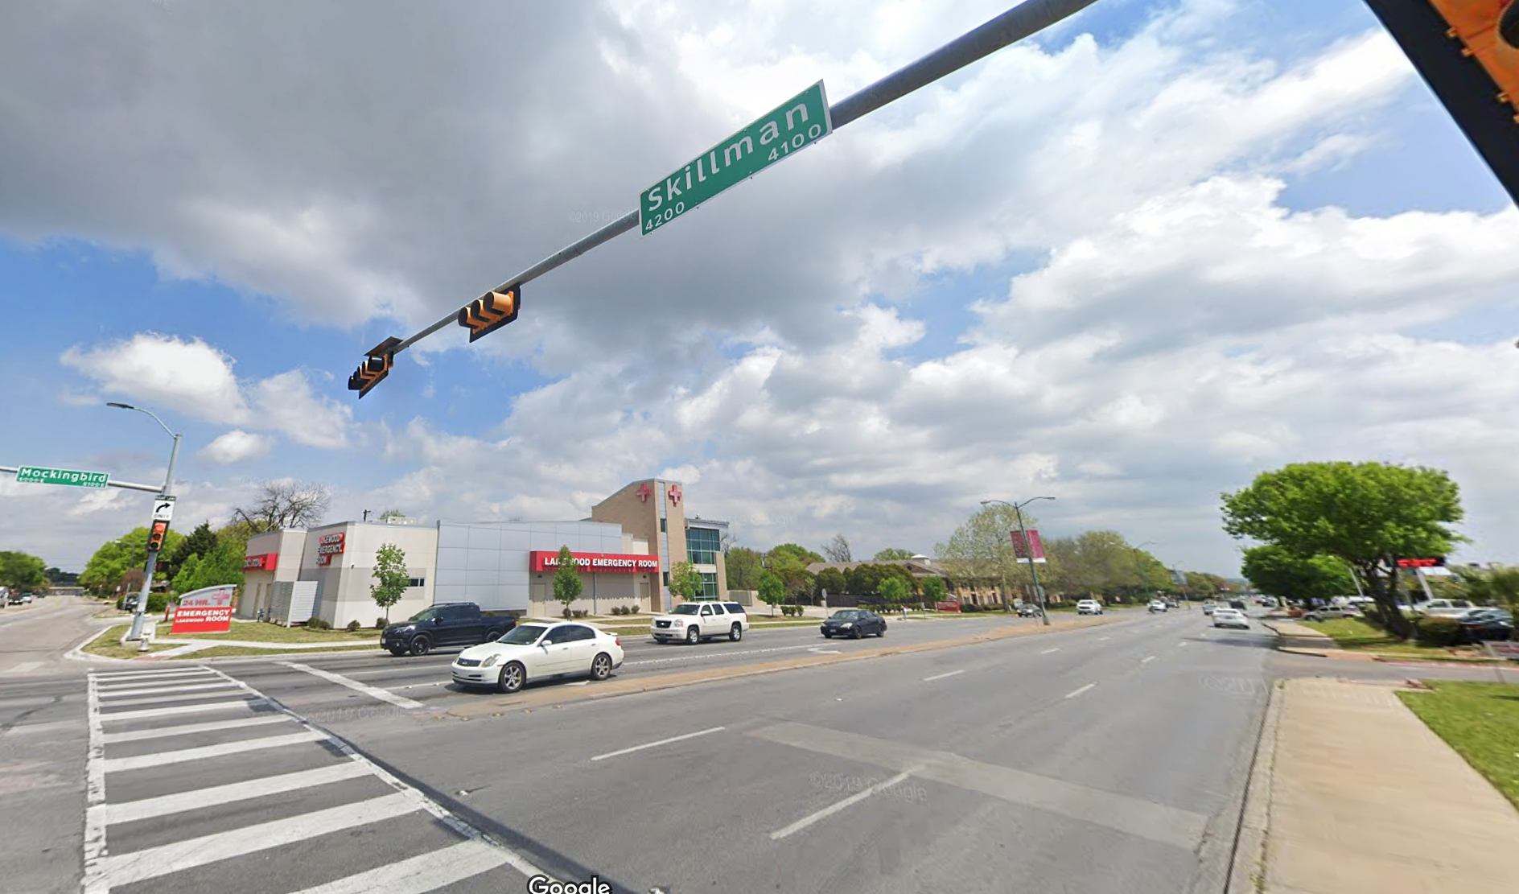
Existing Conditions

Slide 9
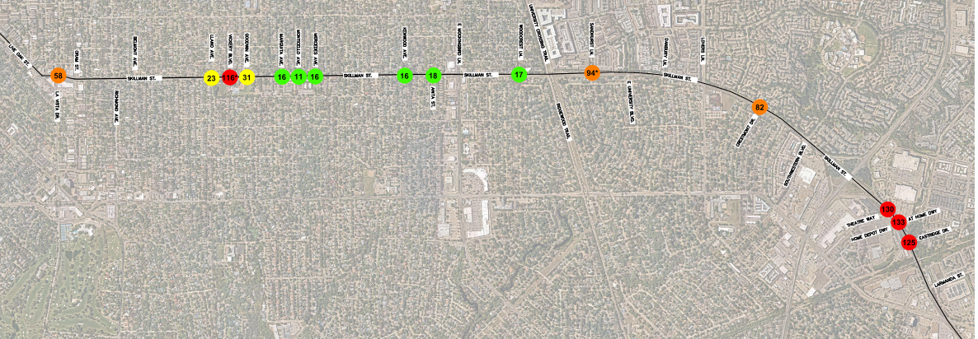


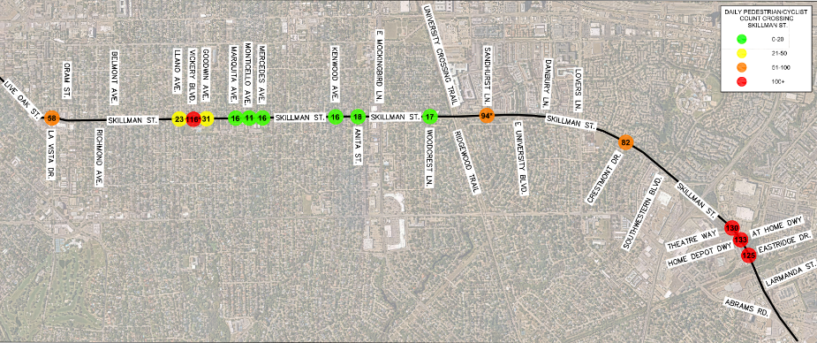
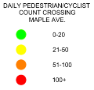
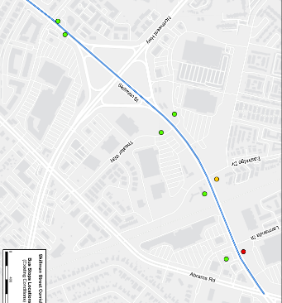
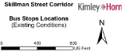

Pedestrian/Cyclist Crossing Volumes
58
23
116*
31
16
11
16
16
18
17
94*
82
130
133
125
Retail/ Restaurants
Apartments
Residential
DAILY PEDESTRIAN/CYCLIST COUNT CROSSING
SKILLMAN ST.
Northwest Hwy
Southwestern Blvd
Skillman St
Theater Way
Eastridge Dr
Tietze Park
Trail Access
Retail
Larmanda St
Larmanda St
Heavy Pedestrian/Cyclist demand near Home Depot Driveway
Major pedestrian generators include the University Crossing Trailhead and Tietze Park
Abrams Rd
Southwestern to Larmanda: High Density of Bus Stops

Slide 10
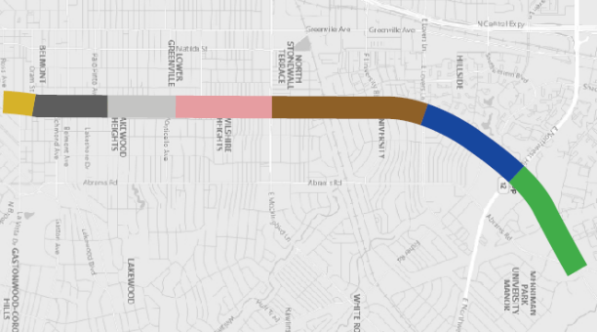

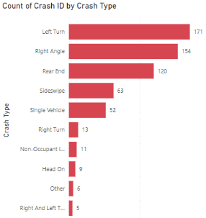
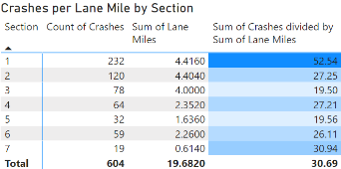
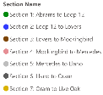
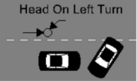
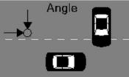
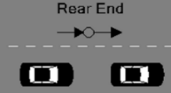
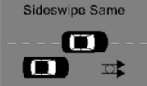
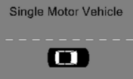
Crash Types by Section
Live Oak St
Llano Ave
Mercedes Ave
Mockingbird Ln
Oram St
Lovers Ln
604 Total Crashes from Jan 2018 to June 2023
7
6
5
4
3
2
Northwest Hwy
Primary Crash Type: Right Angle
Primary Crash Type: Rear End
1
Primary Crash Type: Left Turn
Abrams Rd
Top 5 Crash Types (Full Corridor):
1. Left Turn – 28%
2. Right Angle – 25%
3. Rear End – 20%
4. Sideswipe – 10%
5. Single Vehicle – 9%

Slide 11


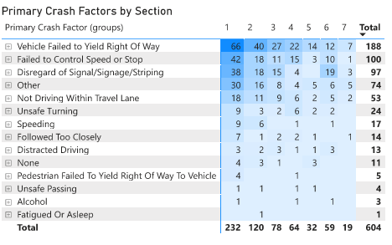
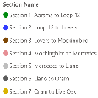
Crash Factors by Section
  Key Crash Factors
  Failed to Yield ROW (Turning Left) – 31%
  Failed to Control Speed – 17%
  Disregard of Signal/ Signage/ Striping – 16%
  Failed to Maintain Travel Lane – 9%
Mercedes Ave
Mockingbird Ln
Oram St
Llano Ave
Lovers Ln
7
6
5
4
3
2
Northwest Hwy
1
Abrams Rd
  Most speeding crashes (15 out of 17) occurred on the north end of the corridor (Sections 1 and 2)
  Running red lights at signals is a key factor at intersections with signals.
Notes:
Contributing Factor No. 4 – “Other” – Refers to a generalized category of unique circumstances such as: Faulty Evasive Actions, Disabled in Traffic Lane, Backed without safety (Unsafe Backing Movement), etc.
Within Section 1, there are:
LT crashes (failure to yield ROW)
Pedestrian/cyclist crashes
Speed issues (failure to control speed) - north of Lovers Ln.
Most speeding crashes (15 out of 17) occurred on the north end of the corridor within sections 1 and 2

Slide 12
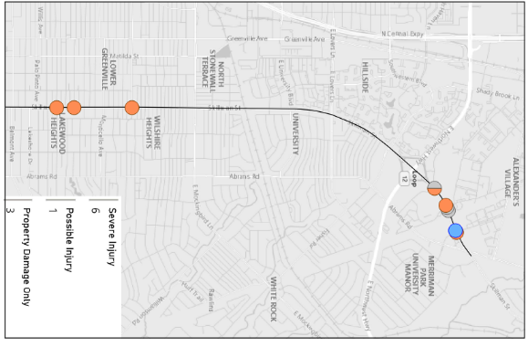

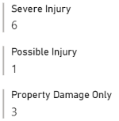

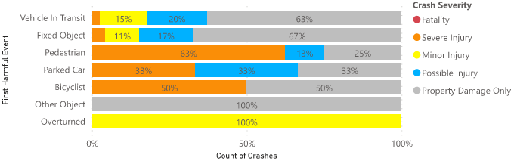
Pedestrian/Cyclist Crashes
70% of the ped/cyclist crashes occurred north of Northwest Highway (section 1)
When a pedestrian or cyclist is involved, the crash severity drastically increases.
  Disproportionate percentage of severe injury
10 Pedestrian/Cyclist Crashes occurred along the corridor from Jan 2018 to June 2023
Notes:
One fatality near Tietze Park (Velasco Ave)
New Pedestrian Hybrid Beacon Recommended

Slide 13
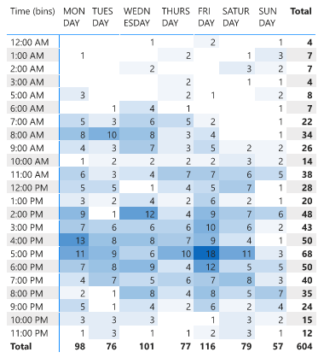

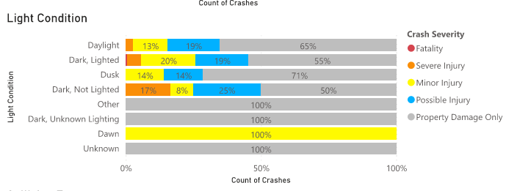
Lighting Conditions and Time Of Day
11 out of 12 dark, not lighted crashes occurred at or north of Mockingbird Ln.
The afternoon hours see greater number of crashes (compared to morning hours) with Friday being the day of the week with the most crashes.

Slide 14
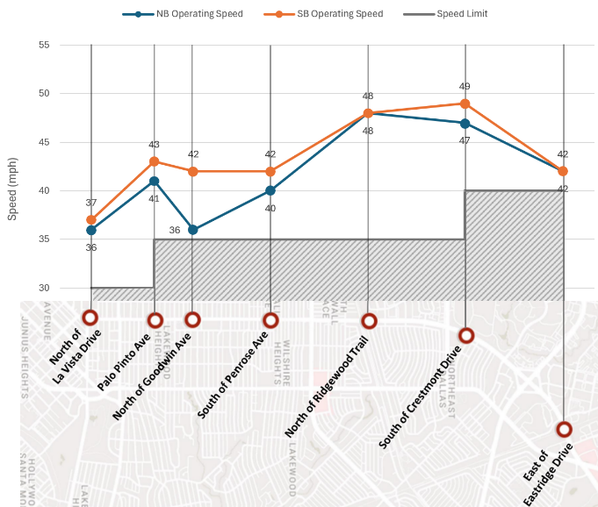

Operating Speeds
Speeding was a top concern during the May 2024 public meeting.
Operating speeds were substantially higher than posted speeds between Penrose Ave. and Crestmont Dr.
On average, vehicles are traveling 35% over the posted speed limit.

Slide 15
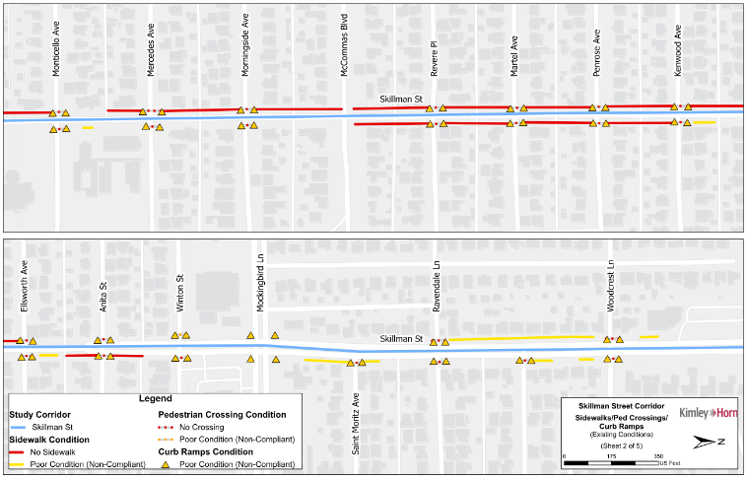
Sidewalk Deficiencies
During the field inventory, many locations were identified with missing or non-traversable sidewalk.
Of the surveyed ramps, over 50% were in poor condition or non-compliant.
Poor accessibility was a top concern during the May 2024 public meeting.
Note: Inventory collected as of October 2023

Slide 16
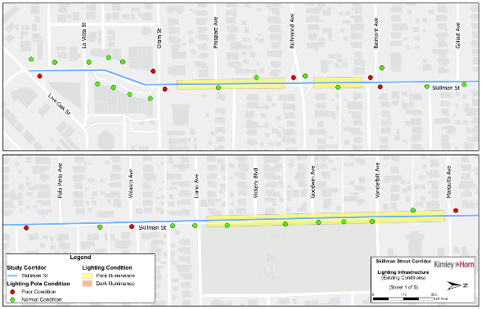
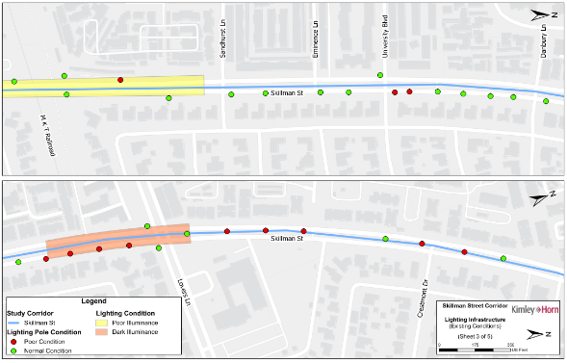
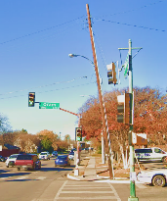
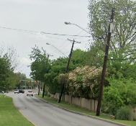
Lighting Deficiencies
Note: Inventory collected as of October 2023
No lighting near Lovers Lane

Slide 17
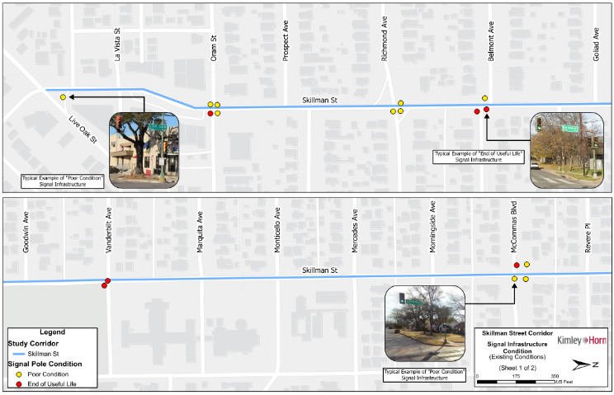
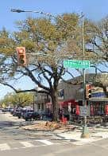
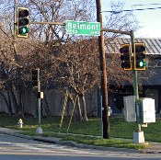
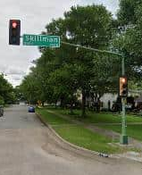

Signal Infrastructure Deficiencies
Most of the signal infrastructure along the corridor is at “end of useful life” and needs to be replaced.
Several signal poles has structural damage, due to vehicles strikes.
Note: Inventory collected as of October 2023

Slide 18
Summary of Existing Conditions
Heavy pedestrian/cyclist demand crossing Skillman St. adjacent to heavy pedestrian generating areas: Local Shops, Recreational Areas, Bus Stops, Apartments, Homes, etc.
Significant sidewalk, crosswalk, ramp, lighting, and signal infrastructure deficiencies throughout the corridor.
Speeding is a significant concern along the corridor.
Highest density of crashes along northern section of Skillman St. Most pedestrian/cyclist crashes occur here.
Failure to yield right of way crashes common throughout the corridor, especially around Home Depot Driveway.

Slide 19
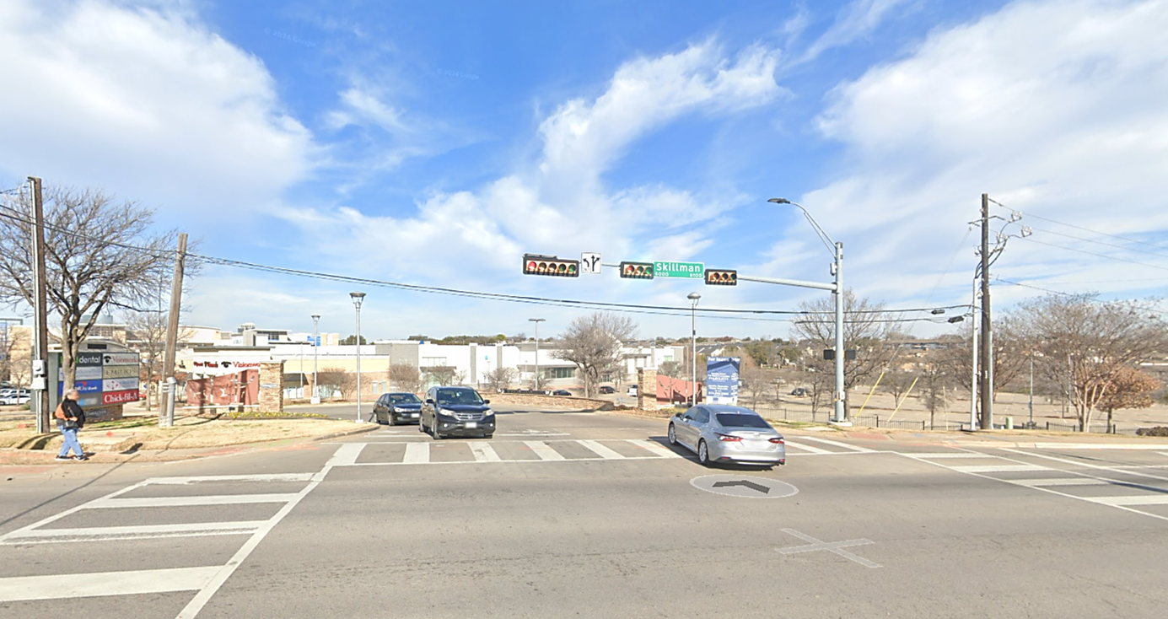
Potential Improvements

Slide 20
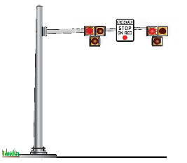
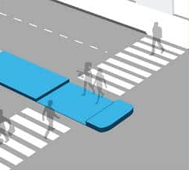
Tools to Improve Existing Corridor Issues
Slow Down Traffic
  Narrow traveled lanes
  Lane reduction (reduce number of lanes)
Improve Sidewalks, Signals, and Lighting
  Widen/repair deficient sidewalks and fill in sidewalk gaps
  Install additional lighting to illuminate street and sidewalk
  Create wide shared use paths for bike and pedestrians
Provide Safe Pedestrian/Cyclist Crossings
  Install Pedestrian Hybrid Beacon (PHB)
  Install Pedestrian Refuge Islands
    Optional Z-Crossing Configuration
Pedestrian Hybrid
Beacon (PHB)
Pedestrian Refuge Island

Slide 21
Future Expected Growth
Historic Traffic Growth Rate
Future Projected Traffic Growth Rate
2023 Existing Volumes
2030 Future Volumes
2045 Future Volumes
1% Annual Growth
0.5% Annual Growth

Slide 22
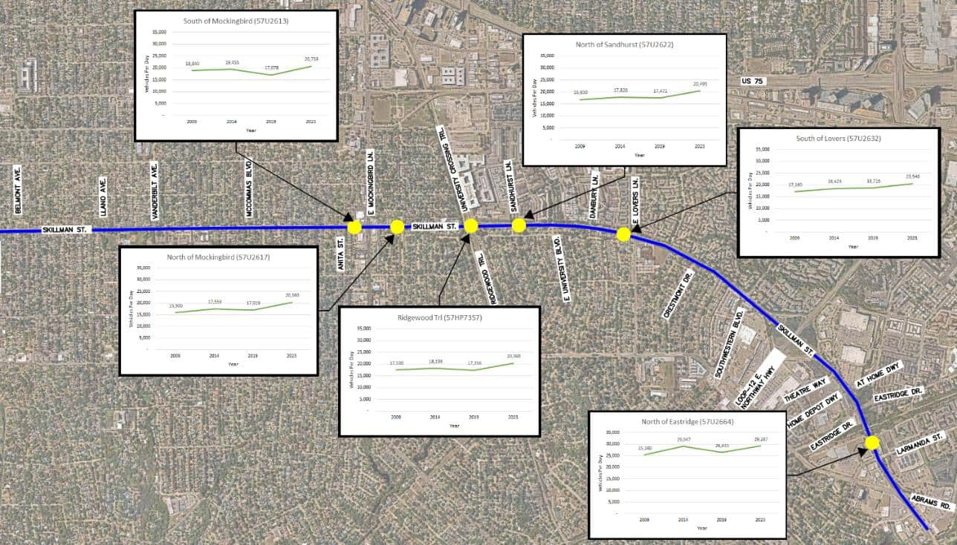
Growth Patterns

Slide 23
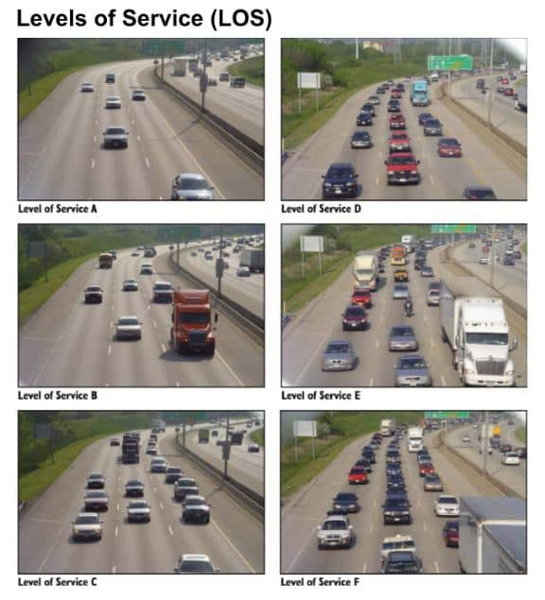
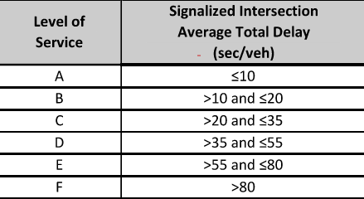
What is LOS?
Notes:
LOS figures – consider updating

Slide 24
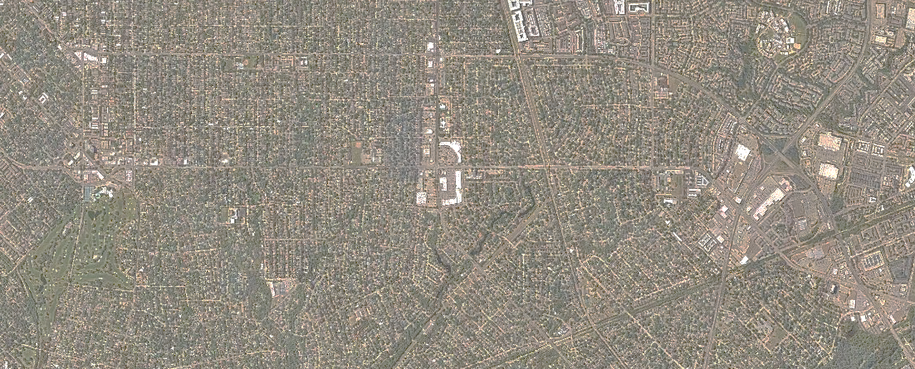

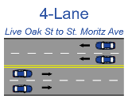



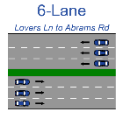


Existing Cross Section of Roadway
Live Oak St
Richmond
Ave
Llano Ave
Monticello
Ave
Mockingbird
Ln
Lovers Ln
Skillman St
La Vista
Dr
Skillman St
St. Moritz Ave
Northwest Hwy
Ridgewood Trail
Southwestern Blvd
4-Lanes
Live Oak to St. Moritz Ave
Eastridge Dr
(Undivided)
4-Lanes
Ridgewood Trail to Lovers Ln
Theater
Way
4-Lanes
(Divided)
6-Lane
Lovers Ln to Abrams Rd
Abrams Rd
5-Lanes
St. Moritz Ave to Ridgewood Trail
(Divided)
5-Lanes
(Undivided)

Slide 25


Skillman St. Peak Hour Link Analysis (2045)
Traffic operations performs adequately (LOS C) when looking at 2045 projections while maintaining the Existing Lane Configuration.
However, if a lane reduction is implemented, LOS operates at LOS E. Therefore, it is recommended to maintain the existing 6 lane cross-section between Lovers Ln. and Southwestern Blvd.
6-Lane (Existing) Cross Section
E. Lovers Ln
Southwestern Blvd.
4-Lane Cross Section
E. Lovers Ln
Southwestern Blvd.
Notes:
This section was the only potential candidate for a road diet, which is why it was evaluated
Make sure to show AM and AM in figure and tables (apples to apples)
Just for reference, LOS C is about 20-35 [sec/vehicle] delay while LOS E is 55-80 [sec/vehicle]
Discussion about why we are not changing the existing cross-section of the roadway. We evaluated changing the cross-section from 6 lanes to 4 lanes from Lovers to Southwestern but decided not to due to LOS capacity constraints.

Slide 26

Skillman St. Peak Hour Link Analysis (2045)
With the Existing Cross Section, operations performs at LOS E when looking at 2045 projection.
However, if a lane reduction is implemented, LOS degrades to LOS F. Therefore, it is recommended to maintain the existing 4 lane cross-section between Llano Ave. to Anita St.
4-Lane (Existing) Cross Section
Llano Ave.
Anita St.
3-Lane Cross Section
Llano Ave.
Anita St.
Notes:
Make sure to show AM and AM in figure and tables (apples to apples)
Just for reference, LOS C is about 20-35 [sec/vehicle] delay while LOS E is 55-80 [sec/vehicle]
Discussion about why we are not changing the existing cross-section of the roadway. We evaluated changing the cross-section from 6 lanes to 4 lanes from Lovers to Southwestern but decided not to due to LOS capacity constraints.

Slide 27





Intersection LOS Evaluation/Signal Warrants – AM Peak Hour
Skillman at Anita
Traffic Signal not warranted/recommended
15 out of 15 signalized intersections are projected to operate at LOS D or better during the AM peak hour in 2045 with signal timing adjustments.
Traffic Signal Warrants
Skillman at La Vista
Failing Intersection.
Traffic Signal recommended. Improves from LOS from E to C
Skillman at Home Depot Drive
Although a traffic Signal was warranted, it is not recommended due to proximity to adjacent signals.
Recommend modifying driveway
access at this intersection
Notes:
Ezekiel - Need to show Mitigation Bubbles (blank for now, Lucy will provide LOS data)

Slide 28



Intersection LOS Evaluation/Signal Warrants - PM Peak Hour
14 out of 15 signalized intersections are projected to operate at LOS D or better during the PM peak hour in 2045 with the signal timing adjustments.
Traffic Signal Warrants
Skillman at La Vista
Failing Intersection.
Traffic Signal recommended. Improves LOS from F to C
Skillman at Home Depot Drive
Although a traffic Signal was warranted, it is not recommended due to proximity with adjacent signals.
Recommend modifying driveway
access at this intersection

Slide 29


Pedestrian/Bike Volumes and PHBs/RRFBs
PHB
PHB^
PHB
PHB
Pedestrian Hybrid
Beacon
(PHB)
*Weekend Pedestrian Volume Displayed
^PHB Recommended to Accommodate Pedestrian Demand

Slide 30
Summary of Traffic Analysis
It is recommended to maintain the existing cross-section of the roadway
Historical data provided an annual growth rate of 0.21%. → Traffic Analysis assumed annual growth rates of 1% through 2030 and 0.5% through 2045
14 out of 15 signalized intersections will operate at LOS D or better in 2045 during the peak hours
PHBs are recommended at Vickery Blvd, Sandhurst Ln, Home Depot Driveway, and Crestmont Dr
  Although not warranted, a PHB is recommended at Crestmont Drive due to high pedestrian demand and potential sight distance constraints with the existing curvature of the roadway.

Slide 31

Recommendations

Slide 32



Between La Vista and Oram
Proposed Curb and Wheel Stops
Proposed New Signal
Proposed Raised Sidewalk
Existing Challenges with drainage and lack of separation between parking and traveled way
Location Along the Corridor
Richmond Ave
Llano Ave
Monticello
Ave
Mockingbird Ln
Live Oak St
Lovers Ln
Skillman St
La Vista
Dr
Ridgewood
Trail

Slide 33

Between Belmont and Velasco
Proposed 12’ Shared Use Path
Proposed 6’ sidewalk
Location Along the Corridor
Richmond Ave
Llano Ave
Monticello
Ave
Mockingbird Ln
Live Oak St
Lovers Ln
Skillman St
La Vista
Dr
Ridgewood
Trail

Slide 34

Between Velasco and Vanderbilt
Pedestrian Hybrid Beacon (PHB) with speed table
Proposed Rumble Strips and Retroreflective Pavement Markers
Speed Reduction Pavement Markings
Advanced Pedestrian Warning Signs
Location Along the Corridor
Richmond Ave
Llano Ave
Monticello
Ave
Mockingbird Ln
Live Oak St
Lovers Ln
Skillman St
La Vista
Dr
Ridgewood
Trail

Slide 35

Between Mockingbird and Ridgewood Trail
Two-Way Left Turn Lane
Proposed 12’ Shared Use Path
Proposed Crosswalk
Location Along the Corridor
Richmond Ave
Llano Ave
Monticello
Ave
Mockingbird Ln
Live Oak St
Lovers Ln
Skillman St
La Vista
Dr
Ridgewood
Trail

Slide 36

Between Ridgewood Trail and University
Existing University Crossing Trailhead
Pedestrian Hybrid Beacon (PHB)
Proposed Median Width Reduction
Curb Realignment for SUP Accommodation
Location Along the Corridor
Richmond Ave
Llano Ave
Monticello
Ave
Mockingbird Ln
Live Oak St
Lovers Ln
Skillman St
La Vista
Dr
Ridgewood
Trail

Slide 37

Between Lovers and Crestmont
PHB with “Z Crossing”
Proposed 12’ Shared Use Path
Location Along the Corridor
Richmond Ave
Llano Ave
Monticello
Ave
Mockingbird Ln
Live Oak St
Lovers Ln
Skillman St
La Vista
Dr
Ridgewood
Trail

Slide 38


Between Theater and Eastridge
PHB with “Z Crossing”
Right-In Right-Out
Provide Left Turn Access for exiting Home Depot Driveway
Proposed 10’ Shared Use Path
Restrict Access to Improve Safety
Location Along the Corridor
Lovers Ln
Skillman St
Northwest Hwy
Abrams Rd
Southwestern Blvd
Theater Way
Eastridge Dr
Notes:
Zoom into this area

Slide 39

Implementation Of Improvements

Slide 40
Implementations of Improvements
Summary of Improvements
Short Term | Long Term
Signal timing improvements at key intersections Wheel stops or curb/gutter installation between La Vista Dr. and Oram St. along Skillman St. Speed reduction pavement markings and rumble strips on Skillman St. Near Tietze Park High visibility crosswalk at Woodcrest Ln. | Installation of 12’ Shared Use Path on east side of Skillman St. and 6’ sidewalk on west side of Skillman St. from Oram St. to Southwestern Blvd. Installation of 10’ Shared Use Path along Skillman St. from Theater Way to Abrams Rd. Installation of curb and gutter with a 6’ sidewalk along Skillman St. from La Vista Dr. to Oram St. (Requires relocation of striped parking stalls) Signal infrastructure improvements at key intersections (with end-of-life signal equipment) Proposed PHB signal at Vickery Blvd. and Skillman St. near Tietze Park Median narrowing from Ridgewood Trail To Lovers Ln. Median Improvements with proposed PHB signal at Home Depot Driveway

Slide 41
Concluding Thoughts
Skillman St. has a history of high crash rates with speeding being a big concern
There are many pedestrian generators along the corridor with high pedestrian crossings
PHBs will improve pedestrian safety
All recommended improvements can be made with nominal impact to LOS
Shared Use Pathways help to accommodate bikes/peds in a safe manner
15 out of 15 signalized intersections are projected to operate at LOS D or better during the AM peak hour in 2045 with signal timing adjustments.

Slide 42

Updates Since Last Public Meeting

Slide 43


Lane Reduction Study Area
The City's consultant assessed the area and identified the following findings:
Skillman St from McCommas Blvd to Richmond Ave
Adjacent to Tietze Park
Existing Cross-Section: 4-Lanes Undivided
Lane Reduction Typical Section: 3-Lanes Undivided (with a center left-turn lane and a shared-use path)
Skillman St north and south of these limits will remain as existing (4-lanes undivided).

Slide 44



Benefits of the Lane Reduction Option
Benefits
Creates room for a wider buffer between the travel lane and the Shared-use Path
Reduces pedestrians crossing the corridor and provides median refuge for pedestrians
  Fewer lanes to cross
Safer left turns into and out of side streets and driveways. Introduces left turn lanes at major intersections
Traffic Calming – tighter cross-section will reduce speeds

Slide 45

Lane Reduction Typical Section

Slide 46



Potential Reliever Routes for Skillman St.
Mockingbird Ln
  Greenville Avenue and Abrams Road were evaluated as potential relief routes for Skillman Street.
McCommas Blvd
  2045 Peak Hour Capacity Analysis
Abrams Road
Abrams Road
  Southbound: Expected to be at capacity by 2045 (LOS F)
    No additional capacity available
  Northbound: Expected to be at capacity by 2045 (LOS F)
    No additional capacity available
Vanderbilt Ave
Llano Ave
Skillman St
Richmond Ave
Belmont Ave
Per the City’s consultant's analysis
Notes:
Below are the results of the peak hour capacity analysis in 2045:

Slide 47



Potential Reliever Routes for Skillman St.
Mockingbird Ln
  Greenville Avenue and Abrams Road were evaluated as potential relief routes for Skillman Street.
McCommas Blvd
  2045 Peak Hour Capacity Analysis
Greenville Avenue
  Southbound: Expected to be at capacity by 2045 (LOS F)
    No additional capacity available
  Northbound: Expected to operate at LOS C/D
    Additional capacity for rerouted traffic
Greenville Ave
Vanderbilt Ave
Llano Ave
Skillman St
Richmond Ave
Belmont Ave
Per the City’s consultant's analysis
Notes:
Below are the results of the peak hour capacity analysis in 2045:

Slide 48

Rerouted Traffic
  Approximately 1/3 of northbound traffic on Skillman St begins south of Belmont Ave and travels to Mockingbird Ln. This is considered regional traffic.
  With the proposed road diet on Skillman, there is capacity for:
    ~19% of regional traffic to be rerouted to Greenville Ave.
    ~30% of local trips to be rerouted to take Greenville Ave.
  With this rerouted traffic, Greenville Ave is expected to operate at LOS D/E in the northbound direction in 2045.
  Approximately 2/3 of southbound traffic on Skillman St begins north of Mockingbird Ln and travels to Live Oak St. This is considered regional traffic.
  Due to the southbound capacity constraints on both Abrams Road and Greenville Ave, no southbound trips on Skillman St are expected to be rerouted to those facilities.
Per the City’s consultant's analysis

Slide 49

Lane Reduction LOS/Queueing with Rerouted Traffic
McCommas Blvd
Legend
Over 1000’ of Vehicle Queue
Reducing lanes would impact intersection LOS and queuing as follows:
  2045 AM peak hour: Southbound queueing significantly increases at Richmond, Belmont, and McCommas, with queues spilling into the adjacent intersections.
  2045 PM peak hour: McCommas Intersection LOS worsens from LOS B to LOS F (112 seconds of delay). Southbound and northbound queueing significantly increases at the intersections mentioned above with queues reaching over 1,000’.
Reducing lanes would impact corridor performance as follows:
  2045 Daily LOS worsens from LOS D to LOS E/F (1.31 V/C)
  2045 AM LOS worsens from LOS C to LOS D/F (1.07 V/C)
  2045 PM LOS worsens from LOS E to LOS F (1.49 V/C)
- Vehicle Queue
Length
- Signalized
Intersections
Vanderbilt Ave
Llano Ave
Skillman St
Long Vehicle Queue Lengths spilling into adjacent intersections
Belmont Ave
Richmond Ave
Per the City’s consultant's analysis

Slide 50
Benefits and Disadvantages of the Lane Reduction
Benefits
Disadvantages
  Will help reduce speeds, especially around Tietze Park area
  Bringing the curb inward would accommodate wider sidewalks and buffer areas
  Enhances multimodal connectivity through the proposed shared-use path
  Will potentially provide an increase in pedestrian safety and quality of life
  Queueing and degradation of LOS and Delay is expected at key intersections
  Significant Queues are expected at Richmond, Belmont, and McCommas
  Potential for traffic rerouting onto neighborhood streets due to long delays
Per the City’s consultant's analysis

Slide 51

Project Website
Notes:
Ezekiel – please add a new image here

Slide 52

Q&A and Comments
Comments will be accepted through July 1st, 2025 . Fill out one of the comment forms.
Project Webpage:
https://dallascityhall.com/departments/transportation/Pages/Abrams-Skillman-Corridor-Studies.aspx

