Slide 1
Overview of
The Dallas Arboretum and Botanical Garden

Slide 2
The Mission
Our mission makes us much more than just a beautiful place as we are charged to:
Provide a place for the art and enjoyment of horticulture
Provide for the education of adults and children
Provide research to return to the field
Do so in a fiscally responsible way

Slide 3
A Tasteful Place
Opened Fall 2017
A Two and a Half Acre Fruit, Herb, and Vegetable Garden Teaching Visitors How to Grow Local and Sustainable Produce and Cook in Nutritious Ways.
Area for tastings or demonstrations each day.
An enclosed building for cooking classes and lectures.
Four quadrants with plantings in trays that are moved to the greenhouse when dormant.
Orchard and vineyard areas.

Slide 4
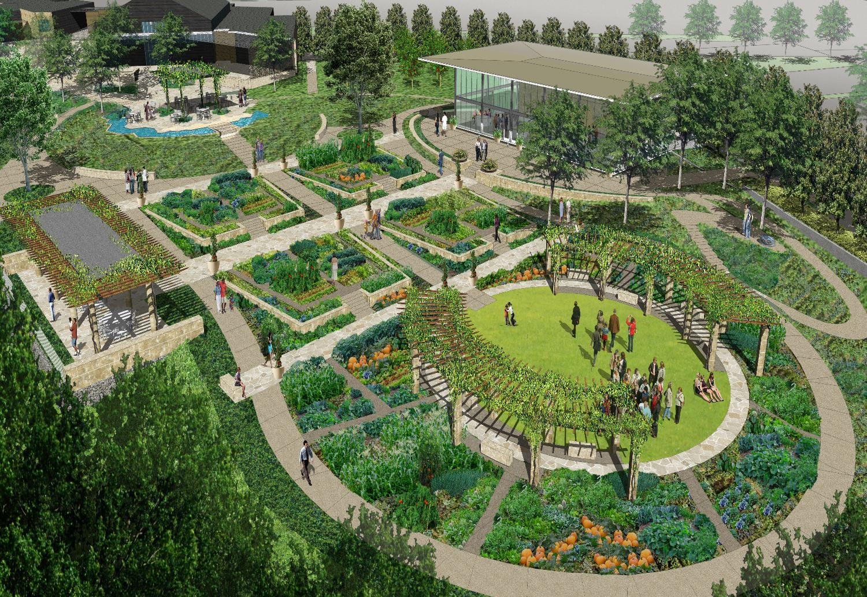

Slide 5
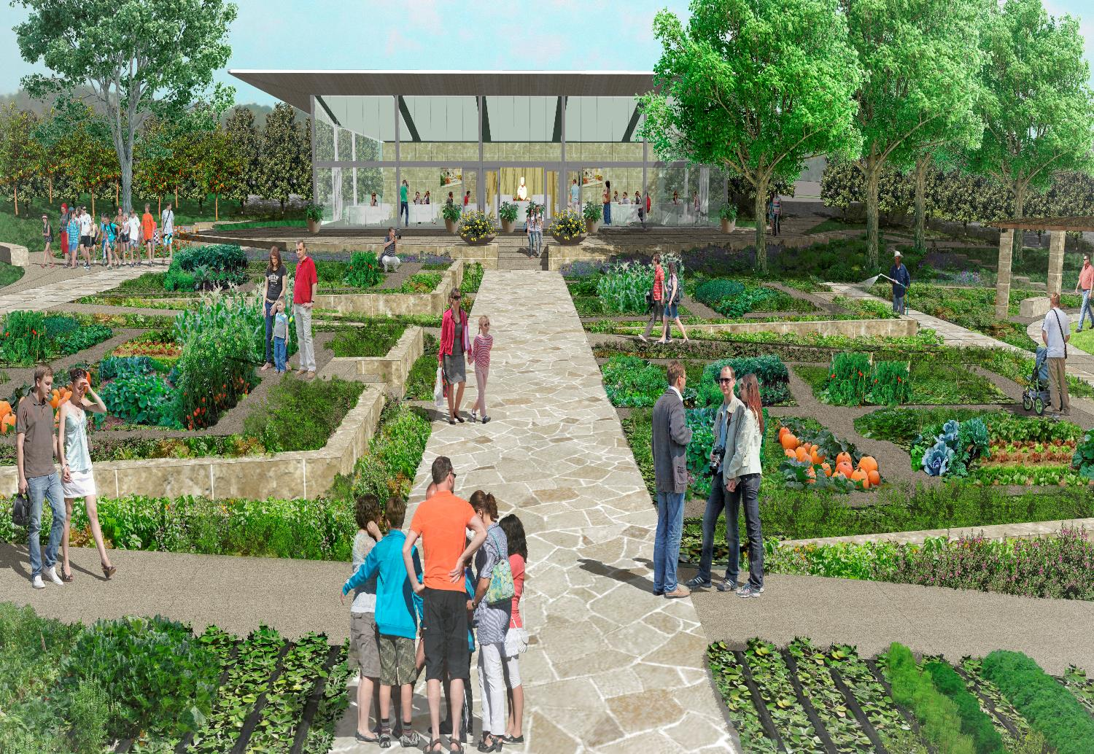

Slide 6
Research as Another Part of our Mission
We have an internationally known research program that trials both annual and perennial plant material as we take some of the most comprehensive data in the trialing industry.
Our diverse and at times extreme climate here in North Central Texas, as well as our unfavorable soil type (heavy clay with a high pH), make our Trial gardens stand out from the rest.
In the industry we are recognized most for our heat tolerance trials (Slogan: “If we can’t kill it, no one can!”).
Field Day – Annual industry only event held in June where horticulture professionals from across the state and US come to the Arboretum to see the trials and learn about our winners for the year.

Slide 7
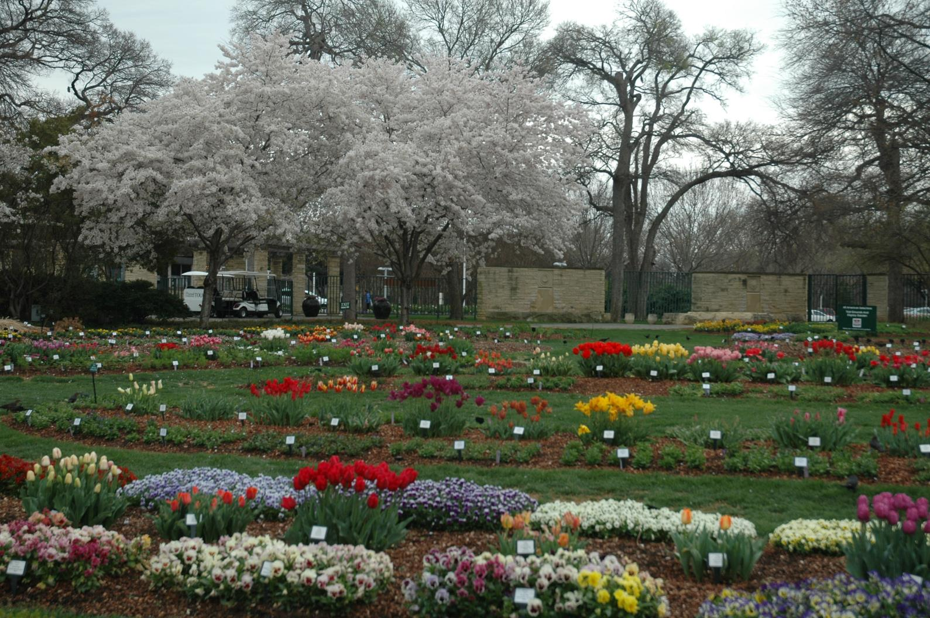
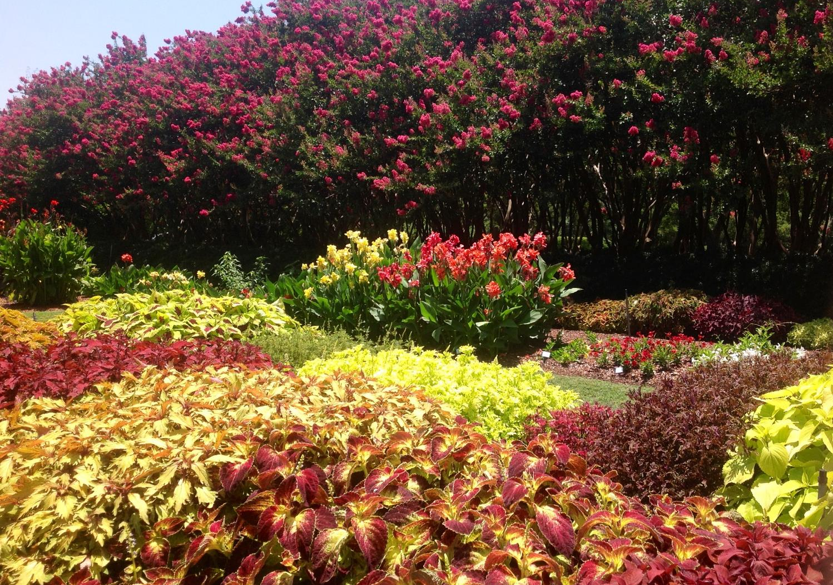

Slide 8
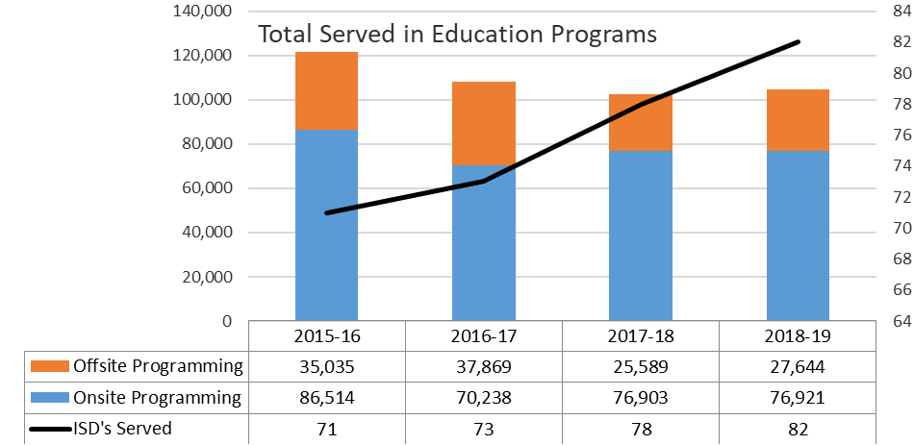
Children’s Education
In 2018-19 School Year
Over 100,000 children in classes taught
119 schools have received bus stipends

Slide 9
The Rory Meyers
Children’s Adventure Garden
Only one of its type in the world
Created around K-6 life and earth science state and national curriculum standards
Many awards and national recognition since opening
National Wildlife Federation Certified Wildlife Habitat
Monarch Watch Certified Monarch Waystation
Texas Parks & Wildlife Department Texas Aquatic Science Field Site
42MM impressions worldwide in first two weeks
SMU Evaluation Results show a significant difference made in children’s retention

Slide 10
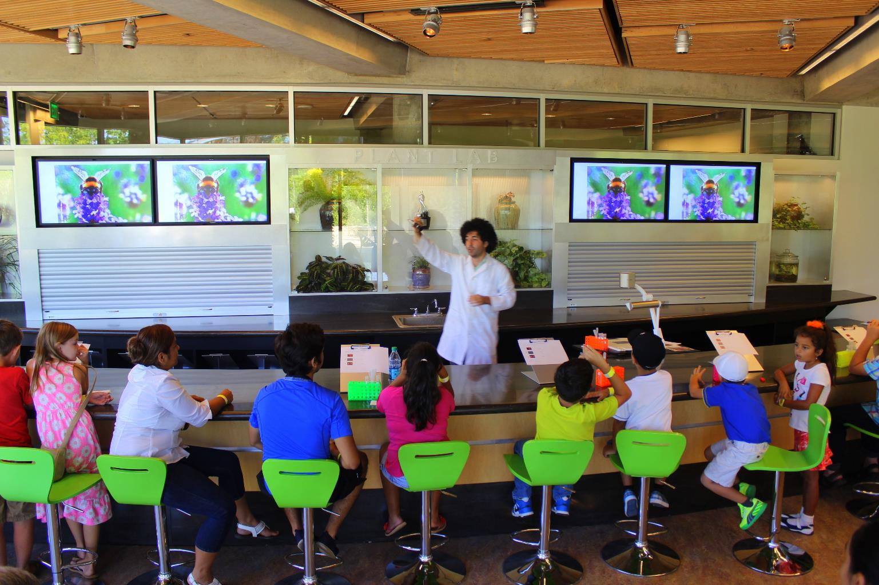

Slide 11
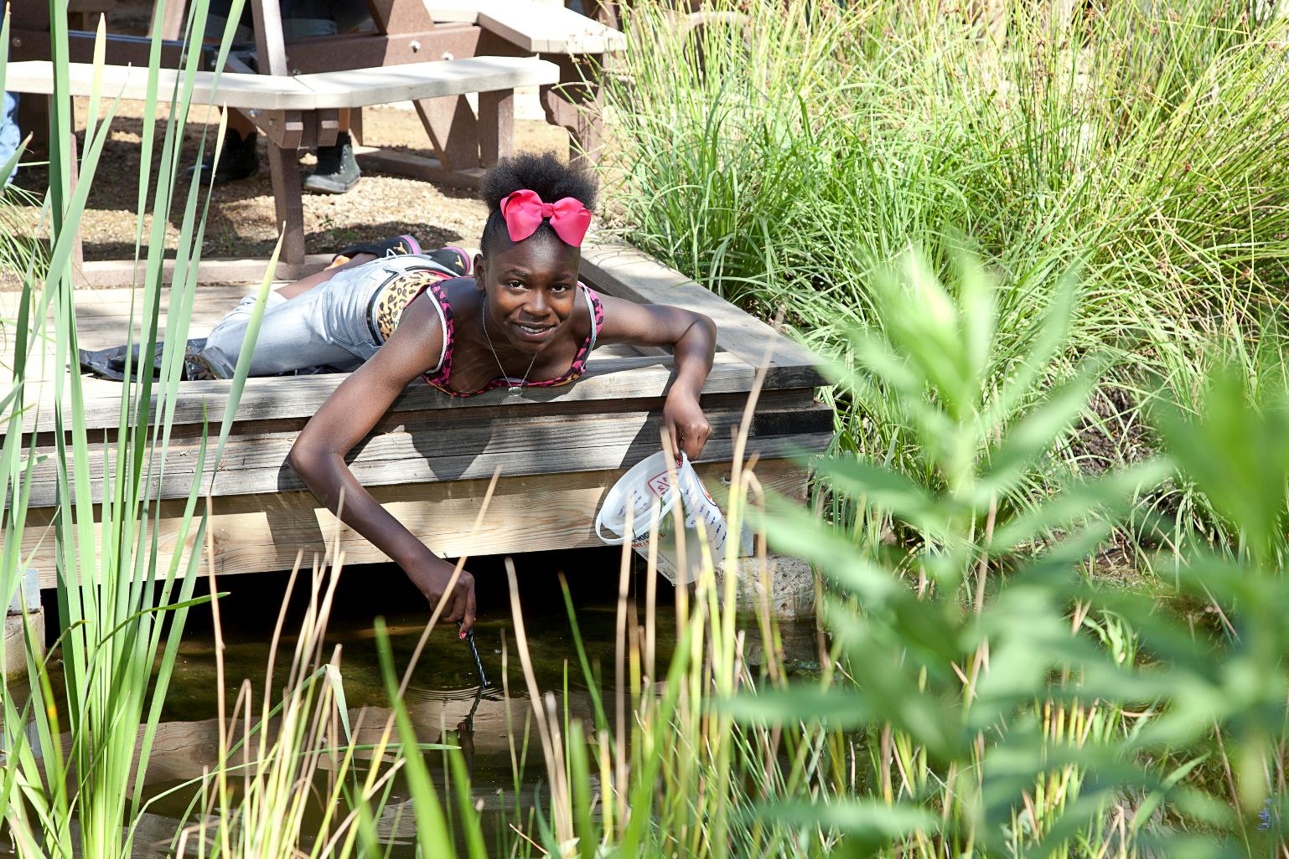

Slide 12
Arboretum Staff
Our staff has 214 full and part time staff.
Our horticulture managers and teachers are degreed in their field, unlike many other gardens.
Current full time staff demographics:
132 Female
85 White
7 African American
33 Hispanic
1 American Native
1 Asian
5 Two or More Races
82 Male
35 White
15 African American
29 Hispanic
1 Asian
2 Other or More Races

Slide 13
Our Senior Staff has an average tenure of 10 years which brings continuity and experience to the success of our garden.
Two of our Accounting Staff are members of Texas Society of Certified Public Accounts (TSCPA) and our Chief Financial Officer is a member of TSCPA sponsored Not-For-Profit Study Group.
Our Vice President of Horticulture serves on the board of the All America Selection Board of Directors, one of the oldest national trialing organizations.
One senior staff is a licensed architect.
One senior staff has served on the eleven member board of the American Public Garden Association and other staff have served as volunteers on its committees.

Slide 14
The Board of Directors: A Cross Section of Community Leaders
Our board officers and chairmen are composed of individuals with a sincere commitment to the Arboretum and to the City of Dallas and have expertise in specific fields, such as finance and accounting, corporate and business management, banking and investments, real estate, and community service and involvement.
They bring this expertise to our eight standing committees (Gardens and Grounds, Architecture and Construction, Finance, Education, Marketing, etc.) and 33 subcommittees.
Our Executive Committee of 22 members which handles the monthly oversight for the Board of Directors has 8 minority members, a significant increase over 2019
Male | Female | African American | Latino | Caucasian/Other
31 | 40 | 12 | 6 | 53

Slide 15
Our Future…By the Numbers
Net Operating Surplus represents the majority of our debt covenant compliance and is the next year’s debt service cash requirements

Slide 16
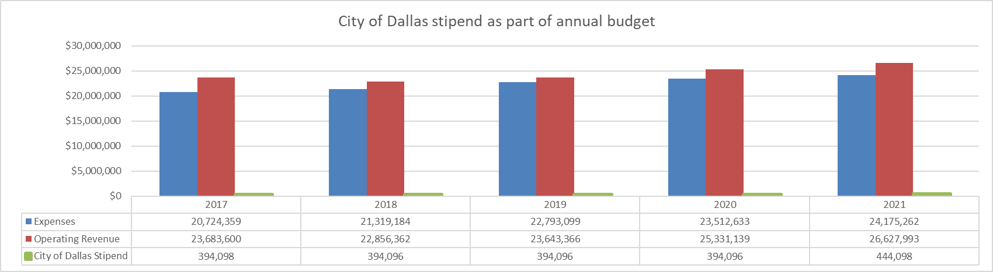
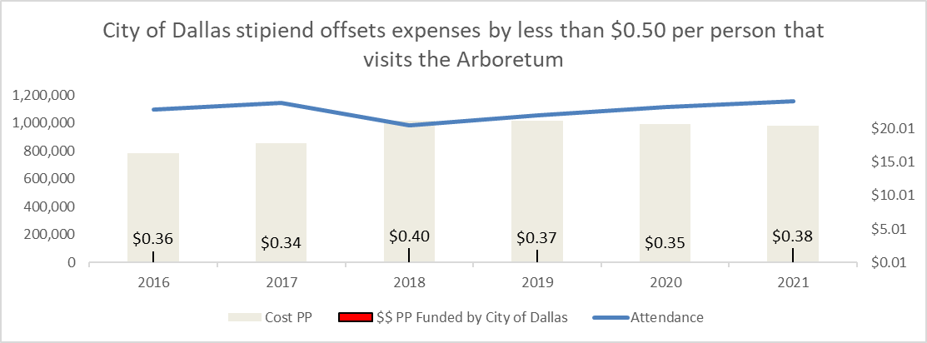
Our Future…By the Numbers
City of Dallas stipend as part of annual budget
Notes:
RB: The intent here is to show that the stipend has been flat and not moving with expenses.

Slide 17
The Visitor Experience
We consistently survey the visitors coming to the garden with a compilation of results by Texas Instruments. You will see extremely strong results in their satisfaction with the experience in their interest in returning again.
For over eight years, Trip Advisor has listed us among the top five places to visit in Dallas as rated by others. The Arboretum has been number one for almost every week of this period.
Notes:
From Charlotte

Slide 18

Annual Visitor’s Survey Satisfaction Ratings

Slide 19
National and International Acclaim
In a city that says all the time it wants its institutions not just its architectural structures to become world class - quietly, the Dallas Arboretum has achieved that status on the shores of White Rock Lake.
MSN has named the Arboretum in the past on its website as one of the ten things you must see in America in the Spring. It has also been named as one of the fourteen gardens you must see in the world during the same time frame. (Other accolades are attached.)
In 2010 the Arboretum was the host to the national convention of Garden Writers of America and to the National Convention of the American Public Garden Association.

Slide 20
In 2013, the Arboretum hosted the directors of large gardens of the APGA national conference.
Its education program has won the highest Award given to a botanic garden in a year from the American Public Garden Association, its Program Excellence Award
The Arboretum is the recognized public garden leader in the world in the testing of warm weather annuals through its plant trail program. Our staff has been invited to Israel and locations around the world to discuss these findings.
Every year the Arboretum brings in distinctive exhibits including touring exhibits such as the great Chihuly exhibit in 2012, ZimSculpt and the Gary Lee Price Sculptures to name a few, and the permanent seasonal displays like the 12 Days of Christmas and the Pauline and Austin Neuhoff Christmas Village.

Slide 21
Reviews and Accolades
One of 29 Best Fall Festivals and Fairs Across the United States- Country Living Magazine 2019
8 Pumpkin Displays You Have to See to Believe- Better Homes and Garden
The World’s Most Beautiful Garden, MSN
Best Places to See Cherry Blossoms in the U.S., National Geographic, April 2019
10 Best Ways to Celebrate Dallas in Fall- USA Today 10 Best 2018
25 Best Fall Festivals to Celebrate the Season, Country Living, September 2018
Named “Favorite Ceremony Site” by American Association of Wedding Planners, February 2018
One of the South’s Best Botanical Gardens, Southern Living Magazine, March 2017
Top Botanical Garden, USA Today 10Best 2017
Trip Advisor Certificate of Excellence, June 2017
#1 of 19 Trips to Put on Your Fall Bucket List - Orbitz.com,
September 2016

Slide 22
Top 10 U.S. Pumpkin Patches- The Travel Channel, September 2016
15 Breathtaking Botanical Gardens to Visit This Season - Architectural Digest, July 2016
Place to Visit in the 14 Most Memorable Cities from The Bachelor
- Expedia.com, July 2016
Number One Most Romantic Thing to Do in Dallas
- USA Today 10 Best
Best Botanical Gardens and The Best Floral Festivals
- USA Today's 10 Best, 2016
Top Botanical Gardens in the US Worth Traveling For - TripAdvisor, 2016

Slide 23
Completed Capital Projects 2019
Pauline and Austin Neuhoff Family Christmas Village
Tom and Phyllis McCasland Greenhouse
DeGolyer Tea Room Renovation
DeGolyer Roof Project- Funded by City Bond Money
DeGolyer restroom renovation- Funded by the SCP Foundation
Jan Late McMillan Family Entrance at the Camp House

Slide 24
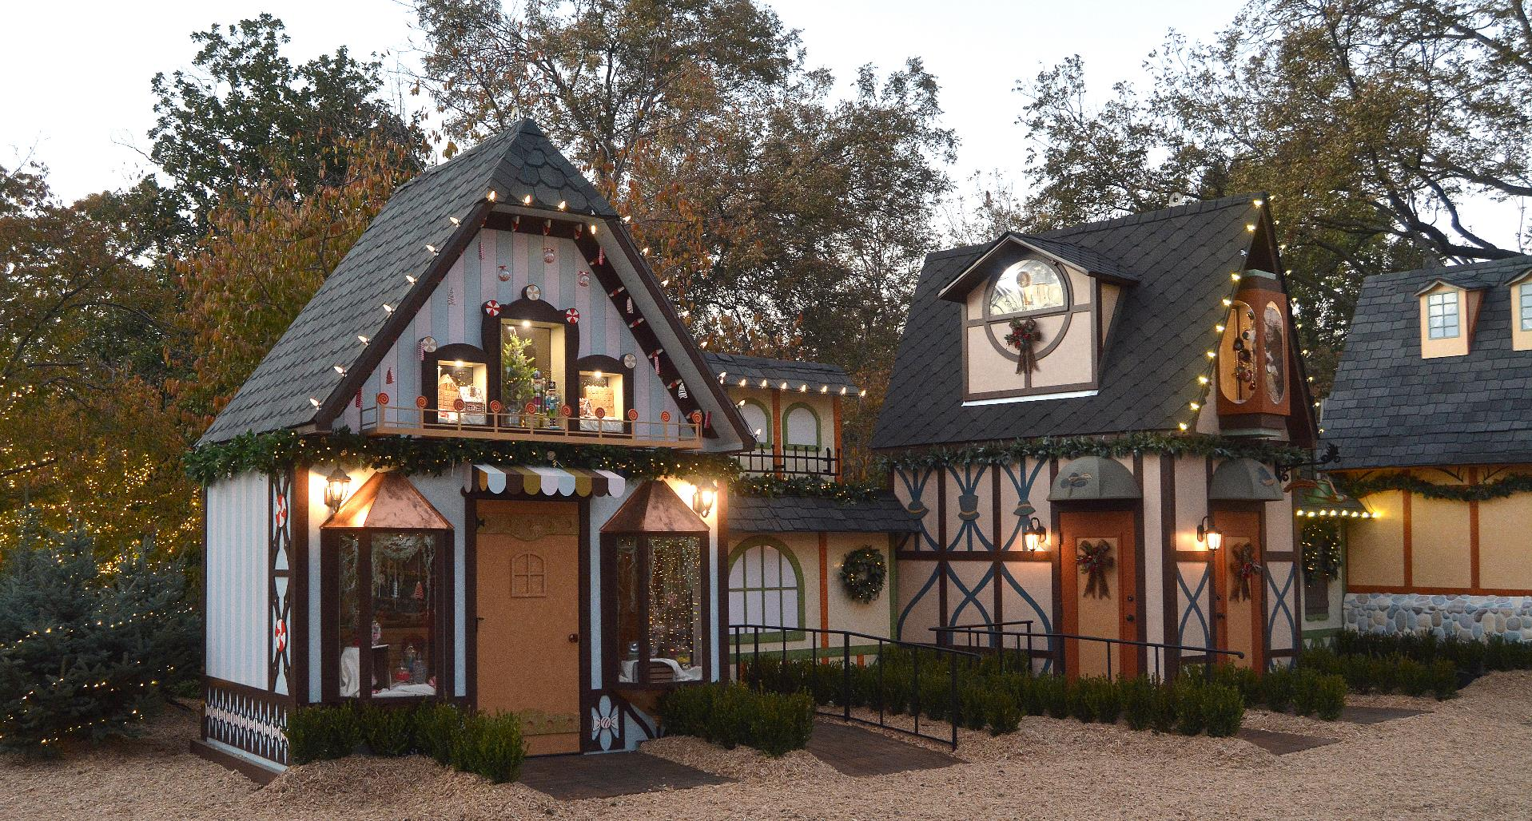

Slide 25
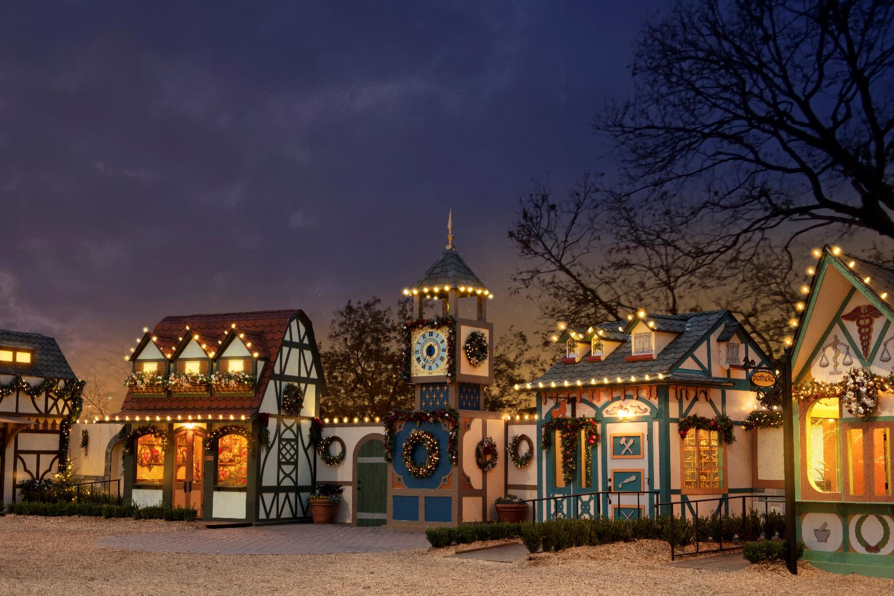

Slide 26
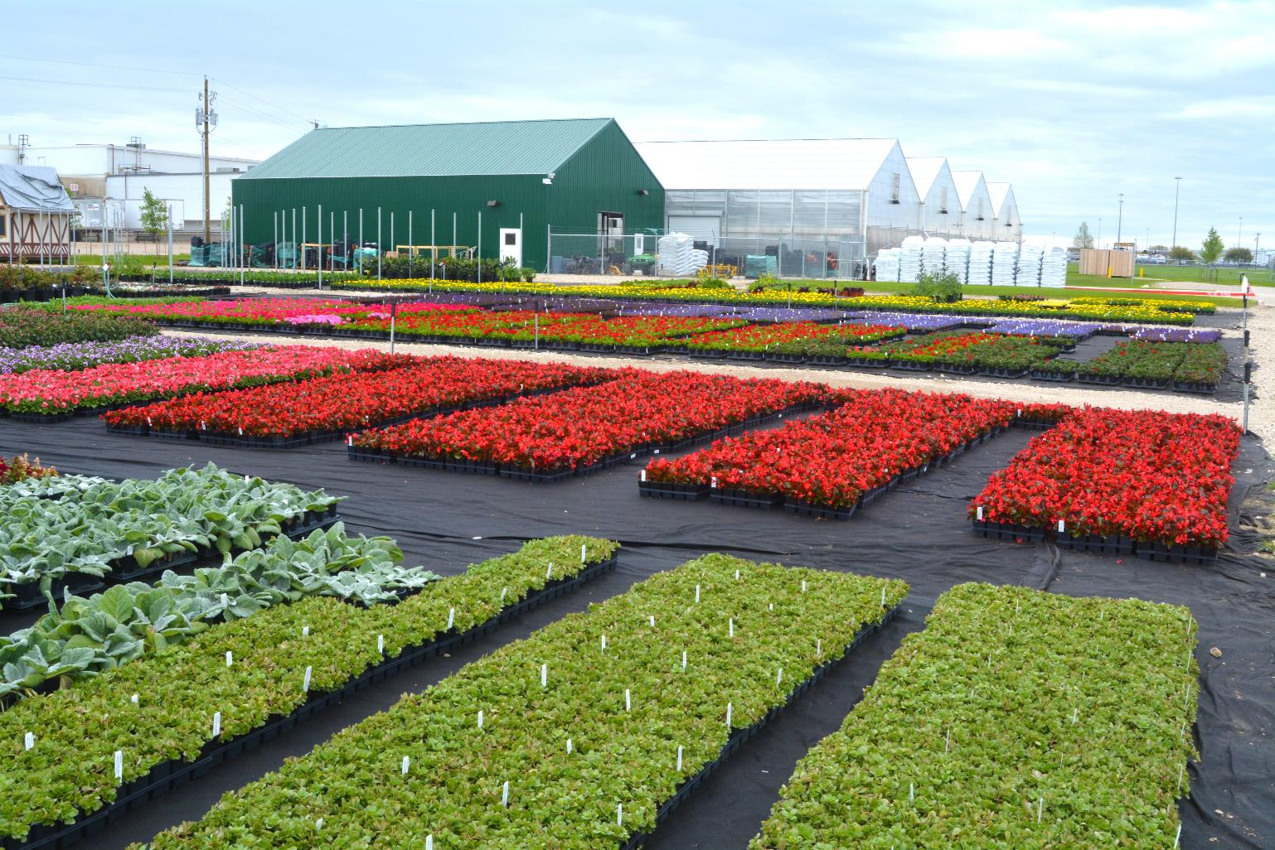

Slide 27
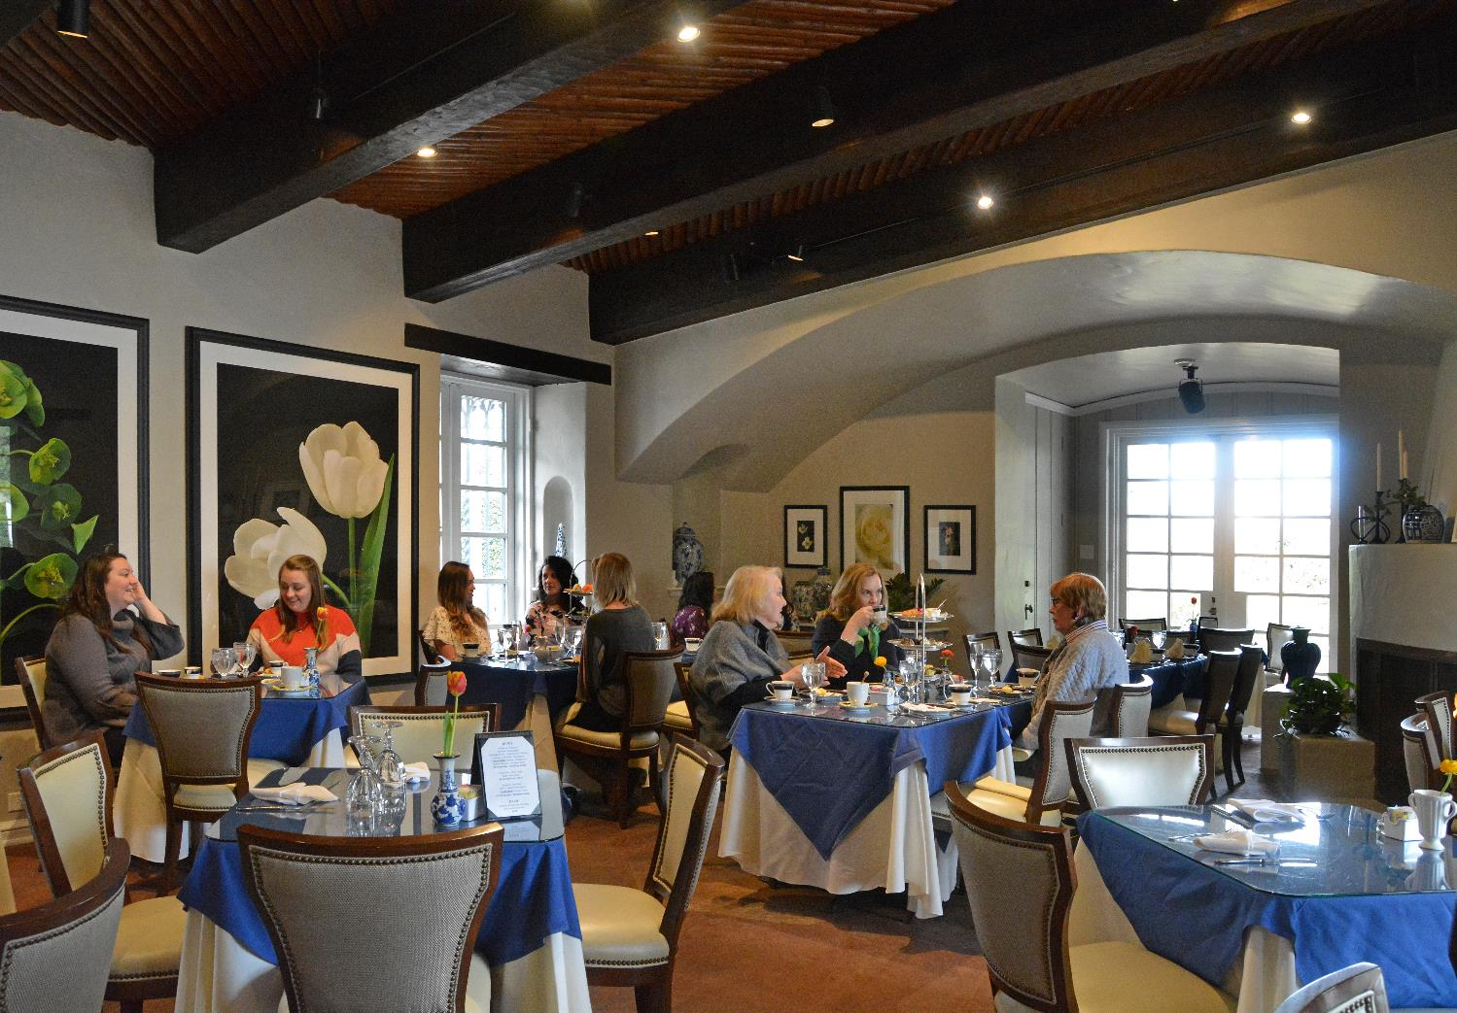

Slide 28
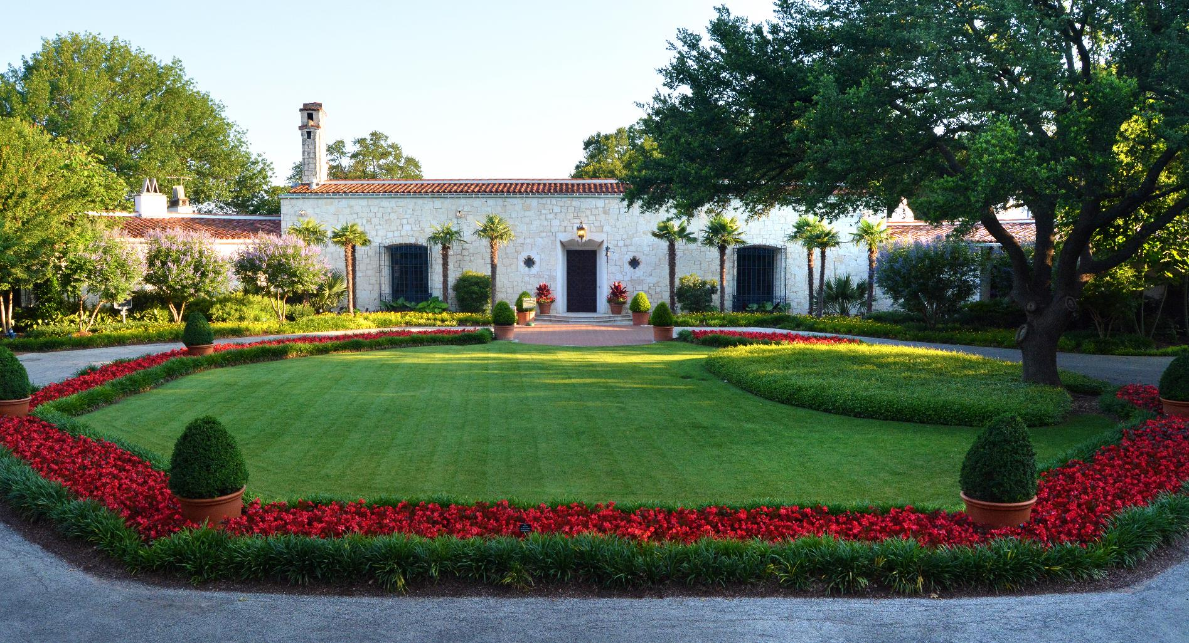

Slide 29
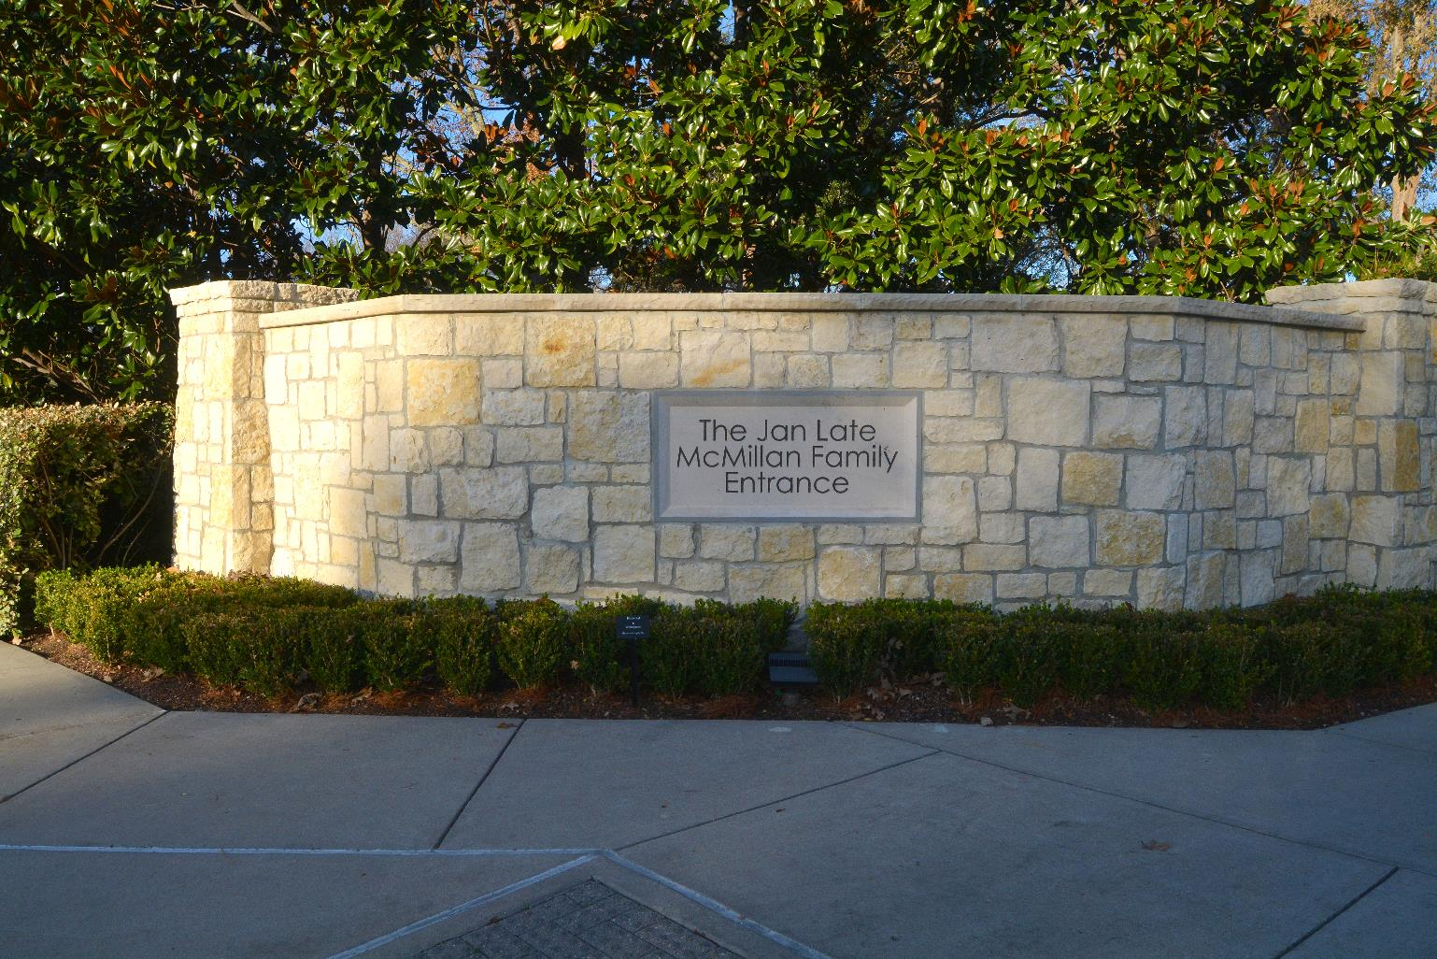

Slide 30
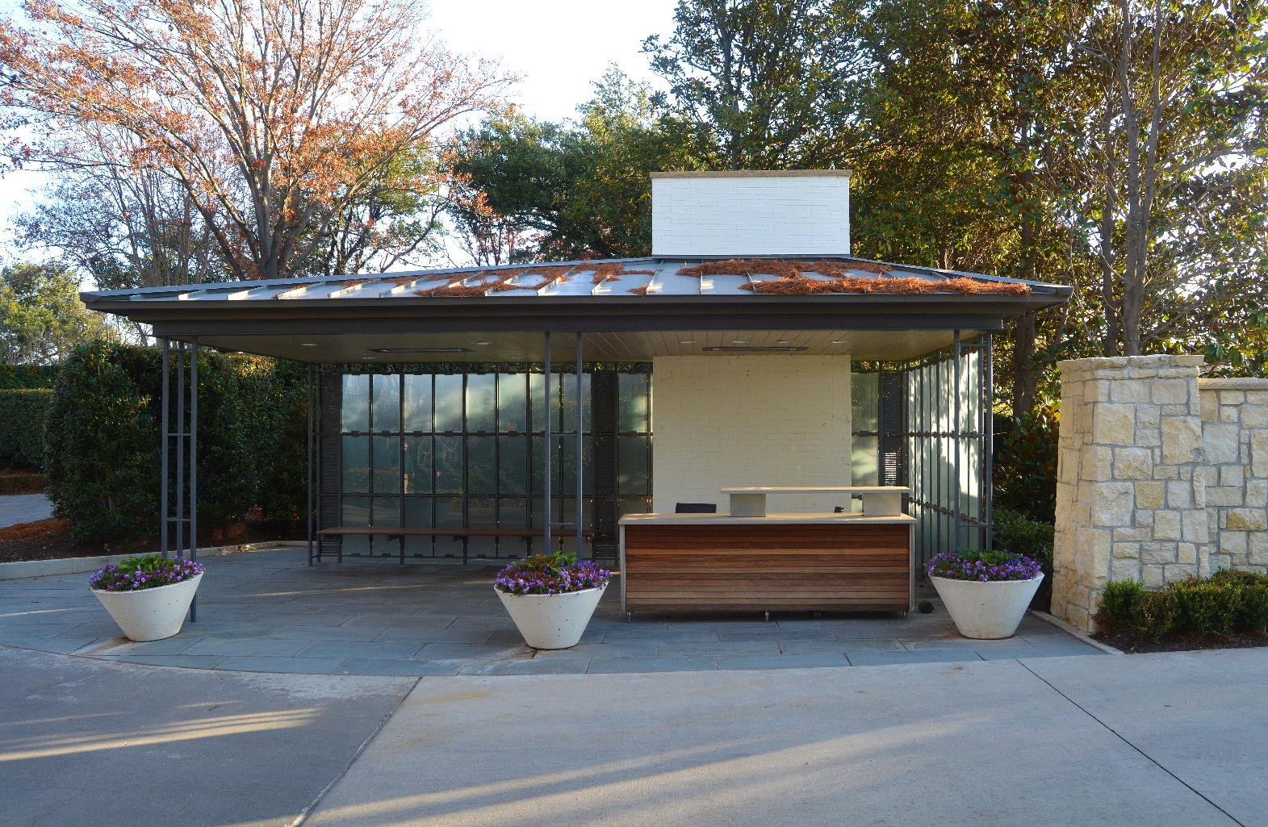

Slide 31
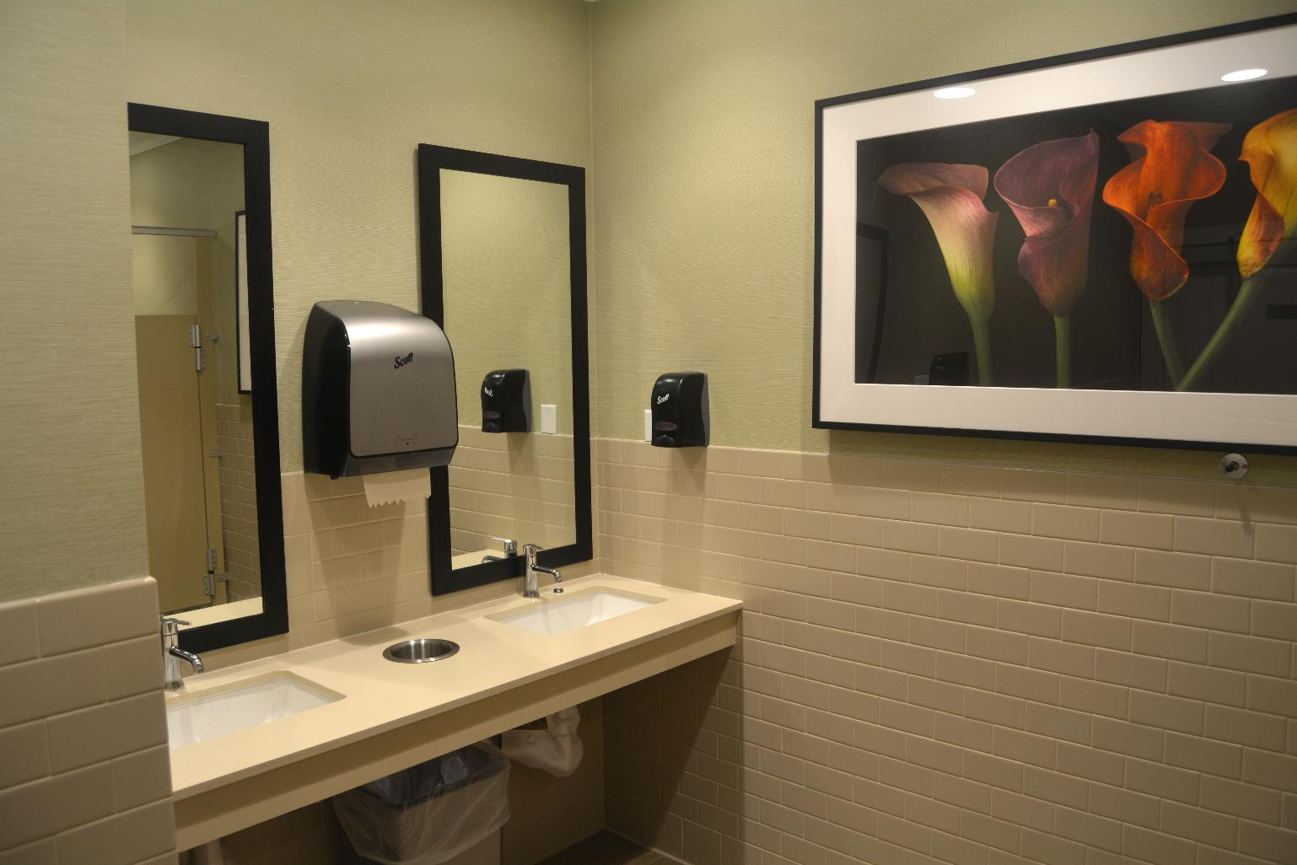

Slide 32
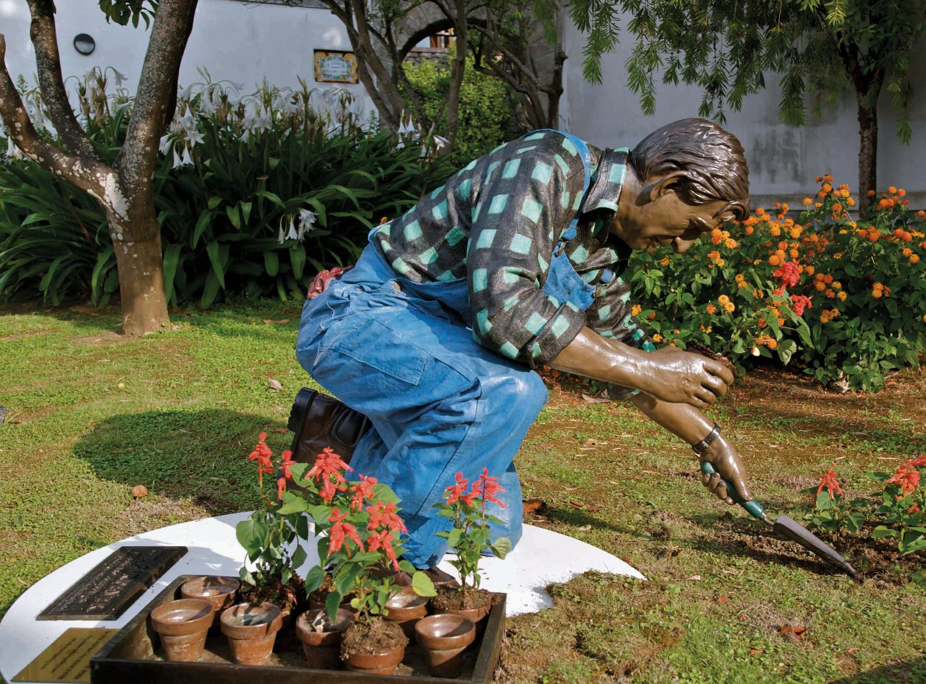
Summer 2020 Exhibit- Seward Johnson, Celebrating the Familiar

Slide 33
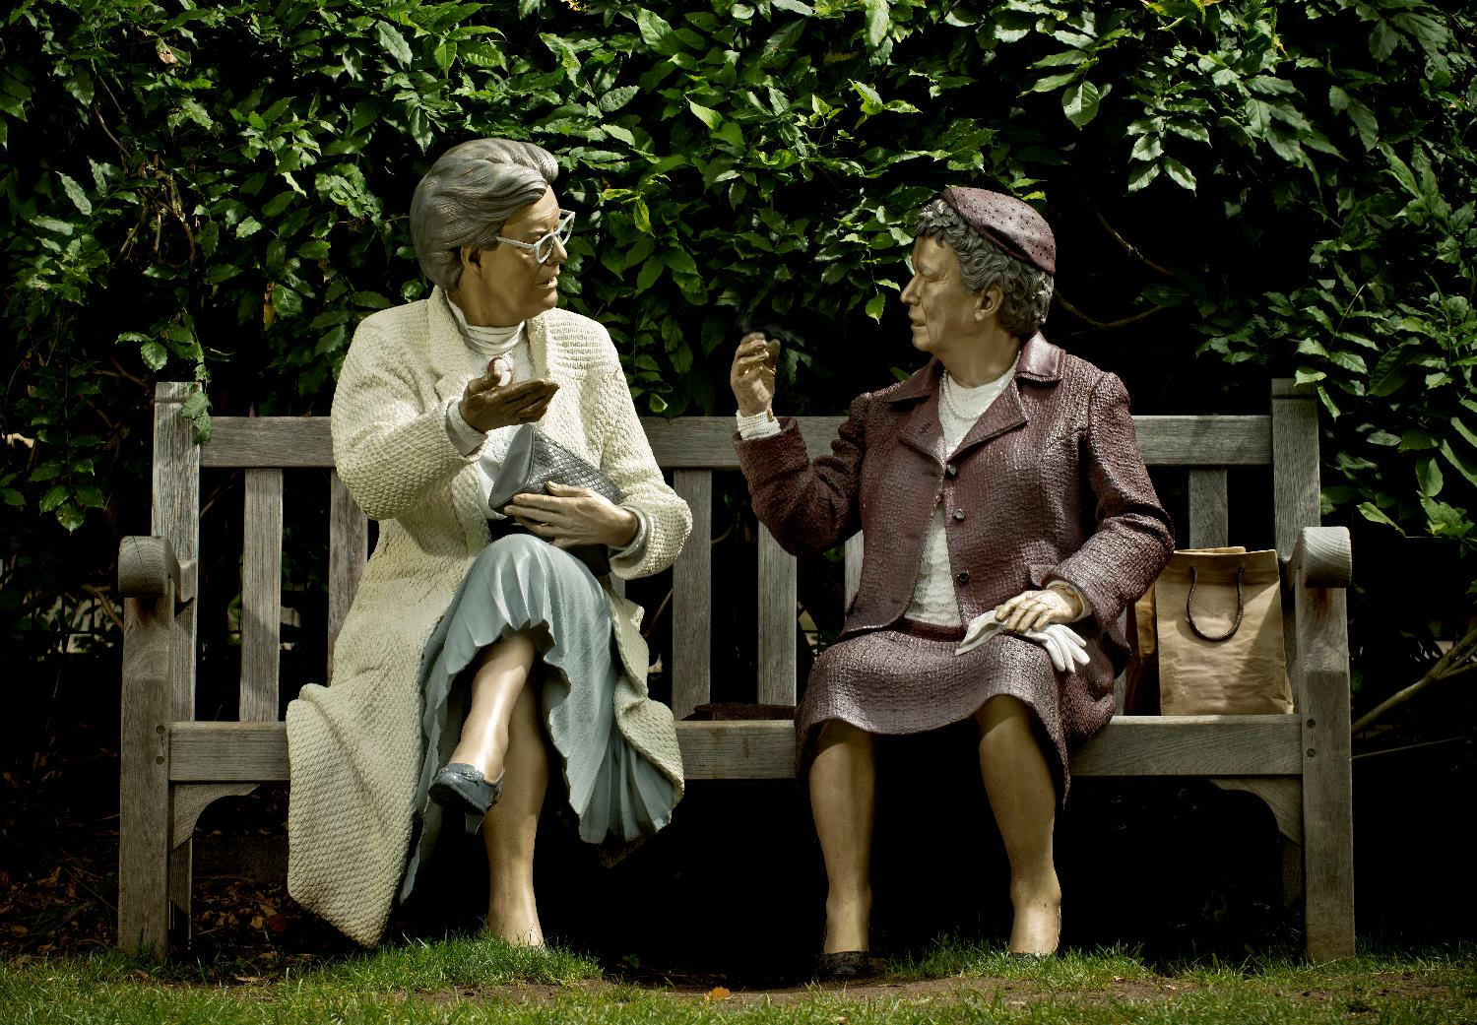

Slide 34
Future Capital Projects
Donor Funded Projects:
The Gallery Garden –Promontory and Gardens Overlooking the Lake.
A Circular Outer Tram Path with Storm Water Retention
The Garden Education Center for the Children’s Garden
Another Pocket Garden near the Camp House
The Indian Court Yard Renovation
Shadow Garden Pavilion
Paseo Redesign and Tram Path Extension and Enhancement
HVAC upgrades in the DeGolyer kitchen to be complete January 2020 –
funded by city bond money

Slide 35
Our Future Looks Bright
We are continually working on visitor satisfaction. 98% of our visitorship has rated their experience as very good or excellent and our members are one percent higher at 99%.
Our role as staff is to serve as stewards, holding to our mission and standards and building the garden to the completion of the adopted Master Plan.
We look forward to seeing you in the garden!

Slide 36
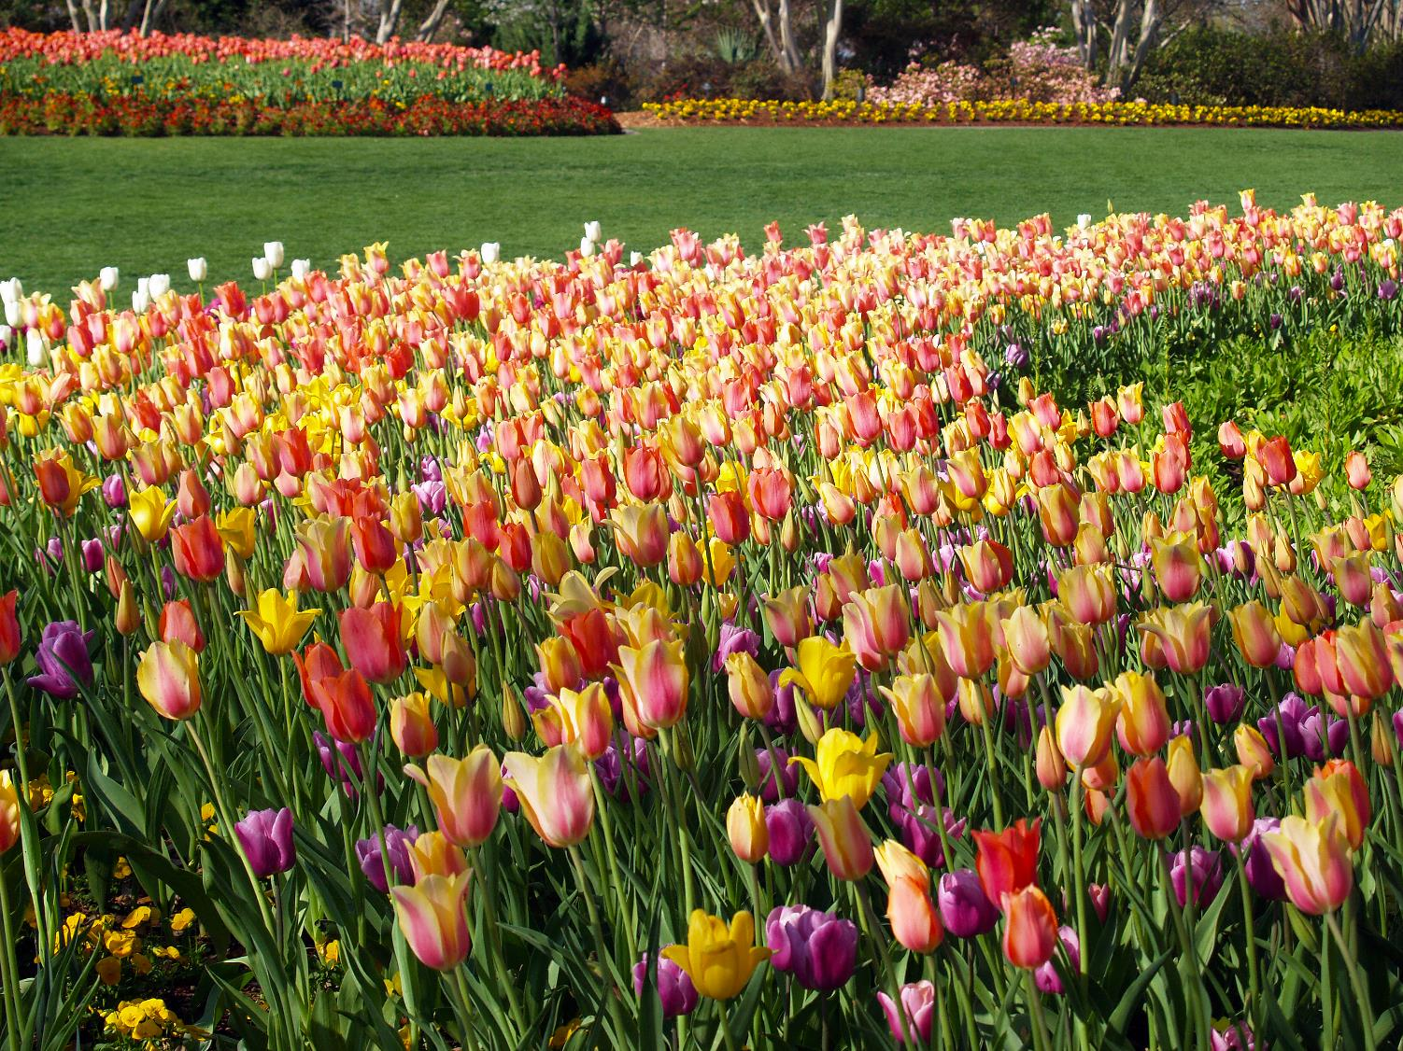
The Jonsson Color Garden

Slide 37
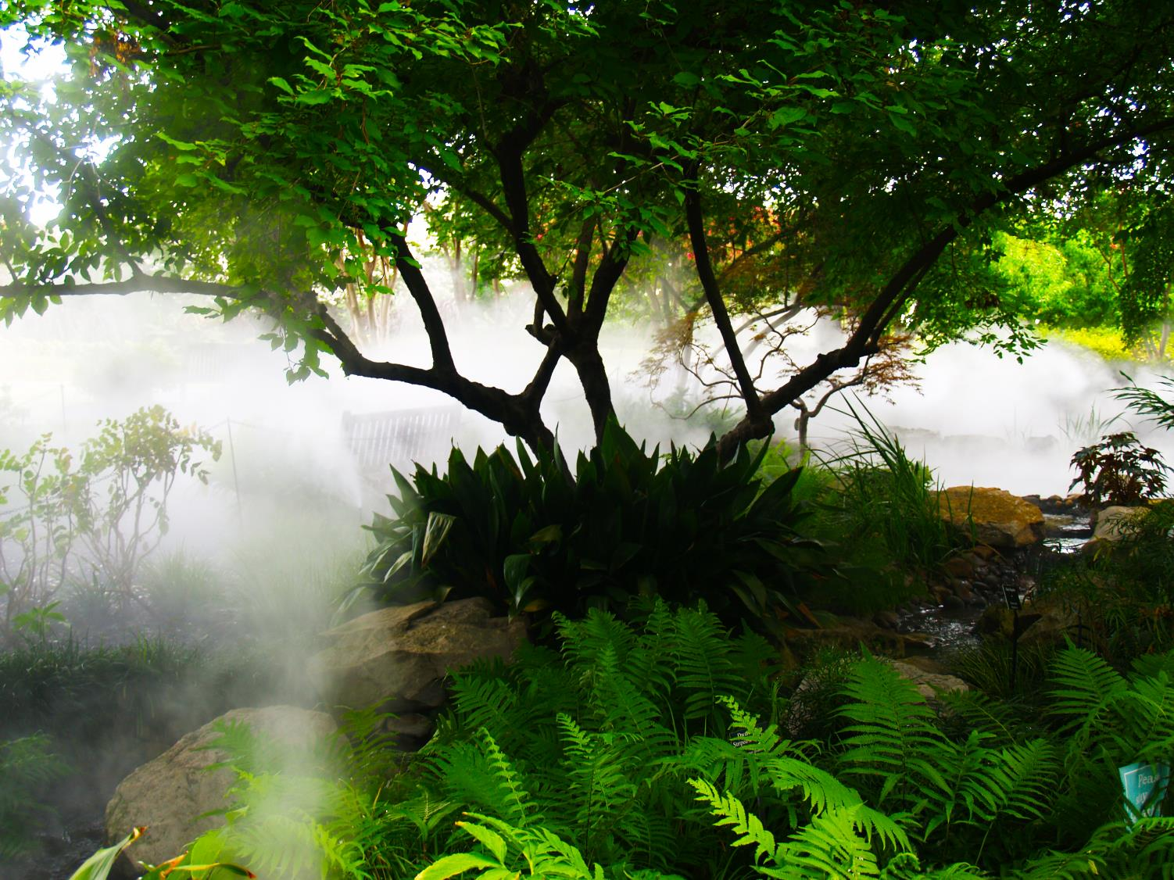
The Palmer Fern Dell

Slide 38
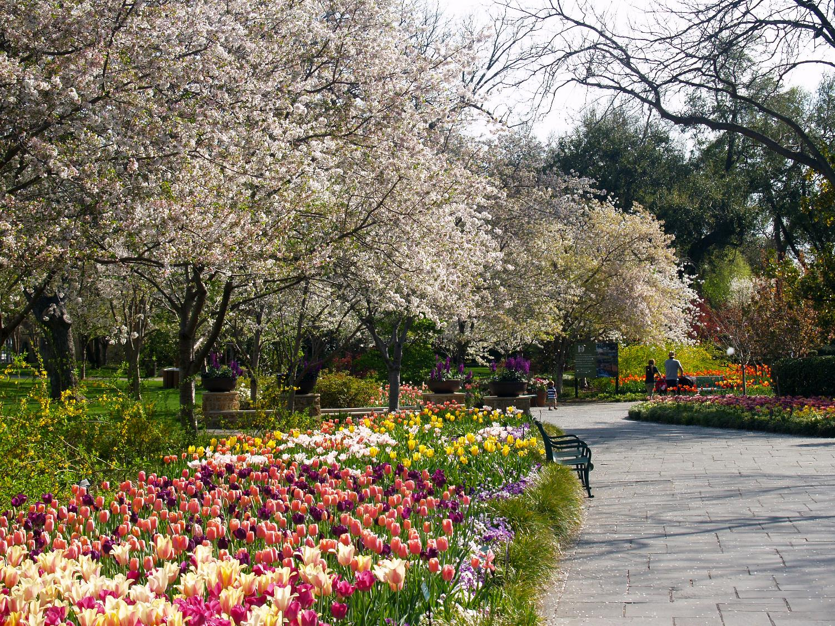
The Paseo de Flores

Slide 39
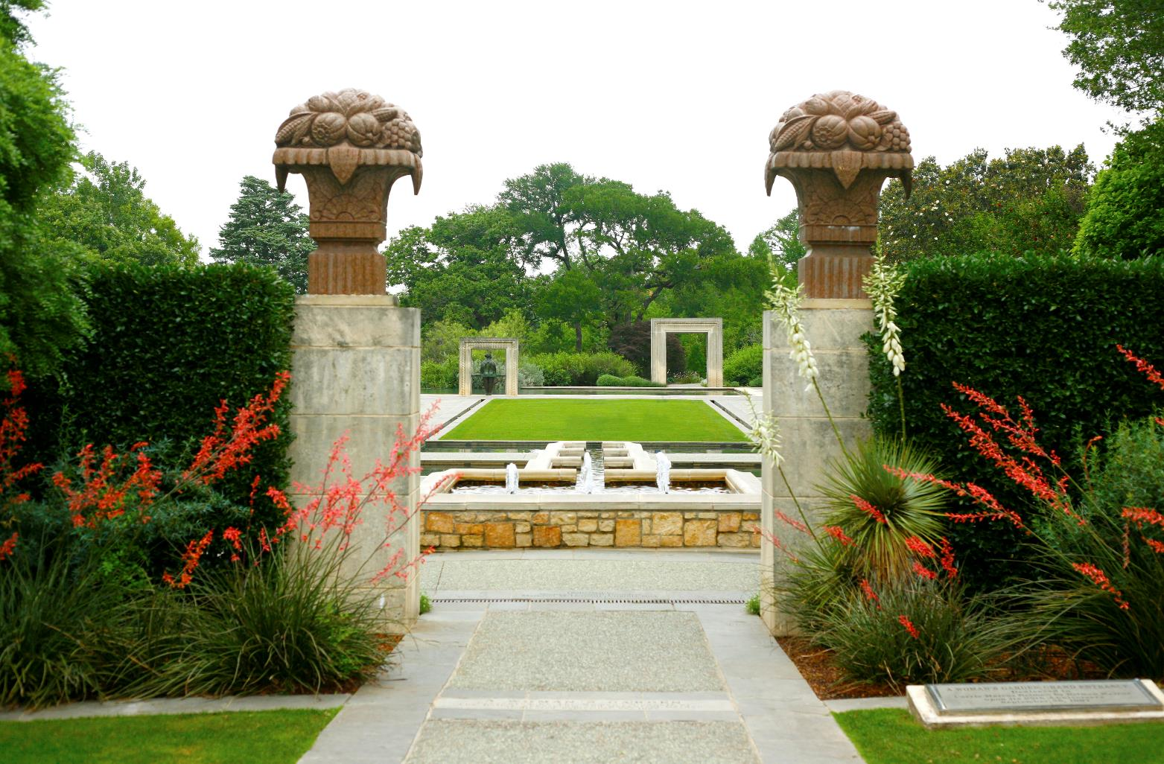
A Woman’s Garden Phase One

Slide 40
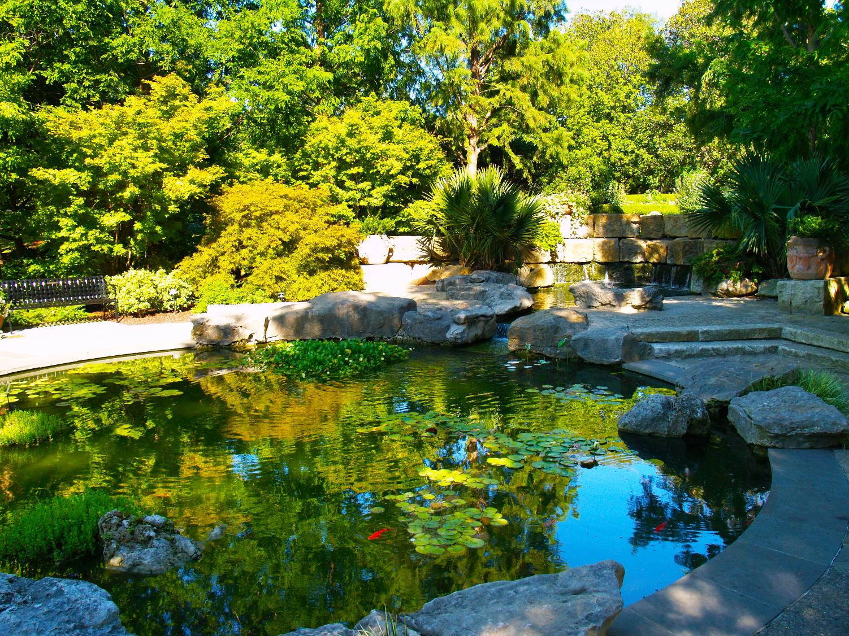
A Woman’s Garden Phase Two

Slide 41
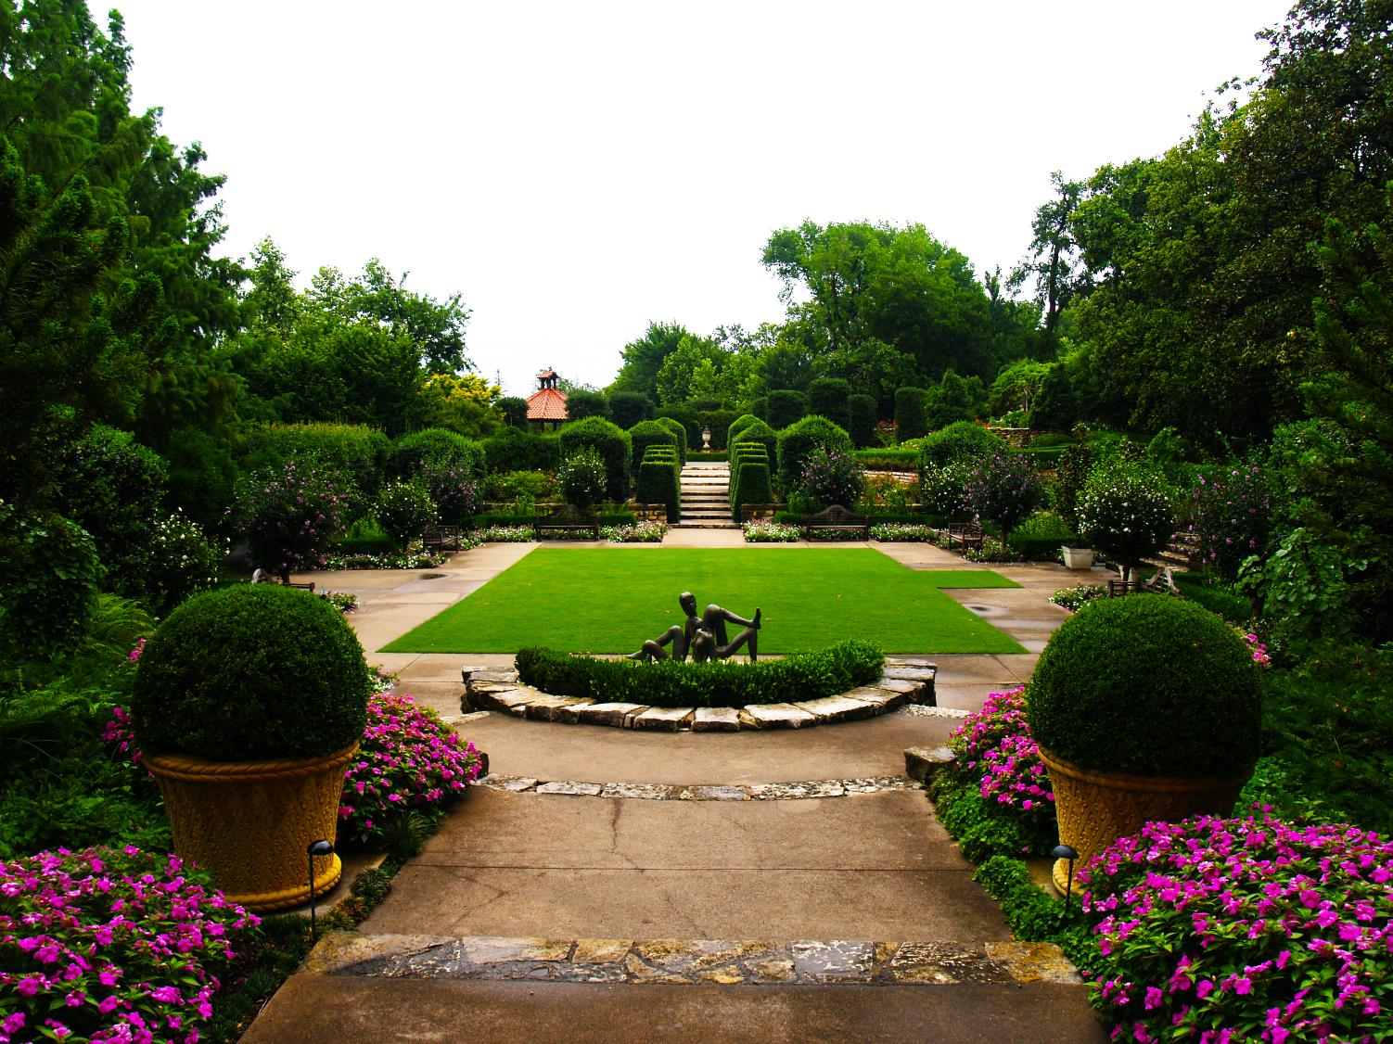
The McCasland Sunken Garden

Slide 42
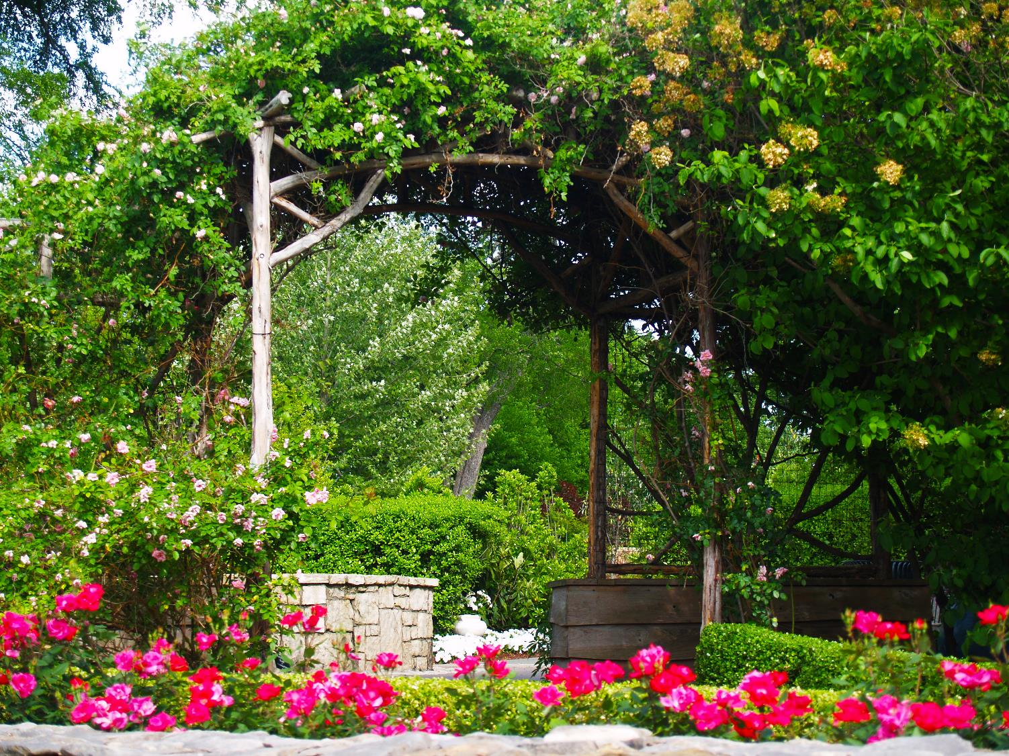
The Boswell Family Garden

Slide 43
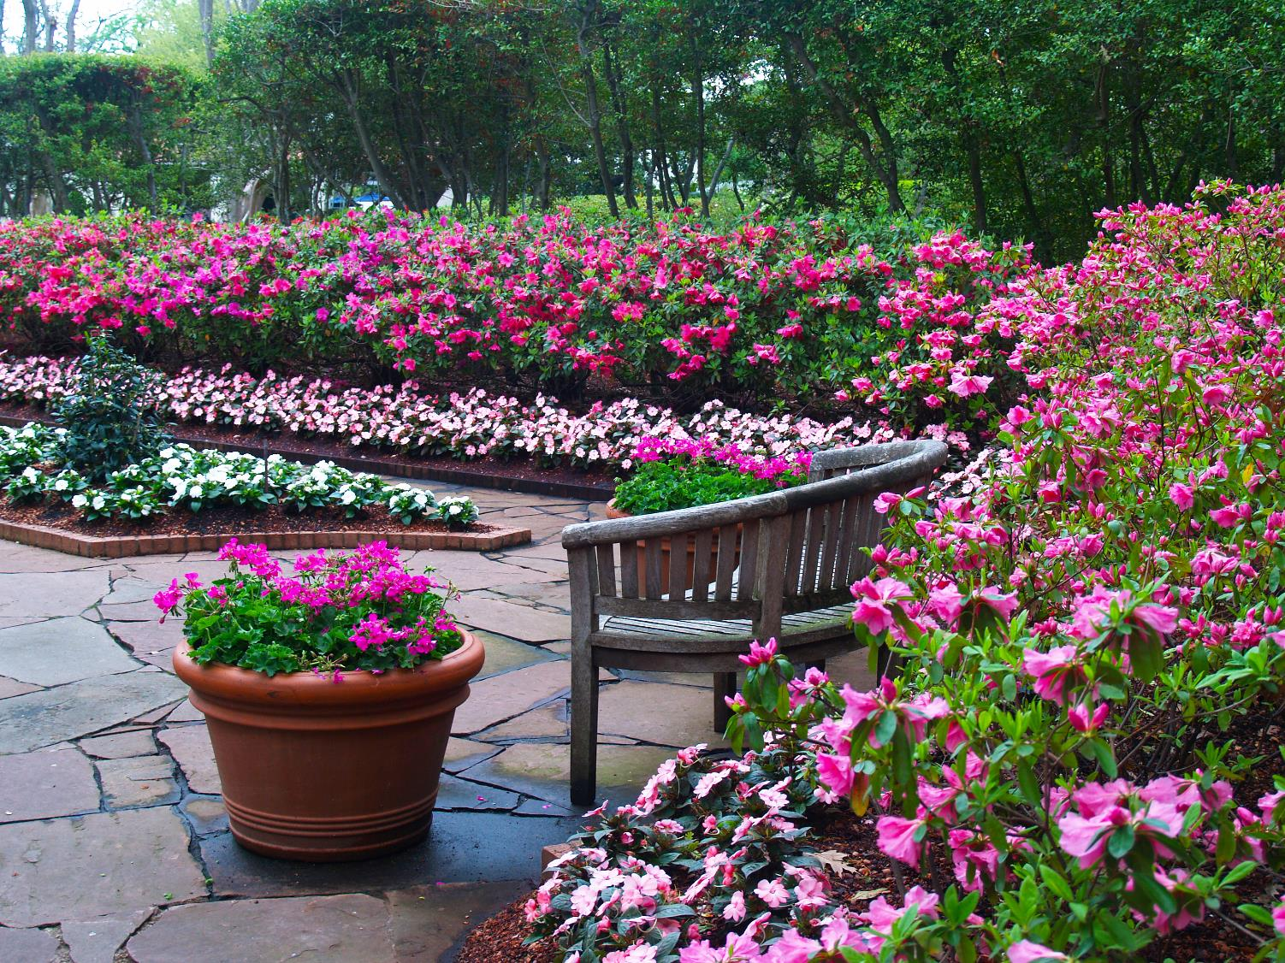
Nancy’s Garden

Slide 44
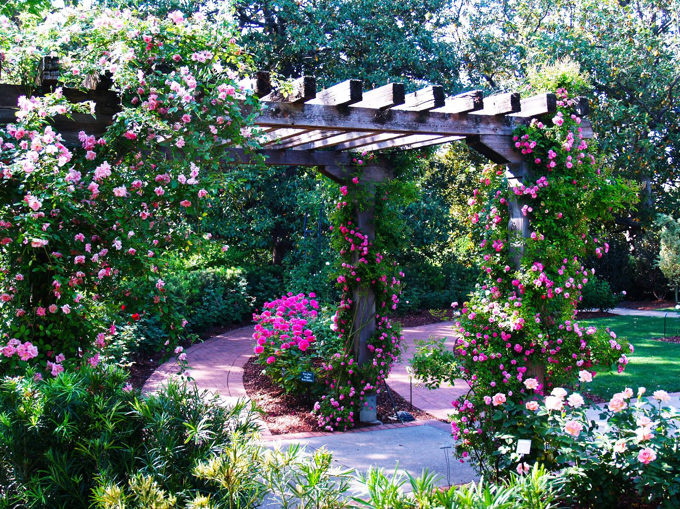
The Rose Mary Haggar Rose Garden

Slide 45
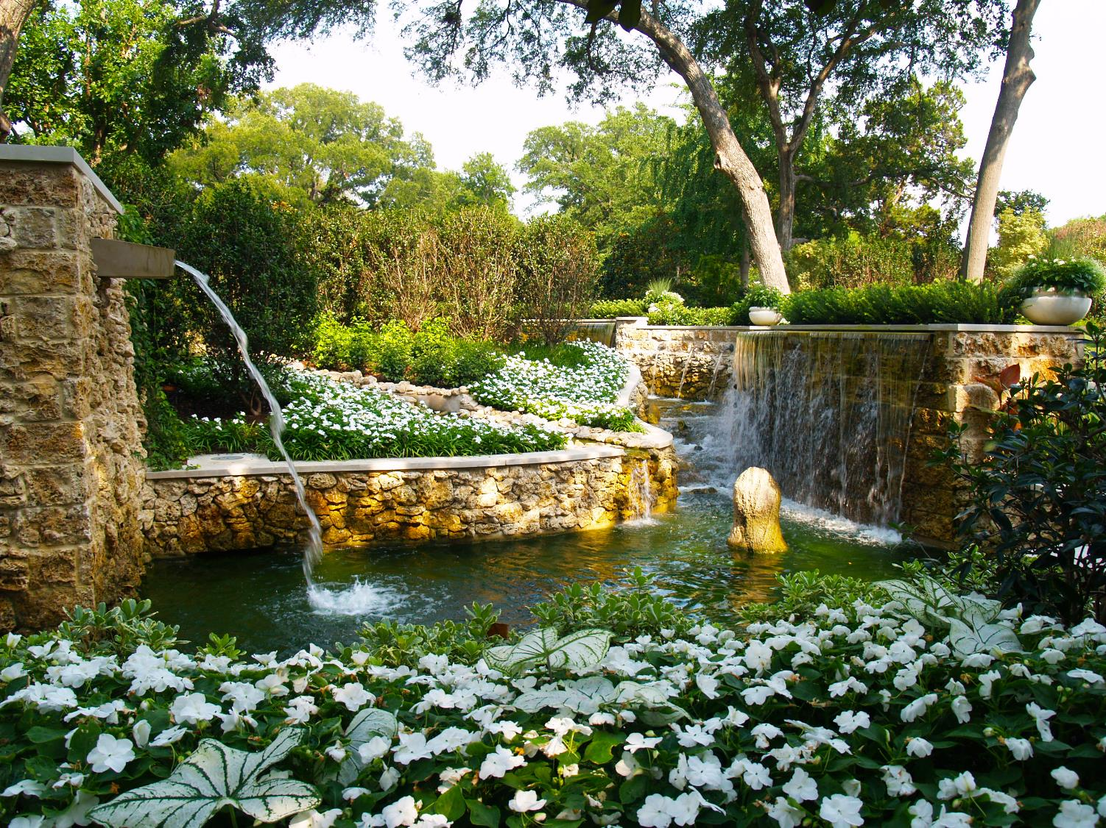
The Nancy Clements Seay Magnolia Glade

Slide 46
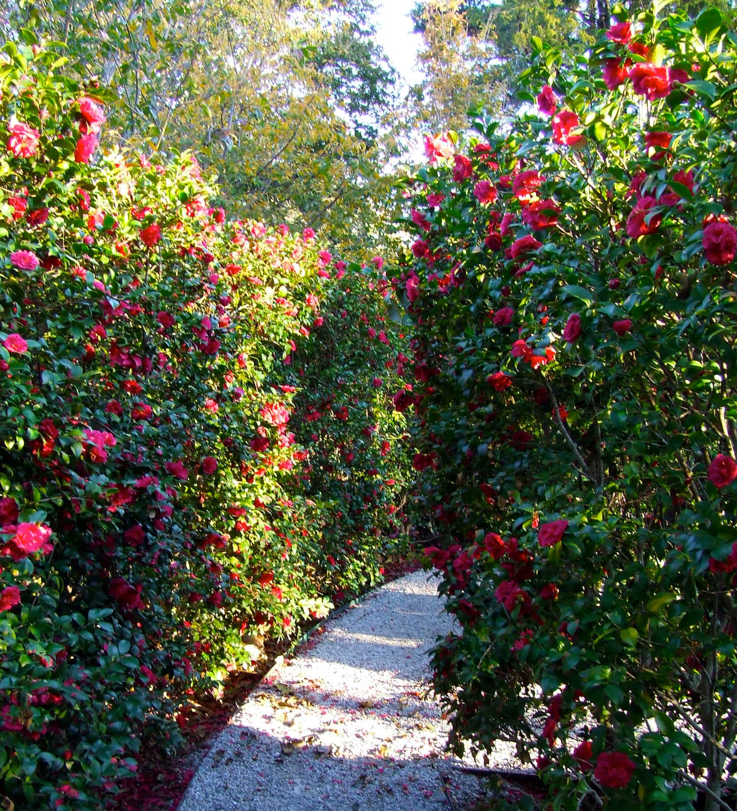
The Martha Brooks Camellia Garden

Slide 47
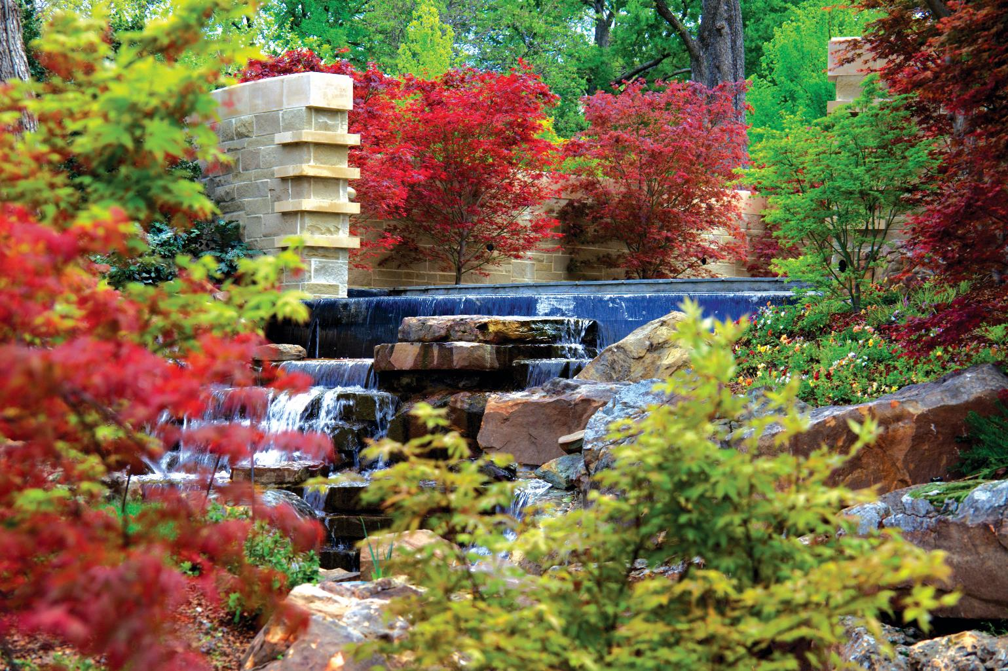
The Nancy Rutchik Red Maple Rill

Slide 48
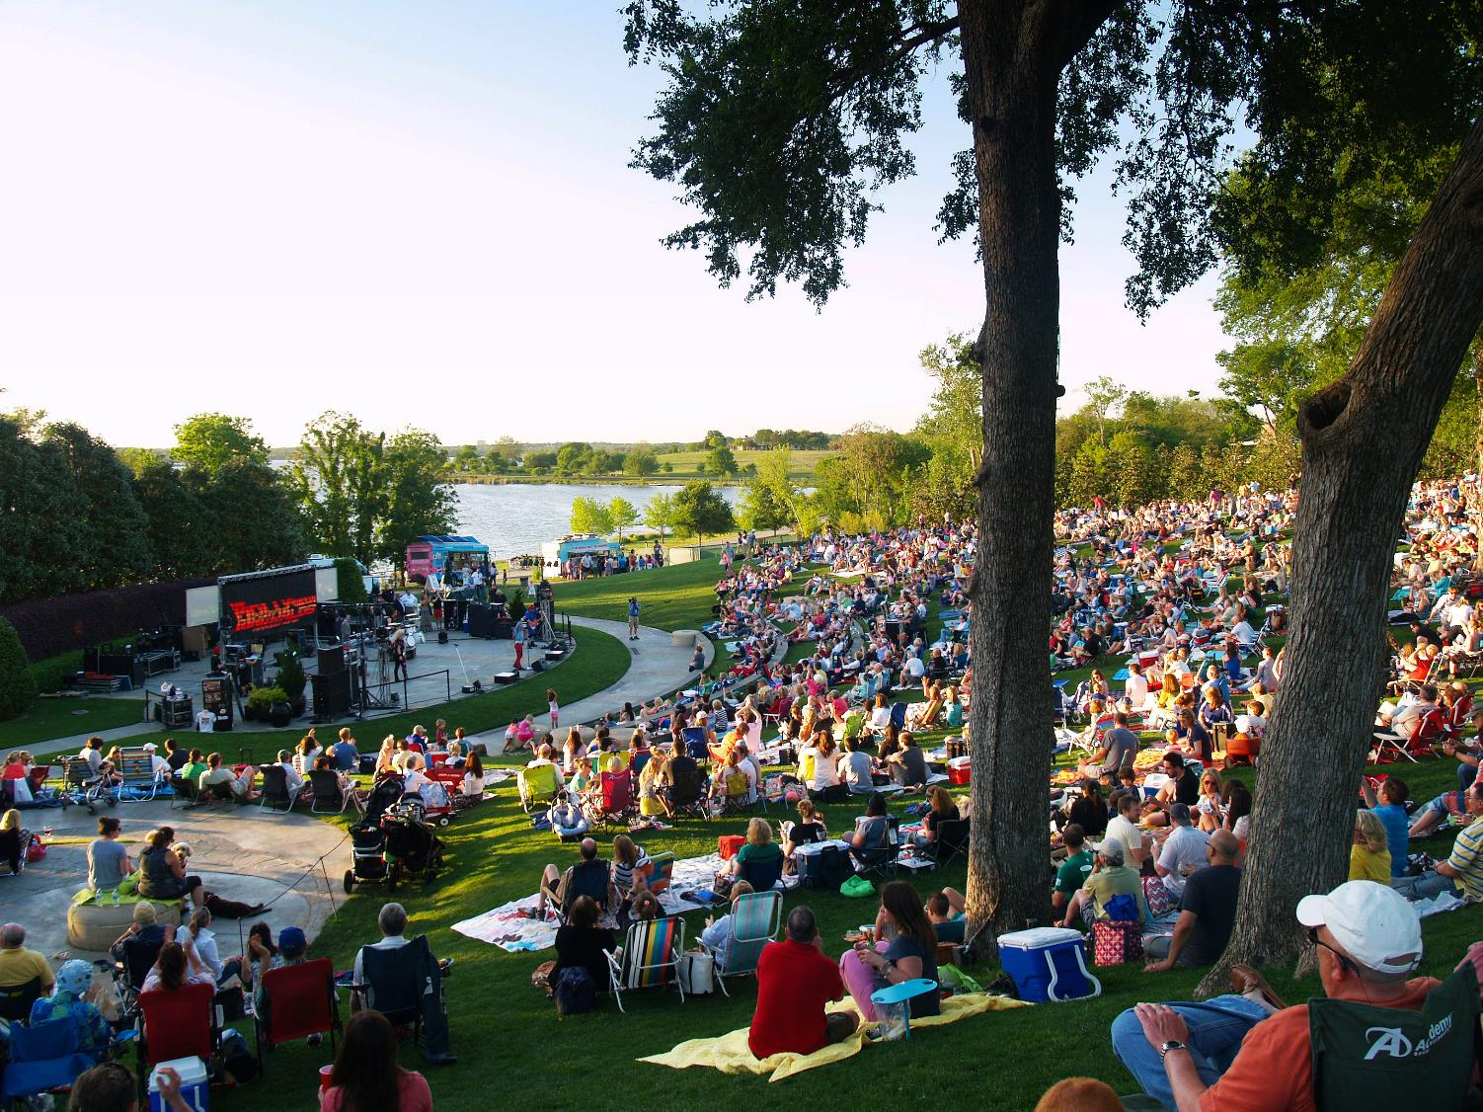
The Martin Rutchik Concert Stage and Lawn

Slide 49
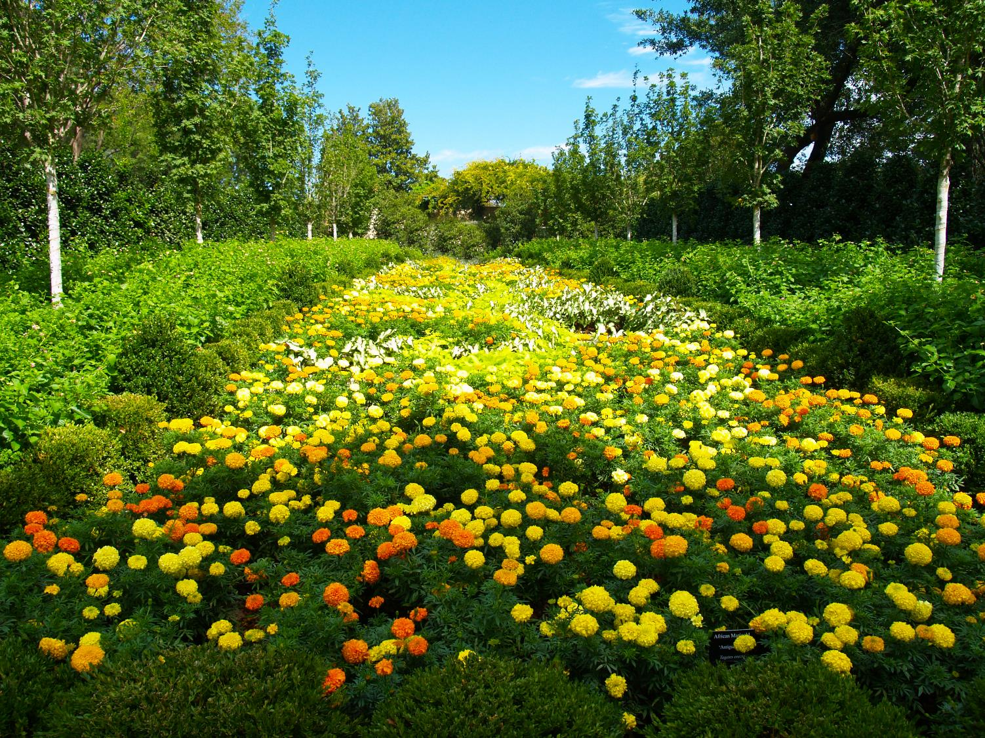
The Lay Family Garden

Slide 50
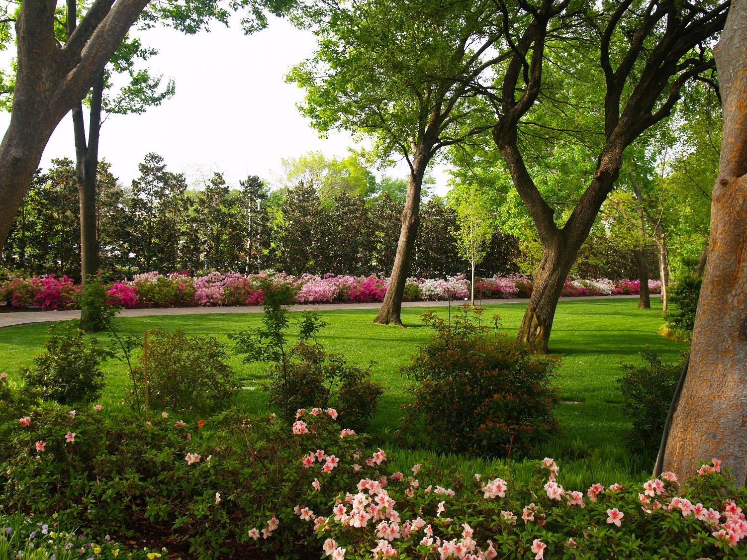
The Henry Lindsley Shadow Garden

Slide 51
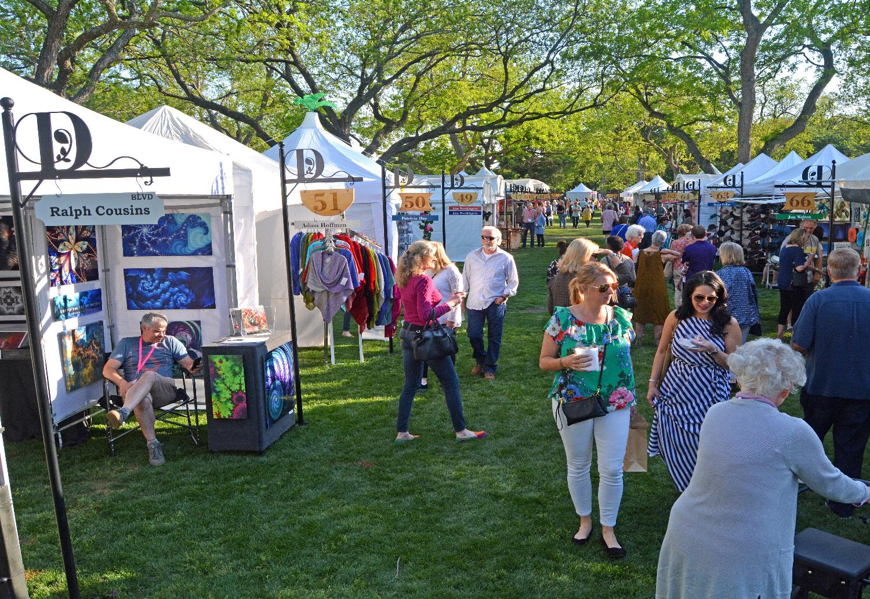
Artscape, Fine Art Show and Sale

