Slide 1

FORT WORTH HOUSING SOLUTIONS’
APPROACH TO AFFORDABLE AND SUSTAINABLE COMMUNITIES
What It Takes for Successful Affordable Housing IN 2016
TERRI ATTAWAY, BOARD CHAIRPERSON – Fort Worth HousinG SOLUTIONS

Slide 2
Fort Worth Housing Solutions
Created in 1938
  Public Housing
    1939 - Ripley Arnold (252 units)
    1940 - Butler Place Apartments (250 units) built in 1940 for minority families onl
    1949 - J. A. Cavile Place (244 units) built in 1949
    Additional low-income public housing built or acquired through the 1980’s
Since 2000:
  Has sold or converted nearly 1,000 Public Housing units and leveraged them to acquire, rehabilitate, and/or develop over 3,500 mixed-income units
  Now owns nearly twenty-five multi-family properties (public housing, LIHTC, and market rate units), with two under construction, eight in the development/ acquisition pipeline, and approximately ten additional to be planned by 2018

Slide 3
Decent housing as a public necessity must be realized and the combined efforts of all people must be put to the task of finding means of supplying safe and sanitary dwellings for every family in the City.
Homer L. Hunter
FWHS Executive Director, 1938

Slide 4
Elements of a Sound Affordable Housing Strategy
1.
LOCAL GOALS
2.
SUPPORTIVE REGULATIONS
3.
RESOURCE & ACTION ALIGNMENT
4.
COMMUNITY BUY-IN

Slide 5
1. Local Goals
Should be based on current accurate need and inventory
  FWHS works closely with the City of Fort Worth (CoFW) to identify areas of need for:
    New multi-family housing
    Revitalization
    Acquisition/ rehabilitation
  FWHS and the CoFW regularly track affordable units and locations of voucher holders
Notes:
A good affordable housing strategy has to be specific to your location and needs. There is no one size fits all template. Rather, a sound strategy has to be based on what your specific area needs and has the capacity to support. You can’t take a plan from New York and use it in Fort Worth, or vice versa. So any plan should be based on accurate and up to date data, research and demographic information for your specific market.
FWHS and the City of Fort Worth regularly track and share data on things like where our voucher holders are living, where rental units are being built, where jobs and educational opportunities are flourishing, where different income levels are residing, etc.

Slide 6
Notes:
Here is a sample of some information the City tracks on income distribution of renters in Fort Worth, and the breakdown of the affordable housing units in Fort Worth. This type of data is regularly shared.

Slide 7
1. Local Goals
Should support diversification and deconcentration
  FWHS’ model is:
    Typically, no more than 20% of units in a property are targeted to families earning at or below 30% of the area median income (AMI)
    The balance of units are targeted towards families earning up to 80% of the AMI
      Is reviewed and can be changed on a site by site basis as necessary
    Units should be spread throughout Fort Worth
      Consider distribution per council district
      Ensure high opportunity areas are represented
Notes:
For FWHS, we believe that a sustainable affordable housing plan has to include deconcentrating pockets of very low income housing units (such as public housing) into mixed income developments. We also believe that you should not oversaturate any one area or market with any one type of housing, and work very closely with each of the City Council districts to look at the current affordable housing stock in their areas, where there is a glut, and where there is a need. We also look at the areas where the affordable housing opportunities are lacking, and plan for providing housing opportunities in those areas (typically higher income areas). Realistically, we can’t build everywhere because things like the cost of land are prohibitive, but we do build in very diverse neighborhoods.

Slide 8
Notes:
Here is a map showing where our current properties and properties under construction are located. We have affordable housing properties in every district in Fort Worth.

Slide 9
1. Local Goals
Should involve the community in the decision-making process
  FWHS partnered with the CoFW to draft a revitalization plan for Cavile Place (300 Public Housing unit property to be redeveloped via RAD) and a surrounding neighborhood historic neighborhood
    Process included months of community and stakeholder meetings
  FWHS is currently in the process of developing another revitalization plan for Butler Place Apartments (412 Public Housing units to be redeveloped through RAD) on 42 acres
    Working with a community group that includes elected officials, community advocates, private development companies, school district, and economic development entities
Notes:
Goals should not only be relevant and include up to date information, but should be goals that are shared with the larger community. FWHS always talks to each City Council member about what their goal is and what their constituents goals are for housing in their districts. We often involve public and private partners in our planning processes. We may not always agree on every facet, but the overall goal is one born out of cooperation and consideration for each partner.

Slide 10
2. Supportive Regulations
Incentives for inclusion of affordable housing
  In 2016, CoFW approved a Resolution to only support 9% Low-Income Housing Tax Credit applications that included either RAD units (from FWHS) or Permanent Supportive Housing (PSH) units
City designation and approval of plans
  In 2015, CoFW incorporated the Historic Stop Six/ Cavile Transformation Plan into the CoFW Comprehensive Plan
Other supportive actions
  CoFW provides a one-stop pre-review process for developments – all City departments will meet with FWHS and review plans for any issues prior to being submitted for approval and permitting
Notes:
The second necessary requirement for a sustainable affordable housing plan is supportive regulations – at all levels (City, State and Federal). FWHS has been lucky that the CoFW is very supportive of affordable housing, and provides a number of financial, administrative and regulatory incentives and supports for affordable housing development.

Slide 11
3. Resource and Action Alignment
CoFW has aligned many of its programs to target affordable housing for individuals and families at or below 80% of the AMI
FWHS’ Strategic Plan focuses on one key tenet – Deconcentration of poverty to increase opportunity for our residents
  All objectives and actions are directly connected to deconcentrating poverty through mixed income affordable housing and providing services to assist our residents in building better lives
Plan and make the most efficient and effective use of funding and revenue streams to ensure that the end result is always considered
Follow the VISION, not the MONEY
Notes:
The third piece of a sustainable plan is ensuring that resources (funds) and actions are aligned with the mission and vision for affordable housing. FWHS looks at the deconcentration of poverty as a way to increase opportunities for our residents, so everything we do ties back to one things – building more housing that deconcentrates poverty with our residents and provides them all the opportunities they need to improve their lives.

Slide 12
4. Community Buy-In
NEEDED: Strong Leaders Who…
  Emphasize the importance of housing diversity in the community
    Persistently publicize the need
    Educate stakeholders to eliminate NIMBY-ism/ NOPE-ism (Not On Planet Earth)
  Articulate solutions
    Inspire other elected officials and community leaders
    Emphasize diversity, balance, and relevance
  Don’t compromise the vision
    Justify, defend and sell the plan
  Don’t ask for permission
Notes:
The last, but maybe the most important piece for any successful affordable housing plan is support and buy-in from your community. And that means you need not just your internal staff and Board to understand and buy-in, but also leaders like your elected officials, community advocates, private individuals not related to your affordable housing agency or plan, etc…

Slide 13
4. Community Buy-In
NEEDED: A Public That…
  Understands, supports and trusts your vision and actions
    Must have clear, open, quality, direct and proactive communications
    Must be able to discuss both PROS and CONS about actions
  Partners with you
    Must develop, nurture and maintain strategic collaborations
    Must understand each other’s roles
  Invites you to share in their discussions
Notes:
A public (communities, neighborhoods, individuals, etc…) who get what you are trying to do. Folks who want to talk through issues to come up with the best solutions and don’t automatically say “Not I nMY Backyard” but are willing to have rational discussions on a) the need and b) the plan.

Slide 14
4. Community Buy-In
NEEDED: Residents Who…
  Want to live in a socially and economically inclusive development
  Appreciate being treated equitably and fairly
    No “Poor Doors” (doors in the back that the poor must use to enter their buildings)
    “Blind” development – where you can’t tell who lives in an affordable unit versus a market rate unit
  Want a sense of ownership and pride
    Participate in programs that provide upward opportunity
  INTEGRATE AND NOT SEGREGATE
Notes:
And residents who want to be afforded the opportunity for a better life and understand that THEY have a responsibility also to overcome misperceptions and misconceptions about who they are and what they do.

Slide 15
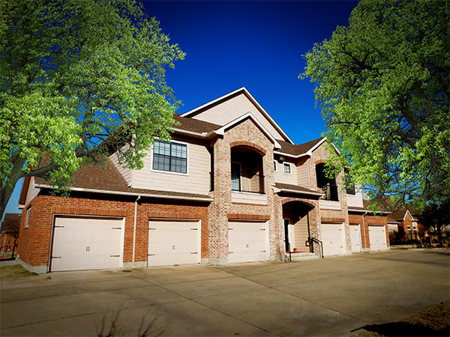

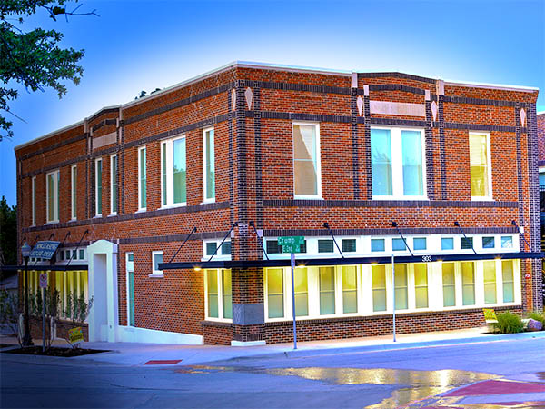
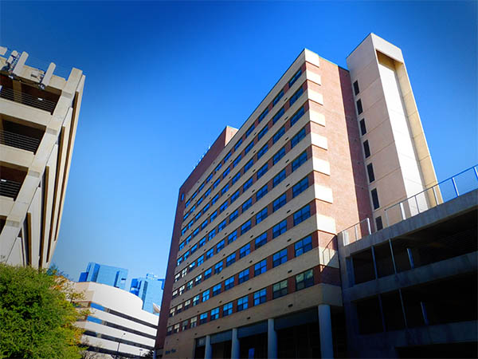
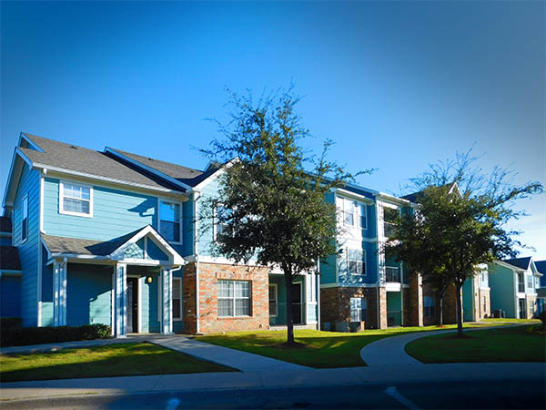
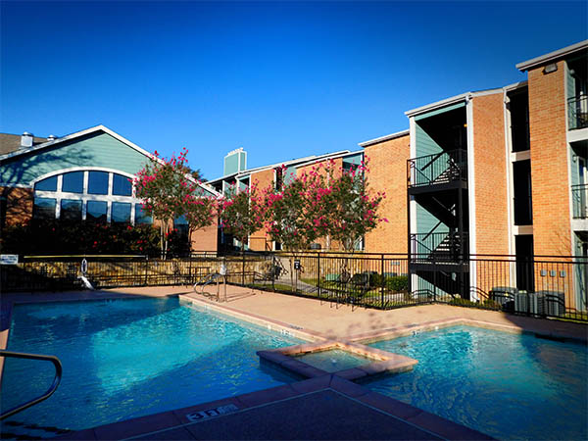
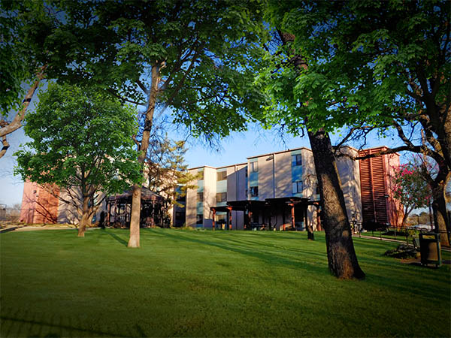
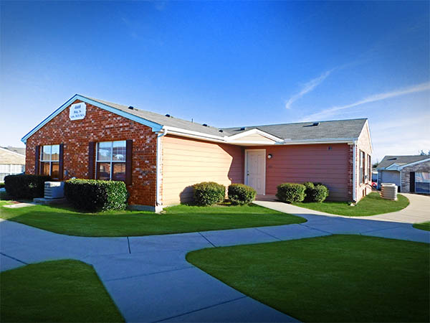
Current
FWHS Properties

Slide 16
Future FWHS Projects
Historic Stop Six/ Cavile Place Transformation
  Build new multi-family housing and demolish old public housing and revitalize development in the whole Stop Six Neighborhood
Butler Place Apartments Redevelopment
  Demolish old public housing and completely redevelop the Butler site
Vickery/ Main Transit-Oriented Development
  Partnership with The T, CoFW to build multi-family apartments, retail, and transit connection in the Near Southside and connect to downtown
Ariston Apartments
  Partnership with CoFW, The T, and DFWI to build multi-family workforce housing for downtown employees
Notes:
There are many projects in the pipeline, but these are the largest and most exciting projects. FWHS is currently planning on building or acquiring 3000+ units for affordable housing to meet our goals of converting 1000 public housing units to a new housing platform (RAD) by the end of 2018.

Slide 17
QUESTIONS?

