Slide 1
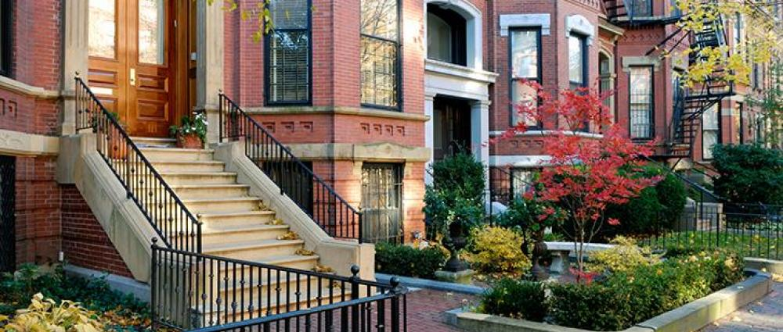
Neighborhoods and Opportunity:
Policies to Overcome Inequality
John N. Friedman
Brown University
XX Insert photo from
http://www.weisradio.com/wp-content/uploads/2013/06/education.jpg
But make the image lower quality so that it takes up less memory and loads fater

Slide 2
The American Dream?
Probability that a child born to parents in the bottom fifth of the income distribution reaches the top fifth:

Slide 3
The American Dream?
Probability that a child born to parents in the bottom fifth of the income distribution reaches the top fifth:
USA
Chetty, Hendren, Kline, Saez 2014
7.5%
UK
Blanden and Machin 2008
9.0%
Denmark
Boserup, Kopczuk, and Kreiner 2013
11.7%
Canada
Corak and Heisz 1999
13.5%

Slide 4
The American Dream?
Probability that a child born to parents in the bottom fifth of the income distribution reaches the top fifth:
→ Chances of achieving the “American Dream” are almost
two times higher in Canada than in the U.S.
USA
Chetty, Hendren, Kline, Saez 2014
7.5%
UK
Blanden and Machin 2008
9.0%
Denmark
Boserup, Kopczuk, and Kreiner 2013
11.7%
Canada
Corak and Heisz 1999
13.5%

Slide 5
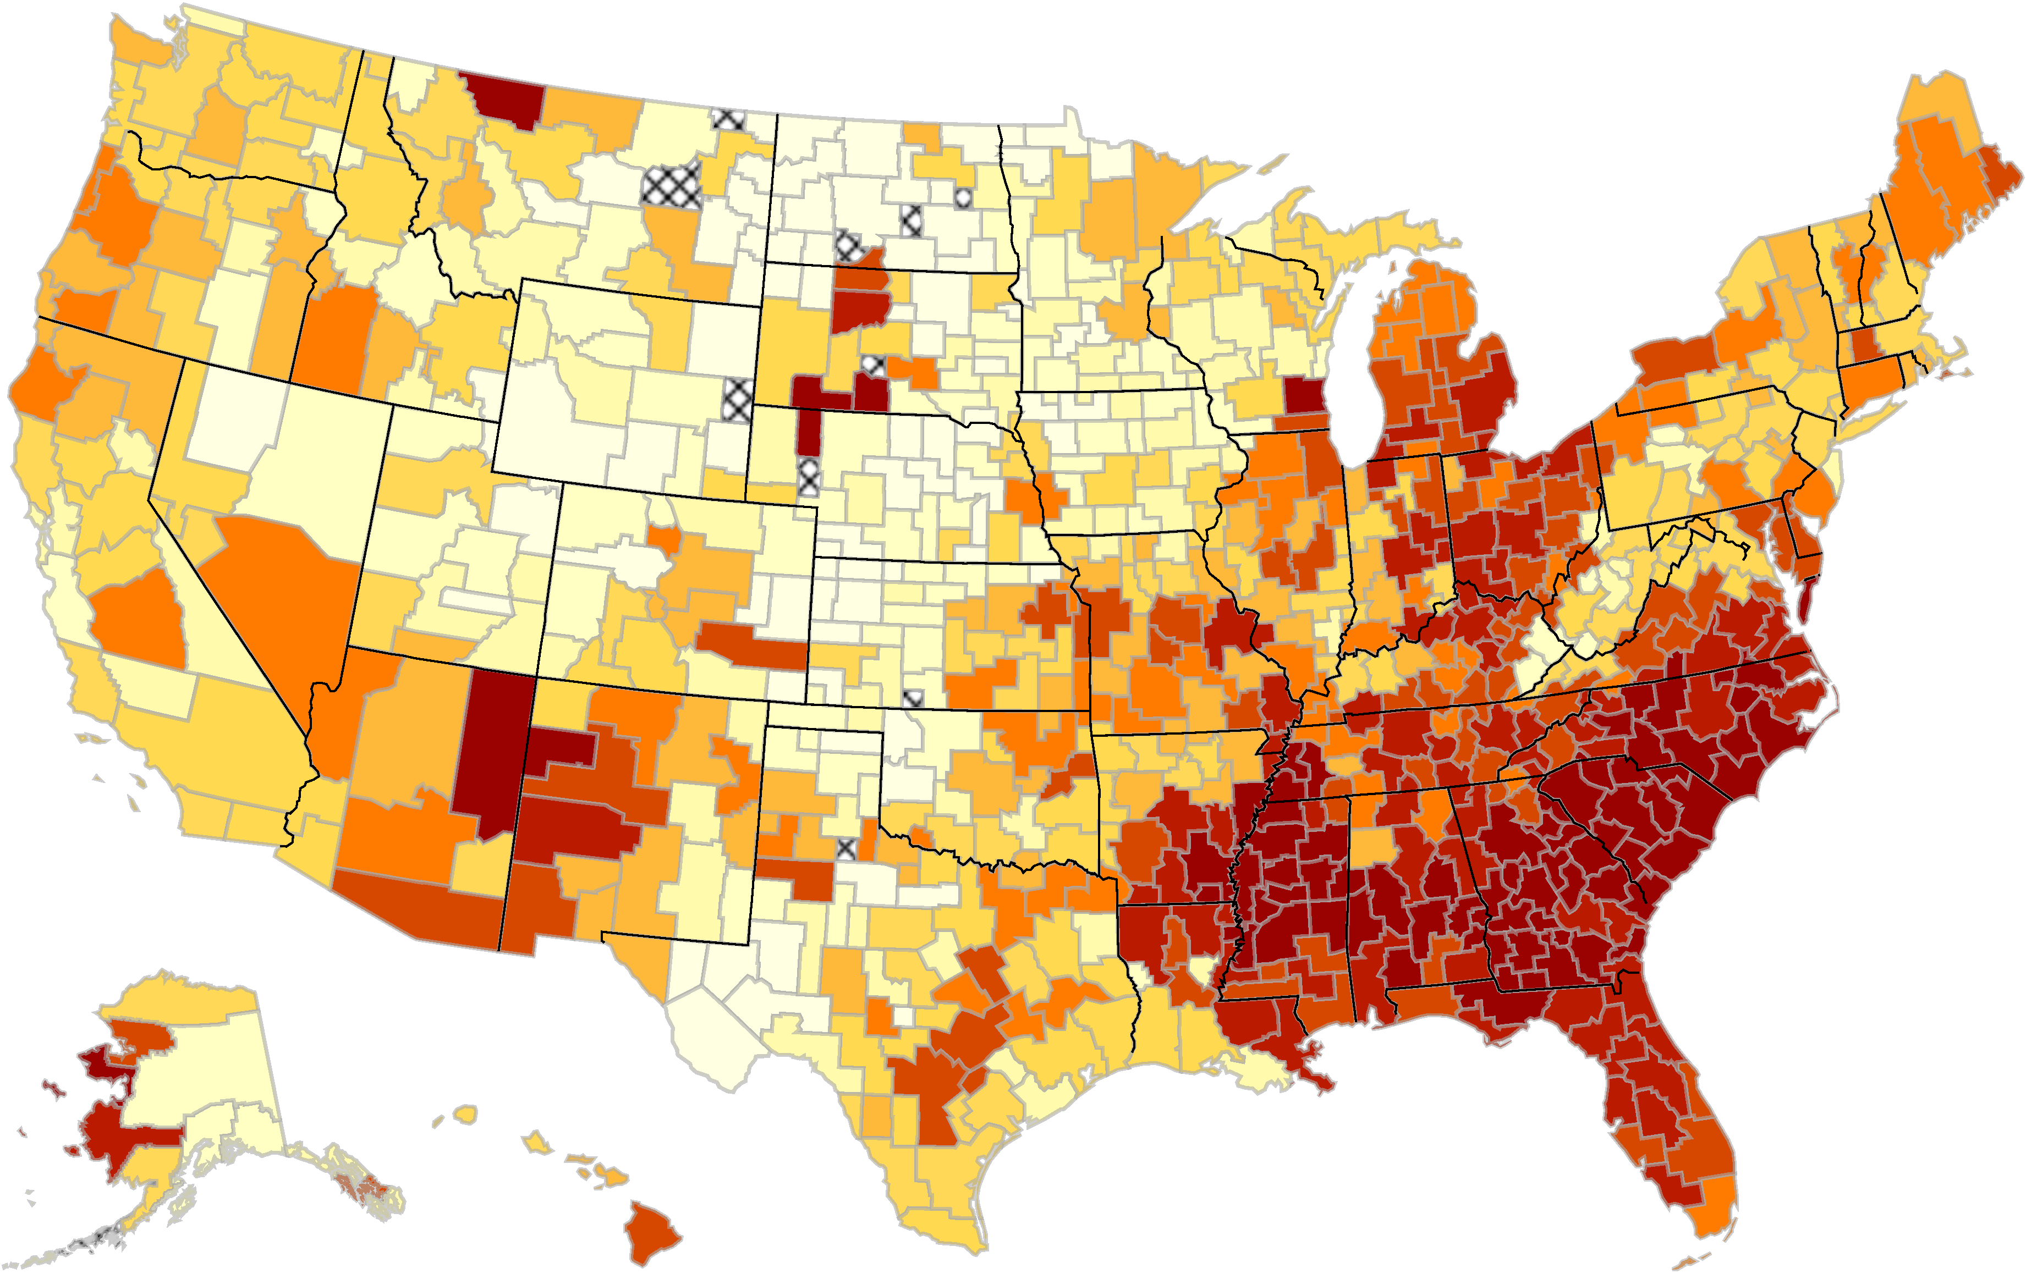
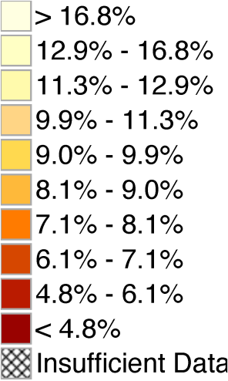
The Geography of Upward Mobility in the United States
Chances of Reaching the Top Fifth Starting from the Bottom Fifth by Metro Area
Denver 8.7%
Minneapolis 8.5%
Milwaukee4.5%
Boston 10.4%
San
Jose
12.9%
Washington DC 11.0%
Charlotte 4.4%
Salt Lake City 10.8%
Atlanta 4.5%
Dallas-Ft. Worth 7.1%

Slide 6
Effects of Moving to a Different Neighborhood
on a Child’s Income in Adulthood by Age at Move
100%
Dallas
80%
60%
Percentage Gain from Moving to a Better Area
40%
20%
0%
Atlanta
10
15
20
25
30
Age of Child when Parents Move

Slide 7
Effects of Moving to a Different Neighborhood
on a Child’s Income in Adulthood by Age at Move
100%
Dallas
80%
Children whose families move from Atlanta to Dallas when they are 9 years old get 54% of the gain from growing up in Dallas from birth
60%
Percentage Gain from Moving to a Better Area
40%
20%
0%
Atlanta
10
15
20
25
30
Age of Child when Parents Move

Slide 8
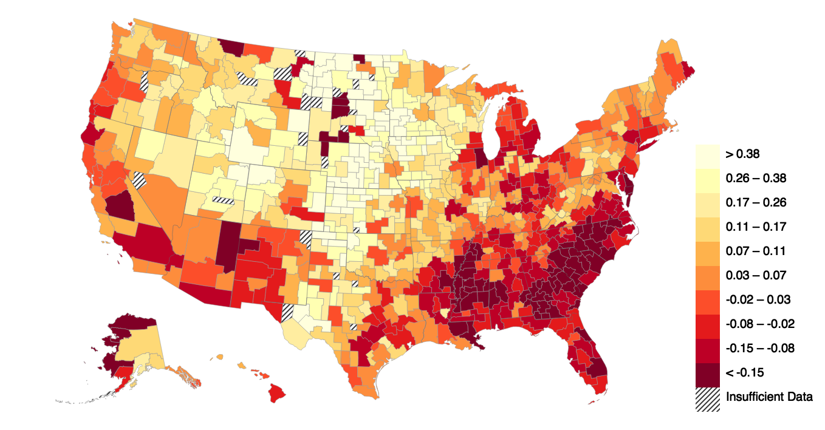
The Geography of Upward Mobility in the United States
Causal Effects on Income for Poor Children, by County

Slide 9
Causal Effects on Earnings for Children in Low-Income Families
Top 10 and Bottom 10 Among the 100 Largest Counties in the U.S.
Top 10 Counties |  |  |  | Bottom 10 Counties
Rank | County | Change in Earnings (%) |  | Rank | County | Change in Earnings (%)
1 | Dupage, IL | +15.1 |  | 91 | Pima, AZ | -12.2
2 | Snohomish, WA | +14.4 |  | 92 | Bronx, NY | -12.3
3 | Bergen, NJ | +14.1 |  | 93 | Milwaukee, WI | -12.3
4 | Bucks, PA | +13.3 |  | 94 | Wayne, MI | -12.5
5 | Contra Costa, CA | +12.1 |  | 95 | Fresno, CA | -12.9
6 | Fairfax, VA | +12.1 |  | 96 | Cook, IL | -13.3
7 | King, WA | +11.3 |  | 97 | Orange, FL | -13.5
8 | Norfolk, MA | +10.8 |  | 98 | Hillsborough, FL | -13.5
9 | Montgomery, MD | +10.5 |  | 99 | Mecklenburg, NC | -13.8
10 | Middlesex, NJ | +8.6 |  | 100 | Baltimore City, MD | -17.3
Estimates represent % change in adult earnings for 20 years of childhood spent in county

Slide 10
Causal Effects on Earnings for Children in Low-Income Families
Male Children
Top 10 Counties |  |  |  | Bottom 10 Counties
Rank | County | Change in Earnings (%) |  | Rank | County | Change in Earnings (%)
1 | Bucks, PA | 16.8 |  | 91 | Milwaukee, WI | -14.8
2 | Bergen, NJ | 16.6 |  | 92 | New Haven, CT | -15.0
3 | Contra Costa, CA | 14.5 |  | 93 | Bronx, NY | -15.2
4 | Snohomish, WA | 13.9 |  | 94 | Hillsborough, FL | -16.3
5 | Norfolk, MA | 12.4 |  | 95 | Palm Beach, FL | -16.5
6 | Dupage, IL | 12.2 |  | 96 | Fresno, CA | -16.8
7 | King, WA | 11.1 |  | 97 | Riverside, CA | -17.0
8 | Ventura, CA | 10.9 |  | 98 | Wayne, MI | -17.4
9 | Hudson, NJ | 10.4 |  | 99 | Pima, AZ | -23.0
10 | Fairfax, VA | 9.2 |  | 100 | Baltimore City, MD | -27.9
Estimates represent % change in adult earnings for 20 years of childhood spent in county

Slide 11
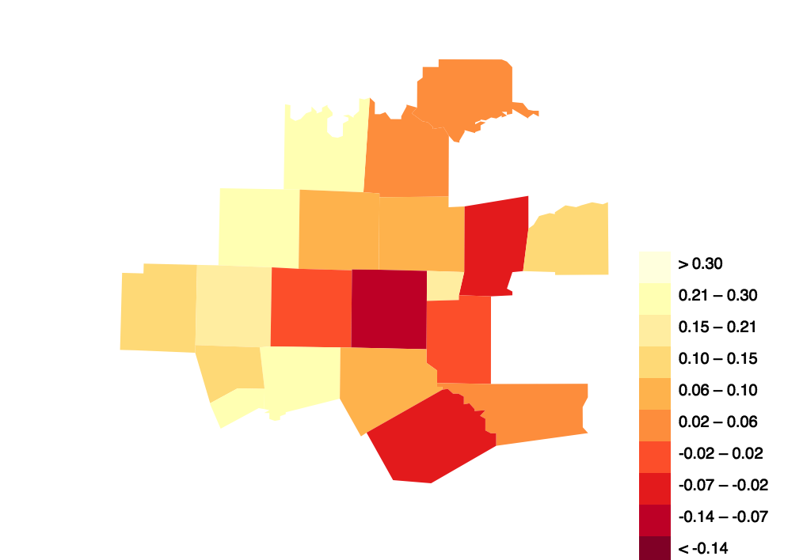
The Geography of Upward Mobility in the United States
For Children from Low-Income Families
Dallas Metro: -2.7% (55th)
Ft. Worth Metro: +3.7% (15th)
Bryan
County, OK
Dallas County: -5.1% (66th)
Tarrant County: +0.3% (38th)
Cooke
Grayson
Johnson County: +18.0%
Wise
Denton
Collin
Hunt
Hopkins
Palo
Pinto
Parker
Ft. Worth
Dallas
Rockwall
Kaufman
Hood
Johnson
Ellis
Henderson
Sommervell
Navarro
Note: Estimates represent change in rank from spending one more year of childhood in county.
Counties colored by national deciles.
Notes:
Wed

Slide 12
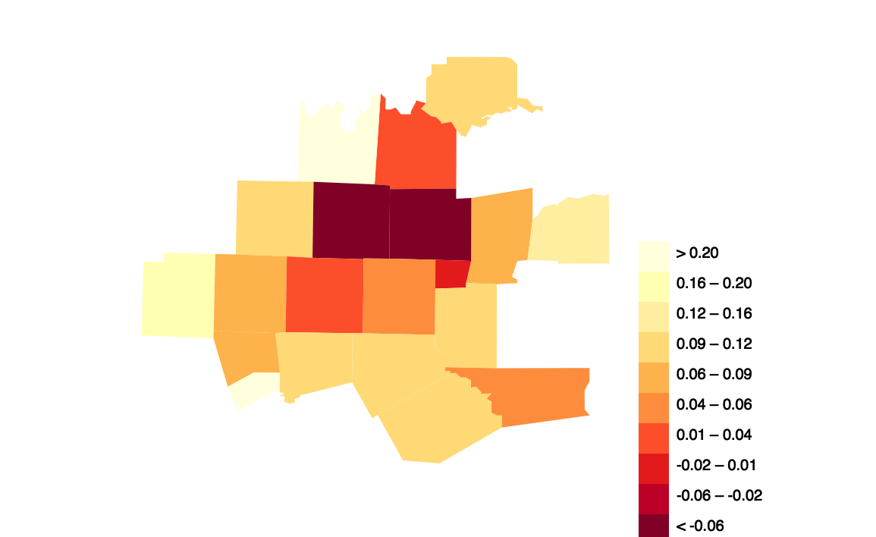
The Geography of Upward Mobility in the United States
For Children from High-Income Families
Bryan
County, OK
Dallas County: +5.7%
Tarrant County: +1.6%
Cooke
Grayson
Johnson County: +6.2%
Wise
Denton
Collin
Hunt
Hopkins
Palo
Pinto
Parker
Ft. Worth
Dallas
Rockwall
Kaufman
Hood
Johnson
Ellis
Henderson
Sommervell
Navarro
Note: Estimates represent change in rank from spending one more year of childhood in county.
Counties colored by national deciles.
Notes:
Wed

Slide 13
What are the Characteristics of High-Mobility Areas?
Five Strongest Correlates of Upward Mobility
Segregation
  Racial and income segregation associated with less mobility
  Long commute times (sprawl) associated with less mobility

Slide 14
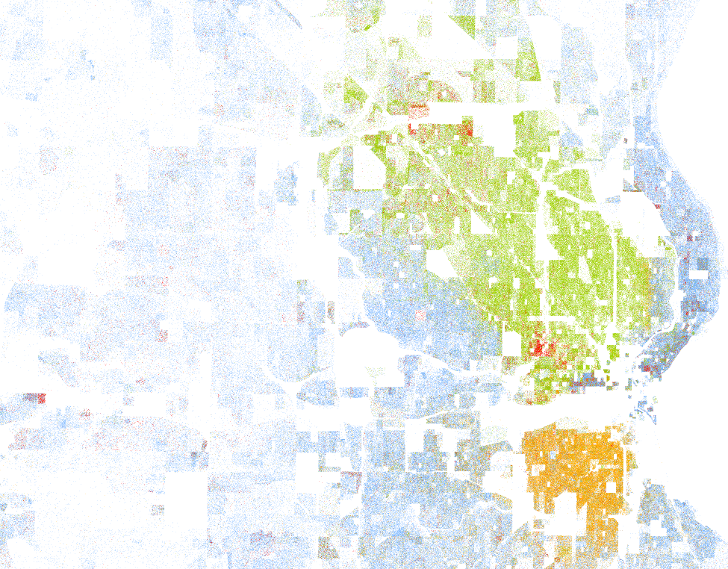
Racial Segregation in Milwaukee
Whites (blue), Blacks (green), Asians (red), Hispanics (orange)
Source: Cable (2013) based on Census 2010 data
Notes:
Milwaukee minority share (black or hispanic) is 16%

Slide 15
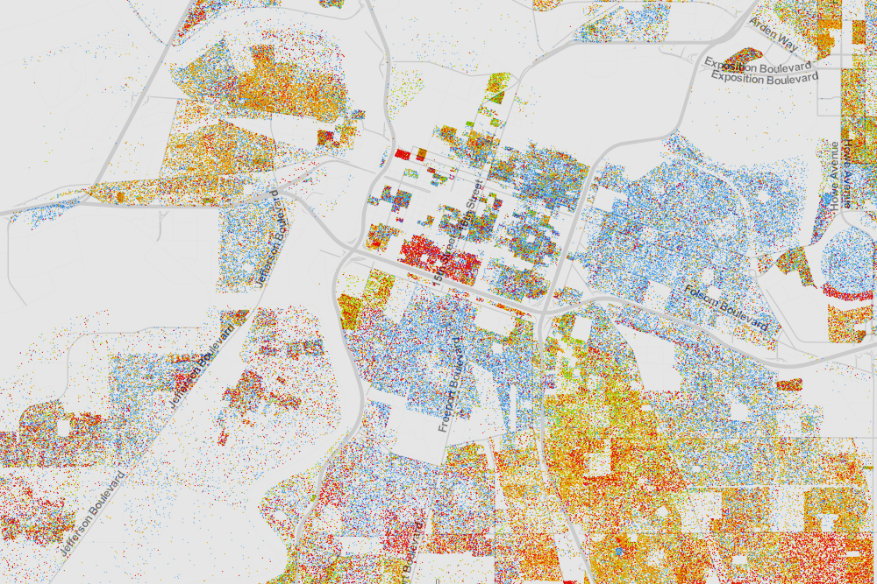
Racial Segregation in Sacramento
Whites (blue), Blacks (green), Asians (red), Hispanics (orange)
Source: Cable (2013) based on Census 2010 data

Slide 16
Five Strongest Correlates of Upward Mobility
Segregation
Income Inequality
  Places with smaller middle class have much less mobility
  Upper tail inequality (top 1%) not strongly related to mobility

Slide 17
Five Strongest Correlates of Upward Mobility
Segregation
Income Inequality
School Quality
  Higher expenditure, smaller classes, higher test scores correlated with more mobility

Slide 18
Five Strongest Correlates of Upward Mobility
Segregation
Income Inequality
School Quality
Family Structure
  Areas with more single parents have much lower mobility
  Strong correlation even for kids whose own parents are married

Slide 19
Five Strongest Correlates of Upward Mobility
Segregation
Income Inequality
School Quality
Family Structure
Social Capital
  “It takes a village to raise a child”
  Putnam (1995): “Bowling Alone”

Slide 20
Correlates of Upward Mobility in Dallas and Fort Worth
Share in Poverty
Racial Segregation
Income Inequality
Fraction Single Moms
Social Capital
Student-Teacher Ratio

Slide 21
Policies to Improve Upward Mobility
What policy changes can improve mobility?
Focus here on two types of policies suggested by correlations:
  Reducing segregation: affordable housing policies
  Improving education: teacher effectiveness

Slide 22
Affordable Housing and Integration of Neighborhoods
One way to increase integration: give low income families subsidized housing vouchers to move to better areas
HUD Moving to Opportunity Experiment: gave such vouchers using a randomized lottery
  4,600 families in Boston, New York, LA, Chicago, and Baltimore in mid 1990’s
Source: Chetty, Hendren, and Katz 2016

Slide 23
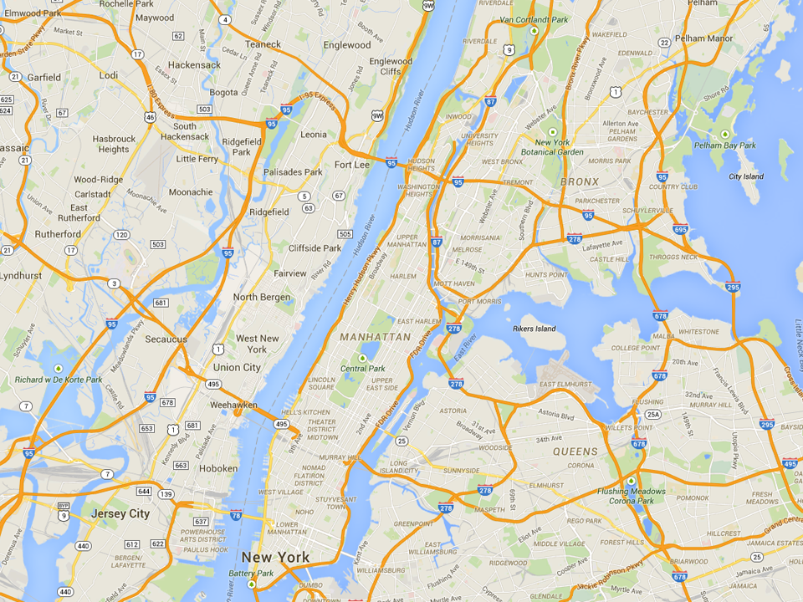
Common MTO Residential Locations in New York
Experimental
Wakefield Bronx
Control
ML King Towers
Harlem

Slide 24
Moving to Opportunity Experiment
Children who moved to low-poverty areas when young (e.g., below age 13) do much better as adults:
  30% higher earnings = $100,000 gain over life in present value
  27% more likely to attend college
  30% less likely to become single parents
But moving had little effect on the outcomes of children who were already teenagers
Moving also had no effect on parents’ earnings
Reinforces conclusion that childhood exposure is a key determinant of upward mobility

Slide 25
Housing Policy Implications
Moving to a mixed-income neighborhood improves outcomes for low-income children
Mixed-income neighborhoods produce, if anything, slightly better outcomes for the rich
  Integration could help the poor without hurting the rich
Notes:
Suggests that targeting existing $20 billion Section 8 voucher program more effectively can have big returns
More broadly, suggests that zoning restrictions, transit systems, and urban planning can have big effects on social mobility

Slide 26
Housing Policy: Limitations
Subsidized housing vouchers and changes in urban planning could increase upward mobility, but there are limits to scalability
  Moving everyone in Harlem to Bronx is unlikely to help
  Ultimately need policies that improve existing neighborhoods rather than simply moving people around
Notes:
Suggests that targeting existing $20 billion Section 8 voucher program more effectively can have big returns
More broadly, suggests that zoning restrictions, transit systems, and urban planning can have big effects on social mobility

Slide 27



Using Big Data to Study Teachers’ Impacts
  School district records
  2.5 million children
  18 million test scores
  Tax records
  Earnings, College Attendance, Teen Birth
Source: Chetty, Friedman, Hilger, Saez, Schanzenbach, Yagan 2011
Source: Chetty, Friedman, Rockoff 2014

Slide 28



A Kindergarten Test
I’ll say a word to you. Listen for the ending sound.
You circle the picture that starts with the same sound
“cup”

Slide 29
Correlation: Wage Earnings vs. Kindergarten Test Score
$25K
$20K
Mean Wage Earnings from Age 25-27
$15K
$10K
0
20
40
60
80
100
KG Test Score Percentile

Slide 30
Causal Effect of Kindergarten Class Quality: Wage Earnings
$18K
+$875 per year
$1 million
NPV gains per classroom
$17K
Mean Wage Earnings from Age 25-27
$16K
Above-Average Class Quality
Below-Average Class Quality

Slide 31

A Quasi-Experiment: Entry of High Quality Teacher
56
Entry of a Top 5% Teacher
54
Average Test Score
52
50
‘93
‘94
‘95
‘96
‘97
‘98
School Year
Scores in 4th Grade
Scores in 3rd Grade

Slide 32

A Quasi-Experiment: Entry of Low Quality Teacher
55
Entry of Bottom 5%
Teacher
54
53
Average Test Score
52
51
50
‘93
‘94
‘95
‘96
‘97
‘98
School Year
Scores in 4th Grade
Scores in 3rd Grade

Slide 33
The Value of Improving Teacher Quality
5th
Median
95th
Teacher Quality

Slide 34
The Value of Improving Teacher Quality
+$50,000 lifetime earnings per child
= $1.4 million per classroom of 28 students
5th
Median
95th
Teacher Quality

Slide 35
Equality of Opportunity and Economic Growth
Traditional argument for greater social mobility is based on principles of justice
But improving opportunities for upward mobility can also increase size of the economic pie
  One child’s success need not come at another’s expense
To illustrate, focus on innovation
  Study the lives of 750,000 patent holders in the U.S.
Source: Bell, Chetty, Jaravel, Petkova, van Reenen 2015

Slide 36
Patent Rates vs. Parent Income Percentile
25
Patent rate for children
with parents in top 1%:
22.5 per 10,000
20
15
Inventors per Ten Thousand
10
5
Patent rate for children
with parents below median:
2.2 per 10,000
0
0
20
40
60
80
100
Parent Income Percentile

Slide 37
Patent Rates vs. 3rd Grade Test Scores
20
85th Percentile
15
Inventors per Ten Thousand
10
5
0
-2
-1
0
1
2
3rd Grade Math Test Score (Standard Deviations Relative to Mean)

Slide 38
Patent Rates vs. 3rd Grade Test Scores
for Children with Low vs. High Income Parents
20
High-ability children much more likely to become inventors if they are from high-income families
15
Inventors per Ten Thousand
10
5
0
-2
-1
0
1
2
3rd Grade Math Test Score (Standard Deviations Relative to Mean)
Parent Income Below Median
Parent Income Above Median

Slide 39
Upward Mobility and Economic Growth
Gaps in test scores grow rapidly as children grow older
  Low income children fall further behind over time
Suggests that innovation gap may again be driven by differences in childhood environments
Improving equality of opportunity could ultimately benefit everyone, not just low-income families

Slide 40
Policy Lessons
    Local policies can also have large impacts on social mobility.
      Focus on specific cities such as Baltimore and on specific neighborhoods within those cities
      Target subsidized housing vouchers to families with young children to help them move to better neighborhoods

Slide 41
Policy Lessons
    Local policies can also have large impacts on social mobility.
    Improve childhood environments and primary education
      Not just spending more money: US already spends more than other developed countries with better outcomes
      Instead, focus on key inputs such as attracting and retaining talented teachers (e.g., Finland)
      Childhood environment matters at all ages, not just the earliest years

Slide 42
Policy Lessons
    Local policies can also have large impacts on social mobility.
    Improve childhood environments and primary education
    Harness “big data” to develop a scientific evidence base for economic and social policy
      Identify which neighborhoods are in greatest need of improvement and which policies work
      “Precision medicine” for economic and social problems

