Slide 1
CD-2 - Lakewood Conservation District Expansion Post-Application Neighborhood Meeting No. 4
October 12, 2022
Trevor Brown, Chief Planner
Scott Bellen, Senior Planner
Planning & Urban Design
City of Dallas

Slide 2
CD-2 - Lakewood Conservation District Expansion Post-Application Neighborhood Meeting No. 4
Agenda
Introduction & Recap
Overview of process
Discussion
Recap – Lot size, slope/drainage
Building height & stories
Floor Area Ratio
Setbacks – Main
Setbacks - Accessory
Next Steps
Staff Contact
Trevor Brown
Trevor.brown@dallas.gov
214-670-4193
Project Webpage
https://bit.ly/LakewoodExpansion

Slide 3
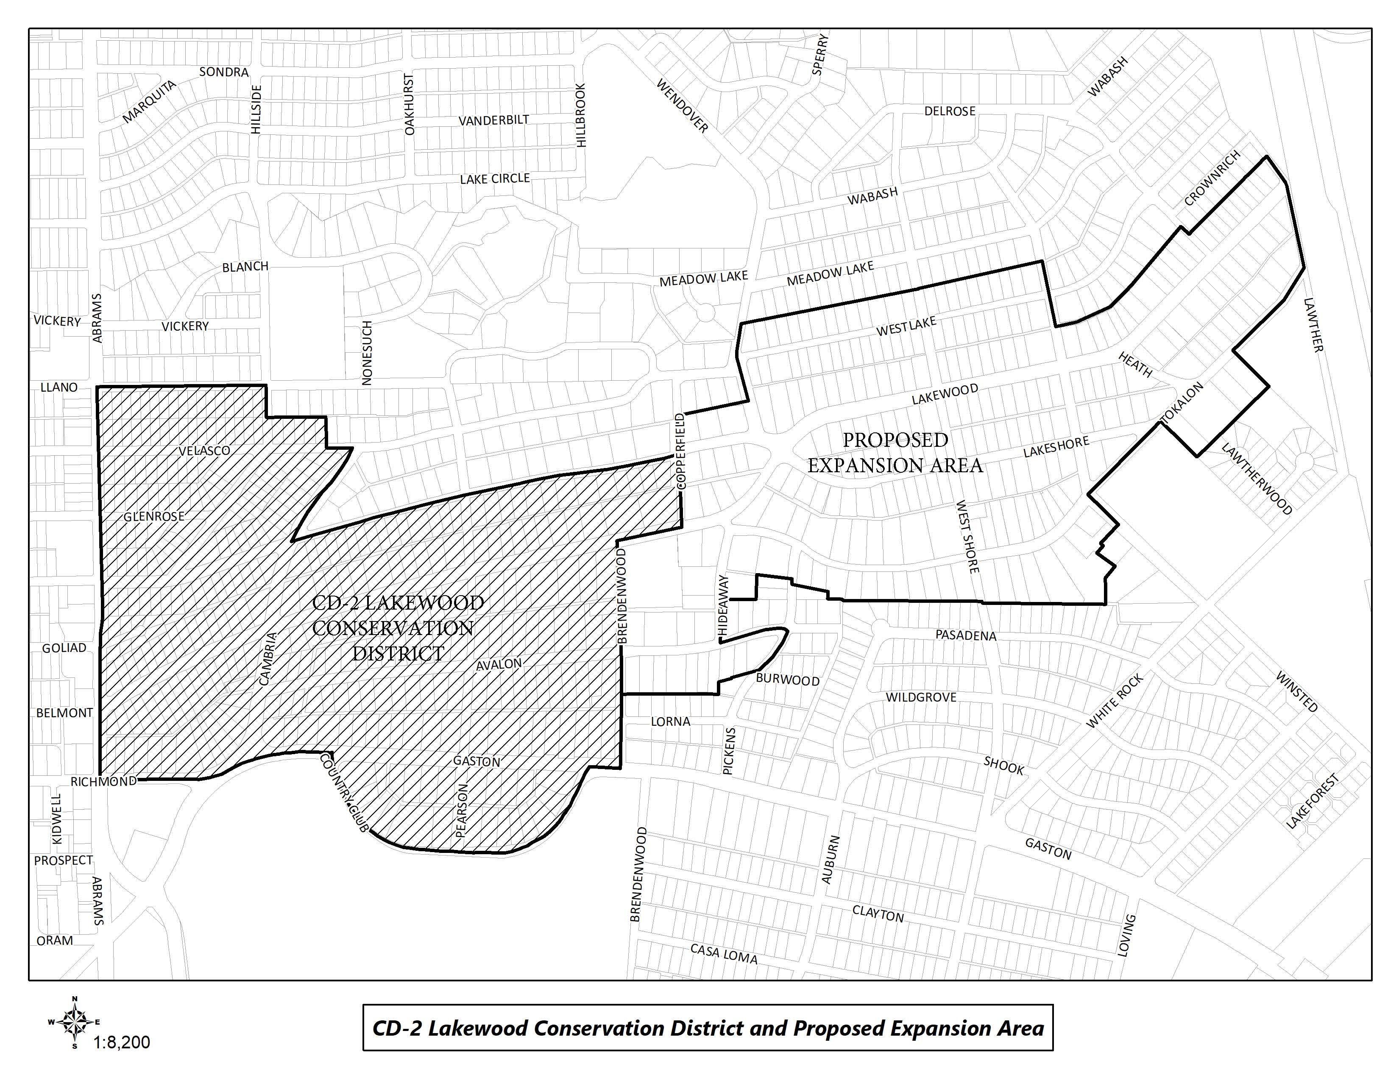
CD-2 Boundaries & Expansion Area

Slide 4
Purpose of This Meeting
This meeting is the 4th Post-Application Neighborhood Meeting to discuss the CD expansion process and the development and architectural standards the neighborhood may want to amend, based on the petition.
Discussion
Recap – Lot size, slope/drainage
Building height & stories
Floor Area Ratio
Setbacks – Main
Setbacks – Accessory

Slide 5
Meeting Schedule
Post-Application Neighborhood Meeting #1 – August 31
Process, schedule, driveways and curbing
Post-Application Neighborhood Meeting #2 – September 14
Driveways and curbing, sidewalks, front yard coverage, uses and parking, density, lot coverage
Post-Application Neighborhood Meeting #3 – September 26
Lot size, slope/drainage
Post-Application Neighborhood Meeting #4 – October 12
Building height & stories, Floor Area Ratio, setbacks-main, setbacks-accessory
Post-Application Neighborhood Meeting #5 – October 26
Accessory structures, fences, retaining walls, waterfall steps, landscape, paint, solar
Post-Application Neighborhood Meeting #6 – November 9
Demolition, documented assurance, roofing materials, windows, porches

Slide 6
Meeting Schedule
Post-Application Neighborhood Meeting #7 – November 16
Contributing architectural styles, new construction standards, remodel/addition standards, areas of regulation, work reviews
Post-Application Neighborhood Meeting #8 – November 30
Architectural styles – Minimal Traditional, Colonial Revival
Post-Application Neighborhood Meeting #9 – December 7
Architectural styles – Spanish Eclectic, French Eclectic
Post-Application Neighborhood Meeting #10 – December 14
Architectural styles – Tudor, Neoclassical, Non-Contributing
Post-Application Neighborhood Meeting #11 – January 4
If needed
Post-Application Neighborhood Meeting #12 – January 18
If needed

Slide 7
Meeting Schedule (cont.)
Final Post-Application Neighborhood Meeting – TBD
Ordinance Review (30-60 days after last meeting)
City Plan Commission – TBD
City Council – TBD

Slide 8
CD-2 Regulations:
Development Standards:
Use
Lot size
Accessory uses
Setbacks
Lot coverage
Height
Landscaping Provisions:
Fences and walls
Driveways and curbing
Sidewalks
Front yard coverage
Berms
Architectural Provisions:
Regulation of Architectural Styles
Garages and accessory structures
Street facade width
Roofs
Glass
Enclosures
Screen and storm doors and windows
Color
8
Notes:
These are all the development standards regulated by CD 2. Every property in the city is governed by a set of these rules, but each CD has a ‘custom’ set of rules.

Slide 9
CD-2 Regulations (cont.):
Review Procedures:
Building permit review
Work not requiring a building permit
9

Slide 10
Topics for Discussion:
Accessory Structures:
Location and materials
Provisions for remodels or additions to non-conforming structures
Building Height:
Modifying how height is measured
Establishing a maximum allowed height for structures, including accessory structures and additions
Demolition:
Applicability to structures
Provisions for existing non-contributing structures
Density:
Consideration of maximum number of dwelling units
10
Notes:
These are the specific items that were on the petition – what we’ll be discussing at these meetings

Slide 11
Topics for Discussion (cont.):
Drainage:
Establishing restrictions on lot-to-lot drainage
Driveways, Curbs, Sidewalks, and Steps
Materials, width, and lot coverage
Provisions for removal of existing rolling or waterfall steps
Provisions for existing non-conforming structures
Fences and Walls
Location, height, and materials
Floor Area Ratio
11

Slide 12
Topics for Discussion (cont.):
Landscaping or Other Natural Features:
Materials and allowable percentage of front yard coverage for impervious surfaces and hardscaping
Provisions for tree preservation
Lot Coverage
Maximum lot coverage
Lot size
Minimum width
Paint
Provisions for painting stone and brick
Consideration of restriction of certain colors
Number of colors allowed
12

Slide 13
Topics for Discussion (cont.):
Off-Street Parking and Loading Requirements:
Minimum parking standards per dwelling unit
Permitted Uses
Single family
Provisions for existing non-conforming uses
Setbacks
Modifying front, side, and rear setback requirements, including accessory structures
Provisions for existing non-conforming structures
Slope
Provisions for modifications to the existing slope of a lot
13

Slide 14
Topics for Discussion (cont.):
Solar Energy Systems:
Location and type
Stories
Maximum stories
Provisions for non-conforming structures
14

Slide 15
Topics for Discussion (cont.):
Accessory Structures:
Style and materials
Roof slope
Replacement or remodeling of existing accessory structures
Clarifying the architectural styles, materials, size, and applicability
Architectural Styles:
Defining the architectural styles allowed
Standards for remodels and additions
Standards for new construction
Provisions for existing non-contributing structures
Building Elevations:
Minimum number of architectural features required
Standards for remodels and additions
Standards for new construction
Provisions for existing non-contributing structures
15

Slide 16
Topics for Discussion (cont.):
Building Materials:
Material types
Applicability and placement of certain allowed materials
Provisions for existing non-contributing structures
Chimneys:
Materials, form, and placement based on architectural style
Porch Styles:
Materials, architectural style, and placement
Standards for enclosures
Provisions for remodels or additions to existing structures
Roof Form and Pitch:
Provisions for remodels or additions to existing structures
16

Slide 17
Topics for Discussion (cont.):
Roofing Materials:
Provisions for remodels or additions to existing structures
Windows:
Placement, architectural standards, and materials
Provisions for remodels or additions to existing structures
Work Reviews:
Language to detail the requirements for a work review by the City
17

Slide 18
Sec. 51A-4.505 Conservation Districts
(b) Findings and purpose.
(1) State law authorizes the city of Dallas to regulate the construction, alteration, reconstruction, or razing of buildings and other structures in "designated places and areas of historic, cultural, or architectural importance and significance."
(2) Conservation districts are intended to provide a means of conserving an area's distinctive character by protecting or enhancing its physical attributes.
(3) Conservation districts are distinguished from historic overlay districts, which preserve historic residential or commercial places; neighborhood stabilization overlay districts, which preserve single family neighborhoods by imposing neighborhood- specific yard, lot, and space regulations that reflect the existing character of the neighborhood; and planned development districts, which provide flexibility in planning and construction while protecting contiguous land uses and significant features.
(4) The purpose of a CD is to:
(A) protect the physical attributes of an area or neighborhood;
(B) promote development or redevelopment that is compatible with an existing area or neighborhood;
(C) promote economic revitalization;
(D) enhance the livability of the city; and
(E) ensure harmonious, orderly, and efficient growth.

Slide 19
Procedure
To speak during the discussion portions of tonight’s meeting:
Please raise your hand and wait to be recognized before you begin speaking
Before your comments, state your name and address for the record
All comments must be related to the topic being discussed at that time
Provide input to inform City Staff to work toward an approach to accomplish your desired objective of maintaining the character of the neighborhood.

Slide 20
Petition Topic – Lot Size
Expand on the requirements minimum width and depth of lots
Existing Regulations CD-2
Lot size requirements
(1) Lots in Tract I must have a minimum area of 5,000 square feet, a minimum depth of 100 feet, and a minimum width of 50 feet.
(2) Lots in Tract II must have a minimum area of 7,500 square feet, a minimum depth of 150 feet, and a minimum width of 50 feet.
(3) Lots in Tract III must have a minimum area of 10,000 square feet, a minimum depth of 150 feet, and a minimum width of 70 feet.

Slide 21
Discussion – Lot Size
Minimum lot size can impact larger lots being subdivided into smaller parcels.
Majority of the expansion area lots are zoned R7.5(A) which has 7,500 square foot lots with 50-foot width.
Lots on Tokalon Dr. and areas south zoned R10(A)
Dallas Development Code has minimum width of 55 feet and depth of 100 feet for R7.5(A) lots and minimum width of 70 feet and depth of 100 feet for R10 lots.
21

Slide 22
Recap – Lot Size
Minimum lot size 7,500 square feet with minimum width of 55 feet.
This only impacts lots that are to be subdivided in the future. No impact on existing lots that may not conform to the minimum requirement.
22

Slide 23
Petition Topic – Drainage & Slope
Consideration of provisions for modifications to the existing slope of a lot
Existing Regulations CD-2
None
Dallas Development Code
No lot-to-lot drainage is allowed.
Notes:
Current regs for driveway access; Point is that access is allowed from EITHER street or alley, but not both

Slide 24
Recap – Drainage & Slope
Maintaining the existing slope of the lot for lots where new construction is proposed.
Sample language
The existing slope of a lot must be maintained. This provision does not prevent minor grading as necessary to allow construction, prevent lot-to-lot drainage, or match the slope of contiguous lots.
For purposes of this subsection, "slope" means any change in elevation from the front lot line to the rear lot line or from a side lot line to the other side lot line.
24

Slide 25
Petition Topic – Building Height & Stories
Modifying how height is measured
Establishing a maximum allowed height for structures, including accessory structures and additions
Establishing a maximum number of stories allowed
Provisions for non-conforming structures
Existing Regulations CD-2
BUILDING HEIGHT means the vertical distance measured from grade to the highest ridge of the roof structure.
ROOF RIDGE means the apex of any roof structure regardless of its style or form.
Maximum building height
(1) Except as provided in Paragraph (2), the maximum permitted height for all structures in Tracts I, II, and III is 30 feet.
(2) If any portion of an existing structure’s roof ridge exceeds the applicable maximum height in paragraphs (1)(A) or (1)(B), the lower portion of that structure’s roof ridge may be raised to the height of the taller portion of the roof ridge.

Slide 26
Discussion – Building Height & Stories
CD-2 BUILDING HEIGHT means the vertical distance measured from grade to the highest ridge of the roof structure.
Dallas Development Code has maximum height of 30 feet.
HEIGHT means the vertical distance measured from grade to:
(A) for a structure with a gable, hip, or gambrel roof, the midpoint of the vertical dimension between the lowest eaves and the highest ridge of the structure;
(B) for a structure with a dome roof, the midpoint of the vertical dimension of the dome; and
(C) for any other structure, the highest point of the structure.
Nonconforming height allow additions to maintain existing height as allowed by CD-2 ordinance.
26

Slide 27
Discussion – Building Height & Stories
How tall are most houses on your street? How many stories?
What are your concerns about height of structures?
Any thoughts on additions that are taller than the original structure?
Maximum number of stories
Consider when talking about different styles - Minimal Traditional, Tudor, Spanish Eclectic, French Eclectic, Noncontributing
27

Slide 28
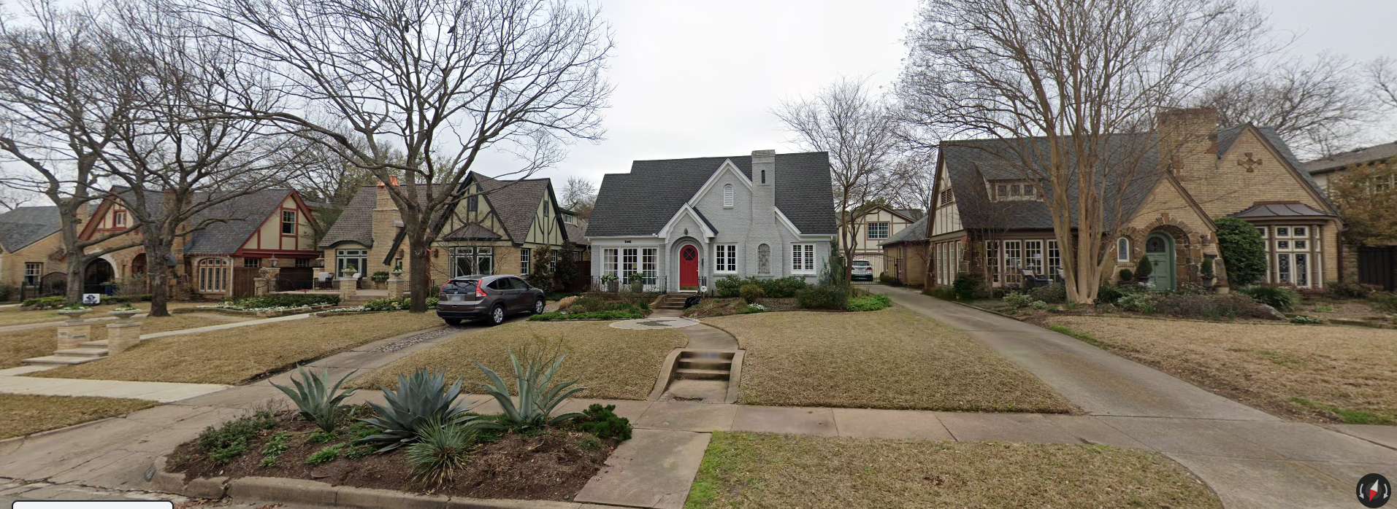
Discussion – Building Height & Stories
28

Slide 29
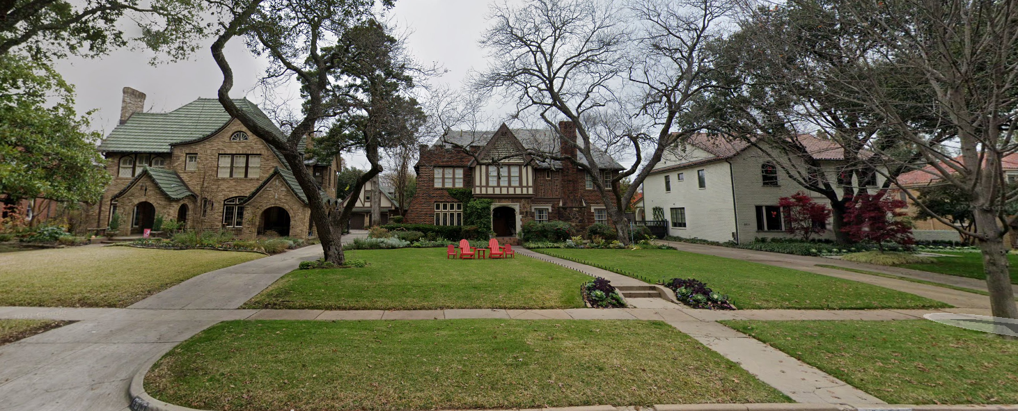
Discussion – Building Height & Stories
29

Slide 30
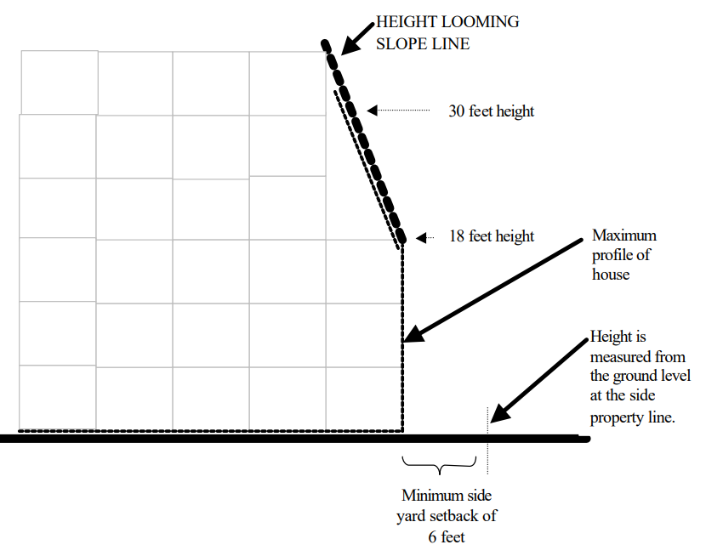
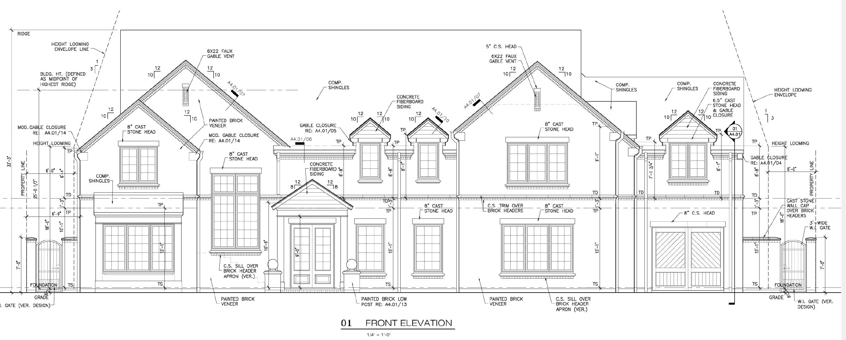
Height Looming (Greenway Parks CD-10)
The height of any structure may not exceed three times its distance from the ground level of the side property line, with the height being measured from the ground level at the side property line. For example, a structure set back six feet from the side yard line may not exceed 18 feet in height above the ground level at the side property line. Chimneys are not subject to this height looming provision.

Slide 31
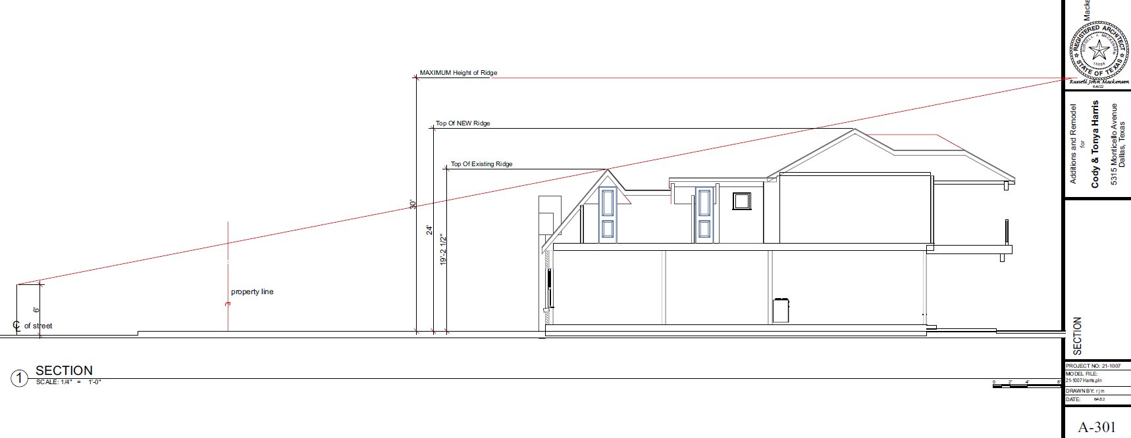
0

Slide 32
Recap – Building Height
& Stories
32

Slide 33
Petition Topic – Floor Area Ratio
Consideration of maximum Floor Area Ratio
Existing Regulations CD-2
None
Dallas Development Code
None for single family residential use
Notes:
Current regs for driveway access; Point is that access is allowed from EITHER street or alley, but not both

Slide 34
Discussion – Floor Area Ratio
Strategy to address massing of buildings on a lot
Floor Area Ratio (FAR) is the measurement of a building’s floor area in relation to the size of the lot that the building is located on.
FLOOR AREA means the total square footage of floor space in a building measured to the outside faces of the exterior walls or to the omitted wall lines, whichever produces the larger area, but excluding the following: (i) Area used solely for off street parking. (ii) Area between an omitted wall line and the structural wall when the area is used solely for foot traffic or landscaping. (iii) Area of a private balcony that is not accessible to the public and does not provide a means of ingress or egress. (iv) Area of a breezeway or an unenclosed stairway located within the first three stories, excluding any basement, of a residential use.
Greenway Parks CD language
Floor area ratio. The intent of this subsection is to encourage the retention of original single family buildings. The maximum floor area ratio for lots containing original single family buildings is 0.55. The maximum floor area ratio for all other lots, including lots with new construction, is 0.50. The term “original single family building” means any single family main building that existed on May 28, 2003. An original single family building shall be considered “new construction” if an expansion results in more than 30 percent of the total exterior surface of the building being removed or obscured. The term “total exterior surface” includes all exterior walls but excludes the roof. (**Greenway Parks counts areas used for parking in FAR calculation which the Dallas Development Code does not.)
May be used to mitigate the building structures out of scale and compatibility with existing houses.
Can be another way of promoting retention of existing structures.
34

Slide 35
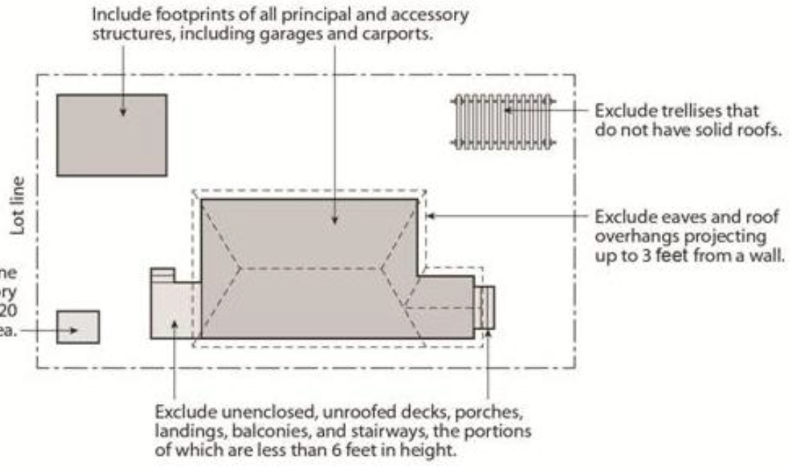
Discussion – Floor Area Ratio
Lot Coverage Examples
50’x150’= 7,500 Sq. Ft.
45%= 3,375 Sq. Ft.
40%= 3,000 Sq. Ft.
FAR .55= 4,125 Sq. Ft.
FAR .5= 3,750 Sq. Ft.
70’x150’= 10,500 Sq. Ft.
45%= 4,725 Sq. Ft
40%= 4,200 Sq. Ft.
FAR .55= 5,775 Sq. Ft.
FAR .5= 5,250 Sq. Ft.
35

Slide 36
Recap – Floor Area Ratio
36

Slide 37
Petition Topic – Setbacks (Main)
Modifying front, side, and rear setback requirements
Provisions for existing non-conforming structures
Existing Regulations CD-2 – Front Yard Setback
A minimum 40-foot front yard setback must be provided on all building sites in Tract I.
A minimum 50-foot front yard setback must be provided on all building sites in Tract II.
A minimum 60-foot front yard setback must be provided on all building sites in Tract III, except for lots located in City Block Q/2983, for which a minimum 40-foot front yard setback must be provided.
Existing Regulations R-7.5(A) – Front Yard 25-foot setback
Existing Regulations R-10(A) – Front Yard 30-foot setback

Slide 38
Petition Topic – Setbacks (Main)
Existing Regulations CD-2 – Side Yard
A minimum side yard setback of five feet and a minimum cornerside yard setback of 15 feet must be provided on all building sites in Tract I and II.
A minimum side yard setback of six feet and a minimum cornerside yard setback of 15 feet must be provided on all building sites in Tract III.
Existing Regulations R-7.5(A) – Side Yard
Five-foot setback
Existing Regulations R-10(A) – Side Yard
Six-foot setback

Slide 39
Petition Topic – Setbacks (Main)
Existing Regulations CD-2 – Rear Yard
A minimum rear yard setback of five feet must be provided on all building sites in Tract I and II.
A minimum rear yard setback of six feet must be provided on all building sites in Tract III.
Existing Regulations R-7.5(A) – Rear Yard
Five-foot setback
Existing Regulations R-10(A) – Rear Yard
Six-foot setback

Slide 40
Discussion – Setbacks (Main)
Do you know your setback?
Is there variation along the street, or do all houses appear to be situated similarly on the lot?
Allowance for nonconforming structures
Any additions must meet applicable setbacks without clarifying language
40

Slide 41
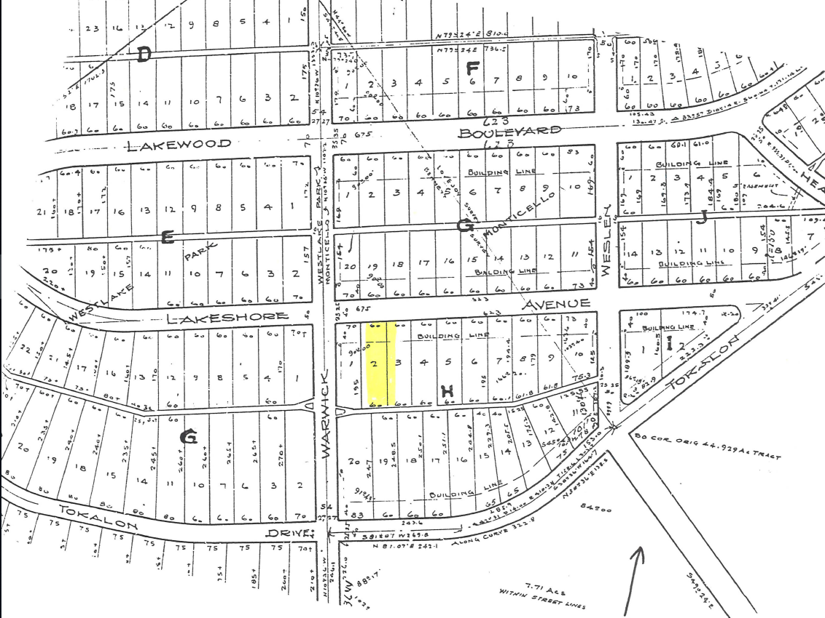
Discussion – Setbacks (Main)
41

Slide 42
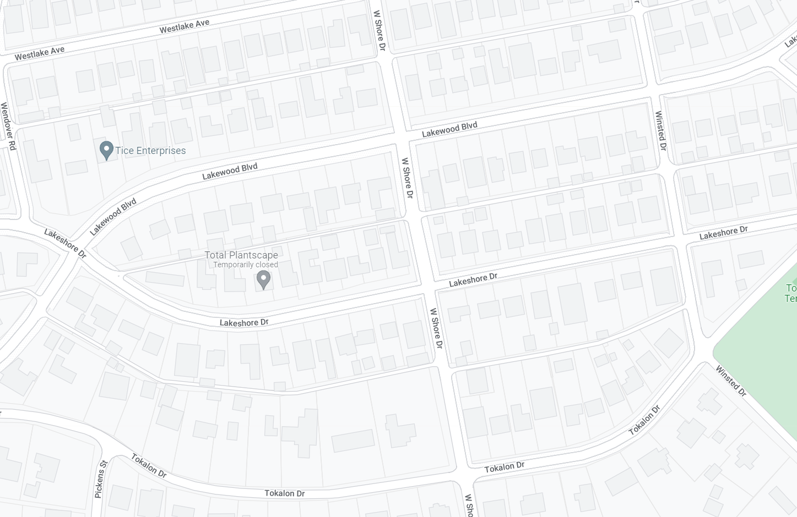
Discussion – Setbacks (Main)
42

Slide 43
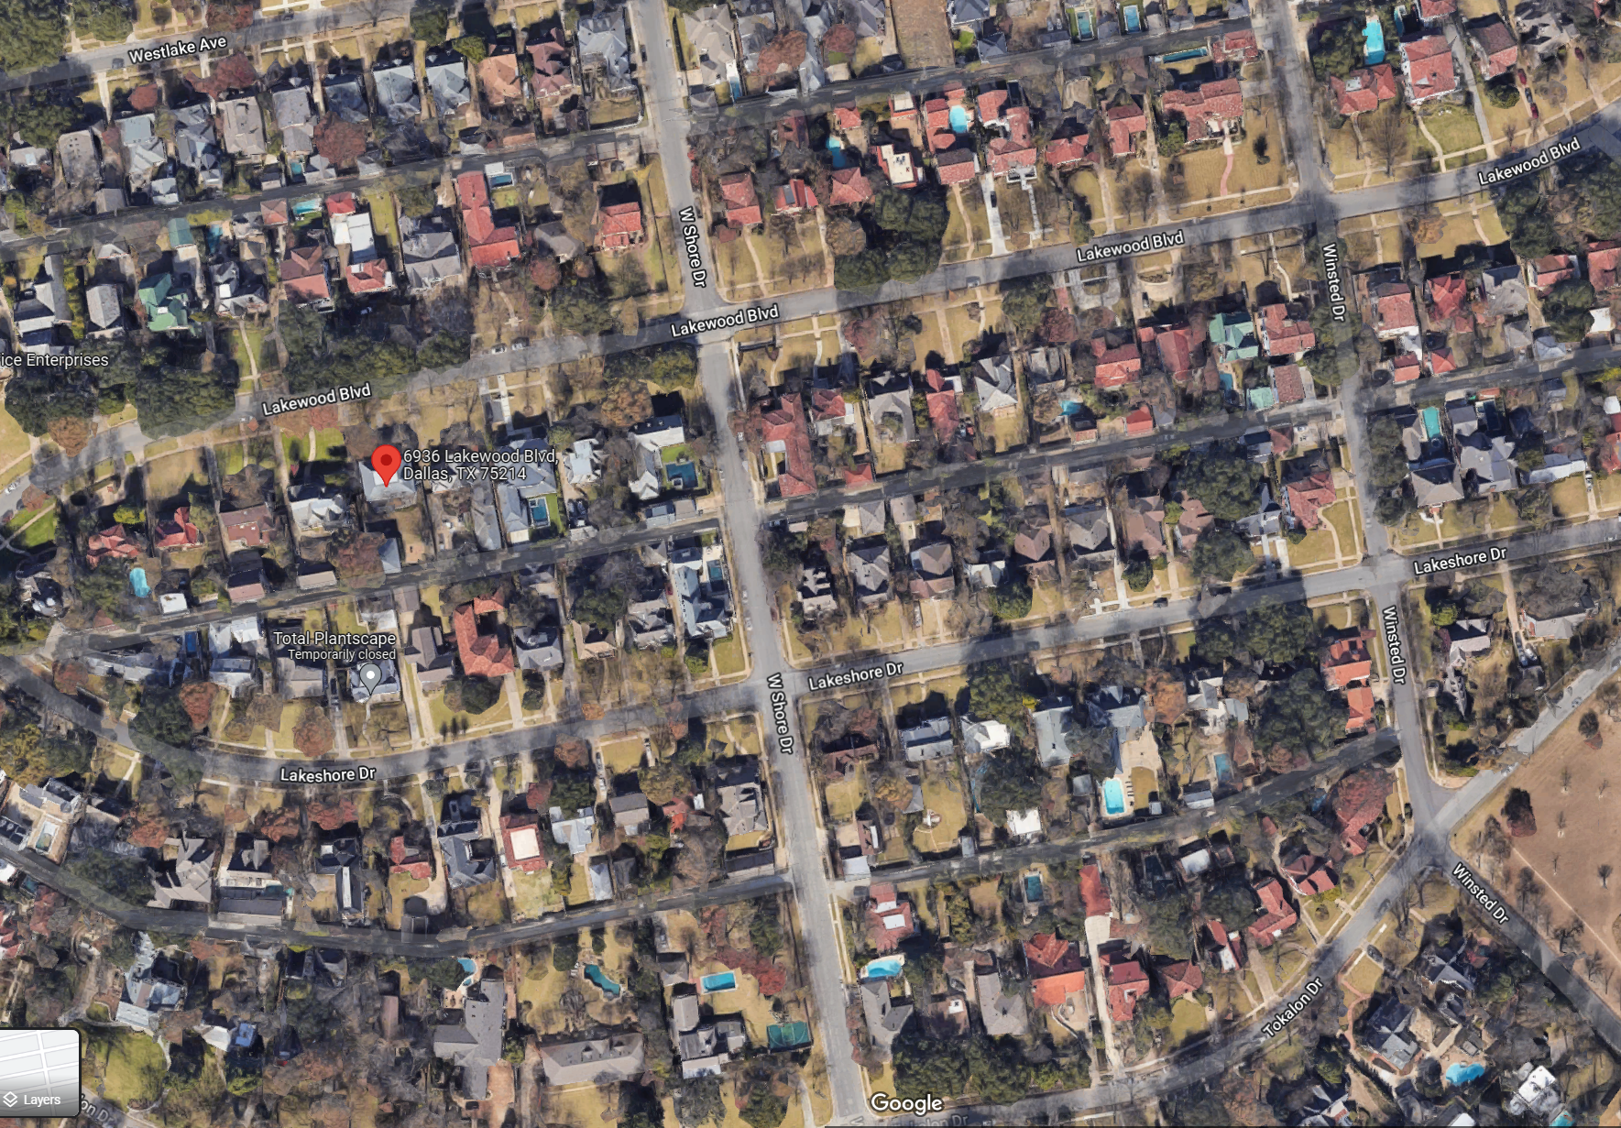
Discussion – Setbacks (Main)
43

Slide 44
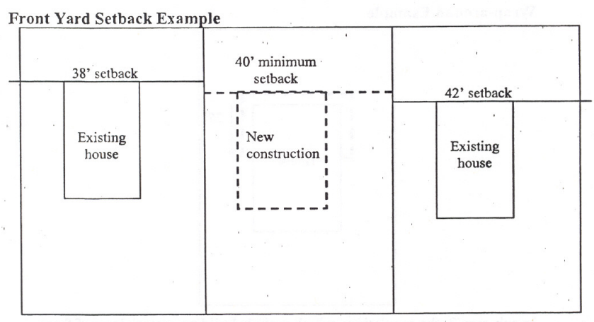
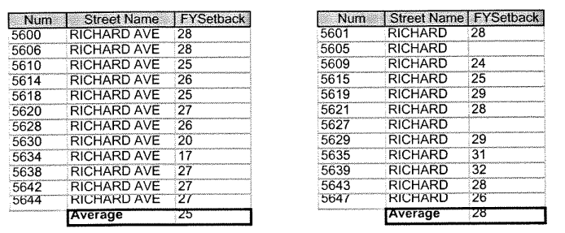
Discussion – Setbacks (Main)
Average Adjacent Lots
Average Blockface
44

Slide 45
Recap – Setbacks (Main)
45

Slide 46
Petition Topic – Setbacks (Accessory)
Modifying side and rear setback requirements for accessory structures
Provisions for existing non-conforming structures
Existing Regulations CD-2
(A) All garage and accessory structures are exempt from side and rear yard setback requirements and may extend along the entire distance of the rear lot line provided that:
(i) no portion of the garage or accessory structure extends into the front half of the area between between the rear lot line and the primary rear facade of the main structure; and
(ii) the second floor of any such structure does not extend along the width of the lot for a distance greater than:
(aa) 40 feet; or
(bb) 60 percent of the length of the rear lot line.
(B) All eaves and overhangs of all accessory structures must be located within the confines of a lot.

Slide 47
Petition Topic – Setbacks (Accessory) (Cont.)
Existing Regulations CD-2 (Cont.)
(C) Any new construction of a wall of a building located less than three feet from an adjacent lot is required to meet a one-hour fire rating as described by the Dallas Building Code, as amended. These walls are not permitted to have window or door openings.
(D) Any construction of a wall of a building located less than three feet from a street or alley must meet the provisions of the Dallas Building Code, as amended.
(E) No side yard setback is required for:
(i) a new or existing one-story porte-cochere; or
(ii) an existing porte-cochere with more than one story; provided that the stormwater runoff from the roof of the porte-cochere is not directed onto an adjacent lot. New additions to a porte-cochere above the first story must meet minimum side yard requirements.

Slide 48
Petition Topic – Setbacks (Accessory) (Cont.)
Existing Regulations R-7.5(A) and R-10(A)
Side yard setback for accessory structures
In a residential district, a person need not provide a side yard setback for a structure accessory to a residential use, including a generator, if the structure:
(A) does not exceed 15 feet in height; and
(B) is located in the rear 30 percent of the lot.
Rear yard setback for accessory structures
In a residential district, a person need not provide a full rear yard setback for a structure accessory to a residential use, including a generator, if the structure does not exceed 15 feet in height. Where the rear yard is adjacent to an alley, a three-foot setback must be provided. Where the rear yard is not adjacent to an alley, no setback is required.

Slide 49
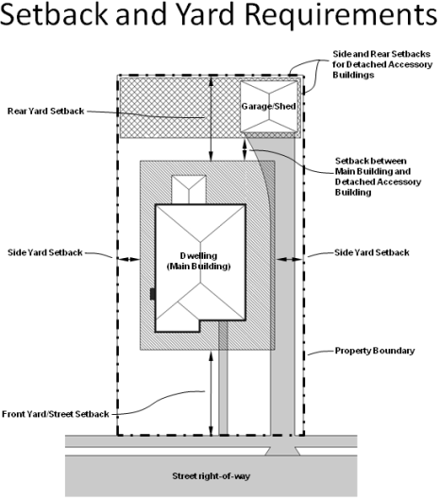
Discussion – Setbacks (Accessory)
Where are original garages and accessory structures located?
Limiting where accessory structures can be located
To the rear of main
Rear 30 percent of lot
Allowance for nonconforming structures
Any additions must meet applicable setbacks without clarifying language
49

Slide 50
Recap – Setbacks (Accessory)
50

Slide 51
Next Steps
Neighborhood Meeting #5: October 26
Neighborhood Meeting #6: November 9
Neighborhood Meeting #7: November 16
Neighborhood Meeting #8: November 30
Neighborhood Meeting #9: December 7
Neighborhood Meeting #10: December 14
Neighborhood Meeting #11-12: If needed
Final Neighborhood Meeting to review ordinance: Date TBD
City Plan Commission Public Hearing: Date TBD (notified 10 days before)
City Council Public Hearing: Date TBD (notified 14 days before)
51

Slide 52
CD-2 - Lakewood Conservation District Expansion Post-Application Neighborhood Meeting No. 4
Staff Contact
Trevor Brown
trevor.brown@dallas.gov
214-670-4193
Project Webpage
https://bit.ly/LakewoodExpansion
Next Meeting October 26, 6:00 pm
Introduction and Recap
Discussion
Accessory structures, fences, retaining walls, waterfall steps, landscape, paint, solar
Next Steps

Slide 53
53

Slide 54
Notes:
Important dates in our specific process.

Slide 56
Notes:
Notification will be mailed of CPC and CC hearings – area + 500’ buffer; anyone can speak to the item at these hearings.

Slide 57
57

Slide 58
58

Slide 59
59

Slide 60
60

Slide 62
62

Slide 63
63

Slide 64
64

Slide 65
65

Slide 66
Notes:
Current regs for driveway access; Point is that access is allowed from EITHER street or alley, but not both

Slide 67
67

Slide 68
Notes:
Current regs for driveway access; Point is that access is allowed from EITHER street or alley, but not both

Slide 69
69

Slide 70
Notes:
Current regs for driveway access; Point is that access is allowed from EITHER street or alley, but not both

Slide 71
71

Slide 72
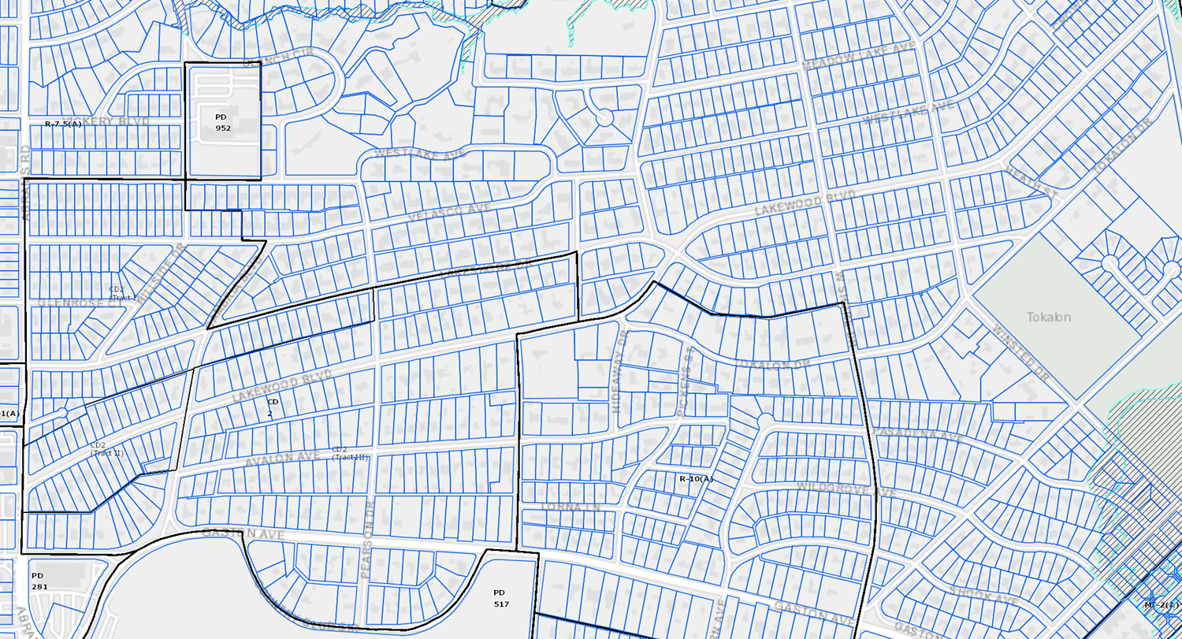
72

