Slide 1
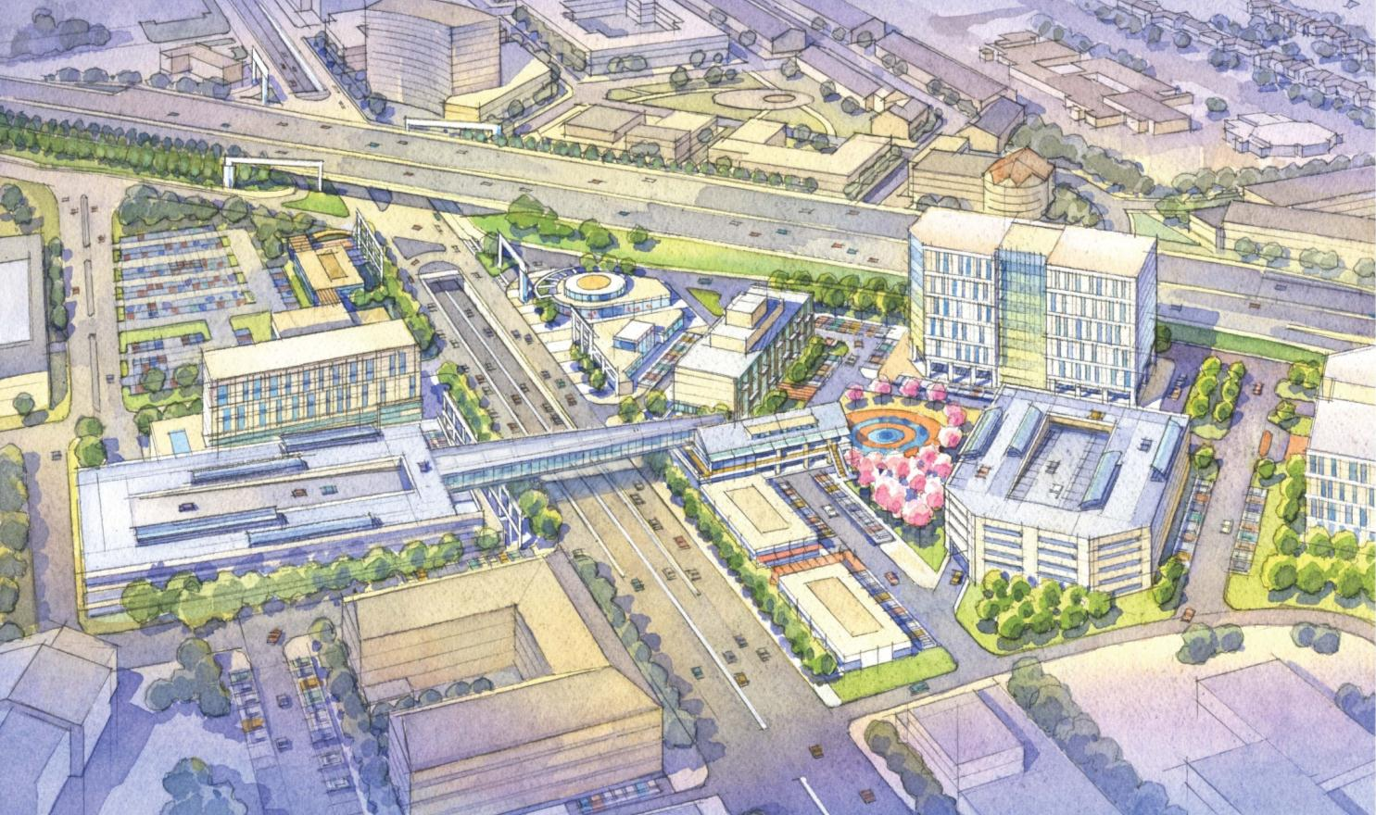
Artist’s Watercolor Rendering

Slide 2
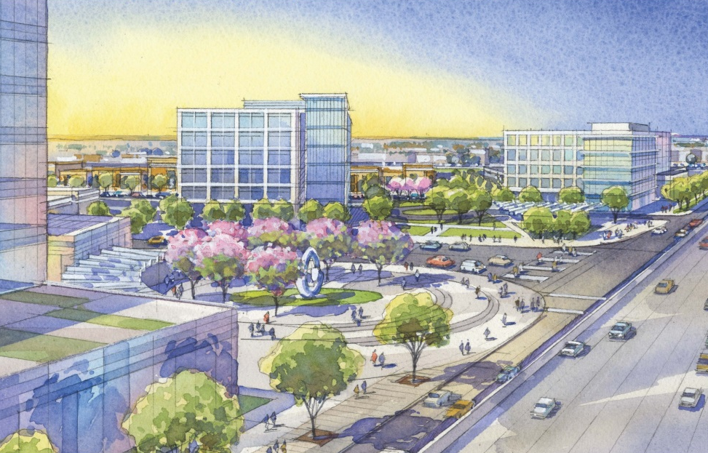
Artist’s Watercolor Rendering

Slide 3
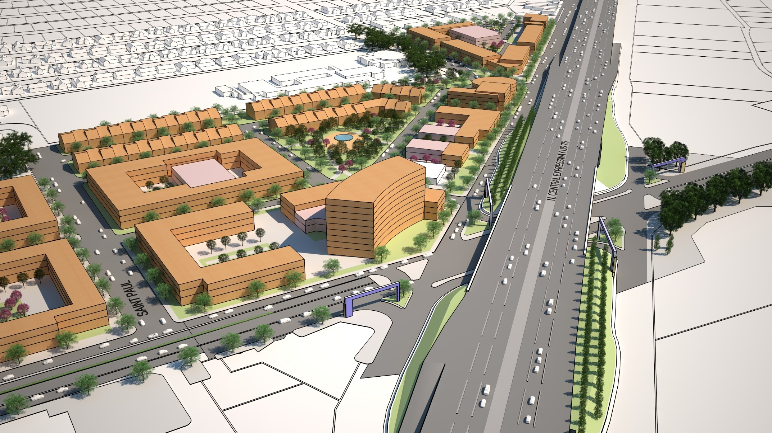
Enhanced Sketch-Up Massing Model

Slide 4
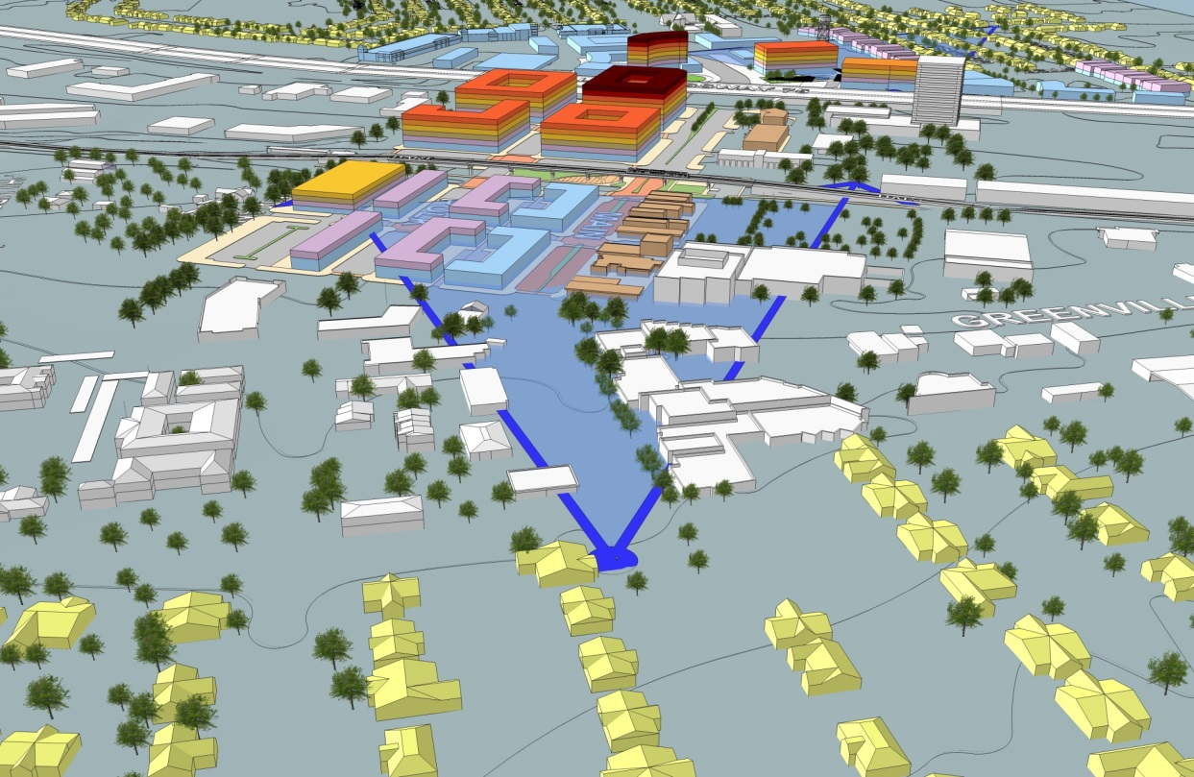
Rough Sketch-Up Massing Model

Slide 5
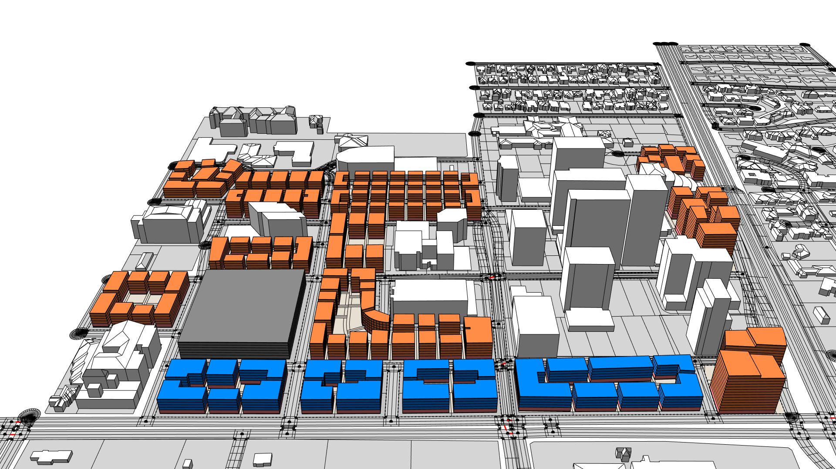
City Engine Massing Model

