Slide 1
Complete Streets & The Urban Design Advisory Committee
Mark R. Brown
Senior Planner
Planning and Urban Design
1

Slide 2
Complete Streets Manual
Planning process began in 2011
15+ Public meetings throughout the city
Adopted by City Council Resolution January 2016
Design guidelines meant for all roadway projects, public & private

Slide 3
Complete Streets Manual
Why are Complete Streets important?
Streets & public ROW generally make up about 20% of a city’s total land area
Complete streets means better mobility, more economic opportunity & cleaner environment for all users
65% of trips under one mile are made by automobile in U.S. ¹ Opportunity for alternate modes
Complete Streets also means safer streets

Slide 4
Ped/Bike Crashes 2009-2013 Heat Map

Slide 5
Design Elements

Slide 6
Traffic Circle

Slide 7
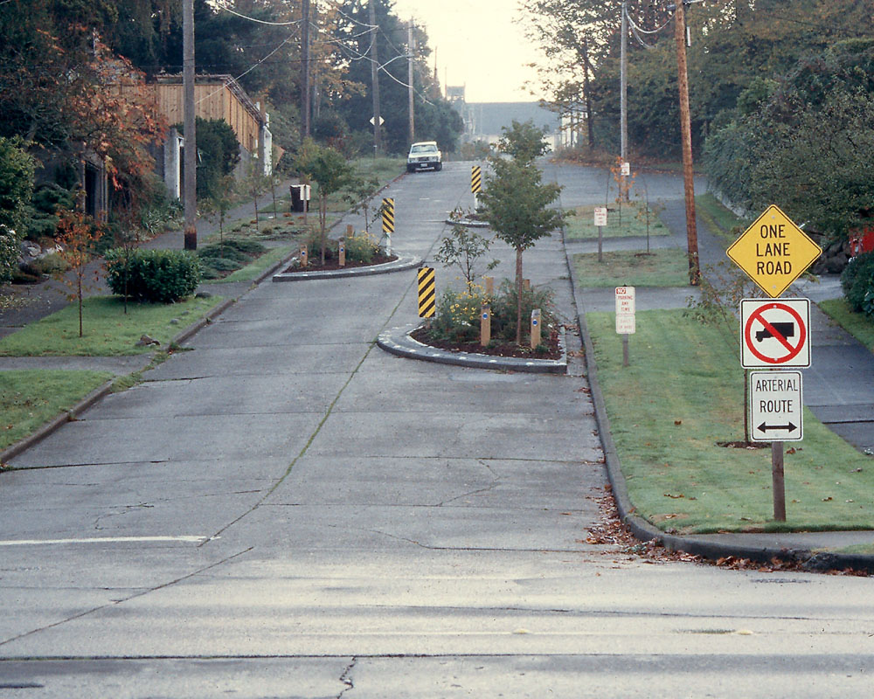
Chicanes

Slide 8
Traditional Bike Lanes

Slide 9
Cycletracks/Protected Bike Lanes

Slide 10
Road Diets

Slide 11
Storm Water Management/Beautification

Slide 12
Pedestrian Plaza Street Conversions

Slide 14
Sidewalk Widening/Road Diet/Full Reconstruction

Slide 17
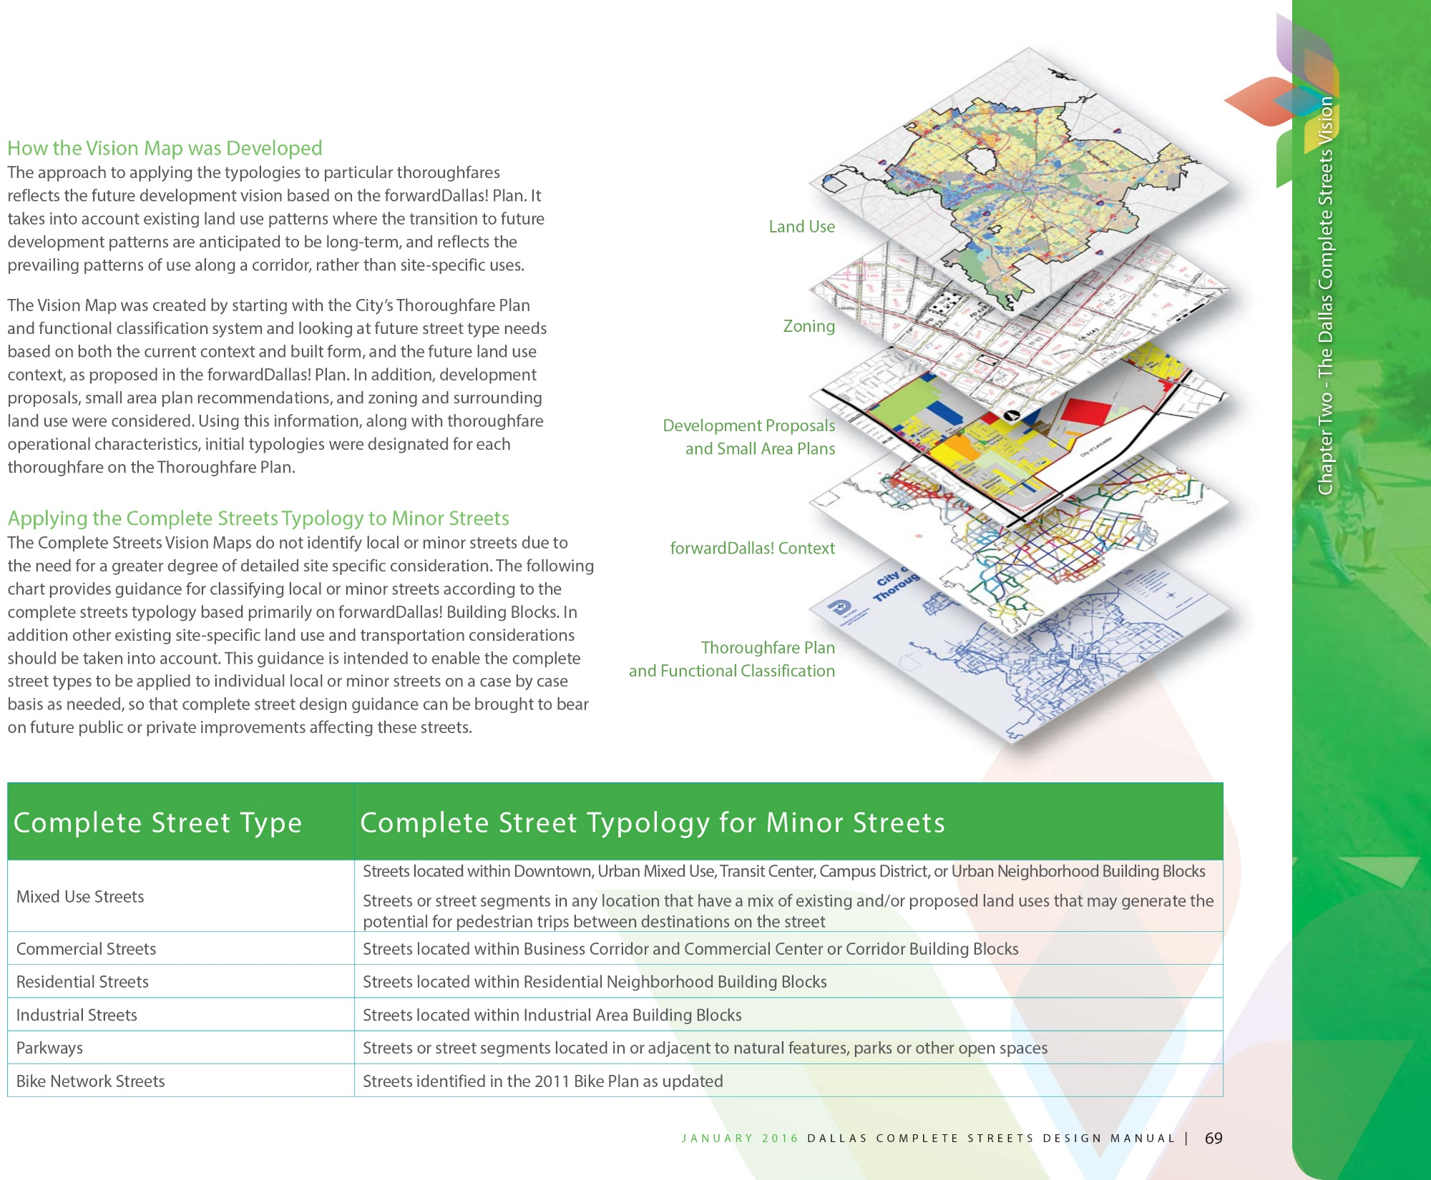

Slide 18
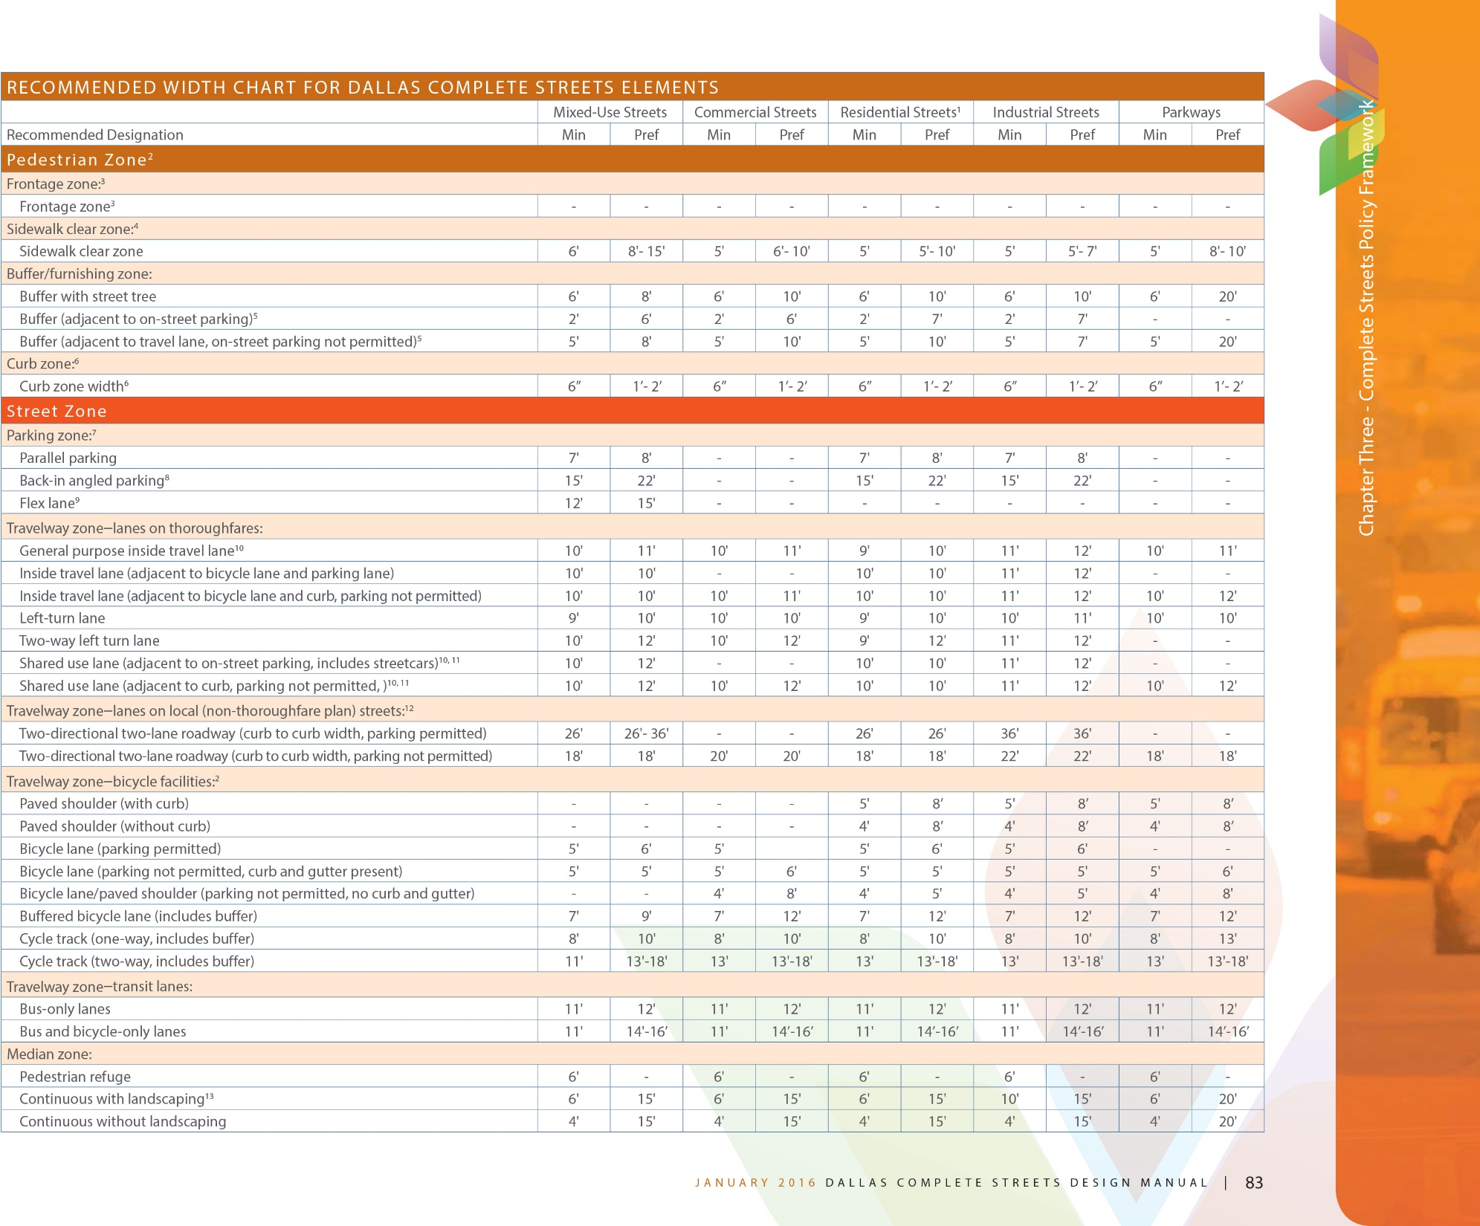

Slide 21
Private Projects
Developments on Thoroughfares
May involve construction/reconstruction of thoroughfares by developer where thoroughfare is not currently built to standard
Large multi-block projects treated differently than incremental development
Design recommendations from Complete Streets Manual should influence zoning regulations/PDs when updates occur
21

Slide 22
Private Projects
Developments on Local Streets
Zoning controls design of local/minor streets rather than Thoroughfare Plan
Complete Streets Manual will provide design policies and standards for minor streets consistent with existing dimensions included in the Development Code
22

Slide 23
Discussion/ Q & A

