Slide 1

UPDATE TO UDAC 6.8.2017

Slide 2
Purpose + Background

Slide 3
Purpose
Provide a progress report on the update of The 360 Plan, a partnership between the City of Dallas, Downtown Dallas, Inc., and the greater 360 community.
Emphasize the integration of priorities from the Dallas Arts District Community Development Plan [as well as other current and future neighborhood-based efforts] into the context of the greater urban core.

Slide 4
Background
Downtown 360 Plan was originally adopted in February 2011.
Impetus for the update stems from significant ongoing development activity, major transportation initiatives, and substantial completion of the 2011 action plan.
Funding for this update provided by Downtown Connections TIF and Downtown Dallas, Inc.

Slide 5
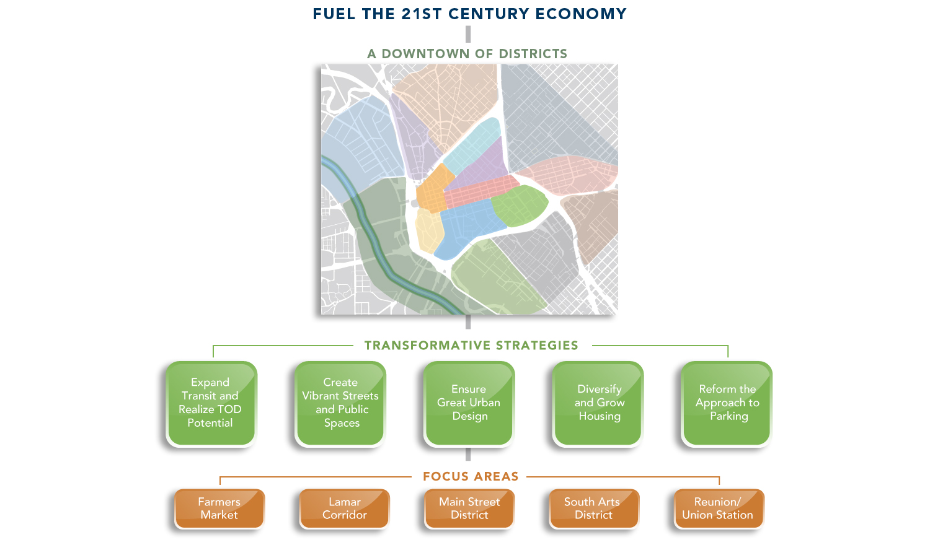
Background: 2011 Plan Framework

Slide 6
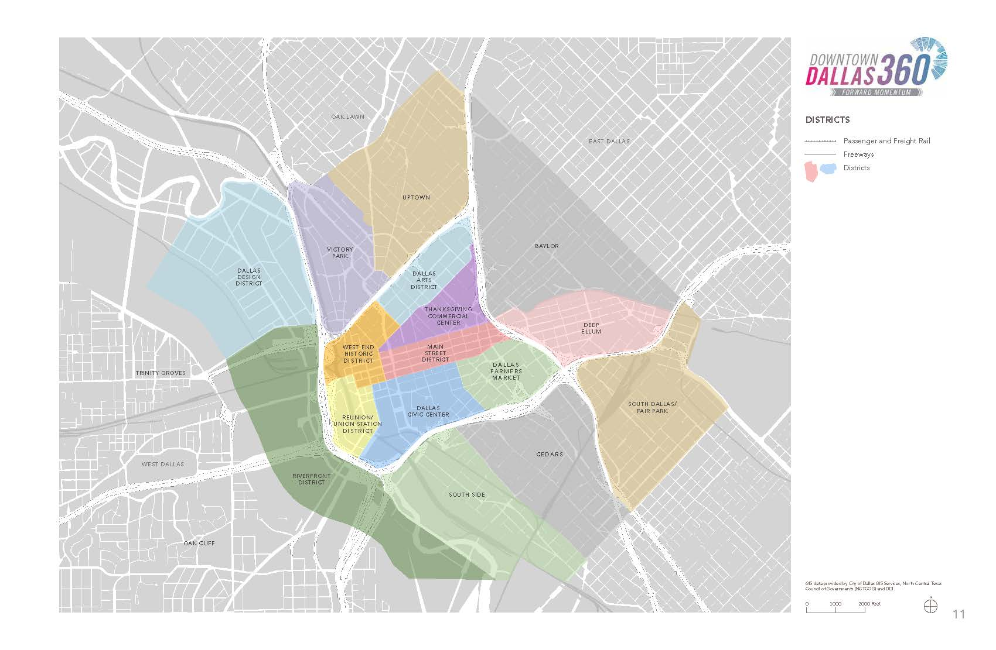

Slide 7
Update Study Area: Evolving Neighborhoods
Notes:
Super impose circle of where we were. Show what we’re doing now
Add label-2011 D360
Revisiting District Boundaries
Show series of arrows into the areas

Slide 8
THE 360 PLAN: VISION [2011]
Downtown Dallas is a complete urban center composed of distinct yet interconnected districts linked by an accessible transit network, each offering a unique and diverse combination of places to live, refreshing open spaces, bustling street activity, successful business and retail, and dynamic urban experiences for residents, workers and visitors alike.

Slide 9
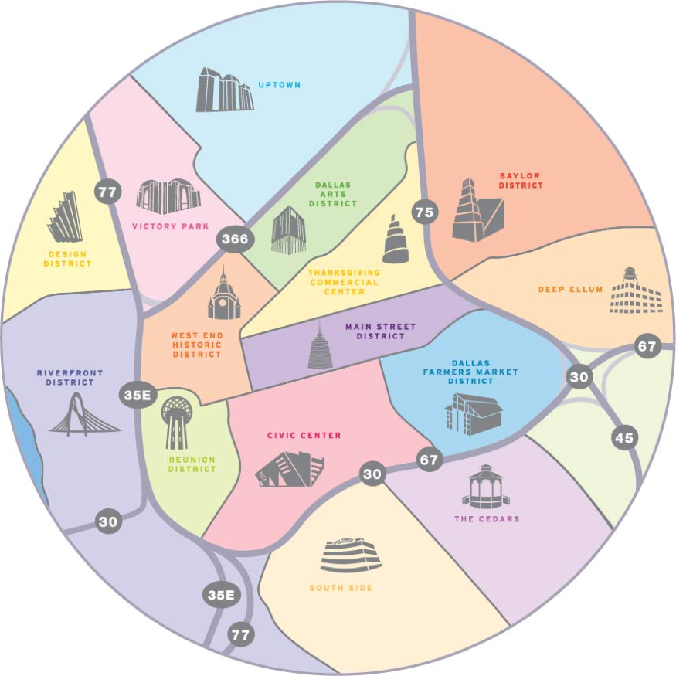
By the Numbers
90+
Developments
Underway
14+
Hotels Under Construction
10,000+
Residents
City Center
50,000+
Residents
Greater Downtown
7,000+
Residential Units
Under Construction
6,400+
Residential Units
Announced
92
Restaurants
Opening in 2016
94%
Occupancy Rate
180+ Planning Efforts within a 2.5 mi radius

Slide 10
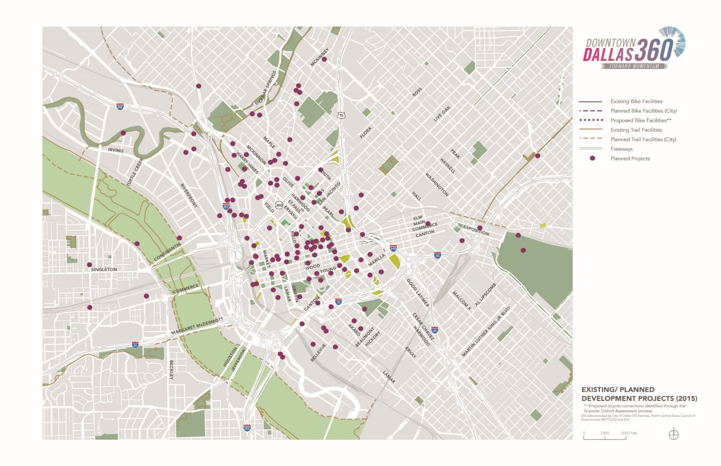
Planned Projects

Slide 11
Transformative Downtown Impact
360
High Speed Rail/DART
Neighborhood Plans, Coalitions and Visions
Public Initiatives
CityMAP
Private Development

Slide 12
Market Assessment

Slide 13
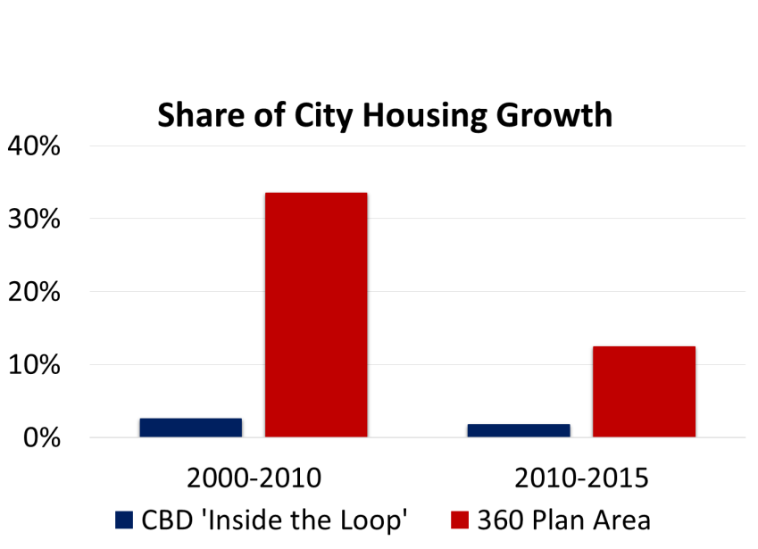
HOUSING UNIT GROWTH 2000-2015
Growth
  150% growth 2000-2015
  15% growth 2010-2015
  2000: 9,700 housing units
  2015: 24,000 housing units
Market Share
  2000-2010: 1/3 of the City’s housing growth
  2010-2014: 12% of City growth

Slide 14
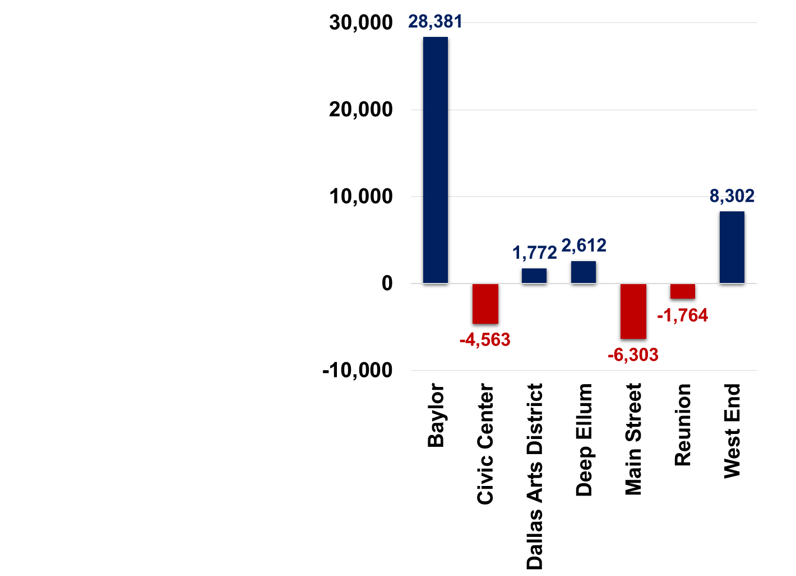
EMPLOYMENT TRENDS 2003-2013
9.0% of Dallas & Collin County job growth
360 Plan Area added 26,800 jobs (+16%)
  Baylor +28,000 jobs
  West End +8,300
Contractions/Shift:
  Civic Center, Main, Reunion
  Conversion of Class B-C office to residential

Slide 15
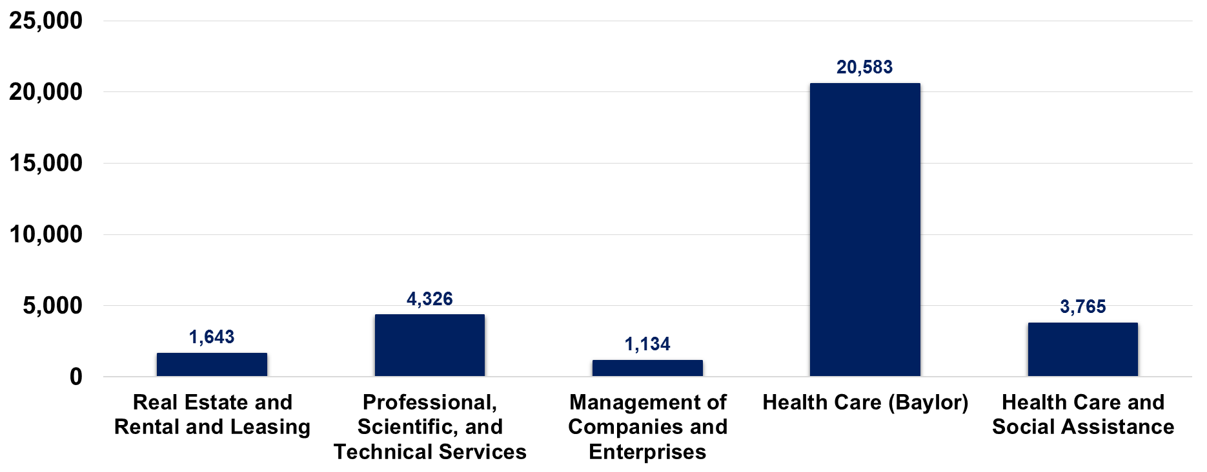
Growth Industries 2003-2013
77% of net growth (20,583 jobs) attributed to the Baylor University Medical Center
Other growth industries include Real Estate, Professional Services, Management, and Health Care

Slide 16
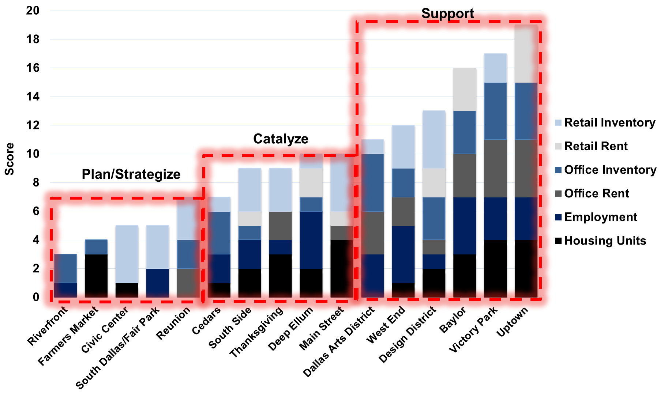
MARKET MOMENTUM SCORING

Slide 17
Alternative Demographic Forecast
ALTERNATIVE 2040 FORECAST
NCTCOG 2040 demographic forecast is not consistent with recent development trends
An alternative 2040 forecast was developed to reflect known development projects and opportunities and to account for high speed rail development
Comparison between scenarios of the jobs to population ratio for the DT 360 area shows significant change that would impact future trip patterns

Slide 18
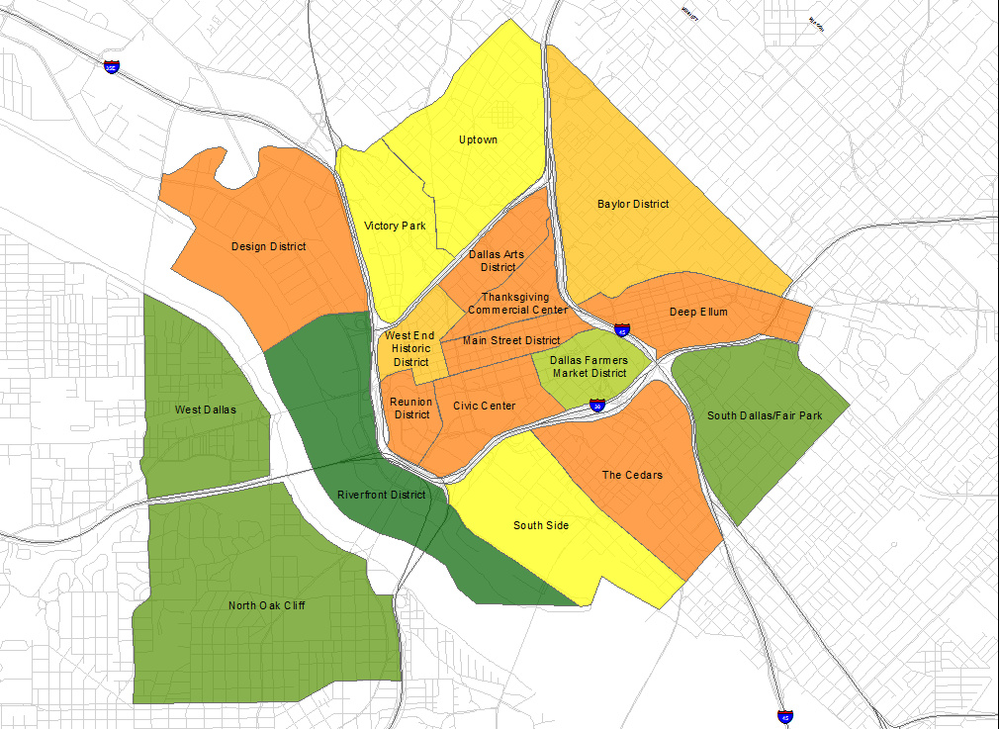
NCTCOG
NTCOG 2040 FORECAST
NCTCOG 2040 Forecast Jobs per Resident
Legend
Less than 1 job per resident
1 to 2 jobs
2 to 3 jobs
3 to 4 jobs
4 to 5 jobs
5 to 10 jobs
Over 10 jobs per resident
Average jobs per resident: 4.2
Source: NCTCOG 2040 estimate

Slide 19
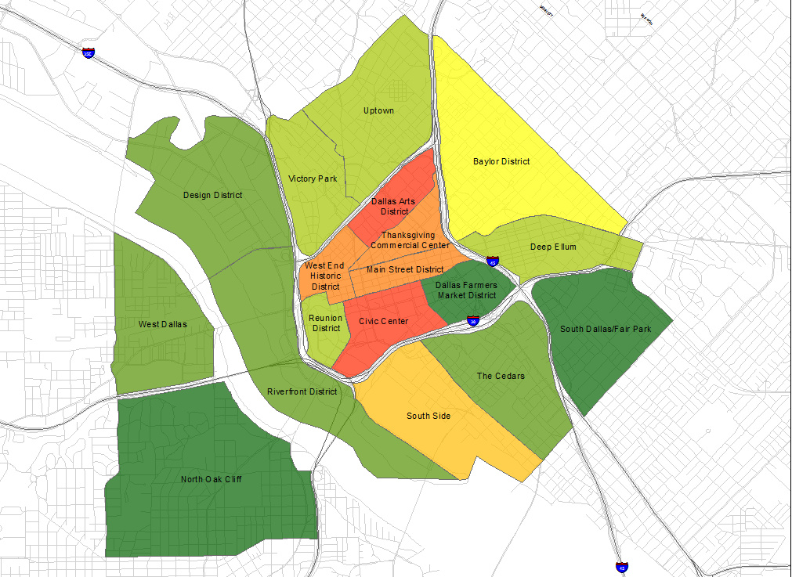
NCTCOG
Alternative Forecast
City of Dallas/Downtown Dallas, Inc. 2040 Forecast Jobs per Resident
Legend
Less than 1 job per resident
1 to 2 jobs
2 to 3 jobs
3 to 4 jobs
4 to 5 jobs
5 to 10 jobs
Over 10 jobs per resident
Average jobs per resident: 3.1
Source: City of Dallas

Slide 20
Streetlight Trip Data
STREETLIGHT TRIP DATA
Cell phone / GPS data shows actual trip patterns related to the DT360 area:
  About 284,000 (19%) of average daily trips are short internal trips
1.54 million trips
472,000 trips
332,000 trips

Slide 21
STREETLIGHT TRIP DATA
Streetlight Trip Data
Uptown accounts for over 110,000 daily short trips within the 360 Area
Notable Daily Internal Trip Patterns
Zones
1 Design District
9 Baylor District
10 Uptown
11 Victory Park
16 Main Street
17 Thanksgiving
18 Art District

Slide 22
DDI Survey
Residents
800 respondents who live and/or work in the study area
66% of residents cite a desire for walkability as the primary reason they live Downtown
52% want to live close to where they work

Slide 23
DDI Survey
Employees
80% of respondents who work in Downtown leave the office at least once a week for lunch breaks
67% stay Downtown for happy hour or dining at least once per month
Most are walking or using DART or rideshare to move between Downtown destinations during lunch or after work

Slide 24
DDI Survey
Getting Around
62% of respondents take a car to work (56% drive SOV)
  13% walk or bike
  15.4% take DART
  7% take “other” (Uber, Lyft, etc.)
99% of respondents drive Downtown when visiting for leisure, but once in Downtown, to move between destinations:
  26% walk or bike
  25% take DART
  23% take “other”

Slide 25
Summary of Key Trends
Rapid residential growth is resulting in a more balanced jobs-population mix and changing travel patterns
An increase in short trips within the study area is impacting automobile congestion at peak hours
Growing demand among downtown stakeholders for pedestrian and bike-friendly street design

Slide 26
Community Based Planning
Community Engagement +
Neighborhood Assessments

Slide 27
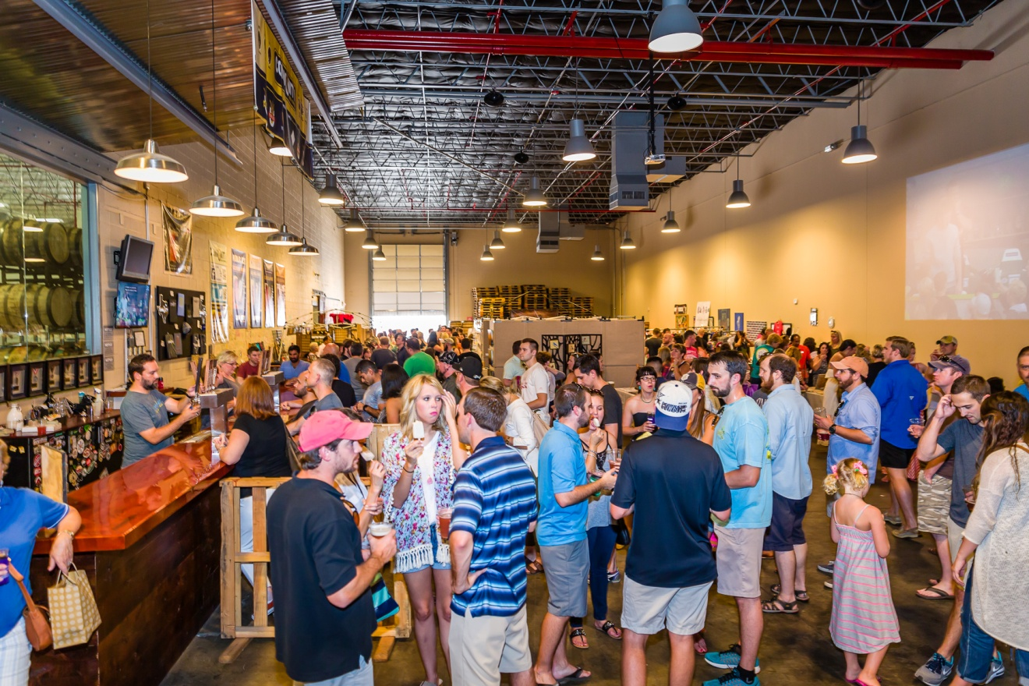

Slide 28
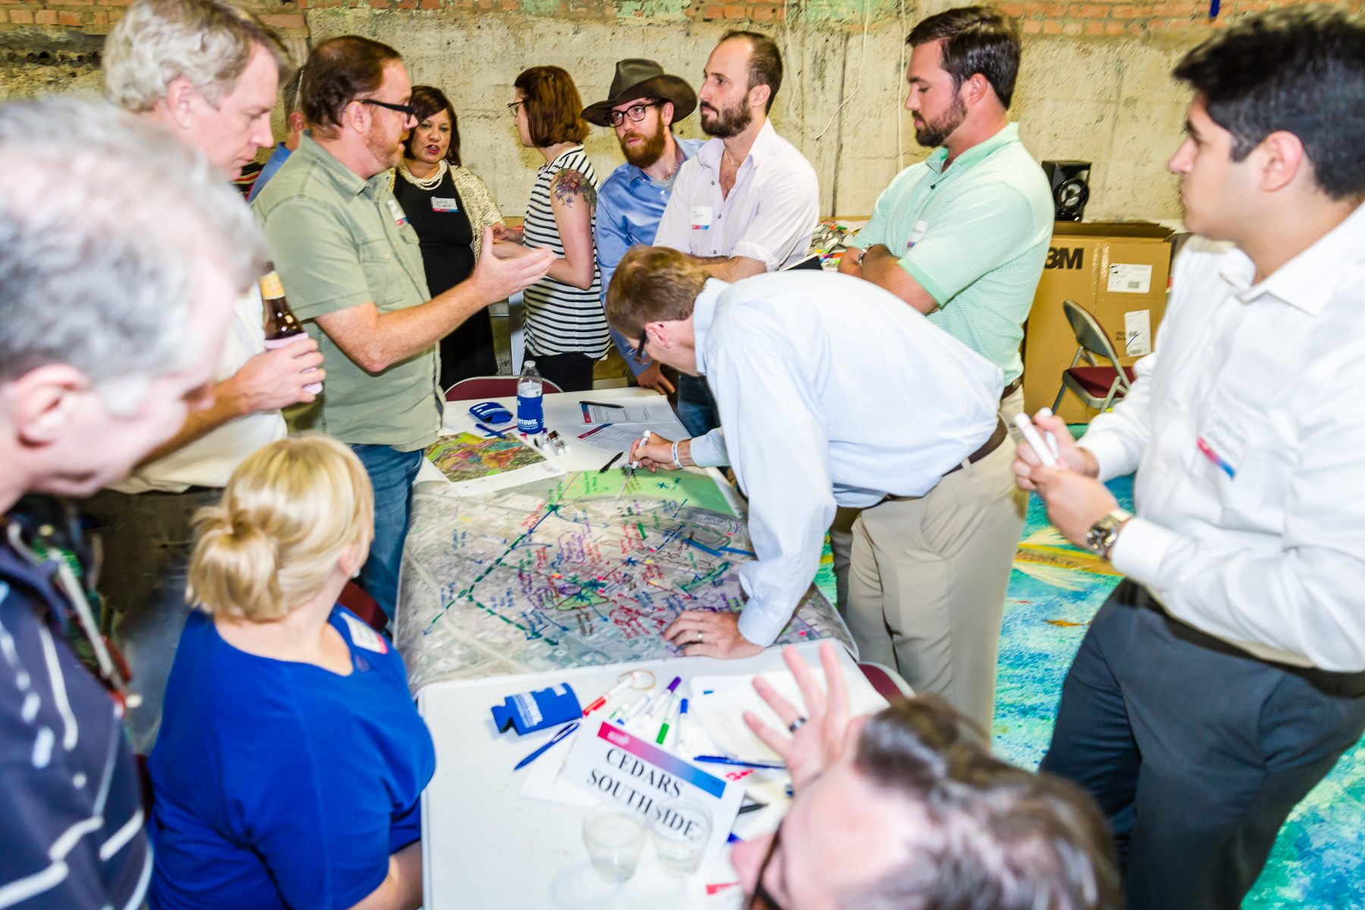

Slide 29
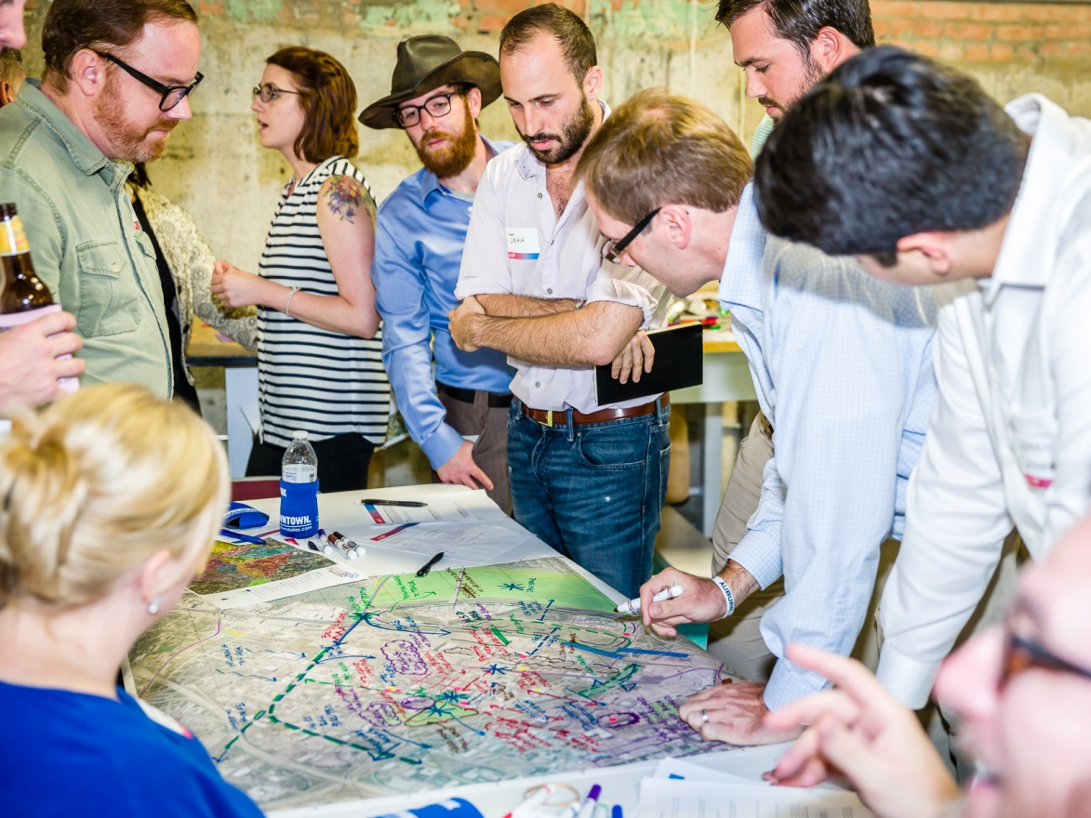
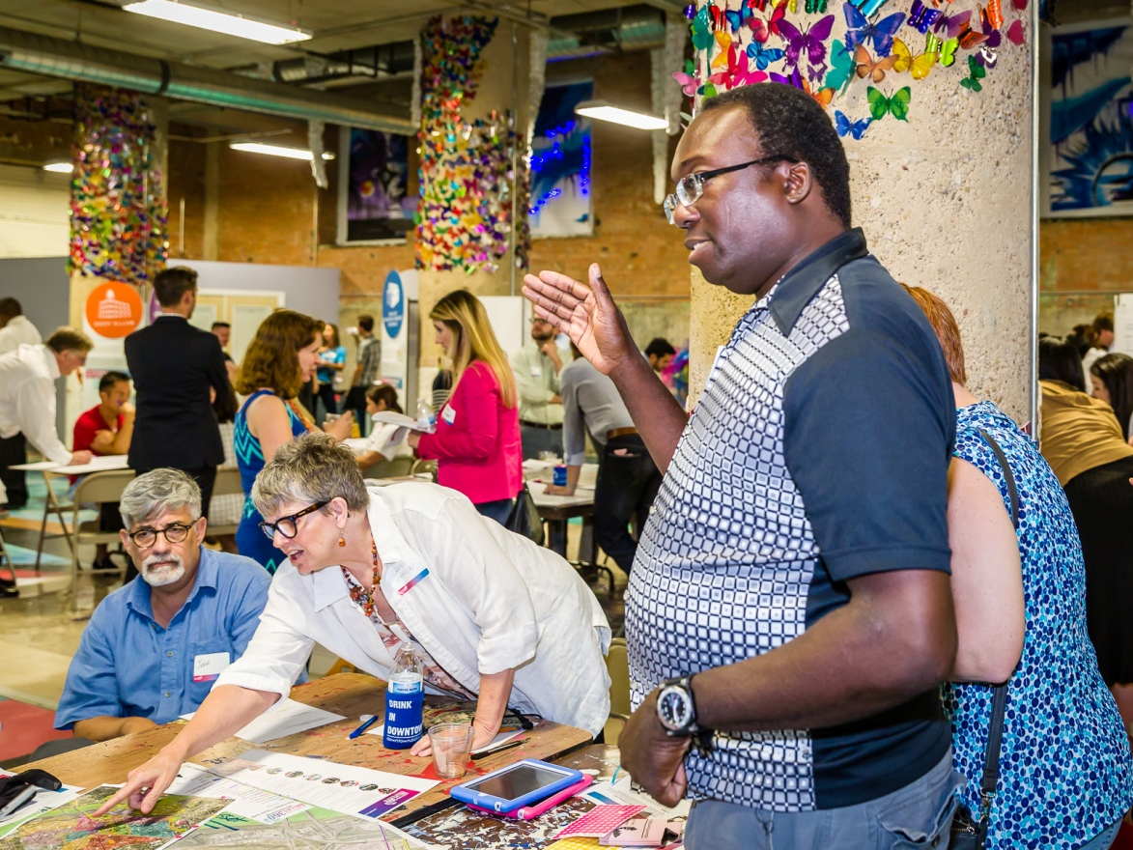

Slide 30
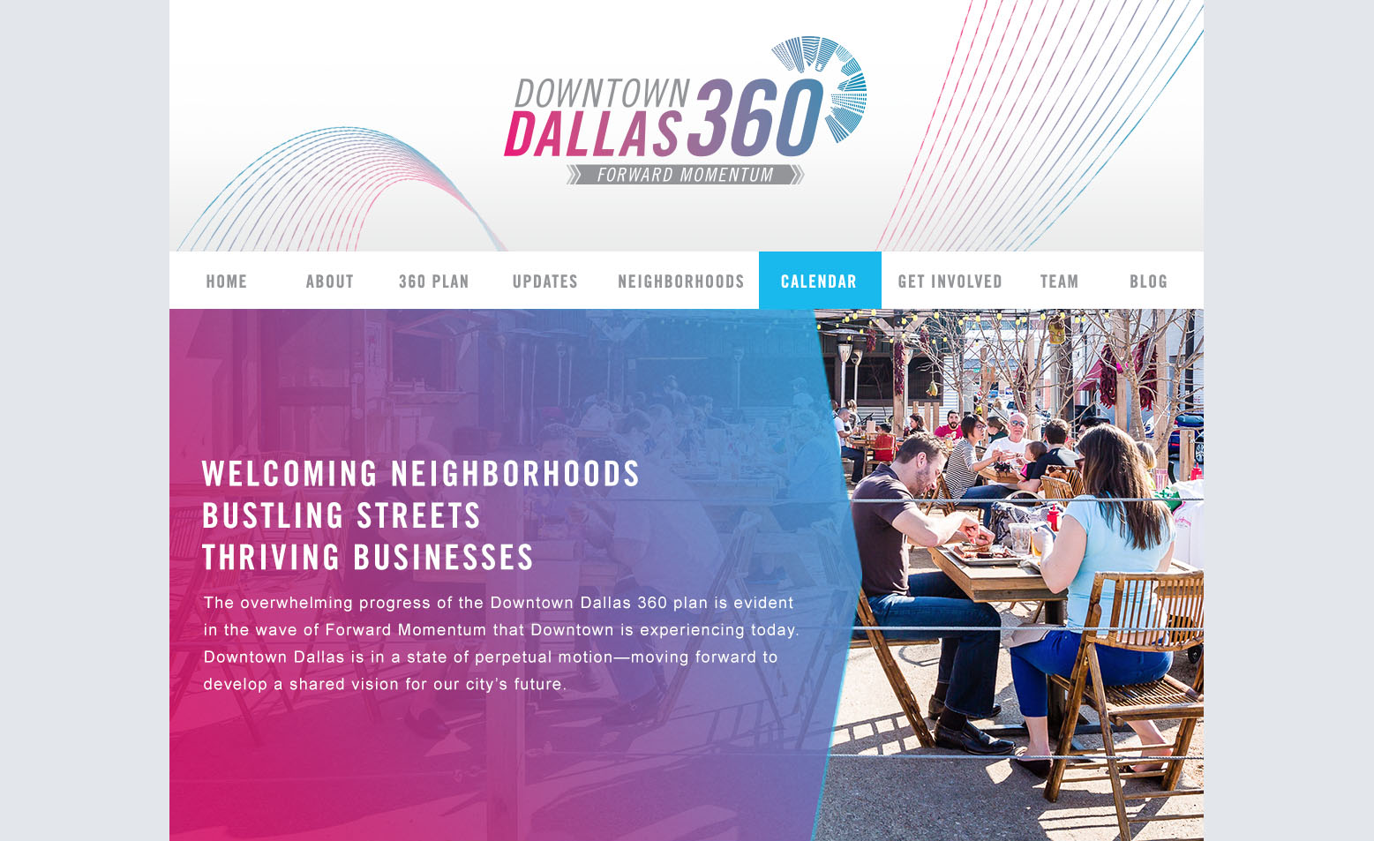

Slide 31
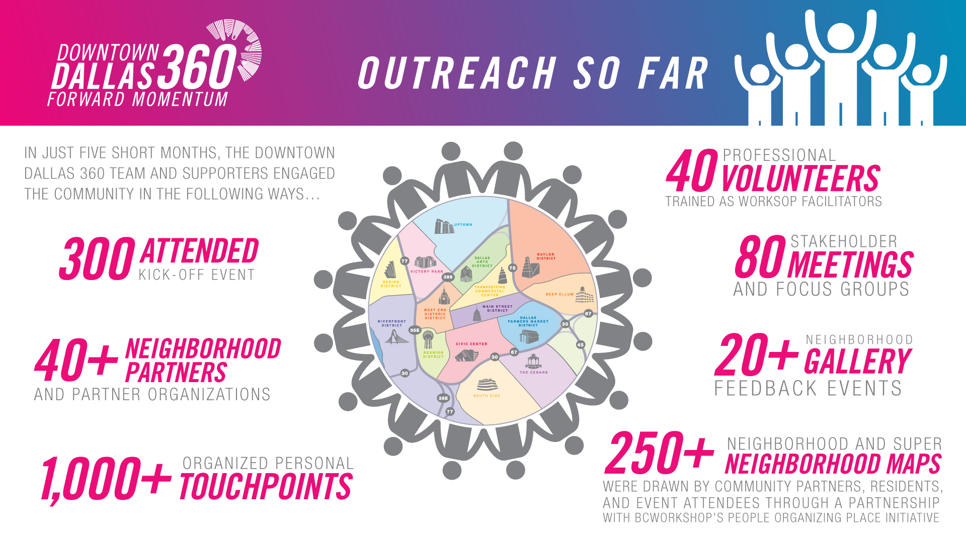

Slide 32
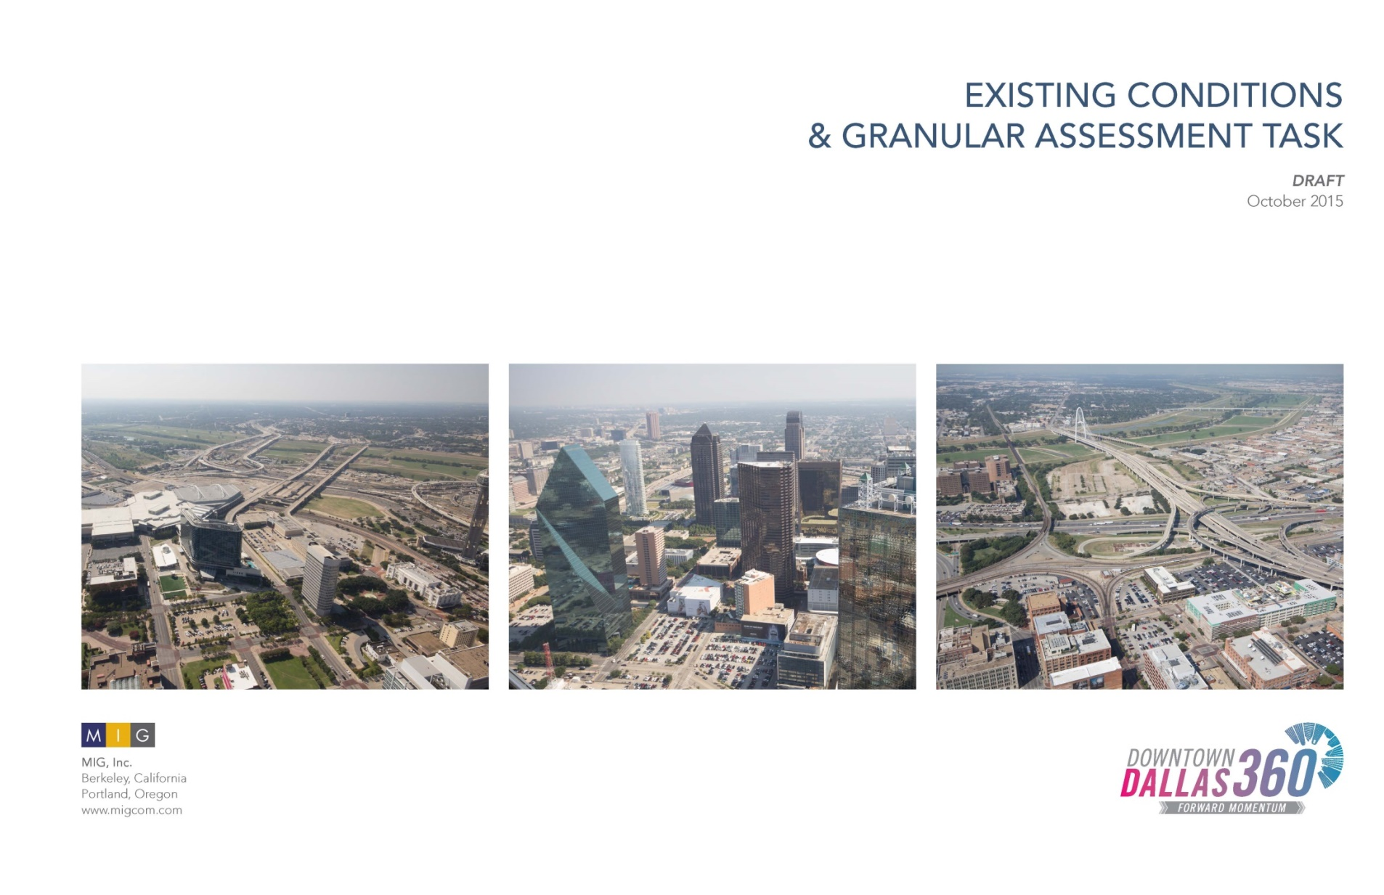
Neighborhood Assessments

Slide 33
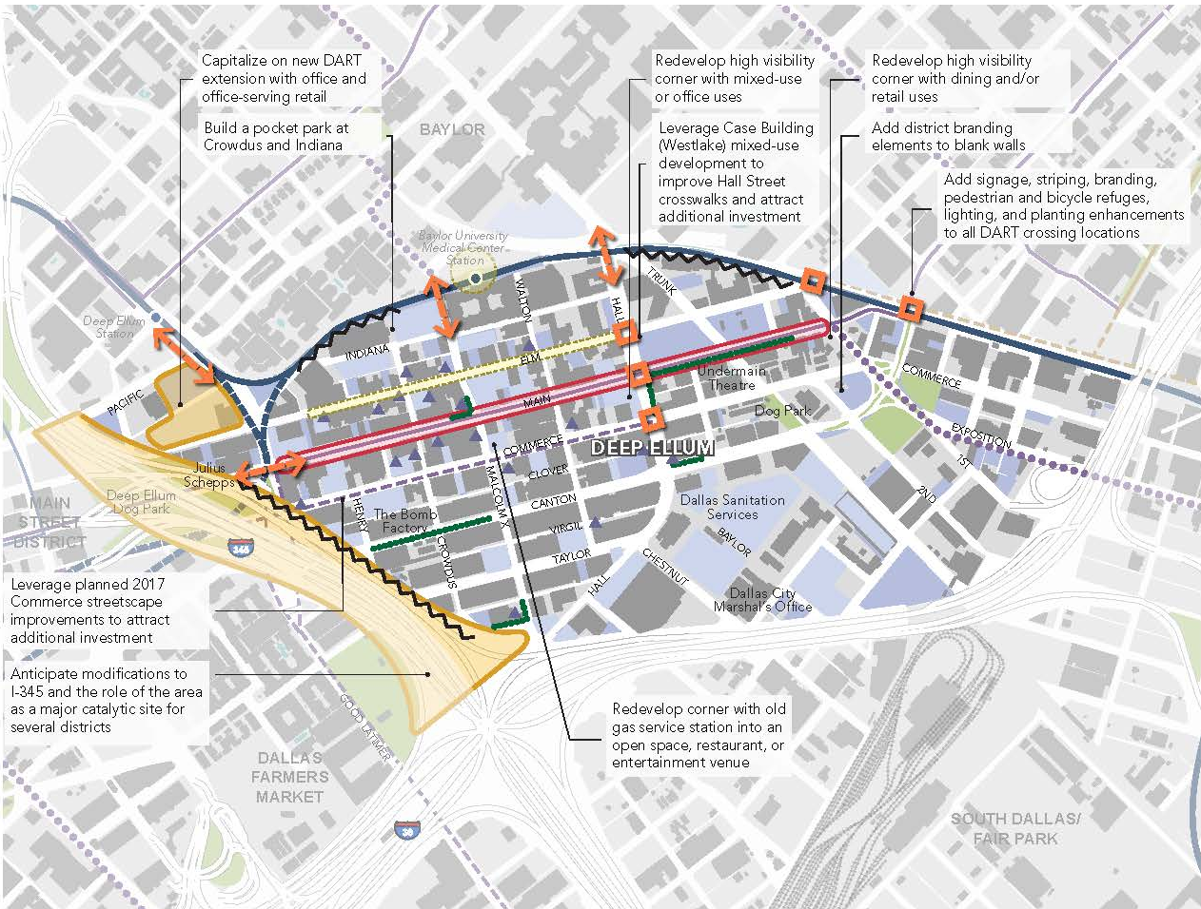

Slide 34
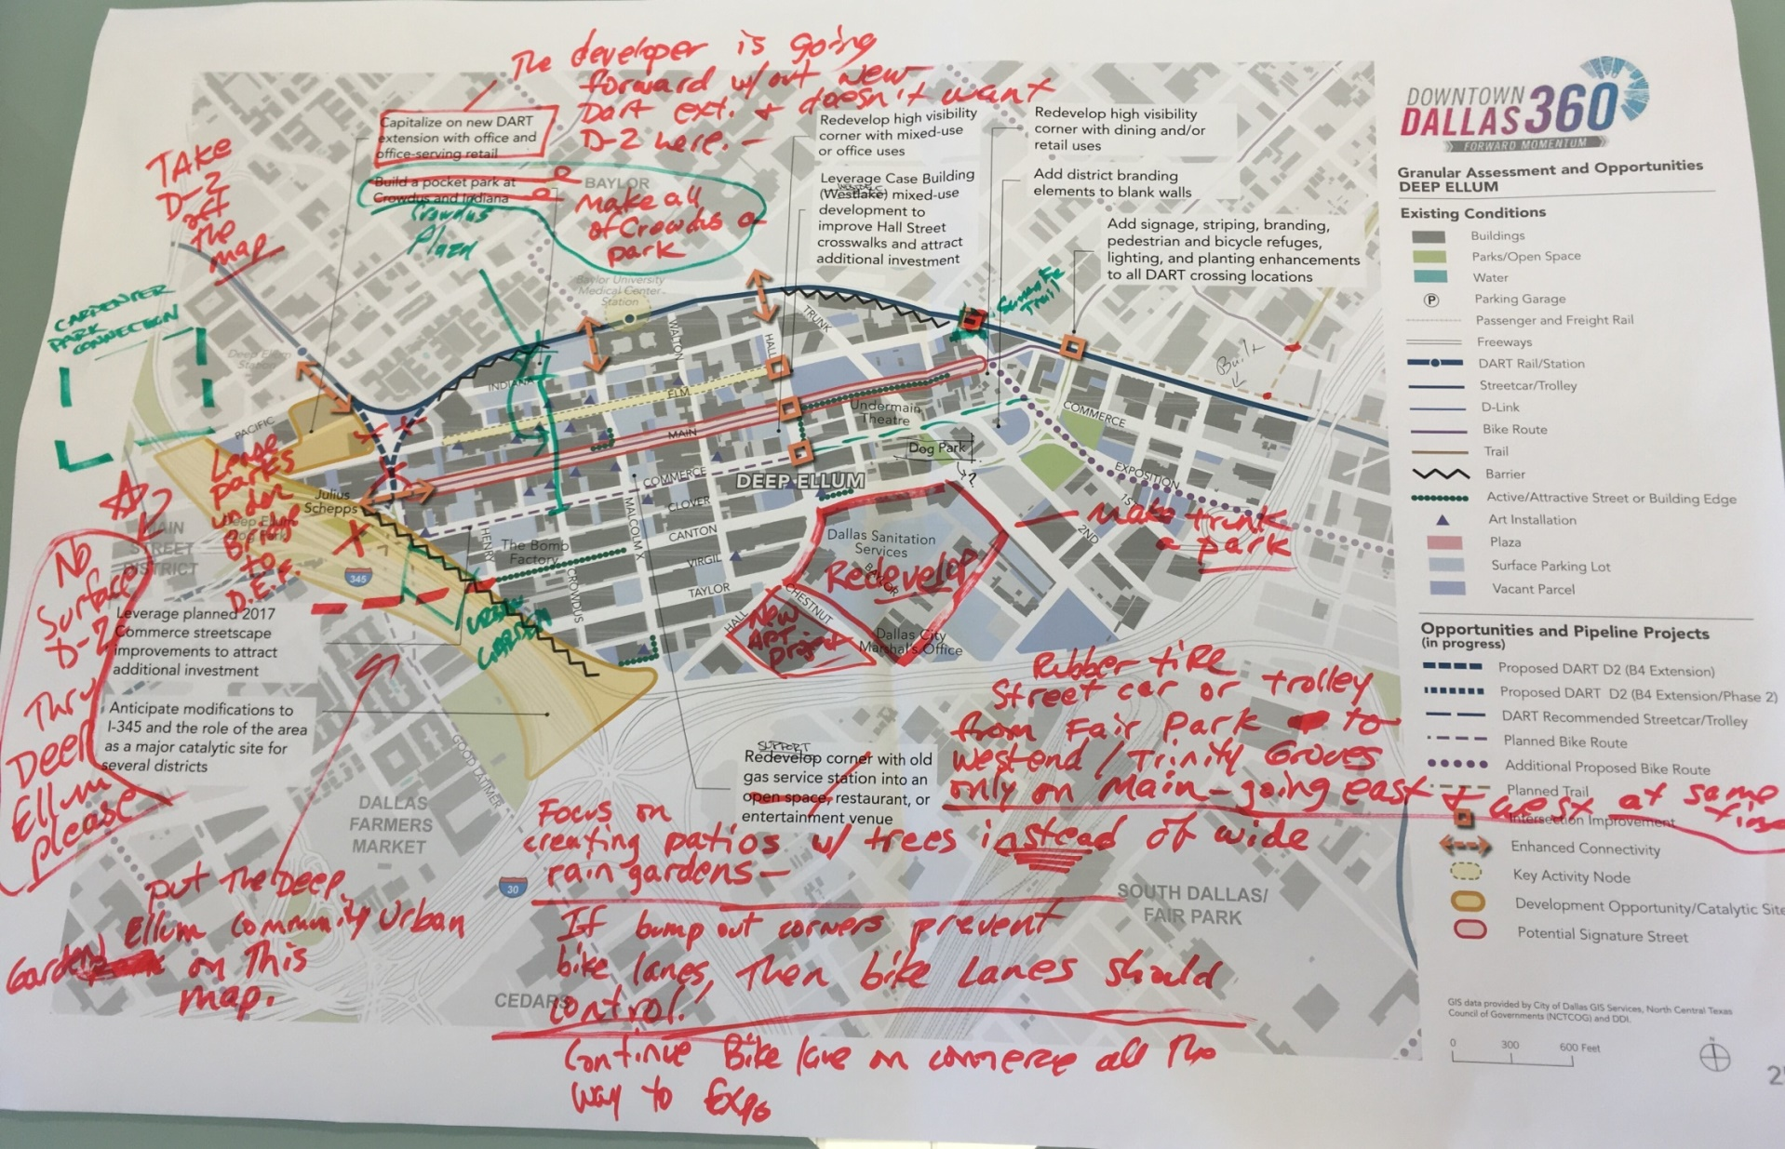

Slide 35
THEMES
Themes
URBAN DESIGN AND PLACEMAKING
Leverage TOD opportunities
Promote development that activates the street
Protect and support neighborhood character
Consider “catalytic streets” to activate and connect districts
Notes:
Themes we heard during community engagement, all of which have attention from other projects by the city and private sector. Leads into the fourth theme and 360’s phase two focus on MOBILITY

Slide 36
THEMES
Themes
HOUSING AND EDUCATION
Provide diverse housing options/product types
Provide good schools Downtown to attract/keep families
Link mobility, education and housing
Notes:
Themes we heard during community engagement, all of which have attention from other projects by the city and private sector. Leads into the fourth theme and 360’s phase two focus on MOBILITY

Slide 37
THEMES
Themes
OPEN SPACE AND RECREATION
Create public spaces that support neighborhoods
Link new parks to existing parks
Build off of successes (Katy Trail etc.)
Notes:
Themes we heard during community engagement, all of which have attention from other projects by the city and private sector. Leads into the fourth theme and 360’s phase two focus on MOBILITY

Slide 38
PRIORITY ON MOBILITY
Themes
THEMES
Create a more balanced transportation system incorporating transit, pedestrians and bicyclists as well as automobiles
Improve connections between the districts
Connect Downtown to the Trinity River
Address access across freeways
Improve the experience on the street

Slide 39
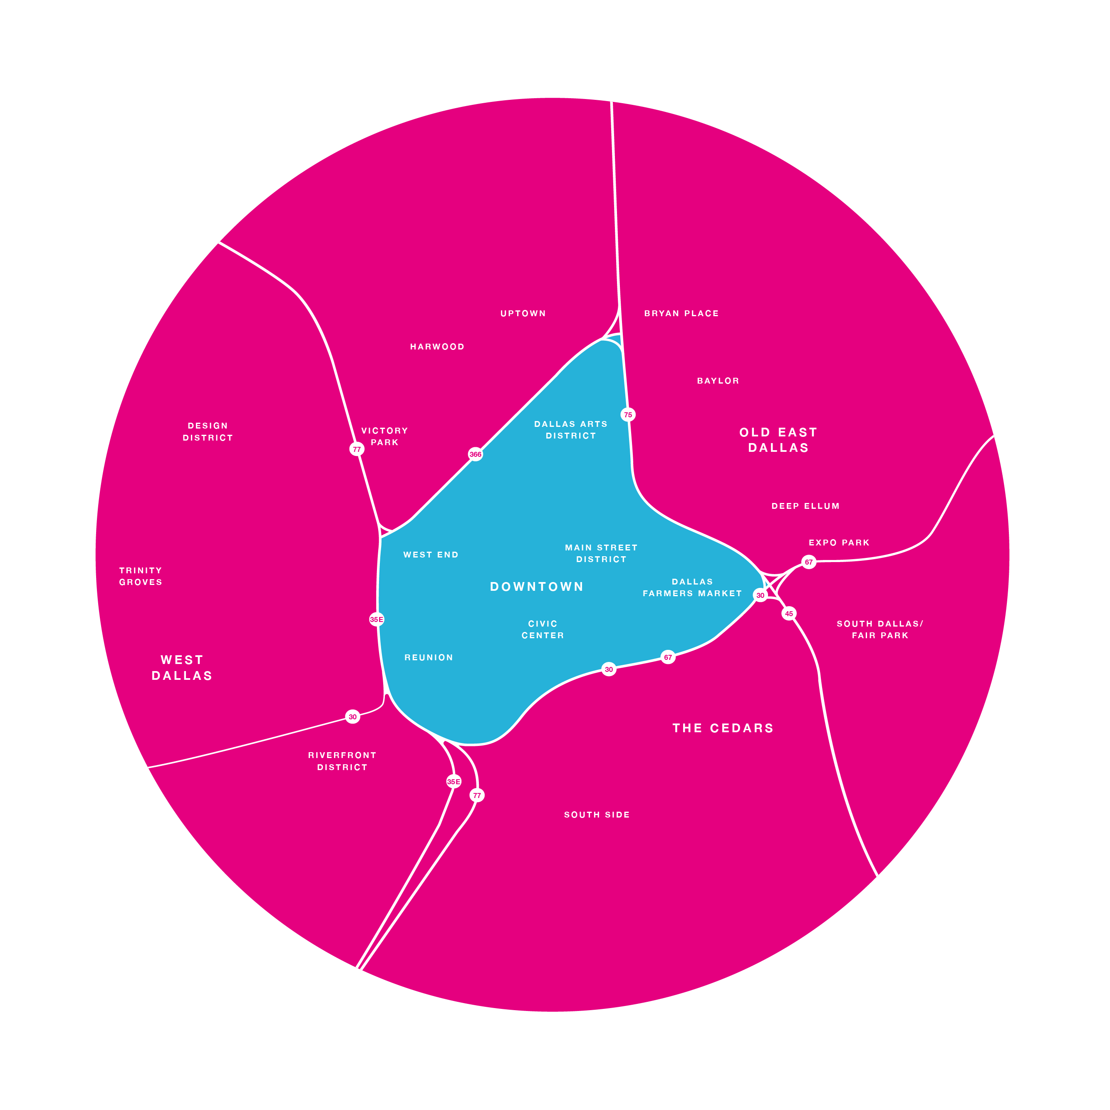
2017 Preliminary Plan Framework
---------- Overarching Goals ----------
Exciting Urban Experience
Balanced + Accessible Transportation System
Inclusive Urban Center
A Connected Urban Center
TRANSFORMATIVE STRATEGIES
Foster the Growth of Complete Neighborhoods
Ensure Great Urban Design and Experiences
Advance Balanced Urban Mobility Principles
Diversify and Grow Housing
Create Vibrant Parks + Neighborhood Spaces
Grow a Diverse Mix of Services and Retail
Increase Opportunities for Quality Education
Urban Design Principles (2011)
Activation Strategies (i.e. Kiosks, flex space, blank wall activation, pop up uses, events, etc. )
Adopted Principles
Street Classifications
Strategic Multimodal Projects [Ped, Bike, Transit, Freeway, Street Improvement]
Focus Areas

Slide 40
Focus on Mobility

Slide 41
MOBILITY PRINCIPLES
Urban Mobility Principles
Create a balanced multimodal system that can support transit, bicycles and pedestrians in addition to automobiles, particularly for short trips.
Provide a system that is safe, well-lit, comfortable and accessible for a diverse base of users.
Improve inter-district connectivity for all modes of travel.
Notes:
Builds off of 2011 Plan
Focuses on all modes and better circulation
Mobility Principles align with public desire for a safe, attractive, and connected network for all users
KG: I would like to move these up in the presentation as the first thing we talk about as a product of phase two that will guide every other outcome of the plan. If it works in the flow, I’d also like to be the one to address the principles since we’ve been really massaging them the most

Slide 42
MOBILITY PRINCIPLES
Urban Mobility Principles
Encourage mixed use, pedestrian-oriented design and development.
Ensure that both regional and local transportation systems support urban design and livability goals for Greater Downtown Dallas.
Deliver a system that responds proactively to future trends in technology, demographics and user preferences.
Notes:
Builds off of 2011 Plan
Focuses on all modes and better circulation
Mobility Principles align with public desire for a safe, attractive, and connected network for all users

Slide 43
Mobility Planning Approach
Mobility Planning Approach
Focus on multimodal mobility
Establish a multimodal street classification system to provide a balanced framework to guide street design and operation
Respond to strategic freeway projects: CityMAP
Respond to strategic transit projects: D2, Central Dallas Streetcar Link, High Speed Rail
Identify and evaluate strategic street improvement projects for near-term implementation (2 to 5 years)
Identify development focus areas and action plans to respond to strategic mobility projects

Slide 44
Multimodal Street Classification
Multimodal Street Classification
District Connectors: Prioritizing multimodal inter-district connections and promoting a uniformly high standard of pedestrian-friendly design
  Bicycle – A network of safe, efficient and dedicated bike facilities across districts
  Transit – Prioritized corridors with high transit frequency and significant existing or planned transit infrastructure
  Auto – Corridors providing key automobile connections to and across freeways
Neighborhood Streets: Intra-district multi-modal streets primarily serving local destinations
Notes:
Two Tiers
District Connectors versus neighborhood streets

Slide 45
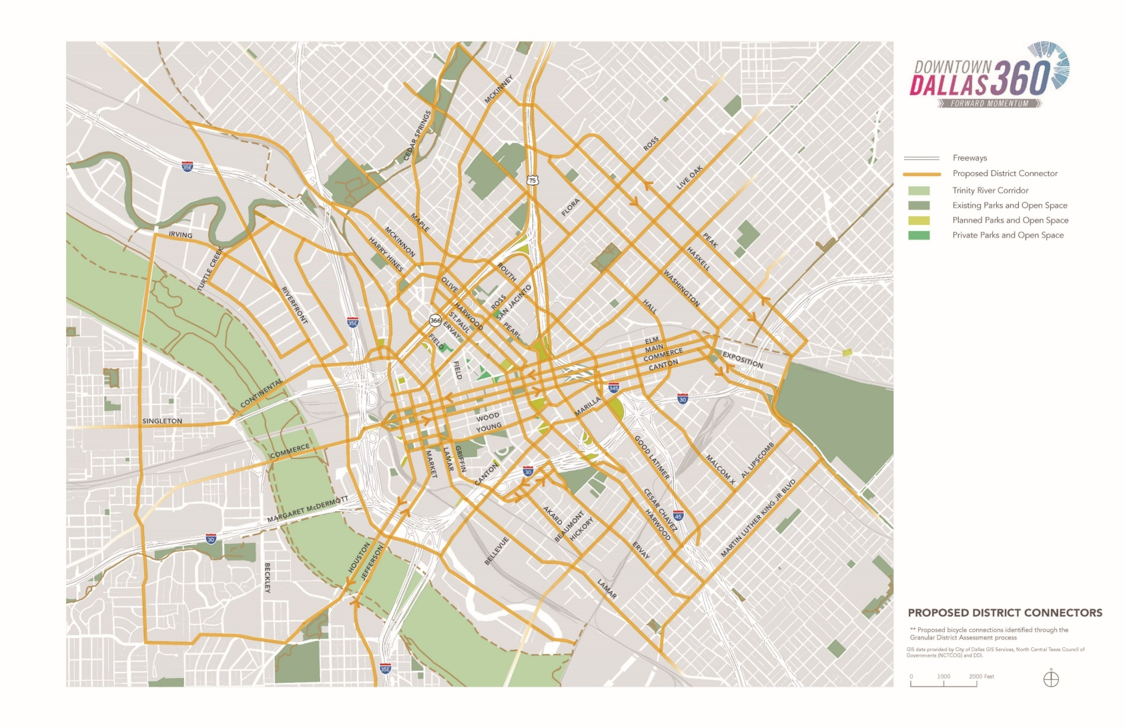
Multimodal Street Classification: District Connectors
District Connectors: inter-district multimodal links that promote a uniformly high standard of pedestrian-friendly design
Neighborhood Streets: Intra-district multi-modal streets primarily serving local destinations

Slide 46
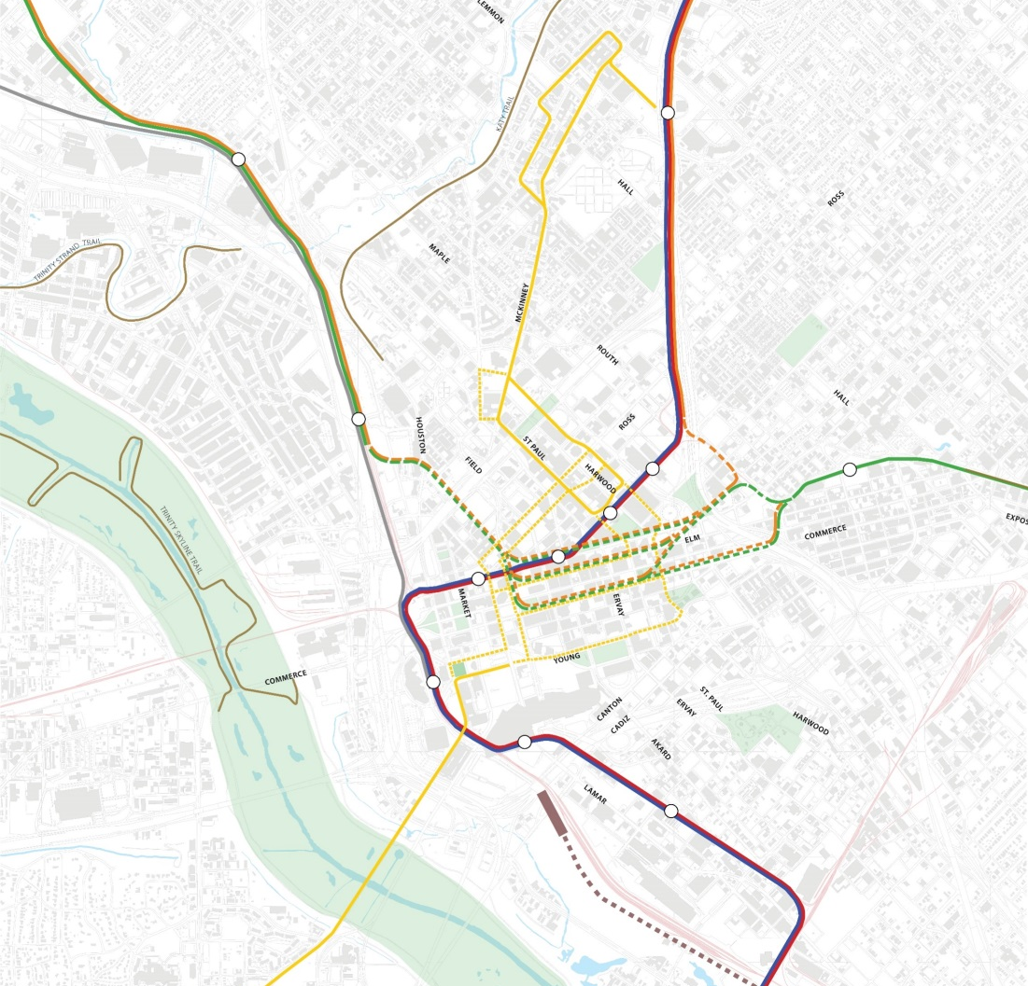
Strategic Transit Projects
Key Projects:
  DART D2
  Central Dallas Streetcar
  High Speed Rail
Focus on design recommendations to maximize multi-modal accessibility to transit stations and corridors

Slide 47
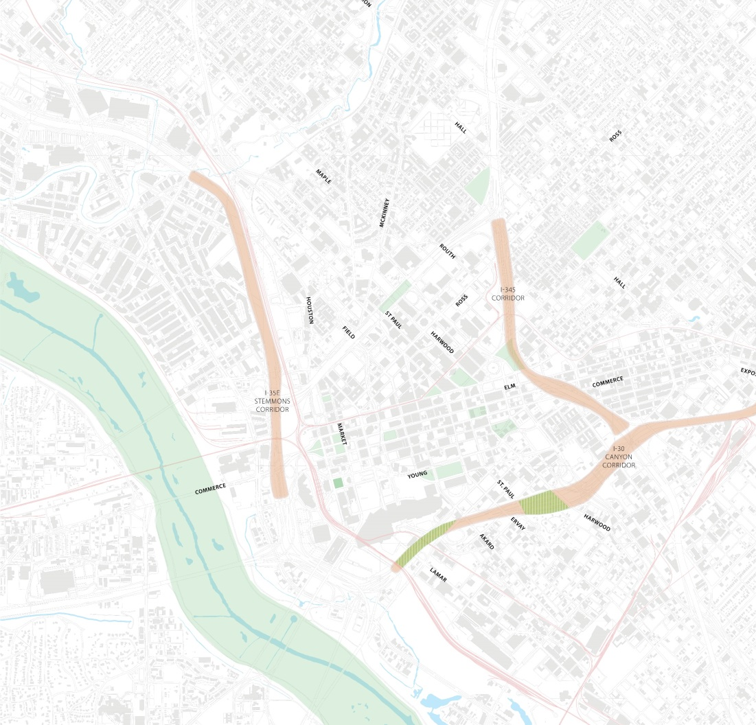
Strategic Freeway Projects
Key Projects
  Lowest Stemmons
  I-30 Canyon
  I-345
Focus on design recommendations to enhance pedestrian, bike and transit crossings and linkages and minimizing the impact of these corridors as barriers

Slide 48
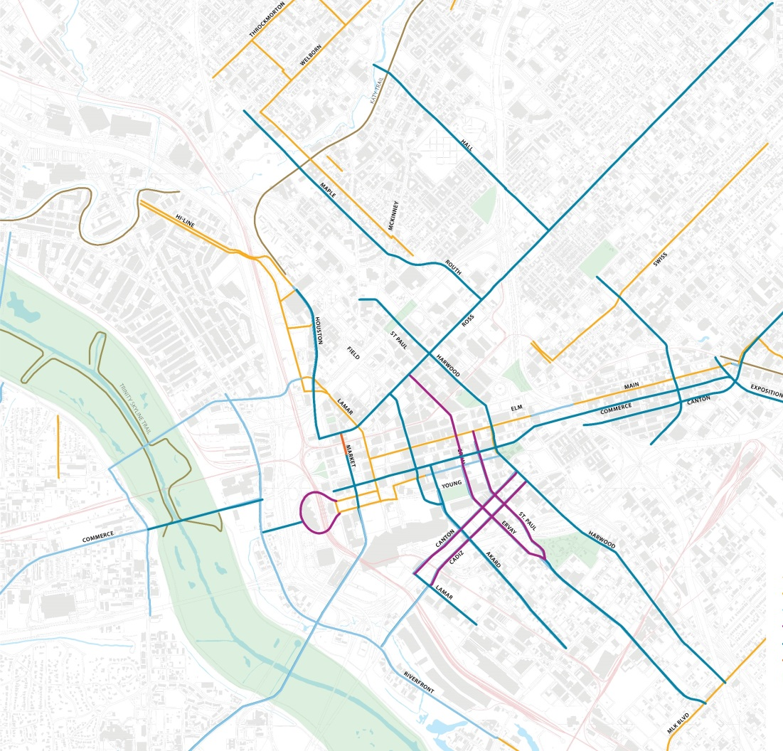
Strategic Bikeway Projects
Priority corridors for dedicated bikeways to jump-start the creation of a central area bikeway network

Slide 49
Strategic Pedestrian Projects
Key corridor and intersections where improvements will significantly enhance pedestrian accessibility to transit and local destinations.

Slide 50

Strategic Street Improvement Projects

Slide 51
Evaluation Scenarios
EVALUATION SCENARIOS
Three scenarios:
  Existing baseline (2017):
    Current regional transportation conditions
    Current local transportation conditions
    Current jobs-population estimate;
  Future baseline (2040):
    NCTCOG 2040 Mobility Plan regional transportation conditions
    Current local transportation conditions
    Alternative 2040 jobs-population forecast
  Alternative scenario (2040):
    NCTCOG 2040 Mobility Plan regional transportation conditions
    Proposed package of strategic local street improvement projects
    Alternative 2040 jobs-population forecast

Slide 52
Evaluation Metrics
EVALUATION METRICS
Vehicle miles travelled per capita
Person hours of vehicle travel per person trip
Mode split: Auto, transit, active mode
Volume/capacity ratio

Slide 53




Performance Measures
PERFORMANCE MEASURES
seconds of delay/trip
26.9s
% of person trips
5.3%
seconds of delay/trip
11.9s
% of person trips
1.3%
seconds of delay/trip
16.4s
% of person trips
7.4%
Average
100%
13.0s
seconds of delay/trip
11.9s
% of person trips
86%

Slide 54
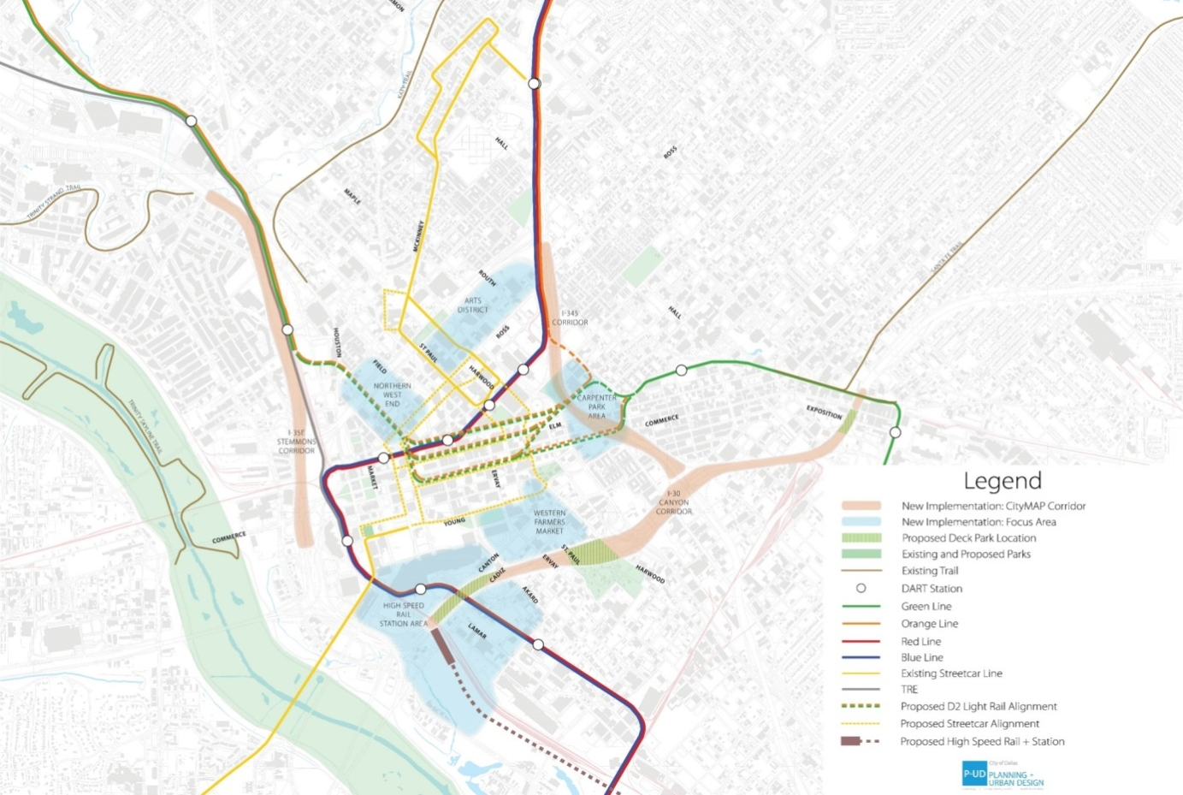
Strategic Focus Areas
Focus areas for exploring catalytic development opportunities

Slide 55

Strategic Focus Area:
Dallas Arts District

Slide 56
Next Steps

Slide 57
Next Steps
DRAFT STAGE
June 8 & 22: UDAC Briefings (with Arts District plan)
June 12-23: Neighborhood Work Sessions
July 12-13: Steering Committee and Public Meeting Window
July 18: DDI Board Briefing
August: CPC and Council Committee Briefings
FINAL DOCUMENTS
Aug-Sept: Neighborhood Workshops (as needed)
September: Council Adoption
September: Public Launch

