Slide 1
CD-2 - Lakewood Conservation District Expansion Post-Application Neighborhood Meeting No. 1
August 31, 2022
Trevor Brown, Chief Planner
Planning & Urban Design
City of Dallas

Slide 2
CD-2 - Lakewood Conservation District Expansion Post-Application Neighborhood Meeting No. 1
Staff Contact
Trevor Brown
Trevor.brown@dallas.gov
214-498-4417
Project Webpage
https://bit.ly/LakewoodExpansion
Agenda
CD-2 background
Overview of process
Discussion
Driveway and curbing
Sidewalk
Front yard coverage
Use and parking
Next Steps

Slide 3
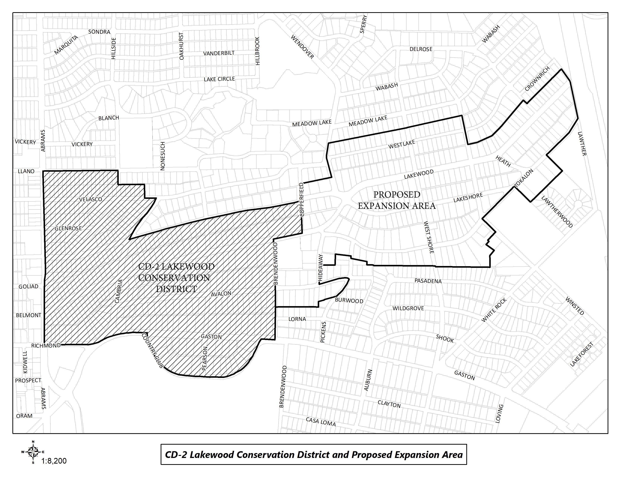
CD-2 Boundaries & Expansion Area

Slide 4
Purpose of This Meeting
This meeting is the 1st Post-Application Neighborhood Meeting to discuss the CD expansion process and the development and architectural standards the neighborhood may want to amend, based on the petition.
Discussion
Driveway and curbing
Sidewalk
Front yard coverage
Use and parking

Slide 5
CD-2 Background
Lakewood Conservation District (CD-2)
Adopted by City Council on July 13, 1988
“This district is established to provide a means of conserving the Lakewood neighborhood and to protect and enhance its significant architectural and cultural attributes.”

Slide 6
CD Amendment Flow Chart
Notes:
This is our process for amending an existing Conservation District – long story short: Pre-applications meetings, petitions, post-application meetings, ordinance revisions, public hearings.
We have verified petitions (75% of owners signed requesting to consider amendments), so we are holding meetings to actually determine what changes are appropriate.

Slide 7
Process for expanding a CD
On April 12, 2022 the neighborhood committee submitted a request for Pre-Application Meetings which initiated the process to potentially expand regulations in CD-2.
On April 28, 2022 the City mailed notification for a Pre-Application Meeting and provided petitions to the Neighborhood Committee.
The Neighborhood Committee has 60 days to get support from at least 58% of all property owners in the proposed expansion area by signing of the official petition by the owner on the last certified municipal tax roll.
Notes:
Important dates in our specific process.

Slide 8
Process for amending a CD
On May 23, 2022 the City holds the Pre-Application Meeting at The Filter Building on White Rock Lake with property owners to discuss the process and list of categories of development and architectural standards the property owners are interested in adopting or adding to the proposed expansion area. Focus is on broad categories.
Neighborhood Committee submits signed original petitions to the City for verification on June 27, 2022.
68% of petitions returned to City and verified on July 26, 2022.

Slide 9
Process for amending a CD
City staff holds Post-Application Neighborhood Meetings to discuss and develop detailed regulations in each of the categories listed in the petition.
At the conclusion of these meetings, City staff prepares ordinance
City holds additional Neighborhood Meeting to review draft ordinance language. (Meeting notices mailed 2 weeks prior to meeting)
City Plan Commission public hearing and recommendation
City Council public hearing and decision
YOU
ARE
HERE
Notes:
Notification will be mailed of CPC and CC hearings – area + 500’ buffer; anyone can speak to the item at these hearings.

Slide 10
Meeting Schedule
Post-Application Neighborhood Meeting #1 – August 31
Process, schedule, driveways/curbing/sidewalks, front yard coverage, uses and parking
Post-Application Neighborhood Meeting #2 – September 14
Density, lot size, lot coverage, building height & stories, Floor Area Ratio, drainage, and slope
Post-Application Neighborhood Meeting #3 – September 26
Setbacks-main, setbacks-accessory, accessory structures
Post-Application Neighborhood Meeting #4 – October 12
Fences, retaining walls, waterfall steps, landscape, paint, solar
Post-Application Neighborhood Meeting #5 – October 26
Demolition, documented assurance, roofing materials, windows, porches
Post-Application Neighborhood Meeting #6 – November 9
Contributing architectural styles, new construction standards, remodel/addition standards, areas of regulation, work reviews

Slide 11
Meeting Schedule
Post-Application Neighborhood Meeting #7 – November 16
Architectural styles – Minimal Traditional, Colonial Revival
Post-Application Neighborhood Meeting #8 – November 30
Architectural styles – Spanish Eclectic, French Eclectic
Post-Application Neighborhood Meeting #9 – December 7
Architectural styles – Tudor, Neoclassical, Non-Contributing
Post-Application Neighborhood Meeting #10 – December 14
If needed
Post-Application Neighborhood Meeting #11 – January 4
If needed
Post-Application Neighborhood Meeting #12 – January 18
If needed

Slide 12
Meeting Schedule (cont.)
Final Post-Application Neighborhood Meeting – TBD
Ordinance Review (30-60 days after last meeting)
City Plan Commission – TBD
City Council – TBD

Slide 13
CD-2 Regulations:
Development Standards:
Use
Lot size
Accessory uses
Setbacks
Lot coverage
Height
Landscaping Provisions:
Fences and walls
Driveways and curbing
Sidewalks
Front yard coverage
Berms
Architectural Provisions:
Regulation of Architectural Styles
Garages and accessory structures
Street facade width
Roofs
Glass
Enclosures
Screen and storm doors and windows
Color
13
Notes:
These are all the development standards regulated by CD 12. Every property in the city is governed by a set of these rules, but each CD has a ‘custom’ set of rules.

Slide 14
CD-2 Regulations (cont.):
Review Procedures:
Building permit review
Work not requiring a building permit
14

Slide 15
Topics for Discussion:
Accessory Structures:
Location and materials
Provisions for remodels or additions to non-conforming structures
Building Height:
Modifying how height is measured
Establishing a maximum allowed height for structures, including accessory structures and additions
Demolition:
Applicability to structures
Provisions for existing non-contributing structures
Density:
Consideration of maximum number of dwelling units
15
Notes:
These are the specific items that were on the petition – what we’ll be discussing at these meetings

Slide 16
Topics for Discussion (cont.):
Drainage:
Establishing restrictions on lot-to-lot drainage
Driveways, Curbs, Sidewalks, and Steps
Materials, width, and lot coverage
Provisions for removal of existing rolling or waterfall steps
Provisions for existing non-conforming structures
Fences and Walls
Location, height, and materials
Floor Area Ratio
16

Slide 17
Topics for Discussion (cont.):
Landscaping or Other Natural Features:
Materials and allowable percentage of front yard coverage for impervious surfaces and hardscaping
Provisions for tree preservation
Lot Coverage
Maximum lot coverage
Lot size
Minimum width
Paint
Provisions for painting stone and brick
Consideration of restriction of certain colors
Number of colors allowed
17

Slide 18
Topics for Discussion (cont.):
Off-Street Parking and Loading Requirements:
Minimum parking standards per dwelling unit
Permitted Uses
Single family
Provisions for existing non-conforming uses
Setbacks
Modifying front, side, and rear setback requirements, including accessory structures
Provisions for existing non-conforming structures
Slope
Provisions for modifications to the existing slope of a lot
18

Slide 19
Topics for Discussion (cont.):
Solar Energy Systems:
Location and type
Stories
Maximum stories
Provisions for non-conforming structures
19

Slide 20
Topics for Discussion (cont.):
Accessory Structures:
Style and materials
Roof slope
Replacement or remodeling of existing accessory structures
Clarifying the architectural styles, materials, size, and applicability
Architectural Styles:
Defining the architectural styles allowed
Standards for remodels and additions
Standards for new construction
Provisions for existing non-contributing structures
Building Elevations:
Minimum number of architectural features required
Standards for remodels and additions
Standards for new construction
Provisions for existing non-contributing structures
20

Slide 21
Topics for Discussion (cont.):
Building Materials:
Material types
Applicability and placement of certain allowed materials
Provisions for existing non-contributing structures
Chimneys:
Materials, form, and placement based on architectural style
Porch Styles:
Materials, architectural style, and placement
Standards for enclosures
Provisions for remodels or additions to existing structures
Roof Form and Pitch:
Provisions for remodels or additions to existing structures
21

Slide 22
Topics for Discussion (cont.):
Roofing Materials:
Provisions for remodels or additions to existing structures
Windows:
Placement, architectural standards, and materials
Provisions for remodels or additions to existing structures
Work Reviews:
Language to detail the requirements for a work review by the City
22

Slide 23
Procedure
To speak during the discussion portions of tonight’s meeting:
Please raise your hand and wait to be recognized before you begin speaking
Before your comments, state your name and address for the record
All comments must be related to the topic being discussed at that time

Slide 24
Petition Topic – Driveways and Curbing
Expand on the requirements for driveway access and location
Existing Regulations CD-2
(1)All driveways and curbing located between a main structure and the front or cornerside lot line must be constructed of a permanent outdoor paving material such as concrete, interlocking concrete paving block, or brick and stone pavers. Loose aggregate pavement such as gravel and bark mulch are not permitted in this area.
(2)Except as provided in paragraph (3), driveways are limited to one curb cut per lot and may not exceed 24 feet in width.
(3)Two curb cuts are permitted on lots with main structures facing Abrams Road or Gaston Avenue.
Notes:
Current regs for driveway access; Point is that access is allowed from EITHER street or alley, but not both

Slide 25
Discussion - Driveways
Material
Concrete
Paver
Stone
Gravel
Width
Type
Ribbon
Circular
25
Notes:
Front yard, corner side yards, rear yard height – delete unless someone brings it up?

Slide 26
Recap
26

Slide 27
Petition Topic - Sidewalks
Expand on the requirements for sidewalks in front yard leading to main structure
Existing Regulations CD-2
Sidewalks located interior to the lot line may be constructed of any legal material.
Petition Topic - Front yard coverage
Expand on the requirements for nonpermeable paving in the front yard
Existing Regulations CD-2
No more than 30 percent of the front yard may be covered in nonpermeable paving material.

Slide 28
Discussion - Sidewalks
Materials
Concrete (brushed, smooth, stamped)
Brick
Stone
Gravel
Width
Type/design
Straight
Curved
Walk with space between for grass/gravel
Coverage by nonpermeable materials
Location
28

Slide 29
Recap
29

Slide 30
Petition Topic – Use and Parking
Expand on the allowed uses and parking requirements
Existing Regulations CD-2
Only single family residential uses are permitted.
A minimum of two off street parking spaces are required for each dwelling unit.
Only one dwelling unit allowed on a lot, but does allow for a special exception from the Board of Adjustment for an additional [deed restricted] dwelling unit as long as it is not rented and does not adversely affect neighboring properties.
Notes:
Current regs for driveway access; Point is that access is allowed from EITHER street or alley, but not both

Slide 31
Discussion - Use
Uses
Parking
31
Notes:
Front yard, corner side yards, rear yard height – delete unless someone brings it up?

Slide 32
Recap
32

Slide 33
Next Steps
Neighborhood Meeting #2: September 14
Neighborhood Meeting #3: September 26
Neighborhood Meeting #4: October 12
Neighborhood Meeting #5: October 26
Neighborhood Meeting #6: November 9
Neighborhood Meeting #7: November 16
Neighborhood Meeting #8: November 30
Neighborhood Meeting #9: December 7
Neighborhood Meeting #10-12: If needed
Final Neighborhood Meeting to review ordinance: Date TBD
City Plan Commission Public Hearing: Date TBD (notified 10 days before)
City Council Public Hearing: Date TBD (notified 14 days before)
33

Slide 34
CD-2 - Lakewood Conservation District Expansion Post-Application Neighborhood Meeting No. 1
Staff Contact
Trevor Brown
trevor.brown@dallas.gov
214-498-4417
Project Webpage
https://bit.ly/LakewoodExpansion
Next Meeting September 14, 6:00 pm
Introduction and Recap
Discussion
Density, lot size, lot coverage, building height & stories, Floor Area Ratio, drainage, and slope
Next Steps

