Slide 1
CD-2 - Lakewood Conservation District Expansion Post-Application Neighborhood Meeting No. 2
September 14, 2022
Trevor Brown, Chief Planner
Melissa Parent, Senior Planner
Planning & Urban Design
City of Dallas

Slide 2
CD-2 - Lakewood Conservation District Expansion Post-Application Neighborhood Meeting No. 2
Agenda
Introduction & Recap
Overview of process
Discussion
Recap - Driveway and curbing
Sidewalk
Front yard coverage
Use and parking
Density
Lot coverage
Next Steps
Staff Contact
Trevor Brown
Trevor.brown@dallas.gov
214-670-4193
Project Webpage
https://bit.ly/LakewoodExpansion

Slide 3
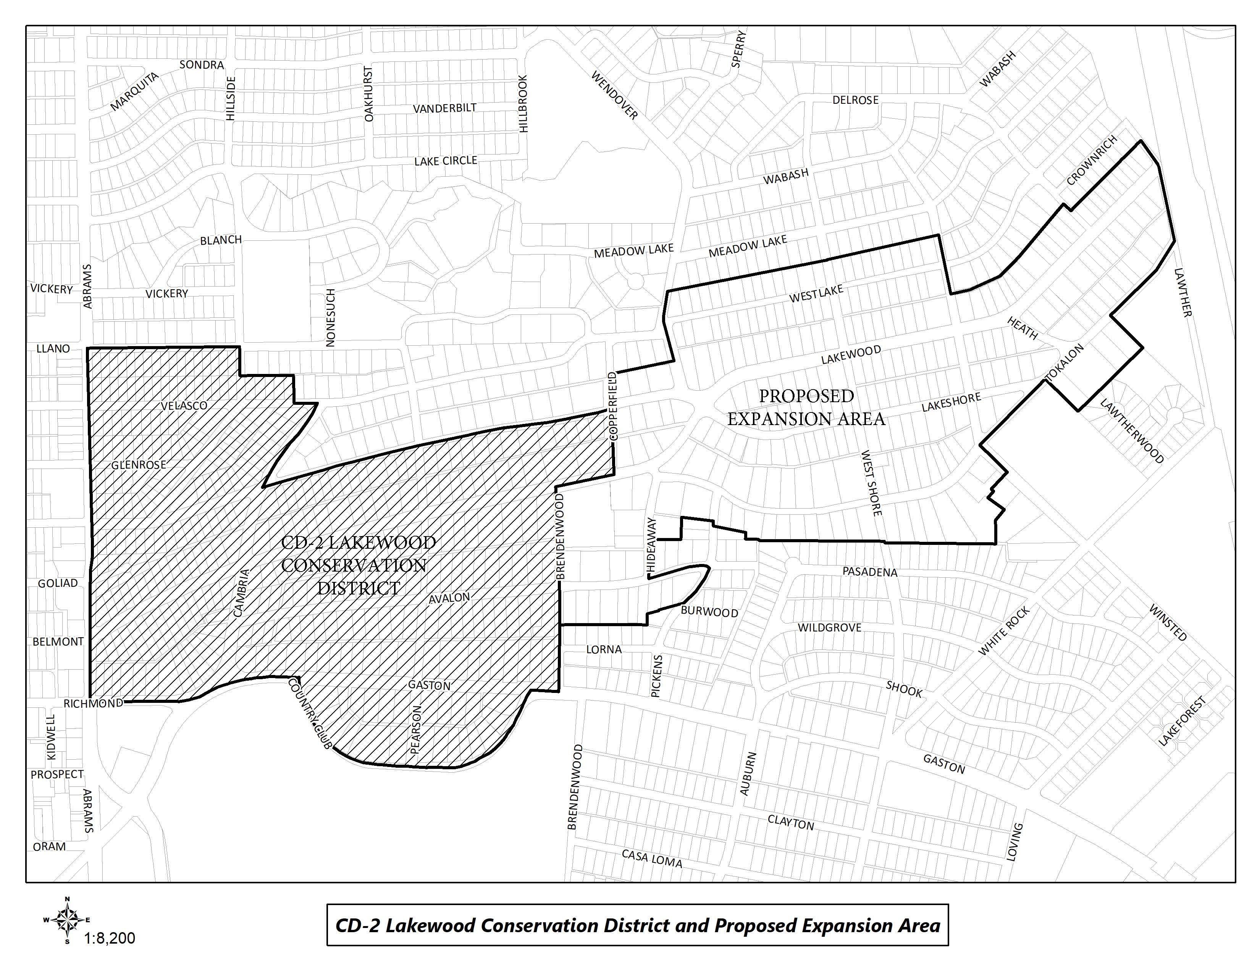
CD-2 Boundaries & Expansion Area

Slide 4
Purpose of This Meeting
This meeting is the 2nd Post-Application Neighborhood Meeting to discuss the CD expansion process and the development and architectural standards the neighborhood may want to amend, based on the petition.
Discussion
Recap - Driveway and curbing
Sidewalk
Front yard coverage
Use and parking
Density
Lot coverage

Slide 5
Meeting Schedule
Post-Application Neighborhood Meeting #1 – August 31
Process, schedule, driveways and curbing
Post-Application Neighborhood Meeting #2 – September 14
Driveways and curbing, sidewalks, front yard coverage, uses and parking, density, lot coverage
Post-Application Neighborhood Meeting #3 – September 26
Lot size, building height & stories, Floor Area Ratio, drainage, and slope
Post-Application Neighborhood Meeting #4 – October 12
Setbacks-main, setbacks-accessory, accessory structures
Post-Application Neighborhood Meeting #5 – October 26
Fences, retaining walls, waterfall steps, landscape, paint, solar
Post-Application Neighborhood Meeting #6 – November 9
Demolition, documented assurance, roofing materials, windows, porches

Slide 6
Meeting Schedule
Post-Application Neighborhood Meeting #7 – November 16
Contributing architectural styles, new construction standards, remodel/addition standards, areas of regulation, work reviews
Post-Application Neighborhood Meeting #8 – November 30
Architectural styles – Minimal Traditional, Colonial Revival
Post-Application Neighborhood Meeting #9 – December 7
Architectural styles – Spanish Eclectic, French Eclectic
Post-Application Neighborhood Meeting #10 – December 14
Architectural styles – Tudor, Neoclassical, Non-Contributing
Post-Application Neighborhood Meeting #11 – January 4
If needed
Post-Application Neighborhood Meeting #12 – January 18
If needed

Slide 7
Meeting Schedule (cont.)
Final Post-Application Neighborhood Meeting – TBD
Ordinance Review (30-60 days after last meeting)
City Plan Commission – TBD
City Council – TBD

Slide 8
CD-2 Regulations:
Development Standards:
Use
Lot size
Accessory uses
Setbacks
Lot coverage
Height
Landscaping Provisions:
Fences and walls
Driveways and curbing
Sidewalks
Front yard coverage
Berms
Architectural Provisions:
Regulation of Architectural Styles
Garages and accessory structures
Street facade width
Roofs
Glass
Enclosures
Screen and storm doors and windows
Color
8
Notes:
These are all the development standards regulated by CD 12. Every property in the city is governed by a set of these rules, but each CD has a ‘custom’ set of rules.

Slide 9
CD-2 Regulations (cont.):
Review Procedures:
Building permit review
Work not requiring a building permit
9

Slide 10
Topics for Discussion:
Accessory Structures:
Location and materials
Provisions for remodels or additions to non-conforming structures
Building Height:
Modifying how height is measured
Establishing a maximum allowed height for structures, including accessory structures and additions
Demolition:
Applicability to structures
Provisions for existing non-contributing structures
Density:
Consideration of maximum number of dwelling units
10
Notes:
These are the specific items that were on the petition – what we’ll be discussing at these meetings

Slide 11
Topics for Discussion (cont.):
Drainage:
Establishing restrictions on lot-to-lot drainage
Driveways, Curbs, Sidewalks, and Steps
Materials, width, and lot coverage
Provisions for removal of existing rolling or waterfall steps
Provisions for existing non-conforming structures
Fences and Walls
Location, height, and materials
Floor Area Ratio
11

Slide 12
Topics for Discussion (cont.):
Landscaping or Other Natural Features:
Materials and allowable percentage of front yard coverage for impervious surfaces and hardscaping
Provisions for tree preservation
Lot Coverage
Maximum lot coverage
Lot size
Minimum width
Paint
Provisions for painting stone and brick
Consideration of restriction of certain colors
Number of colors allowed
12

Slide 13
Topics for Discussion (cont.):
Off-Street Parking and Loading Requirements:
Minimum parking standards per dwelling unit
Permitted Uses
Single family
Provisions for existing non-conforming uses
Setbacks
Modifying front, side, and rear setback requirements, including accessory structures
Provisions for existing non-conforming structures
Slope
Provisions for modifications to the existing slope of a lot
13

Slide 14
Topics for Discussion (cont.):
Solar Energy Systems:
Location and type
Stories
Maximum stories
Provisions for non-conforming structures
14

Slide 15
Topics for Discussion (cont.):
Accessory Structures:
Style and materials
Roof slope
Replacement or remodeling of existing accessory structures
Clarifying the architectural styles, materials, size, and applicability
Architectural Styles:
Defining the architectural styles allowed
Standards for remodels and additions
Standards for new construction
Provisions for existing non-contributing structures
Building Elevations:
Minimum number of architectural features required
Standards for remodels and additions
Standards for new construction
Provisions for existing non-contributing structures
15

Slide 16
Topics for Discussion (cont.):
Building Materials:
Material types
Applicability and placement of certain allowed materials
Provisions for existing non-contributing structures
Chimneys:
Materials, form, and placement based on architectural style
Porch Styles:
Materials, architectural style, and placement
Standards for enclosures
Provisions for remodels or additions to existing structures
Roof Form and Pitch:
Provisions for remodels or additions to existing structures
16

Slide 17
Topics for Discussion (cont.):
Roofing Materials:
Provisions for remodels or additions to existing structures
Windows:
Placement, architectural standards, and materials
Provisions for remodels or additions to existing structures
Work Reviews:
Language to detail the requirements for a work review by the City
17

Slide 18
Sec. 51A-4.505 Conservation Districts
(b) Findings and purpose.
(1) State law authorizes the city of Dallas to regulate the construction, alteration, reconstruction, or razing of buildings and other structures in "designated places and areas of historic, cultural, or architectural importance and significance."
(2) Conservation districts are intended to provide a means of conserving an area's distinctive character by protecting or enhancing its physical attributes.
(3) Conservation districts are distinguished from historic overlay districts, which preserve historic residential or commercial places; neighborhood stabilization overlay districts, which preserve single family neighborhoods by imposing neighborhood- specific yard, lot, and space regulations that reflect the existing character of the neighborhood; and planned development districts, which provide flexibility in planning and construction while protecting contiguous land uses and significant features.
(4) The purpose of a CD is to:
(A) protect the physical attributes of an area or neighborhood;
(B) promote development or redevelopment that is compatible with an existing area or neighborhood;
(C) promote economic revitalization;
(D) enhance the livability of the city; and
(E) ensure harmonious, orderly, and efficient growth.

Slide 19
Procedure
To speak during the discussion portions of tonight’s meeting:
Please raise your hand and wait to be recognized before you begin speaking
Before your comments, state your name and address for the record
All comments must be related to the topic being discussed at that time

Slide 20
Petition Topic – Driveways and Curbing
Expand on the requirements for driveway access and location
Existing Regulations CD-2
(1)All driveways and curbing located between a main structure and the front or cornerside lot line must be constructed of a permanent outdoor paving material such as concrete, interlocking concrete paving block, or brick and stone pavers. Loose aggregate pavement such as gravel and bark mulch are not permitted in this area.
(2)Except as provided in paragraph (3), driveways are limited to one curb cut per lot and may not exceed 24 feet in width.
(3)Two curb cuts are permitted on lots with main structures facing Abrams Road or Gaston Avenue.
Notes:
Current regs for driveway access; Point is that access is allowed from EITHER street or alley, but not both

Slide 21
Recap - Driveways
Language from existing CD-2 ordinance should apply except driveway width should be less than the 24’ allowed. Most stated 12’ width.
Permeability of materials should be considered.
Existing circular drives should be allowed to be rebuilt, and consideration should be made to allow them on larger lots.
Ribbon drives should be allowed with gravel or permeable paving as acceptable fill between drive strips.
21
Notes:
Front yard, corner side yards, rear yard height – delete unless someone brings it up?

Slide 22
Petition Topic - Sidewalks
Expand on the requirements for sidewalks in front yard leading to main structure
Existing Regulations CD-2
Sidewalks located interior to the lot line may be constructed of any legal material.
Petition Topic - Front yard coverage
Expand on the requirements for nonpermeable paving in the front yard
Existing Regulations CD-2
No more than 30 percent of the front yard may be covered in nonpermeable paving material.

Slide 23
Discussion - Sidewalks
Materials
Concrete (brushed, smooth, stamped)
Brick
Stone
Type/design
Straight
Curved
Walk with space between for grass/gravel
Coverage by nonpermeable materials
What materials count as nonpermeable?
23

Slide 24
Recap
24

Slide 25
Petition Topic – Use and Parking
Expand on the allowed uses and parking requirements
Existing Regulations CD-2
Only single family residential uses are permitted.
A minimum of two off street parking spaces are required for each dwelling unit.
Only one dwelling unit allowed on a lot, but does allow for a special exception from the Board of Adjustment for an additional [deed restricted] dwelling unit as long as it is not rented and does not adversely affect neighboring properties.
Notes:
Current regs for driveway access; Point is that access is allowed from EITHER street or alley, but not both

Slide 26
Discussion – Use & Parking
Uses
Single Family
Duplex (any in proposed area?)
Multi-Family (any in proposed area?)
Commercial (any in proposed area?)
Parking
CD-2 requires a minimum two off street parking spaces for each dwelling unit.
Dallas Development Code (Sec. 51A) for Single Family uses requires one space in R-7.5(A) and R-5(A) districts, and two spaces in all other districts.
26
Notes:
Front yard, corner side yards, rear yard height – delete unless someone brings it up?

Slide 27
Recap
27

Slide 28
Petition Topic – Density
Consideration of maximum number of dwelling units
Existing Regulations CD-2
Only one dwelling unit allowed on a lot, but does allow for a special exception from the Board of Adjustment for an additional [deed restricted] dwelling unit as long as it is not rented and does not adversely affect neighboring properties.
Each dwelling unit must have separate utility services, and may have only one electrical meter.
Notes:
Current regs for driveway access; Point is that access is allowed from EITHER street or alley, but not both

Slide 29
Discussion - Density
Dwelling Unit – means one or more rooms designed to be a single housekeeping unit to accommodate one family and containing one or more kitchens, one or more bathrooms, and one or more bedrooms.
Number of dwelling units allowed
Were there accessory dwellings historically?
Accessory Dwelling Units
Allow by CD ordinance
Allow by Board of Adjustment (CD-2 & Dallas Development Code)
Non-conforming buildings
What happens when demolished or number of units is reduced?
29
Notes:
Front yard, corner side yards, rear yard height – delete unless someone brings it up?

Slide 30
Recap
30

Slide 31
Petition Topic – Lot Coverage
Consideration of maximum lot coverage
Existing Regulations CD-2
The maximum lot coverage on each building site is 45 percent
Notes:
Current regs for driveway access; Point is that access is allowed from EITHER street or alley, but not both

Slide 32
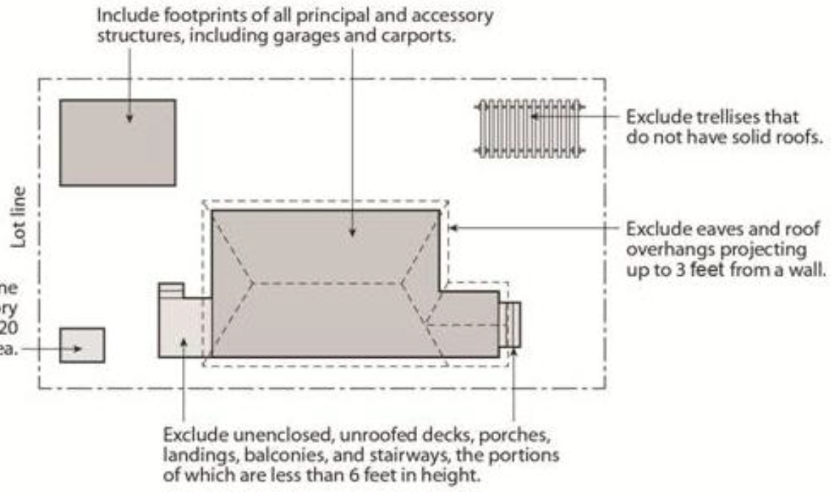
Discussion – Lot Coverage
Stick with standard 45 percent (CD-2 & Dallas Development Code)
Encourage retention of existing housing
Lot Coverage Examples
50’x150’= 7,500 Sq. Ft.
45%= 3,375 Sq. Ft.
40%= 3,000 Sq. Ft.
50’x200’= 10,000 Sq. Ft.
45%= 4,500 Sq. Ft
40%= 4,000 Sq. Ft.
32
Notes:
Front yard, corner side yards, rear yard height – delete unless someone brings it up?

Slide 33
Recap
33

Slide 34
Next Steps
Neighborhood Meeting #3: September 26 (Monday)
Neighborhood Meeting #4: October 12
Neighborhood Meeting #5: October 26
Neighborhood Meeting #6: November 9
Neighborhood Meeting #7: November 16
Neighborhood Meeting #8: November 30
Neighborhood Meeting #9: December 7
Neighborhood Meeting #10: December 14
Neighborhood Meeting #11-12: If needed
Final Neighborhood Meeting to review ordinance: Date TBD
City Plan Commission Public Hearing: Date TBD (notified 10 days before)
City Council Public Hearing: Date TBD (notified 14 days before)
34

Slide 35
CD-2 - Lakewood Conservation District Expansion Post-Application Neighborhood Meeting No. 2
Staff Contact
Trevor Brown
trevor.brown@dallas.gov
214-670-4193
Project Webpage
https://bit.ly/LakewoodExpansion
Next Meeting September 26, 6:00 pm
Introduction and Recap
Discussion
Density, lot size, lot coverage, building height & stories, Floor Area Ratio, drainage, and slope
Next Steps

Slide 36
36

Slide 37
Notes:
This is our process for amending an existing Conservation District – long story short: Pre-applications meetings, petitions, post-application meetings, ordinance revisions, public hearings.
We have verified petitions (75% of owners signed requesting to consider amendments), so we are holding meetings to actually determine what changes are appropriate.

Slide 38
Notes:
Important dates in our specific process.

Slide 40
Notes:
Notification will be mailed of CPC and CC hearings – area + 500’ buffer; anyone can speak to the item at these hearings.

