Slide 1
CD-2 - Lakewood Conservation District Expansion Post-Application Neighborhood Meeting No. 3
September 26, 2022
Trevor Brown, Chief Planner
Melissa Parent, Senior Planner
Planning & Urban Design
City of Dallas

Slide 2
CD-2 - Lakewood Conservation District Expansion Post-Application Neighborhood Meeting No. 3
Agenda
Introduction & Recap
Overview of process
Discussion
Recap – Sidewalk (front walkway), front yard coverage (impervious surface), use and parking, density, and lot coverage.
Lot size
Building height & stories
Floor Area Ratio
Drainage
Slope
Next Steps
Staff Contact
Trevor Brown
Trevor.brown@dallas.gov
214-670-4193
Project Webpage
https://bit.ly/LakewoodExpansion

Slide 3
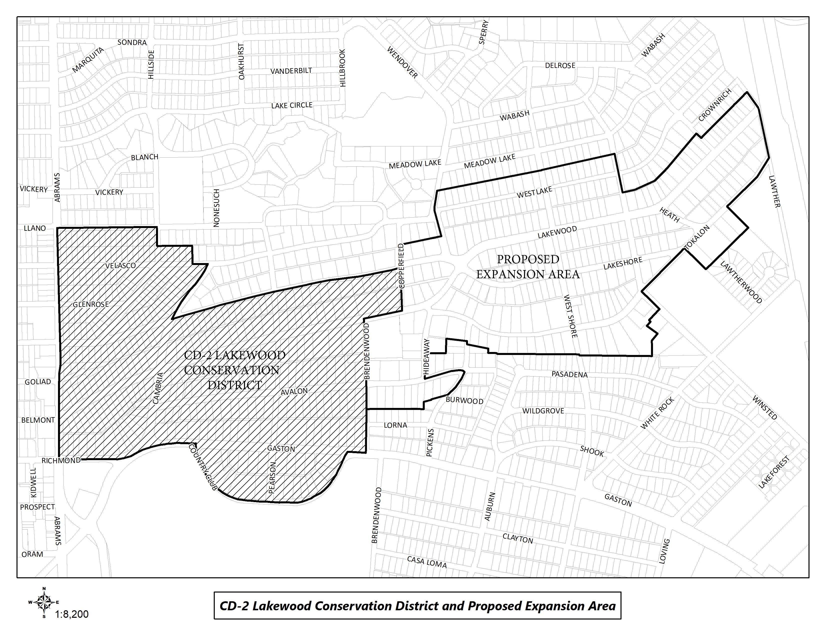
CD-2 Boundaries & Expansion Area

Slide 4
Purpose of This Meeting
This meeting is the 3rd Post-Application Neighborhood Meeting to discuss the CD expansion process and the development and architectural standards the neighborhood may want to amend, based on the petition.
Discussion
Recap – Sidewalk (front walkway), front yard coverage (impervious surface), use and parking, density, and lot coverage.
Lot size
Building height & stories
Floor Area Ratio
Drainage
Slope

Slide 5
Meeting Schedule
Post-Application Neighborhood Meeting #1 – August 31
Process, schedule, driveways and curbing
Post-Application Neighborhood Meeting #2 – September 14
Driveways and curbing, sidewalks, front yard coverage, uses and parking, density, lot coverage
Post-Application Neighborhood Meeting #3 – September 26
Lot size, building height & stories, Floor Area Ratio, drainage, and slope
Post-Application Neighborhood Meeting #4 – October 12
Setbacks-main, setbacks-accessory, accessory structures
Post-Application Neighborhood Meeting #5 – October 26
Fences, retaining walls, waterfall steps, landscape, paint, solar
Post-Application Neighborhood Meeting #6 – November 9
Demolition, documented assurance, roofing materials, windows, porches

Slide 6
Meeting Schedule
Post-Application Neighborhood Meeting #7 – November 16
Contributing architectural styles, new construction standards, remodel/addition standards, areas of regulation, work reviews
Post-Application Neighborhood Meeting #8 – November 30
Architectural styles – Minimal Traditional, Colonial Revival
Post-Application Neighborhood Meeting #9 – December 7
Architectural styles – Spanish Eclectic, French Eclectic
Post-Application Neighborhood Meeting #10 – December 14
Architectural styles – Tudor, Neoclassical, Non-Contributing
Post-Application Neighborhood Meeting #11 – January 4
If needed
Post-Application Neighborhood Meeting #12 – January 18
If needed

Slide 7
Meeting Schedule (cont.)
Final Post-Application Neighborhood Meeting – TBD
Ordinance Review (30-60 days after last meeting)
City Plan Commission – TBD
City Council – TBD

Slide 8
CD-2 Regulations:
Development Standards:
Use
Lot size
Accessory uses
Setbacks
Lot coverage
Height
Landscaping Provisions:
Fences and walls
Driveways and curbing
Sidewalks
Front yard coverage
Berms
Architectural Provisions:
Regulation of Architectural Styles
Garages and accessory structures
Street facade width
Roofs
Glass
Enclosures
Screen and storm doors and windows
Color
8
Notes:
These are all the development standards regulated by CD 2. Every property in the city is governed by a set of these rules, but each CD has a ‘custom’ set of rules.

Slide 9
CD-2 Regulations (cont.):
Review Procedures:
Building permit review
Work not requiring a building permit
9

Slide 10
Topics for Discussion:
Accessory Structures:
Location and materials
Provisions for remodels or additions to non-conforming structures
Building Height:
Modifying how height is measured
Establishing a maximum allowed height for structures, including accessory structures and additions
Demolition:
Applicability to structures
Provisions for existing non-contributing structures
Density:
Consideration of maximum number of dwelling units
10
Notes:
These are the specific items that were on the petition – what we’ll be discussing at these meetings

Slide 11
Topics for Discussion (cont.):
Drainage:
Establishing restrictions on lot-to-lot drainage
Driveways, Curbs, Sidewalks, and Steps
Materials, width, and lot coverage
Provisions for removal of existing rolling or waterfall steps
Provisions for existing non-conforming structures
Fences and Walls
Location, height, and materials
Floor Area Ratio
11

Slide 12
Topics for Discussion (cont.):
Landscaping or Other Natural Features:
Materials and allowable percentage of front yard coverage for impervious surfaces and hardscaping
Provisions for tree preservation
Lot Coverage
Maximum lot coverage
Lot size
Minimum width
Paint
Provisions for painting stone and brick
Consideration of restriction of certain colors
Number of colors allowed
12

Slide 13
Topics for Discussion (cont.):
Off-Street Parking and Loading Requirements:
Minimum parking standards per dwelling unit
Permitted Uses
Single family
Provisions for existing non-conforming uses
Setbacks
Modifying front, side, and rear setback requirements, including accessory structures
Provisions for existing non-conforming structures
Slope
Provisions for modifications to the existing slope of a lot
13

Slide 14
Topics for Discussion (cont.):
Solar Energy Systems:
Location and type
Stories
Maximum stories
Provisions for non-conforming structures
14

Slide 15
Topics for Discussion (cont.):
Accessory Structures:
Style and materials
Roof slope
Replacement or remodeling of existing accessory structures
Clarifying the architectural styles, materials, size, and applicability
Architectural Styles:
Defining the architectural styles allowed
Standards for remodels and additions
Standards for new construction
Provisions for existing non-contributing structures
Building Elevations:
Minimum number of architectural features required
Standards for remodels and additions
Standards for new construction
Provisions for existing non-contributing structures
15

Slide 16
Topics for Discussion (cont.):
Building Materials:
Material types
Applicability and placement of certain allowed materials
Provisions for existing non-contributing structures
Chimneys:
Materials, form, and placement based on architectural style
Porch Styles:
Materials, architectural style, and placement
Standards for enclosures
Provisions for remodels or additions to existing structures
Roof Form and Pitch:
Provisions for remodels or additions to existing structures
16

Slide 17
Topics for Discussion (cont.):
Roofing Materials:
Provisions for remodels or additions to existing structures
Windows:
Placement, architectural standards, and materials
Provisions for remodels or additions to existing structures
Work Reviews:
Language to detail the requirements for a work review by the City
17

Slide 18
Sec. 51A-4.505 Conservation Districts
(b) Findings and purpose.
(1) State law authorizes the city of Dallas to regulate the construction, alteration, reconstruction, or razing of buildings and other structures in "designated places and areas of historic, cultural, or architectural importance and significance."
(2) Conservation districts are intended to provide a means of conserving an area's distinctive character by protecting or enhancing its physical attributes.
(3) Conservation districts are distinguished from historic overlay districts, which preserve historic residential or commercial places; neighborhood stabilization overlay districts, which preserve single family neighborhoods by imposing neighborhood- specific yard, lot, and space regulations that reflect the existing character of the neighborhood; and planned development districts, which provide flexibility in planning and construction while protecting contiguous land uses and significant features.
(4) The purpose of a CD is to:
(A) protect the physical attributes of an area or neighborhood;
(B) promote development or redevelopment that is compatible with an existing area or neighborhood;
(C) promote economic revitalization;
(D) enhance the livability of the city; and
(E) ensure harmonious, orderly, and efficient growth.

Slide 19
Procedure
To speak during the discussion portions of tonight’s meeting:
Please raise your hand and wait to be recognized before you begin speaking
Before your comments, state your name and address for the record
All comments must be related to the topic being discussed at that time

Slide 20
Petition Topic - Sidewalks
Expand on the requirements for sidewalks in front yard leading to main structure
Existing Regulations CD-2
Sidewalks located interior to the lot line may be constructed of any legal material.
Petition Topic - Front yard coverage
Expand on the requirements for nonpermeable paving in the front yard
Existing Regulations CD-2
No more than 30 percent of the front yard may be covered in nonpermeable paving material.

Slide 21
Recap – Sidewalks
(front walkway leading to house)
Front walk not required
Contiguous solid paths preferred
Materials
Concrete
Brick
Stone
21

Slide 22
Recap – Front Yard Coverage
(impervious surface)
Restrict nonpermeable paving in the front yard to 30 percent
Nonpermeable materials
Concrete
Brick
Stone
Artificial turf (prohibited)
Acceptable permeable materials
Gravel
Mulch
22

Slide 23
Petition Topic – Use and Parking
Expand on the allowed uses and parking requirements
Existing Regulations CD-2
Only single-family residential uses are permitted.
A minimum of two off street parking spaces are required for each dwelling unit.
Only one dwelling unit allowed on a lot, but does allow for a special exception from the Board of Adjustment for an additional [deed restricted] dwelling unit as long as it is not rented and does not adversely affect neighboring properties.
Notes:
Current regs for driveway access; Point is that access is allowed from EITHER street or alley, but not both

Slide 24
Recap – Use & Parking
Single family use
Duplex are grandfathered, but if the number of units is voluntarily reduced all rights to duplex are lost.
Two parking spaces required for each dwelling unit, in line with existing CD-2 ordinance.
Sizeable support for only one required parking spot for accessory dwelling units.
Prohibition on parking RV’s, boats, or trailers in the front yard.
24

Slide 25
Petition Topic – Density
Consideration of maximum number of dwelling units
Existing Regulations CD-2
Only one dwelling unit allowed on a lot, but does allow for a special exception from the Board of Adjustment for an additional [deed restricted] dwelling unit as long as it is not rented and does not adversely affect neighboring properties.
Each dwelling unit must have separate utility services, and may have only one electrical meter.
Notes:
Current regs for driveway access; Point is that access is allowed from EITHER street or alley, but not both

Slide 26
Recap - Density
One dwelling unit on a lot except that an accessory dwelling unit is allowed if granted a special exception by the Board of Adjustment with deed restriction that the unit will not be a rental, which is in line with existing CD-2 and Dallas Development Code.
If the number of dwelling units on a lot is voluntarily reduced, all rights to the previous number of dwelling units are lost.
26

Slide 27
Petition Topic – Lot Coverage
Consideration of maximum lot coverage
Existing Regulations CD-2
The maximum lot coverage on each building site is 45 percent
Notes:
Current regs for driveway access; Point is that access is allowed from EITHER street or alley, but not both

Slide 28
Recap – Lot Coverage
Support 45 percent lot coverage for existing structures, in line with existing CD-2 and Dallas Development Code.
Support less lot coverage for new construction on lots where a building has been demolished to encourage retention of existing housing stock.
All new construction to have 40 percent maximum lot coverage which is more in line with existing development.
28

Slide 29
Petition Topic – Lot Size
Expand on the requirements minimum width and depth of lots
Existing Regulations CD-2
Lot size requirements
(1) Lots in Tract I must have a minimum area of 5,000 square feet, a minimum depth of 100 feet, and a minimum width of 50 feet.
(2) Lots in Tract II must have a minimum area of 7,500 square feet, a minimum depth of 150 feet, and a minimum width of 50 feet.
(3) Lots in Tract III must have a minimum area of 10,000 square feet, a minimum depth of 150 feet, and a minimum width of 70 feet.

Slide 30
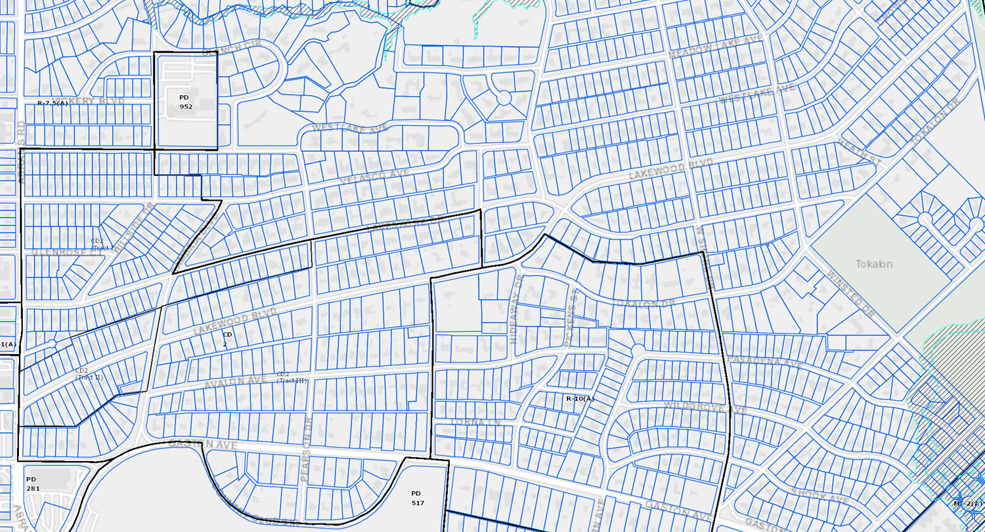
30

Slide 31
Discussion – Lot Size
Minimum lot size can impact larger lots being subdivided into smaller parcels.
Majority of the expansion area lots are zoned R7.5(A) which has 7,500 square foot lots with 50-foot width.
Lots on Tokalon Dr. and areas south zoned R10(A)
Dallas Development Code has minimum width of 55 feet and depth of 100 feet for R7.5(A) lots and minimum width of 70 feet and depth of 100 feet for R10 lots.
31

Slide 32
32

Slide 33
Recap – Lot Size
33

Slide 34
Petition Topic – Building Height & Stories
Modifying how height is measured
Establishing a maximum allowed height for structures, including accessory structures and additions
Establishing a maximum number of stories allowed
Provisions for non-conforming structures
Existing Regulations CD-2
BUILDING HEIGHT means the vertical distance measured from grade to the highest ridge of the roof structure.
ROOF RIDGE means the apex of any roof structure regardless of its style or form.
Maximum building height
(1) Except as provided in Paragraph (2), the maximum permitted height for all structures in Tracts I, II, and III is 30 feet.
(2) If any portion of an existing structure’s roof ridge exceeds the applicable maximum height in paragraphs (1)(A) or (1)(B), the lower portion of that structure’s roof ridge may be raised to the height of the taller portion of the roof ridge.

Slide 35
Discussion – Building Height & Stories
CD-2 BUILDING HEIGHT means the vertical distance measured from grade to the highest ridge of the roof structure.
Dallas Development Code has maximum height of 30 feet.
HEIGHT means the vertical distance measured from grade to:
(A) for a structure with a gable, hip, or gambrel roof, the midpoint of the vertical dimension between the lowest eaves and the highest ridge of the structure;
(B) for a structure with a dome roof, the midpoint of the vertical dimension of the dome; and
(C) for any other structure, the highest point of the structure.
Nonconforming height allow additions to maintain existing height as allowed by CD-2 ordinance.
Maximum number of stories
Minimal Traditional, Tudor, French Eclectic, Noncontributing
35

Slide 36
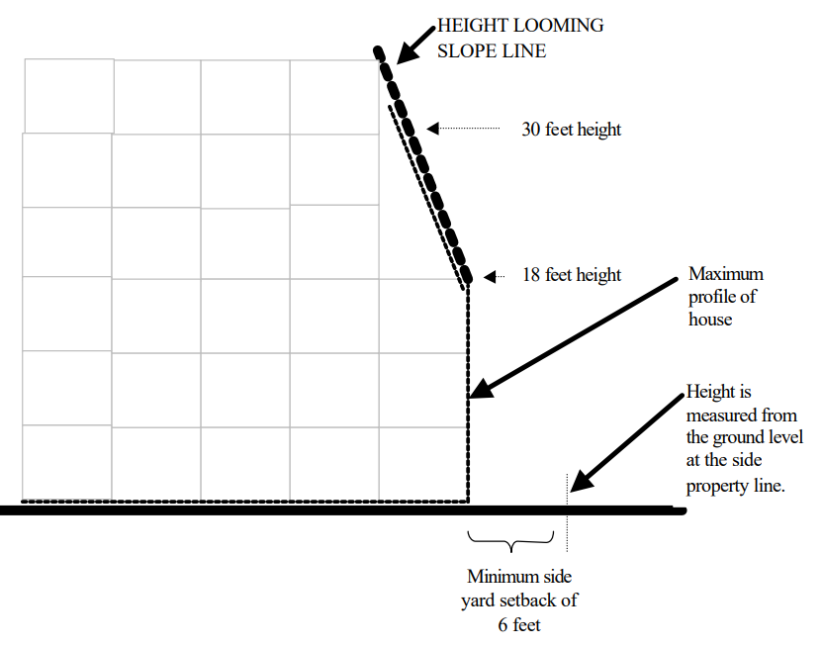
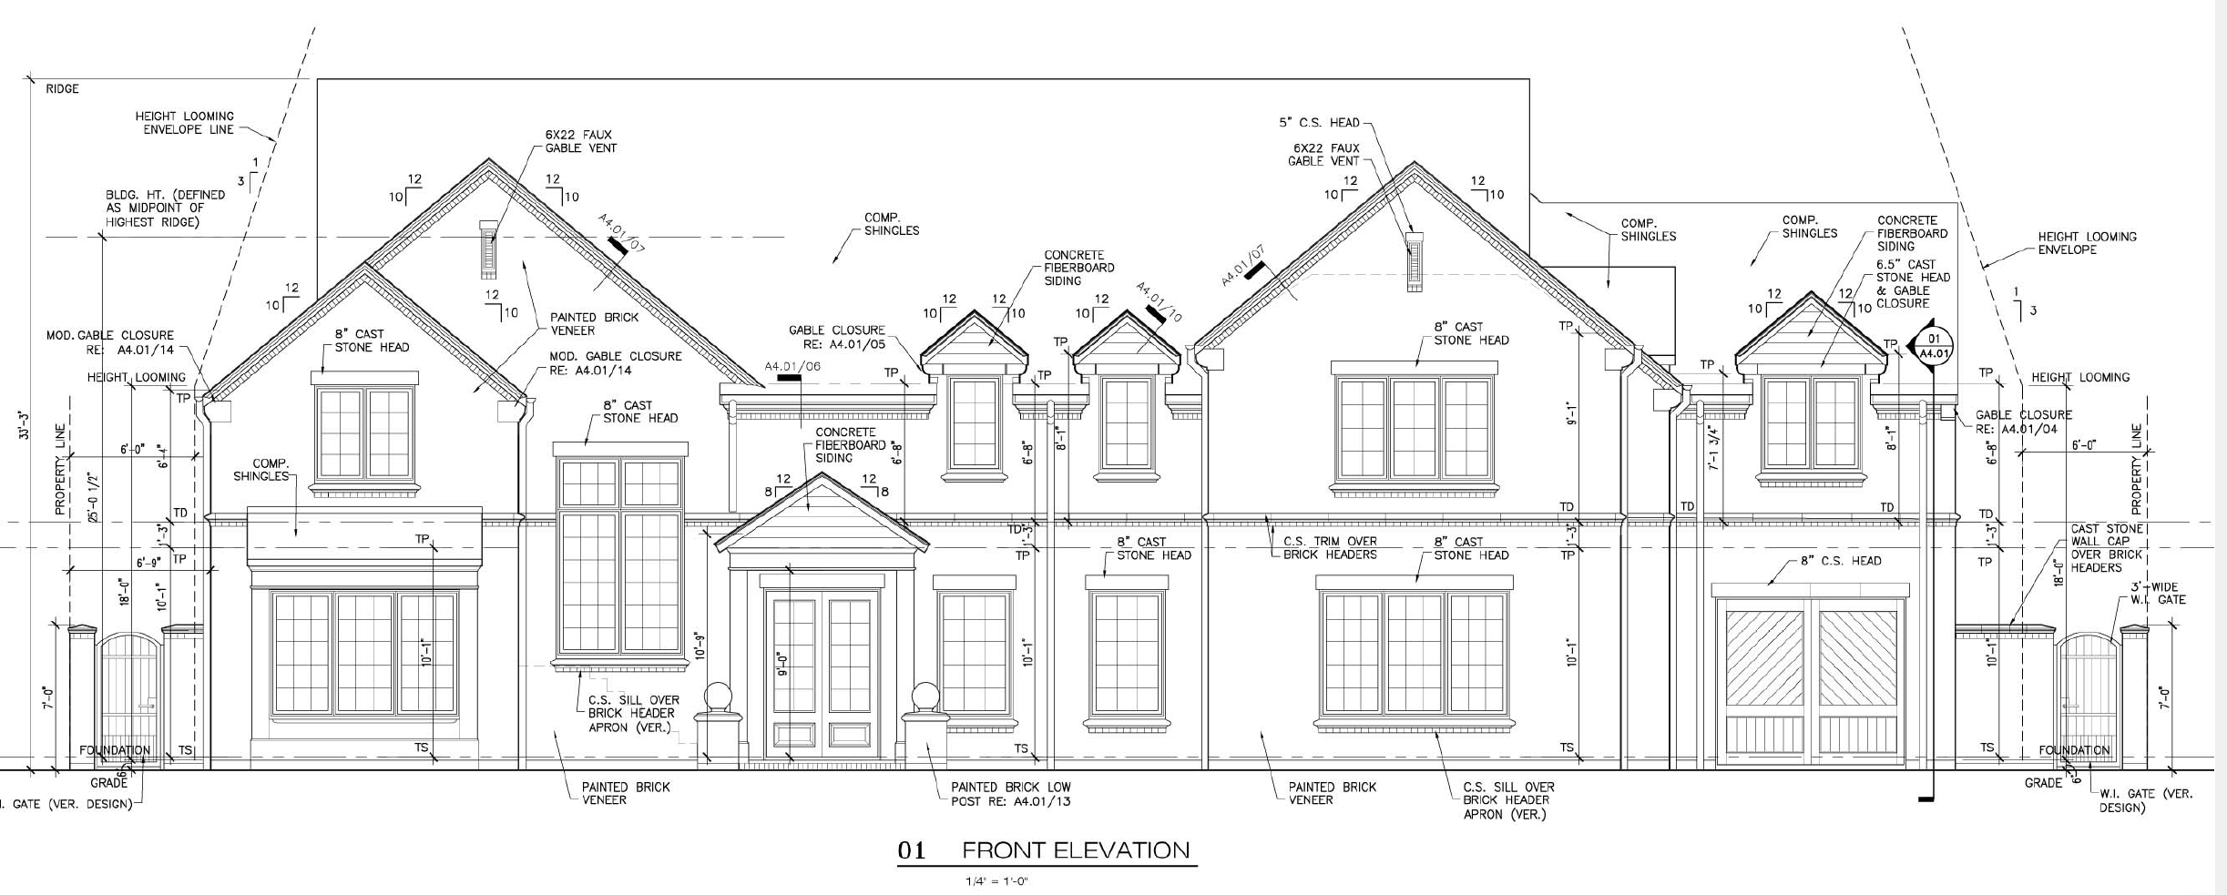
Height Looming (Greenway Parks CD-10)
The height of any structure may not exceed three times its distance from the ground level of the side property line, with the height being measured from the ground level at the side property line. For example, a structure set back six feet from the side yard line may not exceed 18 feet in height above the ground level at the side property line. Chimneys are not subject to this height looming provision.

Slide 37
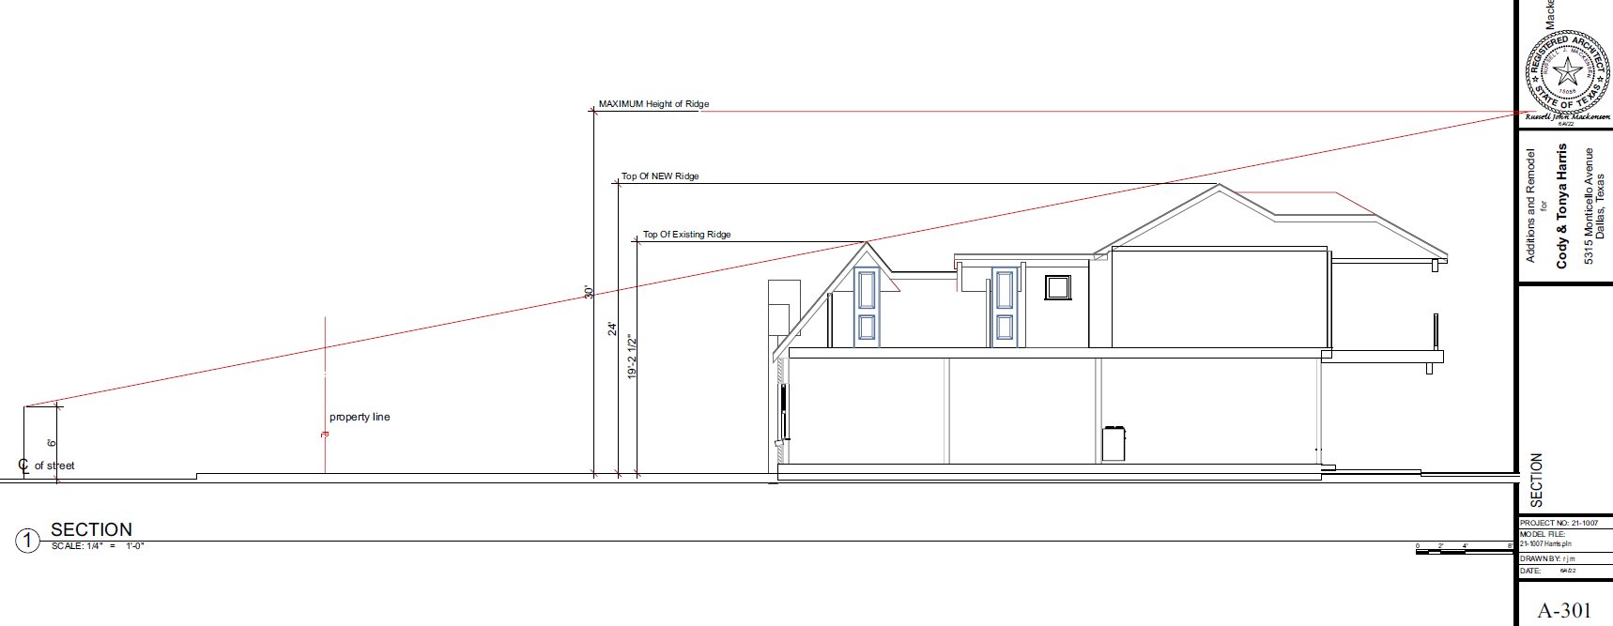

Slide 38
Recap – Building Height
&Stories
38

Slide 39
Petition Topic – Floor Area Ratio
Consideration of maximum Floor Area Ratio
Existing Regulations CD-2
None
Dallas Development Code
None for single family residential use
Notes:
Current regs for driveway access; Point is that access is allowed from EITHER street or alley, but not both

Slide 40
Discussion – Floor Area Ratio
Floor Area Ratio (FAR) is the measurement of a building’s floor area in relation to the size of the lot that the building is located on.
FLOOR AREA means the total square footage of floor space in a building measured to the outside faces of the exterior walls or to the omitted wall lines, whichever produces the larger area, but excluding the following: (i) Area used solely for off street parking. (ii) Area between an omitted wall line and the structural wall when the area is used solely for foot traffic or landscaping. (iii) Area of a private balcony that is not accessible to the public and does not provide a means of ingress or egress. (iv) Area of a breezeway or an unenclosed stairway located within the first three stories, excluding any basement, of a residential use.
Greenway Parks CD language
Floor area ratio. The intent of this subsection is to encourage the retention of original single family buildings. The maximum floor area ratio for lots containing original single family buildings is 0.55. The maximum floor area ratio for all other lots, including lots with new construction, is 0.50. The term “original single family building” means any single family main building that existed on May 28, 2003. An original single family building shall be considered “new construction” if an expansion results in more than 30 percent of the total exterior surface of the building being removed or obscured. The term “total exterior surface” includes all exterior walls but excludes the roof. (**Greenway counts areas used for parking in FAR calculation which the Dallas Development Code
Limits large lots and potential of combining lots to build structures out of scale and compatibility with existing houses.
Can be another way of promoting retention of existing structures.
40

Slide 41
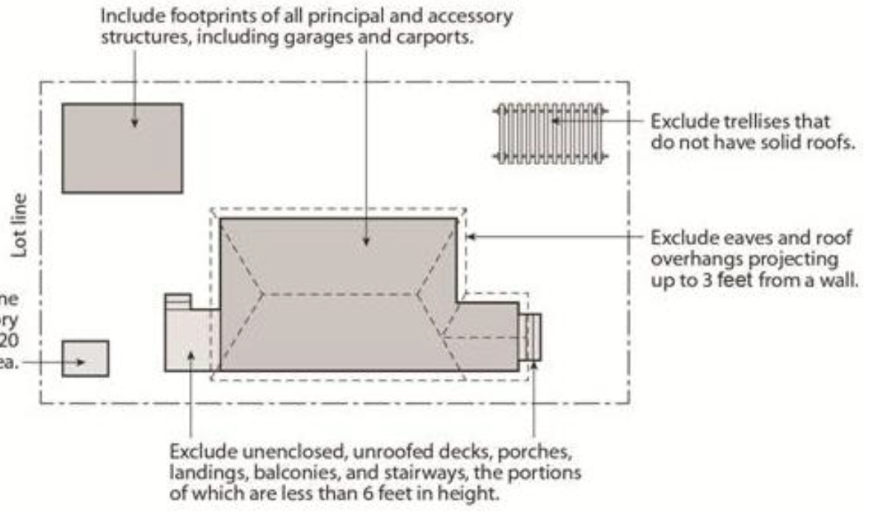
Discussion – Floor Area Ratio
Lot Coverage Examples
50’x150’= 7,500 Sq. Ft.
45%= 3,375 Sq. Ft.
40%= 3,000 Sq. Ft.
FAR .55= 4,125 Sq. Ft.
FAR .5= 3,750 Sq. Ft.
70’x150’= 10,500 Sq. Ft.
45%= 4,725 Sq. Ft
40%= 4,200 Sq. Ft.
FAR .55= 5,775 Sq. Ft.
FAR .5= 5,250 Sq. Ft.
41

Slide 42
Recap – Floor Area Ratio
42

Slide 43
Petition Topic – Drainage & Slope
Consideration of provisions for modifications to the existing slope of a lot
Existing Regulations CD-2
None
Dallas Development Code
No lot-to-lot drainage is allowed.
Notes:
Current regs for driveway access; Point is that access is allowed from EITHER street or alley, but not both

Slide 44
Discussion – Drainage & Slope
Is topography a characteristic of your neighborhood?
Do significant number of lots have noticeable slope from front to back, or side to side?
Is there noticeable slope at the front of the lot?
Conservation Districts with slope of lot language:
M-Streets (CD-9)
Belmont Addition (CD-12)
Vickery Place (CD-15)
The existing slope of a lot must be maintained. This provision does not prevent minor grading as necessary to allow construction, prevent lot-to-lot drainage, or match the slope of contiguous lots.
For purposes of this subsection, "slope" means any change in elevation from the front lot line to the rear lot line or from a side lot line to the other side lot line.
44

Slide 45
Recap – Drainage & Slope
45

Slide 46
Next Steps
Neighborhood Meeting #4: October 12
Neighborhood Meeting #5: October 26
Neighborhood Meeting #6: November 9
Neighborhood Meeting #7: November 16
Neighborhood Meeting #8: November 30
Neighborhood Meeting #9: December 7
Neighborhood Meeting #10: December 14
Neighborhood Meeting #11-12: If needed
Final Neighborhood Meeting to review ordinance: Date TBD
City Plan Commission Public Hearing: Date TBD (notified 10 days before)
City Council Public Hearing: Date TBD (notified 14 days before)
46

Slide 47
CD-2 - Lakewood Conservation District Expansion Post-Application Neighborhood Meeting No. 3
Staff Contact
Trevor Brown
trevor.brown@dallas.gov
214-670-4193
Project Webpage
https://bit.ly/LakewoodExpansion
Next Meeting October 12, 6:00 pm
Introduction and Recap
Discussion
Setbacks – main structure, setbacks – accessory structure, accessory structures
Next Steps

Slide 48
Notes:
Important dates in our specific process.

Slide 50
Notes:
Notification will be mailed of CPC and CC hearings – area + 500’ buffer; anyone can speak to the item at these hearings.

Slide 51
Petition Topic – Driveways and Curbing
Expand on the requirements for driveway access and location
Existing Regulations CD-2
(1)All driveways and curbing located between a main structure and the front or cornerside lot line must be constructed of a permanent outdoor paving material such as concrete, interlocking concrete paving block, or brick and stone pavers. Loose aggregate pavement such as gravel and bark mulch are not permitted in this area.
(2)Except as provided in paragraph (3), driveways are limited to one curb cut per lot and may not exceed 24 feet in width.
(3)Two curb cuts are permitted on lots with main structures facing Abrams Road or Gaston Avenue.

Slide 52
Recap - Driveways
Language from existing CD-2 ordinance should apply except driveway width should be less than the 24’ allowed. Most stated 12’ width.
Permeability of materials should be considered.
Existing circular drives should be allowed to be rebuilt, and consideration should be made to allow them on larger lots.
Ribbon drives should be allowed with gravel or permeable paving as acceptable fill between drive strips.
52
Notes:
Front yard, corner side yards, rear yard height – delete unless someone brings it up?

Slide 53
53

Slide 54
54

Slide 55
55

