Slide 1
CD-2 - Lakewood Conservation District Expansion Post-Application Neighborhood Meeting No. 6
November 9, 2022
Trevor Brown, Chief Planner
Melissa Parent, Senior Planner
Scott Bellen, Senior Planner
Planning & Urban Design
City of Dallas

Slide 2
CD-2 - Lakewood Conservation District Expansion Post-Application Neighborhood Meeting No. 5
Agenda
Introduction & Recap
Overview of process
Discussion
Recap – Floor Area Ratio
Setbacks – Main
Setbacks – Accessory
Accessory Structures
Solar
Next Steps
Staff Contact
Trevor Brown
Trevor.brown@dallas.gov
214-670-4193
Project Webpage
https://bit.ly/LakewoodExpansion

Slide 3
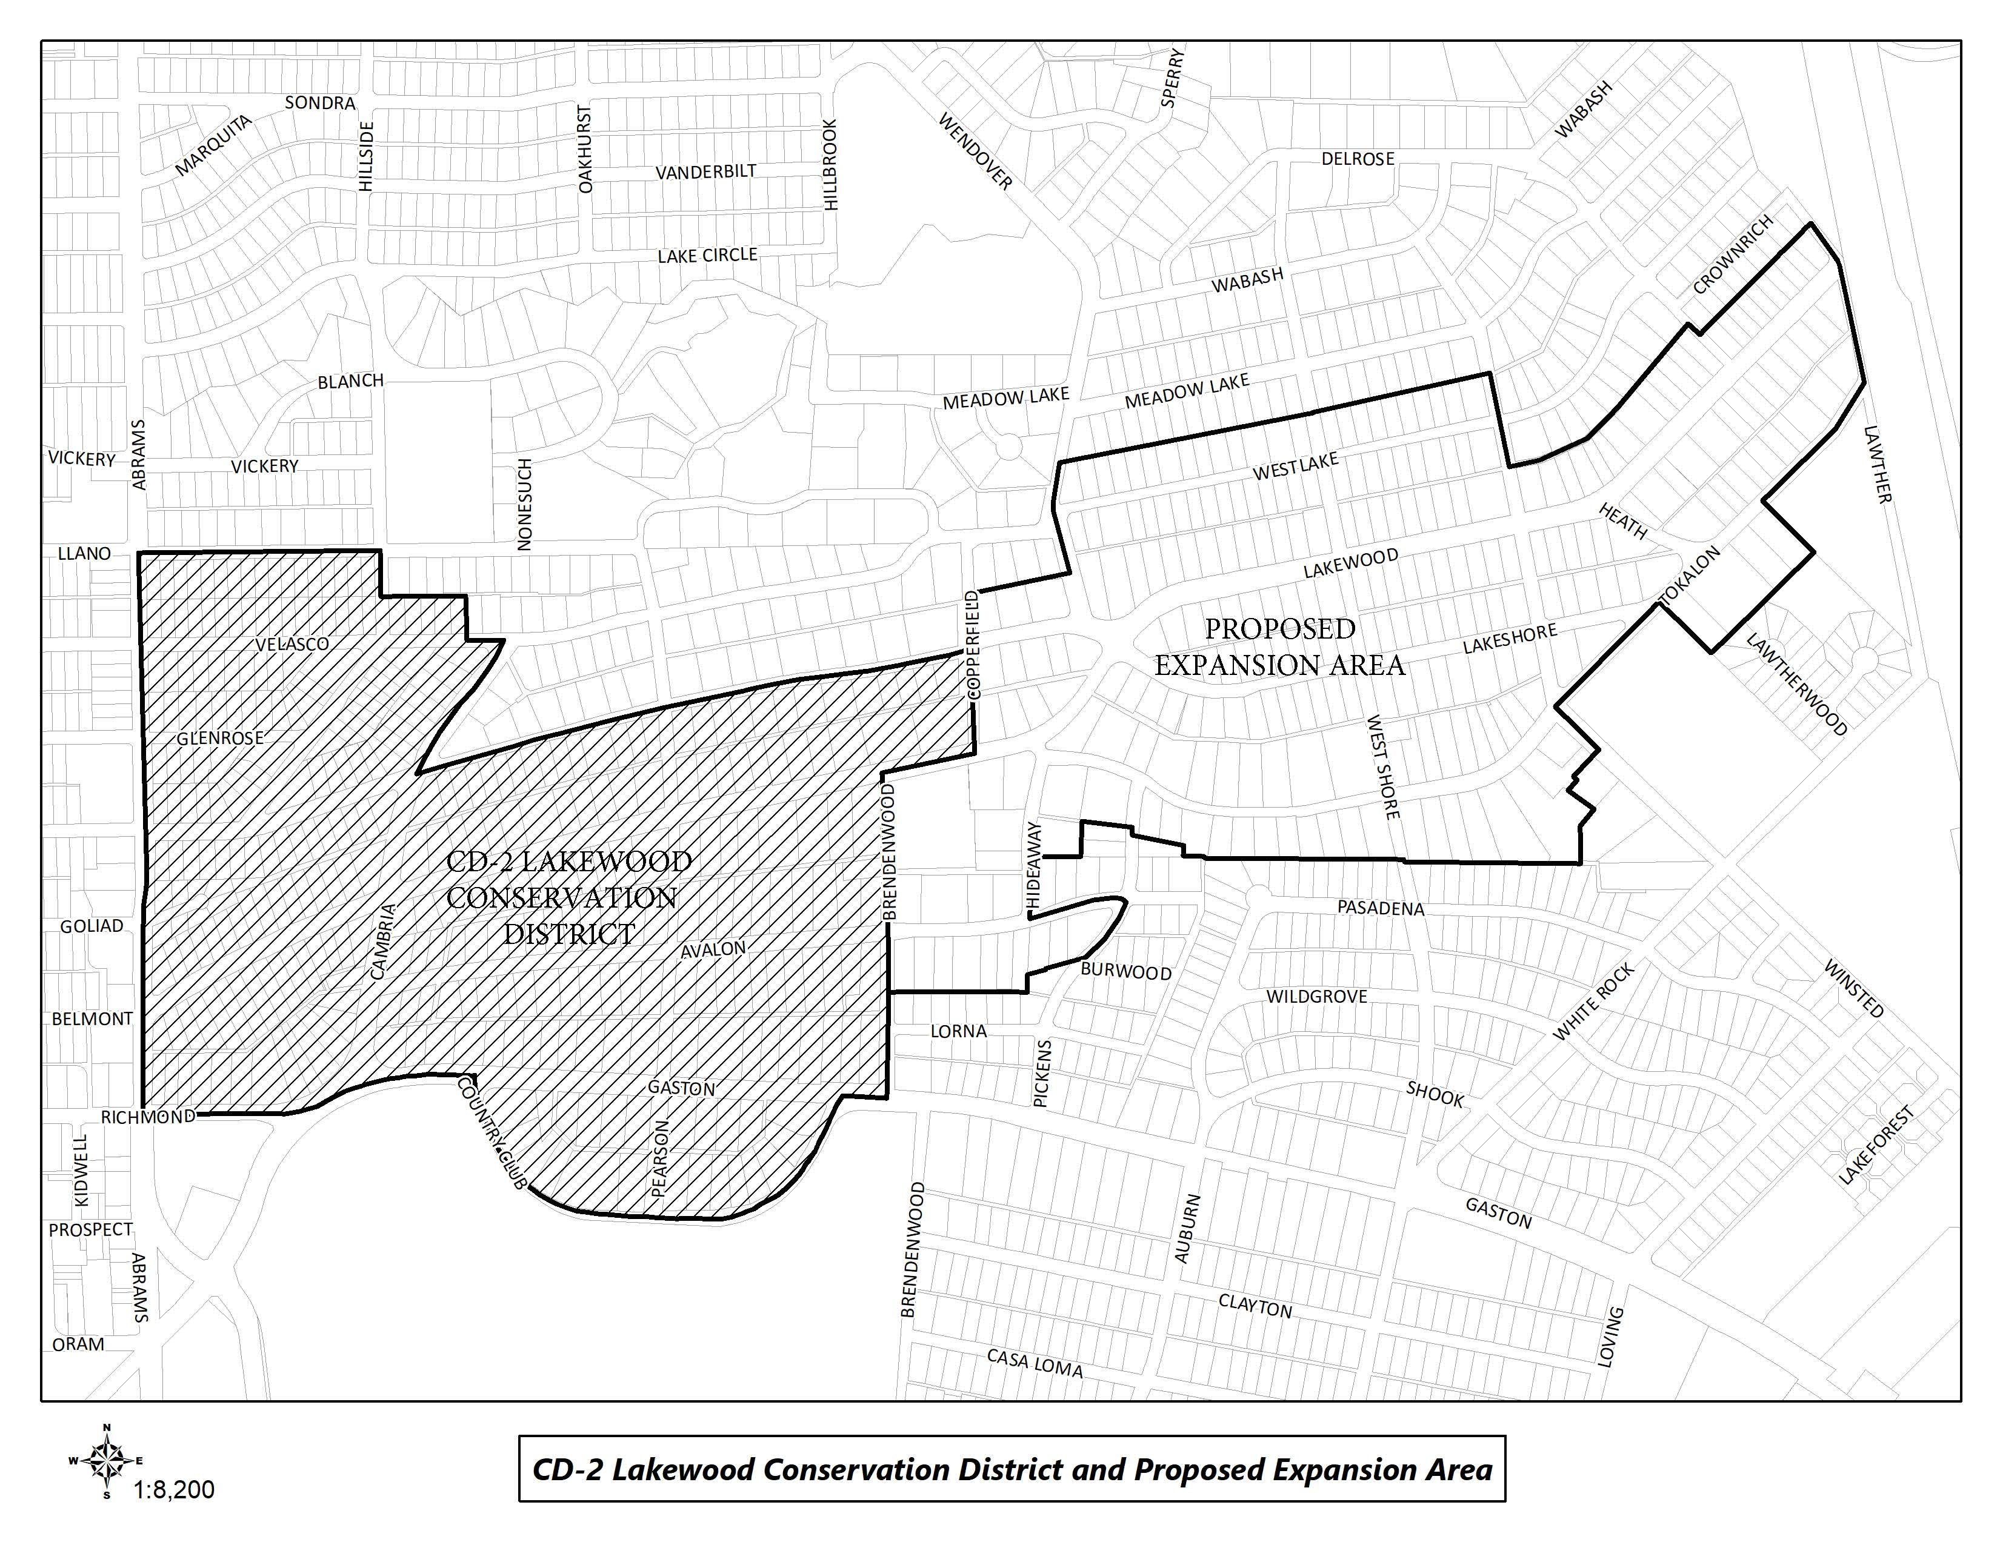
CD-2 Boundaries & Expansion Area

Slide 4
Purpose of This Meeting
This meeting is the 6th Post-Application Neighborhood Meeting to discuss the CD expansion process and the development and architectural standards the neighborhood may want to amend, based on the petition.
Discussion
Recap – Floor Area Ratio
Setbacks – Main
Setbacks – Accessory
Accessory Structures
Solar

Slide 5
Meeting Schedule
Post-Application Neighborhood Meeting #1 – August 31
Process, schedule, driveways and curbing
Post-Application Neighborhood Meeting #2 – September 14
Driveways and curbing, sidewalks, front yard coverage, uses and parking, density, lot coverage
Post-Application Neighborhood Meeting #3 – September 26
Lot size, slope/drainage
Post-Application Neighborhood Meeting #4 – October 12
Building height & stories, Floor Area Ratio
Post-Application Neighborhood Meeting #5 – October 26
Floor Area Ratio, setbacks-main
Post-Application Neighborhood Meeting #6 – November 9
Setbacks-main, setbacks-accessory, accessory structures, solar

Slide 6
Meeting Schedule
Post-Application Neighborhood Meeting #7 – November 16
Fences, retaining walls, waterfall steps, landscape, paint
Post-Application Neighborhood Meeting #8 – November 30
Demolition, documented assurance, roofing materials, windows, porches
Post-Application Neighborhood Meeting #9 – December 7
Contributing architectural styles, new construction standards, remodel/addition standards, areas of regulation, work reviews
Post-Application Neighborhood Meeting #10 – December 14
Architectural styles – Minimal Traditional, Colonial Revival
Post-Application Neighborhood Meeting #11 – January 4
Architectural styles – Spanish Eclectic, French Eclectic
Post-Application Neighborhood Meeting #12 – January 18
Architectural styles – Tudor, Neoclassical, Non-Contributing

Slide 7
Meeting Schedule (cont.)
Final Post-Application Neighborhood Meeting – TBD
Ordinance Review (30-60 days after last meeting)
City Plan Commission – TBD
City Council – TBD

Slide 8
CD-2 Regulations:
Development Standards:
Use
Lot size
Accessory uses
Setbacks
Lot coverage
Height
Landscaping Provisions:
Fences and walls
Driveways and curbing
Sidewalks
Front yard coverage
Berms
Architectural Provisions:
Regulation of Architectural Styles
Garages and accessory structures
Street facade width
Roofs
Glass
Enclosures
Screen and storm doors and windows
Color
8
Notes:
These are all the development standards regulated by CD 2. Every property in the city is governed by a set of these rules, but each CD has a ‘custom’ set of rules.

Slide 9
CD-2 Regulations (cont.):
Review Procedures:
Building permit review
Work not requiring a building permit
9

Slide 10
Topics for Discussion:
Accessory Structures:
Location and materials
Provisions for remodels or additions to non-conforming structures
Building Height:
Modifying how height is measured
Establishing a maximum allowed height for structures, including accessory structures and additions
Demolition:
Applicability to structures
Provisions for existing non-contributing structures
Density:
Consideration of maximum number of dwelling units
10
Notes:
These are the specific items that were on the petition – what we’ll be discussing at these meetings

Slide 11
Topics for Discussion (cont.):
Drainage:
Establishing restrictions on lot-to-lot drainage
Driveways, Curbs, Sidewalks, and Steps
Materials, width, and lot coverage
Provisions for removal of existing rolling or waterfall steps
Provisions for existing non-conforming structures
Fences and Walls
Location, height, and materials
Floor Area Ratio
11

Slide 12
Topics for Discussion (cont.):
Landscaping or Other Natural Features:
Materials and allowable percentage of front yard coverage for impervious surfaces and hardscaping
Provisions for tree preservation
Lot Coverage
Maximum lot coverage
Lot size
Minimum width
Paint
Provisions for painting stone and brick
Consideration of restriction of certain colors
Number of colors allowed
12

Slide 13
Topics for Discussion (cont.):
Off-Street Parking and Loading Requirements:
Minimum parking standards per dwelling unit
Permitted Uses
Single family
Provisions for existing non-conforming uses
Setbacks
Modifying front, side, and rear setback requirements, including accessory structures
Provisions for existing non-conforming structures
Slope
Provisions for modifications to the existing slope of a lot
13

Slide 14
Topics for Discussion (cont.):
Solar Energy Systems:
Location and type
Stories
Maximum stories
Provisions for non-conforming structures
14

Slide 15
Topics for Discussion (cont.):
Accessory Structures:
Style and materials
Roof slope
Replacement or remodeling of existing accessory structures
Clarifying the architectural styles, materials, size, and applicability
Architectural Styles:
Defining the architectural styles allowed
Standards for remodels and additions
Standards for new construction
Provisions for existing non-contributing structures
Building Elevations:
Minimum number of architectural features required
Standards for remodels and additions
Standards for new construction
Provisions for existing non-contributing structures
15

Slide 16
Topics for Discussion (cont.):
Building Materials:
Material types
Applicability and placement of certain allowed materials
Provisions for existing non-contributing structures
Chimneys:
Materials, form, and placement based on architectural style
Porch Styles:
Materials, architectural style, and placement
Standards for enclosures
Provisions for remodels or additions to existing structures
Roof Form and Pitch:
Provisions for remodels or additions to existing structures
16

Slide 17
Topics for Discussion (cont.):
Roofing Materials:
Provisions for remodels or additions to existing structures
Windows:
Placement, architectural standards, and materials
Provisions for remodels or additions to existing structures
Work Reviews:
Language to detail the requirements for a work review by the City
17

Slide 18
Sec. 51A-4.505 Conservation Districts
(b) Findings and purpose.
(1) State law authorizes the city of Dallas to regulate the construction, alteration, reconstruction, or razing of buildings and other structures in "designated places and areas of historic, cultural, or architectural importance and significance."
(2) Conservation districts are intended to provide a means of conserving an area's distinctive character by protecting or enhancing its physical attributes.
(3) Conservation districts are distinguished from historic overlay districts, which preserve historic residential or commercial places; neighborhood stabilization overlay districts, which preserve single family neighborhoods by imposing neighborhood- specific yard, lot, and space regulations that reflect the existing character of the neighborhood; and planned development districts, which provide flexibility in planning and construction while protecting contiguous land uses and significant features.
(4) The purpose of a CD is to:
(A) protect the physical attributes of an area or neighborhood;
(B) promote development or redevelopment that is compatible with an existing area or neighborhood;
(C) promote economic revitalization;
(D) enhance the livability of the city; and
(E) ensure harmonious, orderly, and efficient growth.

Slide 19
Procedure
To speak during the discussion portions of tonight’s meeting:
Please raise your hand and wait to be recognized before you begin speaking
Before your comments, state your name and address for the record
All comments must be related to the topic being discussed at that time
Provide input to inform City Staff to work toward an approach to accomplish your desired objective of maintaining the character of the neighborhood.

Slide 20
Making an Ordinance for Lakewood Expansion
Lot Coverage
Setbacks
Height
Floor Area Ratio
Slope of Lot
Architectural Style
Notes:
Important dates in our specific process.

Slide 21
Petition Topic – Floor Area Ratio
Consideration of maximum Floor Area Ratio
Existing Regulations CD-2
None
Dallas Development Code
None for single family residential use
Notes:
Current regs for driveway access; Point is that access is allowed from EITHER street or alley, but not both

Slide 22
Recap – Floor Area Ratio
Overall in favor of new construction having a lower FAR
Considerable support for including parking in the FAR calculation, which is different than how the City reviews it, though some want only enclosed parking to count.
Smaller lots under 8,000 square feet should not be held to same FAR as the larger lots.
22

Slide 23
Recap – Floor Area Ratio
Language for consideration:
FLOOR AREA means the total square footage of floor space in a main building, accessory building, or covered structure, including the floor space of gazebos, pool houses, screened porches, and areas used for off-street parking, measured to the outside faces of the exterior walls or to the omitted wall lines, whichever produces the larger area, but excluding the following: (i) Area between an omitted wall line and the structural wall when the area is used solely for foot traffic or landscaping. (ii) Area of a private balcony that is not accessible to the public and does not provide a means of ingress or egress.
Floor area ratio. The intent of this subsection is to encourage the retention of original single family buildings. The maximum floor area ratio for lots containing original single family buildings is 0.55. The maximum floor area ratio for all other lots, including lots with new construction, is 0.45. The term “original single family building” means any single family main building that existed on March 1, 2023. An original single family building shall be considered “new construction” if an expansion results in more than 30 percent of the total exterior surface of the building being removed or obscured. The term “total exterior surface” includes all exterior walls but excludes the roof.
FAR only applied to lots greater than 10,000 square feet.
23

Slide 24
Example 1 – FAR under 10,000 SF
Westlake Lot example (1.5 story house) 9,274 sq. ft. lot size
DCAD – 3,234 sq. ft. with 480 sq. ft detached garage (total including parking 3,714 sq. ft.)
45% lot coverage = 4,173 sq. ft.
Existing house expanded to 4,000 sq. ft., retain 480 sq. ft. detached garage and add 350 sq. ft. guest suite above, new 325 sq. ft. outdoor kitchen, and 100 sq. ft. shed. (Approx. 40% lot coverage)
40% lot coverage = 3,710 sq. ft.
New construction could be a 3,500-4,000 sq. ft. 1.5 story house with a 500 square foot detached garage with studio above, and a 200 square foot shade structure.
24

Slide 25
Example 2 – FAR over 10,000 SF
Lakewood Lot example (2 story house) 10,200 sq. ft. lot size
DCAD – 3,384 sq. ft. with 530 sq. ft detached garage and 760 sq. ft. detached quarters (total including parking 4,674 sq. ft. – estimated to be 30% lot coverage)
45% lot coverage = 4,590 (0.55 FAR = 5,610 sq. ft)
Existing home expanded to 4,200 sq. ft., retains 530 sq. ft. detached garage and 760 sq. ft detached quarters, can still add 120 sq. ft. shade structure
40% lot coverage = 4,080 sq. ft. (0.45 FAR = 4,590 sq. ft.)
New 3,400 sq. ft. two-story home with 400 sq. ft. detached garage with studio space above. This still allows 390 sq. ft. of porch/shade/shed to be added.
25

Slide 26
Example 3 – FAR over 10,000 SF
New Construction example (2 story house) 11,462 sq. ft. lot size
DCAD – 5,056 sq. ft. with 506 sq. ft attached garage and 402 sq. ft. outdoor living (total including parking 5,964 sq. ft. – estimated 35% lot coverage)
45% lot coverage = 5,157 (0.55 FAR = 6,304 sq. ft)
Existing new construction (2022) has the ability to add 340 sq. ft. of porch/shade/shed/carport to the lot.
40% lot coverage = 4,585 sq. ft. (0.45 FAR = 5,158 sq. ft.)
New 4,200 sq. ft. two-story home with 400 sq. ft. attached garage, a 400 sq. ft. outdoor living area, and 100 sq. ft. greenhouse.
26

Slide 27
Example 4 – FAR over 10,000 SF
Tokalon Lot example #1 (1 story house) 18,610 sq. ft. lot size
DCAD – 4,633 sq. ft. with 315 sq. ft detached garage and 480 sq. ft. detached carport (total including parking 5,428 sq. ft. – 29% lot coverage)
45% lot coverage = 8,375 (0.55 FAR = 10,235 sq. ft.)
Existing house expanded to 5,300 sq. ft., new 800 sq. ft. detached garage with underground parking (1,600 sq. ft.), retain the 480 sq. ft. detached carport, new 420 sq. ft. outdoor kitchen, new 350 sq. ft. potting shed. All of this is 40% lot coverage and a FAR of 0.44.
40% lot coverage = 7,444 sq. ft. (0.45 FAR = 8,375 sq. ft.)
New 5,300 sq. ft. two-story house with 600 sq. ft. attached garage, detached 500 sq. ft. garage with studio/workout room above (1,000 sq. ft.), 700 sq. ft. detached guest quarters, 420 sq. ft. outdoor kitchen. All of this is approximately 30% lot coverage with at FAR of 0.43.
27

Slide 28
Petition Topic – Setbacks (Main)
Modifying front, side, and rear setback requirements
Provisions for existing non-conforming structures
Existing Regulations CD-2 – Front Yard Setback
A minimum 40-foot front yard setback must be provided on all building sites in Tract I.
A minimum 50-foot front yard setback must be provided on all building sites in Tract II.
A minimum 60-foot front yard setback must be provided on all building sites in Tract III, except for lots located in City Block Q/2983, for which a minimum 40-foot front yard setback must be provided.
Existing Regulations R-7.5(A) – Front Yard 25-foot setback
Existing Regulations R-10(A) – Front Yard 30-foot setback

Slide 29
Petition Topic – Setbacks (Main)
Existing Regulations CD-2 – Side Yard
A minimum side yard setback of five feet and a minimum cornerside yard setback of 15 feet must be provided on all building sites in Tract I and II.
A minimum side yard setback of six feet and a minimum cornerside yard setback of 15 feet must be provided on all building sites in Tract III.
Existing Regulations R-7.5(A) – Side Yard
Five-foot setback
Existing Regulations R-10(A) – Side Yard
Six-foot setback

Slide 30
Petition Topic – Setbacks (Main)
Existing Regulations CD-2 – Rear Yard
A minimum rear yard setback of five feet must be provided on all building sites in Tract I and II.
A minimum rear yard setback of six feet must be provided on all building sites in Tract III.
Existing Regulations R-7.5(A) – Rear Yard
Five-foot setback
Existing Regulations R-10(A) – Rear Yard
Six-foot setback

Slide 31
Discussion – Setbacks (Main)
Do you know your setback?
Is there variation along the street, or do all houses appear to be situated similarly on the lot?
Allowance for nonconforming structures
Any additions must meet applicable setbacks without clarifying language
Continuation of nonconforming setbacks
Documented Assurance for repairs to existing nonconforming structures
31

Slide 32
Discussion – Setbacks (Main)
Address | Lot Size | Front | Side | Side | Rear
6911 WESTLAKE |  | 32’ (est.) | 5.2’ | 5.1’ | 20’ (G)
6960 WESTLAKE |  | 36.3’ | 5.6’ | 10.3’ | 48.9’
7002 WESTLAKE |  | 40.1’ | 5.7’ | 10.2’ | 35 (est.)
7011 WESTLAKE |  | 40.3’ | 5’ | 14.6’ | 42’ (est.)
7022 WESTLAKE |  | 40.1’ | 5’ | 13’ | 45’ (est.)

Slide 33
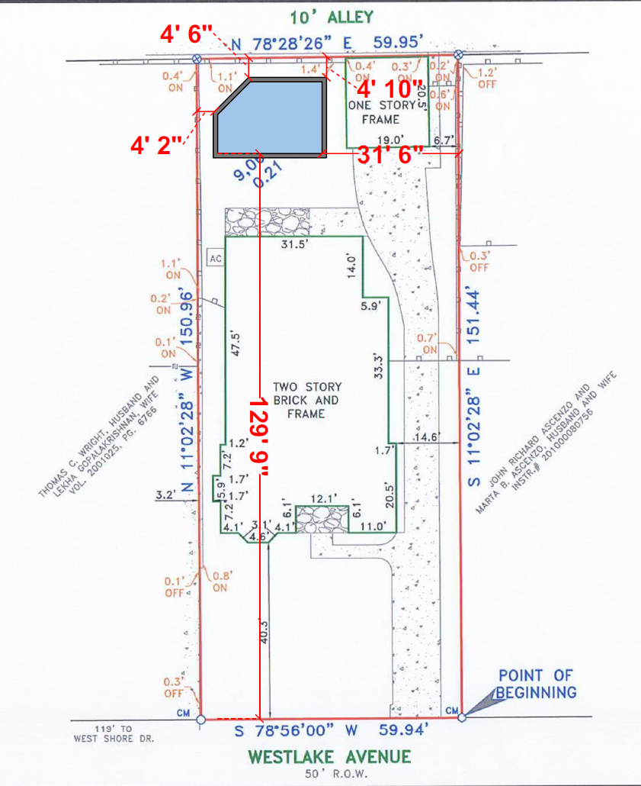
7011 Westlake Ave

Slide 34
Discussion – Setbacks (Main)
Address | Lot Size | Front | Side | Side | Rear
6832 LAKEWOOD |  | 110’ | 7.8’ | 37.4’ | 5’
6944 LAKEWOOD |  | 65’ | 5’ | 5.2’ | 20’ (G)
6956 LAKEWOOD |  | 51.6’ | 3.7’ | 22.5’ | 36.3’
7030 LAKEWOOD |  | 45’ (est.) | 2’ | 3’ | 70’ (est.)
7102 LAKEWOOD |  | 63’ | 10’ | 5’ | 5’
7118 LAKEWOOD |  | 70’ (est.) | 5’ | 8’ | 48’ (est.)
7218 LAKEWOOD |  | 60’ | 5’ | 25’ | 25’ (est.)
7310 LAKEWOOD |  | 58.7’ | 14.3’ | 11.5’ | 48’ (est.)
7311 LAKEWOOD |  | 40’ | 5’ | 8.6’ | 45’ (est.)

Slide 35
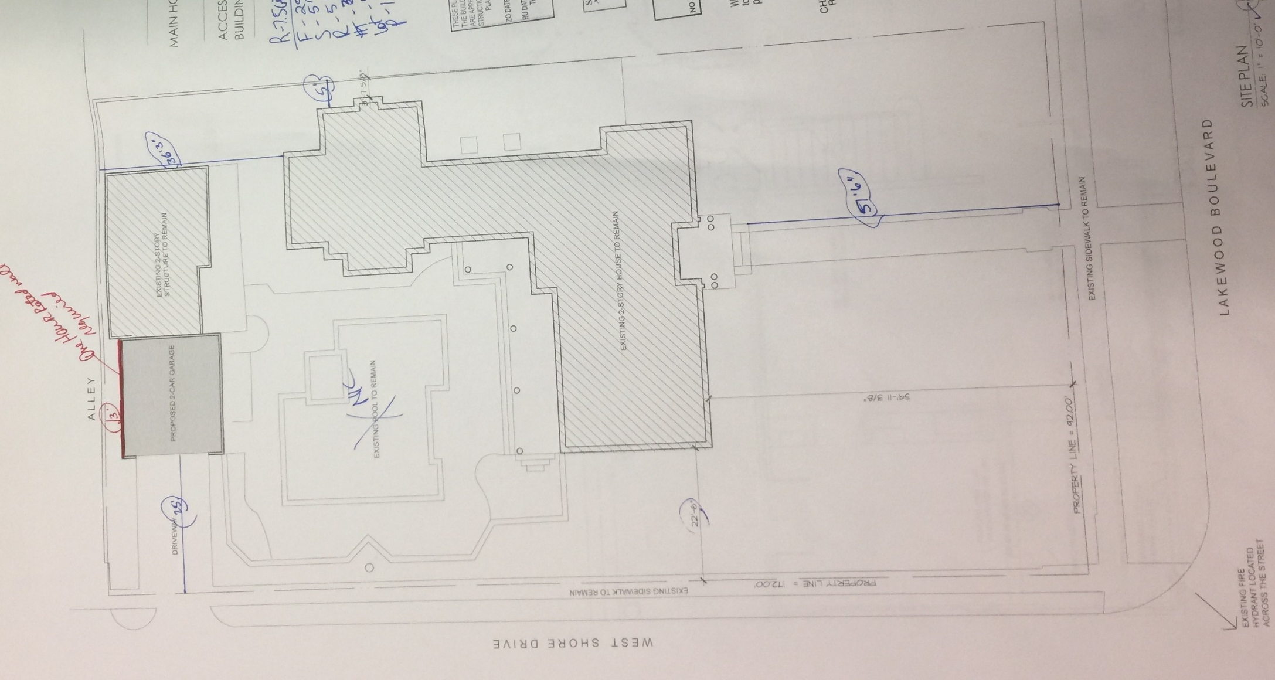
6956 Lakewood Ave

Slide 36
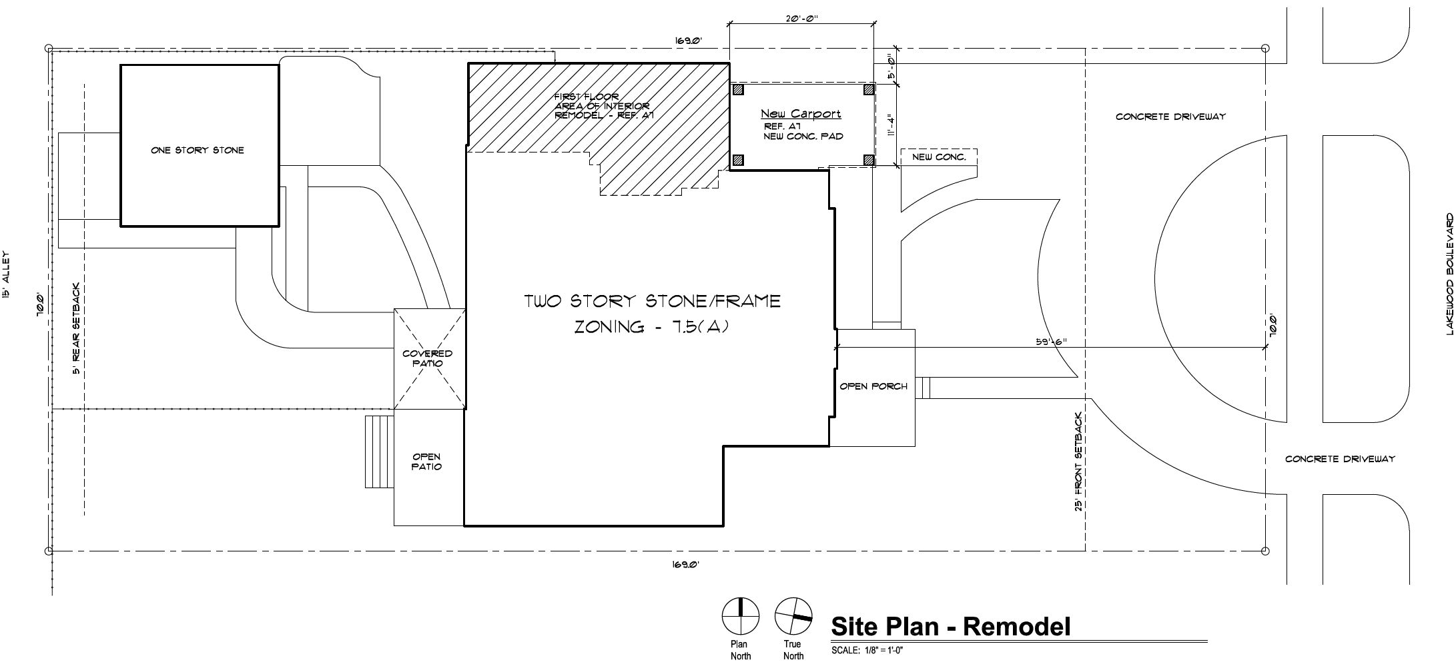
7030 Lakewood Ave

Slide 37
Discussion – Setbacks (Main)
Address | Lot Size | Front | Side | Side | Rear
6944 LAKESHORE |  | 51.9’ | 3’ | 11.9’ | 56.8’
7009 LAKESHORE |  | 32’ (est.) | 5’ | 15.8’ | 64.2’
7012 LAKESHORE |  | 40’ | 5.9’ | 24’ | 95’ (est.)
7021 LAKESHORE |  | 30.5’ | 2.7’ | 9.4’ | 46.6’

Slide 38
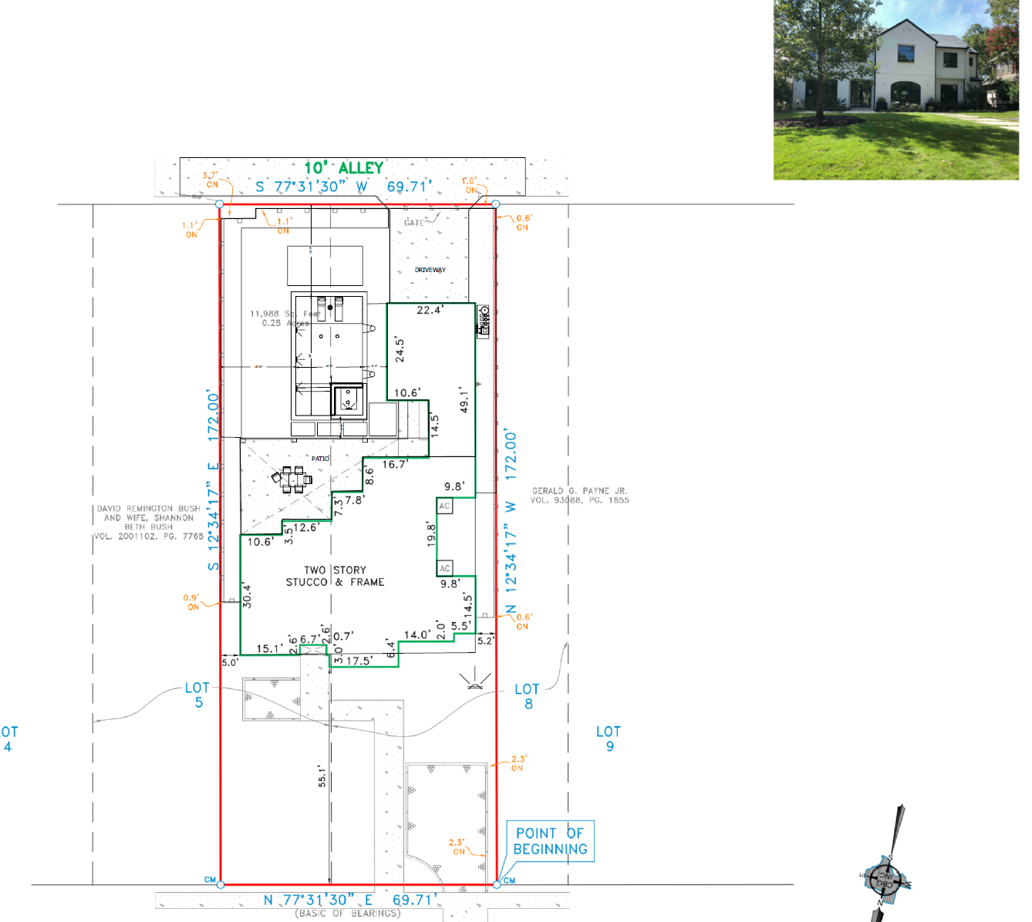
6944 Lakeshore Ave

Slide 39
Discussion – Setbacks (Main)
Address | Lot Size | Front | Side | Side | Rear
7030 TOKALON |  | 60.7' | 18.0' | 26.4'
7022 TOKALON |  | 211.5' | 5' | 5' | 5'
7019 TOKALON |  | 58.1' | 11.2' | 9.8' | 122.5'
6968 TOKALON | 18779 SF | 57.5' | 26' | 12.8'
6875 TOKALON |  |  | 6' | 25’ (est.)
6934 TOKALON | ~13275 SF | 55’ (est.) | 6' | 6' | 6'

Slide 40
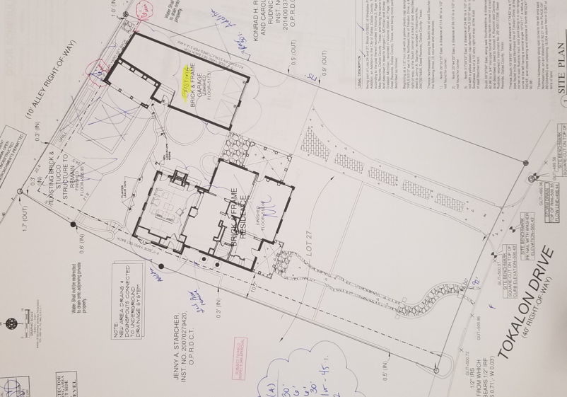
6875 Tokalon Dr

Slide 41
Recap – Setbacks (Main)
Overall – support for using the average of adjacent structures to establish the Front Yard Setback for additions, remodels, new construction.
41

Slide 42
Petition Topic – Setbacks (Accessory)
Modifying side and rear setback requirements for accessory structures
Provisions for existing non-conforming structures
Existing Regulations CD-2
(A) All garage and accessory structures are exempt from side and rear yard setback requirements and may extend along the entire distance of the rear lot line provided that:
(i) no portion of the garage or accessory structure extends into the front half of the area between the rear lot line and the primary rear facade of the main structure; and
(ii) the second floor of any such structure does not extend along the width of the lot for a distance greater than:
(aa) 40 feet; or
(bb) 60 percent of the length of the rear lot line.
(B) All eaves and overhangs of all accessory structures must be located within the confines of a lot.

Slide 43
Petition Topic – Setbacks (Accessory) (Cont.)
Existing Regulations CD-2 (Cont.)
(C) Any new construction of a wall of a building located less than three feet from an adjacent lot is required to meet a one-hour fire rating as described by the Dallas Building Code, as amended. These walls are not permitted to have window or door openings.
(D) Any construction of a wall of a building located less than three feet from a street or alley must meet the provisions of the Dallas Building Code, as amended.
(E) No side yard setback is required for:
(i) a new or existing one-story porte-cochere; or
(ii) an existing porte-cochere with more than one story; provided that the stormwater runoff from the roof of the porte-cochere is not directed onto an adjacent lot. New additions to a porte-cochere above the first story must meet minimum side yard requirements.
(7)(b) Garages and accessory structures must be locate at the rear of the main structure.

Slide 44
Petition Topic – Setbacks (Accessory) (Cont.)
Existing Regulations R-7.5(A) and R-10(A)
Side yard setback for accessory structures
In a residential district, a person need not provide a side yard setback for a structure accessory to a residential use, including a generator, if the structure:
(A) does not exceed 15 feet in height; and
(B) is located in the rear 30 percent of the lot.
Rear yard setback for accessory structures
In a residential district, a person need not provide a full rear yard setback for a structure accessory to a residential use, including a generator, if the structure does not exceed 15 feet in height. Where the rear yard is adjacent to an alley, a three-foot setback must be provided. Where the rear yard is not adjacent to an alley, no setback is required.

Slide 45
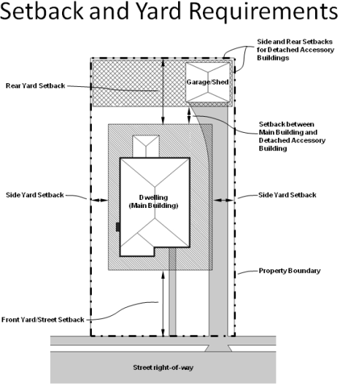
Discussion – Setbacks (Accessory)
Where are original garages and accessory structures located?
Limiting where accessory structures can be located
To the rear of main
Rear 30 percent of lot
No closer to the street than main structure on corner lots
Allowance for nonconforming structures
Any additions must meet applicable setbacks without clarifying language
45

Slide 46
7011 Westlake Ave

Slide 47
6956 Lakewood Ave

Slide 48
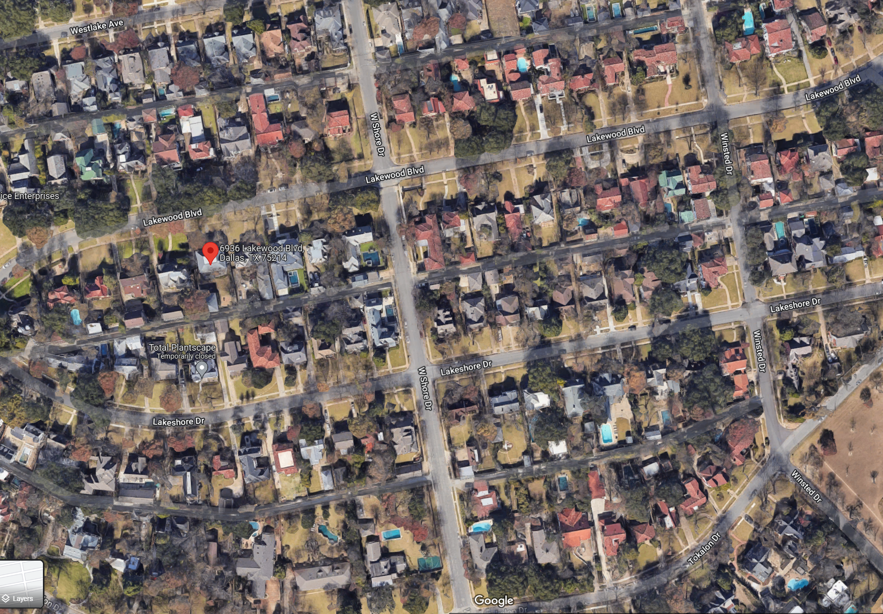
Discussion – Setbacks (Accessory Structures)
48

Slide 49
Recap – Setbacks (Accessory)
49

Slide 50
Petition Topic – Accessory Structures
Provisions for style, materials, roof slope
Consider remodeling or replacement of existing accessory structures
Existing Regulations CD-2
Garages and accessory structures
Garages and accessory structures may be constructed of any legal building material and in any architectural style. New construction of a roof on a garage or an accessory structure must consist of a hipped, side gabled, gambrel, mansard, or cross gable roof form.
Existing Dallas Development Code 51A-4.209(6)(E)
(ff) Accessory structures must have exterior siding, roofing, roof pitch, foundation fascia, and fenestration compatible with the main building. "Compatible" as used in this provision means similar in application, color, materials, pattern, quality, shape, size, slope, and other characteristics; but does not necessarily mean identical. The burden is on the property owner or applicant to supply proof of compatibility. This provision does not apply to accessory structures with a floor area of 200 square feet or less.

Slide 51
Discussion – Accessory Structures
Any style or same style of house?
Materials
Roof slope
When to regulate architecture, if at all
Visible from street?
51

Slide 52
Recap – Accessory Structures
52

Slide 53
Petition Topic – Solar
Consideration for location and type of solar panels
Existing Regulations CD-2
None
Existing Dallas Development Code 51A-4.209(6)(E)
None

Slide 54
Discussion – Solar
Are you concerned with location of solar panels?
If so, how would you like to approach their location and appearance?
New technology considerations
54

Slide 55
Next Steps
Neighborhood Meeting #7: November 16
Neighborhood Meeting #8: November 30
Neighborhood Meeting #9: December 7
Neighborhood Meeting #10: December 14
Neighborhood Meeting #11-12: If needed
Final Neighborhood Meeting to review ordinance: Date TBD
City Plan Commission Public Hearing: Date TBD (notified 10 days before)
City Council Public Hearing: Date TBD (notified 14 days before)
55

Slide 56
CD-2 - Lakewood Conservation District Expansion Post-Application Neighborhood Meeting No. 6
Staff Contact
Trevor Brown
trevor.brown@dallas.gov
214-670-4193
Project Webpage
https://bit.ly/LakewoodExpansion
Next Meeting November 16, 6:00 pm
Introduction and Recap
Discussion
fences, retaining walls, waterfall steps, landscape, paint
Next Steps

Slide 57
Thank You!

Slide 58
58

