Slide 1
Parking Reduction for Multifamily Recycling Container
DCA190-003
Zoning Ordinance Advisory Committee (ZOAC)
February 6, 2020
Sustainable Development & Construction Department

Slide 2
Background
January 23, 2020 ZOAC considered this item and requested additional information from staff
BDA process for requesting a special exception for required parking
Tiered approach to allowing a parking reduction
Correct reference to Chap. 18
Notes:
Referred to as the “Multifamily Recycling Ordinance”

Slide 3
Issue
Section 18-5.1(e) of the Multifamily Recycling Ordinance contains a provision for a parking reduction in order to provide adequate space for recycling containers
Parking is a zoning regulation and all parking requirements, regulations, and reductions are held in Chap. 51A
Currently, Section 51A-4.209(b)(5), “Multifamily Use,” does not provide for a parking reduction
Without an amendment to Chap. 51A, the only way to get a parking reduction as referred to in Chap. 18, is to go to the Board of Adjustment for a special exception to the number of off-street parking spaces required for the site.

Slide 4
BDA Process
Application and fee submitted to BI by deadline date
Fee: $900 + $100/space
Request is scheduled for BDA public hearing date
Approx. 6 weeks from deadline date for that docket
Notification sent to property owners within 200’, 10 days prior to public hearing
Request is scheduled for BDA public hearing date
Public input is taken
May reduce up to 25% of the required parking or 1 space whichever is greater
BDA considers:
That parking demand does not warrant the required number of off-street parking spaces
That special exception to number of spaces will not create a traffic hazard or increase traffic congestion on adjacent or nearby streets

Slide 5
Tiered approach to parking reduction
No. of dwelling units No. of required parking spaces reduced
8 – 24 1
25 – 100 up to 3
101 - 400 3% or maximum 6, whichever is less
401+ up to 9

Slide 6
Reference to Chapter 18
The proposed amendment to Chapter 51A references Chapter 18-5.1
The corrected reference is to Section 18-5.1(e)

Slide 7
Staff Proposal
Amend Section 51A-4.209(b)(5), “Multifamily Use,” to allow for a parking reduction of one required parking space

Slide 8
Rationale
Recycle ordinance allows 3 options for each site to provide recycling
Single Stream
Dual Stream
Valet
Director of Sanitation may grant:
An implementation extension
An exemption for all or specific provisions of the regulations

Slide 9
Rationale
A parking reduction of 1 required space is provided
Intended to work in concert with the opportunities provided in the Recycle Ordinance for compliance
If after all opportunities to comply have been exhausted, an individual property may apply to BDA to request a parking reduction
BDA can grant an exception for up to 25% of the number of required parking spaces
Based on specific site needs

Slide 10
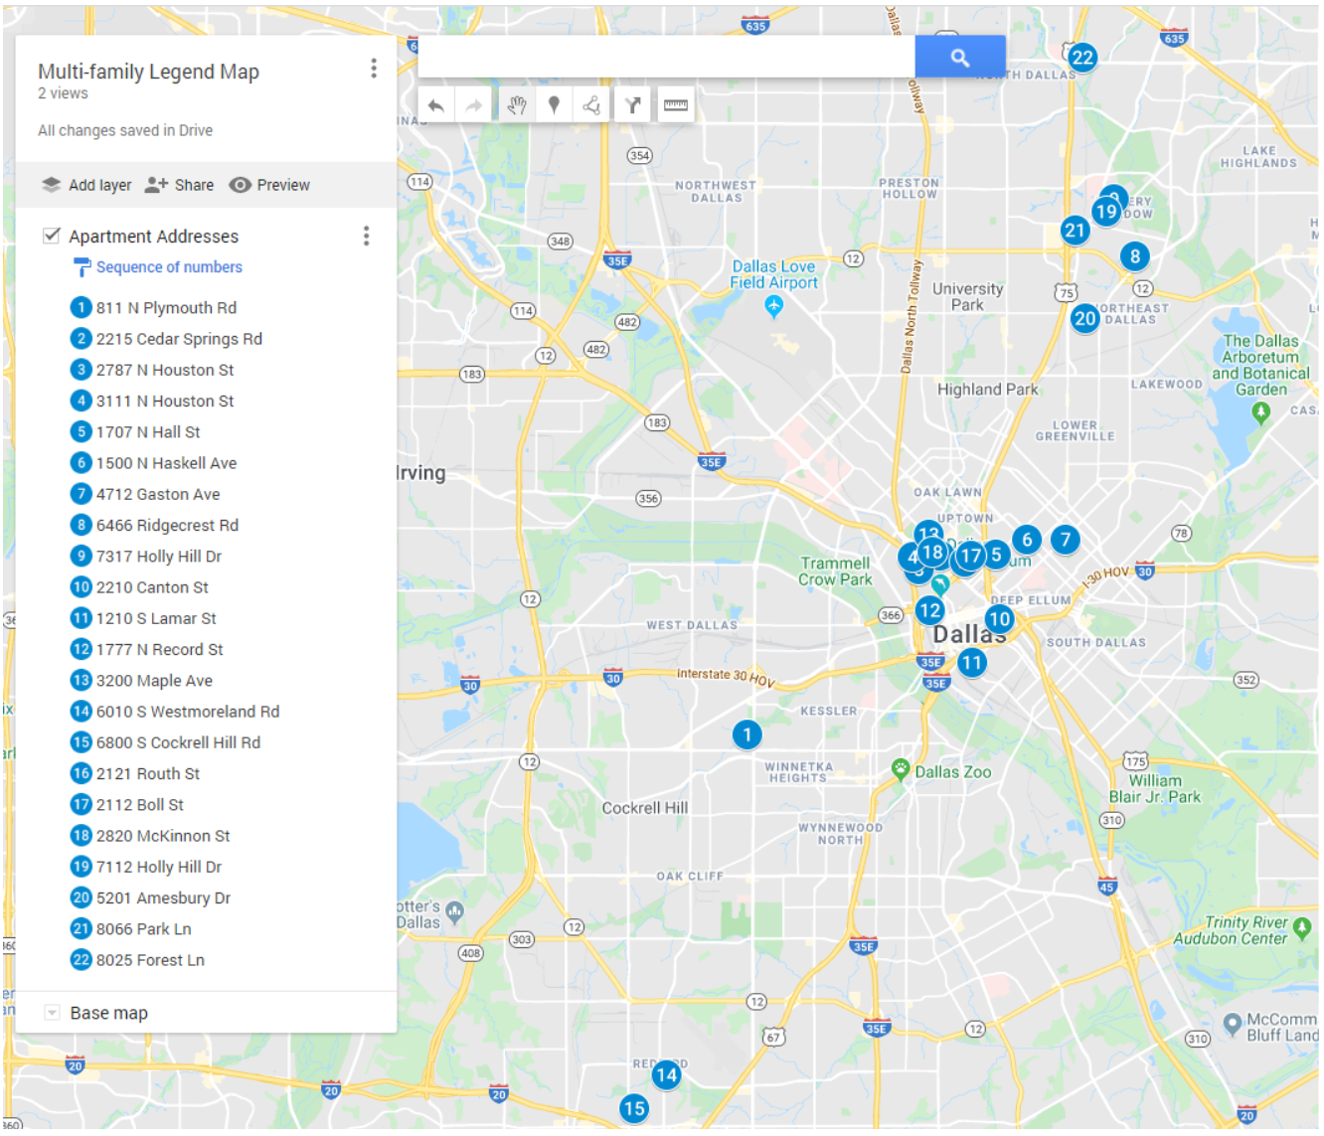
Multifamily Properties Parking Sampling

Slide 11
Findings from Parking Sampling
17 out of 22 properties sampled actually provide more than the number of parking spaces required
4 provide exactly what is required
1 provides significantly less that what is required

Slide 12
Parking Reduction for Multifamily Recycling Container
DCA190-003
Zoning Ordinance Advisory Committee (ZOAC)
February 6, 2020
Sustainable Development & Construction Department

